Slide 1

Visions for the Future –LCDB7008
Theoretical Perspectives on Management
(DBA Programme)
Lecture 3:
What is management? Steve finally gives you some theories.
Lecturer: Steve Griffiths 20 October 2023
Take care when selecting your favourite theories.

Slide 2
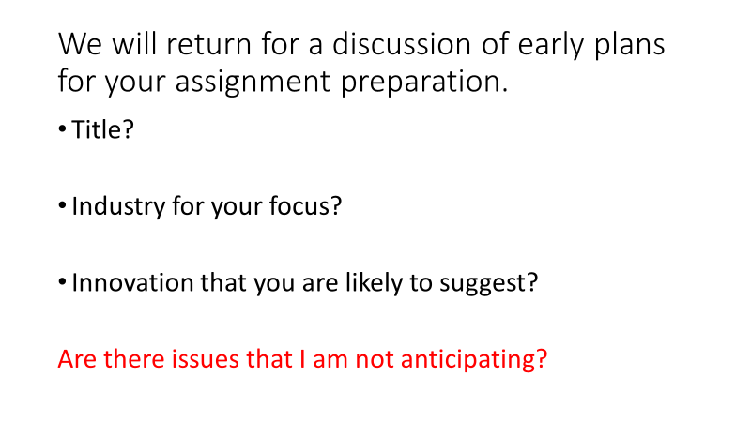
What is your assignment plan?

Slide 3
Takeaway 1 from last week.
There are many versions of definitions of management.
“Lack of consensus”- gives us freedom but undermines certainty.
These might be influenced by:
The sector- Private, Public, Not for Profit & many other hybrids
The size- small, medium, large
Domestic/International
Cultural environment
The business environment
The task to be managed
The functional specialism being reviewed

Slide 4
Takeaway 2 from last week.
There is some disconnect between academic theory and actual business practice.
See separate folder on some articles on this.
What is the implication of this disconnect?

Slide 5
Management theories.
This is a quick run through.
It is worth back tracking when you start your preparation for the assignment to review which theories fit or can be adapted for your purposes.
Many are quite old, but they are still quoted and are in your favourite textbooks.
Your updating and adapting will be rewarded.
Not all theories are covered here e.g. Postmodernism and Feminist management theory. I will return to these.
Not all ways of categorising theory is presented here.

Slide 6
Overlap with other topics.
Management theory often overlaps with other business topics.
For example
Leadership
Strategy
Change/dynamic/learning organisations
Culture
Planning
Managers may exhibit all these or none, but there are separate theories for each.

Slide 7
Management is a field of study with a long history and has evolved. There are different management theories, and the best management practices often change.
A typical list:
Management is a broad concept encompassing leaders and managers.
Management may include those responsible for leading, directing, planning, and organizing everyday operations.
Management defines roles and responsibilities, manages resources, sets goals, and communicates messages from senior management to the subordinates in an organization.
Management monitors progress within all areas of the organization to ensure that goals and standards are met.
Management also assesses the progress of goals and ensures those goals are met on time.

Slide 8
Bennett Conlin, B. (2023) Popular Management Theories Decoded. Business.com. 27 September.
https://www.business.com/articles/popular-management-theories-decoded/
(Retrieved 10-10-23).
See next slide

Slide 9
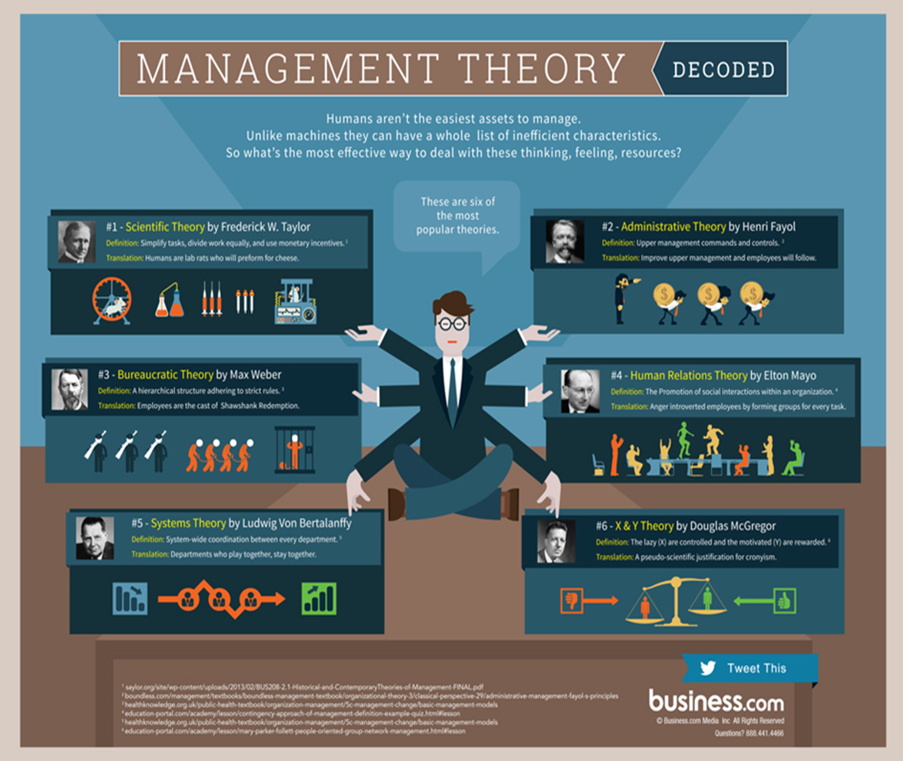

Slide 10
Frederick Taylor (1856-1915) The Principles of Scientific Management (1911)
Taylor's principles focused on making work more efficient by breaking it down into smaller and simpler tasks performed quickly with maximum efficiency. He believed that if workers were given clear instructions and rewarded for their efforts, they would be more productive.
The "father of modern management" attempted to optimize tasks through increased efficiency.
Task Specialization
Time and Motion
Incentivizing Employees
Better Wages

Slide 11
Henri Fayol (1841–1925)
Administrative Theory
Fayol proposed 14 principles for efficient organizations, include unity of command, division of labour, scalar chain (clear line of communication), subordination of individual interests to general interests, remuneration based on merit and equity, centralization or decentralization, order, authority, and responsibility.
Workplace Management
Focused on people rather than machines or production processes. He argued that workers should be treated with respect and given fair treatment, such as good wages and proper training, to motivate them to work harder.
Organizational Theory
Forecasting,
Organizing and staffing
Directing
Coordinating
Controlling and budgeting.

Slide 12
Max Weber (1864–1920)
Bureaucratic Organization Theory- examined hierarchical power structures within organizations. The core elements of this model included a hierarchal design with a transparent chain of command, rules, and regulations for work processes, specialization of labour based on expertise, and impersonal decision-making rooted in rationality.
Social Stratification- within organizations, specifically looking at dominance or superiority achieved through informal channels such as wealth or connections rather than formal qualifications or achievement. He argued that informal networks are minimized if an organization wishes to become more effective in its operations by focusing on rational decision-making based on results, not personal connections or favouritism.

Slide 13
Mary Parker Follett (1868–1933) Theory of collective power. Cooperation to be more effective.
Organizational Dynamics and Human Relations Theory
Shared-Power Model This concept challenges traditional views that emphasize a hierarchical model where power is centralized in individual leaders or managers. Instead, Follett argued that true power should be decentralized and shared between individuals and teams to promote collaboration and democracy in decision-making.
Needs: Good communications. Incentives. Training.
Follett proposed that conflict should be seen as a potentially positive force within organizations since it can bring about creative solutions by allowing those involved to see each other's differences in perspective.

Slide 14
Elton Mayo (1880-1949) Social needs and psychological factors.
Mayo believed that employees should be motivated by more than just financial rewards and that their feelings and attitudes significantly impact performance.
He also emphasized communication between employers and employees to build trust and foster collaboration.
He argued that group interaction could lead to greater productivity than individual efforts alone could achieve.
People need emotional security, recognition, positive relationships with colleagues, and respect from superiors to remain motivated at work.

Slide 15
Chester Barnard (1886-1961) The Functions of the Executive
Social Systems- Organizations are “social systems”. Managers must understand how an organization interacts with its environment and how its internal components interact to make successful decisions. Organizations have specific inherent characteristics which determine their success or failure, including motivation and adaptation capability. Inspiration must come from within individuals and cannot be created by external forces such as rewards or punishments.
Adaptive Cycle- Organizational success depends on an organization’s ability to adapt to changing environmental conditions. Organizations must identify those elements of their environment which could potentially harm them and then implement strategies to mitigate these risks
Principles of Management
Accountability - holding decision-makers responsible for results.
Communication - encouraging dialogue between all levels of staff.
Delegation - delegating tasks to those who are best qualified.
Leadership -being able to inspire others.
Creativity -fostering innovation.

Slide 16
Ludwig von Bertalanffy (1901-1972) Systems theory. How complex systems interact and influence each other.
General System Theory (GST)- how different parts of an organization interact and cooperate to achieve its goals.
This theory states that all-natural or artificial systems possess specific properties such as interdependence, feedback loops, self-regulation, complexity, hierarchy, dynamism, and adaptation to change.
Dynamic conditions and the need for adaptive organisations….the learning organisation?

Slide 17
Douglas McGregor (1906-1964) Theory X and Theory Y
Theory X & Theory Y- This model proposed two different approaches to managing people. It has a negative process (Theory X) that assumes that employees are lazy and need to be motivated by external rewards. And a positive direction (Theory Y) assumes employees are self-motivated and can be trusted with more responsibility.
Leaders who adopted a Theory Y approach were often able to create an environment where employees felt valued and motivated. In contrast, those who adopted a Theory X approach often started an environment where morale was low, and resistance was high.
McGregor also developed some other principles of human resource management, including the following:
Regulation of equity- states that employees should be treated fairly in terms of pay, rewards, opportunities for advancement, etc.
The principle of participation- encourages managers to involve their employees in decision-making processes.
The principle of job enlargement or enrichment- encourages managers to make jobs more interesting by adding a variety of increasing responsibilities.

Slide 18
Peter Drucker (1909-2005) Business strategy and organizational development
Drucker's philosophy on management focused on decentralizing decision-making in organizations, creating teams that could make autonomous decisions, and emphasizing innovation and knowledge creation within organizations. In his view, managers should focus not only on efficiency but also on effectiveness to achieve success. He also believed that there should be a balance between short-term profitability goals and longer-term objectives such as product quality or customer satisfaction.
Take responsibility for decisions; Know your strengths; Focus on value creation; Develop team spirit; Utilize information technology; Develop systems to monitor performance; Adopt a global perspective in decision-making; Develop an adaptive organization structure; Create an entrepreneurial culture, Empower employees through trust.

Slide 19
Can you see any similarities or differences in this list?

