Slide 1
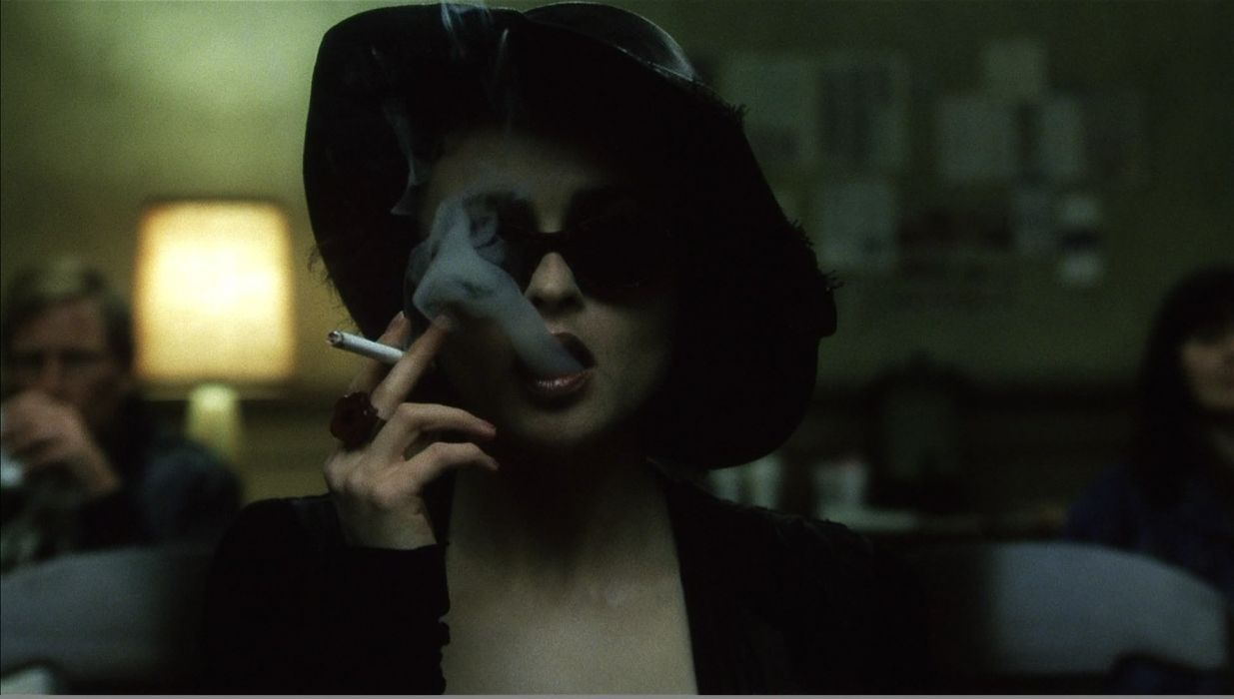

Adaptation Fight Club
https://www.youtube.com/watch?v=tkNIOuZPXSc
https://www.youtube.com/watch?v=QChWIFi8fOY
https://www.youtube.com/watch?v=jZHhE7HpWo4

Slide 2
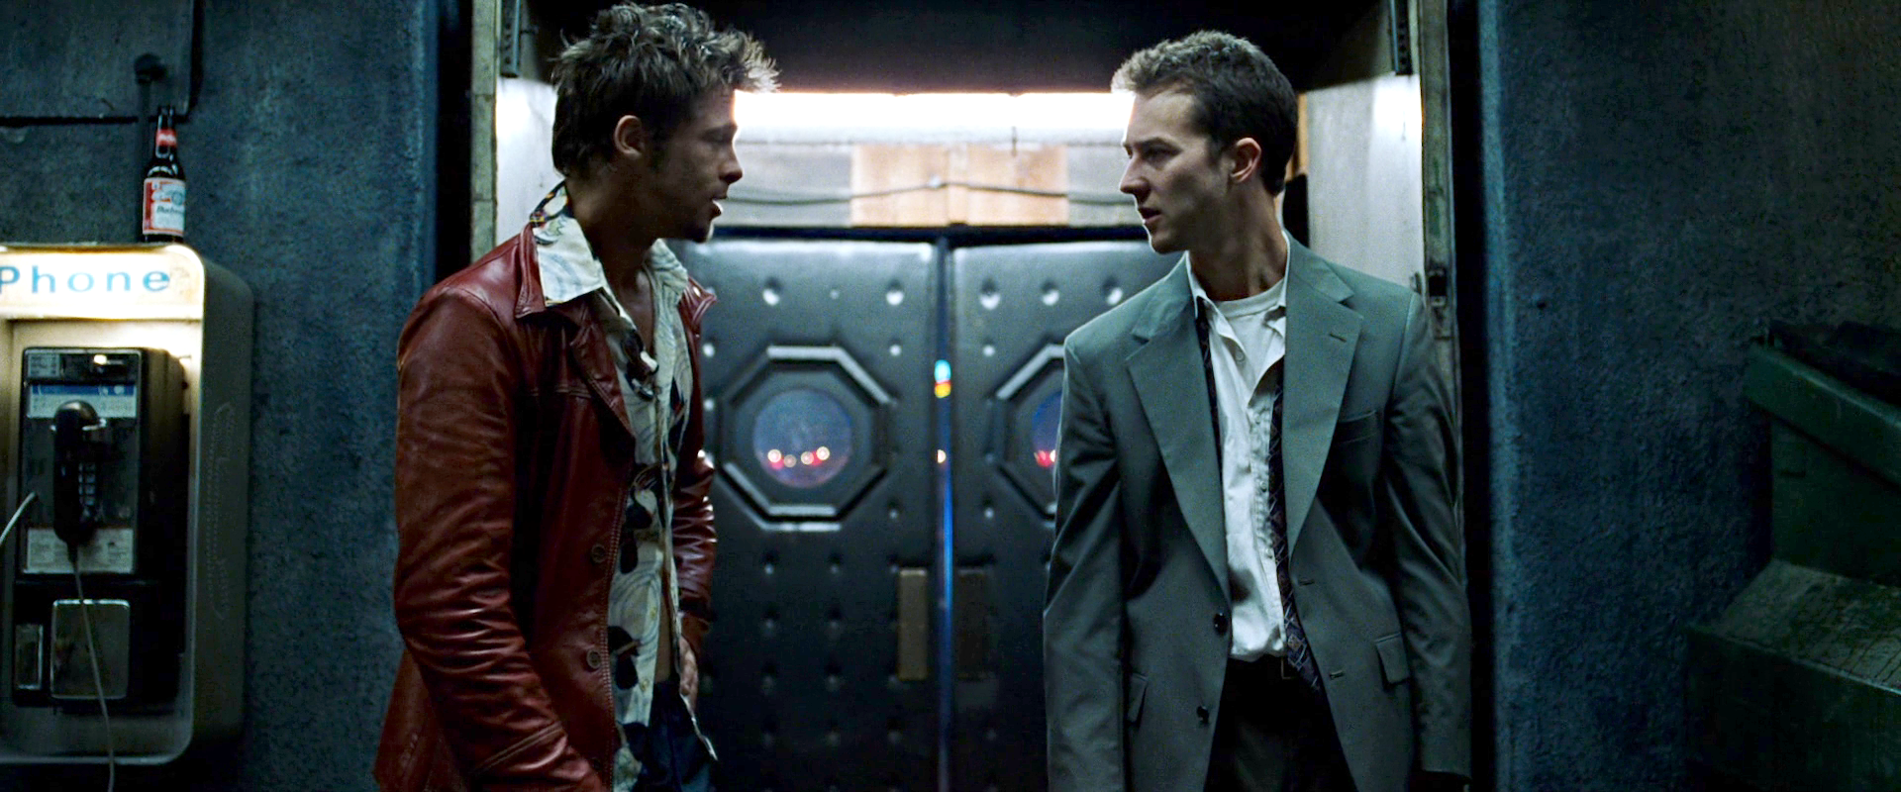
A dialogue between two mediums
‘You have to work as hard as you do on original script because what people want is a workable screenplay. If you turn in to a studio executive an ungodly mess that is really faithful to the novel then you are going to be replaced. The objective is a workable script’.
Jim Uhls (screenwriter, Fight Club) talking about adaptation

Slide 3
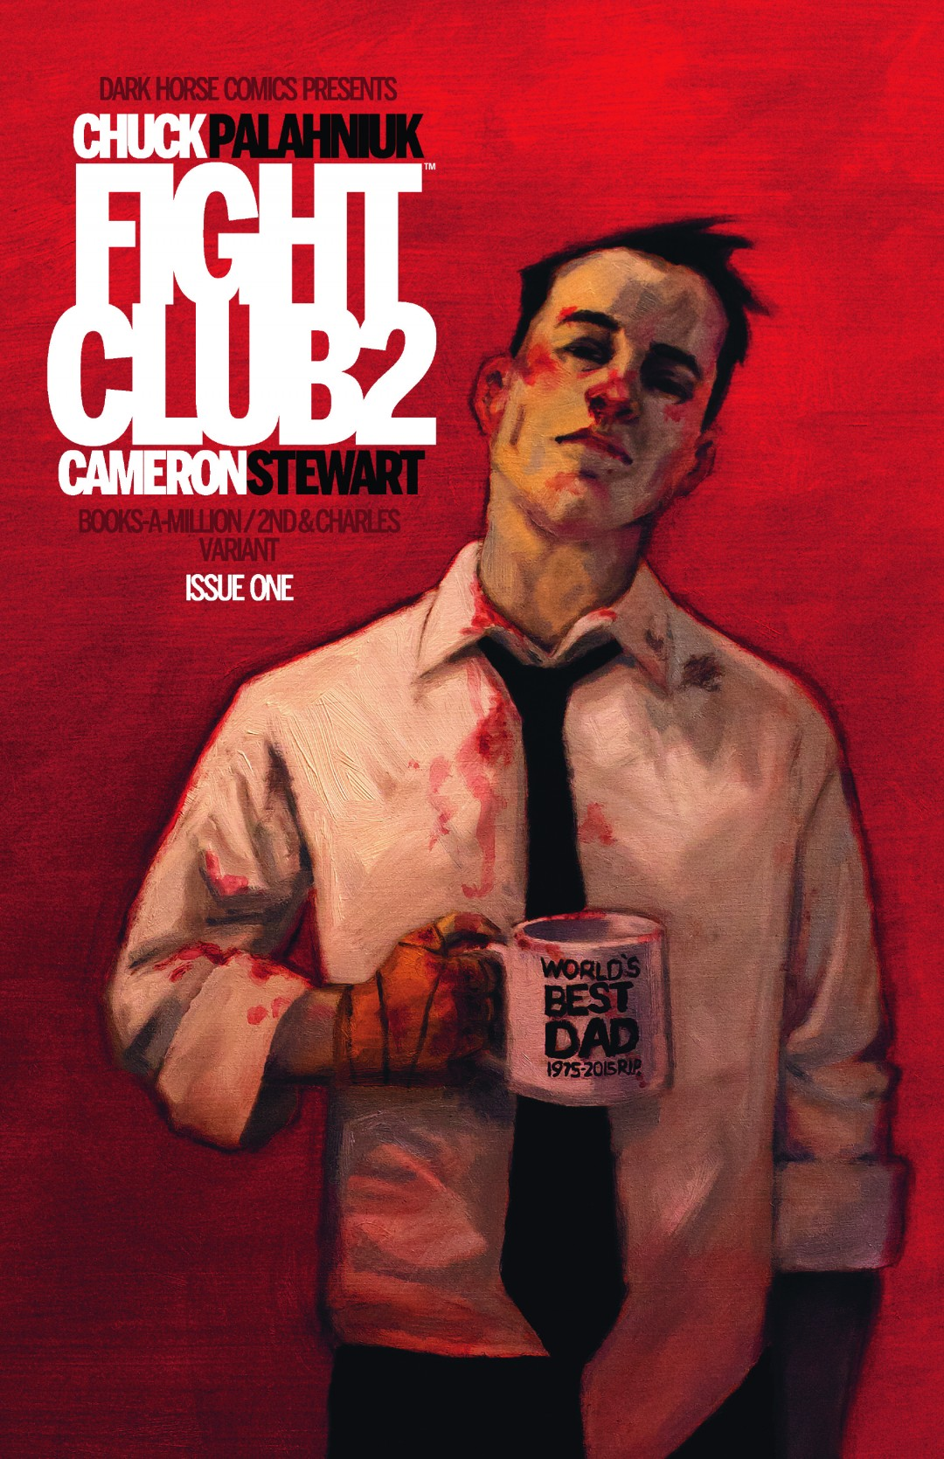
Adaptation theory: overview
Direction/production
Screenwriting
Relationship to source text
Genre
Performance
Visual arts
Music (e.g. Kubrick, Scorsese and Fincher)
Censorship
There are a variety of discourses involved in the Adaptation process. A number of these are listed above.

Slide 4
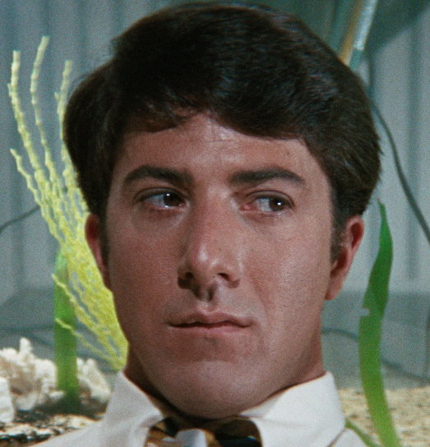
Fight Club: ‘Baby Boomers’ vs. ‘Generation X’
‘The male baby-boomers, as symbolised by Ben in The Graduate, are depicted as confused but wholesome young men looking forward to a ‘world of opportunities’. For Jack the baby-boomers have sold out. It is for this reason that, in the novel, Tyler aims to blow up the National Museum: the past has drained him of a future’.
Mark Ramey, Studying Fight Club (Leighton Buzzard: Auteur, 2014), p.20

Slide 5
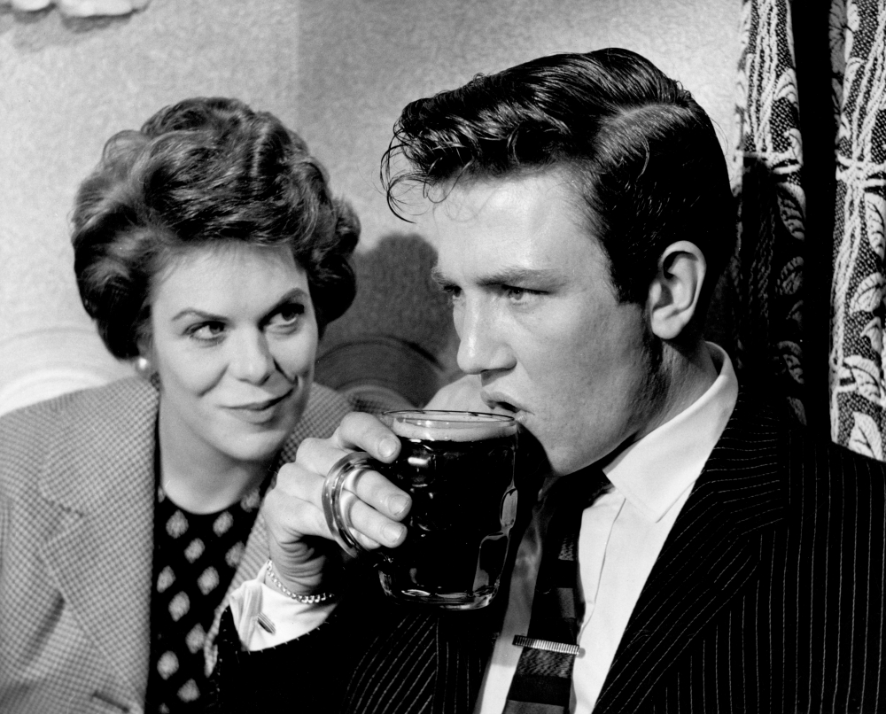
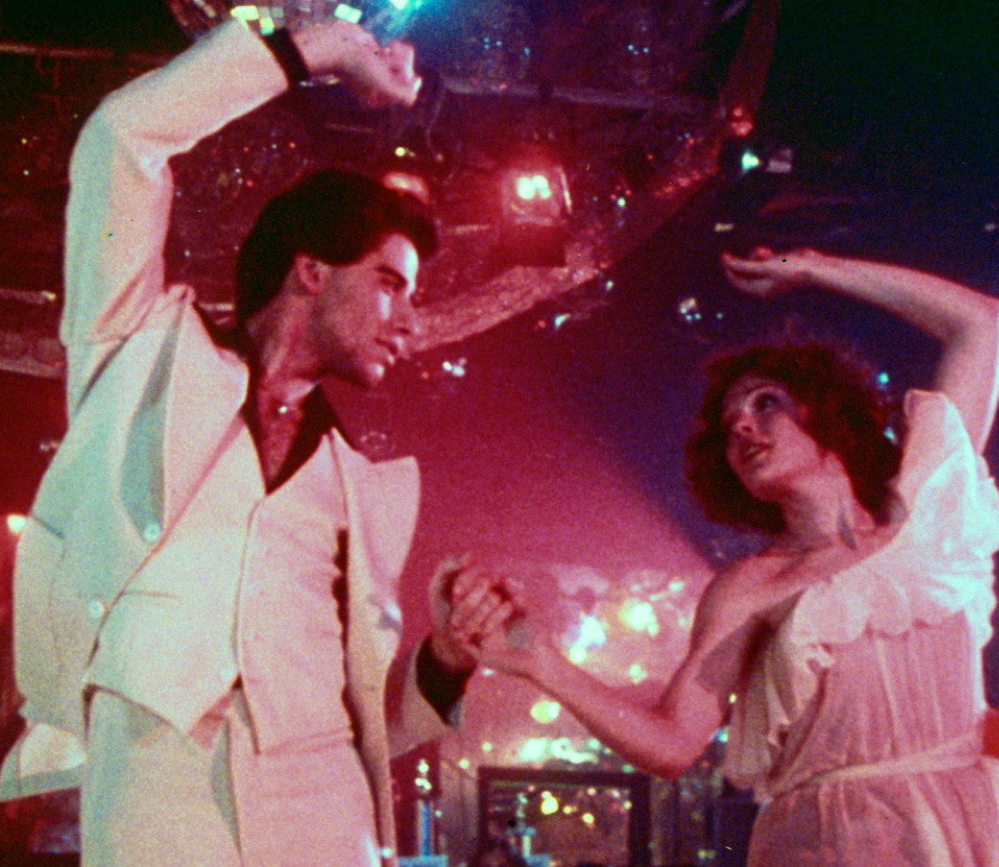
Fight Club: Genre
‘Films about working class men seeking fulfilment’
Mark Ramey, Studying Fight Club (Leighton Buzzard: Auteur, 2014), pp.47-49
Saturday Night, Sunday Morning Reisz 1960
Saturday Night Fever Badham 1977

Slide 6

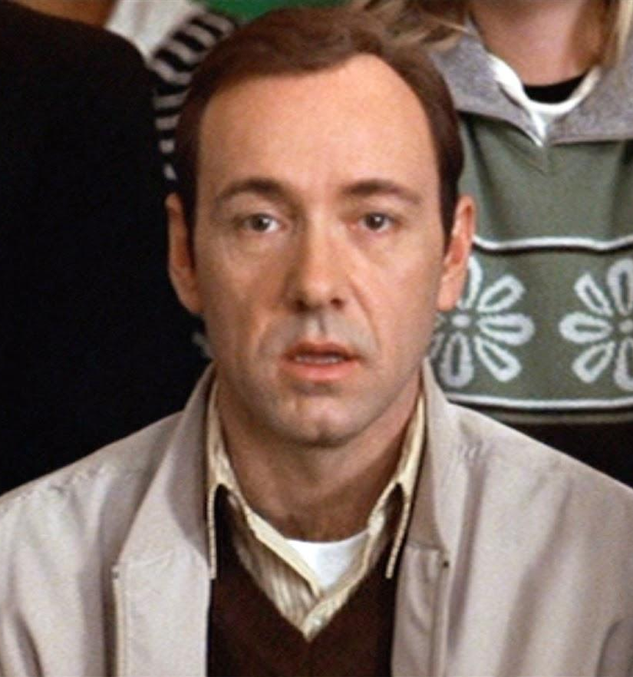
Fight Club: Genre
‘Films that focused on men’s inability to feel and engage with reality in a meaningful way’
Trainspotting Boyle 1996
American Beauty Mendes 1999

Slide 7
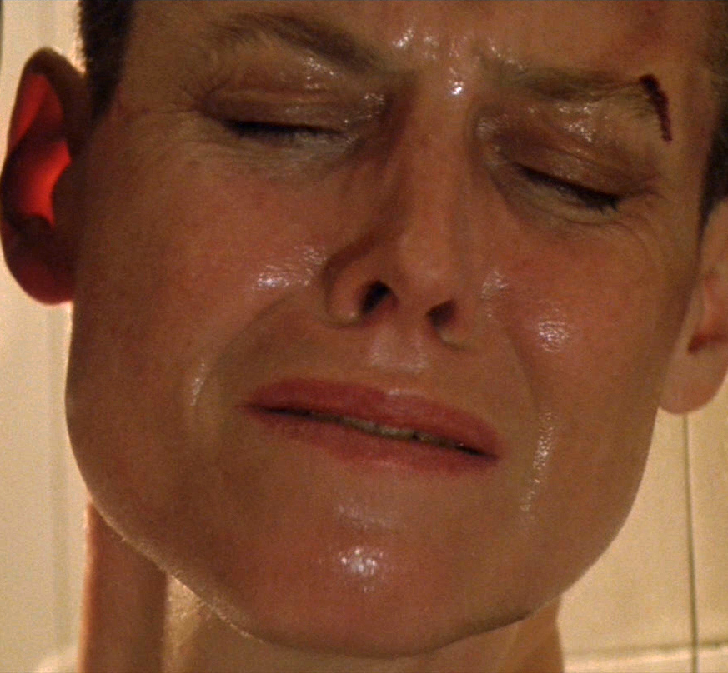
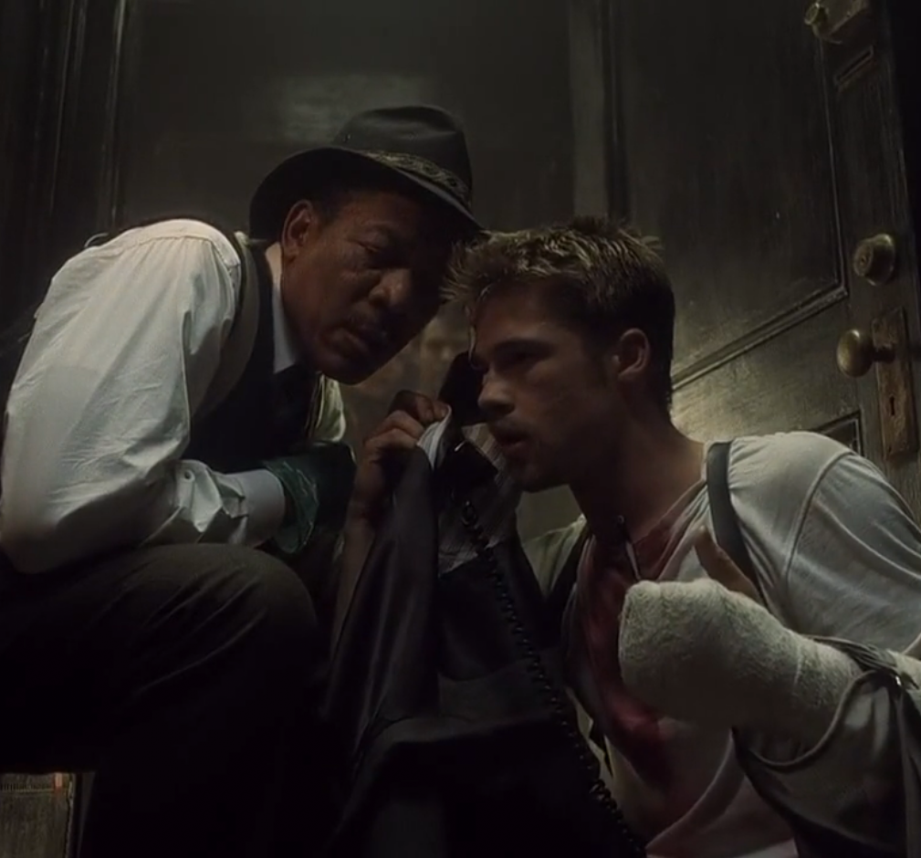
David Fincher (1)
Alien 3 1992
Se7en 1995

Slide 8
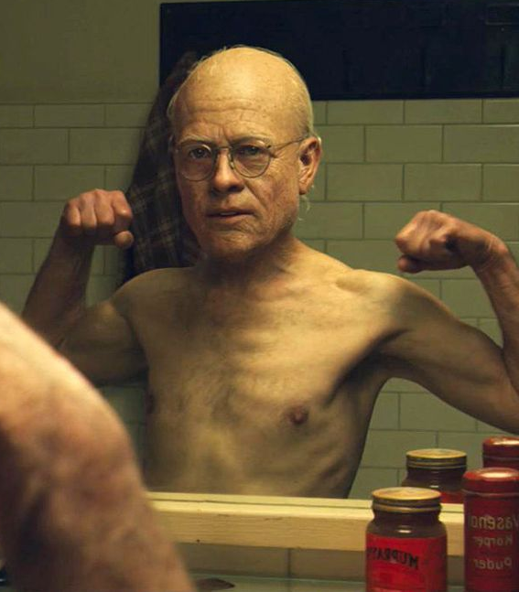
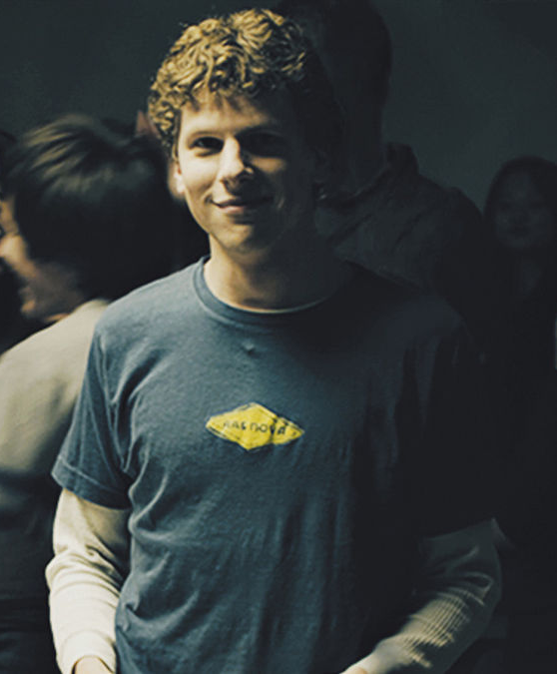
David Fincher (2)
The Curious Case of Benjamin Button 2006
The Social Network 2010

Slide 9

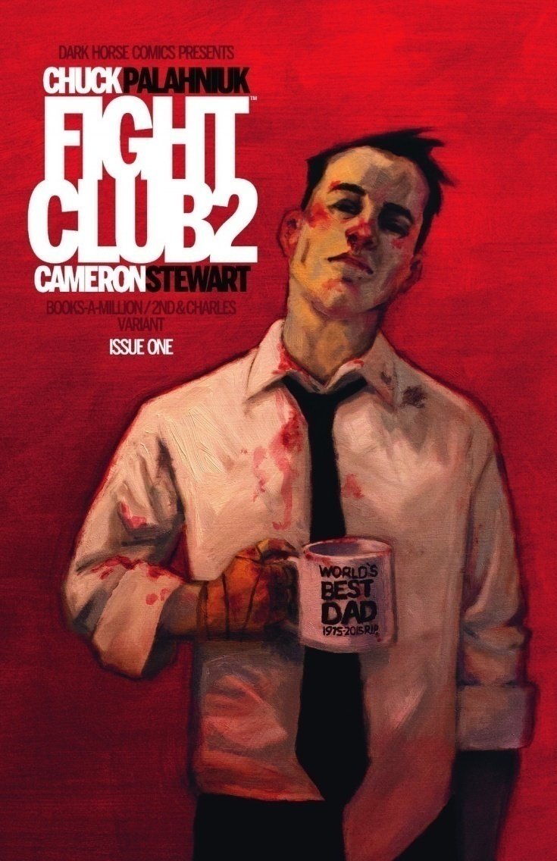
Chuck Palahniuk
Fight Club 1996
Fight Club 2 2010

Slide 10
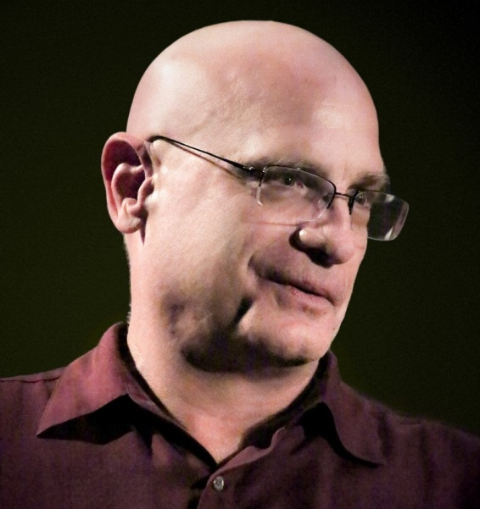

Fight Club: from the book to the screen
Any novel has the advantage of being able to describe both external behaviour and internal behaviour, as well as any exposition that can be ladled on. Screenplays don’t have that luxury at all, it’s watching external behaviour. Even if you’re faithful to a novel, if it works on screen, you have made changes to it because you are not using an internal narrative to describe the interior process – Jim Uhls
Tony and Poppy
Jim Uhls
Chuck Palahniuk

Slide 11
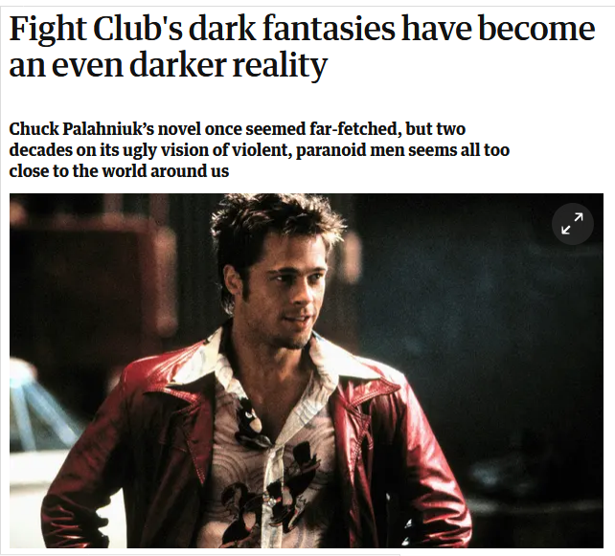
Fight Club: The Legacy?
‘Could [Palahniuk] have realised that what was coming was, in communities with little sense of irony or empathy, his visions of ultra-violent masculinity would be seen as validation rather than satire?’ Sam Jordison, The Guardian, Dec 2016
https://www.theguardian.com/books/booksblog/2016/dec/13/fight-clubs-dark-fantasies-reality-chuck-palahniuk

