Slide 1
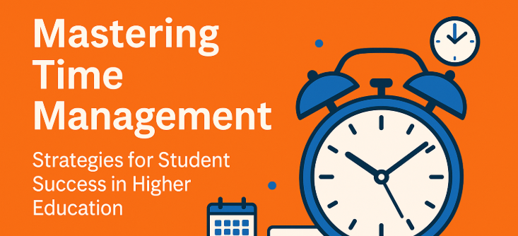
Presented By: Adnan Alsoul
Date:19.06.2025

Slide 2

Why Time Management Matters in Higher Education
Time management helps students balance academic life and personal responsibilities (Wolters and Brady, 2021).
Organised time use improves academic outcomes and reduces last-minute stress (Wilson, Joiner and Abbasi, 2021).
I have felt less anxious and more in control since I started managing my time effectively.
Notes:
Time management is crucial for student success. At university, students face more independence and responsibility, so managing time wisely helps balance assignments, deadlines, and personal life (Wolters and Brady, 2021). When time is well structured, students experience better academic results and reduced anxiety (Wilson, Joiner and Abbasi, 2021). From my own experience, I used to feel overwhelmed during exam periods. But once I started planning my study time in advance, I felt more in control. This also gave me time to relax, which made studying less stressful. Time management truly helps build academic confidence and control over workload.

Slide 3

Common Time Management Challenges
Social media is a major distraction during planned study time (Wilson, Joiner and Abbasi, 2021).
Procrastination often leads to rushed work and missed deadlines (Tsitsia et al., 2021).
I realised I wasted a lot of time on my phone, and changing this improved my productivity.
Notes:
Many students struggle with distractions and poor habits. Social media platforms like TikTok and Instagram often take up study time, breaking focus and reducing productivity (Wilson, Joiner and Abbasi, 2021). Another common challenge is procrastination—putting off work until the last minute, which results in stress and poor-quality outcomes (Tsitsia et al., 2021). Personally, I noticed how much time I lost by constantly checking my phone. Once I limited screen time during study hours, I became more productive and submitted better-quality work. Identifying these challenges is the first step in improving how we use our time as students.

Slide 4

Digital Tools That Support Time Management
Tools like Google Calendar help plan schedules, deadlines, and reminders (Calonia et al., 2023).
Focus apps limit distractions and keep students on track.
I now use digital reminders daily, which helps me avoid forgetting important tasks.
Notes:
Technology can help students develop better time management habits. Google Calendar and similar tools make it easier to organise tasks, track due dates, and plan study sessions across the week (Calonia et al., 2023). Focus apps like Forest and Pomofocus also support productivity by blocking distractions and helping maintain concentration. These tools provide structure and reduce the risk of missing tasks or cramming at the last minute. Personally, using Google Calendar to map out my week helped me prioritise better. Digital reminders reduced the chances of forgetting deadlines or appointments. These tools have made my study routine more reliable.

Slide 5

Final Reflections and Takeaways
Time management is a skill that can be learned and developed over time (Gallagher, 2016).
Good planning habits reduce stress and lead to academic improvement (Wolters and Brady, 2021).
Practicing time management regularly helped me gain control and enjoy studying more.
Notes:
Time management is not something we’re born with—it’s a skill that improves with use (Gallagher, 2016). Students who actively plan their time experience lower stress and higher academic success (Wolters and Brady, 2021). Digital tools, effective strategies like Pomodoro, and awareness of distractions are all helpful. Reflecting on my own learning, I now enjoy my studies more because I feel more in control of my time. I’ve realised that managing time well doesn’t mean doing more, but doing what matters most. These habits are useful not only for education but also for future careers and daily life.

Slide 6

Effective Strategies for Time Management
The Pomodoro Technique improves focus with short timed work sessions and breaks (Tabuenca, Greller and Verpoorten, 2022).
Weekly planning encourages long-term organisation and realistic goal setting (Trentepohl et al., 2022).
Prioritising tasks helps students work on what matters most first (Calonia et al., 2023).
Using these methods helped me stay consistent and complete tasks on time.
Notes:
Several evidence-based strategies can improve student time management. The Pomodoro Technique breaks study time into 25-minute focus blocks with 5-minute breaks, improving energy and attention span (Tabuenca, Greller and Verpoorten, 2022). Weekly planning helps structure workload and prevents last-minute panic (Trentepohl et al., 2022). Prioritising tasks ensures the most important or urgent work gets done first, which boosts productivity (Calonia et al., 2023). Personally, combining all three strategies has helped me feel more stable and less stressed. I no longer leave everything to the last moment, and that has improved both the quality of my work and my mental health.

Slide 7
REFERENCES
Calonia, J.T., Pagente, D.P., Desierto, D.J.C., Capio, R.T., Tembrevilla, J.A.P., Guzman, C.A. and Nicor, A.J.S., 2023. Time Management and Academic Achievement: Examining the Roles of Prioritization, Procrastination and Socialization. Online Submission, 8(6), pp.766-775.
Tabuenca, B., Greller, W. and Verpoorten, D., 2022. Mind the gap: smoothing the transition to higher education fostering time management skills. Universal Access in the Information Society, 21(2), pp.367-379.
Trentepohl, S., Waldeyer, J., Fleischer, J., Roelle, J., Leutner, D. and Wirth, J., 2022. How did it get so late so soon? The effects of time management knowledge and practice on students’ time management skills and academic performance. Sustainability, 14(9), p.5097.
Tsitsia, B., Afenu, D., Kabbah, S., Attigah, A. and Bimpeh, G., 2021. Effective time management practices among colleges of education students. Journal of Human Resource and Leadership, 6(1), pp.1-10.
Wilson, R., Joiner, K. and Abbasi, A., 2021. Improving students’ performance with time management skills. Journal of university teaching and learning practice, 18(4).
Wolters, C.A. and Brady, A.C., 2021. College students’ time management: A self-regulated learning perspective. Educational Psychology Review, 33(4), pp.1319-1351.
Gallagher, K., 2016. Essential study and employment skills for business and management students. Oxford University Press.

Slide 8
Thank you

