Slide 1
‘Strategies to enhance customer satisfaction for Ocado’
Names:Ionela Filip-Datcu,Daniela Nedelcu,Juliana Lopes,Krum Evstatiev Marinov
Student ‘s numbers: 1922490,1922478,1906785,1922542
The module code: LCBB4000
Module title:Academic skills
Lecturer’s name:Tarila Zuofa

Slide 2
Agenda
pkc
Introduction- Ocado
Business strategy of Ocado
Products
Conclusion
References

Slide 3
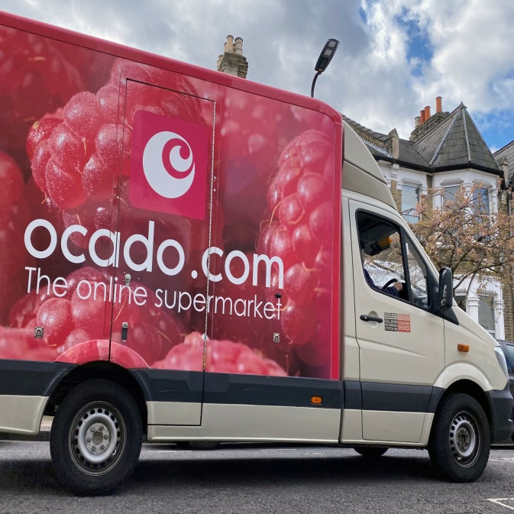
Introduction- Ocado
Founded in the business year 2000, by Tim Steiner, Jonathan Faiman and Jason Gissing;
The company is headquartered at Hatfield, England, UK;
A British online supermarket that represents itself as the largest online grocery retailer in the global world;
Notes:
Ocado is a British online supermarket which has been promoting itself as the world’s largest online grocery retailer. However, the company does not have any chain of stores as well as offers home delivery services from its warehouses which is unlikely from its competitor. The company has been established in the business year 2000, headquartered at Hatfield, England, UK, and founded by Tim Steiner, Jonathan Faiman, and Jason Gissing. However, as the entire business of Ocado relies upon an online delivery network with no in-store presence, the success rate in the upcoming years with the partnership with Marks & Spencer is complicated. For instance, Marks & Spencer has hugely invested in the delivery network and technology of Ocado for bringing ready meals and other internet shoppers, (Hickey, 2019). However, its strategy to enhance its technology platform for the delivery network has raised significant concerns for the company.

Slide 4
Its product and services range from groceries to consumer goods;
In the business year 2019, the company accounted for revenue of £1,756.6 million;
Unlike its competitors, Ocado does every home delivery from its warehouses and does not have a chain of stores.
Notes:
Ocado is a British online supermarket which has been promoting itself as the world’s largest online grocery retailer. However, the company does not have any chain of stores as well as offers home delivery services from its warehouses which is unlikely from its competitor. The company has been established in the business year 2000, headquartered at Hatfield, England, UK, and founded by Tim Steiner, Jonathan Faiman, and Jason Gissing. However, as the entire business of Ocado relies upon an online delivery network with no in-store presence, the success rate in the upcoming years with the partnership with Marks & Spencer is complicated. For instance, Marks & Spencer has hugely invested in the delivery network and technology of Ocado for bringing ready meals and other internet shoppers, (Hickey, 2019). However, its strategy to enhance its technology platform for the delivery network has raised significant concerns for the company.

Slide 5
Strategies for Ocado
The online commercial delivery device for operating a retail business online;
Use of technology-based model for efficient grocer delivery;
Computers and bagging machine are used for packaging and can travel up to 25 km;
Higher competitive pressure from companies like Amazon
fresh requires changes in strategies.
Notes:
As suggested by (Bonetti et al. 2018), both physical and online presence is required to deliver satisfaction to a varying range of customers. Likewise, Ocado must strategize to focus on in-store presence. Additionally, focusing on other segments of products and developing the quality of current products and services is essential due to the changing preferences of customers. Other than that, the investment in marketing and promotional tools is also essential to gain a competitive edge and attracting potential customers.

Slide 6
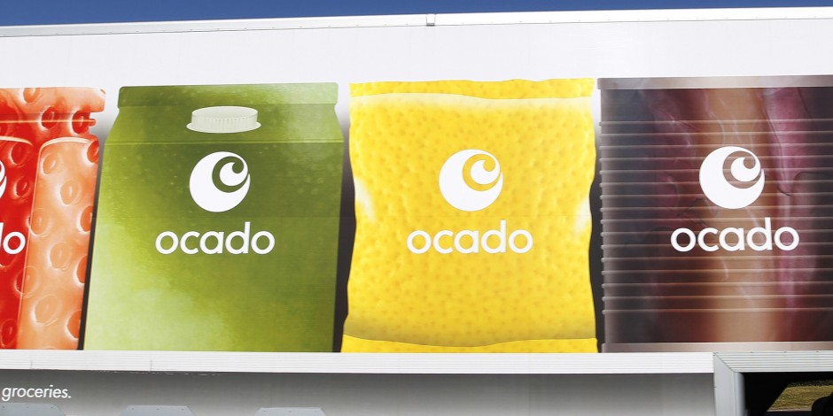
Investing in marketing and promotional tools to attract potential customers;
Focusing on other segments of products such as clothing and other accessories;
Other than technology-driven working style, in-store presence is required for customer satisfaction.
Notes:
As suggested by (Bonetti et al. 2018), both physical and online presence is required to deliver satisfaction to a varying range of customers. Likewise, Ocado must strategize to focus on in-store presence. Additionally, focusing on other segments of products and developing the quality of current products and services is essential due to the changing preferences of customers. Other than that, the investment in marketing and promotional tools is also essential to gain a competitive edge and attracting potential customers.

Slide 7

Products

Slide 8

Facts
+50,000 products
2,000 “free-from” range
15,000 products on
promotion every month.
Products
Beverage
Bakery
Home and Garden
Health
Household
Clothing
Food
Fetch
(Pet shop)
Beauty
+100 on fresh
fruit and vegetables
every month.
Brands
Quorn
M&S
Alpro
Yeo Valley
Tree of life

Slide 9









Dietary & Lifestyle offers
Vegetarian
Vegan
Fairtrade
Free from
(wheat, gluten, lactose, soya, nut, egg and many more)
Organic
Halal
Kosher

Slide 10

Ocado is committed to be the ‘UK’s most sustainable grocer’
“ Ocad0 waste “ -achieve customer satisfaction without changing the life quality of future generations.(Ocado 2020)
Focusing on:
Food waste
Carbon impact
Packaging and responsible impact.

Slide 11
Ocado ‘helps brands grow’
Being open to diverse suppliers gives other companies the opportunity to be seen and promotes their growth.
This also increases sales attracting new customers boosting customer satisfaction/loyalty.

Slide 12
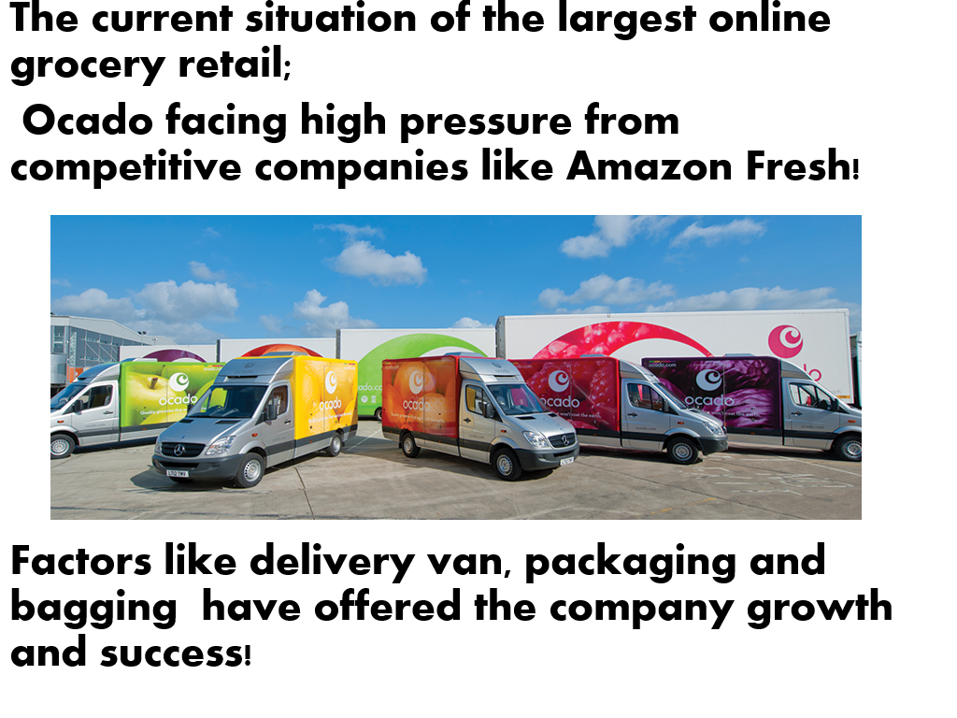

Slide 13
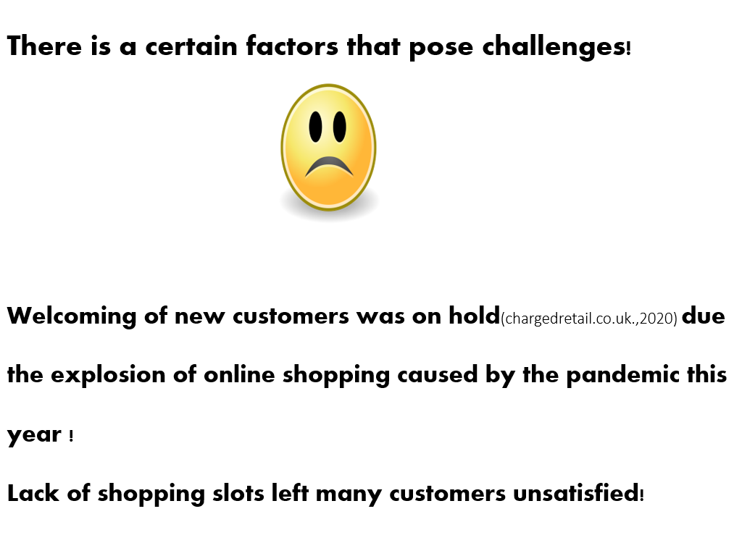

Slide 14
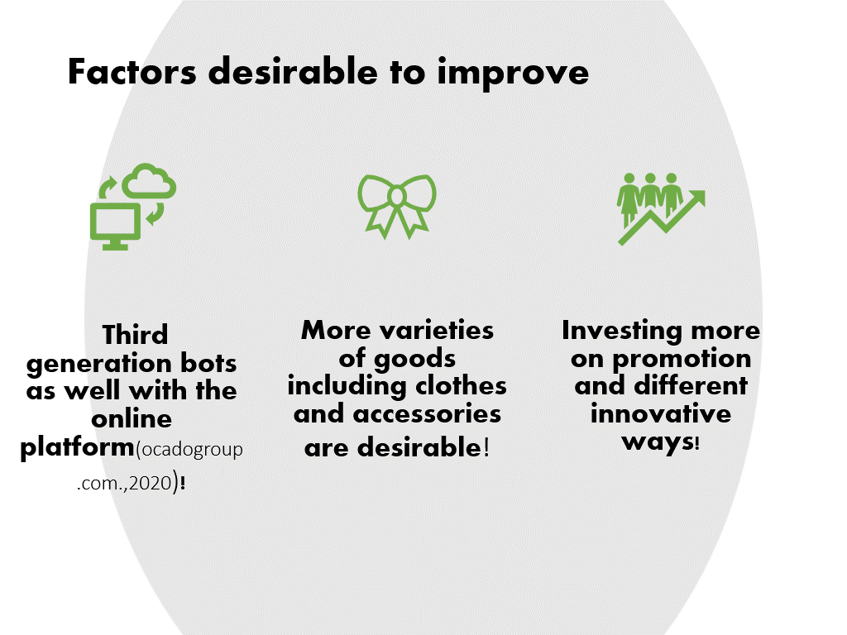

Slide 15
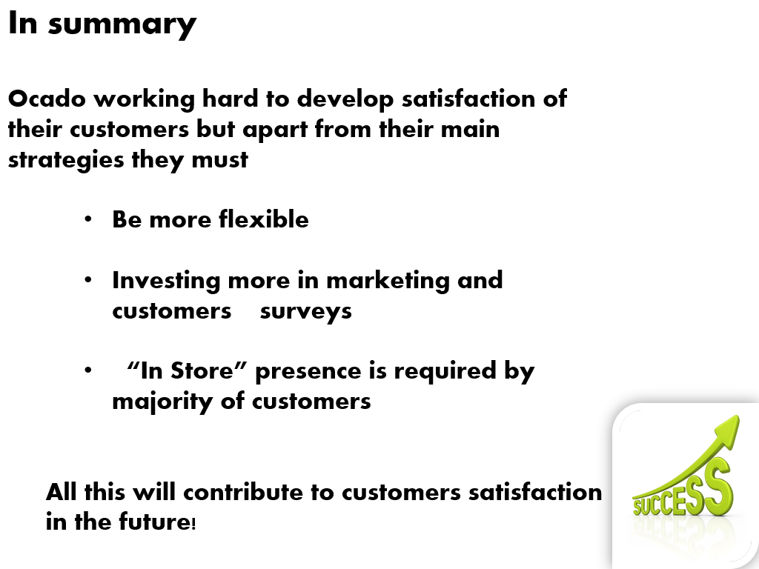

Slide 16


Slide 17
References
Bonetti, F., Warnaby, G. and Quinn, L., 2018. Augmented reality and virtual reality in physical and online retailing: A review, synthesis and research agenda. In Augmented reality and virtual reality (pp. 119-132). Springer, Cham.
Hickey, S., 2019. M&S Must Hope Ocado Will Turn Its Food Problems Into Trifles. [online the Guardian. Available at: <https://www.theguardian.com/business/2019/may/19/marks-and-spencer-ocado-food-problems> [Accessed 30 October 2020].
Notes:
As suggested by (Bonetti et al. 2018), both physical and online presence is required to deliver satisfaction to a varying range of customers. Likewise, Ocado must strategize to focus on in-store presence. Additionally, focusing on other segments of products and developing the quality of current products and services is essential due to the changing preferences of customers. Other than that, the investment in marketing and promotional tools is also essential to gain a competitive edge and attracting potential customers.

Slide 18
Martin, W., 2016. Amazon Is Officially Launching A New Service That Threatens Ocado's Existence. [online] Business Insider. Available at: <https://www.businessinsider.in/finance/Amazon-is-officially-launching-a-new-service-that-threatens160Ocados-existence/articleshow/52670994.cms> [Accessed 30 October 2020].
McDonald, C., 2018. How Ocado Has Disrupted Its Own Model. [online] ComputerWeekly.com. Available at: <https://www.computerweekly.com/news/252448108/How-Ocado-has-disrupted-its-own-model> [Accessed 30 October 2020].
Ocado (2018). Our core pillars. [online] Ocado Group. Available at: https://www.ocadogroup.com/our-responsible-business/our-core-pillars [Accessed 4 Nov. 2020].
Notes:
As suggested by (Bonetti et al. 2018), both physical and online presence is required to deliver satisfaction to a varying range of customers. Likewise, Ocado must strategize to focus on in-store presence. Additionally, focusing on other segments of products and developing the quality of current products and services is essential due to the changing preferences of customers. Other than that, the investment in marketing and promotional tools is also essential to gain a competitive edge and attracting potential customers.

Slide 19
Ocado (2019). Supply Ocado. [online] Supplyocado.com. Available at: https://supplyocado.com/ [Accessed 4 Nov. 2020].
‌Ocado (2020). Ocad0 Waste | Sustainability. [online] Ocado. Available at: https://sustainability.ocadoretail.com/ [Accessed 4 Nov. 2020].
Ocado (2020). Ocado: The online supermarket. [online] www.ocado.com. Available at: https://www.ocado.com/webshop/startWebshop.do.
‌Ocado(2020),’Ocado Technology’2020.,available at;
https://www.ocadogroup.com/technology/technology-pioneers .,visited 05/11/20.
Stevens , B.(2020)Ocado begins accepting new customers for a first time in four months[online]ChargedRetail,2020.Available:<<https:chargedretail.co.uk/2020/07/29/ocado-begins accepting-new-customers-for-the-first-time-in-four-months>> Visited 03/11/20
Notes:
As suggested by (Bonetti et al. 2018), both physical and online presence is required to deliver satisfaction to a varying range of customers. Likewise, Ocado must strategize to focus on in-store presence. Additionally, focusing on other segments of products and developing the quality of current products and services is essential due to the changing preferences of customers. Other than that, the investment in marketing and promotional tools is also essential to gain a competitive edge and attracting potential customers.

Slide 20
Thank You!!!!!!!!

