Slide 1
Wellbeing and Resilience

Slide 2
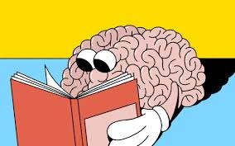
Wellbeing and Resilience: a preamble
Initial input
Reflective practice
Experience
PST
Stress inoculation
Notes:
Slide 2
A short preamble – remind ourselves of what has been covered previously, which was about personal wellbeing, the effects of stress and it’s management.
Wellbeing = being well! Having a positive self image and esteem.
Resilience is related to wellbeing, is being adaptable and able to cope with new and changing situations.
Wellbeing isn’t a constant state of mind – it’s how well we feel - a snapshot in time - this changes and we all have ‘moments’ or ‘good days and bad days’.
It is a subjective state of how we feel in ourselves.
The World Health Organisation defines wellbeing as, a state in which every individual realises his or her potential, can cope with normal stresses of life, can work productively and fruitfully and is able to make a contribution to his or her community.
Our relationship with the world is dynamic and we constantly react to our environment. – a state of permanent wellbeing would be an unreasonable expectation in our unsure World and especially in policing which, given the ‘on call to misery and disaster’ responsibility of the role, policing puts you in harms way.
How well we can tolerate such stress increases the odds of feeling as comfortable as we can be, working optimally for longer in challenging situations and circumstances.
A wellbeing approach is most effective in stress free and relaxing situations – less so when performing an inherently dangerous role i.e. policing, especially when the shit hits the fan.
Resilience is about how well one copes with adversity, hardship and stress – how we bounce back
A resilience approach acknowledges that life (and indeed organisations) is/are at times conflictual or ‘messy’ – when it is important to be able to recover from a bad day , emotive/traumatic incidents or setbacks.
Resilience is the capacity to recover quickly from difficulties, toughness. We can increase our resilience through building our understanding of what stresses us depletes our energies - and what activities help us recover from them – developing personal coping strategies.
Being resilient means accepting that life isn’t fair – it has highs and lows - people and organisations need to recognise that people can’t always be well and our ability to reflect on our physical and psychological state and use the insights to make changes helps our recovery which in turn can further build our resilience.
Some notes on personal safety
You will know well enough that policing puts it’s people in harms way. – you are sent to deal with the full range of society’s problems, any of which can be stress provoking, some extremely so. Such situations affect how our brains function and in turn, our behaviour i.e. our thought processes change dramatically when under intense pressure – when rational thought is most needed it is most difficult. When we’re safe and calm and things seem normal (steady state) most of our thinking is done with the pre-frontal cortex part of the brain - the creative, rational, bit, where good decisions come from. – in the safety of a classroom when you’re asked what you would do in a given situation, this is the part of the brain that is used, however, when the fight or flight response kicks in, when you’re really in fear for your life, when the chemical cocktail is in full flow that part of the brain shuts down - MRI brain scans have shown that when people are under severe stress, blood flow to that area is reduced - instead other parts of the brain take over - the amygdala, responsible for emotional processing, sends a distress signal to the hypothalamus - which functions like a command centre, communicating with the rest of the via the nervous system – this is the fight or flight response - when you do what is instinctive or ingrained through training… if you have trained well.
Whilst the fight or flight response keeps us safe, the flipside can be that it blocks our ability for critical thought so that we react swiftly – sometimes inappropriately e.g. we might become emotional or overreact leaving us perplexed, ashamed, or remorseful. The body also releases the hormone cortisol, which helps restore energy and when the stressful event is over cortisol levels fall as you return to ‘steady state’. Whilst to some degree, we can prepare ourselves for the effects of stress through training e.g. performing drills under physical exertion – twelve hours? a year is not enough – we really need to keep ourselves healthy and fit for role (you cannot be too fit) and practice necessary skills.
Chronic stress however causes a build up of cortisol in the brain which is not a good thing. It can impair brain function and, according to some, even reduce the size of the pre-frontal cortex and increase the size of the amygdala making the brain more stress responsive – a vicious cycle – also high blood pressure, heart problems and diabetes.
Stress inoculation is about understanding the effects of stress before the event – having a picture of what you are or may be about to encounter which, research suggests prepares us better for the after-effects. In the early 1980s, psychologist Donald Meichenbaum developed a therapeutic intervention intended to work similarly to a vaccine for patients at risk for stress. - "stress inoculation therapy"-a type of cognitive behaviour therapy (CBT) that could prepare people for stressful circumstances and events – to help them deal with stress-inducing situations with minimal distress.
Below are some sources of reading material relevant to this area and what follows:
The mind and mental health: How stress affects the brain - https://www.tuw.edu/health/how-stress-affects-the-brain/
The Science Behind Stress - http://themonkeytherapist.com/science-behind-stress/
Understanding the stress response - https://www.health.harvard.edu/staying-healthy/understanding-the-stress-response
2-Minute Neuroscience: HPA Axis - https://www.youtube.com/watch?v=QAeBKRaNri0
Stress Inoculation Therapy: An Approach To Preparing For Stressful Events - https://www.betterhelp.com/advice/stress/stress-inoculation-therapy-an-approach-to-preparing-for-stressful-events/
Mental Toughness Training for Police Officers: the Impact of a Stress Inoculation Program on Police Stress - https://digital.library.unt.edu/ark:/67531/metadc500044/m1/125/
Personal resilience and wellbeing CoP https://www.college.police.uk/What-we-do/Development/professional-development-programme/Pages/National-CPD---Personal-resilience-and-wellbeing.aspx
National Police Wellbeing Service https://oscarkilo.org.uk/the-national-police-wellbeing-service/

Slide 3
PEQF Learning Outcomes
PCDA
DHEP
Understand the potential impact of organisational justice on a police constable
Evolve strategies for dealing with organisational culture in policing
Understand and explain organisational justice in a policing context
Explore the nature of organisational culture within policing
Notes:
Slide 3
Not sure that there is any need for the LOs to differ – they seem to amount to the same thing. Fair to say though that an understanding of organisational justice and culture is required for us to deal with it in the workplace.
You will see that this is an extension of what you have covered before, however at this level it is more about the organisational context and requirements. The aim then of this presentation is to provide an overview of the main themes that will allow students to consider their own personal and organisational situations and needs.

Slide 4

This presentation
Organisational Culture
  Sub-cultures
  Susan Charman
Organisational Justice
Notes:
Slide 4
Another chicken and egg, structure and agency issue; arguably a strong organisational justice ‘structure’ should define an organisation’s culture (agency) but the culture of an organisation and its subgroups (sub-cultures) influences behaviour at all levels - so we’ll start there. A number of sources are relied on throughout the presentation and there are links to these available in the information below each slide. Some recent and significant research was conducted by Susan Charman and her publication ‘Police Socialisation, Identity and Culture: Becoming Blue’ forms the basis of a significant section, which links us nicely to our examination of organisational justice .

Slide 5

Organisational Culture
Personality & character
Structure & agency
Shared values & beliefs
History, function & people
Notes:
Slide 5
Think about the following questions:
Why do different organisations have different character?
Why do the police have a distinct culture – why is it different to other emergency services – is Gwentpol different to S. Wales – if so why??
Do police officers possess a certain type of personality that leads them to view the world in a particular way?​
If there is no personality type, how do these ‘typical’ attitudes develop?​
To what extent can training (or education) impact upon negative attitude formation? ​
What impact does a strong organisational identity have in a policing context?
Organisational culture is the way that things are done in an organisation, the explicit and unwritten rules that influence individual and group behaviour and attitudes. Influencing factors include: the organisational structure, systems and processes of work, attitudes and behaviour of employees, organisational traditions and values, and management and leadership styles adopted. In short, the culture of an organisation is its personality and character – the shared values, beliefs and assumptions regarding people’s behaviour; how decisions are made and work done. Key to an organisation’s culture are its history, function, environment(s) and people.
Differences between organisations are readily discerned – nursing is different to banking; the military different to computer software companies; the police different to H.E. etc.
For new joiners to internalise and understand an organisation’s culture can take a while or happen more quickly, depending upon how they are trained and treated. Existing culture though can be impacted where there is an influx of new employees, especially at senior levels, can modify the existing culture. Remember that change is constant!
Organisational culture has been subject to much research and theorising, and there are several approaches that can be used to understand the culture of any particular organisation. One is the ‘cultural web’ approach (Johnson & Scholes in CMI 2015 see below) which can be readily applied to the police – let’s call it ‘the job’ – this model suggests observation of the following six elements:
Stories - the past and present events and people talked about inside and outside the job – you will have heard lots of these!
Rituals and routines - the regular activity and behaviours that are considered acceptable – consider your relief and other depts. (duffel coats)
Symbols - visual representations – force badge/livery – the uniform and dress codes – e.g. do all your detectives wear similar clothes?
Organisational structure – often defined by organisational charts; importantly the informal influence and power structures that show you who/what is more highly valued
Control systems - the financial, quality assurance and reward systems
Power structures – Policing is hierarchical power lies at the top (COG) and in the rank structure. Other organisations may be ‘flatter’ - whichever, you need to know who has the real influence on decisions, operations, and strategic direction.
This model is applicable to any organisation but does seem fit well when applied to the police. You may want to use it to make a comparison between a university and a police force!
Policing is in a constant process of change – you are at the heart of it.
Leaders of organisations need to have a deep understanding of their organisation’s culture if they are to effectively implement strategy and achieve aims.. Strategies inconsistent with the culture are more likely to be resisted, those more in line with it less so, especially when implementing change.
Whilst an organisation may have an ‘umbrella’ culture which broadly defines what is acceptable – subsidiary cultures emerge based on roles and allegiances. We feel and interpret the culture subjectively in the context of own beliefs. To better understand the culture – we need to weigh up the written and unwritten rules and the values and behaviours of its people.
Reading:
CMI 2015 ‘Understanding Organisational Culture’ available at: https://www.managers.org.uk/~/media/Files/PDF/Checklists/CHK-232-Understanding-organisational-culture.pdf
CoP 2020 ‘Guideline 4: Promoting the right culture’ available at: https://www.college.police.uk/What-we-do/Standards/Guidelines/Neighbourhood-Policing/Pages/promoting-the-right-culture.aspx

Slide 6
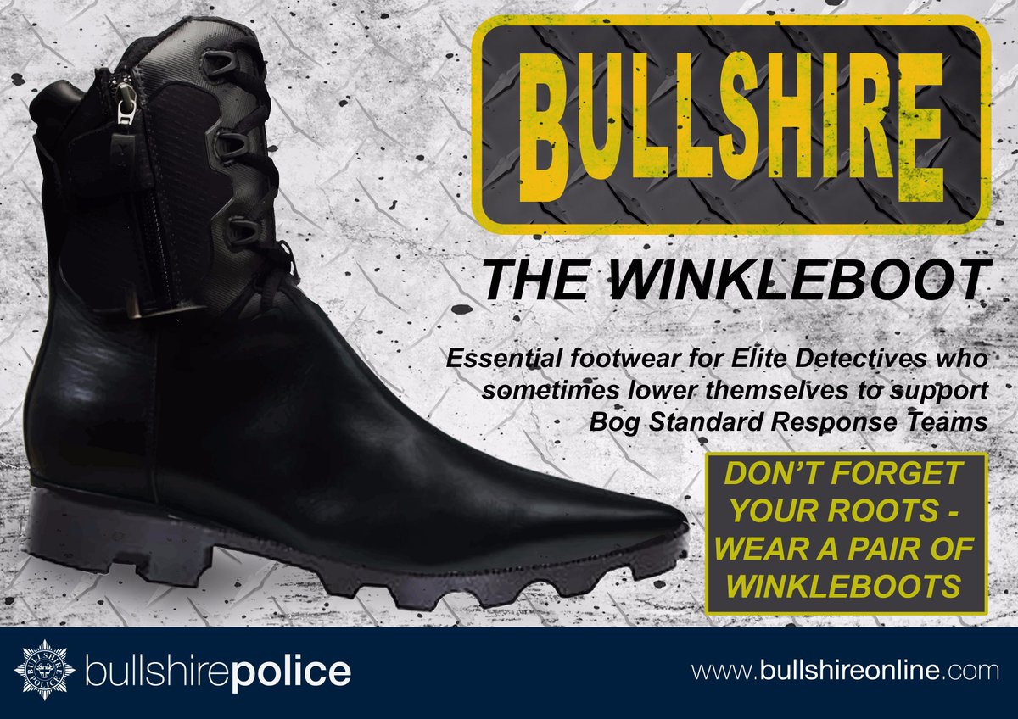
Sub - cultures
Most accounts of the police mention subculture.....but what is it? Evidence?​
​
Police personalities​
​
Occupational culture​
​
Why does it matter? ​
​
Criticisms​
​
Changing cop cult
Notes:
Slide 6
Some research on police cultures seems to suggest that the effect of it (police culture/sub-cultures) might cut two ways,’ in that officers can identify with and to gain confidence from it negatively e.g. misplaced loyalty; there is also the potential for some to comply with instructions and rules without fail, even though they believe it to be wrong (‘blind obedience’?).
Police subculture has been described in the literature as having largely negative characteristics, at odds with the ideal of public service. There is also debate as to whether and how these characteristics shape officer behaviour.
As a ‘truism’ you could say that whenever you put people together for any length of time, a culture develops within that group. Think about all the teams you have been a part of – think about the differences between the reliefs/shifts/teams/groups at your police station.
How are cultures created and sustained – think of the discretionary but regulatory nature of your work – the interactions you have with people linked to danger, risk and unpredictability and how you have been socialised by it – how you have moved from civilian to police officer – from outsider to insider.
​So (sub) ‘culture​’ in this context (arguably more generally) means that a group has an underlying, unifying set of beliefs and practices​, within which their day to day activities are meaningful – think mission/role, which sets you apart from other members of society - also think how your job/team cculture does not necessarily mean that everyone’s attitudes​ are the same or ‘bad’ – as is sometimes portrayed.
Job culture is part of a coping mechanism – shaped by what is done, responses to the uncertain and risky environments you work in, what you learn on the job and is reinforced by colleagues. The trouble you face ‘on the job’ and ‘in the job’ (Waddington PAJ 1994 p43) – Waddington’s characterization of the strain between facing the ‘trouble’ at situations you face whilst out on patrol etc. whilst at the same time avoiding ‘trouble’ from within the organization i.e. covering your back.
​
Police culture is not universal - sub-cultures exist (Chief officers – middle management – working bobbies - departmental etc) and have been the object of portrayal in film, media, satire and facebook groups: ‘Bullshire Police’ have a number of in job stereotypes – CID in winklepickers (that’s the shoes with pointy toes) and clipboards; firearms officers of smaller stature etc – fun of course but also indicative of deeper meaning – although the existence of such sub-cultures may not be a bad thing…
More authoritative accounts/discussions talk about street cops, management cops, authoritarian cops, canteen culture, van culture, conservatism, machismo, isolation, loyalty, mission and cynicism – amongst others. Newburn’s ‘Key Readings’ book has a section of six chapters devoted to police culture. PAJ Waddington wrote fairly extensively about it– notably ‘canteen culture’, which is arguably a title that covers all types. Robert Reiner’s ‘Politics of the Police’ has a section on the sociology of policing – see reading list below.
The public will see many portrayals of police agency – public order cops, undercover cops, firearms cops, detective cops etc. and we know how others see the police – perceptions – is important. We really want to be at a stage where people see the police as professionals (allowing that you cannot please all of the people all of the time).
Cop Culture is constantly changing and evolving. The professionalisation process, whilst not really new at all, has gained traction. Recruitment of more minority ethnic and female officers, PEQF and degree apprenticeships stronger policies regarding harassment and discrimination evidence this progression.
Newburn, Tim 2005 ‘Policing: Key Readings’ Willan; Cullompton
Reiner, R. 2010 ‘The Politics of the Police​’ OUP; Oxford
Waddington P.A.J.(1994) ‘Liberty and Order; Public order policing in a capital city’ UCL Press; London
Waddington P.A.J.(1999) Police (canteen) sub-culture: An appreciation. British Journal of Criminology Vol.39 No.2 Spring 1999

Slide 7
“Police officers are active participants
who shape the creation and development of the different elements of policing cultures...
cultures are learned and shared in an environment characterised by
socialisation with and the validation of others.
These complex… often hidden interactions all contribute to the process of learning,
becoming and being a police officer.”
Charman, S 2017
Notes:
Slide 7
This quote from Sarah Charman’s book ‘Police Socialisation, Identity and Culture: Becoming Blue’ . Her findings rely on recent research conducted regarding the development of identity during the first four years of police service.
This research found that recruits learned in six distinct but complementary ways—learning from doing, learning from watching, learning from mistakes, learning from common sense, learning from experience and learning from adapting. The recruits saw their tutors and ‘shift’ colleagues as being the most influential in their learning.
The more ‘formal’ aspects of the old police training format worked well but Charman identified a paradox, in that new recruits began their police socialisation (‘culturisation’?) process whilst learning law and procedure delivered by police trainers in a rigid, inflexible and behaviourist environment (arguably this remains so for stage one of training in S.Wales and Gwent) whilst a new officer’s requirement is more about gaining an understanding of how to police a democratic society. Perceiving how this format and its part in the socialisation process, creates a cultural tension is important, as the whole PEQF concept is predicated upon graduate officers being better able to conceptualise and understand their societal role critically,; one of the aims of the change and professionalisation process.
Any analysis of police training needs to appreciate how police officers learn and how identities develop,. Charman’s ‘square of police learning’ is the result of her 2017 research and shows the style and the direction of learning, and that it is an inherently social process…

Slide 8
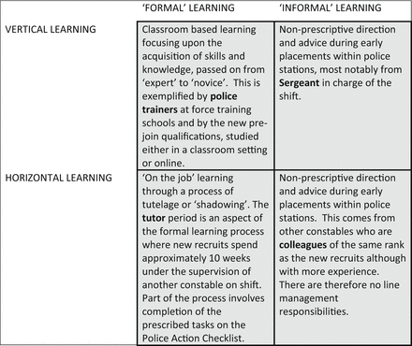
The Square of Police Learning
Notes:
Slide 8
Charman’s research was conducted two years before the PEQF format began, so the tutored period shown has changed, the findings though remain valid. All four sites of learning affect a new police recruit, in different ways and at different times of the process.
The early stages of a police career is a period of anxiety and ambiguity, when ‘reference groups’ from whom new officers can obtain support and guidance are sought out. The need to fit in - culturally assimilate - with the new group affects the extent to which they are influenced by those reference groups. As such organisational newcomers adopt an observational methodology learning particularly from their tutor constables and other shift members. Charman’s ‘square of learning’ depicts this as horizontal learning within the organisation.
If our social identity is how group membership gives us a sense of who we are, it can be helpful to think of it as a reference point for our contextual understanding.
When we join the police (or other organisations) we undergo a process of identity formation. We scale and rate others through a process of categorisation and comparison. We do this for all the groups we become part of. Charman’s research suggests that the emerging and enduring cultural characteristics developed by new officers are those of: cynicism, communication, comradeship, code of self-protection, categorisation and compassion. It is worth summarising them, whilst remembering that we’re all different – so these characteristics are not uniformly displayed.
Cynicism: Cynicism is part of a coping strategy. What is learned from formal and informal training and personal experiences of policing causes many officers to feel two levels of disappointment. Firstly the disconnect between expectations and the realities of the job and secondly, the absorption of a cultural narrative of ‘the job’s not what it was’ decline from more experienced officers. Although the ‘old sweat’ narratives were viewed with some frustration by new officers, they acknowledged that ‘fitting in’ required participation, rather than challenge. The consequence of such disappointments is a more cynical ‘newbie’ . When asked about changes in their cultural identity, some spoke of being less emotional and saw this adaptive response of emotional hardening negatively (Chan in Charman 2017).
Communication:
When officers were asked what skills are required to be a good’ police officer, communication came out on top; communication was seen as being the most effective skill related to the role, with public safety and welfare incidents being the main category of incidents reported to the police. This highlights again the changing nature of crime and the role of policing., with vulnerability and safeguarding now being more significant than crime fighting. This more community-focused and public engagement role has made communication the primary tool in policing practice. Officers dealing with complex tasks such as neighbourhood disputes, community engagement, threat of terrorism and cyber crime require very effective communication skills – seen by many as a ‘soft skill’ – which are acquired n the less formal horizontal learning environments.
Comradeship
Comradeship was cited as a reason for joining the police in the first place, in addition to the action-/outdoors-oriented nature of the job and the community service principles connected with the role. New recruits identified that police officers have high levels of solidarity with each other and enjoyed the teamwork aspect of the job. When asked to describe aspects of policing cultures, comradeship was cited more often than any other. Charman’s analysis finds this to be more a horizontal organisational commitment towards immediate colleagues rather than a vertical organisational commitment towards the wider police organisation.
Code of Self Protection
A number respondents did not see policing as being ‘a job for life’, more a ‘job for now – as being a ‘job’ rather than a ‘lifestyle’. Although comradeship is strong it is not unqualified, and there are limits to solidarity. These limits appear to be related to perceptions of a ‘blue code of silence’ (a code of secrecy - protecting your colleagues) that is changing into more a ‘blue code of self protection’ which is more aligned to staying out of Waddington’s ‘trouble in the job’ “influenced by a more individualist, risk-averse and publically accountable policing organisation.”
Categorisation
Self- or social categorisation with the group is part of identity formation - people become part of their ‘in group’, perform their group role, support its leaders and adopt the group values. Members scale and rate others against their group values., We should recognise the dangers of such ‘ethnocentrism’ which can result in hostility to those others. Charman’s research respondents verbalised the difference between themselves and others both within and outside policing – e.g. the difference between deserving and undeserving victims – this kind of categorisation has long been an aspect of police culture and it is one which impacts legitimacy – fairness has to be universal - procedural justice should be dispensed equitably.
Compassion
Compassion for others is a part of the community service principles that are one of the motivations for becoming a police officer; Charman’s respondents cited ‘making a difference’ as one of the main reasons they joined and that empathy and understanding, integrity and compassion as important characteristics, with ‘empathy and kindness’ being the most useful advice they’d received from colleagues. Respondents also cited ‘helping victims’ as one of the most enjoyable aspects of the job. These responses further evidence the changing role of policing – from fighting crime and catching villains to a more citizen protection, safeguarding and public reassurance role. The new recruits in this research placed “‘protecting citizens’ first, then ‘protecting society’, then ‘catching criminals’, then ‘upholding the law’ and then, finally, ‘fighting crime’. Policing and police officers, it could be argued, are now more comfortable with their social identity as ‘peacekeepers’ rather than as ‘crime-fighters’” (Charman 2017)
Charman’s research is offered here because it is recent and it resonates with personal experiences and learning. Policing can be argued to have been in a perpetual and prolonged process of change, - at least sine the days of ‘Dixon’ – since when levels of public confidence in the police have decreased. As with society, policing is changing on many levels and as part of the PEQF entry programme you are at the forefront of this process. Charman’s research confirms that police officers are active participants in this developmental process and in sharing their cultures – organisational culture is not static, and an understanding of this area is helpful in our consideration of organisational justice…

Slide 9
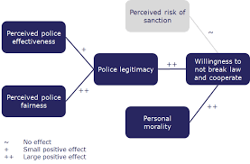
Organisational Justice
Distributive
Procedural
Interpersonal
Informational
Notes:
Slide 9
Organisational justice, first postulated by Greenberg in 1987, is rooted in equity theory and refers to employee's perceptions of the fairness of their organisation's behaviours, decisions and actions and how these influence attitudes and behaviours at work – most of the extant literature on the subject has focused on whether employees see themselves as fairly treated but more recently theorists have considered how employees view and react to the treatment of others.
Depending upon which sources you read, the concept is comprised of up to four ingredients or facets of justice that influence an individual’s perceptions about fairness. These are distributive justice, procedural justice, interpersonal justice and informational justice.
Distributive justice refers to the equity principle - perceived fairness of decision outcomes - the distribution of outcomes (e.g. pay, conditions, and responsibility) within the organisation.
Procedural justice – fairness of decision-making procedures - the extent procedures are perceived as being fair; fair procedures being free from bias, and consistently applied over time; where decision makers use accurate and timely information and when they are not fair there is a means of correcting them in place.
Interpersonal justice is about fairness of interactions - treatment by managers and supervisors – being treated with politeness, dignity and respect and having the opportunity to present your views.
informational justice refers to the fairness of communications - the adequacy of information used to describe and justify decisions – with reasonable explanations for them where possible – not always so given the nature of the job and the frequent need for a command and control approach.
Arguably, organisational justice relates to fairness in much the same way that procedural justice does; certainly they are explicitly complementary concepts., interdependent in this context. Fairness though is a subjective entity and can seemingly mean different things depending upon context – policing is s disciplined service – it is hierarchical – rank has authority and purpose – routinely cops do what they are told to do based on trust.
Organisational justice is integral to occupational health and well-being in policing and, consequently, the professionalism and commitment, dedication if you like, of it’s employees. So if the organisational culture of a police force is a positive ‘organisational justice’ one, it should deliver a high quality of service to the communities it serves.
Police organisations that are committed to implementing change must do it from within through an organisational justice approach, developing good policies, practices and procedures – fairness - for their employees, who, as a consequence, are more likely to have greater job satisfaction and be more committed to the organisation’s goals and objectives and, critically, have trust in their profession – part of a ‘righteous circle’ - thereby complementing procedural justice and improving wider relationships.
Inwardly facing organisational justice is particularly concerned with the implications of justice judgments on staff attitudes, staff retention, workplace relations, productivity and performance. Outwardly facing procedural justice is concerned with the interactions between police organisations and the public.
It’s about developing a professional organisational culture…
Further questions that remain to be fully answered – probably by further research:
Is organisational justice, as currently understood, fully achievable in policing given the diversity of demands on it and that major operations are usually characterised by command-and-control management? (call handling/classification is part of a command and control system – ‘control room’
How do other factors such as ethnicity and previous experiences of the police impact upon organisational justice in policing?
Reading:
Baldwin, Susanna. 2006 ‘Organisational Justice’ Available at: ttps://www.employment-studies.co.uk/system/files/resources/files/mp73.pdf
Beckley, Alan. (2014) Organisational justice: is the police service ready for it?, Journal of Policing, Intelligence and Counter Terrorism, 9:2, 176-190 available at: https://www.researchgate.net/profile/Alan_Beckley/publication/265297930_Organisational_justice_is_the_police_service_ready_for_it/links/5699805a08ae748dfaff7785/Organisational-justice-is-the-police-service-ready-for-it.pdf?origin=publication_detail
Quinton, Paul & Myhill, Andy & Bradford, Ben & Porter, Gillian. (2015). Fair Cop 2: Organisational Justice, Behaviour and Ethical Policing. An Interpretative Evidence Commentary.
Robert, K & Herrington, V. 2013 ‘Organisational and procedural justice: a review of the literature and its implications for policing’ available at: https://www.researchgate.net/profile/Karl_Roberts3/publication/263499049_Organisational_and_procedural_justice_A_review_of_the_literature_and_its_implications_for_policing/links/570362ee08aeade57a2476b8/Organisational-and-procedural-justice-A-review-of-the-literature-and-its-implications-for-policing.pdf?origin=publication_detail
‘Adamovic, M. 2014 ‘Organizational Justice and Cultural Values in Teams’ https://www.agrh.fr/assets/actes/2014-Adamovic.pdf

Slide 10
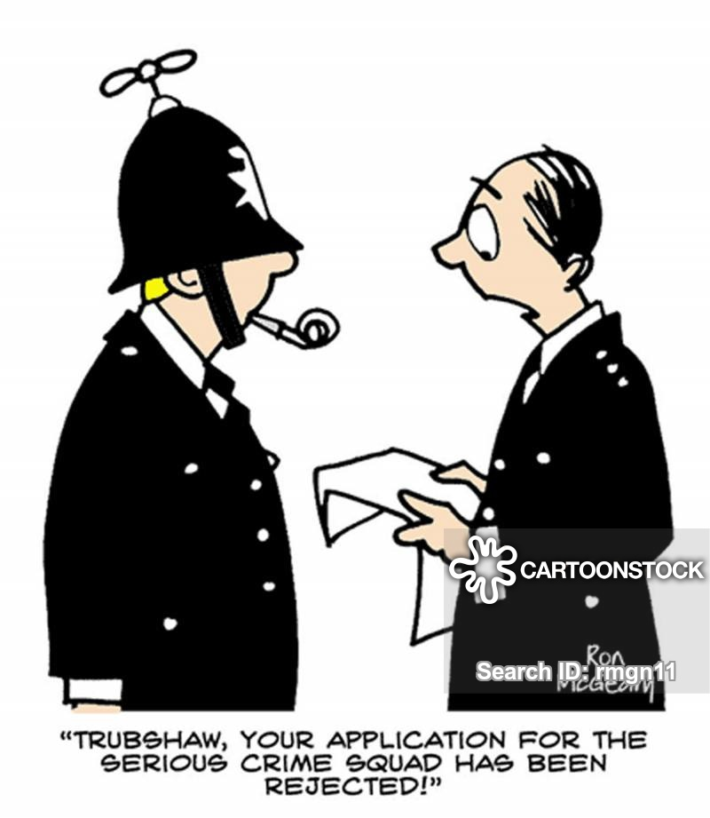
Organisational Justice
Open environment
Make change positive
Improve happiness
Maximise overall wellbeing
Close the gaps
Notes:
Slide 10
This slide included as a bit of a ‘checklist – you could use it to consider your own organisation and situation.
There are several less formal internet sources about organisational justice, most offer similar ideas on how organisations can improve wellbeing and resilience. Here they are ‘boiled down’ into five main points:
Create an open environment in which employees can learn about their own well-being, strengthen personal resources (health, self esteem) and share the ideas with their colleagues.
Help employees identify how change affects them positively.
Involve staff in developing ideas to improve well-being and happiness at work e.g. team brainstorming sessions.
Practice participative management style to strengthening well-being at work. Identify and assess how worker’s conditions - workload, salary distribution, rewards and stability etc. interact with their personal resources – their levels of autonomy, competence, security and happiness at work. Give roles to suit aptitudes,, improve skills and strengthen their expertise to increase commitment.
Action plan to close the gaps on an individual and organisational level - create opportunities for employees to connect and improve relationships, particularly with their managers.

Slide 11
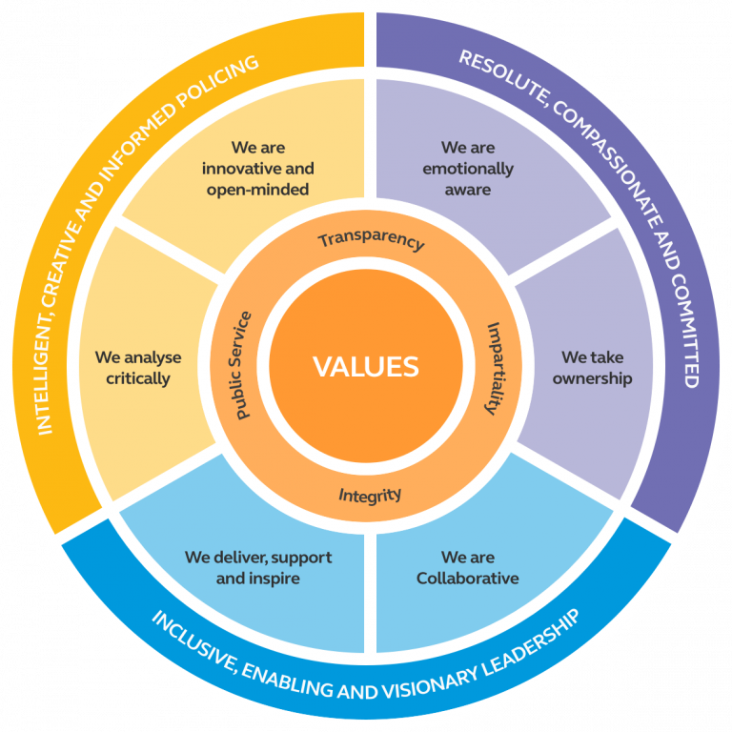
In summary
Treat others as we would like to be treated
  Fairness – respect - dignity
Organisational justice and culture are interdependent
Personal responsibility
Notes:
Slide 11
There’s not much new in the World is there?!
Ultimately organisational justice is about fairness, respect, and dignity – how we treat others and how others treat us – inside and outside the organisation. Clearly these characteristics are the same as those highlighted in the code of ethics, professional standards and PACE Act requirements. They are the characteristics of professionalism.
Research on organisational justice and cultural values has tended to focus on the vertical relationship in hierarchies – between bosses and employees,, perhaps at the expense of the more horizontal relationships between team members, where peer pressure (peer justice?) comes into play – think both big teams and little teams – and consider how strong the moderating role of cultural & sub-cultural values are and the relationship between distributive justice and task performance - It is fair to assert that culture, combined with organisational, situational, and individual characteristics affect how people react to agency both within and outside the organisation – their perceptions of justice, particularly injustice. Positive perceptions of justice are linked to positive outcomes.
Certainly organisations have a responsibility to their employees but there is also a personal responsibility - the need for continual professional development is clear… andragogy – developing a heutagogical approach (andragogy is the science of teaching adults. Heutagogy is about self-determined student-centred learning where the student has the autonomy, capacity and capability to define and manage their own learning) – ‘no-one will develop your career like yourself’ – understanding your organisation is key to your progress through it – through building your knowledge by keeping an open mind and using critical reflection to gain greater understanding.

Slide 12
Bibliography
‘Adamovic, M. 2014 ‘Organizational Justice and Cultural Values in Teams’ https://www.agrh.fr/assets/actes/2014-Adamovic.pdf
Brown, J. (1996) ‘Police research: some critical issues’ in Leishman, F., Loveday, B. and Savage, S. (eds) Core Issues in Policing, London: Longman
CMI 2015 ‘Understanding Organisational Culture’ available at: https://www.managers.org.uk/~/media/Files/PDF/Checklists/CHK-232-Understanding-organisational-culture.pdf
CIPD 2013 ‘The changing contours of fairness’ available at: https://www.cipd.co.uk/Images/the-changing-contours-of-fairness_2013-individual-organisation-perspectives_tcm18-9566.pdf
CoP 2020 ‘Guideline 4: Promoting the right culture’ available at: https://www.college.police.uk/What-we-do/Standards/Guidelines/Neighbourhood-Policing/Pages/promoting-the-right-culture.aspx
Baldwin, Susanna. 2006 ‘Organisational Justice’ Available at: ttps://www.employment-studies.co.uk/system/files/resources/files/mp73.pdf
Beckley, Alan. (2014) Organisational justice: is the police service ready for it?, Journal of Policing, Intelligence and Counter Terrorism, 9:2, 176-190 available at: https://www.researchgate.net/profile/Alan_Beckley/publication/265297930_Organisational_justice_is_the_police_service_ready_for_it/links/5699805a08ae748dfaff7785/Organisational-justice-is-the-police-service-ready-for-it.pdf?origin=publication_detail
GREENBERG, J. (1987b) A taxonomy of organizational justice theories. Academy of Management Review. Vol 12, No 1, January. pp9–22.
Quinton, Paul & Myhill, Andy & Bradford, Ben & Porter, Gillian. (2015). Fair Cop 2: Organisational Justice, Behaviour and Ethical Policing. An Interpretative Evidence Commentary.
Robert, K & Herrington, V. 2013 ‘Organisational and procedural justice: a review of the literature and its implications for policing’ available at: https://www.researchgate.net/profile/Karl_Roberts3/publication/263499049_Organisational_and_procedural_justice_A_review_of_the_literature_and_its_implications_for_policing/links/570362ee08aeade57a2476b8/Organisational-and-procedural-justice-A-review-of-the-literature-and-its-implications-for-policing.pdf?origin=publication_detail

