Slide 1
BUSINESS PLAN FOR BRIGHT FUTURE LLP
TABLE OF CONTENTS
1. BUSINESS DETAILS
2. EXECUTIVE SUMMARY
3. BUSINESS OVERVIEW
4. MARKETING ANALYSIS
5. SWOT ANALYSIS
6.PESTEL ANALYSIS
7. MARKETING
8. OPERATIONS
9. MANAGEMENT TEAM
10. FINANCIAL OVERVIEW

Slide 2
BUSINESS DETAILS
Business owner(s): Ana-Maria Luiza Macovei, Ionela Diana Bojila and Maria Francisca Bumbu. Business name: Bright Future LLP
Business address:
134A Narborough Leicester Leicestershire
LE3 0BT
Phone: 07471474659
Email: Brightfuture10@gmail.com
Website: https://www.brightfuture.com.index.html
Notes:
The company Bright Future LLP is specialised in the study of foreign languages. It is handling the translation of documents and paperwork in foreign languages such as Romanian, Spanish and Italian to English. The company is a partnership between three associates.

Slide 3
EXECUTIVE SUMMARY
Bright Future LLP is a partnership, specialising in the online study of numerous different foreign languages within the online teaching industry.
Management team
Ana-Maria Luiza Macovei Role: CEO
Ionela Diana Bojila Role: CEO
Maria Francisca Bumbu Role: CEO
Ownership structure of business
Owner(s):
Ana-Maria Luiza Macovei
Share owned: 33.3%
Ionela Diana Bojila Share owned: 33.3%
Maria Francisca Bumbu Share owned: 33.3%
.
Notes:
The ownership of the company is divided into the three people that are managing it. The structure is basically formed of the three CEOs and in the future when the company will be expanding, it will need more employees to act as translators. As a partnership, all income of the company must be divided into equal parts towards the associates.

Slide 4
BUSINESS OVERVIEW
Overview: The business specialises in the online study of numerous different foreign languages (Jayachandran, Javier and Rajan, 1999).
Service(s):
Bright Future LLP provides: Online teaching
Unique Selling Points (USP)
Our primary sales channel is the internet.
Notes:
The company is providing online teaching of foreign languages to various customers. It also provides translation services for documents and paperwork. The compoany acts as an online company and as such is providing services online via the Internet. The company has its own social media page on Facebook and is using the advertising channels provided by the social media platform to promote its services.

Slide 5
MARKET ANALYSIS
Target market description
MARKET ANALYSIS
Our business don't have a specific target of people.
Specific segment of market to be targeted
We are targetting are those whose are unable to complete a certain level of study but who yet feel compelled or obligated to lear a new language.
Competitive Landscape
Set out below are the names of the business's key competitors with a summary of what they do and why they are key competitors.
Competitor name Summary of the competitor's business Why are they a competitor?
Duolingo | Duolingo is an American educational technology company which produces apps for language-learning and provides language certification. | Duolingo has a extremely large, active user forum where learners can ask questions,get answers from more seasoned learners,swap tips and share resources (Lamb, Hair, McDaniel & Terblanche, 2007). Is the first free language-learning app to rival expensive paid programs and is one of the most popular app in Apple Store and Galaxy Apps.
Notes:
The main competitor of Bright Future is Duolingo which is also producing apps for language learning and has a large customer base and could become a threat if Bright Future does not come up with a proper marketing strategy to maintain its position on the market. Unlike Bright Star, Duolingo has a large forum base where customers can ask questions, whereas Bright Future is offering answers only via the Facebook platform if the customers are engaging with the posts made by the company.

Slide 6
SWOT ANALYSIS
Strengths (internal, positive factors) Strengths describe the positive attributes, tangible and intangible, of your business. These are within your control and are your advantages over your competition (Douglas and Craig, 1989). | Weaknesses (internal, negative factors) Weaknesses are aspects of your business that detract from the value you offer or place you at a competitive disadvantage.
Bright Future is an universally accessible website, personalized and fun, our goal is to continuously enhance its product design in order to encourage the proper user behaviour based on data. | Disadvantage compared to the competition: Bright Future isn't promoted and known enough. Addressing disadvantage compared to the competition: The fact that our rival is better known and publicised than we are our chances of success may be diminished . Disadvantage compared to the competition: As compared to the competitors, our financial resources are insufficient. Addressing disadvantage compared to the competition: Our competitor can invest more in their app since their economic potential is higher than ours.
Opportunities (external, positive factors) Opportunities are external attractive factors that represent reasons for your business to exist and prosper. | Threats (external, negative factors) Threats are external factors beyond your control that could put your business at risk. You may benefit from having contingency plans for them.
Education is broken,especially in developing countries. People without money, who can't afford to attend an universities, it have very limited literacy skills.Than Bright Future has born promising a free language learning to everyone.Accesible to everyone who wants to learn. | Reason your business may not work including any problems in the marketplace: The business vision not meet with the innovation that we using now. We need to invest more in our technologies to standout in competitive market. Contingency plan: Our contingency plan is to locate a sponsor who will contribute to the technology and operational infrastructure of the business.
Strengths, Weaknesses, Opportunities and Threats
Notes:
Bright Future is accessible due to its Facebook page because many customers are Facebook users and are able to engage with the company via the social media platform. Bright Star does not own its own website which makes it more difficult to promote itself due to using only one social media platform. The company has the opportunity to expand to other countries and expand its customer portfolio. Lack of investment can be considered as a threat as if the associates do not invest sufficient funds, the company could go into insolvency.

Slide 7
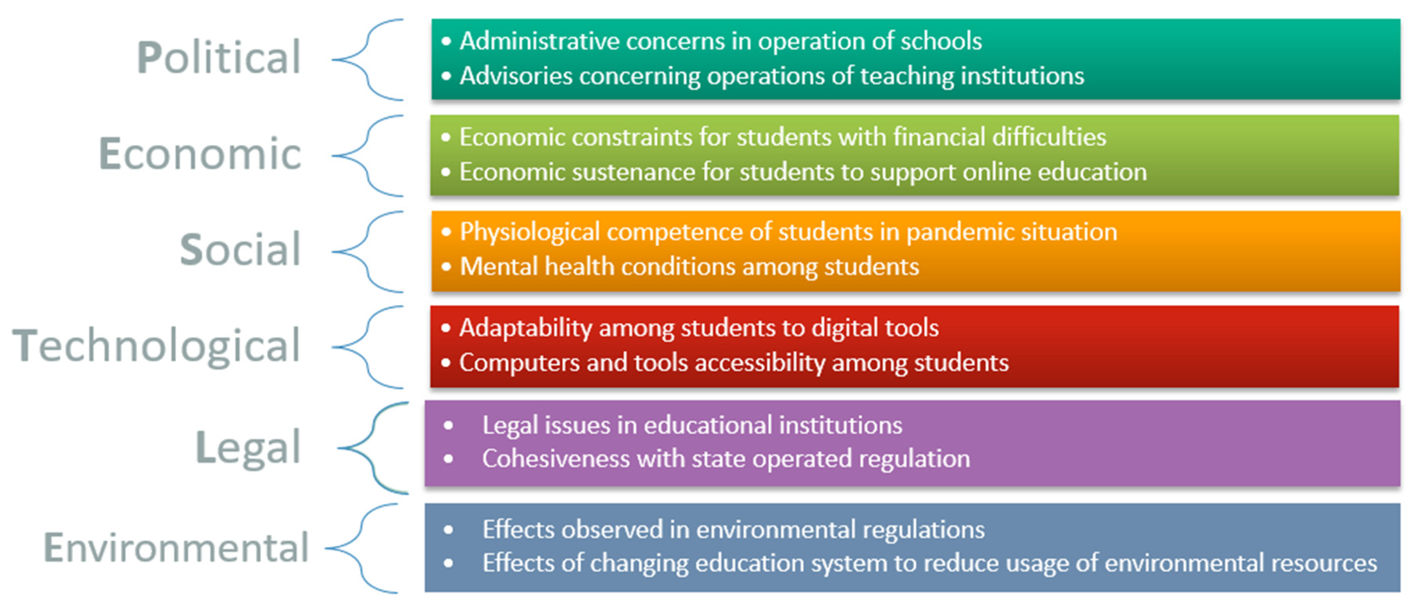
PESTEL ANALYSIS
Notes:
Political factors such as laws given by the Government can either support or stall the activity of the company. From an economical point of view, the UK is a very well developed country and its Government supports small businesses, so the company associates can require funding from the Government in order to perform its activities on the UK territory. Due to the repercussions of the pandemic, students might have delays in accessing the courses provided by the company. Students need to familiarize themselves with the programs used by the company. The company must adhere to UK laws and regulations. The company adopts a paperless method to send the courses to its students, therefore reducing the use of paper.

Slide 8
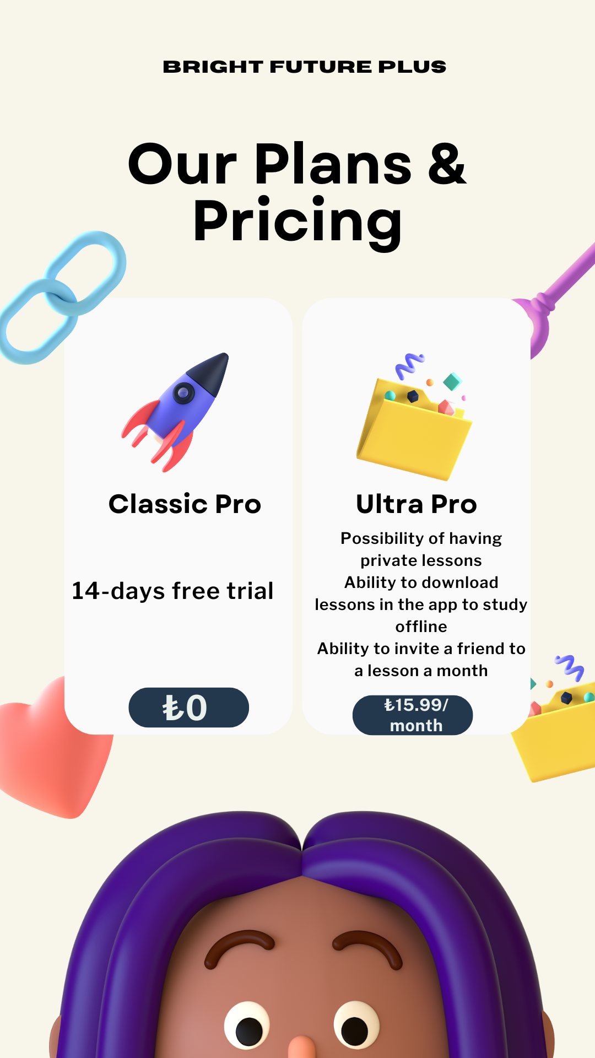
MARKETING
Pricing plan
MARKETING
Price: Bright Future offer the freemium model to our use base.Initially Bright Future Plus give a 14-days free trial, and then the cost is 15.99 per month (Gillespie, Jean-Pierre and David 2004).
Level of pricing compared to competitors: Our pricing strategy is to provide a sizeable number of private courses taught by qualified professors for a marginally higher price than rivals while still providing superior quality and premium services (Kotabe and Helsen, 2004).
Sales and marketing techniques
We will use the following marketing techniques: Online marketing
Sales processes
We anticipate using the following sales processes: Online
Notes:
The company is providing a free 14 days trial for its customers in order to attract them into using the app, then it would cost only 15,99 pounds per month which is accessible considering the services that are being provided. The product offered by the company is foreign languages study and translation services. The advertising campaigns for the company are being done online via the Facebook platform. The distribution channel is via the Internet.

Slide 9
OPERATIONS
Teachers Graphic Designer Copywriter Software Engineer Business Analysts Customer service representative | Teachers Graphic Designer Copywriter Software Engineer Business Analysts Customer service representative | Planning lessons,encurage student participation, making student work and recording the lesson, providing learners with one-to-one support. Creates engaging content for a variety of mediums, including web, social media, print and more. Write clear, attractive copy with a distance voice. Collaborate with designers. Edit and proofread copy as need. Sources images and other content. Purchases and implements software. Understands strengths and weaknesses in system architecture,anticipating vulnerabilities and developing contingency plans (Perreault & McCarthy, 1996) . Track the data and give adequate advice. Financial modelling ,forecasting and reporting on your insight. (Schiffman, Leon & Kanuk, 1994) Be in constant communication with clients and correspond with them on a regular basis through emails, social media and phone call. Make sure the users are satisfied with the services.
Employees required Employee role
OPERATIONS Number
Duties
Licences required
Sales tax licences Seller's permit
Insurance required
Professional indemnity insurance
Equipment or machinery required
Computers Video recorder Microphone
Notes:
The company would need a license to function legally. It also needs insurance and sales tax licenses in order for its activity to be considered as legal. The company also needs to invest into professional computers for its customers as some of them might not own computers and might be in need of them. The company could create its own website but it needs to invest funds into IT specialists that can create a website on which customers can find out information about the company and about the services provided.

Slide 10
MANAGEMENT TEAM
Skills and experience of business owners
Ana-Maria Luiza Macovei
Role: CEO
Skills and experience: Leadership capabilities, big picture thinking, stress management.
Ionela Diana Bojila
Role: CEO
Skills and experience: Sociability,teamworking,learning new things,cretivity and strong communication skills.
Maria Francisca Bumbu
Role: CEO
Skills and experience: Motivational people skills, sales skills, financial management skills, problem solving skills.
Notes:
The management team is formed of the three CEOs who have various skills such as team working, punctuality, financial management skills, problem solving and critical thinking skills. These skills are necessary for the associates to be able to manage such a company.

Slide 11
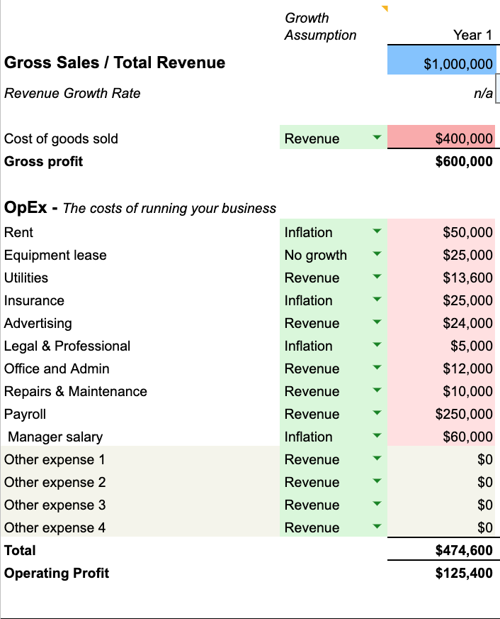
FINANCIAL OVERVIEW
Notes:
The expected profit for the first year of activity based on the market analysis is approximated at 999,023 pounds which is a good value for the first year of activity. Due to its location and the fact that there are not many other companies with similar activity nearby, the company could be successful in existing on the market for a long term.

Slide 12
The company is expected to have income from the first year of activity as it can be seen in the table above.
If the necessary investments are made, the company will be successful.
Notes:
The income is calculated per one year of activity and it shows that the company will generate revenue from the first year of activity.

Slide 13
References
Douglas, Susan P. and C. Samuel Craig (1989), “Evolution of Global Marketing Strategy: Scale, Scope and Synergy,” Columbia Journal of World Business, Fall, 47-59
Gillespie, K., Jean-Pierre J. and H. David H. (2004), Global Marketing: An Interactive Approach. Houghton Mifflin: Boston (MA)
Jayachandran, S, Javier G, and P. Rajan V. (1999), “The Theory of Multimarket Competition: A Synthesis and Implications for Marketing Strategy,” Journal of Marketing, 63 (July), 48-66
Kotabe, Masaaki and Kristiaan Helsen (2004), Global Marketing Management. 3rd Edition, John Wiley: New York
Lamb, Charles W Jr, Hair, JF, McDaniel, C, Boshoff, & C, Terblanche, NS. (2007) Marketing. 2nd South African edition. Cape Town: Oxford University Press
Perreault, W.D. & McCarthy, E.J. (1996) Basic Marketing. Chicago: McGraw-Hill, p.8
Schiffman, Leon G, & Kanuk, LL. (1994) Consumer Behavior. 5th edition. London: Prentice-Hall

