Slide 1
Arrays
C# Arrays
Using Arrays

Slide 2
Objectives
How to declare an array and assign values to array elements?
How to initialize an array?
How to use subscripts to access array elements?
How to use the Length field?
How to use foreach to control array access?

Slide 3
Objectives
How to manually search an array to find an exact match
How to search an array to find a range match
How to use the BinarySearch() method
How to use the Sort() and Reverse() methods

Slide 4
Objectives
How to pass an array to a method?
How to use parameter arrays?
How to declare an array of objects?
How to use the BinarySearch() and Sort() methods with object arrays?

Slide 5
Declaring an Array and Assigning Values to Array Elements
Sometimes storing just one value in memory at a time is not adequate
An array is a list of data items that all have the same type and same name
Example of array declaration:
double[] salesFigure;
Like objects, memory is not actually reserved until the new keyword is used
Example: salesFigure = new double[20];

Slide 6
Declaring an Array and Assigning Values to Array Elements
A subscript or index is an integer contained within square brackets that indicate the position of one of an array’s variables, or elements
An array’s elements are numbered beginning with 0
A common mistake is to forget that the first element in an array is element 0

Slide 7
Initializing an Array
Arrays, like object fields, have default values
You can assign nondefault values to array elements upon creation
Examples:
  int[] myScores = new int[5] {100,76,88,100,90};
  int[] myScores = new int[] {100,76,88,100,90};
  int[] myScores = {100,76,88,100,90};

Slide 8
Using Subscripts to Access Array Elements
The power of arrays become apparent when you begin to use subscripts that are variables rather than constant values
A loop can be used to cycle through the elements of an array
Through the use of loops and arrays, code can become more efficient

Slide 9
Using the Length Field
Because every array is automatically a member of the class System.Array, you can use the fields and methods that are part of the System.Array class
The Length() field is a member of the System.Array class

Slide 10
Using foreach to Control Array Access
C# supports a foreach statement that you can use to cycle through every array element without using subscripts
With the foreach statement, the programmer provides a temporary variable that automatically holds each array value in turn

Slide 11
Manually Searching an Array for an Exact Match
One way to determine if some variable holds one of many possible valid values is to use a series of if statements
Instead of creating a long series of if statements, a more efficient solution is to compare the variable against the items in an array
In certain situations, where arrays are involved, it might be a good idea to use parallel arrays

Slide 12
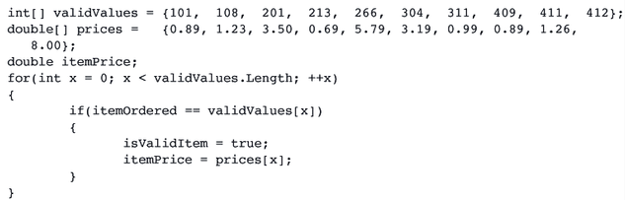
Manually Searching an Array for an Exact Match
Accessing information in parallel arrays

Slide 13
The BinarySearch() Method
The BinarySearch() method finds a requested value in a sorted array
This method accepts two arguments: an array and the field to be searched for
The method returns –1 if the value is not found in the array, otherwise it returns the index where the value is located

Slide 14
The BinarySearch() Method
This method does NOT work under the following conditions:
  If the array items are not arranged in ascending order, the BinarySearch() method does not work correctly
  If the array holds duplicated values, then the BinarySearch may not work
  If you want to find a range match rather that an exact match, the BinarySearch() method does not work

Slide 15
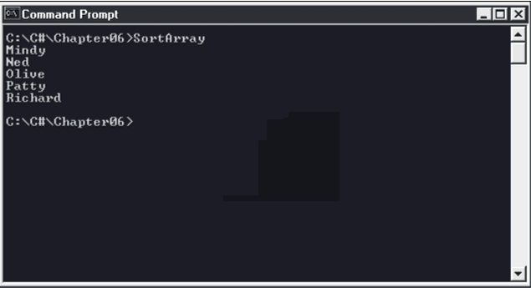
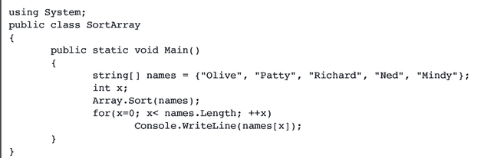
Using the Sort() and Reverse() Methods
The Sort() method arranges array items in ascending order

Slide 16
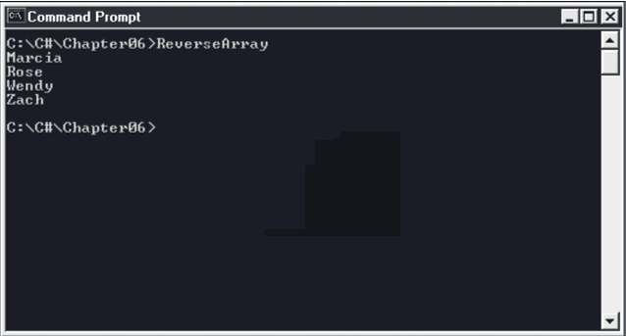
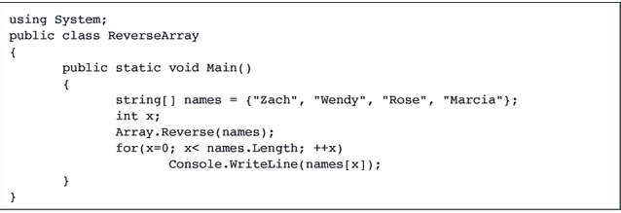
Using the Sort() and Reverse() Methods
The Reverse() method reverses the order of items in an array

Slide 17
Writing Methods That Accept Array Parameters
When you pass an array to a method, changes you make to array elements within the method are permanent
Arrays, like all objects, are passed by reference
Within the method header, a parameter is declared as an array using square brackets after the argument type

Slide 18
Using Parameter Arrays
When you don’t know how many arguments you might eventually send to a method, you can declare a local array within the method header using the keyword param
For example:
public static void DisplayStrings (param string[] people)

Slide 19
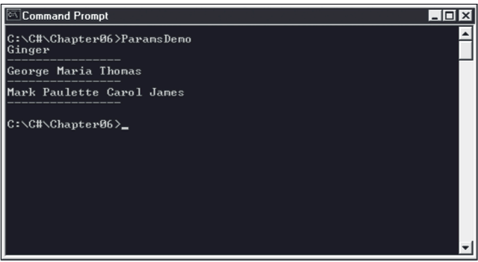
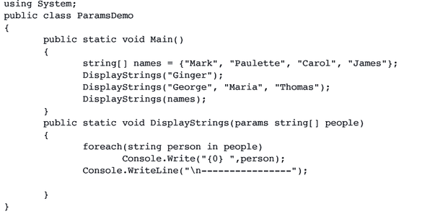
Using Parameter Arrays
ParamsDemo program and the output

Slide 20
Declaring an Array of Objects
You can declare arrays that hold elements of objects
To use a method that belongs to an object that is part of an array, insert the appropriate subscript notation after the array name and before the dot-method
Example:
  empArray[x].SetId(999)
  empArray[x].SetSalary(7.25)

Slide 21
Using the BinarySearch() and Sort() Methods with Object Arrays
The use of methods like BinarySearch() and Sort() become complicated when you use them with arrays of user-defined objects
When you create a class containing many fields, you must tell the compiler which field to use when making comparisons
An interface is a collection of methods that can be used by any class, as long as the class provides a definition to override the interface’s abstract definition

Slide 22
Chapter Summary
An array is a list of data items, all of which have the same type and the same name
In C#, arrays are objects of a class named System.Array; like all objects, their fields are initialized to default values
The power of arrays becomes apparent when you begin to use subscripts that are variables rather than constant values
When you work with array elements, you must ensure that the subscript you use remains in the range 0 through length -1

Slide 23
Chapter Summary
You can use the foreach statement to cycle through every array element without using subscripts
When you want to determine whether some variable holds one of many possible valid values, you can compare the variable to a list of values in an array
You can create parallel arrays to more easily perform a range match
The BinarySearch() method finds a requested value in a sorted array
The Sort() method arranges array items in ascending order. The Reverse() method reverses the order of items in an array.

Slide 24
Chapter Summary
You can pass a single array element to a method in exactly the same manner as you would pass a variable. Alternatively, instead of passing a single array element to a method, you can pass an entire array.
When you don’t know how many arguments you might eventually send to a method, you can declare a local array within the method header by using the keyword params
Just as you can declare arrays of integers or doubles, you can declare arrays that hold elements of any type
When you create a class containing fields, you must create an IComparable interface containing a CompareTo() method

