Slide 1




EVALUATING ARTIFICIAL INTELLIGENCE MODELS FOR LOAN APPROVAL PREDICTION
A Comparative Analysis Using Machine Learning Techniques
Masters Project Dissertation
ACFA7003

Slide 2



RESEARCH BACKGROUND & PROBLEM
Why AI for Loan Approval?
Traditional credit scoring is often manual and rule-based
Growing applications increase processing time
Fixed rules may miss complex applicant patterns
Different officers may produce inconsistent decisions
AI can support faster and more consistent lending
Key message:
Can AI improve loan approval prediction without compromising fairness and transparency?

Slide 3

AIM, OBJECTIVES & RESEARCH QUESTIONS
Research Aim
Identify the most suitable ML model for predicting loan approval.
Key Objectives
Review AI/ML in credit risk
Identify important applicant characteristics
Develop 4 ML models
Compare performance using 5 metrics
Recommend the most suitable approach
Research Questions
Which applicant factors matter most?
Which model predicts approval most accurately?
Which model is most reliable?
When is AI appropriate for lending?
*

Slide 4
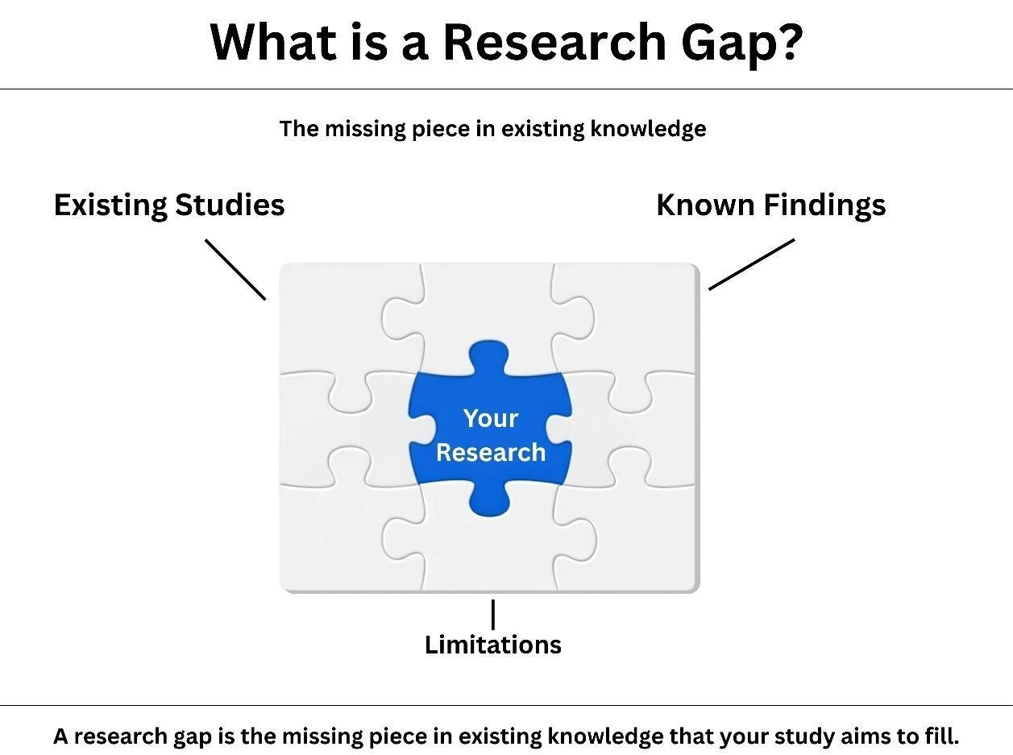

LITERATURE REVIEW & RESEARCH GAP
What Does Existing Research Tell Us?
AI can identify complex credit-risk patterns
Feature selection and data preparation are critical
Complex models can improve prediction
Interpretability remains important in finance
Human oversight is often recommended
Research Gap
Limited studies compare multiple AI models under the same data, metrics and validation conditions.
Limited hyperparameter analysis
Limited focus on accuracy and explainability

Slide 5
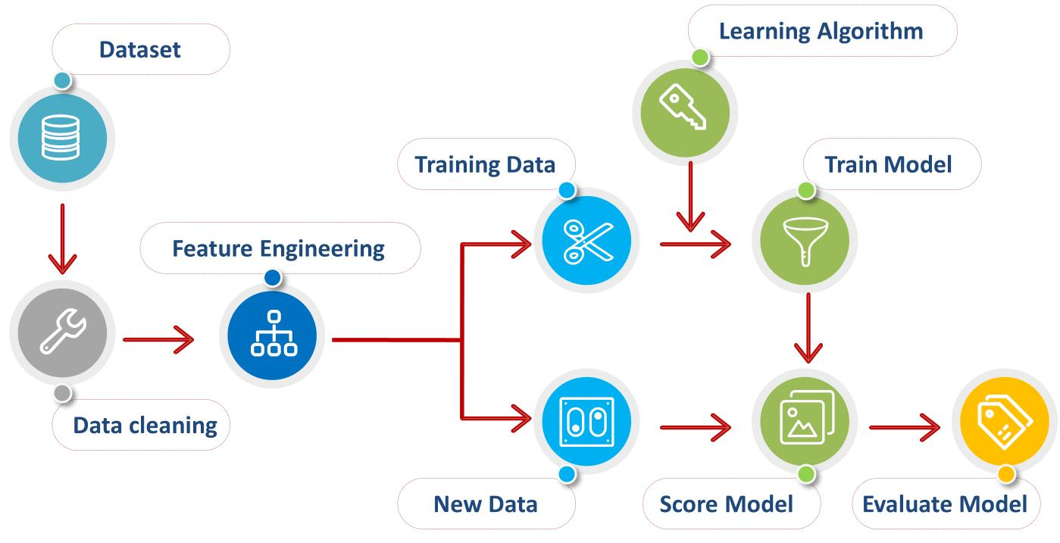
DATA & METHODOLOGY
Research Design
Dataset
Public Kaggle loan dataset
367 applicants
12 original attributes
Financial + demographic information
Data Preparation
Missing-value treatment
Categorical encoding
Feature preparation
70% training / 30% testing
Validation
5-fold cross-validation
Python + Scikit-learn + XGBoost

Slide 6
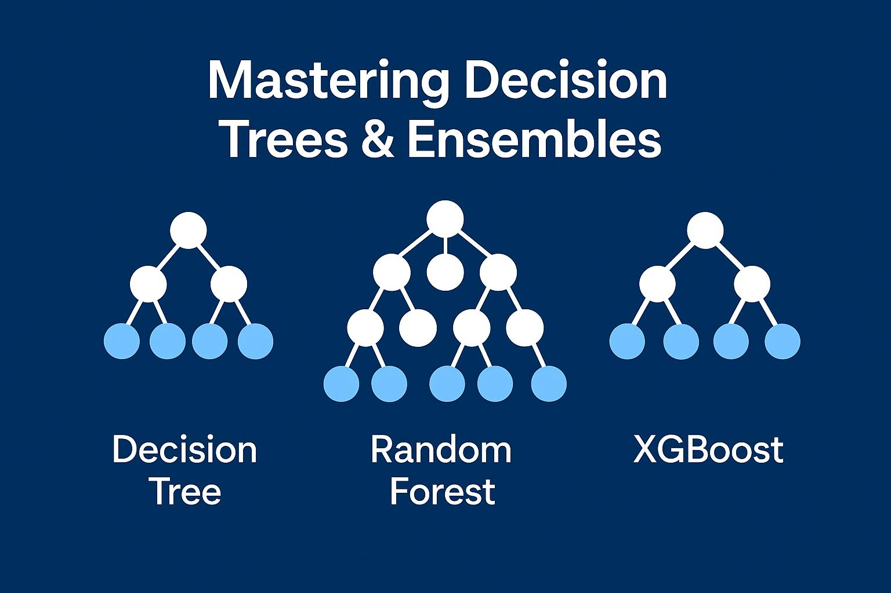
AI MODELS COMPARED
Model | Main Strength
Logistic Regression | Simple & interpretable
Decision Tree | Easy-to-understand decisions
Random Forest | Robust ensemble approach
XGBoost | Powerful boosting technique
Evaluation Metrics
Accuracy
Precision
Recall
F1-Score
ROC-AUC

Slide 7
BASELINE MODEL RESULTS
Model | Accuracy | ROC-AUC
Logistic Regression | 0.75 | 0.727
Random Forest | 0.71 | 0.718
Decision Tree | 0.70 | 0.650
XGBoost | 0.64 | 0.640
Key Findings
Logistic Regression achieved the best baseline performance
Random Forest was close and more robust
Decision Tree showed high recall but weaker discrimination
XGBoost had the weakest baseline results

Slide 8

KEY PREDICTORS & MODEL INTERPRETATION
What Influences Loan Approval?
Most Important Factors
Credit history
Applicant income
Loan amount
Property area
Combined financial capacity
Important Insight
Credit history appeared as the initial Decision Tree split
Income-related factors were consistently important
Model performance depends heavily on data quality

Slide 9
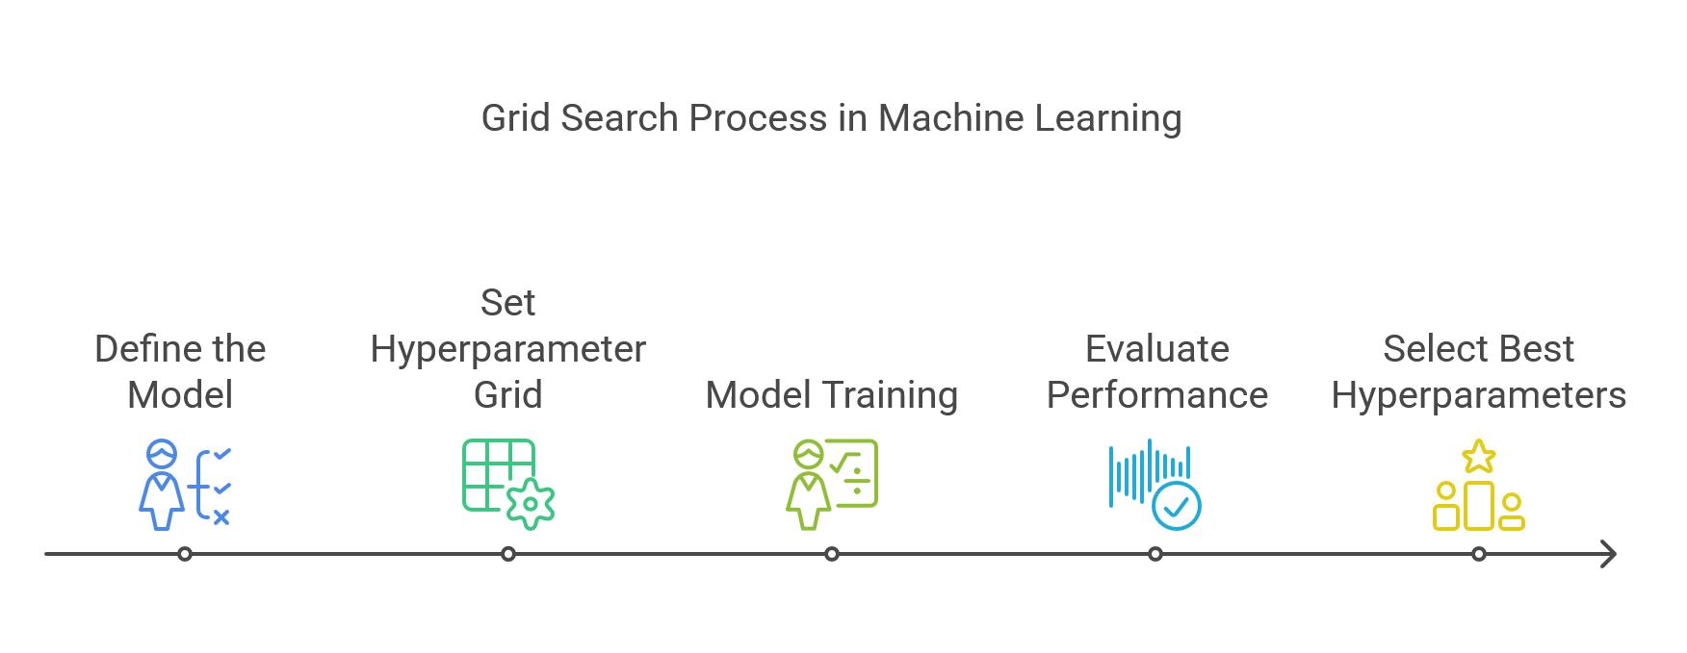
HYPERPARAMETER OPTIMISATION
Can Model Tuning Improve Performance?
GridSearchCV + 5-Fold Cross-Validation
Logistic Regression: C = 0.01, lbfgs
Decision Tree: Depth = 3, entropy
Random Forest: 100 estimators, depth = 5
XGBoost: 100 estimators, depth = 3, learning rate = 0.01
Performance Improvement
Decision Tree ROC-AUC: 0.65 → 0.69
XGBoost ROC-AUC: 0.64 → 0.69
Random Forest: No meaningful improvement
Takeaway: Tuning helped, but improvements were modest.

Slide 10

CONCLUSIONS, LIMITATIONS & RECOMMENDATIONS
Conclusions
Simpler models performed strongly
Logistic Regression provided the strongest baseline
Random Forest showed robust performance
More complexity ≠ better prediction
Limitations
Small dataset: 367 records
Single public data source
Potentially artificial approval labels
Limited representation of real lending populations
Recommendations
Use larger, real-world datasets
Conduct formal fairness audits
Maintain human oversight
Regularly retrain and monitor models

Slide 11
REFERENCES
Pagano, T. P. et al. (2023). Bias and Unfairness in Machine Learning Models: A Systematic Review. Big Data and Cognitive Computing, 7(1), 15.
Yang, W. et al. (2023). Survey on Explainable AI: From Approaches, Limitations and Applications Aspects. Human-Centric Intelligent Systems, 3, 161–188.
Sheppert, A. P. (2026). Techniques for mitigating overfitting in machine learning: A comprehensive review, taxonomy, and practical guide. Frontiers in Artificial Intelligence, 9, 1794271.
Bahlool, R., Hewahi, N., & Elmedany, W. (2026). Performance, Fairness, and Explainability in AI-Based Credit Scoring: A Systematic Literature Review. Journal of Risk and Financial Management, 19(2), 104.
Ghandour, A. (2021). Opportunities and Challenges of Artificial Intelligence in Banking: Systematic Literature Review. TEM Journal, 1581–1587.

