Slide 1

Session 1
Introduction to the module &
Overview of Financial Management for Projects

Slide 2
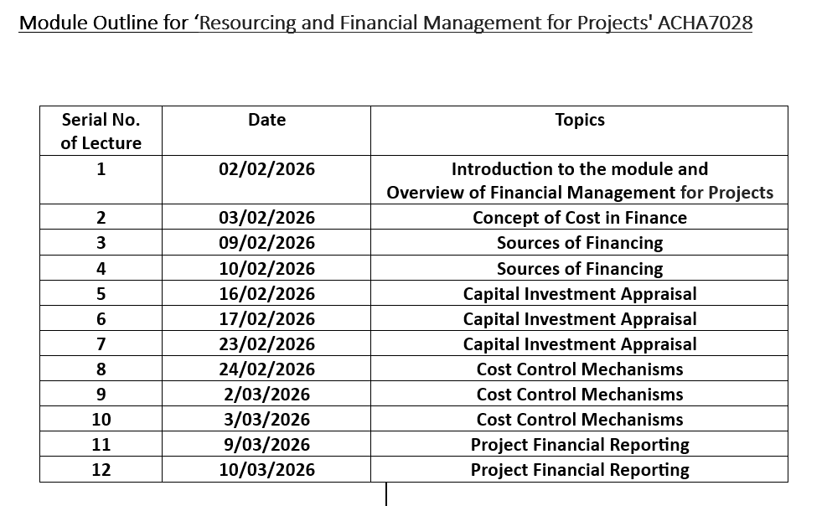

Slide 3
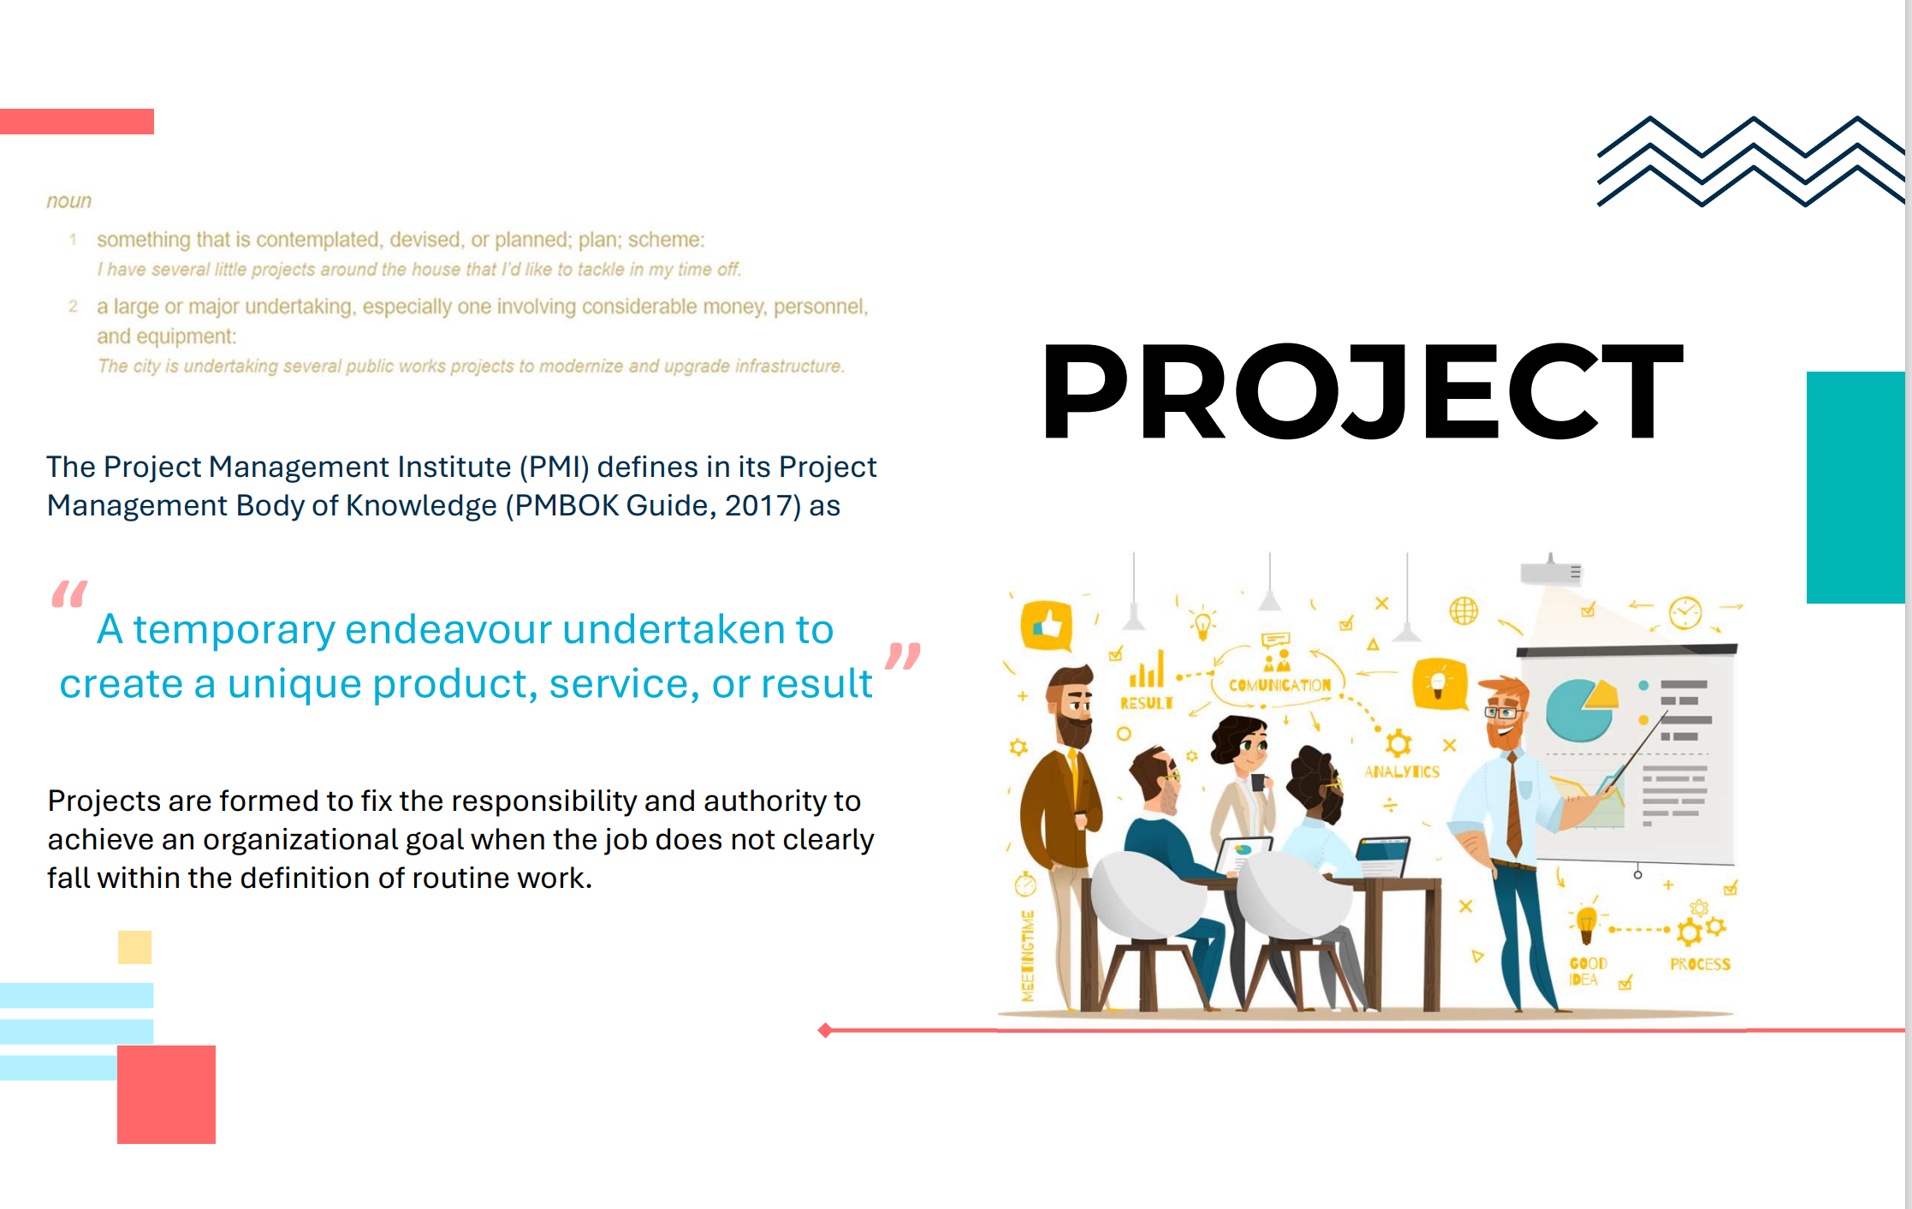

Slide 4
What Is a Project?
A project is a temporary, unique, goal‑oriented activity undertaken to create a specific outcome such as a product, service, or result.

Slide 5
Examples
Building a new bridge
Launching a new product
Developing a mobile application
Conducting a research study

Slide 6
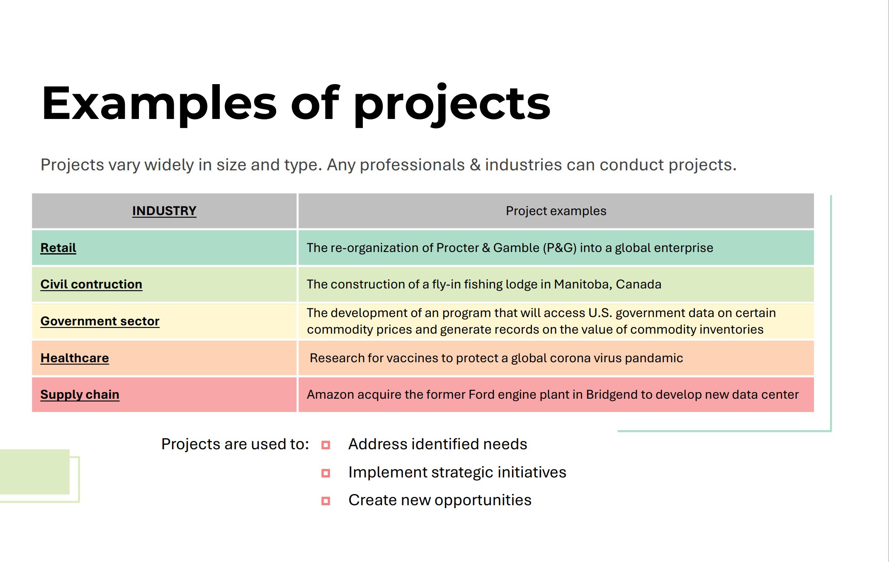

Slide 7
Key Characteristics of a Project
Temporary
  Has a defined start and end date.
Unique
  Produces something new or different (not routine work).
Specific objectives
  Aims to meet a particular need or solve a specific problem.
Progressive elaboration
  Plans become more detailed as information becomes available.
Defined scope, time, and cost
  Known as the project management “triple constraint.”
Uses resources
  People, technology, money, materials.

Slide 8
In simple terms:
➡️ A project is a planned effort to achieve a unique outcome within a limited time and budget.

Slide 9
What Is Financial Management of a Project?
Project Financial Management refers to the processes used to plan, organize, control, and monitor the financial resources of a project to ensure it is completed within budget and delivers financial value.
It integrates financial planning with project management to ensure the project remains financially viable from start to finish.

Slide 10
Key Components of Project Financial Management
1. Financial Planning & Budgeting
Estimate project costs
Develop cost baselines
Allocate budgets to phases/work packages
2. Cost Estimation
Predicting the financial resources needed
Methods include bottom-up, analogous, and parametric estimating

Slide 11
Key Components of Project Financial Management
3. Financing the Project
Deciding how the project will be funded:
  Debt
  Equity
  Grants
  Corporate funds
  Public–private partnerships
4. Cash Flow Management
Ensuring the project has enough liquidity at each stage
Forecasting inflows and outflows
Monitoring working capital

Slide 12
Key Components of Project Financial Management
5. Financial Evaluation
Using tools such as:
  Net Present Value (NPV)
  Internal Rate of Return (IRR)
  Payback period
  Real options
  Cost–benefit analysis
6. Cost Control
Tracking actual costs vs budget
Using Earned Value Management (EVM) to measure financial performance
Taking corrective actions when overspending occurs

Slide 13
Key Components of Project Financial Management
7. Financial Reporting
Regular reports to stakeholders
Forecasting final project cost (EAC – Estimate at Completion)
8. Risk Management
Identifying and quantifying financial risks
Managing contingencies
Hedging (FX, interest rates, commodities)

Slide 14
Why Project Financial Management Matters
✔ Ensures project stays within budget
✔ Improves decision-making and prioritization
✔ Maximizes financial value for stakeholders
✔ Supports resource planning and cash flow stability
✔ Helps avoid cost overruns and financial failure

Slide 15
In simple terms:
➡️ Financial management of a project is making sure the project has enough money, uses it wisely, and delivers value for the investment.

Slide 16
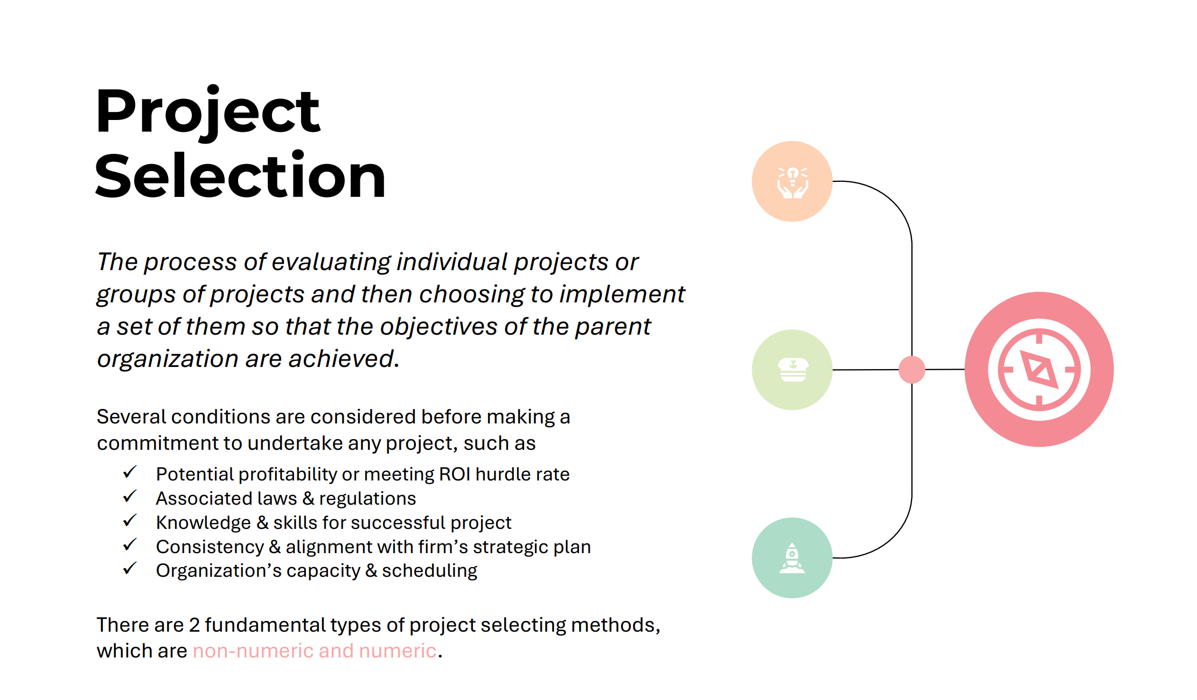

Slide 17
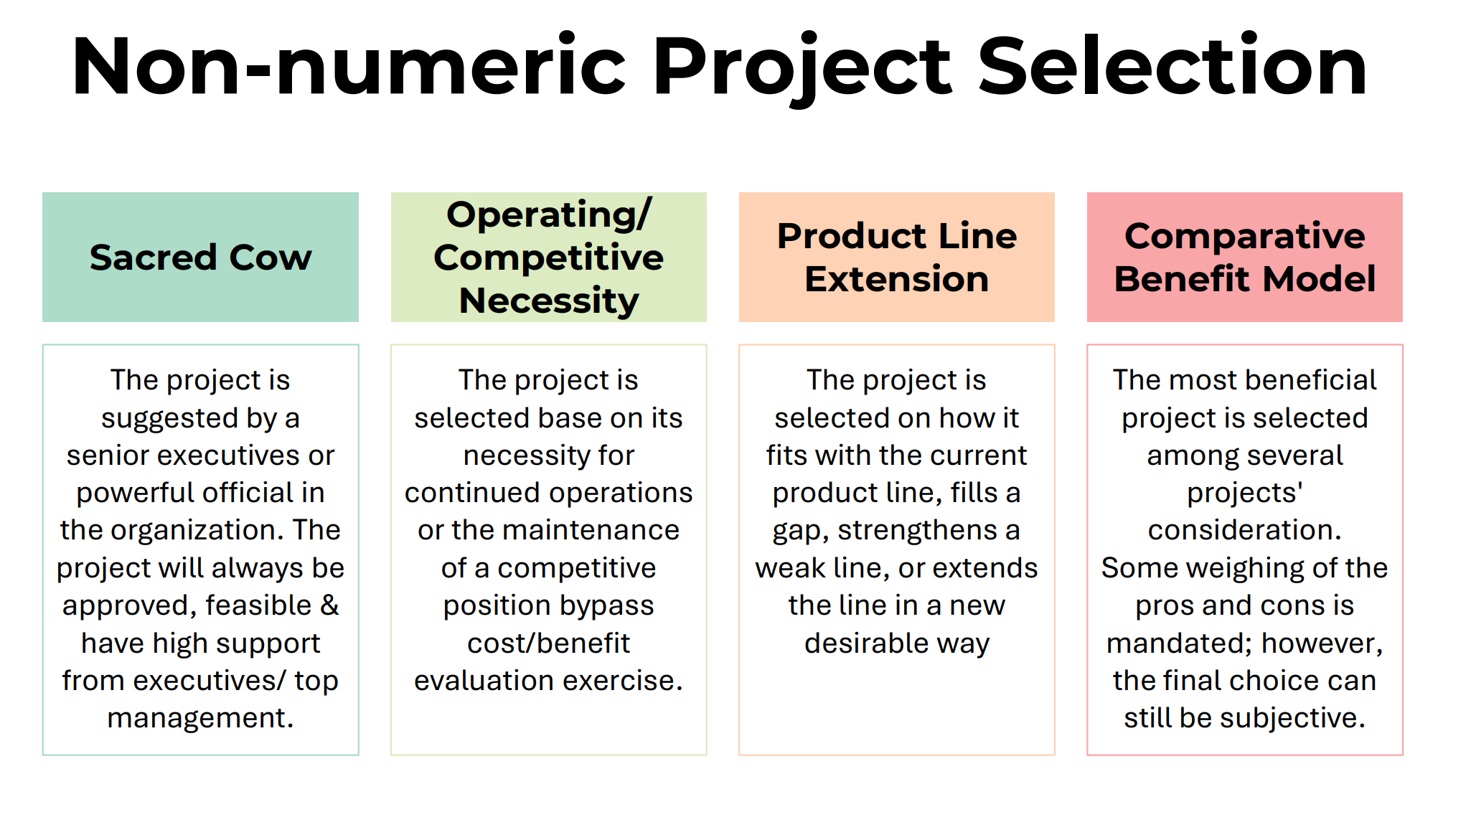

Slide 18
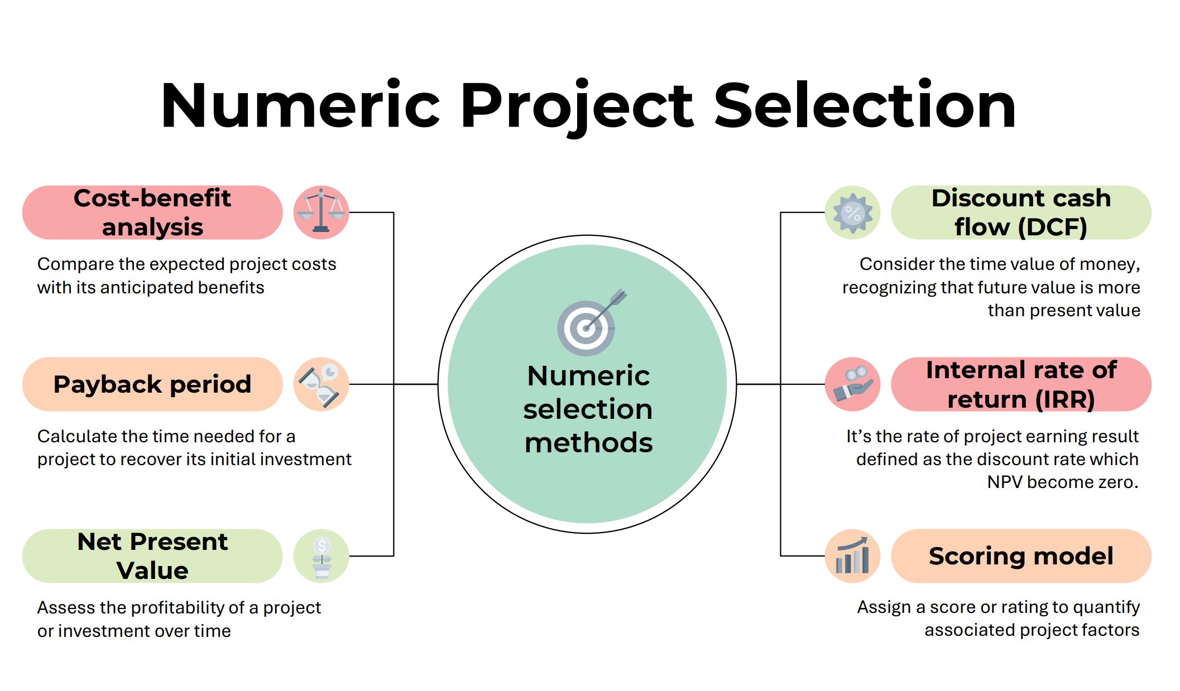

Slide 19
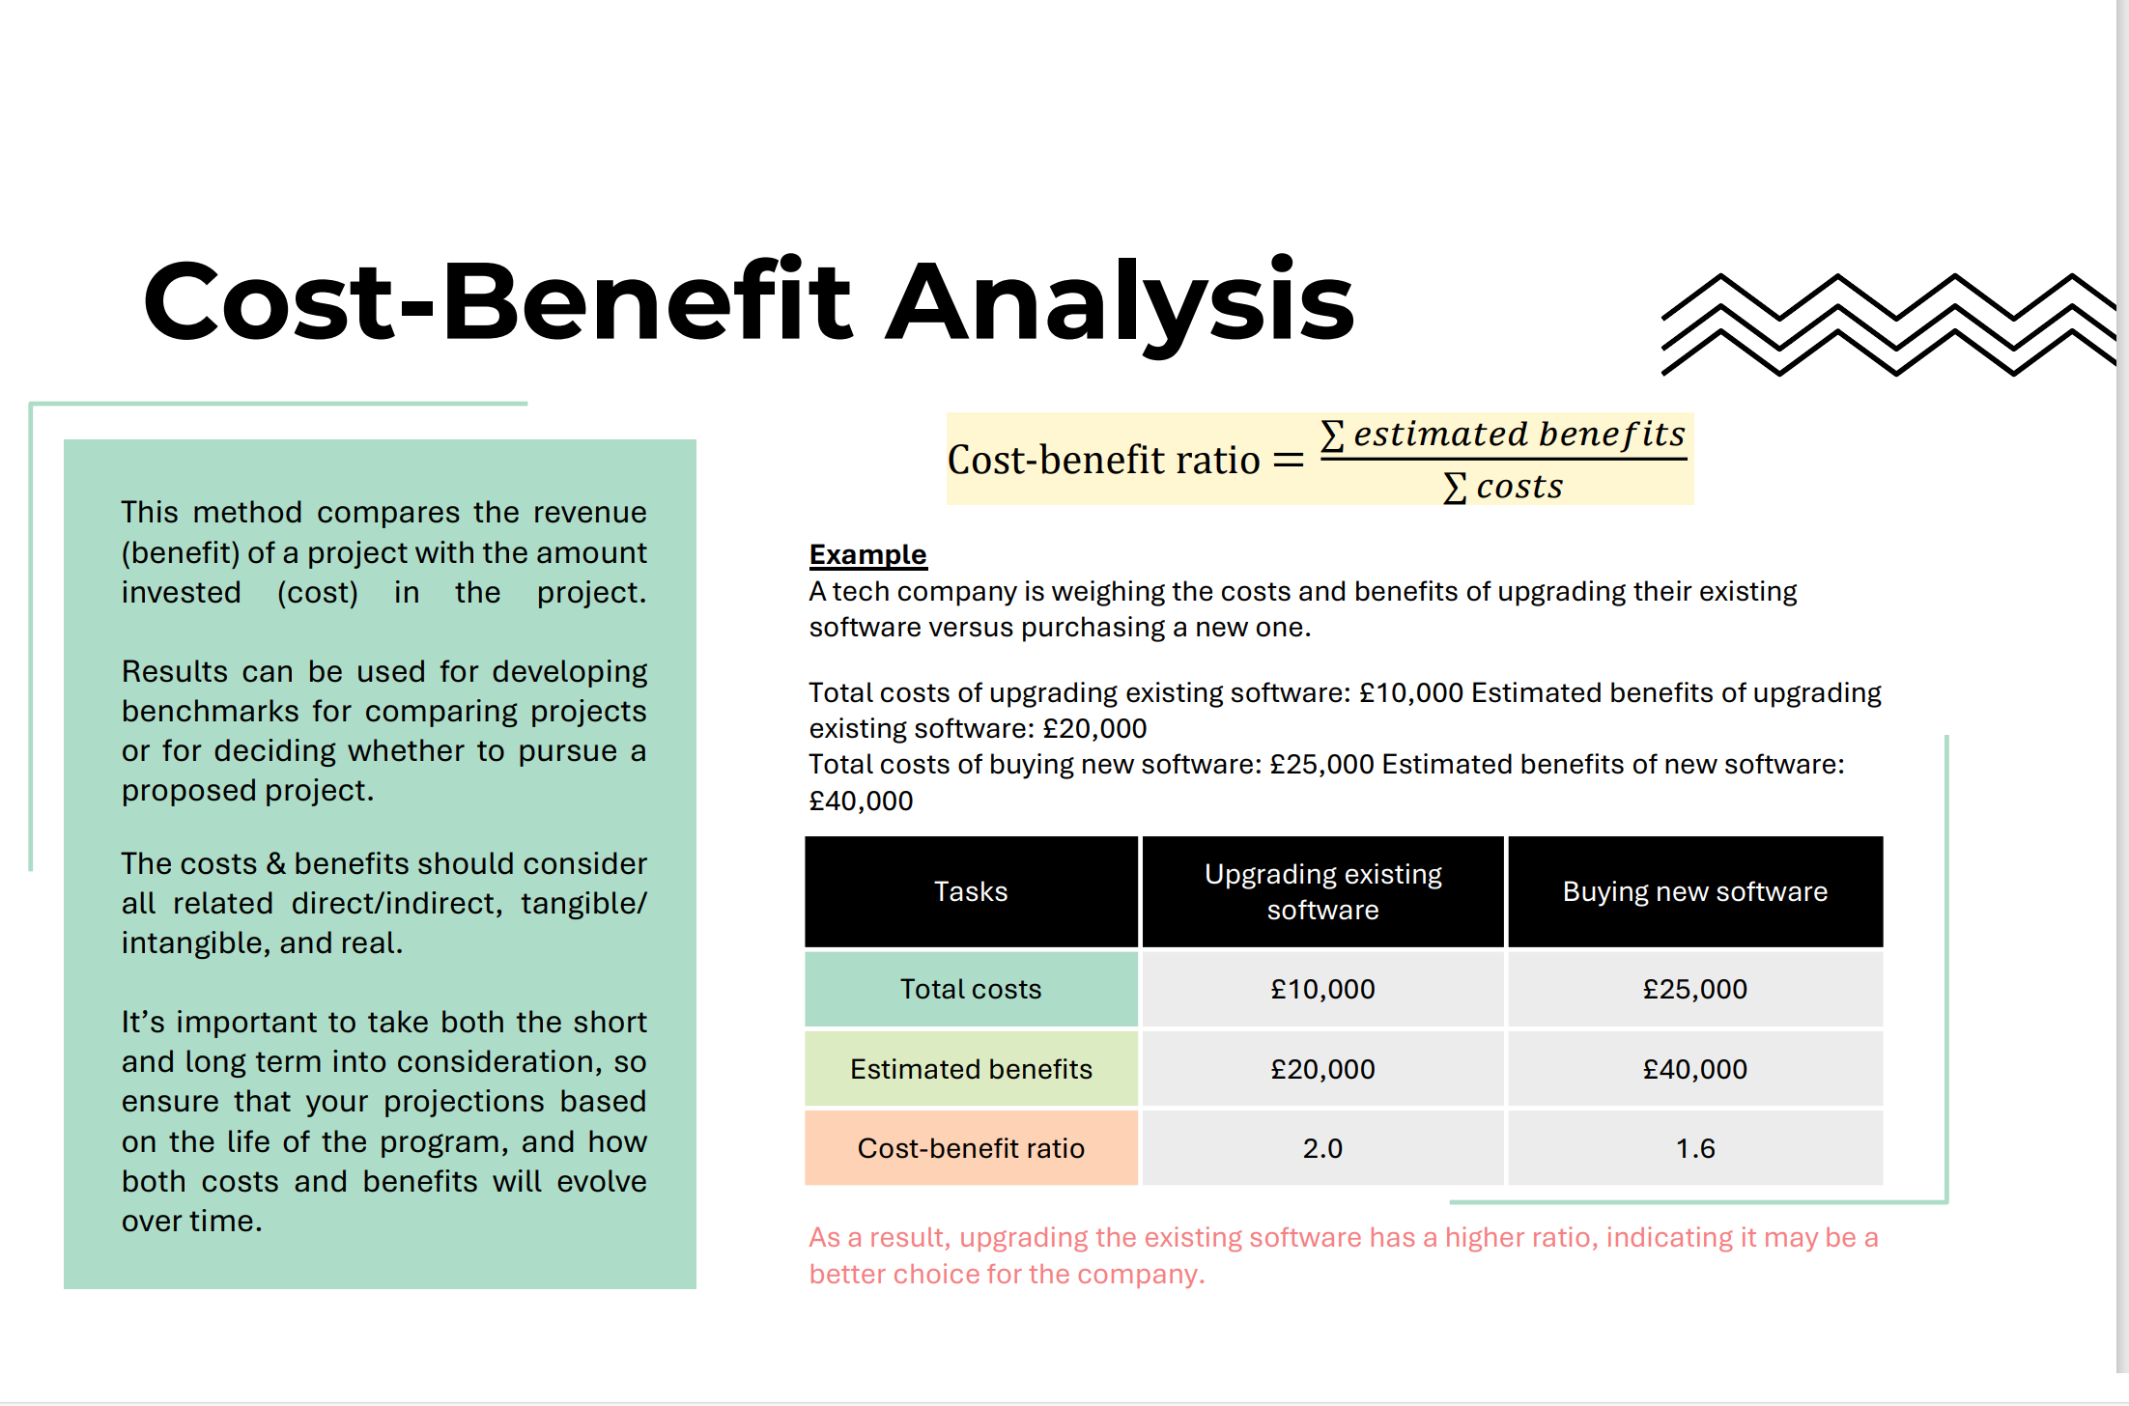

Slide 20
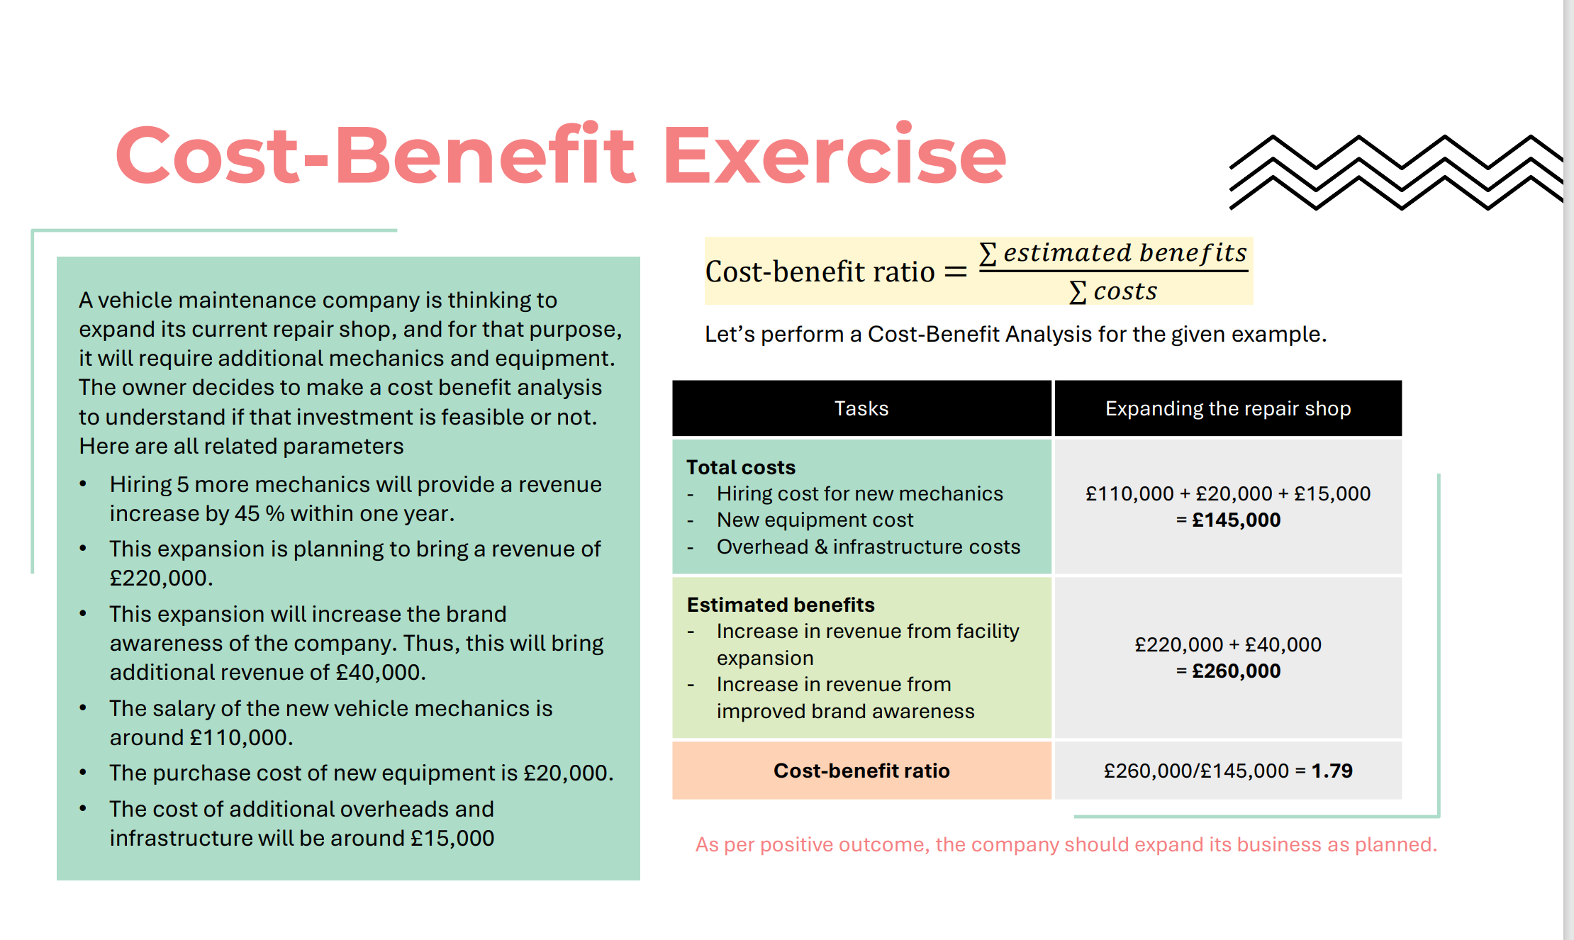

Slide 21
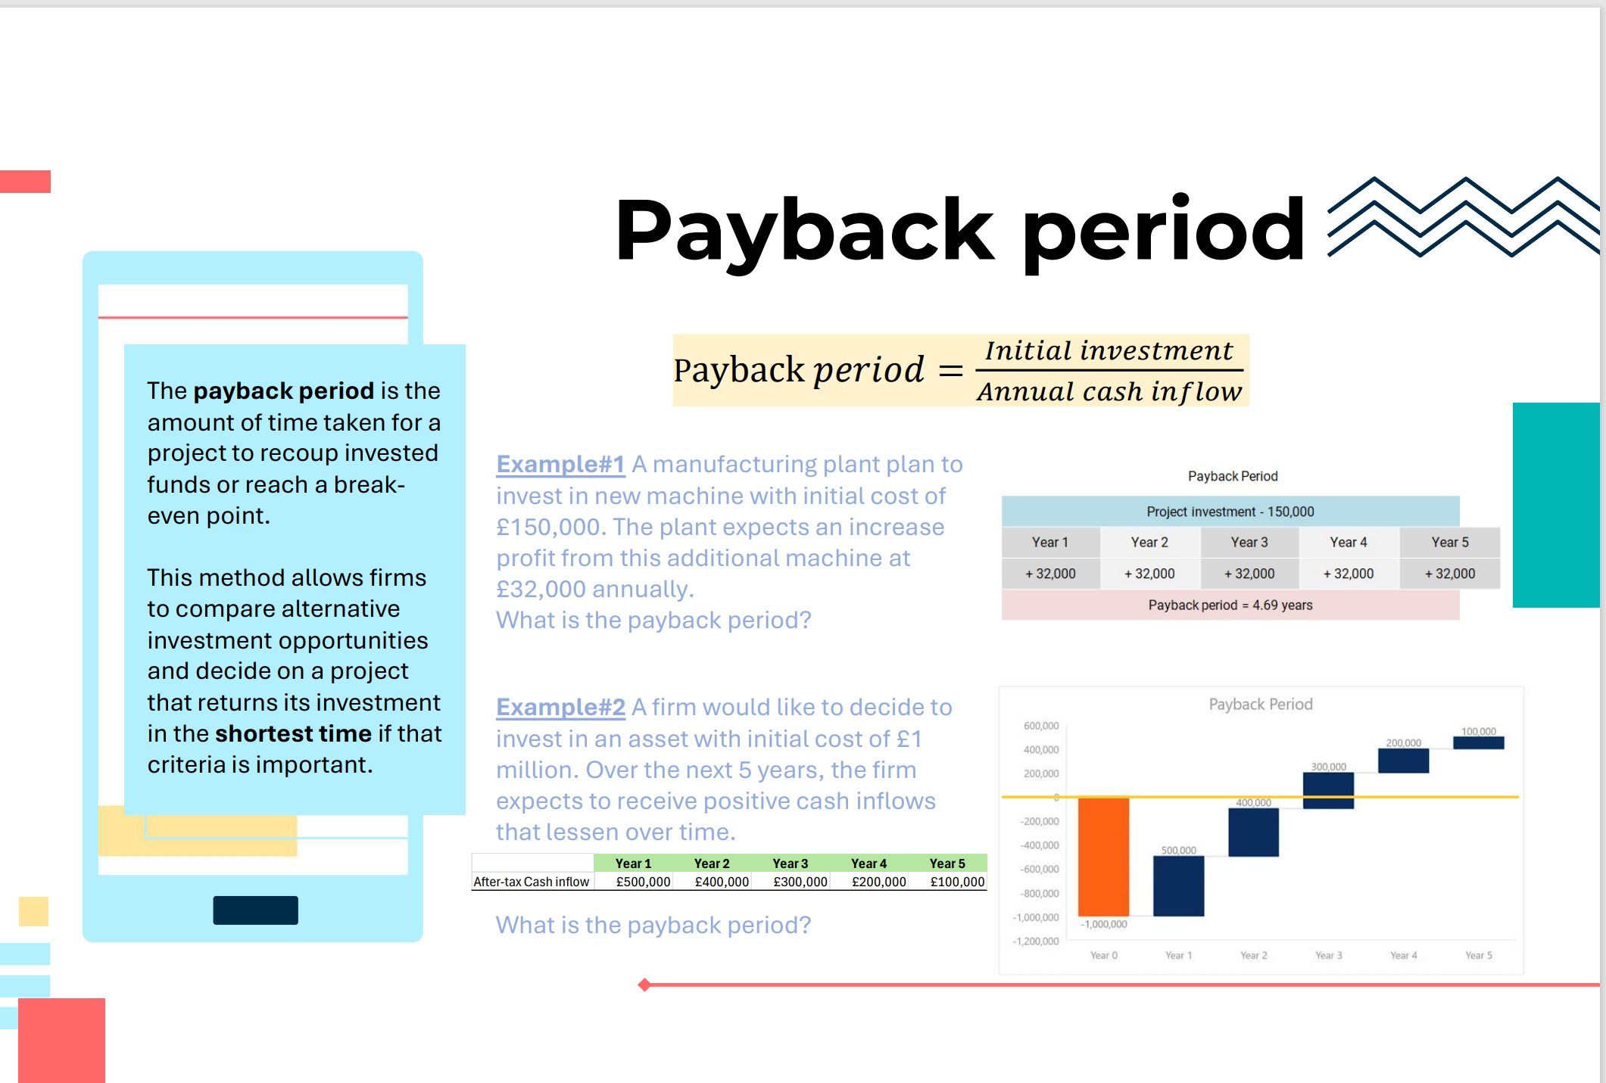

Slide 22
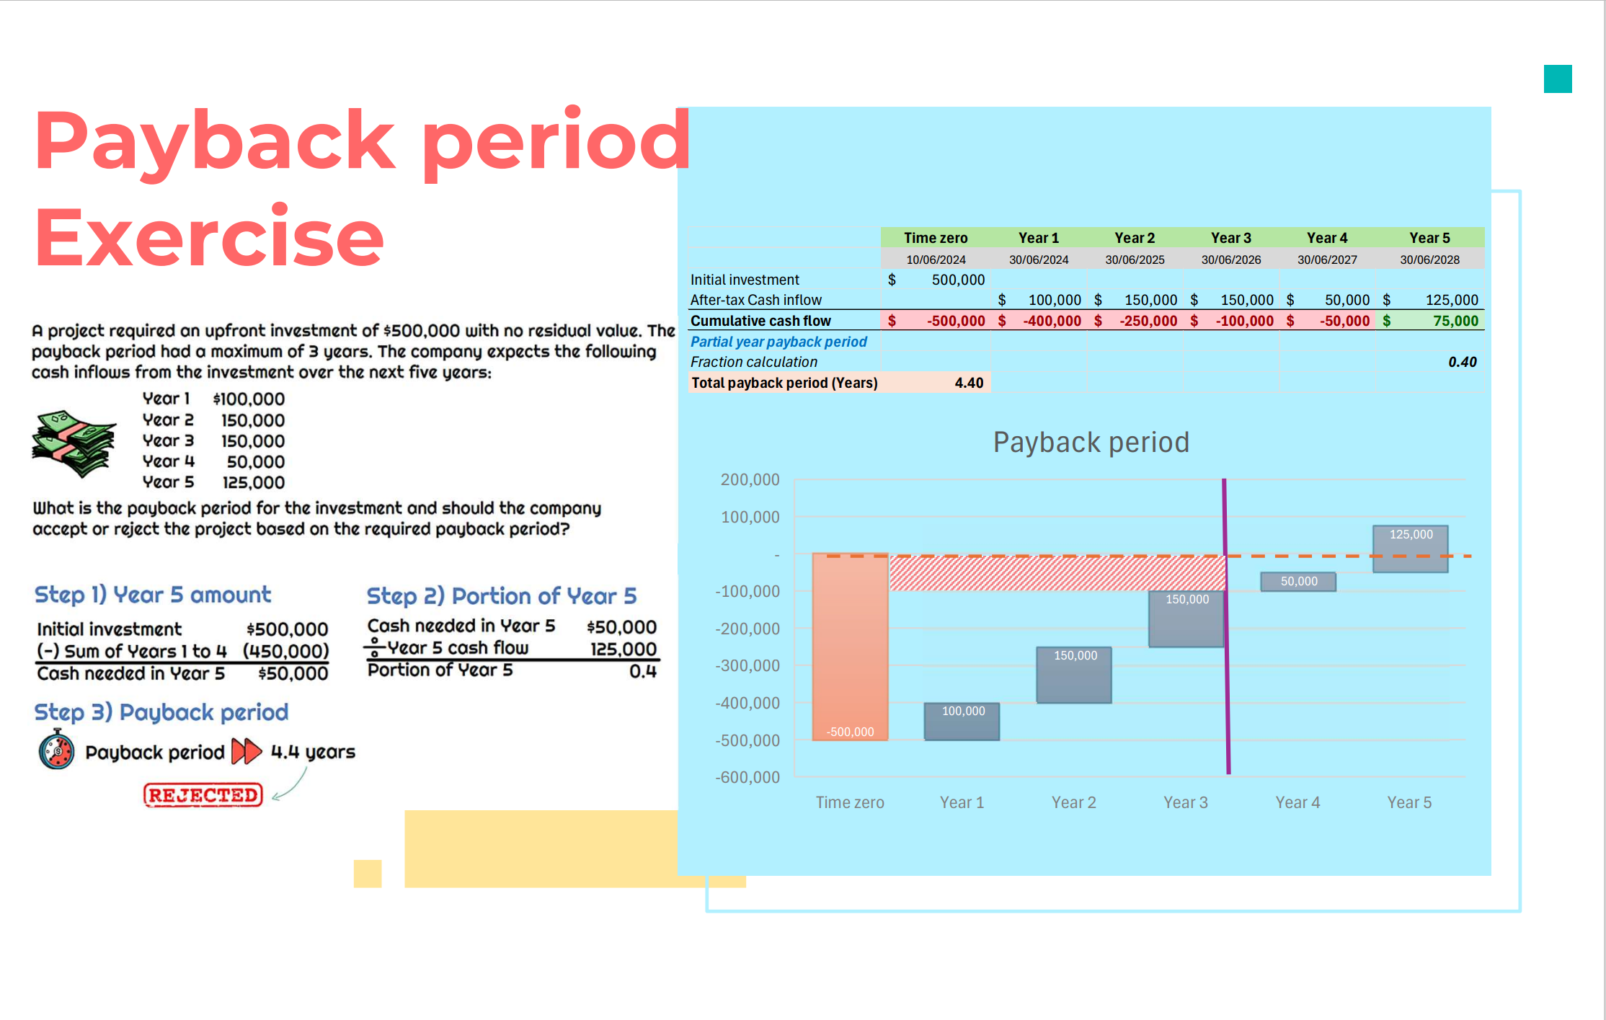

Slide 23
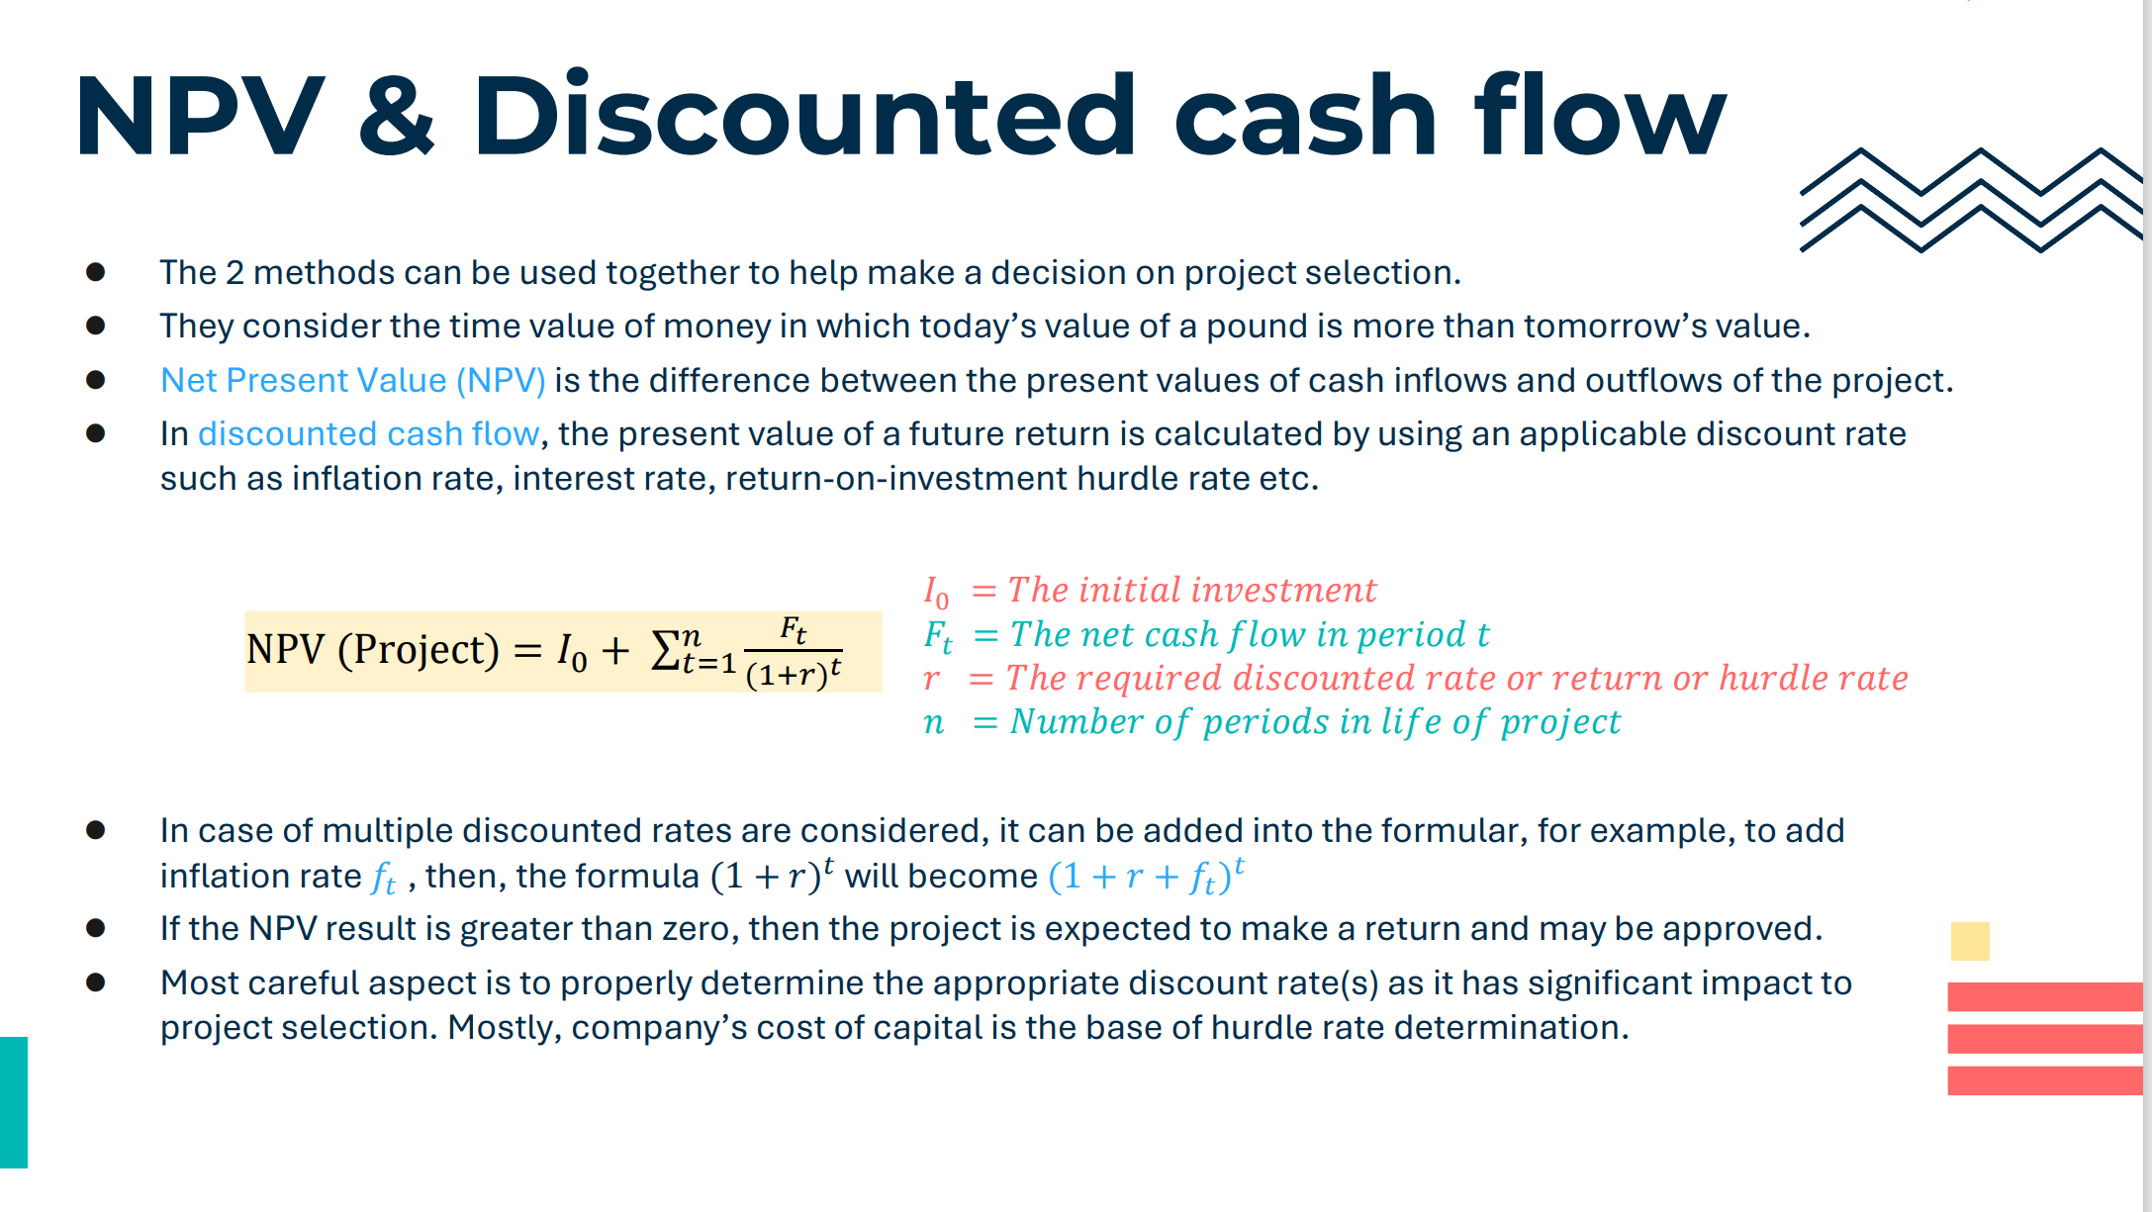

Slide 24
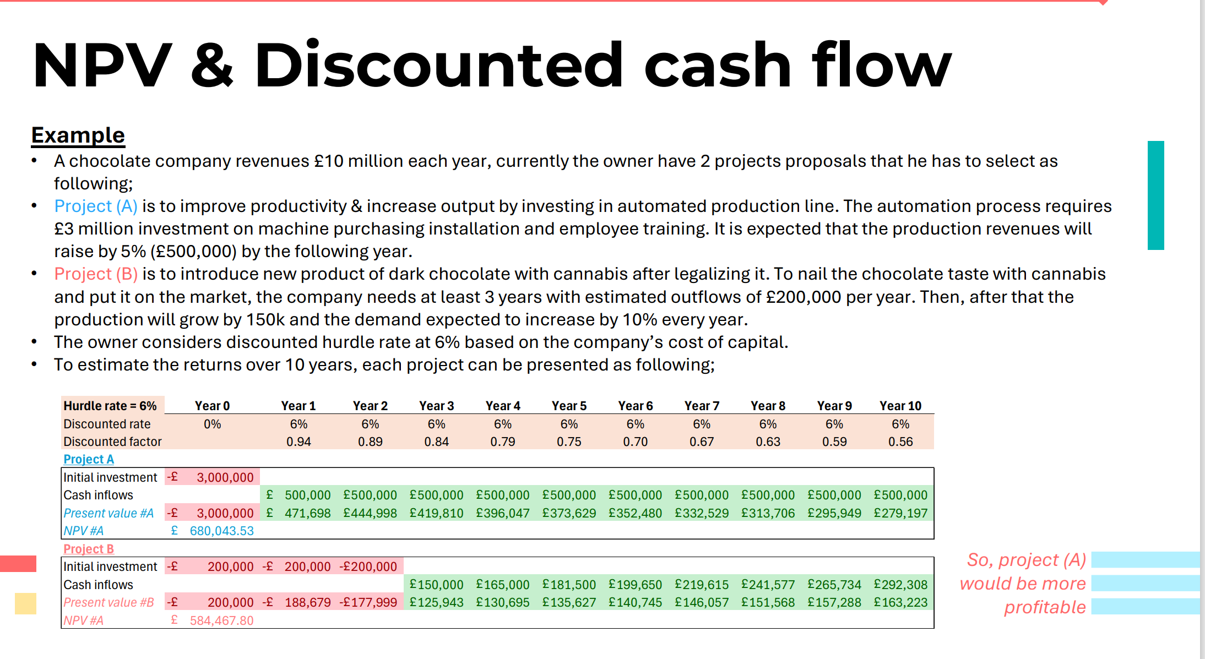

Slide 25
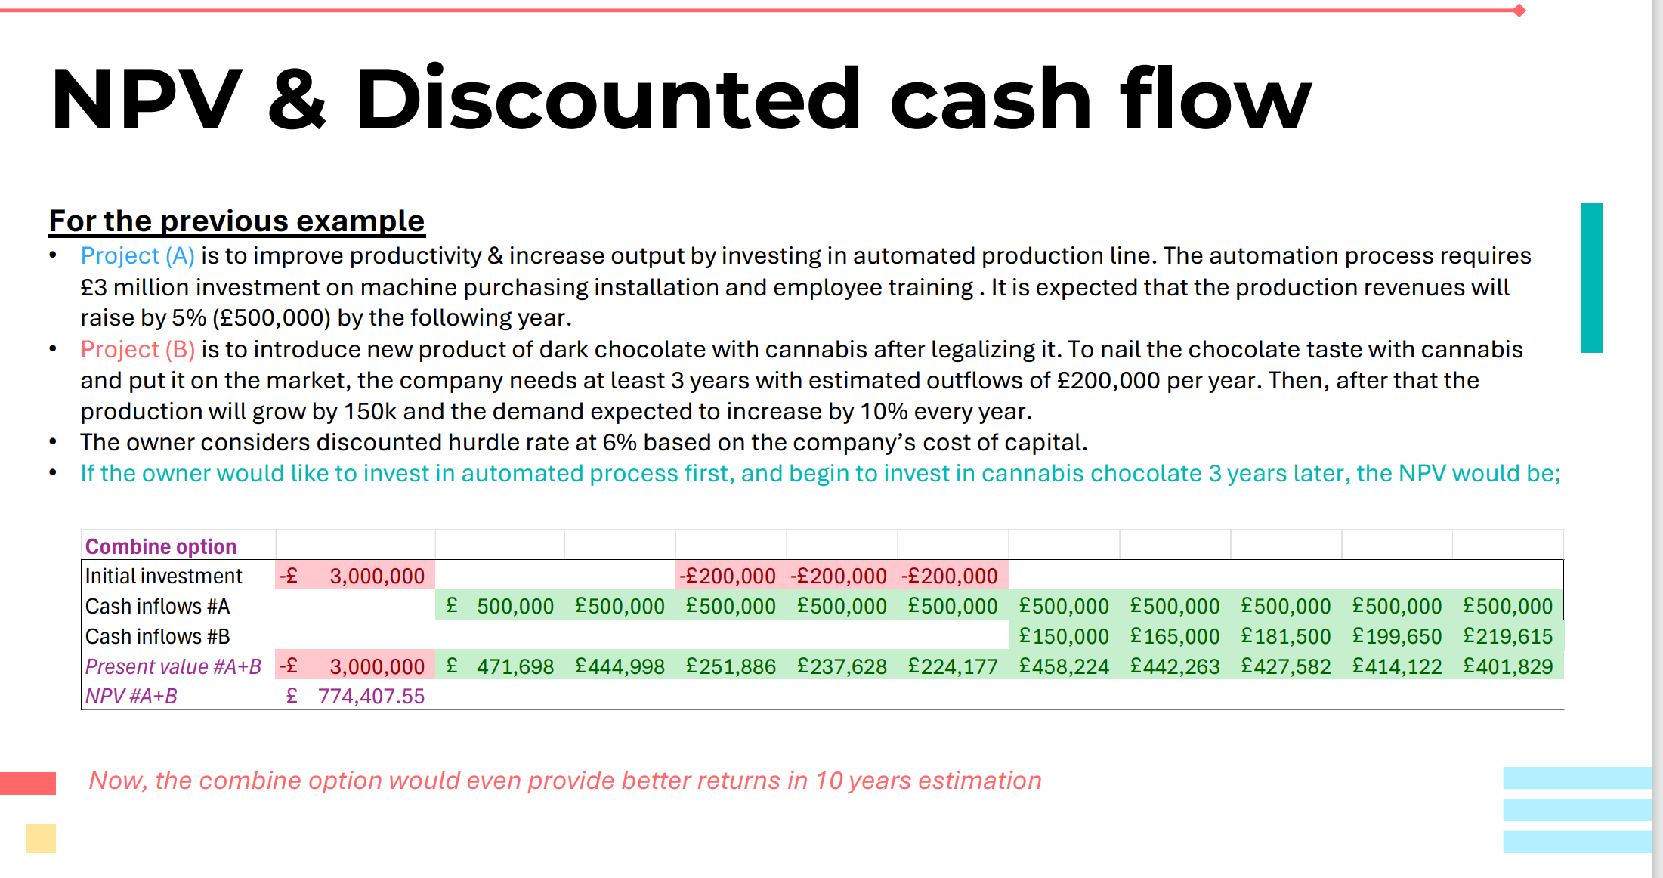

Slide 26
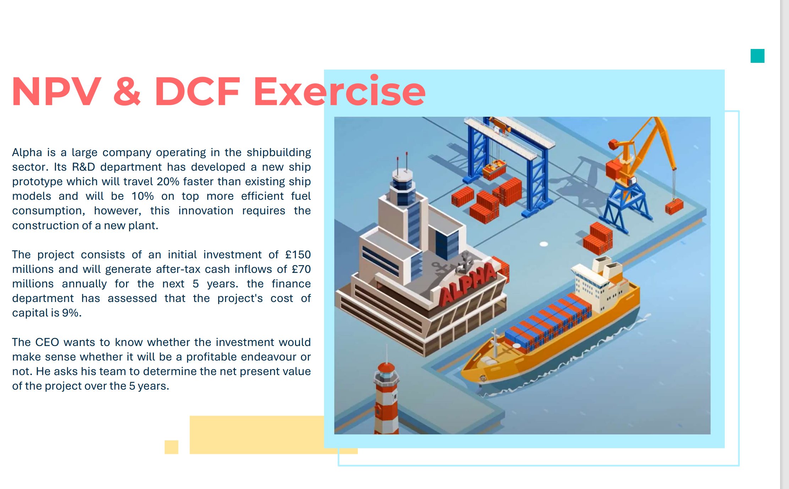

Slide 27
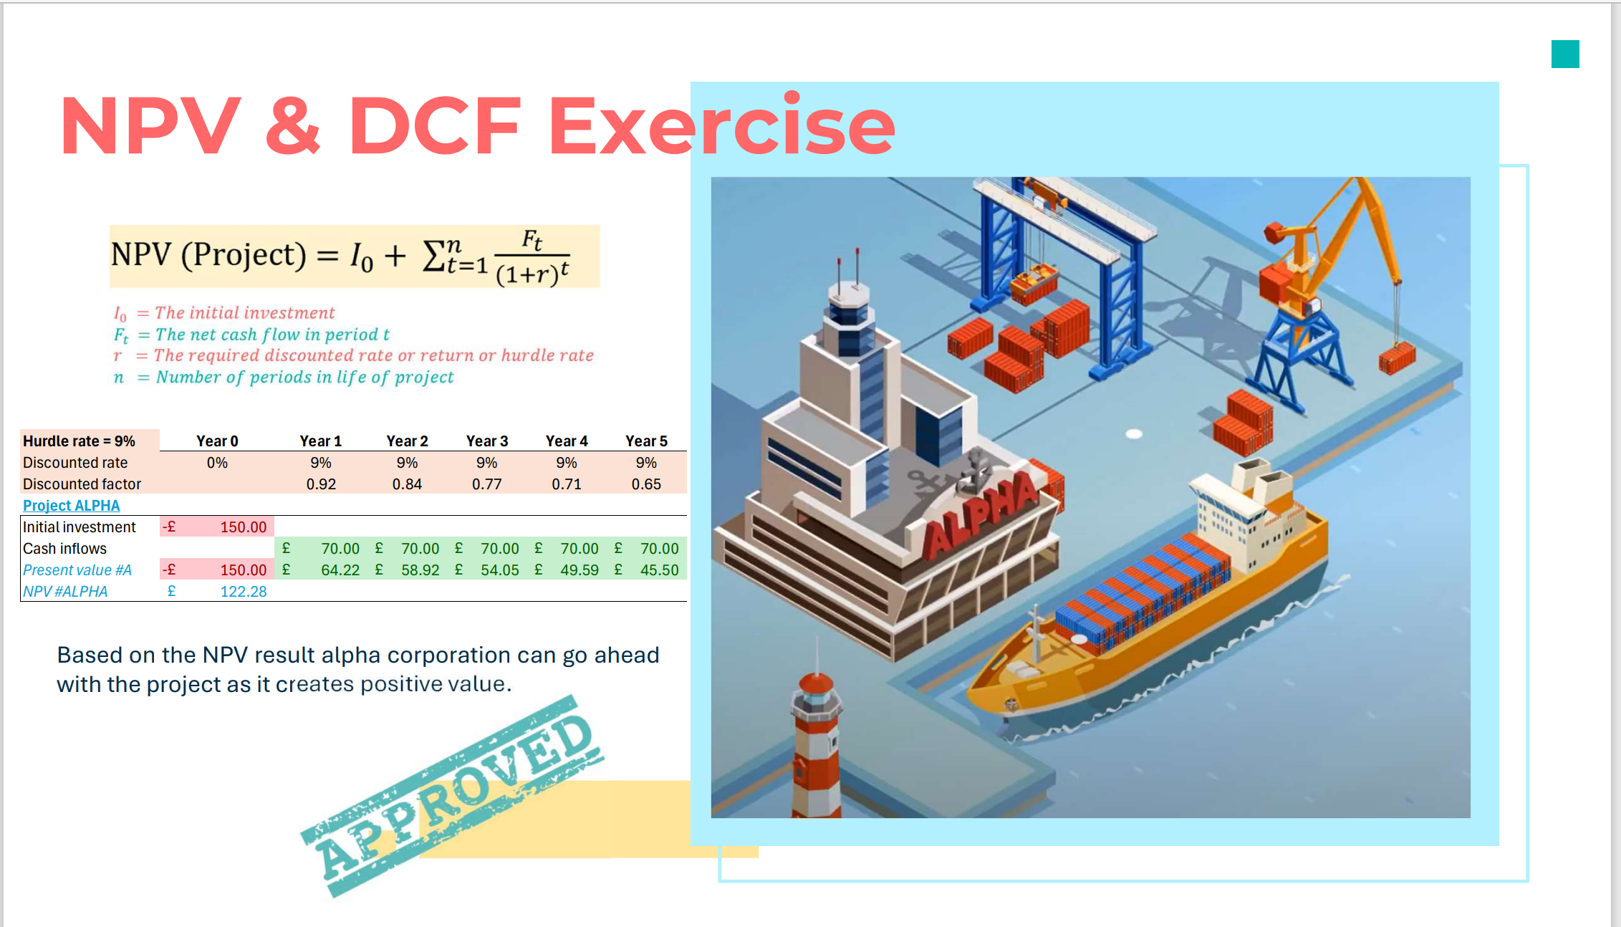

Slide 28
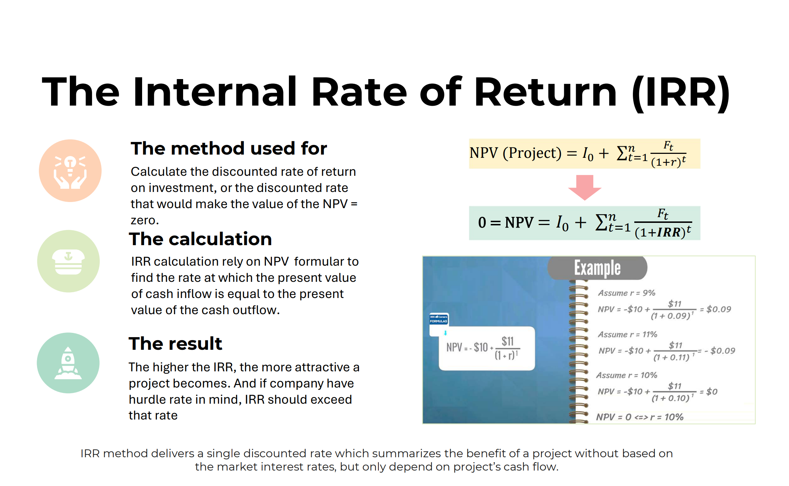

Slide 29
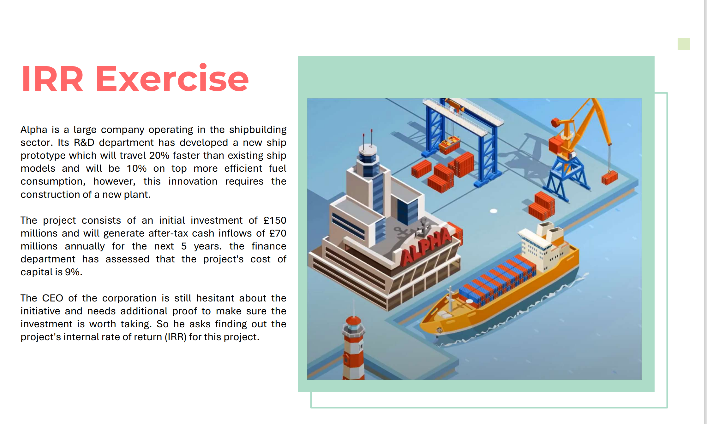

Slide 30
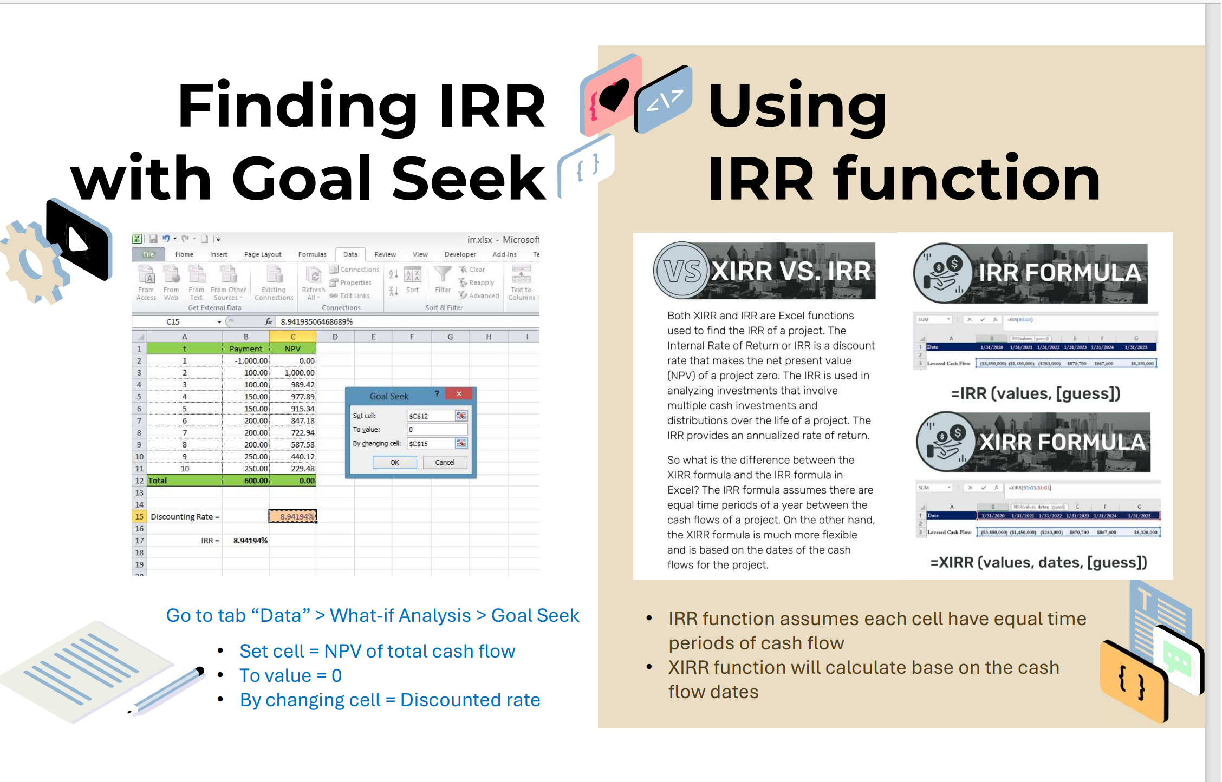

Slide 31
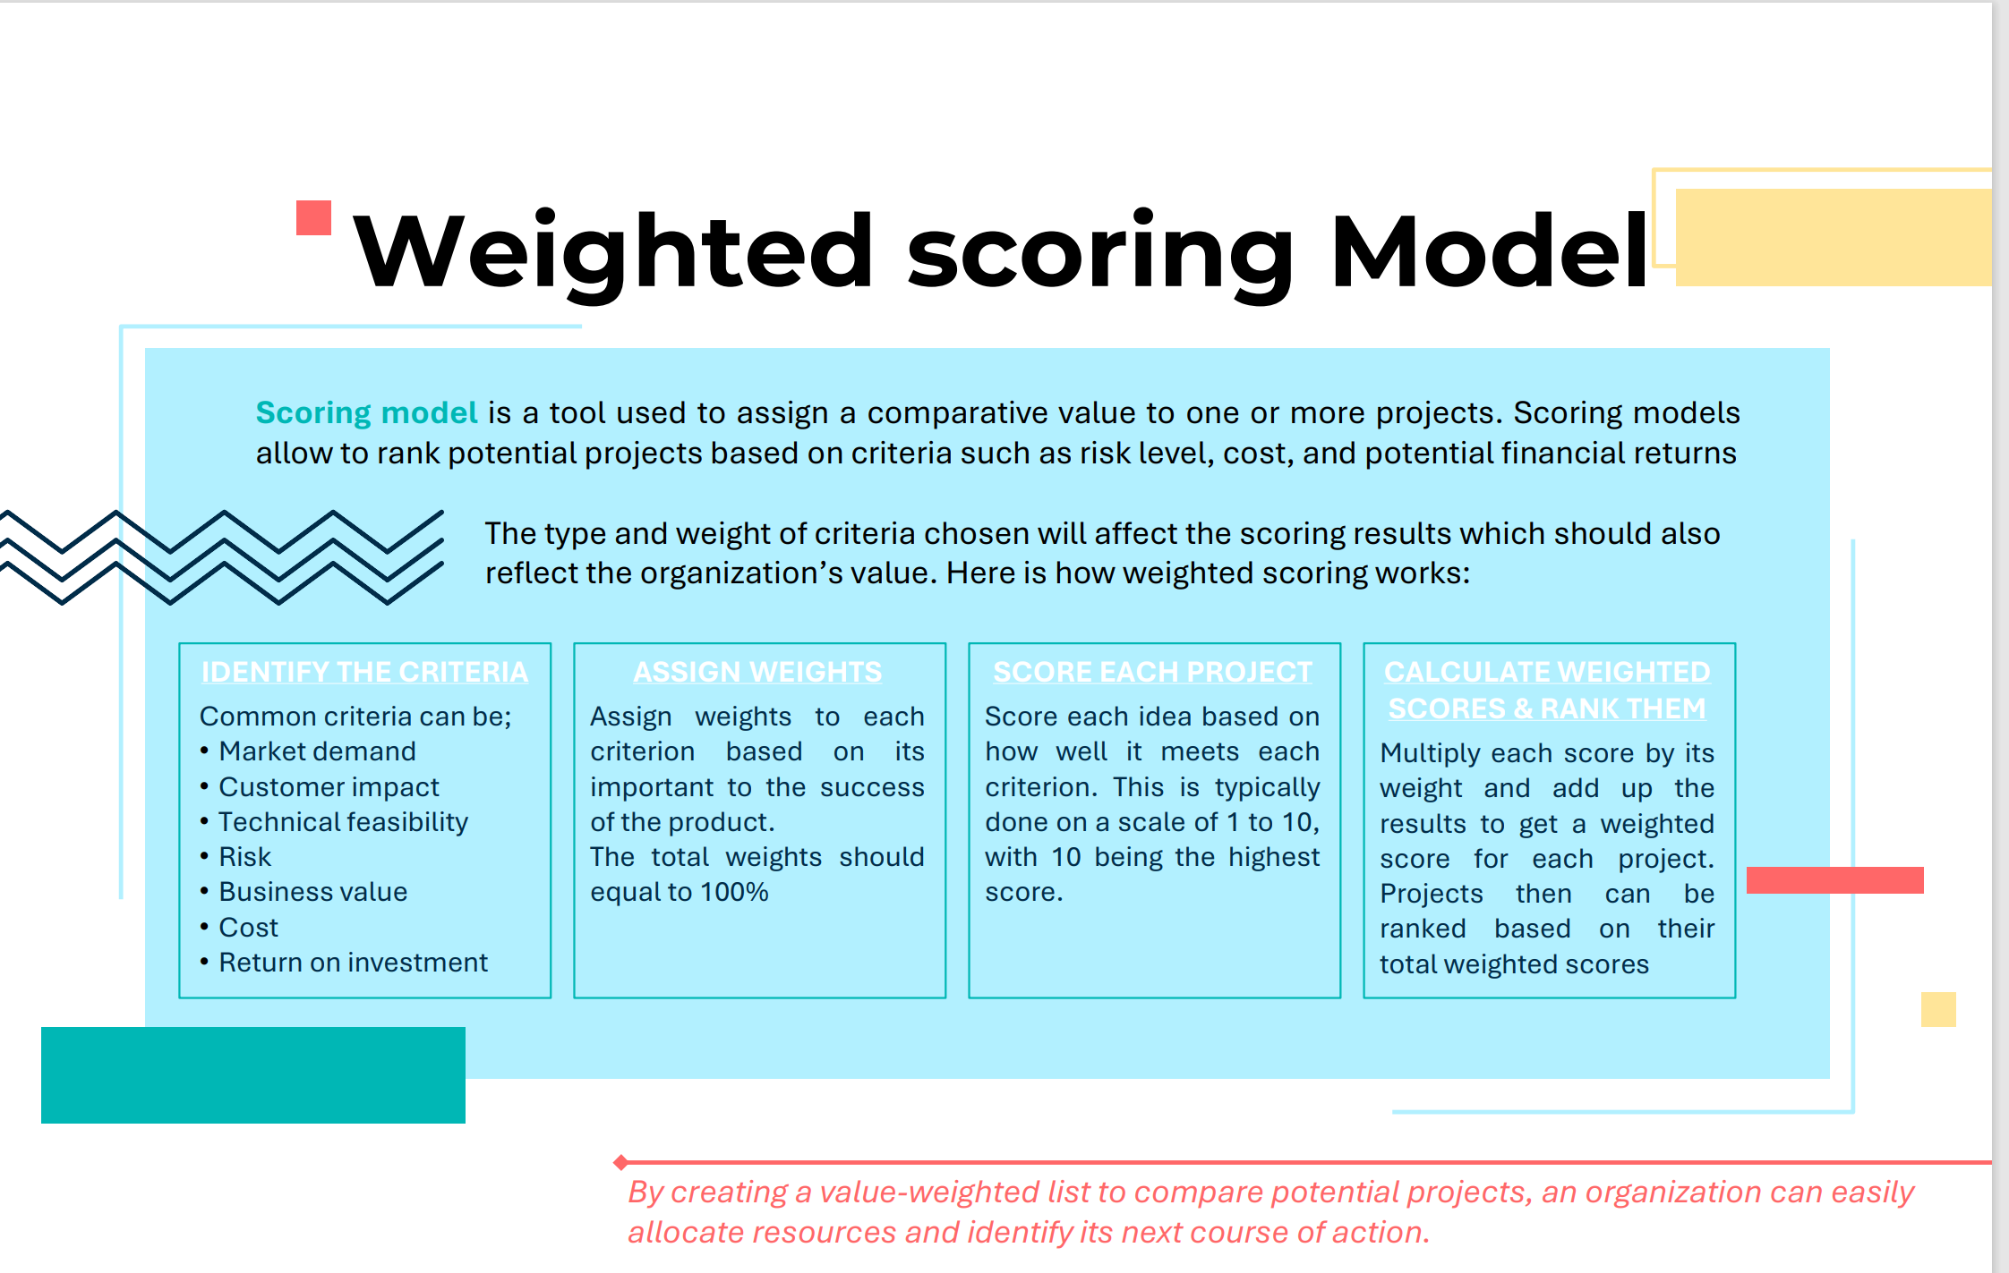

Slide 32


