Slide 1
Introduction to the Module
Legal Process

Slide 2

Lecturer
SiânTurvey
BA (Hons) F.CILEX GDL PGDip
Solicitor
Programme Manager for Law
Institute of Management and Health Swansea
Sian.turvey@uwtsd.ac.uk

Slide 3
Legal Process
AIM(S)
• To equip students with a broad understanding of the operation of the English legal system
• To develop students’ critical awareness of the social, political and cultural context in which law operates and its international dimensions
LEARNING OUTCOMES
Upon the successful completion of this module, the student should be able to demonstrate the ability to:
• Demonstrate knowledge and understanding of the relevant legislation and the legal process including the relationship between legislation and policies and practices.
• Identify and evaluate the fundamental legal techniques of reasoning from precedent and interpreting statutes, including knowledge of fact-finding,

Slide 4
Assessment
1. Coursework (50%)
Essay – 1500 words
2. Coursework (50%)
Essay – 1500 words

Slide 5
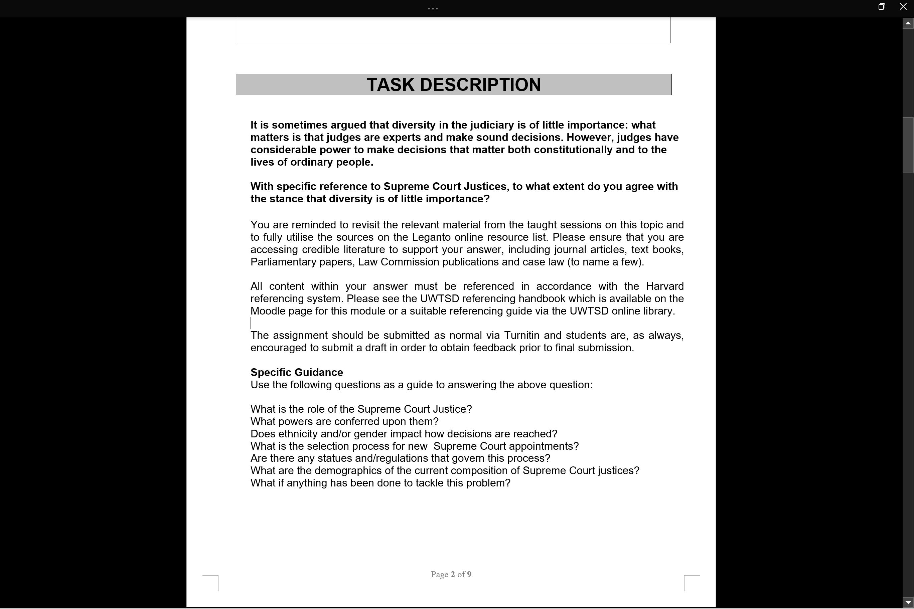
Assignment 1

Slide 6
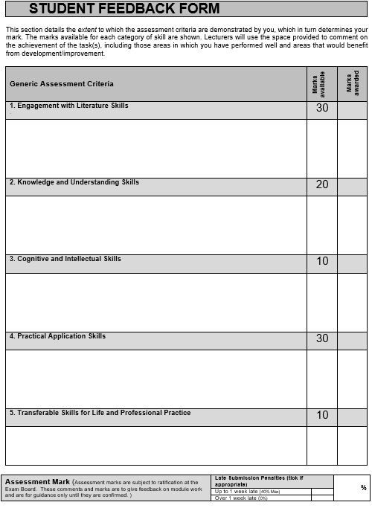
Mark Sheet

Slide 7
Submission Dates
Draft submission 24th february
Hand in date 4th march
Feedback on 4th april

