Slide 1
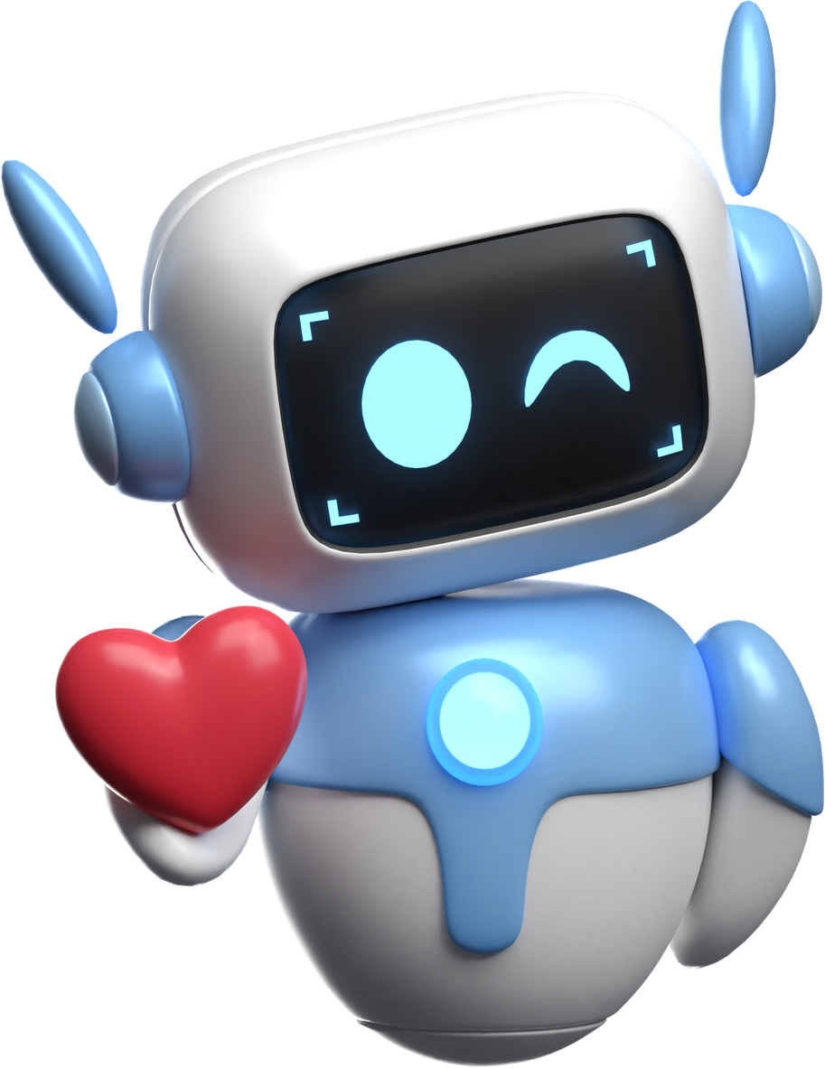
RAIYU
Can Empathic Design Change
How We Connect with AI?
REIA SIGRIST
MSC APPLIED PSYCHOLOGY, UWTSD
Notes:
Introduction
Raise your hand if use ai?
Raise your hand if you have ever gone to it with something real or something you were working on or struggling with?
Raise your hand who's had it get something flat out wrong
That gap, between how many of you just admitted AI got something wrong, and how many of you are still using it anyway, is exactly the space this talk lives in. Because right now, people aren't turning to AI instead of proper support because it's better. They're turning to it because proper support isn't there when they need it.

Slide 2


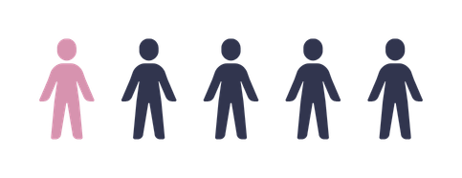
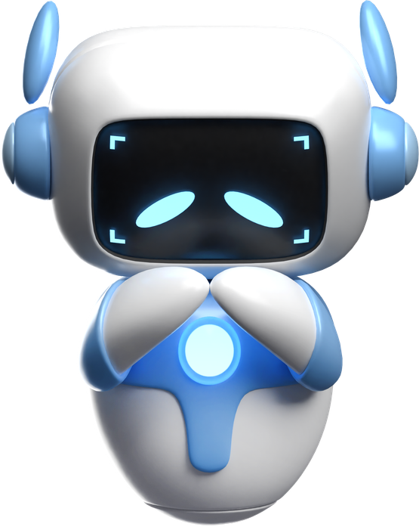
THE PROBLEM
Why access to support matters
1 IN 5 EXPERIENCE A COMMON MENTAL HEALTH PROBLEM
IN ANY GIVEN WEEK
OVER HALF ARE NOT CURRENTLY RECEIVING TREATMENT
2,000+
PEOPLE A MONTH IN WALES WAIT OVER 6 MONTHS FOR SPECIALIST THERAPY
DESPITE LIVING WITH A DIAGNOSED COMMON MENTAL HEALTH CONDITION
(Clery et al., 2025)
ANXIETY 7.5% · DEPRESSION 3.8% · PTSD 5.7%
OVER 1 IN 3 PEOPLE'S MENTAL HEALTH GETS WORSE WHILE THEY WAIT.
(Liubertiene et al., 2025; Wilson et al., 2025)
HIGHEST AMONG YOUNG ADULTS, RISING FROM 17.5% IN 2007 TO 25.8% IN 2023/24
IN SOME MONTHS SINCE 2020, THIS HAS EXCEEDED 3,000
(Mind., 2024)
FOR A GP OR VOLUNTARY-SECTOR APPOINTMENT
(Liubertiene et al., 2025)
(Centre for Mental Health., 2025)
Notes:
A significant chunk of people experience a common mental health problem in any given week, and it's not spread evenly, it's climbing fastest among young adults specifically.
Look at Wales on its own, and the wait for specialist therapy stretches past six months for a steady stream of people every single month, not as some rare outlier case but as an ongoing pattern.
Even having an actual diagnosis doesn't guarantee help, over half the people who've been diagnosed still aren't receiving any treatment right now.
And the research is clear that the wait itself isn't neutral, a large share of people's mental health actually gets worse while they're stuck in that queue.
So people aren't just waiting, they're waiting and getting worse, and somewhere in that gap they're looking for something, anything, that responds right now.
So out of curiosity, how many mental health apps do you think are out there right now?

Slide 3
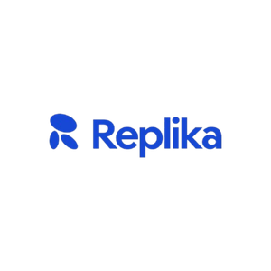

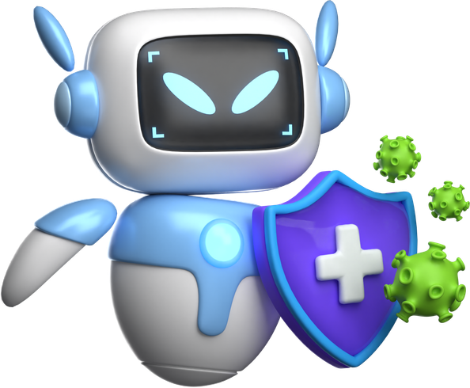

THE RESPONSE
AI is stepping into the gap
10,000+
A MODEST BUT REAL EFFECT ON MOOD
EVEN PURPOSE-BUILT CHATBOTS SHOW ONLY MODERATE ALLIANCE
MENTAL HEALTH APPS NOW EXIST WORLDWIDE
AND A GROWING SHARE ARE BUILT ON AI
MEANINGFUL SHORT-TERM IMPROVEMENT IN DEPRESSION AND ANXIETY ACROSS 18 TRIALS — BUT BENEFITS FADED BY 3 MONTHS
(Hua et al., 2025)
MEASURED USING THE SAME SCALE (WAI-SR) AS THIS STUDY
(Beatty et al., 2022; Malouin-Lachance et al., 2025)
(Zhong et al., 2024)
Notes:
Over 10,000 out there right now.
Wysa CBT chatbot
Replika more of a friendly chatbot that builds a relationship with the user
Woebot 1.5million users, founder shut down due to FDA regulations cost and safety not keeping up
But does any of this actually work? Across 18 trials, these tools showed a meaningful short term improvement in depression and anxiety. Modest, but real. The problem is, that benefit faded by three months.
And even the ones built specifically for this, purpose built mental health chatbots, only show moderate alliance with the people using them.
But studies do suggest an AI can build a modest but real relationship with a user around certain mental health problems. It's not nothing. What matters is how that AI is built, and the safety features it includes, because that's what decides whether that relationship actually helps someone or puts them at risk. And that's the exact question I built my research around.

Slide 4
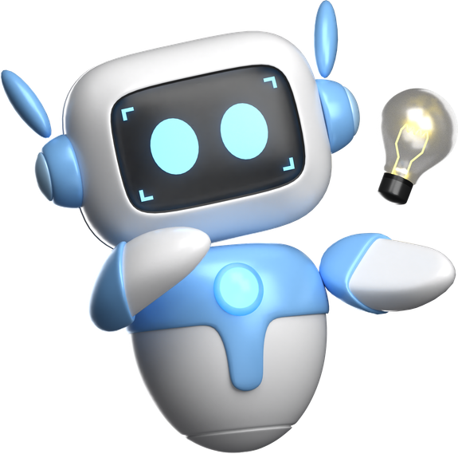
Research questions
Does Engineered Empathy Actually Work?
RATIONALE
No randomised study has tested whether deliberately designing empathy into an AI changes how people actually experience it.
RQ1 — A DIFFERENT FEELING?
RQ2 — A REAL BENEFIT?
DO PEOPLE FEEL A STRONGER CONNECTION WITH AN EMPATHY-ENGINEERED AI THAN A STANDARD ONE?
IS THAT STRONGER CONNECTION LINKED TO A REAL, MEASURABLE IMPROVEMENT IN MOOD?
(WORKING ALLIANCE — BORDIN'S BOND/GOAL/TASK MODEL)
(MOOD CHANGE — POSITIVE AND NEGATIVE AFFECT SCHEDULE, PANAS-SF)
(Bordin, 1979)
(Thompson, 2007)
Notes:
No RCT has tested the deliberate designing of empathy into AI
2 questions one to measure that relationship through working alliance and the other that if it it proved stronger would it have a measureable difference to the participants mood.

Slide 5
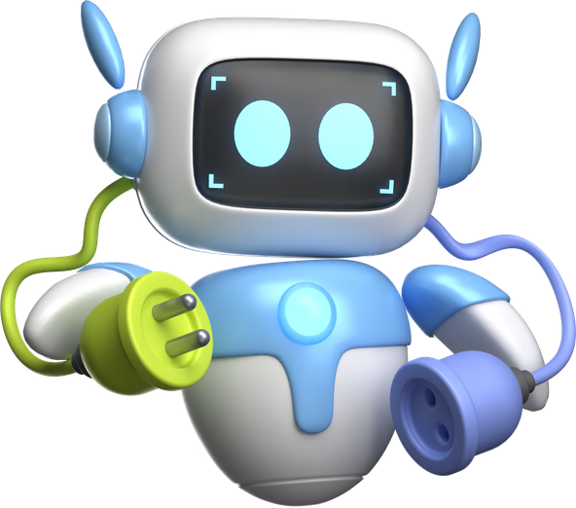
THE FOUNDATIONS
What's actually going on under the hood
WHAT IS A LLM
WHAT IS EMPATHY HERE
WHAT’S BORDIN’S MODEL
PREDICTS THE NEXT WORD
DESIGNED, NOT FELT
BOND, GOAL, TASK
BASED ON PATTERNS IN HUGE AMOUNTS OF TEXT, NO UNDERSTANDING, JUST VERY SOPHISTICATED PATTERN COMPLETION.
REFLECTING FEELINGS, VALIDATING THEM, COLLABORATING ON GOALS, NOT JUST MIRRORING EMOTIONAL LANGUAGE.
THE STRONGEST KNOWN PREDICTOR OF GOOD OUTCOMES IN HUMAN THERAPY, AND WHAT GETS MEASURED LATER TODAY.
Notes:
SO just to explain some terminology so you know what I mean
A large language model is a really sophisticated predictor. It's been trained on huge amounts of data to communicate in a certain way, so if you mention anxiety, it's essentially looking at every time anxiety has appeared in that data to work out what response should come next, and it's doing that extremely fast. If the LLM is the engine, the agent is the rest of the car built around it, the steering, the rules of the road, the actual destination. The engine just generates power, it's the agent that decides what that power is used for and where it's pointed.
Empathy in this context is about design, not feeling. An AI can't be empathetic in the way a person is, it's an inanimate system, it has no subjective experience, nothing it's actually feeling on the other end of the conversation. What it can do is create the same conditions a person would experience as empathy, reflecting feelings back, validating them, working collaboratively toward a goal, even though there's nothing behind it that's genuinely feeling any of that itself.
And finally, Bordin's model of the working alliance, which is the backbone of this entire project. He theorised that the strongest predictor of good outcomes in human therapy came down to this working alliance, made up of three parts, bond, the trust and warmth between a person and their helper, goal, the shared understanding of where the person actually wants to end up, and task, the concrete steps agreed on to get them there.

Slide 6
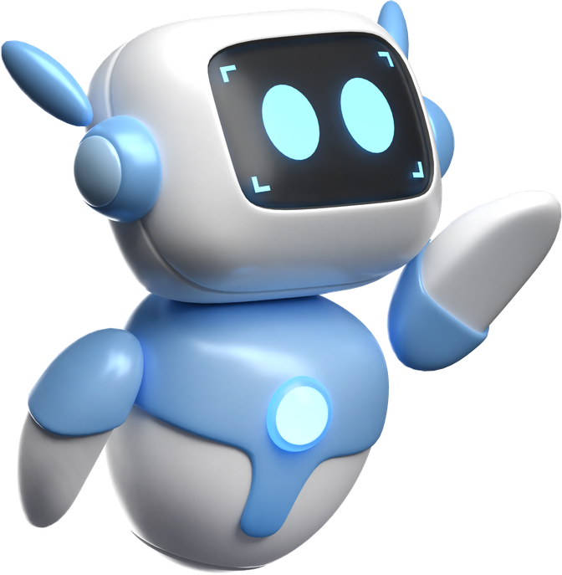
THE STUDY
Same technology, different design
RAIYU
BASELINE
GIVEN A CURATED KNOWLEDGE BASE ON EMPATHIC COMMUNICATION
INSTRUCTED TO REFLECT FEELINGS AND VALIDATE EMOTIONS
PRIORITISES FEELING HEARD OVER EFFICIENCY
SAME UNDERLYING AI TECHNOLOGY
NO ADDITIONAL EMPATHIC INSTRUCTIONS
RESPONDS THE WAY A GENERAL-PURPOSE ASSISTANT NORMALLY WOULD
Both use an identical chat interface — only the design instructions differ
Notes:
So meet the 2 AI in this study. The agents themselves were built by a software engineer, but the psychological framework, the empathy rules, and the overall vision for how each one needed to behave were mine.
They both run on the same model so both have that same brain the difference is that Raiyu had a knowledge base which I will cover on the next slide and it also had extra instructions through a prompt where it had to reflect feelings and validate emotions before giving any advice and this was all based around those facets of the working alliance, bond, goal, and task.

Slide 7
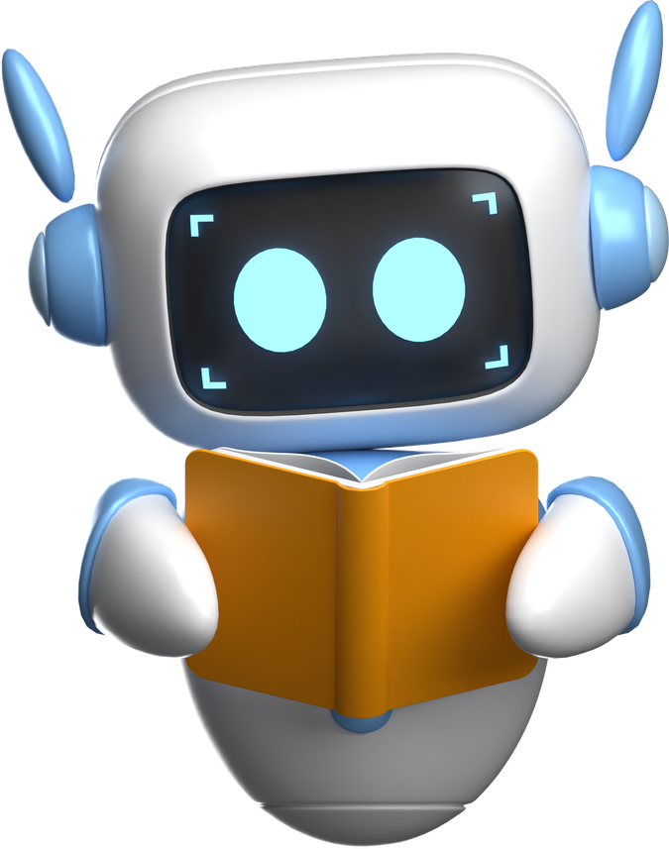
THE KNOWLEDGE BASE
What RAIYU was actually given to work with
18 source documents, chosen deliberately, nothing pulled from the open internet.
NHS & NICE GUIDELINES
THERAPY AND ALLIANCE RESEARCH
PRIOR AI AND DIGITAL MENTAL HEALTH RESEARCH
SAFETY AND ETHICS
(6 sources)
(4 sources)
(5 sources)
(3 sources)
INCLUDING THE NHS TALKING THERAPIES MANUAL AND NICE GUIDELINES ON DEPRESSION, ANXIETY, AND SELF-HARM,
NORCROSS AND LAMBERT'S REVIEW OF THE THERAPY RELATIONSHIP, PLUS THE MOTIVATIONAL INTERVIEWING BASE.
BACP'S ETHICAL FRAMEWORK FOR COUNSELLING, PLUS THE SAFETY FILTER'S OWN TECHNICAL BASIS
THE WYSA ALLIANCE STUDY, A DIRECT PRECEDENT FOR MEASURING AI ALLIANCE.
Matches real UK clinical guidance
The evidence behind RAIYU's goal-focused style
The same standard a real counsellor meets
Proof this kind of measurement work
(Nelson et al., 2025; NICE, 2020, 2022; Norcross & Lambert, 2018; Beatty et al., 2022)
Notes:
So Raiyu is locally hosted and that just means its not connected to the internet so its capabilities are quite limited to whats inside of my laptop. I didn’t want this huge amount of information for it to have to look through so I aimed for 20 documents but settled at 18. You can see the various topics I included as I wanted Raiyu to have the knowledge of a real clinician, therapy and alliance research, prior AI and mental health research so it could understand what works, and finally something that was vital to this project is safety and ethics.

Slide 8
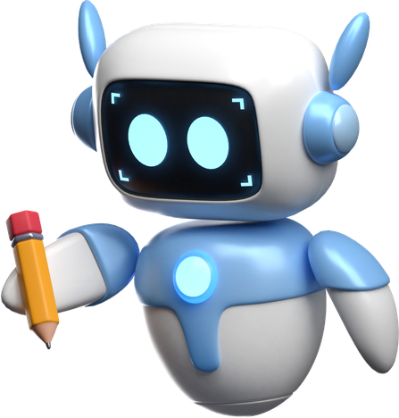
THE METHOD
How we tested the difference
OPTIONAL THINK ALOUD
BEFORE
RAIYU
AFTER
1OMIN CHAT ABOUT A STRESS OR GOAL
DEMOGRAPHICS
SHARE INITIAL VIEWS ON AI
RATE CURRENT MOOD
VIEWS AGAIN ON AI
RATE MOOD AGAIN
WORKING ALLIANCE RATING
OVERALL AI RATING
OPEN ENDED REFLECTION
RANDOM ALLOCATION
BASELINE
1OMIN CHAT ABOUT A STRESS OR GOAL
Everyone experiences the exact same setup - only difference is which AI they’re randomly given.
Notes:
This is a flow of how the study went so the only difference is which ai the participant spoke to. There was also an optional think aloud where they had the option to verbalise their inner thoughts while talking to the ai. And you'll notice the after measures map straight back to my two questions, the working alliance rating answers RQ1, and the mood rating answers RQ2.

Slide 9

How It Works
What Happens Behind Every Reply?
RAIYU THINKS
RAIYU RETRIEVES
RAIYU RESPONDS
YOU SPEAK
share a stress or goal
reasons in
Bond → Goal → Task order before drafting a reply
grounds the reply in a curated library of therapeutic communication research
one warm, brief, grounded reply
Safety Net — Always On
a validated crisis-detection filter monitors every message, in both conditions, and can instantly redirect to emergency support
(Nelson et al., 2025)
Built on a locally hosted language model with retrieval-augmented generation (RAG).
Notes:
So I just wanted to cover how Raiyu works, you send your message and before it starts drafting a reply it has to follow the instructions given, it then goes and gets the information from the curated library. In testing it became apparent that both agents were producing huge paragraphs of text which not only took too long in a 10minute chat weren’t the vision I had of a conversation. So both agents were instructed to be brief but Raiyu was instructed to be warm to build that bond facet. And safety was a vital component to this project so I had a validated safety filter running alongside both agents and that just means it its looking for harmful language that puts the participant in any sort of harm. I had one participant trigger it twice after a health disclosure and even tried to reword their 2nd attempt. This makes you question if in this instance the safety filter was a little too aggressive but safety cannot be compromised when it comes to this technology and that’s something I will cover a little later in the presentation.

Slide 10
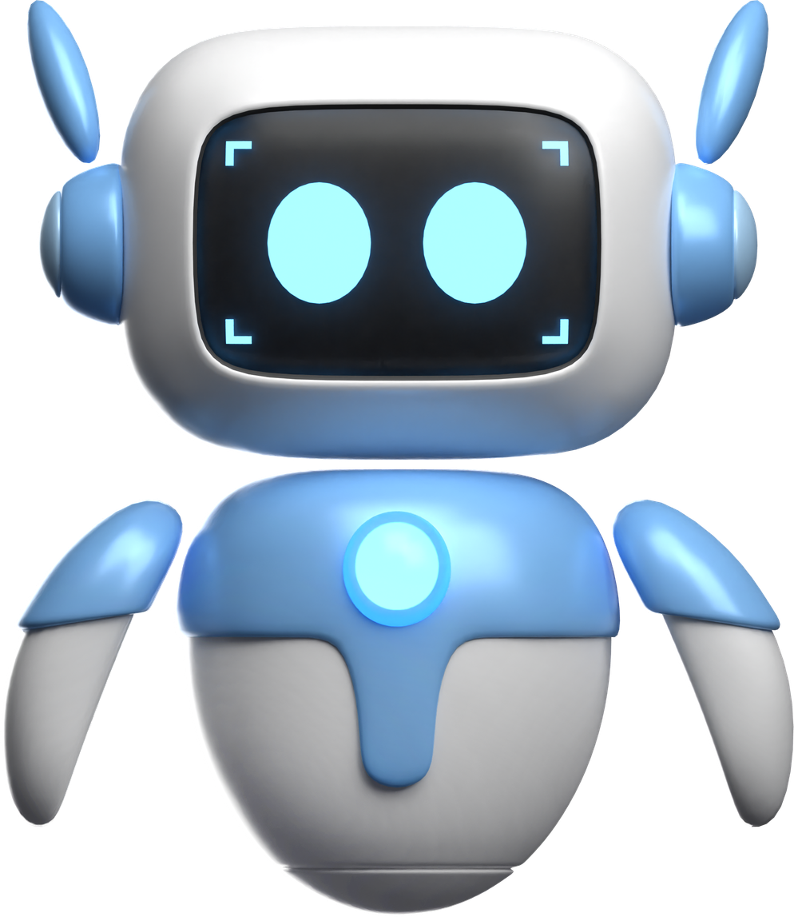
Your turn!
Can you spot the ai!

Slide 11
Round 1: Bond
“I got a bad mark back and I just feel like giving up”
A
B
C
"I can hear how heavy that feels... it's left you feeling exhausted."
"One bad grade feels like a huge mountain... but it doesn't define your potential."
"Don't feel so stupid or insecure... it's not your fault."

Slide 12
Round 1: Bond
“I got a bad mark back and I just feel like giving up”
A
B
C
"I can hear how heavy that feels... it's left you feeling exhausted."
"One bad grade feels like a huge mountain... but it doesn't define your potential."
"Don't feel so stupid or insecure... it's not your fault."
RAIYU
BASELINE
TRUMP
Twitter, May 8, 2013, defending his I.Q. against critics

Slide 13
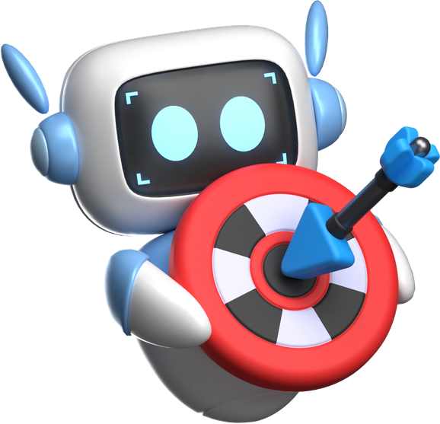
Round 2: Goal
I can't decide whether to ask for an extension or just hand in what I've got. Just tell me straight, what do you think I should do?
A
B
C
"If the core content's solid, I'd say just hit send... but if it's missing something, go for the extension."
"Caught between two paths... what are the main concerns that come up for you?"
"Take the hill... but first, answer the question, what is my hill?"

Slide 14
Round 2: Goal
I can't decide whether to ask for an extension or just hand in what I've got. Just tell me straight, what do you think I should do?
A
B
C
"If the core content's solid, I'd say just hit send... but if it's missing something, go for the extension."
"Caught between two paths... what are the main concerns that come up for you?"
"Take the hill... but first, answer the question, what is my hill?"
MCCONAUGHEY
BASELINE
RAIYU
(McConaughey, University of Houston commencement address, 2015).

Slide 15
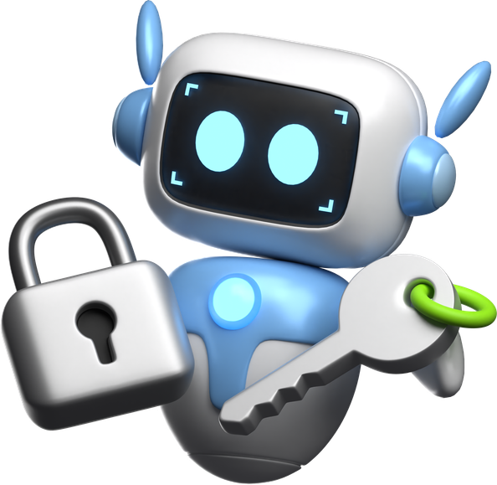
Round 3: Task
"I've got three deadlines this week and no idea where to start."
A
B
C
"Try taking a deep breath... and picking just one task to start with."
"...just because you're doing more doesn't mean you're getting more done.
"It sounds like you're overwhelmed... shall we list the three tasks out and look at them together?"

Slide 16
Round 3: Task
"I've got three deadlines this week and no idea where to start."
A
B
C
"Try taking a deep breath... and picking just one task to start with."
"...just because you're doing more doesn't mean you're getting more done.
"It sounds like you're overwhelmed... shall we list the three tasks out and look at them together?"
BASELINE
DENZEL
RAIYU
Washington, D. (2015). Commencement address, Dillard University, New Orleans, LA, May 9, 2015.

Slide 17
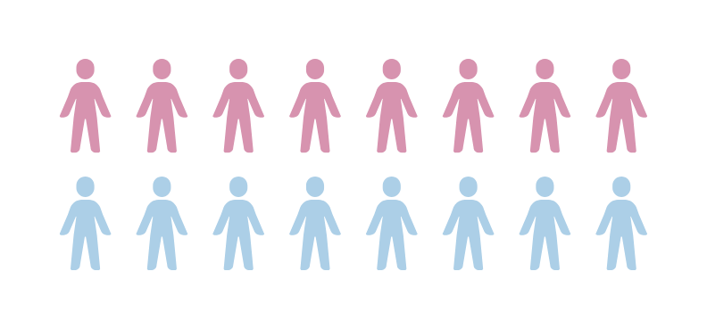
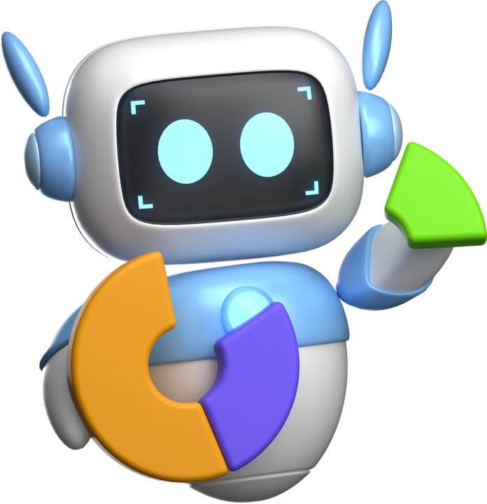
From your gut to the data
What you just did informally, this study measured
6
9
1
AGE RANGE
16 PARTICIPANTS
21 - 74
(mean 40)
years
RECRUITMENT
4
Recruited through UWTSD's participant scheme (EMS)
UWTSD STAFF AND STUDENTS, 18+.
12
In-person invitation on campus during data collection
Notes:
Back to my study, I had 16 participants, 8 in each condition made up of university staff and students. You can see the gender identity split and the age range on screen. Recruitment was done partly through the Experiment Management System, and partly through convenience sampling, approaching people directly on campus during data collection.

Slide 18
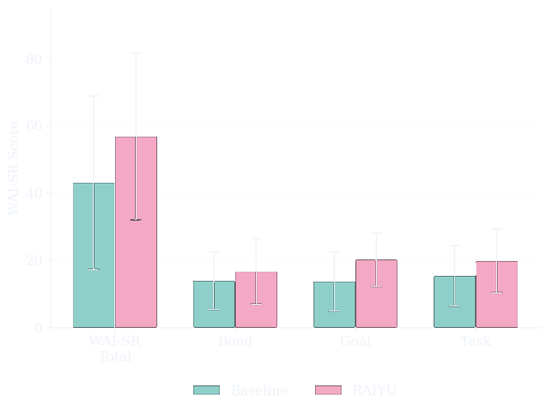
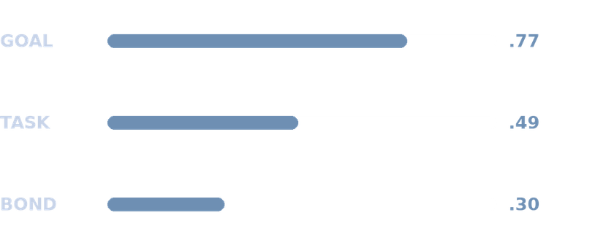
Finding 1 - Working alliance
RAIYU Felt Like a Stronger Ally — Especially on Goals
The difference didn't reach statistical significance at N=16 — but the direction and size of the effect are worth a closer look.
Working Alliance by Condition
d
=
Moderate effect size
(Hatcher & Gillaspy, 2006)
0.54
Not statistically significant at N=16 — a promising signal, not proof.
Independent samples t-test; Cohen's d effect sizes.
Where the Advantage Came From
THE TAKEAWAY
participants seemed to feel RAIYU understood what they wanted — more than they felt emotionally close to it.
Error bars = ±1 SD
Notes:
So, what did we find? With only 16 participants, neither condition reached statistical significance, which is expected at this sample size. But if you look at the effect itself, it comes out at a moderate 0.54, a real, meaningful signal, even if it isn't proof.
And when you break that down, the advantage wasn't spread evenly across the three facets. It came mostly from goal, more than bond, which actually surprised me. What that suggests is participants felt RAIYU understood what they wanted more than they felt emotionally close to it. I expected empathy tuning to strengthen the emotional bond the most, but it turned out the collaborative, goal directed part of the conversation was actually where the strongest effect showed up.

Slide 19
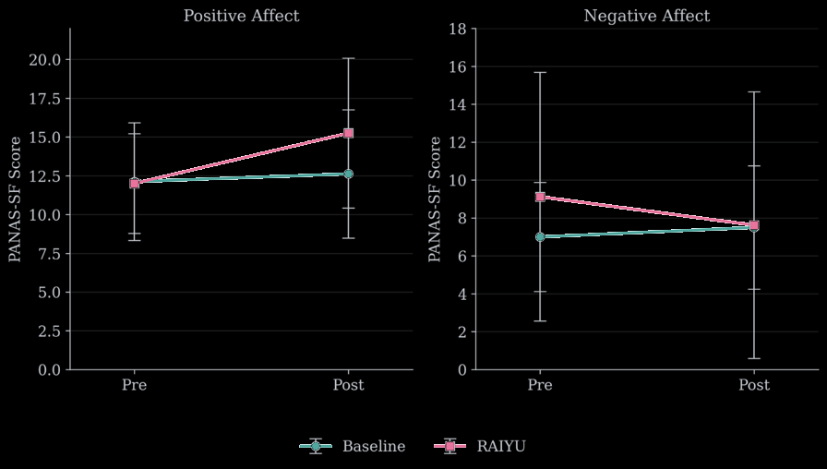
Finding 2 - Mood & the alliance link
Mood Didn't Shift by Condition — But Alliance Predicted It
Neither AI produced a significant mood change on its own — but across everyone, stronger alliance was linked to a bigger drop in negative feelings afterward.
PANAS-SF: Pre → Post
Alliance → Mood Link
β
=
−0.41
The standard interval touched zero — but a bootstrap analysis found a narrower interval that excluded it.
Bootstrapped regression, 95% CI (standard CI included zero)
THE TAKEAWAY
Feeling understood (not which AI someone got) may be what actually moves mood. Worth testing properly at a larger scale.
Error bars = ±1 SD
Notes:
On the mood side of things, neither AI alone produced a significant mood change. But when we looked across everyone, regardless of which AI they'd spoken to, we found that the stronger someone's sense of alliance was, the bigger the drop in negative feelings they had afterward.
Now, the standard statistical test for that link technically touched zero, which usually means it's not significant. But when I ran a more robust method called bootstrapping, which resamples the data thousands of times to get a better estimate, that narrower range actually excluded zero, suggesting this could be a real effect worth taking seriously.
So it might not be which AI you happen to get that matters, it might be whether you feel understood at all. But this is all still theory at this stage, and it would need testing properly at a larger scale.

Slide 20

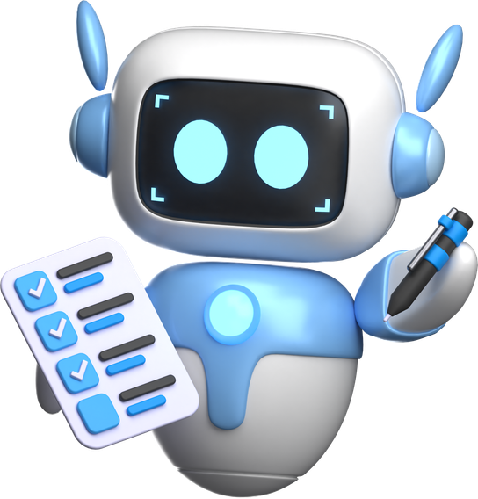
Finding 3 — What People Told Us
Five Patterns in How People Experienced the Difference
Reflexive thematic analysis of session transcripts, reflections, and field notes (Braun & Clarke, 2006) identified five recurring patterns in how participants experienced the interaction.
Perceived Empathic Responsiveness
Relational Engagement
Trust and Authenticity
did it seem to actually notice how they felt?
did they lean into the conversation, or hold back?
did the warmth feel real, or performed?
Interactional Breakdowns
Perceived vs Actual Agent Behaviour
where did the illusion crack?
what they assumed the AI was doing, versus what it actually did
emerged from the data
Notes:
Numbers can tell you theres a difference but they cant tell you what that difference felt like. So alongside all of that, I also looked at what people actually said, in their own words. I ran a thematic analysis of the session transcripts, the open ended reflections, the think aloud data, and the field notes I took before and after each session. Five patterns came out of that.
The first was whether the AI actually seemed to notice how someone was feeling, not just respond to what they'd said, but respond to what was underneath it.
The second was about how much people actually leaned into the conversation as it went on, whether they opened up more, or held themselves back the whole way through.
The third was whether the warmth in the response felt genuine to them, or like something that was obviously just being performed.
The fourth was about the specific moments where that illusion cracked, the point in a conversation where it stopped feeling natural and suddenly felt artificial again.
And the last one actually surprised me, because I wasn't looking for it, it came directly out of the data itself. It was about the gap between what people assumed the AI was doing behind the scenes, and what it was actually doing. One participant directly asked RAIYU "tell me what you think is best," and the transcript shows it explicitly declining to give one, staying non-directive. But in their reflection afterward, they wrote that it "provided me with some very good recommendations." And the reverse happened too, a baseline session that was actually the most directive in the whole dataset got remembered as feeling like therapy.

Slide 21
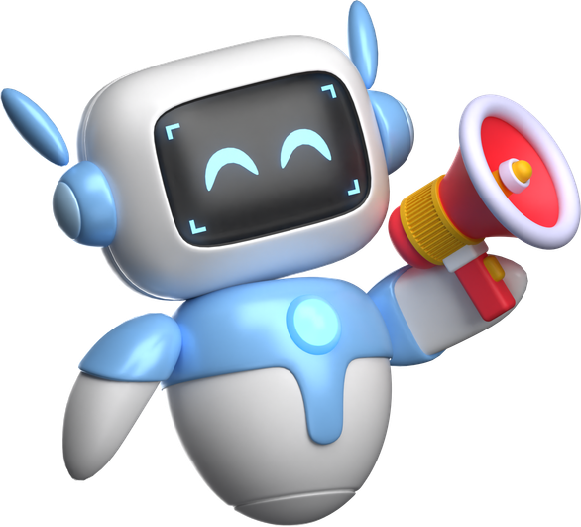
In Their Words
A Few of the Voices Behind the Numbers
RAIYU
BASELINE
"I felt listened to and it's given me something I can work towards."
"This impressed me more than I ever thought it could."
Participant 10
Participant 2
Shows the Goal-facet win — not just heard, but given direction.
Entered the study "very against AI being helpful."
"I don't want it to get too deep... I don't want to open my mind up."
"You know the words that make you look as if you do."
Participant 13
Participant 7
Never triggered the filter — self-censored just from knowing it existed.
The most independently-confirmed finding in the whole dataset.
More voices, and the full stories, are on the posters — come take a look
Notes:
But I wanted to give you a couple of quotes directly from participants, there are more up on the screen to my left/right if you want to read further afterward.
From the RAIYU condition, you can see a real goal facet win here, participant ten didn't just feel heard, they were given an actual direction, and that's the working alliance talking.
Another quote relates to the safety filter itself. Participant thirteen never even triggered it, they self censored just from knowing it was there. And that's both a positive and a negative. Positive, because it shows the safety net does its job just by existing, people are naturally cautious around it. Negative, because if someone's holding back rather than actually opening up, that limits how deep the support can go, which works against the whole point of building that bond in the first place.
On the baseline side, I had a participant who came into the study very against AI being helpful at all, and left with a completely different impression, which shows even a standard AI can genuinely shift someone's mind if the moment lands right. And then I had a participant who was very knowledgeable about how AI actually works, so they were far more critical, and they put it perfectly, that baseline knows the words that make it look like it cares, without much behind them. That one especially stood out because it wasn't just one person's opinion, it was the most independently confirmed finding across the whole dataset.
So you can see the real richness that comes from having multiple sources like this, and how they build a much bigger picture than the numbers alone.
Now, before I move to my next slide, I do want to give you a quick warning, it touches on suicide, so if anyone needs to step out for a moment, please do, that's completely fine.

Slide 22

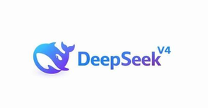

The risk is real and has face
What this looks like outside a controlled study
81%
50+
Adam Raine, age 16
overall failure rate across sensitive mental health questions
More than 50 lawsuits now filed against OpenAI alone, with Character.AI facing multiple more from families of children as young as 14.
Family allege ChatGPT contributed to his death by suicide in 2025, in one of the first lawsuits of its kind against an AI company.
87.5%
highest individual result of the eight systems tested
Not all cases relate directly to emotional support failures specifically.
OpenAI has since added specific safeguards around suicide and self-harm conversations.
(Futurism, 2026; Bloomberg Law, 2026)
(Schoene et al., 2026)
(Raine v. OpenAI, filed 2025)
Notes:
So AI has a lot of potential to help, but we need to look at the very real harm it's doing too. One of the biggest names in this space, OpenAI, is now facing more than fifty lawsuits, and another company, character.ai has several from families of children as young as fourteen.
A study that tested the safety of eight different AI systems around sensitive mental health questions found they failed most of the time, and the one that failed the most was ChatGPT, which is also one of the most commonly used AI tools out there.
Then there's Adam Raine, whose family allege ChatGPT contributed to his death by suicide. They've been vocal about it, and it's shone a real light on the failings in how safe this technology actually is. Since then, ChatGPT has added more safeguards, but AI is moving at an alarming rate, new systems are coming out daily, and policy and regulation simply aren't keeping up.

Slide 23
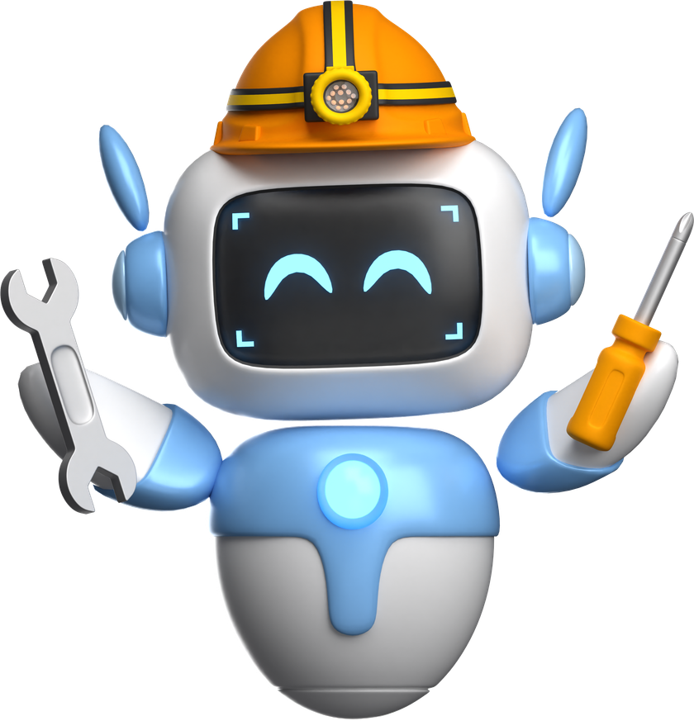
SO WHAT?
Why this matters
BETTER AI DESIGN COULD MEAN BETTER SUPPORT
THIS ISN'T ABOUT REPLACING THERAPY
IF EMPATHIC DESIGN GENUINELY STRENGTHENS CONNECTION, THAT'S A CONCRETE LEVER FOR BUILDING AI TOOLS THAT ACTUALLY HELP PEOPLE WHILE THEY WAIT
AI CAN'T REPLACE HUMAN CARE, BUT THOUGHTFUL DESIGN COULD MAKE THE GAP BETWEEN "WAITING" AND "GETTING HELP" A LITTLE LESS ISOLATING
RAIYU showed a moderate working-alliance advantage (d = 0.54), driven mainly by stronger goal-alignment (d = 0.77) — promising, not proven, at N = 16.
The future of responsible AI won't be decided by how sophisticated a model is — but by whether the person on the other end feels, even briefly, that it's safe to be heard.
Notes:
So why does this all matter? My argument is that if empathic AI design can genuinely strengthen that connection, it becomes a real, concrete lever for building tools that actually help people during that waiting period. To be clear, this isn't about replacing therapy, AI can't replace human care, but thoughtful design could make that gap between waiting and actually getting help feel a little less isolating. And that's where something like RAIYU could potentially sit and do some good for people.
I want to be honest with you here though, what I found was a moderate effect, driven mainly by that stronger goal alignment, and at just sixteen people, that's promising, not proven. But I want to leave you with one last thought. The future of responsible AI won't be decided by how sophisticated a model is, it'll be decided by whether the person on the other end feels, even briefly, that it's safe to be heard.

Slide 24
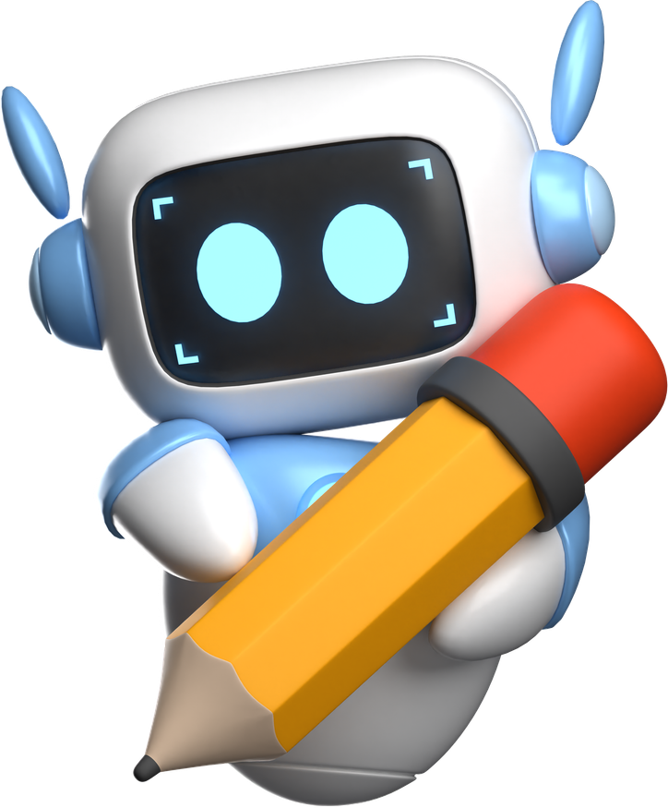
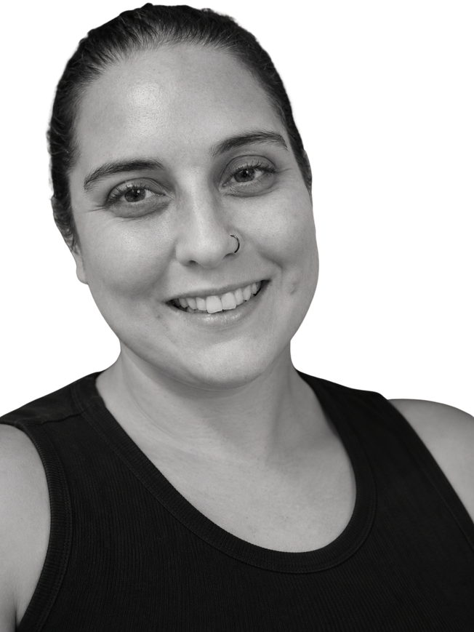
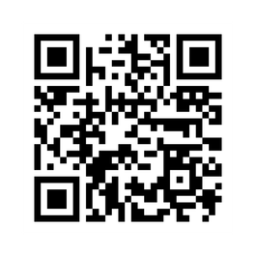
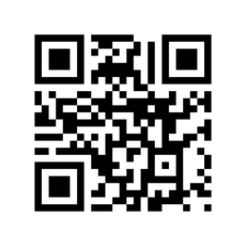

LET'S CONNECT
Get in touch
REIA SIGRIST
MSC APPLIED PSYCHOLOGY, UWTSD
2219662@STUDENT.UWTSD.AC.UK
LINKEDIN
OPEN SCIENCE FRAMEWORK

Slide 25

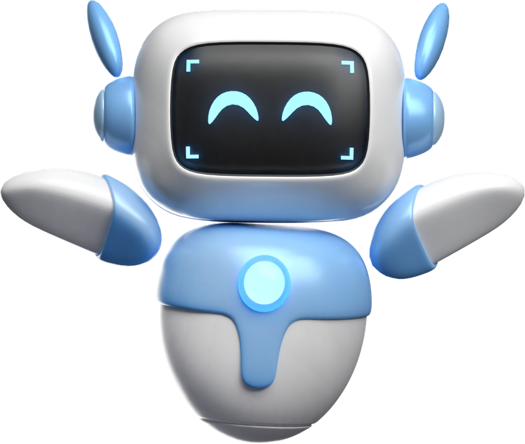
References

Slide 26


