Slide 1
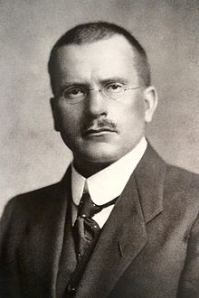
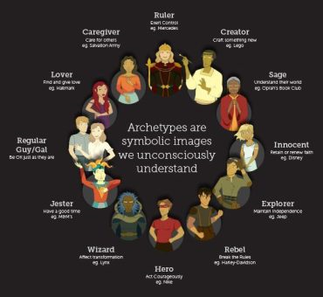
I’ll be focusing on his ideas of religion, but specifically on two parts which are;
Religious experiences
Archetypes
Biography
Carl Gustav Jung was born on July 26th 1875 in Kesswil, Switzerland and died June 6th 1961 in Küsnacht
He studied medicine and became a psychiatrist and studied in the Universities of Basel (1895–1900) and Zürich (M.D., 1902). Also, joined as a staff member of Burghölzli Asylum and this developed his ideas.
Jung was a Swiss Psychiatrist and Psychoanalyst.
His work is influential in the study areas of Religion, literature and other fields.
Carl Gustav Jung
Archetypes
Unconscious mind
God as an Archetype
Religious experiences
Jung defines ‘religious experience as a numinous experience that seizes and controls the human subject’.
He had a positive attitude towards religion and saw it as a good way for personal growth in an individual.

Slide 2
Bibliography
Fordham, S.M.Michael, Carl Gustav Jung, (2019)< https://www.britannica.com/biography/Carl-Jung> [accessed on 09/12/2019]
Jung, C.G, The Archetypes and the Collective Unconsciousness (Princeton University Press, 1991) [accessed on 09/12/2019]
Morris, Brian, Anthropological studies of religion An introductory text (Cambridge: Cambridge University Press, 1987)
Philosophyzer, Jung on Religion, (2015)<www.philosophyzer.com> [accessed on 09/12/2019]
Roberts, M, A2 philosophy of religion, theme one (not published, 2018)
Photos used
Photo of Carl Jung, Wikipedia,<https://en.wikipedia.org/wiki/Carl_Jung> [accessed on 8/12/2019]
Photo of collective unconscious,<www.maylynno.wordpress.com>[accessed on 9/12/2019]

