Slide 1

MENISCAL INJURY OF THE KNEE

Slide 2
MENISCUS
Once thought to be a vestigial muscle remnant with no known purpose, now known to be:
–Important structure for knee force distribution– Secondary stabiliser of the knee
–Loss of entire mensicus (open meniscectomy) leads to progressive degenerative changes decades later
•Fairbanks, JBJS, (1948)
Notes:
Why would loss of Meniscus lead to Degenerative changes? Think back to last terms tissues

Slide 3
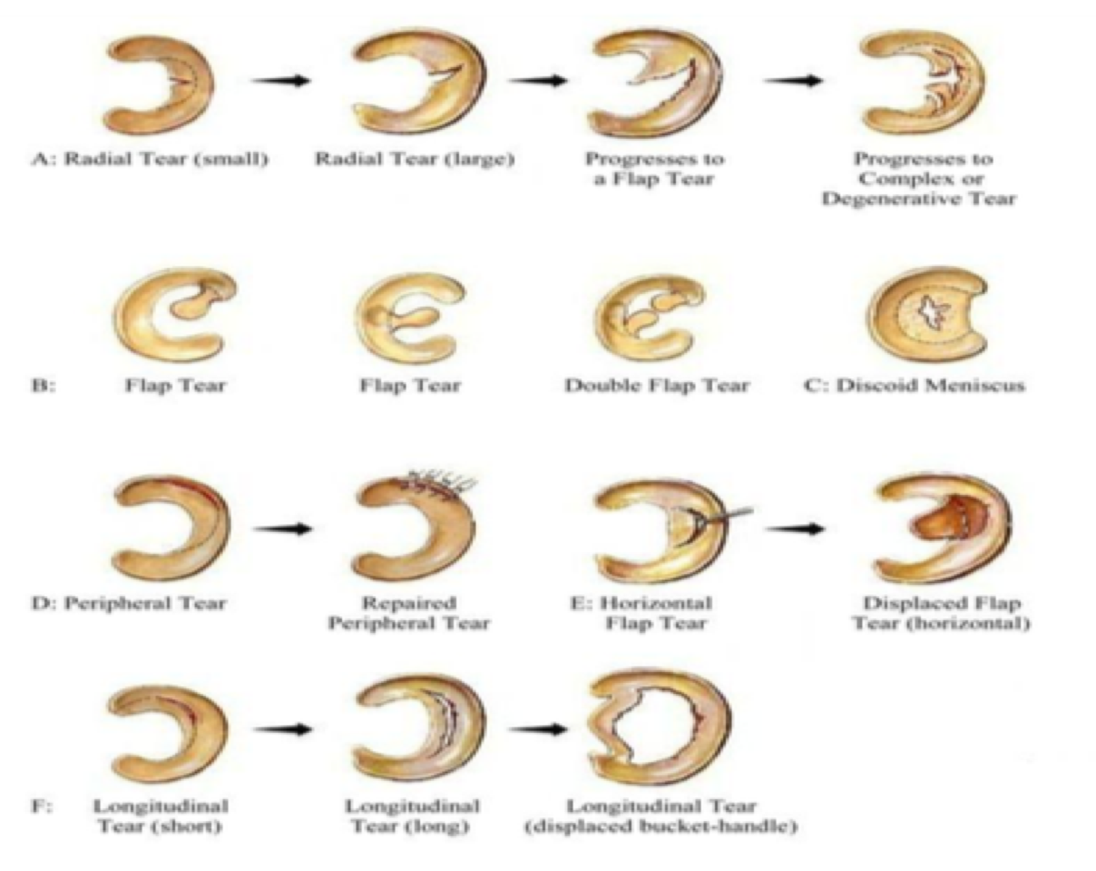

Notes:
How would you diagnose which type of Meniscal tear someone may have? X-ray? Mri? Arthroscopy?

Slide 4
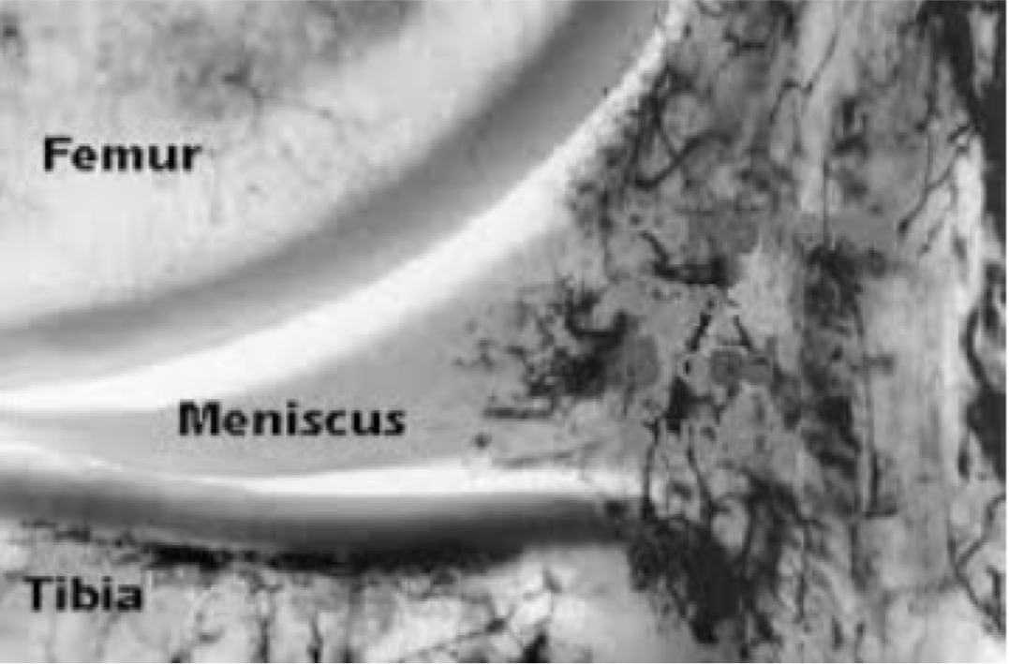
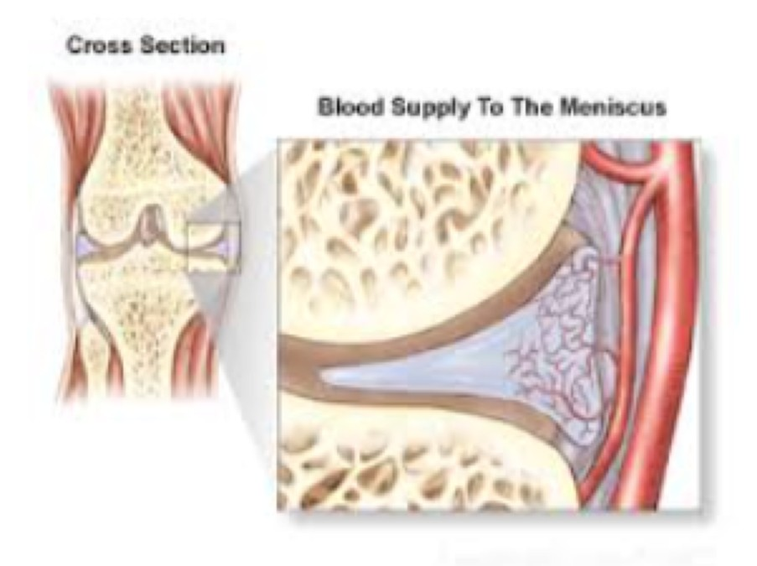
ANATOMY OF RECOVERY
IS IT ALL ABOUT THE BLOOD SUPPLY?

Slide 5
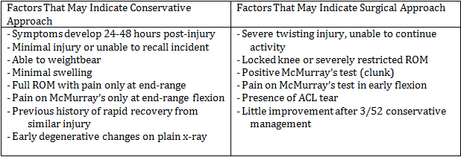
RECOGNISING MENISCUS INJURY
MRI, X-ray will not show detail of meniscus
Clinical picture, special tests etc
Conservative treatment (rehabilitation), or surgery???
Table 1.1 Clinical Factors which may indicate a surgical or conservative approach, Brukner & Khan, 2012 pg 636.

Slide 6
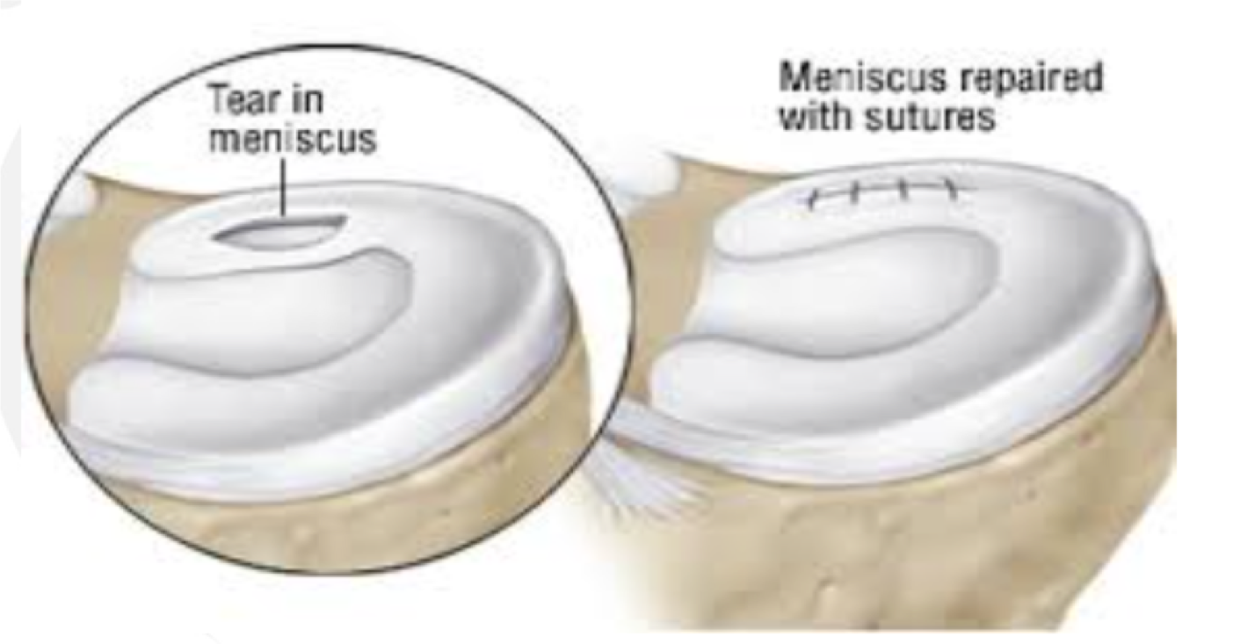
MENISCAL REPAIR
Notes:
There are new strategies being trialled concurrently with repair, look for the studies.

Slide 7
MENISCECTOMY
REMOVAL OF MENISCAL TISSUE DECREASES CONTACT STRESS AREA, INCREASING STRESS ONTHE ARTICULAR CARTILAGE
INCREASED STRESS IS IN PROPORTION TO THE AMOUNT OF MENISCUS REMOVED
INCREASED STRESS INEVITABLY LEADS TO DEGENERATION OF THE JOINT
Notes:
How does this relate to what we looked at regarding Cartilage and Osteoarthritis?

Slide 8
HISTORY WITH MENISCAL ISSUES
• Traumatic vs atraumatic/degenerative
  Traumatic:Younger, acutely painful swollen knee
  Degenerative: Middle age-older, chronic vs acute-on-chronic vs acutely painful knee
Catching, clicking, locking of the knee may occur
Exam may include painful range of motion, affected joint line tenderness, and positive provocative manoeuvres (McMurray’s, Appley’s)
Swelling of the knee (sweep test), in 24-48hrs after injury
History, X-Rays, MRI

Slide 9
MENISCAL MANAGEMENT OF THE YOUNG
• Non operative treatment NOT typically recommended although things are changing
• Surgery to PRESERVE the meniscus (i.e., repair or debride, prevent tear progression)
• Definition of young?
  <25 years old?
  <35 years old?
  <50 years old?
• Why?
Notes:
Preserve the meniscus is a very important theme in current decision making. Why?

Slide 10
MENISCECTOMY
Stein, AJSM, 2010
Level 3 Cohort
4. 5 and 9yr blinded radiographic f/u
Young(ish) patients: avg age ~31
Isolated, “traumatic tears”; both groups, vertical tears/bucket handle
Results at years:
  Meniscectomy: 60% OA changes (Grade I Fairbanks)
  Meniscus repair: 20% OA changes (Grade I Fairbanks)
No Grade 2 or 3 changes seen
Repair much higher return to prior sport (96% vs 50%)
Notes:
Simple message, repair resulted in better long term outcomes than menisectomy

Slide 11
MENISCUS TEAR
Common
–35% of people over the age of 50 have a meniscus tear
–2/3 of these people are ASYMPTOMATIC
In the presence of osteoarthritis, prevalence increases to 100% if Grade IV arthritic changes
Can be traumatic or degenerative....

Slide 12
SURGERY??
Sihvonen, N Eng J Med, 2013
Multicenter RCT, Level 2 Evidence
Arthroscopic partial meniscectomy vs. sham surgery in patients without OA
Findings: NO DIFFERENCE b/t GROUPS @ 12mos
Importantly, statistical difference in severity of non-radiographic appearance of arthritis seen in surgical vs. sham group.
.

Slide 13
OUTCOMES THERAPY V SURGERY
Herrlin,KSSTA, 2013
RCT, Level 1
No or minimal OA (<grade 1)
Middle aged patients
Findings:
PT group did as well as Arthroscopy/PT group at 5years

