Slide 1

Isolation
By: Donna Walters
Module code: SJSS4002

Slide 2

What is isolation?
A lack of social or familial contact, involvement in the community and access to services.

Slide 3
What can cause isolation?
Living in a rural area
Lack of social relationships
Lack of emotional support
Poor transportation
Disability
Bullying
Personal choice
Having a baby
Gender
……………And many more
(HM GOVERNMENT, 2018)

Slide 4

However ….
Image: (Canarie, 2019)
Scientific research has found a genetic link to Isolation & loneliness
(Day et al., 2018)

Slide 5
The impact of isolation
Loneliness
Poor self esteem
Anxiety
Depression
Suicide
Increased risk of substance misuse
Increased risk of poor health
Increased mortality
(Beyonddifferences, 2019).

Slide 6

Social isolation in schools
Image: (Wisgeek, n.d.)

Slide 7
Social exclusion
A term used to describe a situation when a person (or a group of people), is excluded from the main activities of the society they reside in, and factors beyond his or her control prevent participation
(NHSWales, 2010)

Slide 8

Bullying
Nearly half of suicides in children aged between 10-14 is as a result of social exclusion.
(Dickinson, 2010)

Slide 9

Attachment theory
‘Lasting psychological connectedness between human beiings’
Image: (Psychologistworld, n.d.)
(Bowlby, 1969, p.194)

Slide 10
UK Government view
‘For far too many people loneliness is a sad reality in modern life’ – Theresa may
(Walker, 2018)

Slide 11
Isolation in wales
“Tackling loneliness and isolation in Wales is a national priority” – Huw Irranca-Davies
(Gov, 2018)

Slide 12

Image: (Sunstrans, 2017)

Slide 13
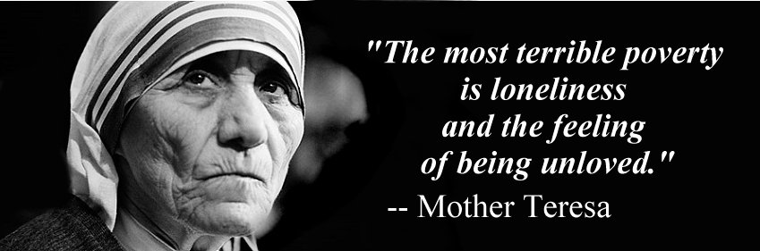
Image: (Golfan, 2017).

Slide 14
References
Actionforchildren.org.uk. (2017). it starts with hello. [online] Available at: https://www.actionforchildren.org.uk/media/9724/action_for_children_it_starts_with_hello_report__november_2017_lowres.pdf [Accessed 18 Jan. 2019].
Beyonddifferences.org. (2019). What is Social Isolation?. [online] Available at: https://www.beyonddifferences.org/social-isolation/ [Accessed 16 Jan. 2019].
beta.gov.wales. (2018A). Connected communities - Tackling loneliness and social isolation | beta.gov.wales. [online] Available at: https://beta.gov.wales/connected-communities-tackling-loneliness-and-social-isolation [Accessed 18 Jan. 2019].
Beta.gov.wales. (2018B). Connected Communities Tackling Loneliness and Social Isolation. [online] Available at: https://beta.gov.wales/sites/default/files/consultations/2018-10/consultation-document_1.pdf [Accessed 18 Jan. 2019].
Bowlby J. (1969). Attachment. Attachment and loss: Vol. 1. Loss. New York: Basic Books. P.194
Campaigntoendlonliness.org. (n.d.). About loneliness. (online) available at: https://www.campaigntoendlonliness.org/about-loneliness/ (accessed 16 jan. 2019).
Day, F., Ong, K. and Perry, J. (2018). Elucidating the genetic basis of social interaction and isolation. Nature Communications, [online] 9(1). Available at: https://www.nature.com/articles/s41467-018-04930-1 [Accessed 17 Jan. 2019].
Fenton, K. (2015). Loneliness and isolation: Social relationships are key to good health - Public health matters. [online] Publichealthmatters.blog.gov.uk. Available at: https://publichealthmatters.blog.gov.uk/2015/12/08/loneliness-and-isolation-social-relationships-are-key-to-good-health/ [Accessed 18 Jan. 2019].
Golfian.com. (2017). The Most Terrible Poverty Is Loneliness And The Feeling Of Being Unloved-Mother Teresa - Golfian.com. [online] Available at: http://www.golfian.com/70-top-poverty-quotes-and-sayings/the-most-terrible-poverty-is-loneliness-and-the-feeling-of-being-unloved-mother-teresa/ [Accessed 14 Jan. 2019].
Gov.wales. (2015). Talk to me 2 Suicide and Self Harm Prevention Strategy for Wales 2015-2020. [online] Available at: https://gov.wales/docs/dhss/publications/150716strategyen.pdf [Accessed 18 Jan. 2019].
Gov.wales. (2015). Wellbeing of Future Generations (Wales) Act 2015. [online] Available at: https://gov.wales/docs/dsjlg/publications/150623-guide-to-the-fg-act-en.pdf [Accessed 18 Jan. 2019].
Gov.wales. (2018a). Welsh Government|“Loneliness and isolation in rural Wales is a ticking time bomb” – Huw Irranca-Davies. [online] Available at: https://gov.wales/newsroom/health-and-social-services/2018/lonliness/?lang=en [Accessed 17 Jan. 2019].
Gov.wales. (2018b). Welsh Government|“Tackling loneliness and isolation in Wales is a national priority” – Huw Irranca-Davies. [online] Available at: https://gov.wales/newsroom/health-and-social-services/2018/isolation/?lang=en [Accessed 17 Jan. 2019].

Slide 15
references
HM Government, (2018). A connected society A strategy for tackling loneliness. London. HMSO https://assets.publishing.service.gov.uk/government/uploads/system/uploads/attachment_data/file/750909/6.4882_DCMS_Loneliness_Strategy_web_Update.pdf
Holt-Lunstad, J., Smith, T., Baker, M., Harris, T. and Stephenson, D. (2015). Loneliness and Social Isolation as Risk Factors for Mortality. [online] Sage journals. Available at: https://journals.sagepub.com/doi/10.1177/1745691614568352 [Accessed 18 Jan. 2019].
Jopling, K. (2015). Promising approaches to reduce loneliness and isolation in later life. [online] Campaigntoendloneliness.org. Available at: https://www.campaigntoendloneliness.org/wp-content/uploads/Promising-approaches-to-reducing-loneliness-and-isolation-in-later-life.pdf [Accessed 14 Jan. 2019].
NHSWales, (2010) Health and Social Exclusion Available at: http://www.wales.nhs.uk/sitesplus/888/page/44499 (Accessed: 16 Jan, 2019). Lau, S., Chan, D. and Lau, P. (1999). Facets of Loneliness and Depression Among Chinese Children and Adolescents. The Journal of Social Psychology, [online] 139(6), pp.713-729. Available at: https://www.tandfonline.com/doi/pdf/10.1080/00224549909598251?needAccess=true [Accessed 18 Jan. 2019].
Sustrans. (2017). Sustrans Cymru's reaction to Prosperity for All, Welsh Government's new national strategy for Wales. [online] Available at: https://www.sustrans.org.uk/news/sustrans-cymrus-reaction-prosperity-all-welsh-governments-new-national-strategy-wales [Accessed 18 Jan. 2019].
Walker, P. (2018). May appoints minister to tackle loneliness issues raised by Jo Cox. [online] the Guardian. Available at: https://www.theguardian.com/society/2018/jan/16/may-appoints-minister-tackle-loneliness-issues-raised-jo-cox [Accessed 18 Jan. 2019].
Wcva.org.uk. (2018). Volunteering to tackle loneliness. [online] Available at: https://www.wcva.org.uk/volunteering/volunteering-latest/2018/11/volunteering-to-tackle-loneliness [Accessed 18 Jan. 2019].
Wisgeek. (n.d.). What are THE DIFFERENT TYPES OF TEENAGE BULLYING?. [online] Available at: http://www.wisegeek.net/what-are-the-different-types-of-http://www.wisegeek.net/what-are-the-different-types-of-teenage-bullying.htmteenage-bullying.htm [Accessed 15 Jan. 2019].

