Slide 1
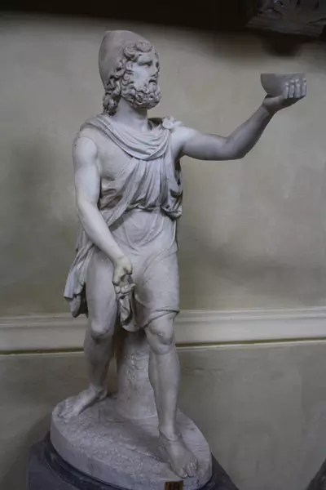
The Changing Representation between Odysseus and Ulysses
Available at: https://www.ancient.eu/odysseus/
By Nicholas Weir

Slide 2
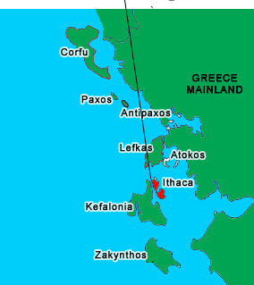
Who was Odysseus?
Son of Laertes and Antikleia
His wife is Penelope
His son is Telemachus
King of Ithaca and leader of the Kephallenians
Greek Homeric Hero
Available at: http://www.greece-charters.com/islands/ionion-islands/ithaca.html

Slide 3
Polyphemus-brief summary of Book 9
In Book 9 Odysseus gets captured by the Cyclops Polyphemus. Odysseus and his crew get trapped in a cave and have use their wits to escape.
Odysseus gets Polyphemus drunk and uses the stake he made to blind him.
Odysseus and his crew then hid under sheep so when morning came and Polyphemus moved the boulder blocking the cave entrance they escaped.
-(Homers, The Odyssey. Book 9, lines 1-560)

Slide 4
Polyphemus
“So he spoke, and again I handed him the flaming wine. Thrice I brought and gave it him, thrice he drained it in his folly.” (Hom, Od. 9.360)
-

Slide 5
Polyphemus
they took the stake of olive-wood, sharp at the point, and thrust it into his eye, while I, throwing my weight upon it from above, whirled it round, as when a man bores a ships timbers with a drill. (Hom, Od. 9.360)

Slide 6
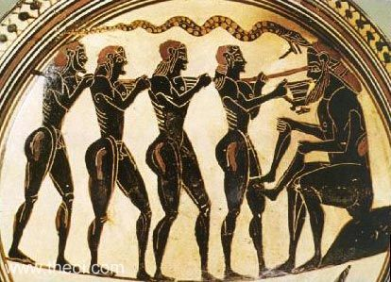
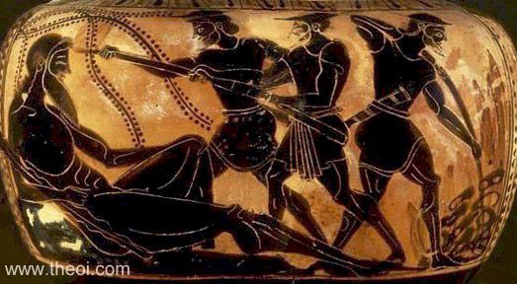
Polyphemus
black figure pottery piece depictting Odysseus stabbing Polypheamus' eye with a stake and holding a pot used for wine. from 550 BC. Available at: https://www.theoi.com/Gallery/L8.5.html
black figure pottery piece depicting Odysseu stabbing polyphemus in the eye on the left and on the right it is Oydssues making the stake used to stab him. From 510-490 BC. Available at: https://www.theoi.com/Gallery/L8.1.html

Slide 7
Polyphemus
“you ask me my name. I'll tell it to you; and in return give me the gift you promised me. My name is Nobody. That is what i am called by my mother and father and by all my friends.” (Hom,Od. 9.364-366)
“out of the cave came mighty Polyphemus' voice in reply; “O my friends it's Nobody's treachery”” (Hom, Od. 9.407-408)
“and off they went,while i laughed tmyself at the way in which my cunning notion of a false name had taken them in.” (Hom, Od. 9.414-15)

Slide 8
Aeolus- breif summary of Aoelus
After escaping from Polypheamus Odysseus and his crew end up at Aeolia where Aoelus live.
Odysseus tells him the story of troy and asks for his help to get back to Ithaca.
Aeolus gives him a bag of winds which will help him get back to Ithaca.
on the way back Odysseus' crew become jealous and think Odysseus is hiding some gold and they go to find out what Odyssues was hiding and they open the bag of winds and they get blown all the way back to Aeolia where he refuses to help them again.
-(Homers, The Odysseys. Book 10, lines 1-80)

Slide 9
Aeolus
“but my comrades meanwhile began to speak to one another, and said that I was bringing home for myself gold and silver as gifts from Aeolus.”(Hom,Od. 10.1)
“so they spoke, and the evil counsel of my comrades prevailed. They loosed the wallet, and all the winds leapt forth, and swiftly the storm-wind seized them and bore them weeping out to sea away from their native land.” (Hom, Od, 10.46)

Slide 10
Bibliography
Homer’s, The Odyssey, A.T. Murray (trans), 1919, Cambridge MA, Harvard University Press.
Greece: Ithaca-Sailing Vacation. Available at: http://www.greece-charters.com/islands/ionion-islands/ithaca.html [Accessed: 4th February 2019]
Odysseus (2013), Available at: https://www.ancient.eu/odysseus/ [Accessed: 4th February 2019]
Odysseus and Polyphemus. Available at: https://www.theoi.com/Gallery/L8.5.html [Accessed: 4th February 2019]
Polyphemus and Odysseus. Available at: https://www.theoi.com/Gallery/L8.1.html [Accessed: 4th February 2019]

