Slide 1






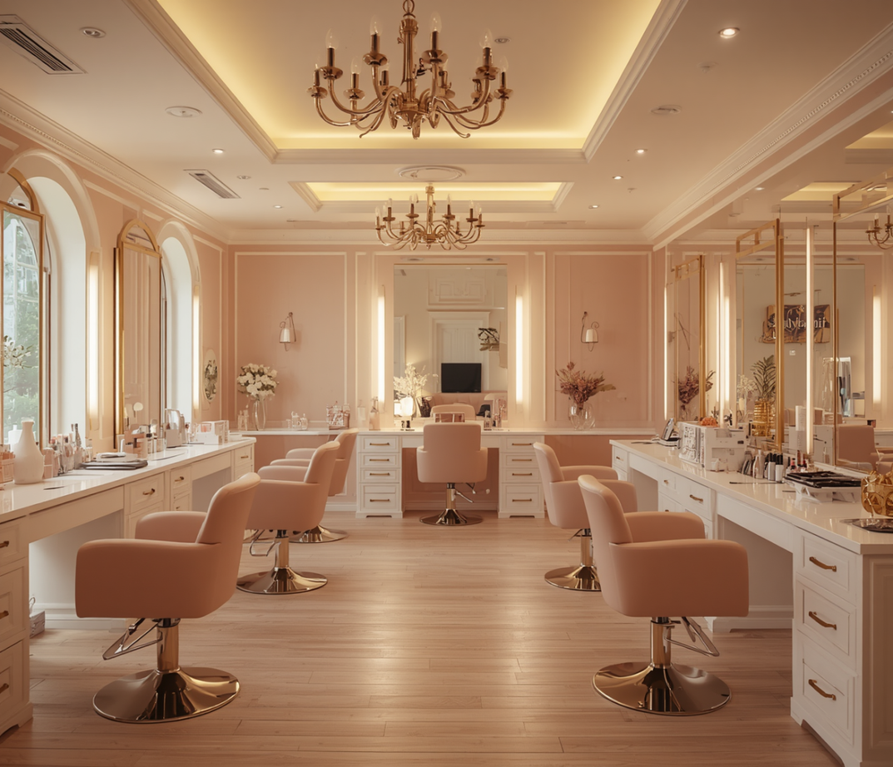

Yt
LCLM4006 Enterprise and Entrepreneurship
Presented By:
Date:
Florentina Tifachi (2514649)
Lecturer: Shengfeng Mei
11.08.2026

Slide 2

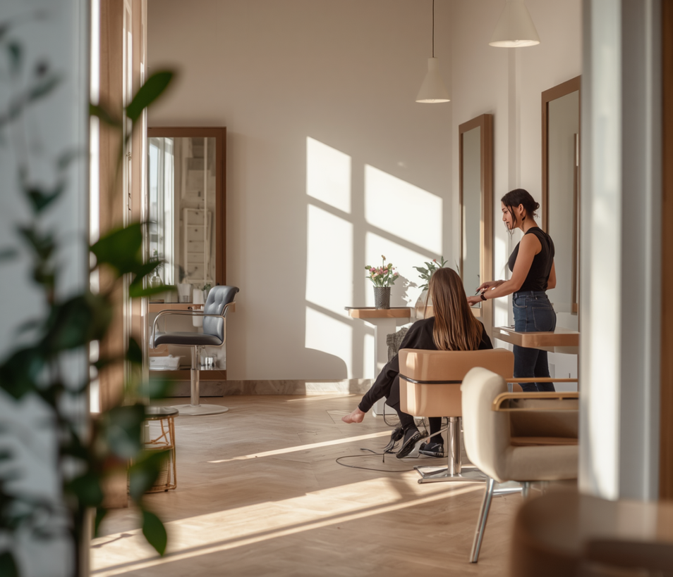
Business
Overview
Founded by Florentina Tifachi, Tina Beauty Salon is built on the concept of "Beauty for Every Budget" — offering three flexible pricing tiers (Basic, Standard, Premium) to make professional beauty services accessible to everyone. Legally structured as a sole trader, the salon is committed to affordability, a welcoming atmosphere, and sustainable practices.
Explore Our Services & Pricing Tiers
Our comprehensive services include haircuts, styling, coloring, nail care, eyebrow shaping, eyelash treatments, and makeup. Every client receives quality care tailored to their budget, ensuring inclusivity and satisfaction at every visit.

Slide 3

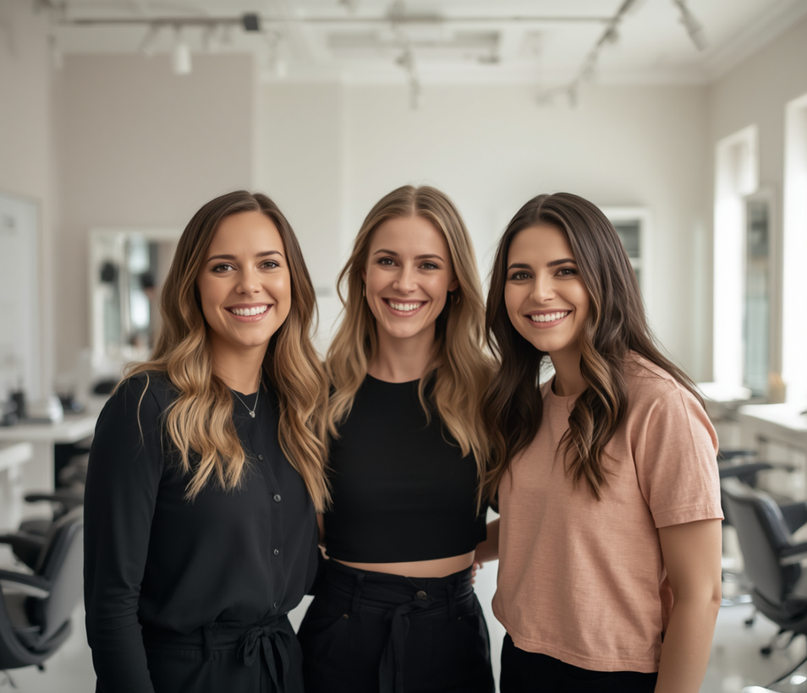
Management
Structure & Team Roles
Our dedicated team brings together expertise in beauty services, business operations, and client care to deliver an exceptional salon experience.
Owner / Manager
Hair & Beauty Specialist
Bookings & Reception
Florentina Tifachi leads all business operations, financial management, and marketing strategy. She also provides nails and beauty services directly to clients.
Cristina Mocanu delivers expert hair and beauty services, ensuring high-quality results across all pricing tiers for every client.
Paula Maftei manages all client bookings, front-of-house reception, and ensures a warm, welcoming experience for every visitor.

Slide 4
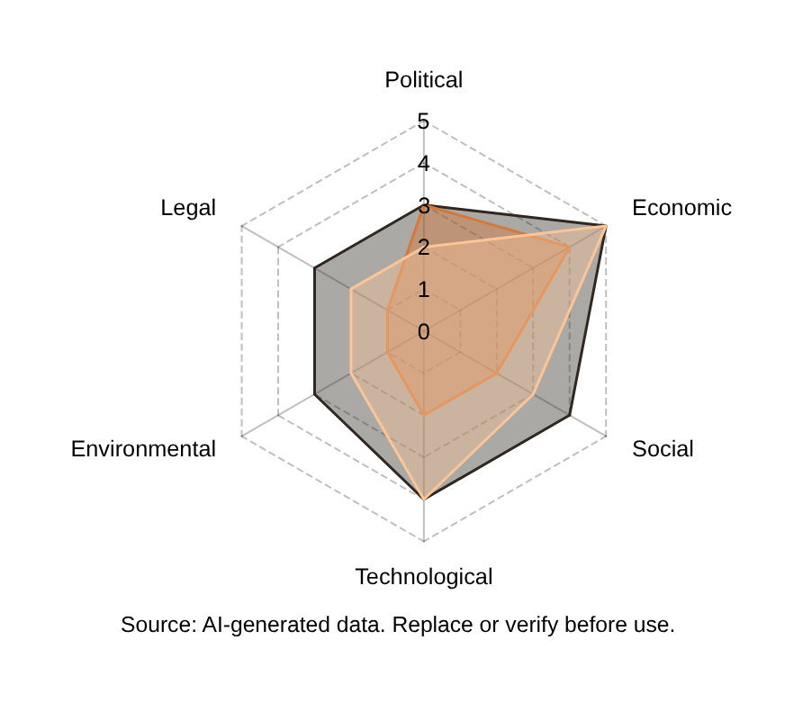
Market & Environment
Context
PESTEL Analysis
Political: Small business compliance. Economic: Affordable pricing addresses lower disposable incomes.
Social & Technological
Social: Growing beauty trends via social media. Technological: Online booking, card payments, digital marketing.
Environmental & Legal
Environmental: Cruelty-free products, recycling, LED lighting. Legal: Health & safety, employment & data protection.

Slide 5
Marketing
Strategies
01
02
03
05
Social Media Presence
First-Time & Student Discounts
Loyalty Card Program
Bring a Friend Promo

Slide 6
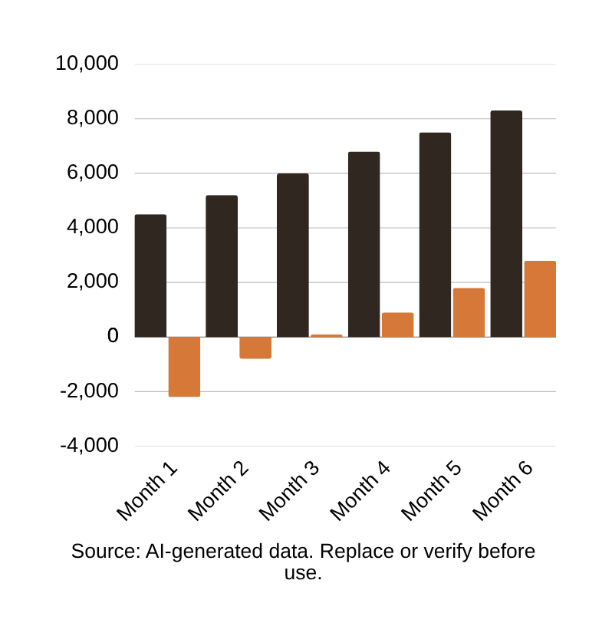
Financial
Overview
Start-Up Costs: £14,000
Furniture & equipment, salon renovation, website setup, initial marketing, and business insurance.
Monthly Fixed Costs: £5,900
Rent, staff salaries, insurance, utilities, and ongoing marketing expenses per month.
6-Month Profit Forecast
Month 1 revenue £4,500 (loss £2,200). Break-even at Month 3. Profit grows to £2,800 by Month 6.

Slide 7
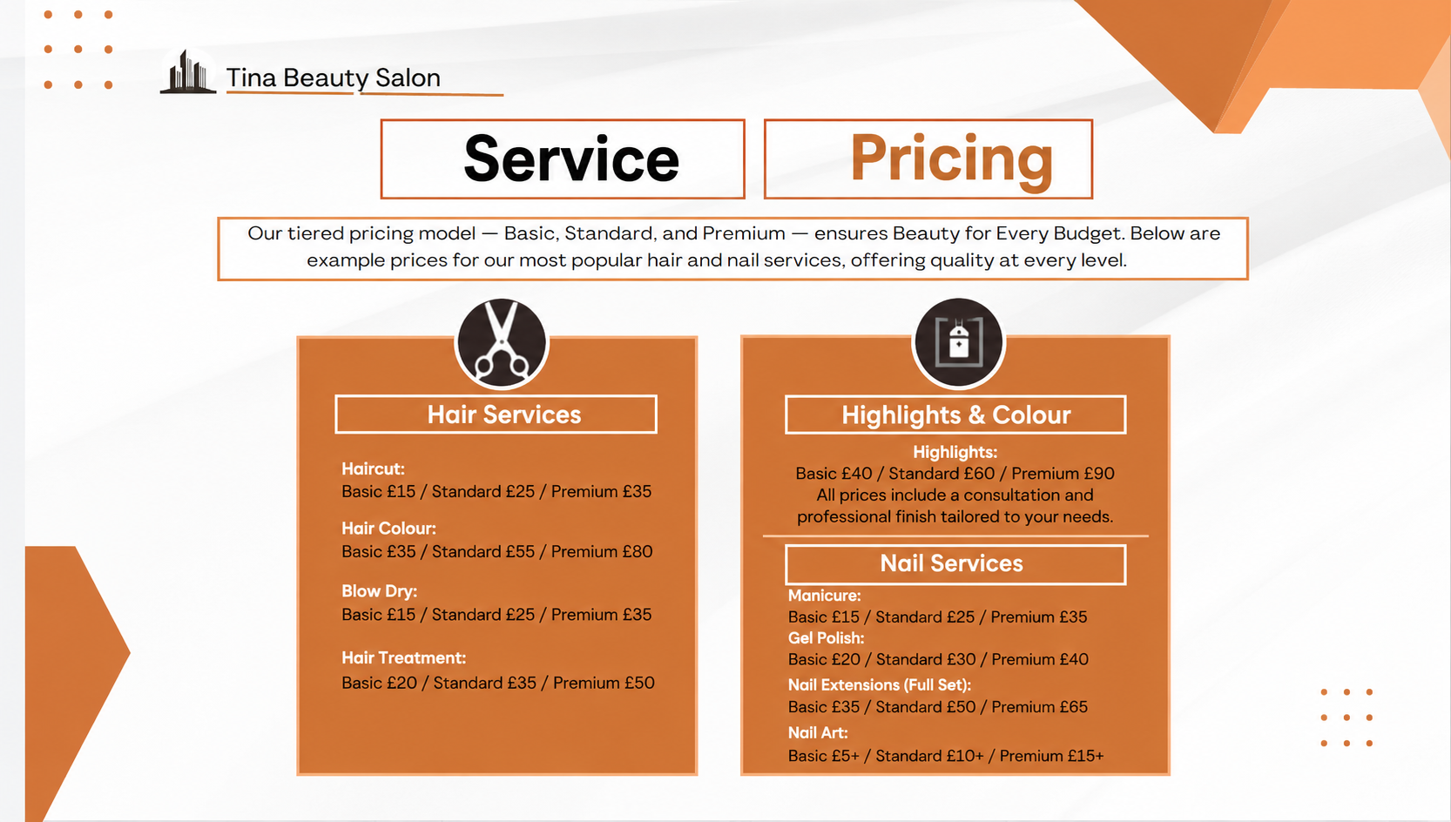


Slide 8
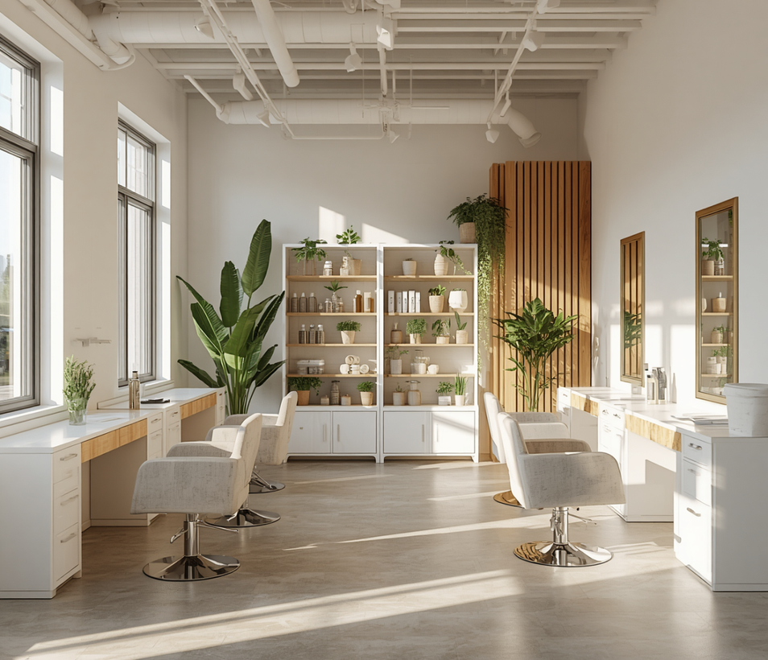
Vision & Future Outlook
Our vision is to become a trusted, affordable local salon that serves every member of the community. By offering tiered pricing — Basic, Standard, and Premium — we ensure that quality beauty services remain accessible to all, regardless of budget.
We are committed to inclusivity, customer trust, and environmental responsibility. Tina Beauty Salon will operate using cruelty-free products, implement recycling practices, and use energy-efficient LED lighting to minimise our environmental footprint.
Looking ahead, we plan to grow our loyal client base, deepen community engagement through local partnerships and student outreach, and expand our service offerings — building a salon that the community is proud to call their own.

Slide 9
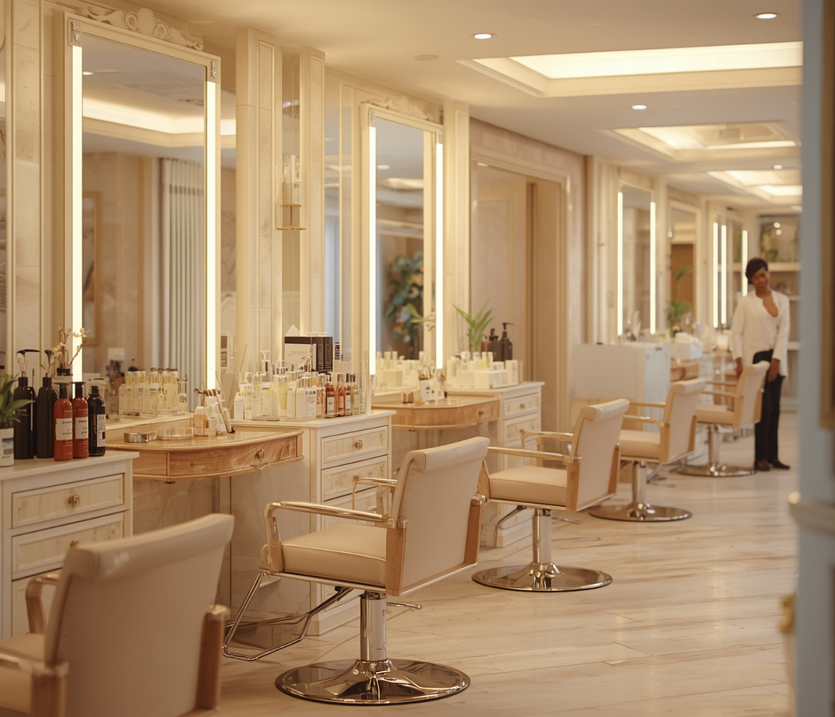
THANK YOU!
Questions & Discussion Welcome
Presented By:
Date:
Florentina Tifachi (2514649)
11.08.2026

