Slide 1

BMHP5004 CHILDREN, YOUNG PEOPLE AND FAMILIES
Lecturer Dr Muhammad Hossain
Case study – group presentation
Group 7
Alina Elena Radu 2018723
Sanah Ellahi 2019343
Elena Vasinc 2016813
Sabina Masih 2015962
Ophelia Chase 2020346

Slide 2

Introduction
We will be addressing and discussing John’s case study. John who suffered with complex health needs has had a sudden death in epilepsy. We will be looking at the key domains of perception of well-being of John and his mother.
We will discuss the importance's of polices and professional interventions that could have taken place by use of multi-disciplinary services to meet diverse needs of children, young people and family's well-being.
Many health care professionals had concerns of John’s health and at the time of John’s death he had a Child In Need Plan. John's mother was mostly involved in his care needs and medical care which impacted the health of John and what professional could have done to reduce the risks of his death and preventions for the similar situations in the future.

Slide 3

Perception of well-being
“Every Child Matters, 2003:
• to be healthy;
• to be safe;
• to enjoy and achieve;
• making a constructive contribution;
• financial well-being.”
“Well-being”- a broad concept
“Children and Families Act, 2014:
physical and mental health and emotional well-being;
protection from abuse and neglect;
control by them over their day-to-day lives;
participation in education, training or recreation;
social and economic well-being;
domestic, family and personal relationships;
the contribution made by them to society.”
(Gov.uk, 2003)
(Gov.uk, 2014)
(Free Pik, 2022)

Slide 4
Key domains of children and young people’s well-being
Childhood well-being is often understood as the quality of life of children and young people, as well as educational resources, health but also happiness and joy.
Different aspects such as needs, poverty, quality of life, ignorance, physical illness, social exclusion divide well-being into five different domains: physical, financial, emotional, social and intellectual.
Various laws, programs, conventions such as Children’s Rights, UNICEF, United Nations Conventions on the Rights of the Child (UNCRC), Multi-national projects for monitoring and measuring children’s well-being come to the aid of children and families to provide support and guidance.
From our case study we understand that John was part of o program to help children in need, what is very good, but we also find that health care professionals did not do their job well. On the other hand, it is good for the family to be in involved, but not when the parents’ problems neglect the patient’s needs.

Slide 5

Analysis of the rationale of the case study what policies and professional interventions are in place
In this case study, John the child of 15 years old passed away due to Epilepsy and he had other disabilities too.
His mother was a patient of such mental disorders as well, but his father was not concerned about them at all.
It becomes a civil challenge towards the mother of John as she has to manage her physical disabilities along with her son.

Slide 6


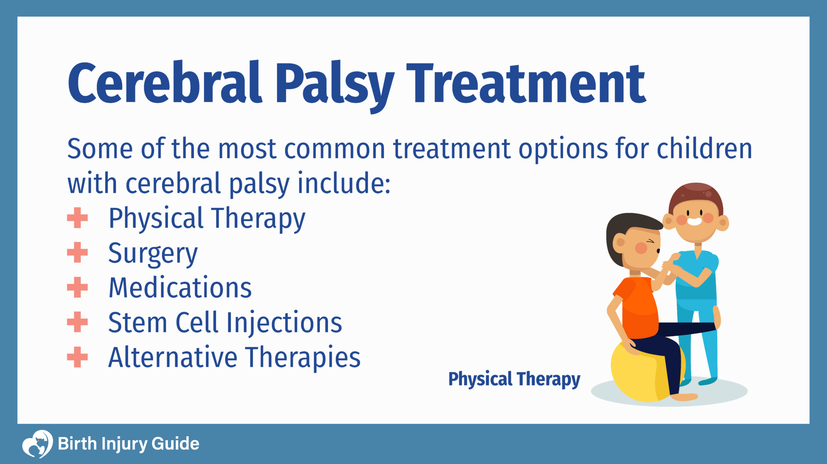
Discuss and evaluate current policy and the professional interventions
Notes:
As you already know John was 15 years old and had many complex health needs, his cerebral palsy was severe and also suffered from epilepsy. When John passed away a sudden death in childhood was held otherwise known as SUDIC this is a sudden unexpected death of a child between the age 1 to 18 which remains unexplained after a thorough investigation is conducted. The death was caused by sudden unexpected death in epilepsy (SUDEP). There is a lot of help and support for children that suffer from health needs but it is also a lot of work, caring for a child is hard enough but if the child has special needs it is much more pressure ensuring that you make sure that they getting all the possible help they need. There are early interventions that a child can get which include speech therapy, occupational therapy, psychological counselling, vision therapy, and physical therapy, this aims to prevent problems occurring, or to tackle them head on when they do, before getting any worse.

Slide 7
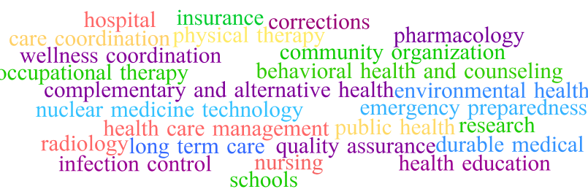
Notes:
All organisations that work with or come into contact with children should have safeguarding policies and procedures to ensure that every child, regardless of their age, disability, gender reassignment, race, religion or belief, sex, or sexual orientation, has a right to equal protection from harm. The 2018 guidance working together to safeguard children defines it as:
Protecting children from maltreatment
Preventing impairment of children's health or development
Ensuring that children are growing up in circumstances consistent with the provision of safe and effective care
Taking action to enable all children to have the best outcomes
Safeguarding, in essence, is about protecting children, not from everything but from unnecessary risk and harm (Haye 2019).

Slide 8

Conclusion
Health and care services are organised and coordinated by multidisciplinary and interdisciplinary teams in order to meet the needs of those with complex care needs such as John. As a team, different professional contribute the expertise and skills to assess, plan and manage the care using person-centred and Child Protection Act by social workers, occupational therapist and other professionals involved. Using attributes for collective practise, clear communication, clear definition of tasks and responsibilities, using goals and objectives and strategies.

Slide 9
References
Centres for Disease Control and Prevention, (2022), Well-Being Concepts, Available at: https://www.cdc.gov/hrqol/wellbeing.htm#three, [Accessed: 20/02/2022].
Cline, M. (2022), Cerebral Palsy from Birth injury, Birth Injury Guide, 03 January 2022. Available at https://www.birthinjuryguide.org/birth-injury-types/cerebral-palsy/
Free Pik, (2022), Well being images, Available at: https://www.freepik.com/free-photos-vectors/wellbeing, [Accessed: 24/02/2022].
Gov.uk (2022), Every child matters 2003, Available at: https://assets.publishing.service.gov.uk/government/uploads/system/uploads/attachment_data/file/272064/5860.pdf [Accessed: 25/02/2022]
Gov.uk (2014), Children and Families Act 2014, Available at: https://www.legislation.gov.uk/ukpga/2014/6/section/76/enacted [Accessed: 01.03.2022]
Gov.uk (2022), Using the Care Act guidance, Available at: https://www.gov.uk/government/publications/care-act-statutory-guidance/care-and-support-statutory-guidance [Accessed: 01.03.2022]
Green, P., (2020). Risks to children and young people during a covid-19 pandemic. Bmj, 369.
Haye, M. (2019) Safeguarding children with SEND: What parents need to know, Special Needs Jungle, 22 November 2019. Available at https://www.specialneedsjungle.com/safeguarding-and-children-with-send-what-parents-need-to-know/ [Accessed 17/02/2022]
Jerrim, J., (2021). National tests and the wellbeing of primary school pupils: new evidence from the UK. Assessment in Education: Principles, Policy & Practice, pp.1-38.
Kings Fund, (2019). What’s your problem, social care? The eight key areas for reform. Available at: https://www.kingsfund.org.uk/publications/whats-your-problem-social-care. [Accessed 17/02/2022].
Kvc, (2022) What Contributes to Child Wellbeing? Available at: https://www.kvc.org/blog/4-state-specific-factors-that-affect-a-childs-wellbeing/ [Accessed: 21/02/2022]
Mental Health, (2022) Children, young people and families, Available at: https://www.mentalhealth.org.uk/our-work/children-young-people-and-families [Accessed: 21/02/2022]
NSW Health (2014). Multidisciplinary Team Care. Available at: https://www.health.nsw.gov.au/healthone/Pages/multidisciplinary-team-care.aspx. [Accessed 17/02/2022].
Statham J.& Chase E. (2010) Childhood Wellbeing Research Centre, Available at: https://assets.publishing.service.gov.uk/government/uploads/system/uploads/attachment_data/file/183197/Child-Wellbeing-Brief.pdf [Accessed: 24/02/2022].
Taberna, M., Gil Moncayo, F., Jané-Salas, E., Antonio, M., Arribas, L., Vilajosana, E., Peralvez Torres, E. and Mesía, R. (2020). The Multidisciplinary Team (MDT) Approach and Quality of Care. Frontiers in Oncology, Available at: https://www.ncbi.nlm.nih.gov/pmc/articles/PMC7100151/. [Accessed 17/02/2022].
THM Training. (n.d.). Health and Social Care Courses. [online] Available at: https://www.thmtraining.co.uk/health-and-social-care-courses/ [Accessed 17/02/2022].
Wood M.& Selwyn J. (2017) Looked after children and young people’s views on what matters to their subjective well-being, Available at: https://journals.sagepub.com/doi/abs/10.1177/0308575916686034 [Accessed: 24/02/2022].

