Slide 1
Design Toolkit
Systematic Idea Isolation
Decision/Pugh Matrix

Slide 2
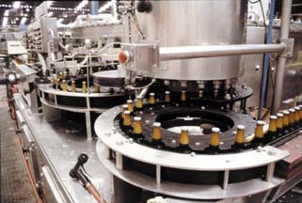
Synthesis, Comparison & Evaluation (Example)
By way of an example we will consider the following design problem:
A brewery is producing large quantities of bottled beer, bottling occurs ‘on site’. In an effort to maintain quality control the bottles are weighed to ensure that a specified quantity of beer has been injected. Due to problems with the current bottling process, a small number of bottles do not meet the required standard and must consequently be rejected from the conveyor belt .

Slide 3
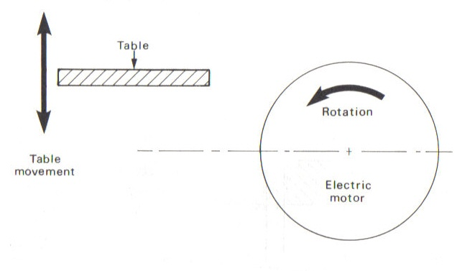
Synthesis, Comparison & Evaluation (Example)
  Another member of the production engineering design team has designed and installed a system that is able to determine if a bottle has less beer in it than it should. In this event it sends a signal causing an electric stepper motor’s output shaft to rotate through 360° (see diagram)
  You have been given the task of designing a mechanism which will, using the 360° rotation of the stepper motor output shaft, reciprocate a table thus rejecting the bottle in question.

Slide 4
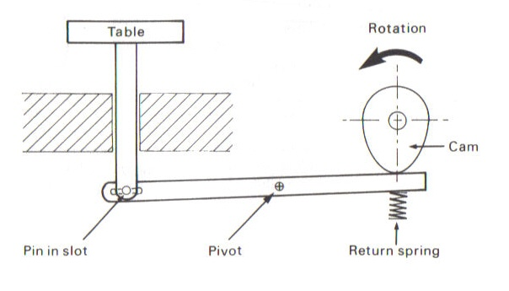
Design A
A cam has been attached to the output shaft of the stepper motor
A beam is pivoted about a central location
A return spring is used to ensure that the beam follows the motion of the cam lobe
A slot & pin has been used to transmit the motion of the beam to the table

Slide 5
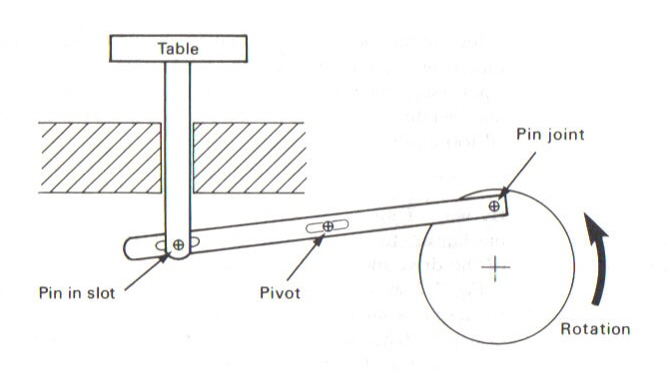
Design B
A wheel or disc has been mounted onto the output shaft of the stepper motor
To accommodate the increased range of motion of the beams pivot point, the hole has been elongated
A slot & pin has been used to transmit the beams motion to the table

Slide 6
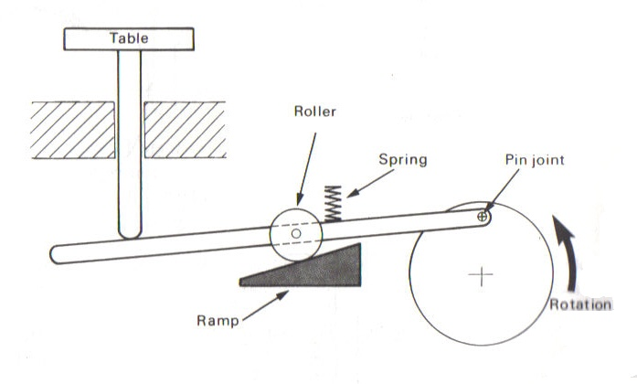
Design C
This design uses a wheel or disc mounted onto the output shaft of the stepper motor to transmit the rotary motion of the motor to the beam
A mechanism comprising of a spring, roller and a ramp has been used to pivot the beam at its centre
The motion of the beam is transmitted to the table via a sliding contact between the two components
This mechanism relies on gravity to return the table to its lowest position

Slide 7
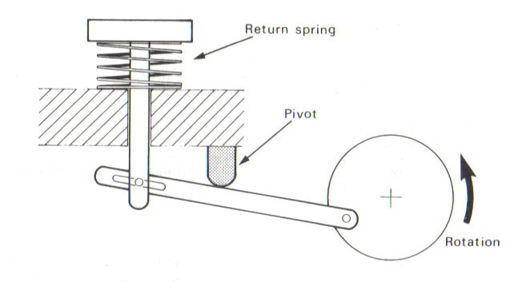
Design D
Design D uses a wheel or disc to transmit the rotary motion of the stepper motor to the beam
An inverted projection is used to pivot the beam
A return spring is used to counteract the effect of gravity on the table
The beam is attached to the table via a pin & slot

Slide 8
Design Feature Ratings
Feature | Design A | Design B | Design C | Design D
Fulfilment of function | High | High | High | High
Reliability | Medium | High | Low | Low
Serviceability | Medium | Medium | Medium | Low
Life | Low | Medium | Low | Low
Ease of maintenance | Medium | Medium | Medium | Low
Ease of manufacture | Medium | High | Low | Low
Efficiency of operation | Low | Medium | Low | Low
Simplicity of layout | Medium | High | Low | Low
Cost | Moderate | Cheap | Moderate | Expensive

Slide 9
The Resulting Scores for Each Design
 | Design A | Design B | Design C | Design D
High | 1 | 4 | 1 | 1
Medium | 5 | 4 | 2 | 0
Low | 2 | 0 | 5 | 7
Cost | Mod | Cheap | Mod | Exp
Design B has more ratings in the high/medium category than the other designs
The cost is also favourable due to the simplicity of the design
The terms high, medium & low may vary from person to person. They should therefore be used as objectively as possible.

Slide 10
Design Feature Ratings
A More Detailed Grading Structure
Feature | Design A | Design B | Design C | Design D
Fulfilment of function | 10 | 10 | 10 | 10
Reliability | 6 | 8 | 3 | 2
Serviceability | 4 | 6 | 5 | 1
Life | 3 | 7 | 3 | 2
Ease of maintenance | 5 | 6 | 5 | 3
Ease of manufacture | 6 | 9 | 3 | 2
Efficiency of operation | 2 | 5 | 1 | 1
Simplicity of layout | 5 | 8 | 2 | 1
Cost | 5 | 8 | 6 | 2

Slide 11
Design Feature Ratings
Applying Weightings to the Selection Criteria
Feature | Weighting | Design A | Design B | Design C | Design D
Fulfilment of function | 3 | 10 | 10 | 10 | 10
Reliability | 3 | 6 | 8 | 3 | 2
Serviceability | 2 | 4 | 6 | 5 | 1
Life | 2 | 3 | 7 | 3 | 2
Ease of maintenance | 2 | 5 | 6 | 5 | 3
Ease of manufacture | 1 | 6 | 9 | 3 | 2
Efficiency of operation | 1 | 2 | 5 | 1 | 1
Simplicity of layout | 1 | 5 | 8 | 2 | 1
Cost | 2 | 5 | 8 | 6 | 2

Slide 12
Design Feature Ratings
Applying Weightings to the Selection Criteria
Feature | Weighting | Design A | Design B | Design C | Design D
Fulfilment of function | 3 | 30 | 30 | 30 | 30
Reliability | 3 | 18 | 24 | 9 | 6
Serviceability | 2 | 8 | 12 | 10 | 2
Life | 2 | 6 | 14 | 6 | 4
Ease of maintenance | 2 | 10 | 12 | 10 | 6
Ease of manufacture | 1 | 6 | 9 | 3 | 2
Efficiency of operation | 1 | 2 | 5 | 1 | 1
Simplicity of layout | 1 | 5 | 8 | 2 | 1
Cost | 2 | 10 | 16 | 12 | 4
Design total weighted ratings |  | 95 | 130 | 83 | 56

Slide 13
Design Feature Ratings
A More Detailed Grading Structure
It is important to define how you are going to award/allocate points to each of the selection criteria.
Criteria such as weight and cost are relatively simple to define.
Criteria such as ease of use, manufacturability or aesthetics may require more complex definitions.
Cost
Value (£) | 0 - 1 | 1 - 2 | 2 - 3 | 3 - 4 | 4 - 5 | 5 –6 | 6 –7 | 7 –8 | 8 –9 | 9 – 10 | <10
Point Score | 10 | 9 | 8 | 7 | 6 | 5 | 4 | 3 | 2 | 1 | 0

