Slide 1

Communication Problems at
Flight Foods Ltd
A Case Study Analysis on Organizational Dynamics, Communication Barriers, and Workplace Solutions
Group Presentation
Student ID & Names :
Vali Bariz (2235648)
Moussa Camara (2533146)
Mihai Anton Hrit Hreniu (2530657)
Misha Akhvlediani (2530047)

Slide 2
Overview
Introduction to Flight Food Ltd (Moussa)
Communication barriers identified:
1. Environmental Noise (Moussa)
2. Language/Communication/Body language (Misha)
3. Age/Generational Differences (Misha)
4. Cultural (standards and practices) (Vali)
5. Emotional (Vali)
Recommendations (Mihai)
Conclusion (Mihai)
References

Slide 3



Case Overview & Core Issues (Moussa)
Company Profile
Quality Failures
Environment
Flight Foods Ltd is a medium-sized manufacturer producing ready meals for major airlines. The company is currently losing market share due to critical food standard complaints and operational breakdowns.
Severe airline client complaints including under-cooked meals, poor packaging standards, and dangerous cross-contamination (e.g., meat discovered in vegetarian meals).
A factory floor with 40 workers across 5 distinct cultural groups. High language barriers, complete lack of pre-job hygiene training, and severe noise from old machinery.
(Flight foods Ltd, 2026)

Slide 4


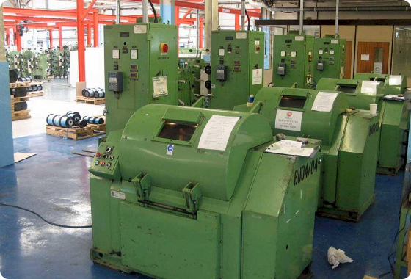
Barrier 1: Environmental Noise (Moussa)
Physical Channel Interference: Old, noisy, and clanking factory machinery creates intense physical channel noise on the plant floor.
Acoustic Breakdown: The ambient sound level routinely masks oral instructions given by Floor Manager Gary.
Theoretical Framing (Berlo, 1980): Physical environmental noise disrupts the transmission medium, causing severe message distortion before reception.

Slide 5


Barrier 2: Language & Decoding (Misha)
Minimal English Proficiency: The workforce speaks very limited English, rendering verbal orders ineffective.
Ineffective Signage: Plastered text signs fail because workers lack the language skills required to decode written instructions.
Theoretical Framing (Schramm): Absence of a shared "Field of Experience" prevents accurate message encoding and decoding between management and staff.

Slide 6



Barrier 3: Generational Disparities (Misha)
Older Demographic (Up to 60 yrs)
Younger Demographic (16+ yrs)
Older employees rely heavily on established informal communication norms and implicit workplace culture, often bypassing newer procedures due to long-standing habits.
Younger, inexperienced hires require structured formal training and clear feedback loops. Lacking guidance, they struggle to grasp baseline hygiene standards.

Slide 7

Barrier 4: Cultural Standards (Vali)
Diversity Breakdown
Theoretical Framing (Hofstede, 1980)
The workforce consists of 5 distinct cultural groups, each operating under different implicit workplace practices and power distance expectations.
Varying cultural dimensions impact how authority is perceived and how compliance is enacted, leading to inconsistent hygiene standard adoption across teams.

Slide 8

Barrier 5: Emotional Barriers (Vali)
Managerial Stress & Fatigue
Floor Manager Gary suffers from acute sleep deprivation and extreme pressure, leading to volatile verbal outbursts (e.g., calling staff "Idiots!").
Eroded Leadership Trust
Hypocritical hygiene behavior by management and hostile emotional outbursts destroy psychological safety, shutting down two-way operational communication.

Slide 9

Barrier 6: Transmission Noise
Production Pressure
Message Fidelity Loss
Urgent client deadlines cause management to rush new hires directly onto the active production floor without formal orientation or hygiene induction.
Bypassing formal training channels causes immediate decay in operational message fidelity, leaving workers without basic procedural knowledge.

Slide 10

Strategic Recommendations (Mihai)
Mandatory Onboarding: Enforce mandatory pre-job Food Hygiene induction prior to floor placement.
Multilingual Pictograms: Replace text-heavy posters with visual infographics and multilingual signs (Schramm, 1954).
Noise Mitigation: Maintain machinery and install acoustic baffles to restore verbal channel clarity (Berlo , 1980).
Leadership Training: Provide Manager Gary with cross-cultural leadership and stress management coaching.

Slide 11

Conclusion (Mihai)
Flight Foods Ltd's quality operational crisis stems primarily from systemic communication failures rather than deliberate worker negligence.
Noise Reduction: Addressing mechanical sound fixes physical channel noise (Berlo, 1960).
Visual Communication: Multilingual pictograms align overlapping fields of experience (Schramm, 1954).
Leadership Accountability: Modeling proper hygiene and emotional composure restores trust across diverse teams (Hofstede, 1980).

Slide 12

References
Berlo, D. K. (1960). The Process of Communication: An Introduction to Theory and Practice. New York: Holt, Rinehart and Winston.
•
Hofstede, G. (1980). Culture's Consequences: International Differences in Work-Related Values. Beverly Hills, CA: Sage Publications.
•
Schramm, W. (1954). How Communication Works. Urbana, IL: University of Illinois Press.
•
Shannon, C. E., & Weaver, W. (1949). The Mathematical Theory of Communication. Urbana, IL: University of Illinois Press.
•

Slide 13


