Slide 1
BA International Hotel Management
Business Skills for International Hotel Industry
(M4X01917)
Communication and Importance of Communication Skills in Hospitality Organisations

Slide 2

So far…..
We have..
Overview the module
We have set class rules
Explored SWOT Analysis
Discussed PDP

Slide 3
In this session, we will discuss…
Communication and Importance of Communication Skills in Hospitality Organisations

Slide 4
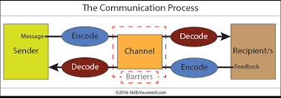
First, What is communication?
The exchange of thoughts, information, or ideas that results in mutual understanding between two or more people.
The process requires at least one sender, one receiver, and message that is transmitted within a communication medium.

Slide 5
Types of organisational communication
Every organisation must enable communication in several directions;
Vertical Communication
Horizontal Communication
Diagonal Communication

Slide 6
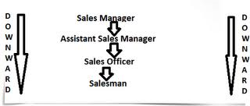
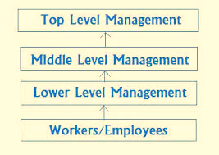
Vertical Communication
Downward Communication
It is the formal communication in which the line of authority starts from the top and extends to the lowest level.
In companies with extremely authoritative style of management (Weihrich, Koontz, 1993).
The oldest to types of communication.
Seniors, superiors or elder ones give some information, advice, counseling, suggestion, instruction, order or warning to their juniors, subordinates or younger ones.
An integral part of the traditional organisation.
Still the most frequently used channel in the organisation.
It may be oral, written, visuals and by electronic devices.
Upward Communication
Communication flows from down to upward, i. e. from subordinates to superior levels.
Either in the nature of feedback or in the nature of original thoughts and suggestions at the initiative of the lower levels.
The communication are invited from the lower levels.
The subordinates convey their actions, attitudes and opinions about varied subjects of vital concern to their superiors.
Upward communication is often communicated for decision making purposes. Subordinates pass information about progress and problems to superiors so that superiors i.e. Management can decide what to do and when to do.

Slide 7
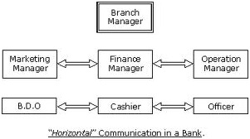
Horizontal Communication
It is the formal/ informal exchange of ideas between different individuals/departments at the same level of hierarchy in the organisation.
Advantages:
Encourages free information exchange.
Higher information flow between departments is necessary.
Makes an atmosphere where employees are comfortable to talk to people in different departments and gain from their learning.
Disadvantage:
Sometimes, horizontal communication leads to disputes between individuals/departments. In such cases higher officials have to step in to resolve the matter.

Slide 8
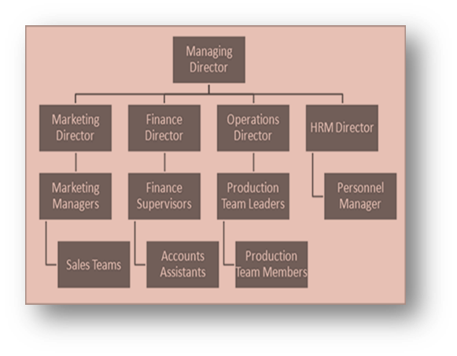
Diagonal Communication
Communication that takes place between a manager and employees of other workgroups is called diagonal communication.
It generally does not appear on organisational chart.
For instance - To design a training module a training manager interacts with an Operations personnel to enquire about the way they perform their task.

Slide 9
Methods of Communication in Organisations
Internal & External communication
  Internal communications happen within the business.
  External communications take place between the business and outside individuals or organisations.
Formal & Informal communication
  Formal communications are official messages sent by an organisation,
  eg a company memo, fax or report.
  Informal communications are unofficial messages not formally approved by the business, eg: everyday conversation or gossip between staff.
Verbal communication: face-to-face, telephone, radio or television and other media.
Nonverbal communication: eye movements, gestures, facial expressions.

Slide 10
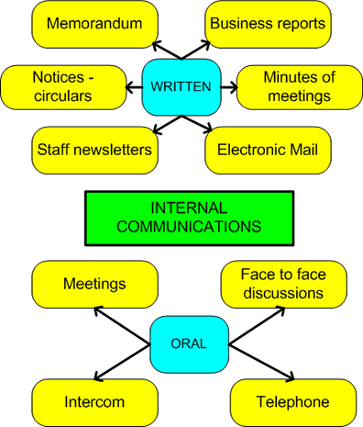
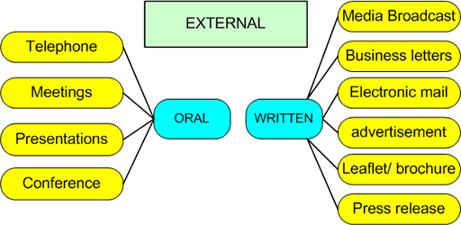
Channels of communication
Source: Taylor. S (1996)
Notes:
Discuss about the various stakeholders of an organisation.

Slide 11

WRITTEN COMMUNICATION IN BUSINESS
EFFECTIVE BUSINESS COMMUNICATION DOCUMENTS:
EXERCISE:
NAME AND EXPLAIN THE PURPOSES OF FIVE EFFECTIVE BUSINESS DOCUMENTS FOR COMMUNICATION YOU KNOW

Slide 12
PRINCIPLES OF WRITTEN COMMUNICATION IN BUSINESS
Business Writing: It is a form of business writing and technical writing. It can be both internal and external.
Examples include newsletters, memos, letters, proposals, power point presentation, reports, press release, fax, etc.
There are five key principles to effective business writing:
Clarity
Conciseness
Brevity
Awareness of audience
Appropriate tone
Attention to format
Emphasis

Slide 13
WRITTEN COMMUNICATION IN BUSINESS
Content Criteria for effective writing style:
Accuracy
  A high degree of accuracy often require considerable detail and qualification of the information
Brevity
  Text must be brief with unnecessary information the reader also knows.
Clarity
  Lack of clarity is often due to poor style and may be caused by stilted phrases and clichés; too much detail and repetition; lack of logical structure; and excessive use of abstract and generic terms.
Emphasis
  Emphasize important information, i.e. information that is important to the audience; and information that will support your arguments as writer.

Slide 14

GROUP EXERCISE:
The Letter in the next slide is not a good one for several reasons. Read the letter, state where the issues are, and produce a simplified and improved version of this letter

Slide 15
Dear Sir
Supply of Food Items to Macarana Restaurant
We are in receipt of your esteemed enquiry letter of the 22 Sept. ‘17 and subsequent communication with regard to the estimate you require for the supply of weekly delivery of 50 carton of chicken, 20 gallons of cooking oil 150 crates of organic egg, 50 packets of table salt, 10 packs of chopping stick, and daily supply of 10 carton of sea food to your restaurant at 235 Malami Dorovia Rd.
We wish to confirm the order for this items whereby our representative, Mr S Tilton, will be in your office at 10:00 hrs on 6th of Nov. ‘17 at the above-mentioned address, to meet with your supply manager to confirm the above-mentioned items with a view to avoid error in ordering and delivering of same.
We trust that your procurement manager will be available for us on the said date and time. We will then submit our quotation for your consideration and hope that we may be entrusted to undertake the aforementioned work. Our quotation will remain valid for seven days.
We will be able to deliver your order provided we receive your confirmation in writing in good timeous.
We beg for your cooperation in this regard.
Yours faithfully
Warner Gary
Supply Manager

Slide 16
Suggested errors in the letter
use of abbreviations e.g. 22 Sept. ’17, should have been written as September 22nd, 2017.
fuzzy facts. What precisely is meant by ‘subsequent communication’ and ‘timeous response’?
pompous words, e.g. ‘timeous’, ‘in receipt of’.

Slide 17
Communication Skills
Communication Skills are foundational for individual, team, and organisational success (Kinnick & Parton, 2005).
Oral communication and interpersonal skills are usually cited as the most important criteria in evaluating job candidates

Slide 18
Communication Skills
Interpersonal skills were mentioned more frequently than any other competency listed in classified ads for entry-level jobs in major metropolitan newspapers.

Slide 19
Communication Skills
Communication and interpersonal skills are vital requirements for future workers in the hotel and hospitality industry.

Slide 20

Summary
Can you explain;
Define communication?
The types of organisational communication?
Explain importance of communication skills in organisations?
Questions & Answers

Slide 21
References
Barrows, C., Powers, T. and Reynolds, D. (2012). Introduction to Management in the Hospitality Industry. Hoboken, New Jersey: Wiley.
Chehimi, N. (2014). The social web in the hotel industry. Wiesbaden: Springer Gabler.
Edery, D., Edery, D. and Mollick, E. (2009). Changing the game.
Kinnick, K., & Parton, S. (2005). Workplace communication: What The Apprentice teaches about communication skills. Business Communication Quarterly, 68, 429-456.
Wood, R. and Verginis, C. (1999). Accommodation management. London: International Thomson Business. Upper Saddle River, N.J.: FT Press.

