Slide 1

Contemporary Technologies

Slide 2

Activity 1- Digital Literacy Poll
Click on the following link to take you to the poll
https://www.menti.com/al9goyaddpsw
Reflect on your own experiences and consider how digital technology might affect health and social care in the future.

Slide 3

Digital Age
Nowadays, commonly referred to as the ‘digital era or age’(Selwyn and Facer, 2014; Redshaw, 2019), people are immersed within a vast array of digital technologies.
The Covid 19 Pandemic accelerated digitalisation (José et al., 2021).
Society has become increasingly dependent on digital technology.

Slide 4
The Digital Divide
The pandemic brought a tide of ‘new normality’, which highlighted three main inequalities (the Digital Divide):
  Access
  Competencies
  Educational Outcomes
Sub-categories:
  Socioeconomic position
  Age
  Sex/Gender

Slide 5
The Global Digital Divide
Access to to digital technology has been rigorously examined by researchers (considering gender, age, ethnicity, education + SES).
On a Global Scale:
65% of women engage with the internet and digital platforms compared to 70% of males.
2.6 Billion people are digitally excluded worldwide.
A widening divide between developing and developed states is further excluding the worlds poorest from the fourth industrial revolution and new technologies.
This also hampers progress on the Sustainable Development Goals (SDGs),
(Statista, 2024; UN, 2023)

Slide 6
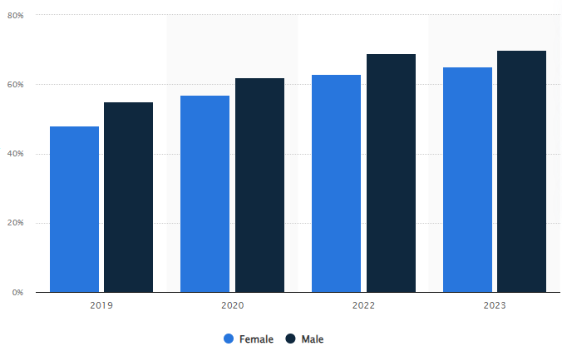
Percentage of Global Population Accessing the Internet From 2019 to 2023, By Gender
(Statista, 2024)

Slide 7
The UK Digital Divide
51% British households earning under £10,000 had insufficient access.
99% British households earning £40,000+ have access 10 million people in the UK lack the very basic foundation skills needed for our digital world.
Those who are marginalised through disability, gender, SES or ethnicity are more likely to be digitally excluded.
Those who are not online have difficulty accessing NHS and other essential services.
(GTF, 2024; Local Government Association, 2021)

Slide 8
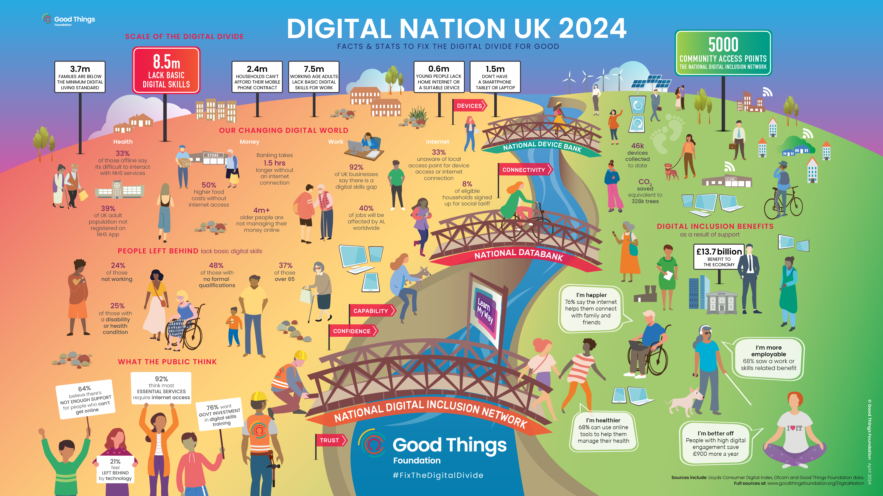
(GTF, 2024)

Slide 9

Wales Digital Literacy: Digital 2030 Strategy
To address the inequalities the WG and Post-16 sector developed the 2030 digital strategy:
Equip everyone with the right skills for a changing world
Support young people to make the most of their potential
Drive sustainable growth and combat climate change
Promote good health and wellbeing for everyone.

Slide 10

Digital Inclusion within Health and Social Care
According to the NHS, the incorporation of digitalisation can be crucial to achieving:
physical and mental wellbeing
prevention
self-care
shared care and shared decision making
long term condition management
appropriate use of urgent and emergency care
https://digital.nhs.uk/about-nhs-digital/corporate-information-and-documents/digital-inclusion/digital-inclusion-in-health-and-social-care

Slide 11

Contemporary technology within H+SC
Personal health records (PHR’s) were traditionally paper based:
Electronic Health Records: (HER’s) or Electronic Personal Health Records: (EPHR,s):
offer the opportunity for……
Empowerment
Increased accessibility
Promote digital literacy
Assist H+SC professionals to work collaboratively
Increase productivity in both NHS and SC sector.
(The Health Foundation, 2024; Nuffield Trust, 2007)

Slide 12
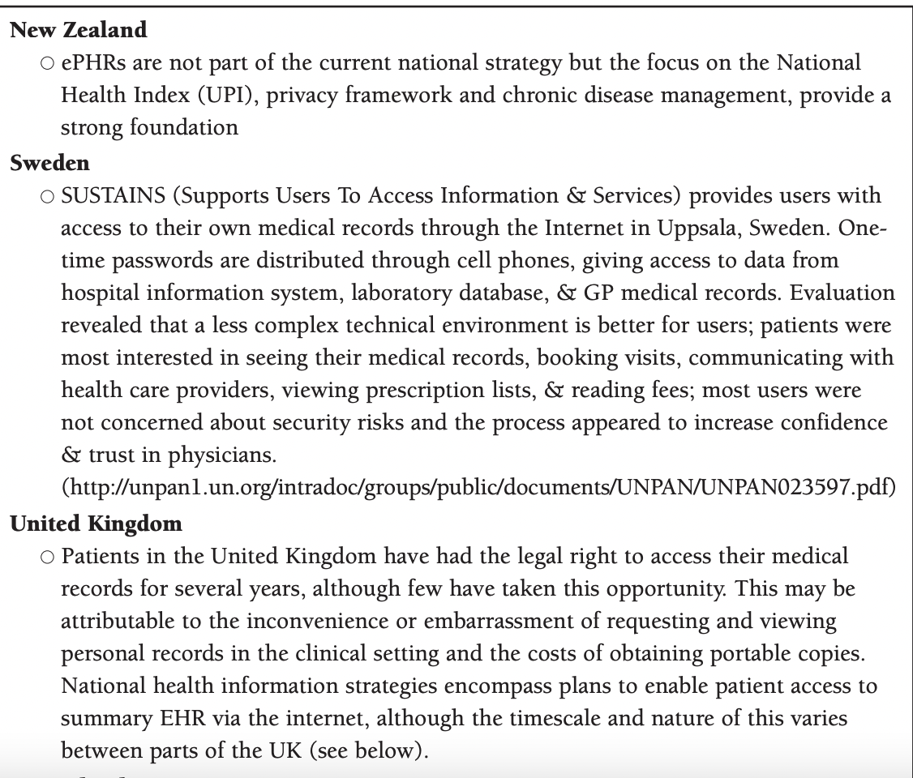

Slide 13
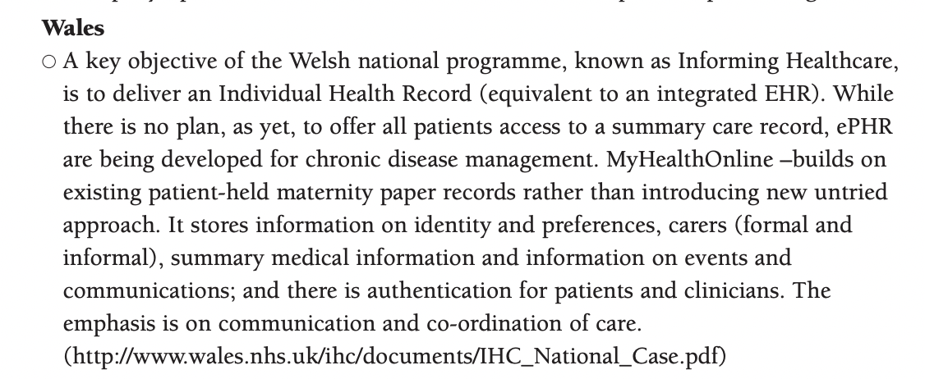

Slide 15

Testimony on EPHR

Slide 16


Slide 17

Telehealth and Telemedicine
Telehealth or Telehealth can be considered as providing healthcare remotely using digital technology (Olla and Tan, 2009).
Transferring medical data
Consultations
Monitoring diagnosis
Treatment and Education

Slide 18

Telehealth and Telemedicine
The Covid-19 pandemic accelerated the development and adoption of digital technologies to delivery health services widely and efficiently.
Streamline/ Triage
Free space for acute conditions within hospitals
Prevent infection transmissions
NHS:
NHS App
NHS login
e-prescription services.

Slide 19
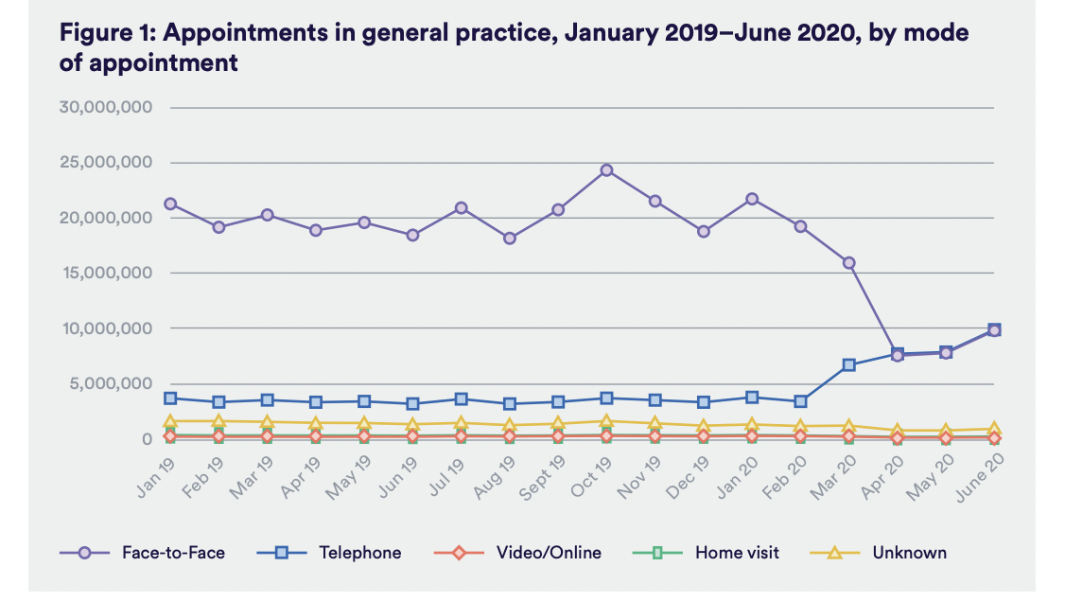
(Hitchings, 2020)
Notes:
https://www.nuffieldtrust.org.uk/sites/default/files/2020-08/the-impact-of-covid-19-on-the-use-of-digital-technology-in-the-nhs-web-2.pdf

Slide 20

Immersive Technology
AR - Augmented Reality: technology to superimpose digital elements (such as sounds, images, and text) to the world we see using a tablet, or a smartphone camera.
Virtual Reality is an immersive, three-dimensional, computer-generated environment which can be explored and interacted with by a person.
Mixed Reality is the merging of real and virtual worlds to produce new environments where both physical and digital objects co-exist and interact in real time.

Slide 21





Health Apps

Slide 22
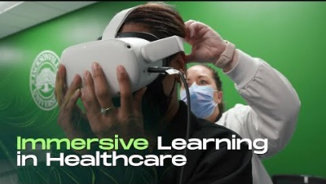
Immersive Technology Application

Slide 23

Artificial Intelligence and Dementia

Slide 24

Activity 2- Case Study
In small groups…
Look at the case study for Mr Jones
Consider the questions provided and discuss in your groups
Feedback to the class
You will find details on this activity in the week 4 tile on the Moodle page

Slide 25

Social Media
Hewson (2013, p.14 ), “outlines a person’s online activities, including their use of social networking platforms” (p. 14); A digital footprint is therefore created whenever we use networked technology.
Notes:
LinkedIn

Slide 26

Building an Online Reputation
Recruiters spend hours researching their networks, seeking out candidates and analysing profiles.
If you were in the market for a new job right now and they landed on your profile, or read your recent updates, would they be impressed?

Slide 27

Why is an Online Presence Important?
Return on Investment (ROI):
Building your reputation to gain gainful employment can be considered as
Return of Reputation (ROR):
Building your reputation and establishing new connections can lead yield opportunities.
(Phillips and Ellinas, 2014)
Notes:
Return on Investment: The more time you spend crafting an online reputation, the more likelihood of gaining traction.
Return of Reputation: Establishing meaningful connections can yield opportunities for collaboration.

Slide 28
Building an Online Reputation
Phillips and Ellinas (2014) advocates that people need to apply the ‘three Cs’ when attempting to develop their online reputation.
Clarity (Focus on key messages you want to share)
Consistency ( Apply consistent imagery and information)
Care (Be honest and authentic)

Slide 29

Blogs + Vlogs Road Map
Turning ideas into tangible SMART Goals
Specific: Narrow down vague goals to increase brand awareness (increase traffic to your blog)
Measurable: Numerical visits or replies
Achievable: Realistic goals within time restraints/ outreach.
Relevant: What will be useful for your brand? (Growing audience)
Time-bound. Time frames will help you to make an action plan

Slide 30

Blog Structure
A blog will have 4 elements:
Title/ Headline
Introduction
Main Body
Conclusion
Notes:
https://www.blogtyrant.com/blog-post-style/
Blogs are unconventional method of developing student’s academic writing skills.
Create an overall theme: and focus directly on that theme.
Incorporation of imagery and charts is useful to support written content as blogs are typically short.
Blogexamples: https://www.buzzlogic.com/blogging/examples-successful-blogs/
Research one.

Slide 31

Blog Examples
How to structure the perfect blog:
https://www.blogtyrant.com/blog-post-style/
Blog examples:
https://www.championingsocialcare.org.uk/blog/

Slide 32

Vlogging
Since the development of digital platforms like YouTube, vlogging (Video Blog) as been an accessible and creating method of providing informative information in creative ways.
Personal insight to your life
Insight to practice
Platform to share experiences
Platform to raise awareness

Slide 33


Podcasts
What is a podcast?
A podcast is an audio programme, just like Talk Radio, but you subscribe to it on your smartphone and listen to it whenever you like.
Purpose:
To entertain its audience.
Listeners might want to hear updates and breakdowns of current events
Podcasts Types:
Conversational ( Informal and topics are organically generated)
Narrative nonfiction (Long-form story telling)
Scripted fiction (Fictional entertainment such as TV and movies; episodic nature)
Repurposed content (repacking existing content)

Slide 34

How to Start a Podcast
https://www.smartpassiveincome.com/guide/how-to-start-a-podcast-tutorial-pat-flynn/

Slide 35
Task 3-Blog
Each of the eight tasks will be combined and submitted to form Assessment 1
Each student will need to think of a current topic or issue within the HSC sector and use an online platform to inform a specific target audience.
Students should present their findings in a Blog.
This should be approx 300-words in length.
You can include images/diagrams to support your claims.
You will find a more detailed copy of this task in the Week 4 Tile.

Slide 36
References
GTF (2024) Building a Digital Nation Available at: https://www.goodthingsfoundation.org/insights/building-a-digital-nation/ (Accessed: 27 May 2024).
Hitchings, R. (2020) The impact of Covid-19 on the use of digital technology in the NHS. London: Nuffield Trust.
National Health Service (2022) Why Digital Inclusion Matters to Health and Social Care. Available at: https://digital.nhs.uk/about-nhs-digital/corporate-information-and-documents/digital-inclusion/digital-inclusion-in-health-and-social-care (Accessed: 30 May 2024).
Olla, P. and Tan, J. (2009) Mobile Health Solutions for Biomedical Applications. London: Information Science Reference
Pagliari, C. Detmer, D. and Singleton, P. (2007) ELECTRONIC PERSONAL HEALTH RECORDS. London: Nuffield Trust.
PHILLIPS, S. and ELLINAS, S., 2014. Chapter 06: Building your reputation online. London: Kogan Page Ltd.
Spencer J and Oung C (2020) ‘How has lockdown affected general practice and where do we go from here?’. Nuffield Trust blog. Available at: www.nuffieldtrust.org.uk/news-item/how-has-lockdown-affectedgeneral-practice-and-where-do-we-go-from-here. (Accessed: 30 May 2024).
Statista (2024) Percentage of Global Population Accessing the Internet From 2019 to 2023, By Gender Available at: https://www.statista.com/statistics/1362981/share-of-internet-users-worldwide-by-gender/#:~:text=As%20of%202023%2C%20the%20share,male%20users%20was%2062%20percent. (Accessed: 25 May 2024).
The Health Foundation (2024) Which technologies offer the biggest opportunities to save time in the NHS? Available at: https://www.health.org.uk/publications/long-reads/which-technologies-offer-the-biggest-opportunities-to-save-time-in-the-nhs (Accessed: 30 May 2024).
UN. (2023) Widening Digital Gap between Developed, Developing States Threatening to Exclude World’s Poorest from Next Industrial Revolution, Speakers Tell Second Committee Available at: https://press.un.org/en/2023/gaef3587.doc.htm (Accessed: 30 May 2024).
Welsh Government (2019) Digital 30: A strategic framework for post-16 digital learning in Wales. Available at: https://gov.wales/sites/default/files/publications/2019-06/digital-2030-a-strategic-framework-for-post-16-digital-learning-in-wales.pdf (Accessed: 30 May 2024).

