Slide 1
INTRODUCTION TO PHYSIOLOGY
(BMHP5003)
THE SKELETAL SYSTEM

Slide 2
SESSION TWO (2HRS)
Lesson Objectives
By the end of the session students should be able to:
Explain the function of the skeleton.
Name the different types of the bones.
Describe the principles of joints and support systems.

Slide 3
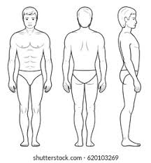
Anterior
Posterior
Lateral

Slide 4
INTRODUCTION
Bone is a hard, dense connective tissue that forms most of the adult skeleton, the support structure of the body.
In the areas of the skeleton where bones move, cartilage, a semi-rigid form of connective tissue, provides flexibility and smooth surfaces for movement.
Notes:
Dense : think
Semi rigid: Partly but not whole rigid

Slide 5
Activity #1
Label the diagram on Question 1 in the in-class Workbook Exercise Two (10 mins)
Let’s have a whole class discussion to feedback on our activity

Slide 6
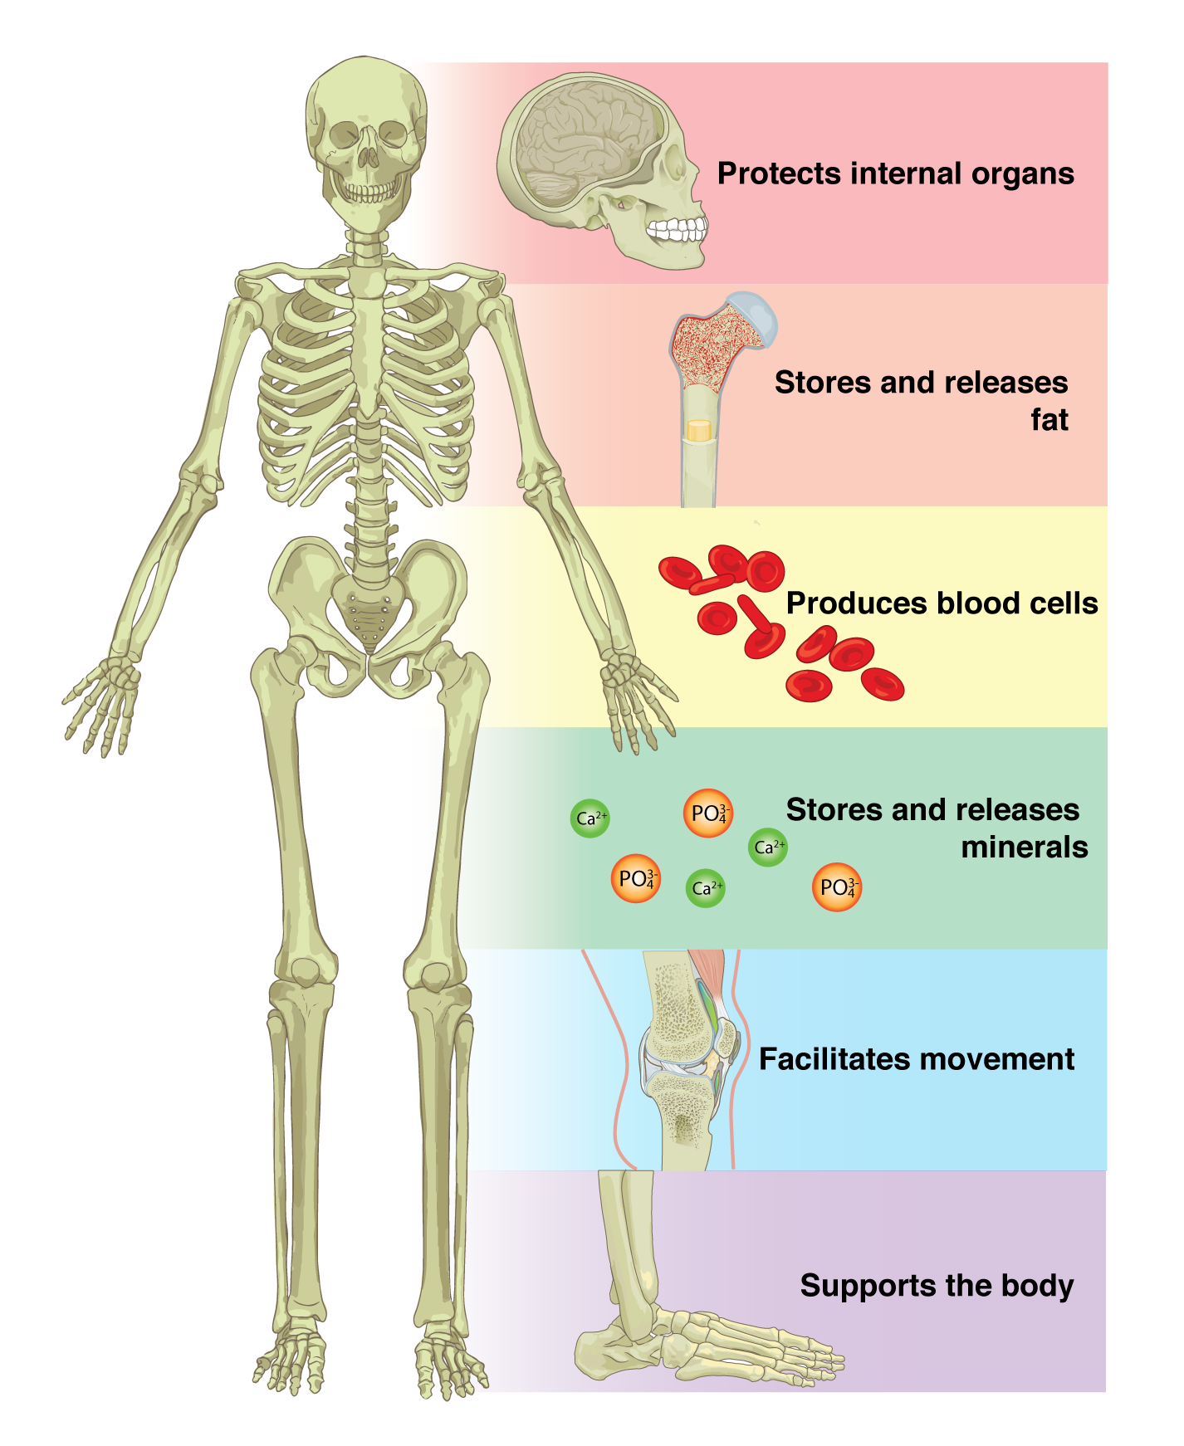
SKELETAL SYSTEM
Functions
Notes:
Stored calcium

Slide 7
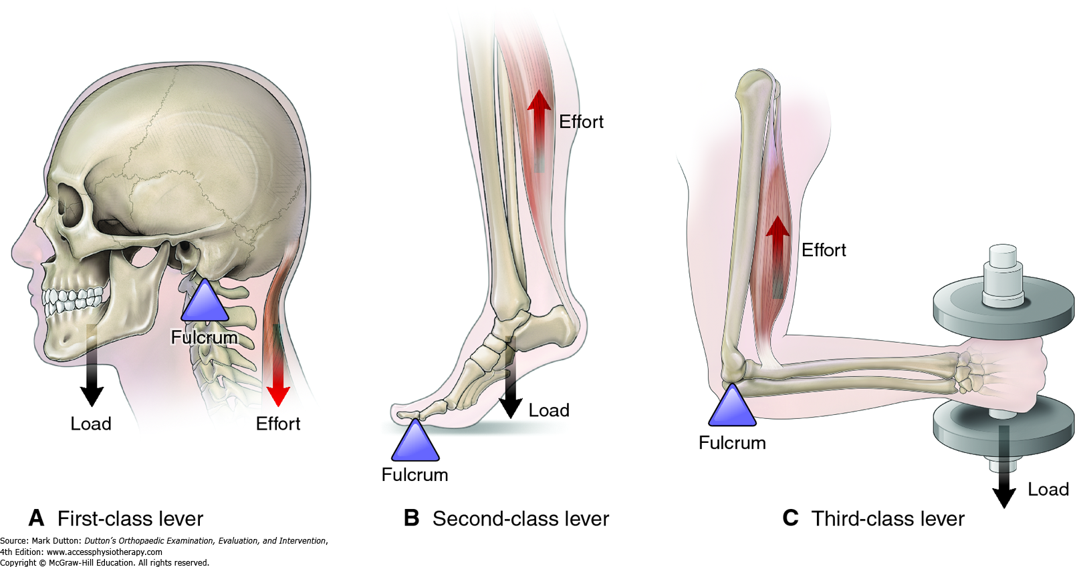
Support, Movement, and Protection
Bones support the rest of our body.
Facilitate movement by serving as points of attachment for your muscles.
some bones only serve as a support for the muscles
Other bones also transmit the forces produced when your muscles contract.
From a mechanical point of view, bones act as levers and joints serve as fulcrums.
Bones protect internal organs e.g. ribs protect the heart, while the vertebral column protects the spinal cord.
Notes:
In our bodies: bones act as lever arms. joints act as pivots. muscles provide the effort forces to move loads.
Fulcrum: on which it turns or is supported.
Lever:

Slide 8
Mineral Storage, Energy Storage, and Haematopoiesis
Bone serves as a reservoir for a number of minerals important to the functioning of the body, especially calcium, and phosphorus.
The can be released back into the bloodstream when needed.
Bone also serves as a site for fat storage and blood cell production.
Red blood cells, white blood cells, and platelets are all produced in the red bone marrow.
Notes:
reservoir : a place where something is kept in store

Slide 9
Skeletal System
How it Works
The Skeletal System made up of bones, cartilage, and connective tissue.
These all work together to make certain parts of the body that preform certain functions that are vital to human life.
Injuries/Diseases
The Skeletal System can come with some Injuries, such as breaking or fracturing a bone could count as a injury, a joint can also be dislocated or sprained.

Slide 10
Skeletal System
Relation to Sports
The Skeletal System can also relate to swimming and other sports like in swimming (freestyle) etc.
How it Interacts with the Other Systems
The Skeletal System also works with your Muscular System to:
protect and move you around
lift you up right so you don't fall to the ground while moving around
it also give you strength.

Slide 11
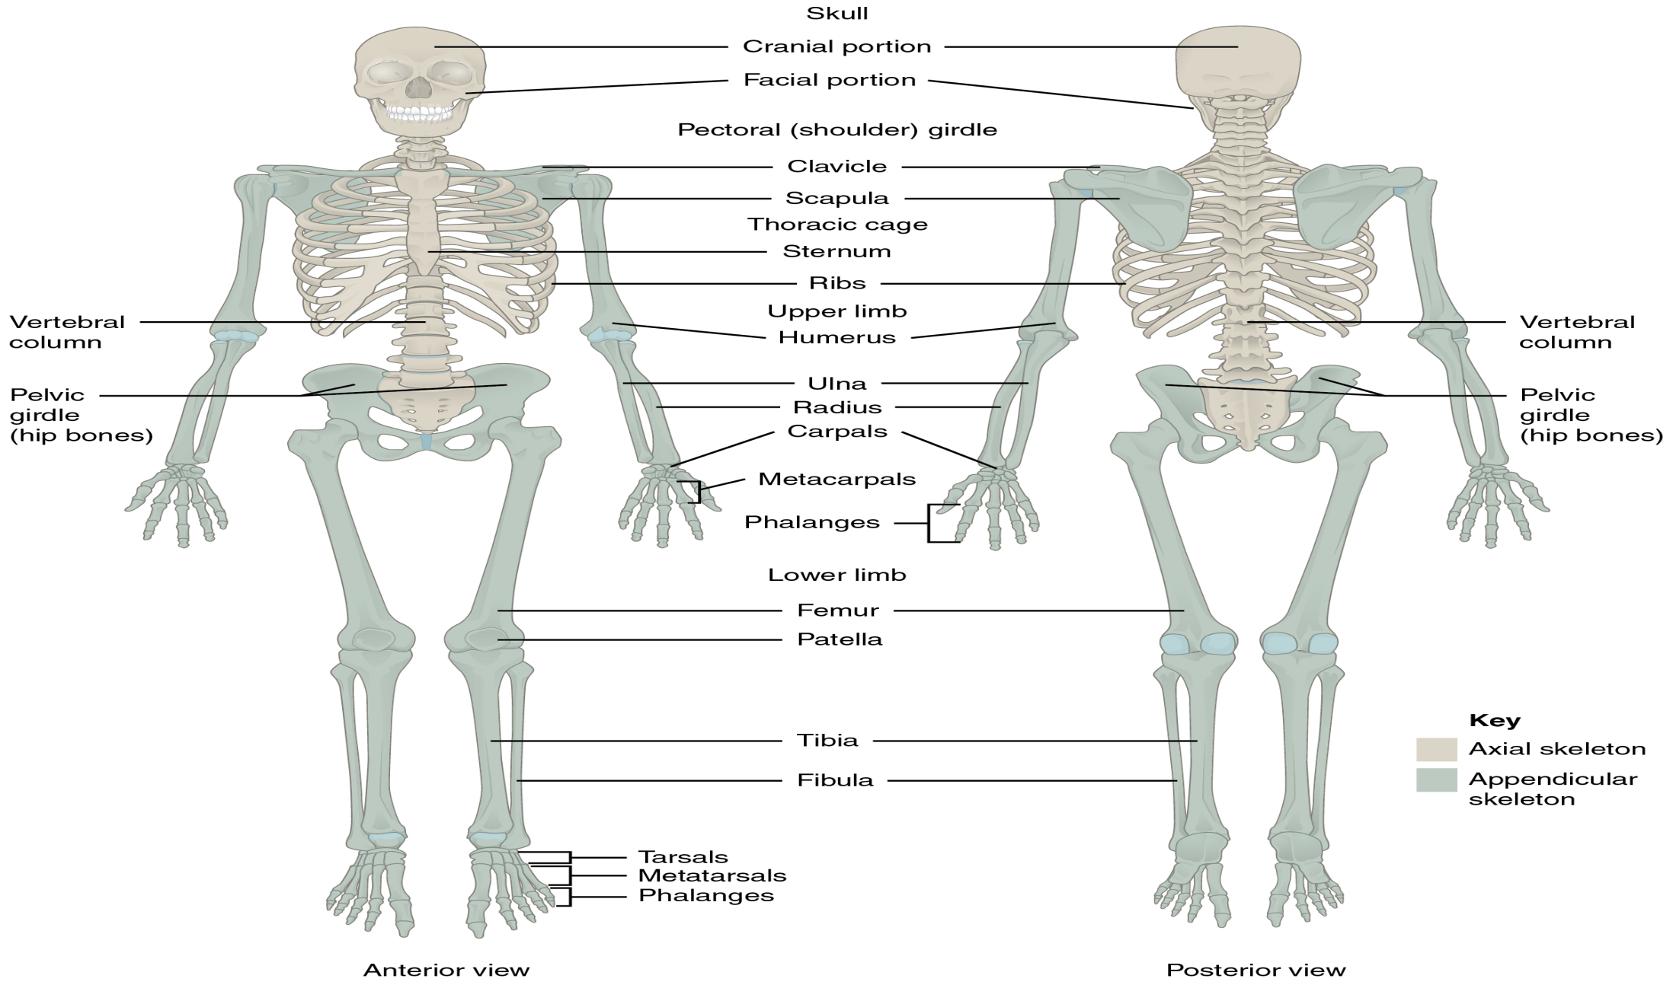
(https://opentextbc.ca/anatomyandphysiology/ )

Slide 12
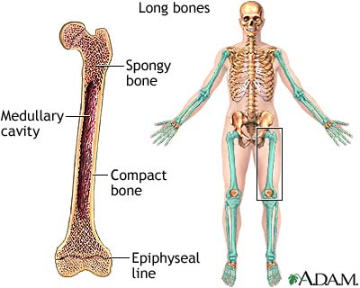
Types of Bones
Compact bone- also known as cortical bone, forms the cortex, or hard outer shell of most bones in the body.
The remainder of the bone is formed by cancellous or spongy bone. Which is the less harder part of the bone in which some physiological activities such as cell formation occurs.

Slide 13
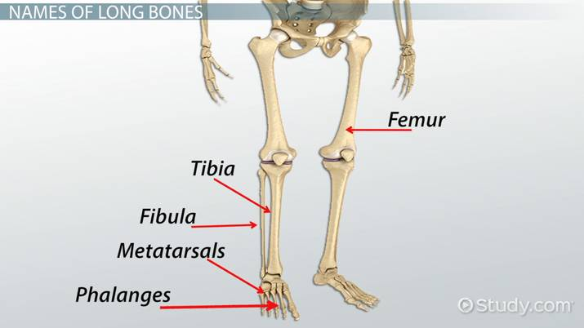
BONE CLASSIFICATION
Long Bones
A long bone is one that is cylindrical in shape, being longer than it is wide.
Long bones are found in the arms (humerus, ulna, radius) and legs (femur, tibia, fibula), as well as in the fingers (metacarpals, phalanges) and toes (metatarsals, phalanges).
Long bones function as levers; they move when muscles contract.
Notes:
Muscle contraction is the tightening, shortening, or lengthening of muscles when you do some activity

Slide 14
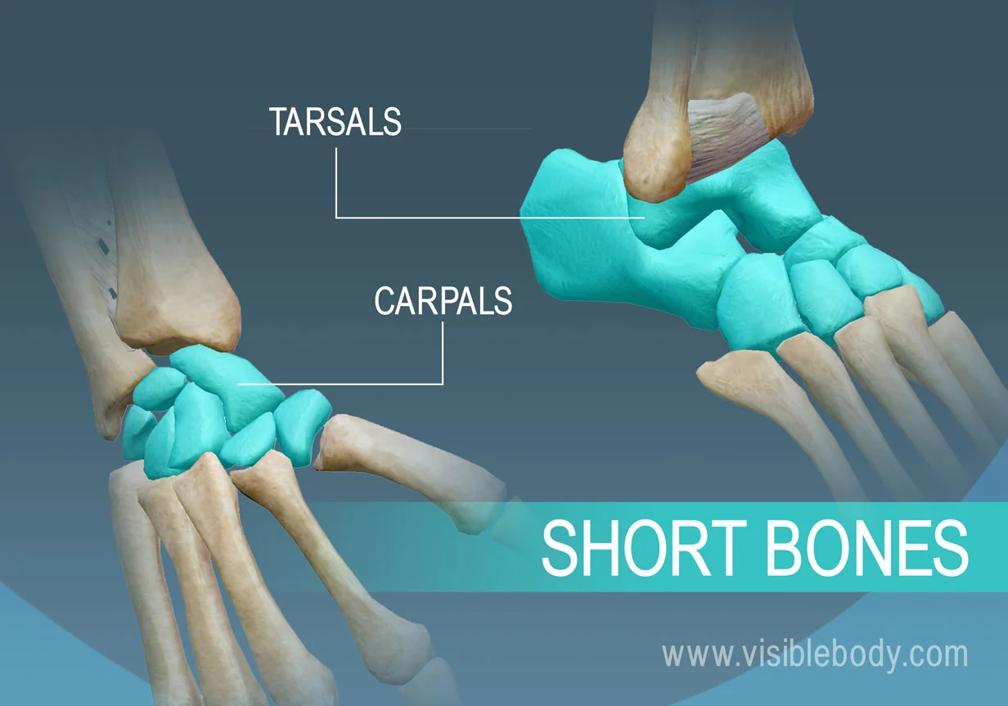
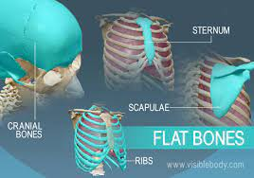
Short Bones
A short bone is one that is cube-like in shape, being approximately equal in length, width, and thickness.
The only short bones in the human skeleton are in the carpals of the wrists and the tarsals of the ankles.
Short bones provide stability and support as well as some limited motion.
Flat Bones
A flat bone is typically thin, it is also often curved.
Examples include the cranial (skull) bones, the scapulae (shoulder blades), the sternum (breastbone), and the ribs.
Flat bones serve as points of attachment for muscles and often protect internal organs.

Slide 15
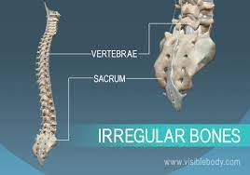
Irregular Bones
An irregular bone is one that does not have any easily characterized shape and therefore does not fit any other classification.
These bones tend to have more complex shapes, like the vertebrae that support the spinal cord and protect it from compressive forces. Many facial bones, particularly the ones containing sinuses, are classified as irregular bones.

Slide 16
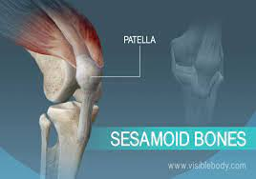
Sesamoid Bones
These bones form in tendons (the sheaths of tissue that connect bones to muscles) where a great deal of pressure is generated.
Sesamoid bones vary in number and placement from person to person but are typically found in tendons associated with the feet, hands, and knees.
The patellae are the only sesamoid bones found in common with every person.
Notes:
A tendon is a fibrous connective tissue that attaches muscle to bone

Slide 17
Additional information
Long Bones, Short Bones, Flat Bones, Irregular Bones, Sesamoid Bones:
https://www.youtube.com/watch?v=VXsYri-d4QE

Slide 18
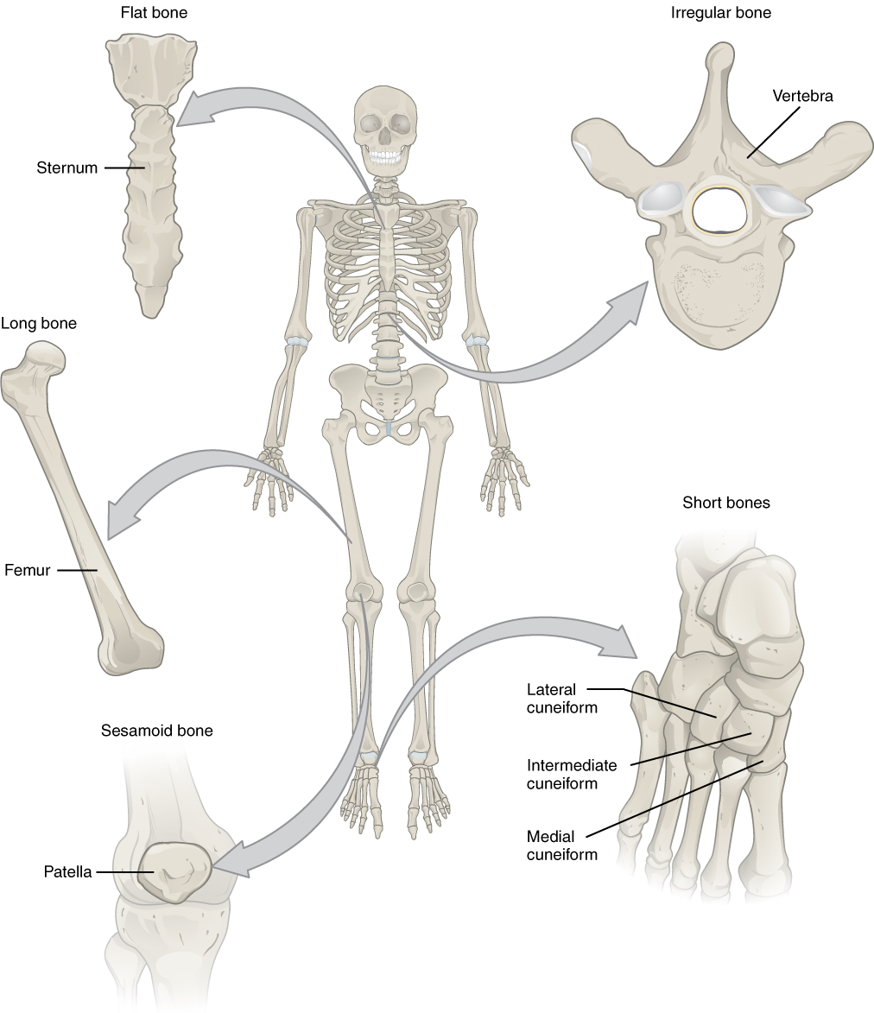

Slide 19
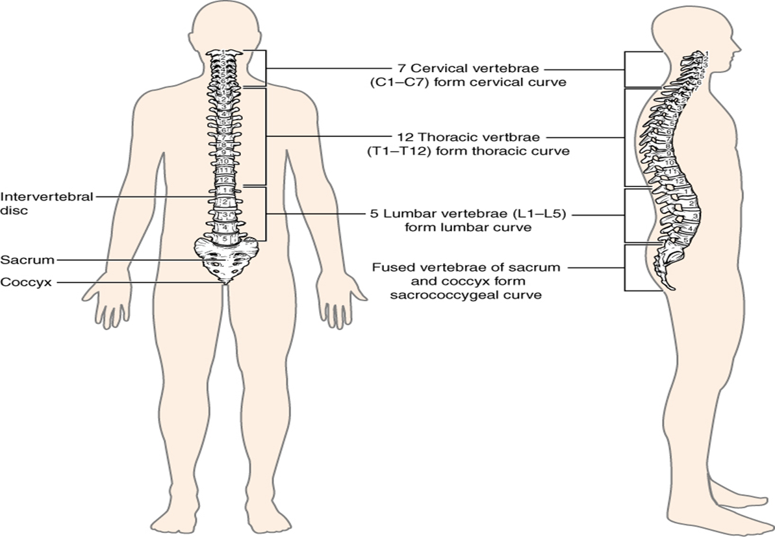
BONES OF THE SPINE
https://opentextbc.ca/anatomyandphysiology/

Slide 20
Additional information
Anatomy and Physiology - Structure of Bone:
https://www.youtube.com/watch?v=XSyWgLz47c8

Slide 21
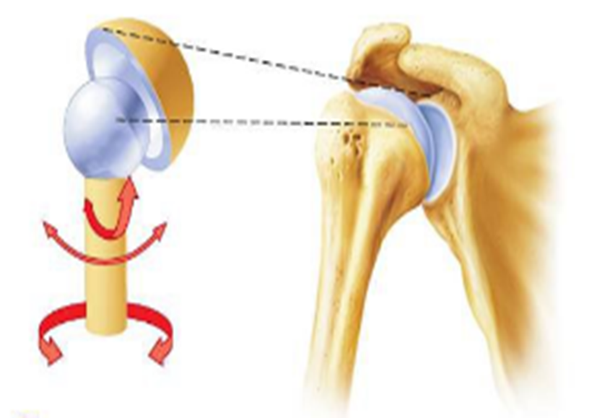
Types of Joints
Ball and socket
(pivotalphysio.com)

Slide 22
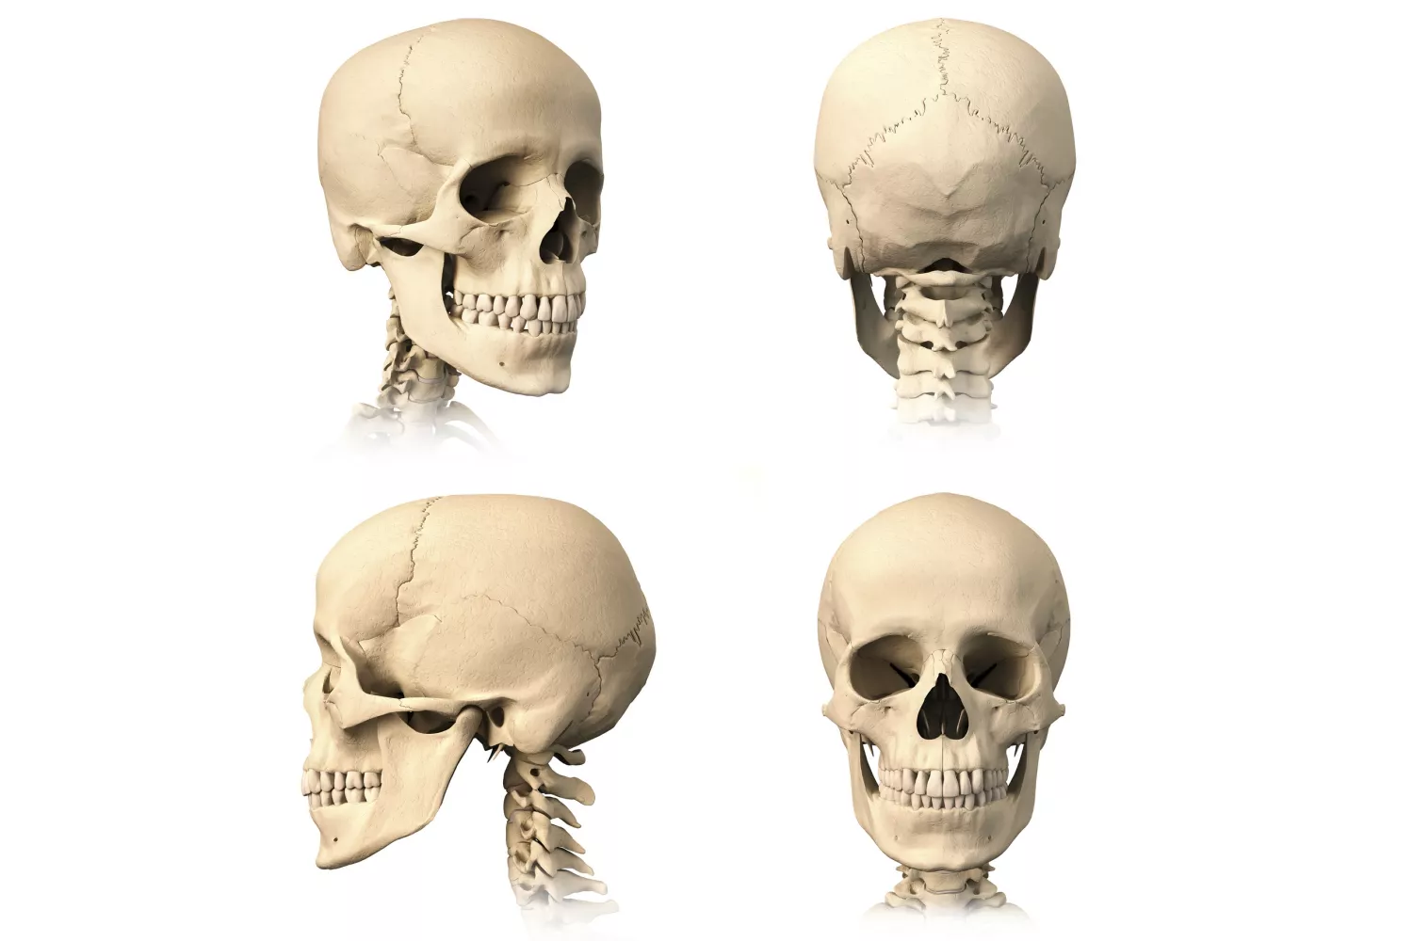
Immovable/Fixed joint

Slide 23
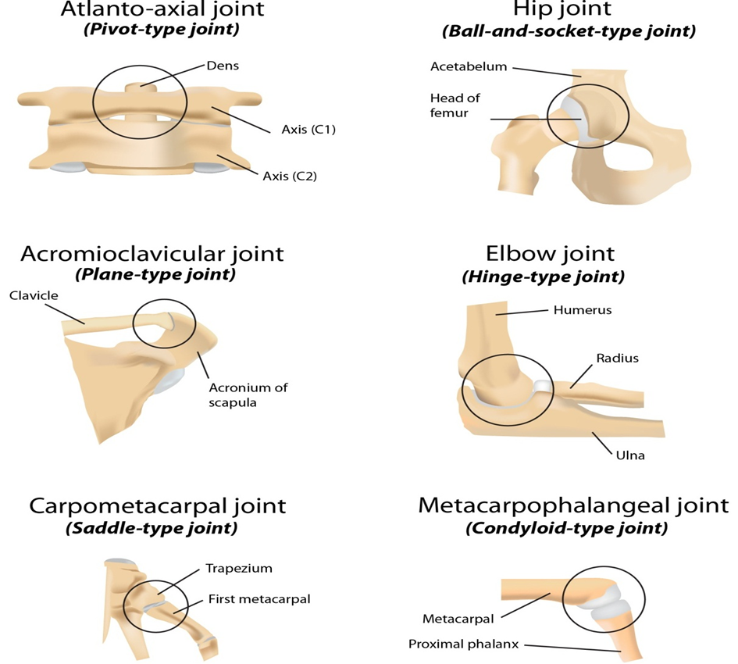
Zhang (2015)

Slide 24
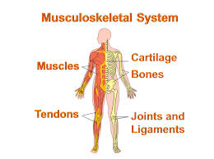

Slide 25
Why it is important to learn skeletal system in health and social care practice
Case study
A 67-year-old female client who tripped and fell, landing on her right arm and breaking the top of the humerus (bone) (the bone of the upper arm that connects to the shoulder
What could be the cause of her fall?
As being a care worker or social care worker how you would prevent fall?

Slide 26
Causes and Risk Factors for Falls
Older people are more likely to have a fall because they may have:
balance problems and muscle weakness
Vision loss
A long-term health condition, such as Heart disease, Dementia or Low blood pressure (hypotension), which can lead to dizziness and a brief loss of consciousness
A fall is also more likely to happen if:
floors are wet, such as in the bathroom, or recently polished
the lighting in the room is dim
rugs or carpets are not properly secured

Slide 27
Causes and Risk Factors for Falls
The person reaches for storage areas, such as a cupboard, or is going downstairs
the person is rushing to get to the toilet during the day or at night
Another common cause of falls, particularly among older men, is falling from a ladder while carrying out home maintenance work.
In older people, falls can be particularly problematic because osteoporosis is a fairly common problem.
It can develop in both men and women, particularly in people who smoke, drink excessive amounts of alcohol, take steroid medication, or have a family history of hip fracture.
But older women are most at risk because osteoporosis is often associated with the hormonal changes that occur during menopause.
https://www.nhs.uk/conditions/falls/

Slide 28
How to Prevent Falls
There are several simple measures that can help prevent falls in the home/care homes.
For example:
Using non-slip mats in the bathroom
Mopping up spills to prevent wet, slippery floors
Ensuring all rooms, passages and staircases are well lit.
Removing clutter
Getting help lifting or moving items that are heavy or difficult to lift
https://www.nhs.uk/conditions/falls/

Slide 29
Other Musculoskeletal conditions
Musculoskeletal (MSK) conditions affect the joints, bones, and muscles, and also include rare autoimmune diseases and back pain.
Arthritis is one of the examples of musculoskeletal conditions.
https://www.nhs.uk/conditions/falls/

Slide 30
In-Class Activity #2
Complete Question 2 from Workbook Exercise Two.
Let’s discuss the free online quiz available from: https://www.free-anatomy-quiz.com/skeletonIDQ1.html
You are expected to label your diagram as we discuss the answers.

Slide 31
HOMEWORK
Complete Question 3 on Workbook Exercise Two.
We will start by reflecting on this next in the next session week.

Slide 32
REFERENCES
Anatomy and Physiology [Online Book]. Available from: https://opentextbc.ca/anatomyandphysiology/ [Accessed 19 October 2019].

Slide 33
Any questions?

