Slide 1
Evaluating information for credibility and reliability
Fire and Rescue | Level 4

Slide 2
Explain what makes information credible and reliable.
Use the CRAAP test to evaluate information.
Distinguish academic and popular sources.
Recognise misinformation and disinformation.
Apply evaluation skills to fire and rescue information in England and Wales.
Locate, retrieve and communicate useful information.
Explain why you choose one source over another.
Learning outcomes

Slide 3
Imagine you are speaking to a member of the public who asks:
“I saw on TikTok that sleeping with my bedroom door open is always safer in a house fire. Is that true?”
What would you do?
A. Agree because the video is popular.
B. Use the first search result.
C. Check the claim against credible fire safety guidance and evidence.
D. Say everything on social media is false.
Which answer would you choose?
What would you check?
What could happen if the information was wrong?

Slide 4
Key message:
In fire and rescue, poor-quality information can affect fire prevention, operational decisions, public behaviour and safety.

Slide 5
When selecting sources, these questions can help you decide on their suitability:
Question | Evaluating sources
Who? | Is there an identifiable author / organisation? Do they have academic / official credibility?
What? | How relevant is the subject content to your research questions?
Where? | How does the context relate to your research area? (e.g. your assignment is about UK G.P. clinics; you find a report about US hospitals)
When? | How does the location and legal context relate to your question? (e.g. England or Wales guidance, rather than a US fire code)
Why? | How current is the source? Check whether guidance, legislation or equipment standards have changed.

Slide 6
a. A peer-reviewed journal article on smoke alarm effectiveness. b. A TikTok video claiming that all domestic fires can be extinguished with water. c. A BBC news report on new fire research. d. An official fire and rescue service webpage explaining home fire safety. e. A website selling a gadget claiming to prevent every house fire.
Rank these from 1 (most trustworthy) to 5 (least trustworthy).

Slide 7
REcap
What made you put your top source first?
Does a professional-looking website automatically mean it's reliable?
Can a source be accurate but unsuitable for an assignment?
Can a source be popular but unreliable?
Does something being published online make it less trustworthy?

Slide 8
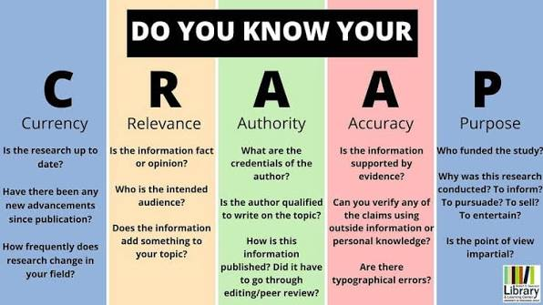
CRAAP test — deeper exploration

Slide 9
A source doesn't have to score highly on every CRAAP criterion to be useful.
For example, an older report may still be valuable when studying the history of fire and rescue services, even if it should not guide current operational practice.

Slide 10
Academic vs popular sources
Academic sources
Written by researchers/subject specialists.
Published in academic journals or books.
Often peer reviewed.
Include references.
Explain methodology/evidence.
Use specialist academic language.
Intended primarily to contribute to knowledge.
Popular sources
Examples include:
Newspapers.
Magazines.
Blogs.
Social media.
General-interest websites.
Online articles.
These aren't automatically bad.
Popular doesn't mean unreliable, and academic doesn't mean automatically correct.”
Evaluate the evidence, author, purpose and context.

Slide 11
Fake news and misinformation
Misinformation
False or inaccurate information that is shared without necessarily intending to cause harm.
Disinformation
False information deliberately created or shared to deceive or manipulate.
Fake news
A broad, everyday term for fabricated or misleading content presented in a news-like format.

Slide 12

Fake news: Red flags 🚩
Sensational headline: “Firefighters HATE this one trick!”
No identifiable author.
No references or evidence.
Anonymous ‘fire safety experts’.
Claims that sound too good to be true.
Excessive capital letters or exclamation marks.
Strong emotional language.
Cherry-picked incident statistics.
Old guidance presented as current.
One incident presented as proof of a universal rule.
Commercial products pushed as guaranteed protection.
No details of the publisher or organisation.

Slide 13

Quiz
What does the first A in CRAAP stand for?
What is the difference between authority and accuracy?
Why might an old source still be relevant?
Give two signs that an online source may be unreliable.
What is peer review?
What is the difference between misinformation and disinformation?

Slide 14
The take-away:
Stop
Check
Compare
Decide

Slide 15

Summary
Good academic practice is not about finding sources that agree with your opinion. It is about evaluating evidence critically and selecting the most credible information available.
One thing I have learnt from this session that I consider important…….
Name three things to check before using information in your assignment…

Slide 16

Next - we will be CRAAP detectives:

