Slide 1
INTRODUCING THE MODERN WORKPLACE- ASSESSMENT 2

Slide 2
LCBB4003 Introducing the Modern Workplace
Iulian Poenaru ID: 1817475
Ciprian Simpliceanu ID: 1817169
Andrei Ionut Balaci ID: 1714716
Volodea Craus ID: 1816780
Tutor: Husam Helmi
TESCO

Slide 3
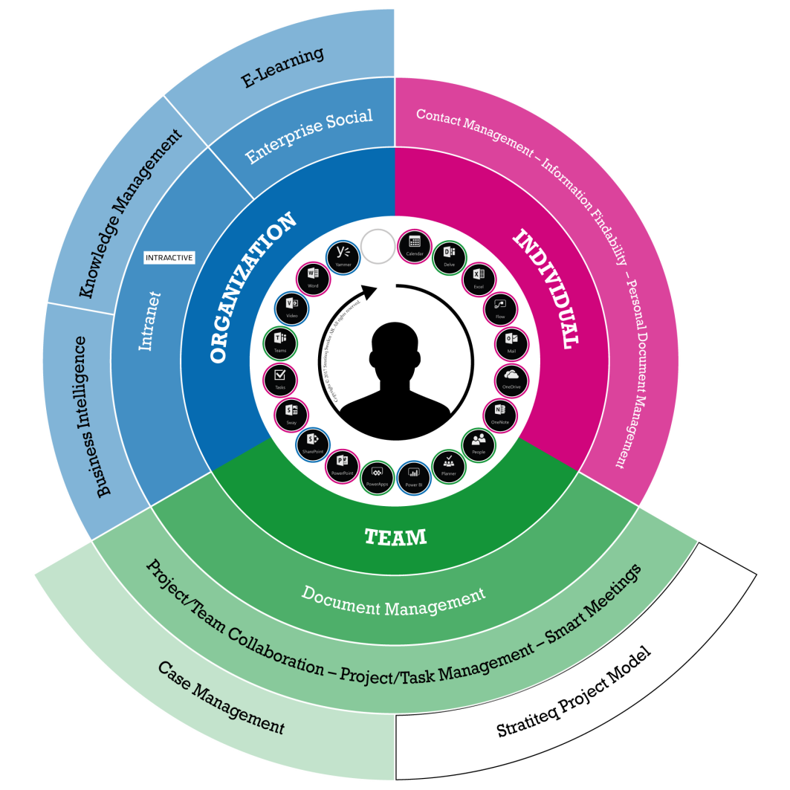
Introduction
Modern workplace consists of positive values, cooperation, support, compassion, commitment to excellence and open communication (Maduenyi et al. 2015).
Effective design or workflow, practices as well as policies.
Leadership and management behaviors, motivational aspects of Tesco
Notes:
Modern workplace is a field within the organization where the management and leadership approaches empower the teams to be collaborative and creative. Thus, modern workplace consists of positive values, cooperation, support, compassion, commitment to excellence and open communication (Maduenyi et al. 2015). This makes the workplace flexible, integrated and full of productive atmosphere. When this kind of approaches is achieved the motivation takes place which is the main reason behind commitment to excellence. However, in the modern workplace, there should be effective design or workflow, practices as well as policies which make a critical difference in regards to the organization’s ability. This study describes the essential nature of managerial work in context to Tesco and various leadership and management practices. Moreover, leadership and management behaviors, motivational aspects of Tesco are going to be described in this study.

Slide 4

Background of the Project
Tesco is a company that believes in long term success
they focused on business practices and strategies that help in achieving success for the company
According to vom Brocke et al. (2015), this is the reason the company is growing day by day with a promising revenue and profit.
Tesco is an organization, built around colleagues and customers.
Notes:
This project is based on the leadership and managerial skill adopted by the senior management in Tesco. This study is going to discuss the entire management behaviors and practices. This will also cover the importance of individual and teamwork in the organization that helps the company to grow.

Slide 5

Organization overview
Tesco was founded by Jack Cohen in the year 1919
Tesco has expanded their market operations into 12 countries including Malaysia, Poland, Czech Republic, Ireland, India, China and Hungary (Tesco-careers.com, 2019).
Tesco have a strategy of ‘Every Little Helps’ which put communities, customers as well as employees at the heart of every day-to-day operation
Notes:
Tesco is a leading global brand and marked as one of the largest retailers in the world. This company was founded by Jack Cohen in the year 1919 from a market stall located in East End of London. Tesco is known as the widest range of food varieties of any retailer in the whole UK and thus its core business provides 60% of all sales and profits. Tesco has expanded their market operations into 12 countries including Malaysia, Poland, Czech Republic, Ireland, India, China and Hungary (Tesco-careers.com, 2019). The leaders of Tesco have set clear goals, high standards and the best settling ever. They have employed in excess of 530,000 employees and management keeps the best efforts for their valuable outcomes. They have two main food brands namely Everyday Values and Finest sold over £1 billion each per year. Tesco have a strategy of ‘Every Little Helps’ which put communities, customers as well as employees at the heart of every day-to-day operation. Moreover, this company provides a great shopping experience regardless of the offline or online customers and puts additional service provisions for them.

Slide 6

Goals as well as objectives
Goals
Adapting the changes with the changing world
Restructuring their strategies as well as practices
Objectives
To become a growing business with full of opportunities
To become innovative and maintaining modern workplace
To be the most highly valued business in retail rector
To inspire, earn loyalty and trust from communities, colleagues and customers
Notes:
Tesco has the main goal of adapting the changes with the changing world and restructuring their strategies as well as practices in order to enjoy long-term success. Moreover, they want to become the most highly valued business by the communities in which they operate, committed and loyal to their shareholders and colleagues and serving customers little better every day.
The main objectives of Tesco is to become a growing business with full of opportunities, become innovative and maintaining modern workplace, be the most highly valued business in retail rector, inspire, earn loyalty and trust from communities, colleagues and customers.

Slide 7
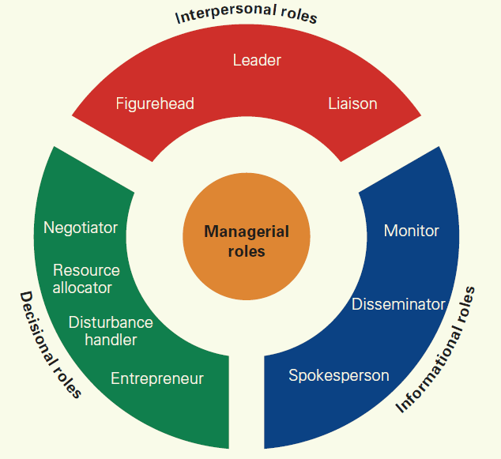
Essential Nature of Managerial Work
The nature of managerial work defines the characteristics of a manager during work
They perform great quality and variety of work with ease and pace.
This is a process that defines the capabilities of a manager during work both externally and internally
Tesco is planning on the ‘Three Big Ambitions’ and ‘The Essentials’ to show how it is using managerial skills to make the company better (Tesco-careers.com, 2019).
Notes:
This function is introduced in business to achieve the business goals set up by the company. Tesco’s managerial aim is to establish a business where strategies and goals are achieved through a strategic planning process. They are responsible to take a variety of activities, fragmentation, and activity.

Slide 8
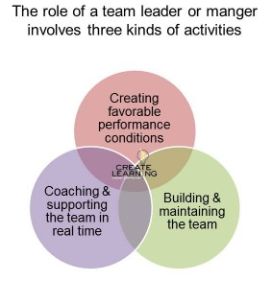
Role of Leadership
Leadership is an important aspect of any organization
A leader must do a variety of work and activity depending upon their section of responsibilities, roles, and activities
A successful leader concentrates on aligning vision to their followers, ensuring execution and envisioning.
They are responsible to influence their co-workers in a positive manner.
As stated by Maduenyi et al. (2015), this change must be in a responsive way that fulfills the long-term needs and true factors of stakeholders of the company.
Notes:
They are also responsible for their own goals and desires that help in the success of the business. The leaders of the company are concentrating on the five elements that help Tesco to grow and achieve the goals. They are concentrating on modern, new and innovative ideas. They went to grow the company in a manner where there is an ample chance of opportunities to grow.

Slide 9
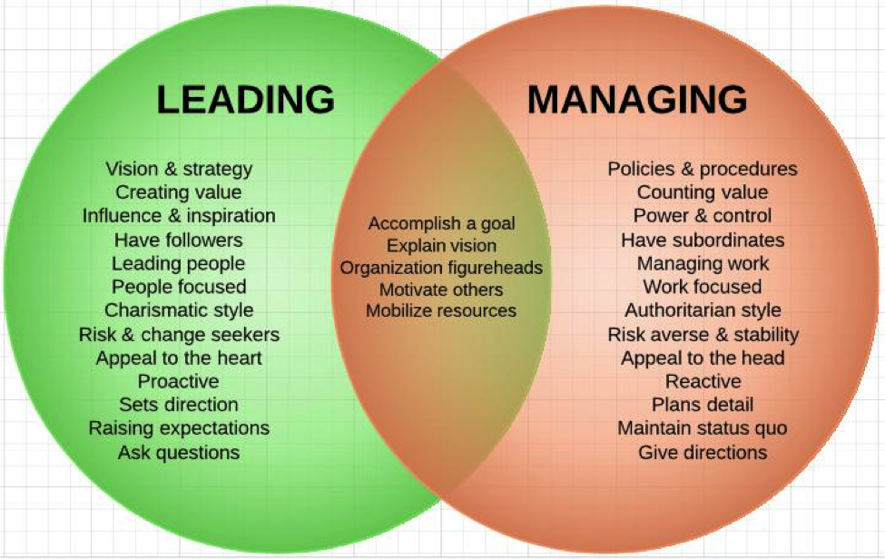
Variables of effective leadership and management
Variables of effective leadership
Personality of the leader, expectation and past experiences
Peer’s behavior and expectations
Superior’s behavior and expectation
Characteristics of the subordinates, their expectation and past experiences (Artino Jr , 2016)
Task requirements
Organizational culture as well as politics
Notes:
Variables of effective management
Managerial skills
Managerial perception
Degree of constraints and demands
Organizational criteria
Presence of opportunities as well as choices for effectiveness
Comply with non-negotiable minimum standards of the organization that is following legal framework and other regulation parameters
Focusing on employee’s attention towards the organizational strategy and motivating them to take decisions that are consistent with organizational goals
Leadership variables depend on many factors such as the nature of the task, organization culture and many more. the leader’s authority or power, relation with the subordinates, external environment, and internal environment matters a lot while maintaining effective leadership style by the leaders.
for effective management, motivation works a lot and it should be varied with nature of inter and intra-organizational relationships. Moreover, they should look upon the influential roles toward organizational structure as well as operations.

Slide 10
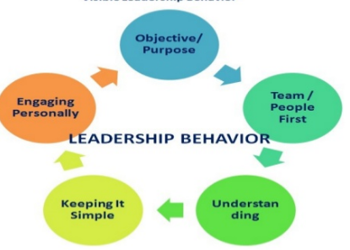
Leadership and Management Behaviors
Leadership Behavior
Productivity and creativity
Problems effectively, make a strong orientation of results
Supporting the Team
Solve all the work-related problems easily and effectively
Showing authenticity and sincerity, the leaders become successful in getting the trust of their coworkers
Notes:
This is the main reason Tesco is growing new methods and technology in its organization. Their work helps co-workers to overcome their difficulties and do productive and quality work for the success of the organization. The leaders of the Tesco are always concentrated to support their teamA leader is responsible for setting a new vision and direction for the team they are heading. Basically, a leader is the spearhead for the new vision and direction

Slide 11
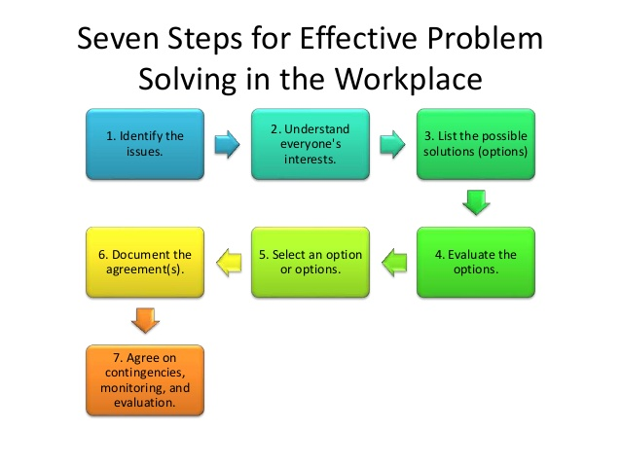
Cont…
Effective Problem-Solving Skill
Problem-solving skill helps the company to grow in a reasonable manner
As opined by Taub (2015), this skill helps in creating, analyzing, communicating, decision making, team building
Focused on Different Perspectives
This behavior is all about encouraging colleagues, giving them a chance to speak and let them contribute with their creativity for the success of the company
This helps in inspiring, earning trust and loyalty of the team members and make them inclined to more productive and creative.
Notes:
This is an initiative that needs to be active and intentional. The leader of the Tesco has adopted this behavior in order to understand their coworkers initiative towards the success of the company. The leaders of Tesco are concentrated more on this behavior and this is the reason the company is winning locally and applying the skills globally. With the help of comprehensive and informative knowledge skills, the leaders of the Tesco solve the problems effectively.

Slide 12
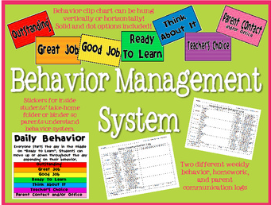
Management Behavior
Recognizing the Limits of Employees
According to Amanchukwu et al. (2015), a manager needs to be a good coach, creative, micromanaged, result-oriented, productive and good communicator.
Tesco analyze the limits of their employees and allocate the department and work accordingly
Use of Positive talk
Communication is the key that plays an important role in bridging the gap between employees and senior management
As stated by Araújo et al. (2015), this is a way where a manager appreciates their employees for their work and dedication to the company
Notes:
Management is responsible for directing and controlling resources or people in an organization and a group. They focus on fulfilling the values and principles that have been established by the company. There is a slight difference between a manager and a leader. A manager is responsible for managing the activities set up by the organization whereas a leader’s work is to provide information to its team to grow and get success

Slide 13

Cont…
Attentive and Mindful
The managers of the Tesco are mindful and attentive towards the employees
The behavior of management needs to be mindful and attentive in order to understand the feelings and behavior of an employee
This behavior helps in regain control over an employee (Bititci et al. 2016).
Notes:
A manager needs to be mindful as they are responsible for developing the strategies that help the company to grow. The manger of the company is attentive as they pay all the concentration towards the problems, ideas, creativity and new techniques developed by an employee. With the help of this behavior, Tesco makes its employees ambitious and creative.

Slide 14
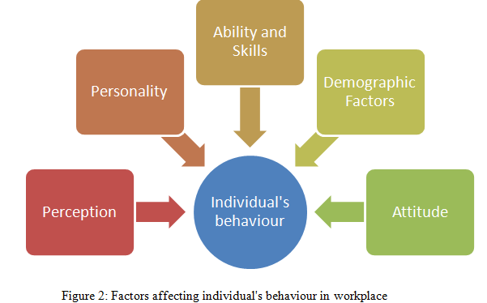
Factors that affect differences in Individual Behavior
Personal Factor
Tesco always tries to hire employees who have extensive knowledge of modern technologies and who have a creative mind (Tesco-careers.com, 2019)
This is basically based on childhood experiences, knowledge, personality
Difference in Achievements
Every person has their own ability and with the help of their ability, they achieve goals in their life
In context to Cook et al. (2016), a leader and a manager need to be attentive towards rewarding their employees.
Influence of Race, Caste, and Nation
A person can easily be targeted by their religion, race, and sex
Tesco always pays attention to this and this is the reason the company is becoming more prosperous to the employees (Tesco-careers.com, 2019)
Notes:
An individual can affect negatively and positively by their behavior to an organization. The leaders and managers of Tesco are very attentive and informative. They always try to give positivity to an employee in order to make them productive and creative. However, there are some of the factors that can affect the behavior of an individual in an organization are as follows. his knowledge and behavior can make a great impact on the behavior of an individual as well as on the growth of the company.

Slide 15
Leadership and Management Practices and Processes
Leadership process and practices
Transformational leadership theory, Leader-member exchange theory, Servant leadership theory, Charismatic leadership theory
Autocratic leadership style, democratic leadership style, Transformational leadership , Transactional leadership
Management process and practices
Authentic Management Style, Collaborative Management Style, Autonomous Management Style, and Authoritative Management Style
Planning stage, Organizing stage, Directing or leading stage, and Controlling stage
Notes:
Autocratic leadership style is followed in Tesco in order to make decisions quickly and controlling the budget. However, in order to create modern workplace, the leaders of Tesco consider inspiring, influencing as well as guiding their staff. Moreover, they provide a clear direction to their employees and create short term goals so that they can achieve these goals effectively. In Tesco, leaders maintain positive relationships and believe in team collaboration and thus they focus much on personal integrity that means building trust as well as respect among them. In addition to this, the team leaders also follows participatory or transformational leadership style and motivate their subordinates to feel like they are a vital part in decision making process. In these years, Tesco has improved their organizational culture and made the operational performance effective by ensuring integrity, respect and responsibility of each member. The leadership approach of Tesco has proved that the stakeholders of that company are the paramount of the business success.
The management of Tesco has declared five functional departments such as administration, marketing, finance, human resources and research and development in their business operations. Previously they have utilized autonomous management style and this time they are focusing on Collaborative Management Style. The managers are now emerged in setting clear visions for the company supported by strong commitments. Moreover they perform all the practices of management style and all of the business aspects are monitored regularly. In addition to this, necessary plans are adopted by Tesco management and they share the ideas or knowledge with the employees when necessary. This management style has helped them to establish the commitments like ‘The Essentials’ and ‘Three Big Ambitions’. This management style is also aided in reducing the cost as well as expenses for Tesco while enhancing the performance with time.

Slide 16
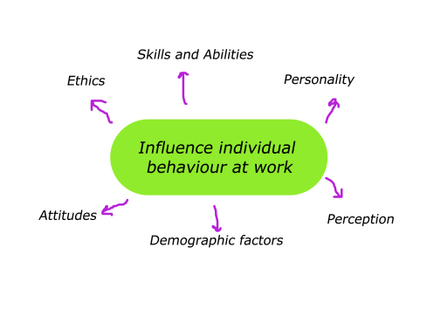
Positive influence individual behavior
The transformational leadership style is very adaptive
Directions and explaining the expectations from the work
In collaborative style, individuals get benefit from thoughts, concerns, as well as suggestions shared by the managers
Responsibility towards the organization (McClory et al. 2017).
Notes:
The transformational leadership style is very adaptive and it has a positive influence definitely on individual behavior. The democratic leadership styles help to maintain loyalty as well as creativity while empowering the employees. Moreover, their opinions are taken into considerations while making important decisions regarding the tasks and organizational culture. Autocratic leadership approach helps individuals in setting the directions and explaining the expectations from the work. With the help of transactional leadership, managers help individuals to gain interest with the help of rewards. These leadership styles will help employees to enhance their performance while maintaining creativity. All of these leadership approaches are focused in such a way that each of the individual employees feel motivated and holds their responsibility towards the organization (McClory et al. 2017).
In Authentic management style, employees feel the managers are here to help them in answering the queries, the best possible way to perform the task. In collaborative style, individuals get benefit from thoughts, concerns, as well as suggestions shared by the managers and they develop their own skills and knowledge. In autonomous style, the employees are guided with the directions and this totally goes like professional field. On the other hand, in an authoritative style, individuals are instructed to the requirements and the workloads they need to maintain within specific time work. This helps them in time management skills. Above all, it can be said that all of the management style is to guide the employees to work according to the directions.

Slide 17

The Group as well as Team Behaviors
Power and the Role Culture
Power and role culture is an important element in today’s organization
Tesco has developed this behavior to work as a team and a group.
Wide Organizational Structure
This group behavior forces a manger to make clear objectives and policies for the company.
As stated by Baltaci and Balcı (2017), this helps the team to possess awareness about the job and obligations.
This behavior is helpful in building the team as a manager cannot ensure work on a daily basis.
Notes:
A group and team behavior can be defined as two or more interdependent and interacting individuals come together in order to achieve a particular objective and strategy. Group behavior can be stated as a course of action taken as a family. There are a lot of benefits of working in a group or team. Tesco has followed some of the team or group behavior that help the organization to grow and achieve success and profit for the organization.

Slide 18
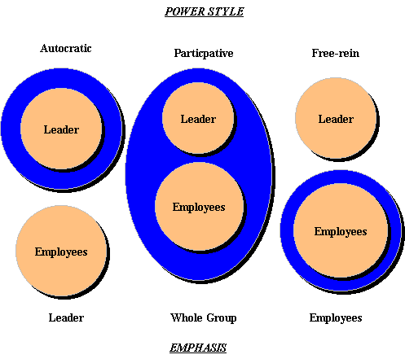
Cont…
Pay and Interest Boosting
The team behavior that is important to build a team and group is to pay and boost the interest
This is helpful when an employee has seen losing interest towards its work and becoming less productive
Participative and Declarative Behavior
Tesco has applied participative and delegative behavior in order to form a team and group
Participative is well established and large method of leadership that helps team to grow in a positive manner (McClory et al. 2017).
Notes:
The company has opened to get all the ideas and proposals of their employees. This helps in the positive result of the revenue of the company. Employers have a certain trust in their leaders and managers and they work as a team with all the new ideas and proposals by their senior management. Delegative is quite secure and less complex team behavior management that helps in the formation of a positive group and team. During this period, a team or a group offers reward, accomplishment and encourages the employee to work with all the attention and creativeness. Tesco offers a good payment to its employee this is the reason the company has a high level of teams and groups that helps in getting the profit for the company.

Slide 19

Motivation as well as perception
Amanchukwu et al. (2015), defined motivation as the ability to satisfy individual needs by the organization when employees have willingness to exert efforts at high level towards organizational goals.
According to Taub (2015), in the modern workplace, the motivating factors include responsibility as well as empowerment, appreciation of hard work, opportunity for advancement, a sense of achievement and a sense of enjoyment in challenging environment.

Slide 20
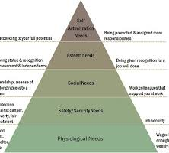
Maslow and Herzberg’s motivational theory in TESCO
Basic needs
Security needs
Social needs
Self-esteem needs
Self-actualization needs
Notes:
Basic needs: This ensures food, shelter, rest and other psychological needs. Tesco follows this by including monthly payment system, a place with positive culture, and various other essential facilities such as lockers for personal belongings and food facilities.
Security needs: In security needs the first concept that comes to mind is the job security and this should be incorporated with protection against hazards, prevention from harassment or discrimination, fair treatment and many more (Cook and Artino Jr, 2016). Tesco maintain this segment by providing formal contracts security at the time of employment and offering sickness schemes. Moreover, there is a union where the health and safety measures are maintained.
Social needs: Social need means support at work from colleagues and a sense of belongingness to a team. Tesco promotes group working, effective communication, and encourages long service.
Self-esteem needs: Everybody seeks recognition for completing tasks in good manner. This segment is ensured by having recognition and status, independence and recognition. Tesco values self-respect as well as respect for others and praise for hard work. A 360 degree appraisal and feedback system is applied to recognize individual contribution levels and thus they celebrate achievements.
Self-actualization needs: This is the segment where employees are assigned to more job responsibilities and being promoted. Tesco offers Personal Development Plans which holds career progression program, promotional opportunities and talent management meetings. Thus, they bring out the skillful and talented employees and make their promotions.
Besides this, Tesco also follows two-factor theory by applying the hygiene factors like payment and benefits, improved working conditions, maintaining good relationships with co-workers. All of these factors are followed by company policy as well as administration.

Slide 21
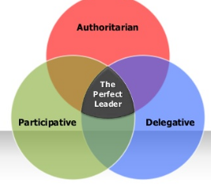
Conclusion
They follow the leadership style like Transformational leadership theory, Leader-member exchange theory, Servant leadership theory, Charismatic leadership theory
The company has increased its sales and profit by 60% with the help of the above practices and theories.
With the help of these management practices and leadership behaviors Tesco become one of the leading global brands and most profitable retailers in the business.
Notes:
Tesco has applied the leader and managerial behaviors like supporting the team member, active listening, use of positive talks, mindful and attentive behavior among others to become successful in the business. They have applied theories like Trait theories, Contingency theories, and Behavioral theories to become an achiever in the retail market. This study also covers the influence of individuals and groups that effect positive results for the company. The overall study is developed on the fact of leadership and management skill in modern organization and business.

Slide 22

References
Amanchukwu, R.N., Stanley, G.J. and Ololube, N.P., 2015. A review of leadership theories, principles and styles and their relevance to educational management. Management, 5(1), pp.6-14.
Araújo, D., Silva, P. and Davids, K., 2015. Capturing group tactical behaviors in expert team players. Rotledge Handbook of Sport Expertise: Routledge.
Baltaci, A. and Balcı, A., 2017. Complexity leadership: A theorical perspective. International Journal of Educational Leadership and Management, 5(1), pp.30-58.
Bititci, U., Cocca, P. and Ates, A., 2016. Impact of visual performance management systems on the performance management practices of organisations. International Journal of Production Research, 54(6), pp.1571-1593.
Cook, D.A. and Artino Jr, A.R., 2016. Motivation to learn: an overview of contemporary theories. Medical education, 50(10), pp.997-1014.
Eriksson, T. and Kadefors, A., 2017. Organisational design and development in a large rail tunnel project—Influence of heuristics and mantras. International Journal of Project Management, 35(3), pp.492-503.
Maduenyi, S., Oke, A.O., Fadeyi, O. and Ajagbe, A.M., 2015. Impact of organisational structure on organisational performance.
McClory, S., Read, M. and Labib, A., 2017. Conceptualising the lessons-learned process in project management: Towards a triple-loop learning framework. International Journal of Project Management, 35(7), pp.1322-1335.
Mosadeghrad, A.M., 2015. Developing and validating a total quality management model for healthcare organisations. The TQM Journal, 27(5), pp.544-564.
Taub, R., 2015. A New Educational Reform in Israeli High Schools Affecting Teachers’ Motivation and Perception of the Teaching Profession. Procedia-Social and Behavioral Sciences, 209, pp.503-508.
Tesco-careers.com, 2019. Welcome to Tesco Careers. Accessed from: https://www.tesco-careers.com/. [Accessed: 19th November,2019].
vom Brocke, J. and Lippe, S., 2015. Managing collaborative research projects: A synthesis of project management literature and directives for future research. International Journal of Project Management, 33(5), pp.1022-1039.

Slide 23


