Slide 1

Team:
Andriyana Eftimova 2236843
Krasimira Chausheva 2231627
Milena Ilieva 2231625
Slavi Sinapov 2236845
Introduction to the modern place (LCBB4003)
Assessment 1
Coursework: TASK 1 Group presentation

Slide 2

Content of the Presentation
Organisation’s profile.
Organization structure.
Management, role of Managers.
Leadership.
Factors which influence group and team behaviours.

Slide 3
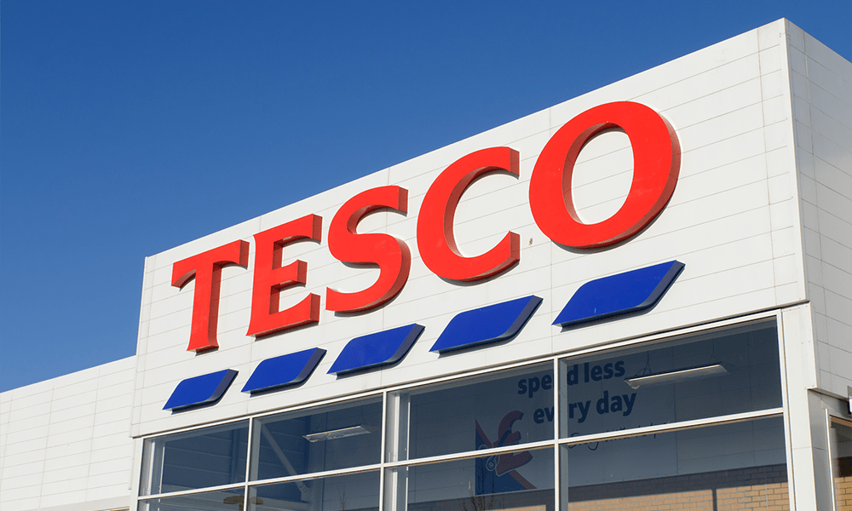
Introduction
TESCO PLC by Slavi Sinapov
The company's major products, services and brands include the following:
Tesco is one of the biggest retailers in the UK.
The company operates 4,359 stores and 393 franchise stores.
( Market Line, 2023)
The company's major products and services include the following:
Products: : Food products; Fresh food; Frozen food; Bakery products; Home electrical products; Car products;
Services: Telecommunication services TESCO MOBILE; Financial services Tesco Bank; Technology, software and consultancy services
Sports and leisure products; Party and gift products; Health products; Hygiene products; Clothing and jewellery; Entertainment

Slide 4
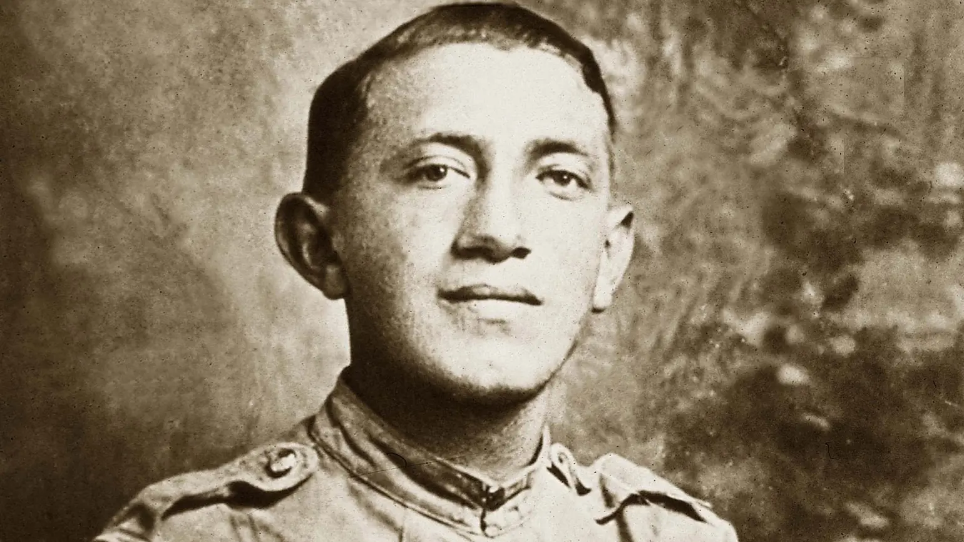
History
1919
Tesco was founded by Jack Cohen in 1919
1924
the first own–brand product ( Tesco Tea) has been sold.
1946
Jack Cohen travelled to the United States in 1946 to introduce self-service to Britain. He returned with an idea that would revolutionize British shopping.
1947
On the stock exchange Tesco Stores (Holdings) was floated on the stock exchange with a share price of 25 pence.
1955–1960
500 new stores has been opened
https://www.tescoplc.com/about/our-history/

Slide 5

Mission
Tesco’s mission statement is “We make what matters better, together.
The main parts of the statement are as follows:
Improving health
Distinguished Quality
Improving lives.
(Team, 2022)

Slide 6
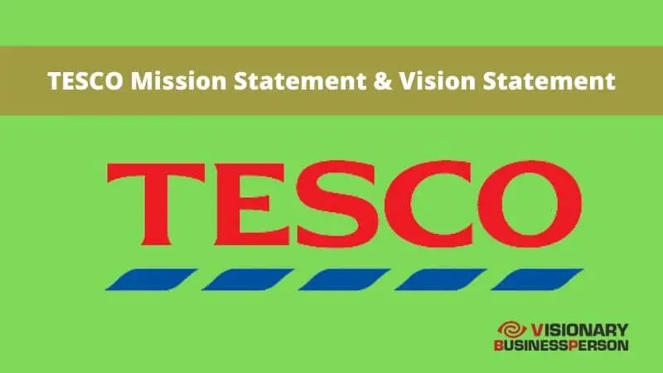
Vision
Vision Statement
Tesco’s vision statement is “to be the most highly valued business by the customers we serve, the communities in which we operate, our loyal and committed colleagues and of course, our shareholders.” (Team, 2022)

Slide 7
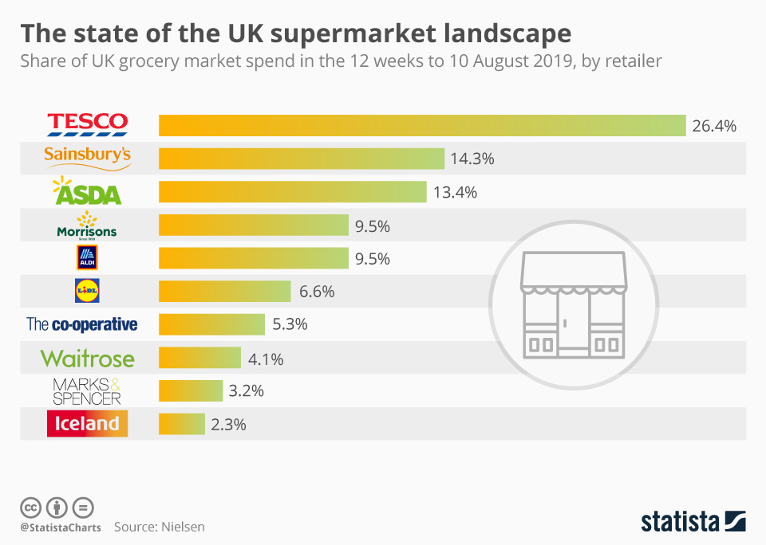
Competitors
The share of UK grocery market spend in the 12 weeks to 10 August 2019, by retailer
(Armstrong & Richter, 2019).

Slide 8

Organization Structure by Andriyana Eftimova
Organizational structure is the framework of the relations on jobs, systems, operating processes, people and groups making efforts to achieve the goals. Organizational structure is a set of methods dividing the task. to determined duties and coordinates them (Monavarian, Asgari, & Ashna, 2007).

Slide 9
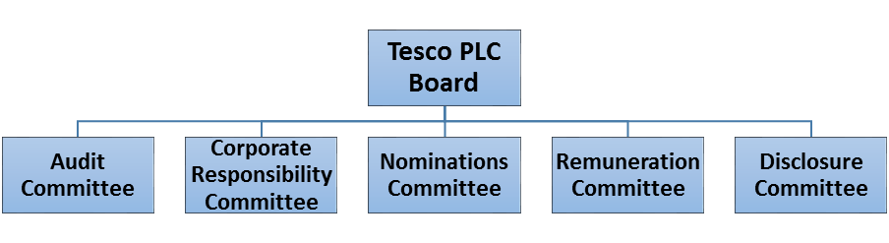
TESCO Organization structure
To begin with, Tesco PLC's organizational structure is decentralised. A decentralized organizational structure is when lower levels in a business have decision power.
Tesco's organizational structure consists of three groups of employees at the top, mediate and base level of management.
(Dudovskiy, 2016).

Slide 10
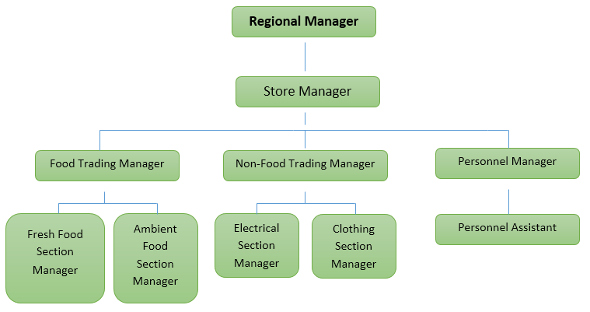
After the Tesco PLC board and committees, there is a base level of management, where employees are divided into specific regions.
(Dudovskiy, 2016)

Slide 11
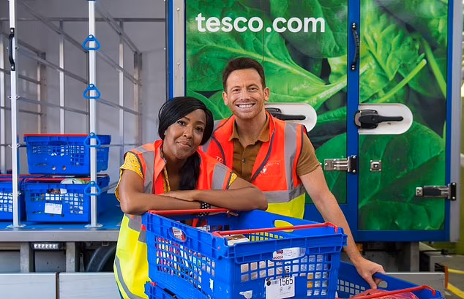
Features of organisational structure at Tesco
Geographically based
Shared friendly culture
Employee empowerment is high
Decentralized structure
Decentralized decision making
Flexible work environment
Shared values and beliefs
Picture (Tingle, 2021).

Slide 12
Tesco Performance Management and Measurement
The purpose of performance management and measurement is to increase the quality, efficiency and control resources that have for business to stay in the market longer (Mackie, 2008).
High-Level Aspirations and Strategic Plan
A differentiated brand
Reduce costs
Innovation

Slide 13

The role of the managers.
By Milena Ilieva
Managers play a crucial role in organizations.
They are constantly engaged in various tasks, switching their focus to address issues as they arise.
They spend significant time interacting with others, including subordinates, superiors, and external stakeholders.
Managers rarely make big decisions
Decisional roles involve making difficult decisions in ambiguous situations and allocating resources (Kotler, 2009).

Slide 14
Managers at TESCO
Planning
Organizing
Controlling
Managing inventory
Analysing data
Overseeing customer service

Slide 15

Managers skills
Adaptability
Critical thinking
Decision making
Communication
Team building
Communication
Leadership

Slide 16
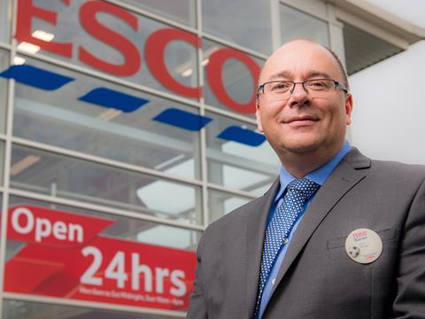
Darren Swain, who won Tesco’s award for manager of the year 2015 says what is the secret to be the best manager:
The team are all happy
We all working hard
Always have fun
(The Grocer, 2023).

Slide 17
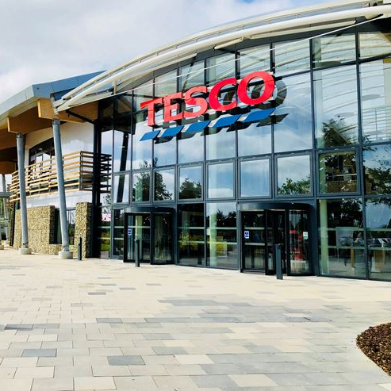
Tesco academy
Тesco have a specially created Academy where their employees can learn, collaborate and innovate. This academy prepares employees and allows them to develop within the company (Tesco, n. d.).

Slide 18

What is leadership and why is it important?
By Krasimira Chausheva
Ralph Stogdill defined leadership as an influencing process aimed at goal achievement. That definition has three components. First, it defines leadership as an interpersonal process in which one individual seeks to influence the behaviour of others. Second, it sets leadership in a social context, in which the other members of the group to be influenced are subordinates or followers. Third, it identifies a criterion for effective leadership - goal achievement - which is one practical objective of leadership theory and research (Buchanan & Huczynski, 2016).

Slide 19

Several reasons why leadership is important:
-Improves communication.
-Creates a better work environment.
-Improves productivity.
-Increases efficiency.
-Decreases mistakes.
-Motivates employees.
-Sets a good example for others.
-Inspires hard work.
-Creates a strong vision for the future.
-Helps keep employees on track.

Slide 20

Management and leadership in Tesco.
Transformational leadership is one of the most well-liked theories of leadership, and it denotes that the leader has a tremendous vision and a burning desire to accomplish great things.
Transactional leadership theory.
(Circlebizz, 2020)

Slide 21
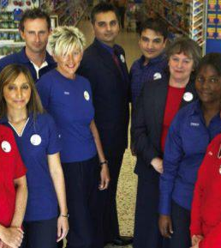
Motivational theory in practice at Tesco
Various speculations have been proposed for inspiring workers. Pay is thought to be a major motivator. The following are additional motives:
appreciation of hard work
a sense of achievement
responsibility and empowerment
opportunity for advancement
a sense of challenge and enjoyment.
(By Careers Help , 2021).

Slide 22

The factors which influence group and team behaviour.
Activity Reinforcement
Contract
Reprimand
Interest Boosting
Pay

Slide 23
Tesco leadership style
Democratic leadership style, also known as participation leadership
Offering its clients high-quality services
Strong focus on the value of selecting departmental heads to oversee organisational processes
Tesco encourages staff members by rewarding them with benefits
Tesco is focused on its consumers
Tesco places a high priority on high-performance management

Slide 24
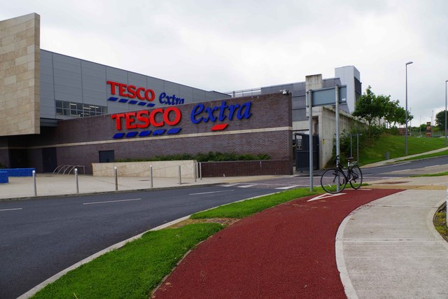
Conclusion
Tesco's performance demonstrates how flexible, and decentralised the organization's culture, structure, and management style are. Everyone has a voice and the opinions of the employees are taken into consideration. They have been able to continue to get stronger for the future by concentrating on their long-term strategies. Tesco continues to be the market leader in the retail sector because of its democratic leadership approach.
Тази снимка от Неизвестен автор е лицензирана с CC BY-SA

Slide 25
Reference list:
Armstrong, M. and Richter, F. (2019) Infographic: The state of the UK supermarket landscape, Statista Daily Data. Available at: https://www.statista.com/chart/19075/uk-supermarket-market-share/ (Accessed: 13 July 2023).
By and Careers Help (2021) Motivational theory in practice at Tesco |, Careers Help. Available at: https://careershelp.co.uk/motivational-theory-in-practice-at-tesco-2/?utm_content=cmp-true (Accessed: 17 July 2023).
Circlebizz (2020) Leadership theory of Tesco, CIRCLE OF BUSINESS. Available at: https://circlebizz.com/management/leadership-theory-of-tesco/ (Accessed: 17 July 2023).
Dudovskiy, J. (2016) Tesco organizational structure - research-methodology, Research. Available at: https://research-methodology.net/tesco-organizational-structure/ (Accessed: 13 July 2023).
Kotler, P. (2009) Marketing management. Harlow: Pearson Prentice Hall.
Mackie, B. (2008) ‘Organisational performance management in a government context: a literature review”, Scottish Government Social Research, p. 23
Monavarian, A; Asgari, N; Ashena, M. Structural and content dimensions of knowledge-based organizations. The first national conference of k knowledge management. Bahman 2007.
Opportunities to get on | tesco careers.(no date) Available at: https://www.tesco-careers.com/explore-our-world/opportunities-to-get-on/ (Accessed: 22 July 2023).
Our history (no date) Home. Available at: https://www.tescoplc.com/about/our-history/ (Accessed: 13 July 2023).
Team, V. (2022) What does Tesco Mission Statement & Vision statement really say?, Visionary Business Person. Available at: https://visionarybusinessperson.com/tesco-mission-statement/?utm_content=cmp-true (Accessed: 13 July 2023).
Tesco plc – Business description (2023) Market line. Available at: Tesco Plc - Profile Tesco Plc | MarketLine Intelligence Center (uwtsd.ac.uk) [Accessed 13 July. 2023.]
Tesco plc. (2023). Core Purpose and Values. [online] Available at https://www.tescoplc.com/about/how-we-do-business/core-purpose-and-values/[Accessed 12 July. 2023.]
Tingle, R. (2021) Watch joe swash and Angellica Bell try their hand at delivering food in an eco-friendly electric van... will they make the cut?, Daily Mail Online. Available at: https://creative.dailymail.co.uk/tesco/2021/watch-joe-swash-and-angellica-bell-try-their-hand-at-delivering-food-in-an-eco-friendly-electric-van-will-they-make-the-cut.html (Accessed: 22 July 2023).
The Grocer (2023) Darren Swain, Tesco Beckenham: G33 Store of the week, The Grocer. Available at: https://www.thegrocer.co.uk/the-grocer-33/darren-swain-tesco-beckenham-g33-store-of-the-week/524448.article (Accessed: 22 July 2023).
Picture (No date). Available at: https://beingintelligent.com/group-cohesiveness.html. [Accessed: 17 July 2023].
Watch joe swash and Angellica Bell try their hand at delivering food in an eco-friendly electric van... will they make the cut? (no date) Daily Mail Online. Available at: https://creative.dailymail.co.uk/tesco/2021/watch-joe-swash-and-angellica-bell-try-their-hand-at-delivering-food-in-an-eco-friendly-electric-van-will-they-make-the-cut.html (Accessed: 17 July 2023).

