Slide 1
Structure of Introductions and Conclusions (with video links)

Slide 2
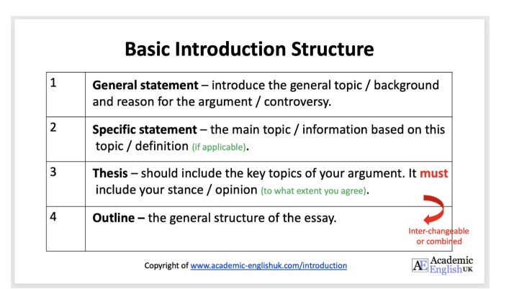

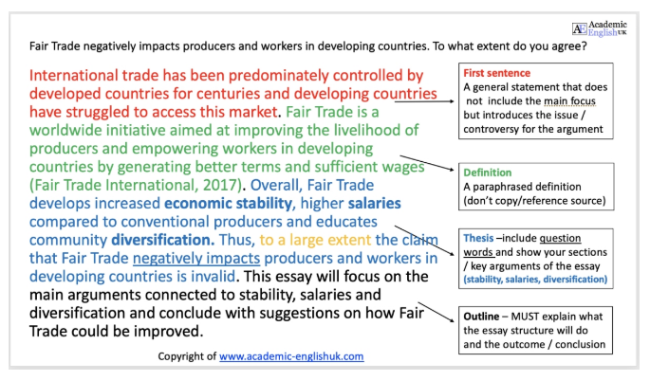

Slide 3


