Slide 1
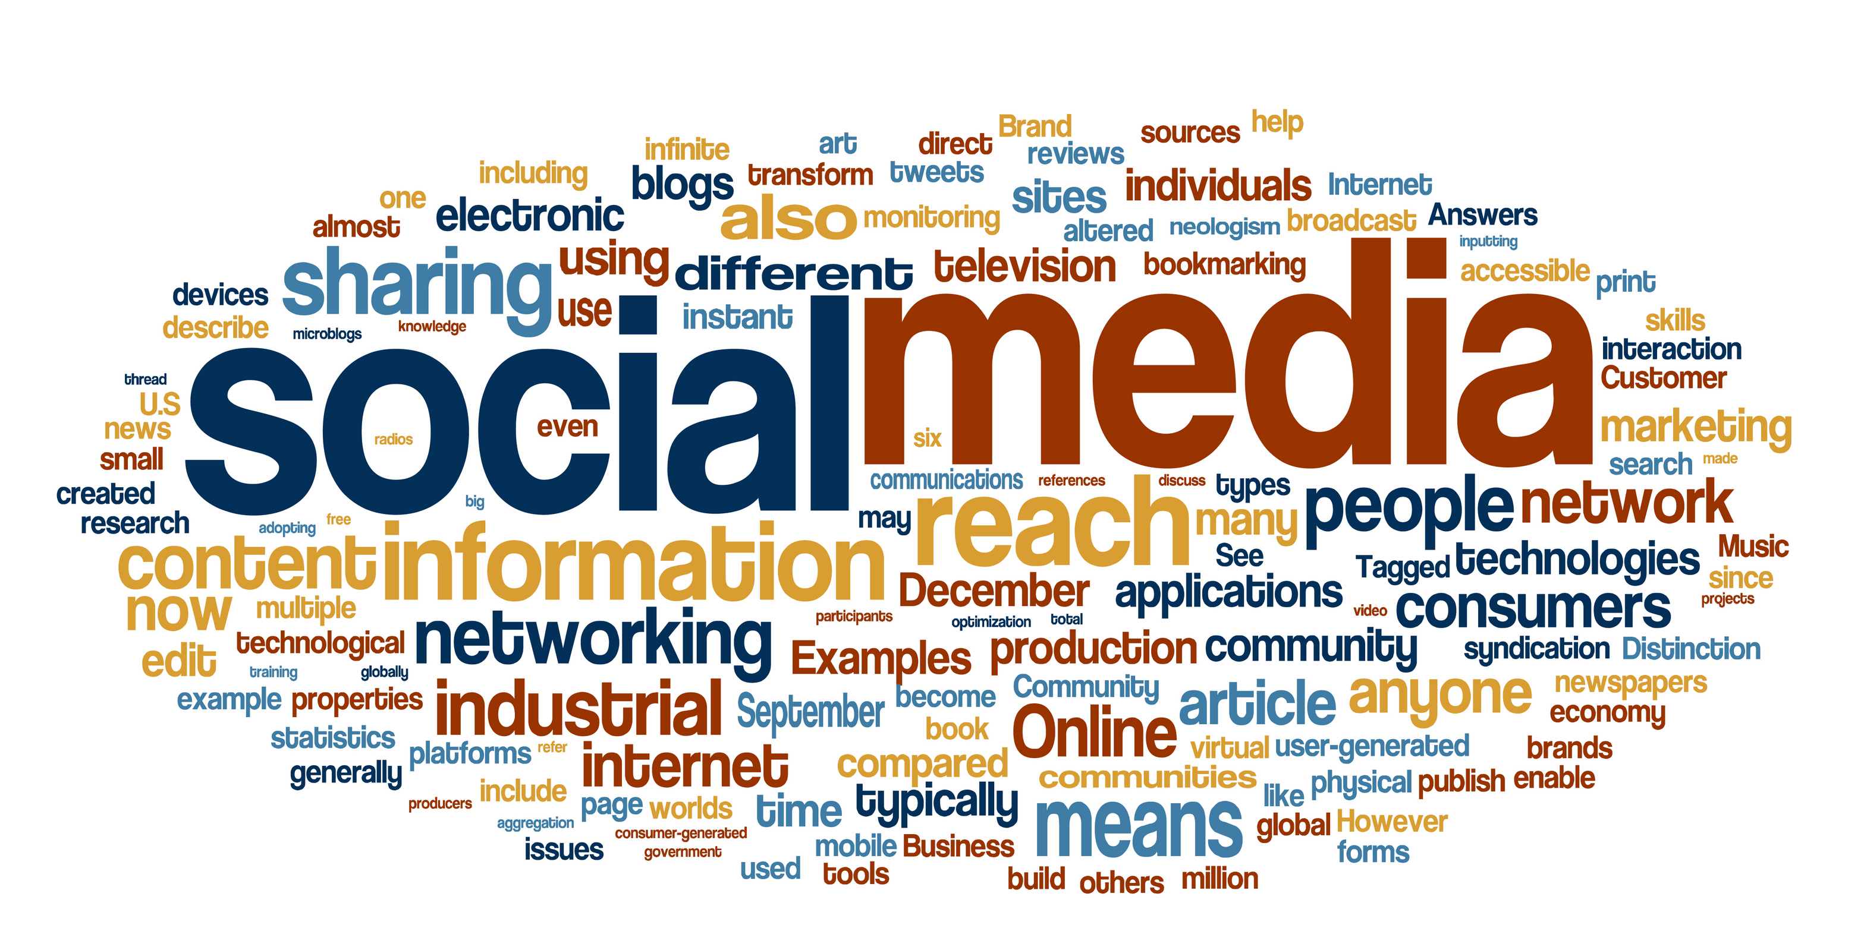
What is the impact of the media on UK policing?

Slide 2
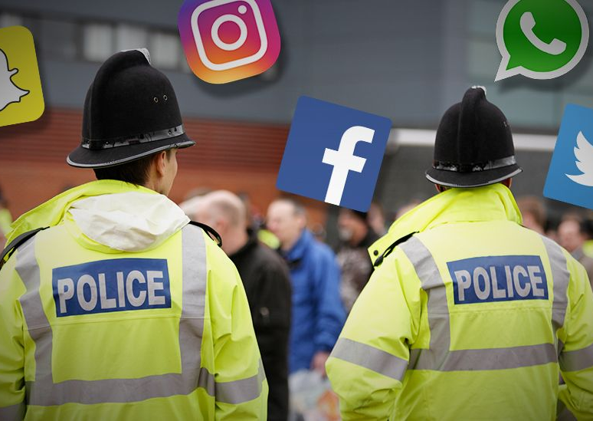
How do police in the UK use the media?
(BBC, 2017).

Slide 3
The three roles for social media in policing:
Public information,
Engagement
Monitoring and Crime prevention
Notes:
Public information: In order for community policing to be effective, the police and the community must be able to share information. Therefore, the police use social media to reach out to there community and pass on any information that may be of relevance to them, such as road closures, missing persons or updates on local criminals. It is also useful to control the spread of rumours and misinformation.
Engagement: Social media provides a platform for police and communities to engage with one another. It allows for the debate of issues and the opportunity for the police to act upon the communities concerns. They may also give out crime prevention tips to emphasise the duty of care officers have for their community (Bullock, 2017).
Monitoring and crime prevention: Crimes can be reported through social media, and can be prevented through the use of public appeals and the sharing of crime prevention tips. Public requests made through social media can also reduce crime such as increased policing in crime hotspots, this also shows that the police care in the terms of the broken windows theory.

Slide 4

Framework for engagement with the media
Research suggests that the way in which officers behave when engaging with the public helps reduce crime.
The framework sets out : why the police need to engage with communities, who they must engage with and how to engage with them.
Code of ethics: sets clear guidance on specific issues that are relevant to engaging with the media.
The simple rule
(College of Policing, 2022)
Notes:
Encouraging respect for the law and fostering social responsibility can result in people being more likely to help the police in oppose to breaking the law.
Code of ethics: openness and transparency, confidentiality, the officers involved must be fit for work and officers must not accept any hospitality, gifts or gratuities.
As a simple rule, officers must ask themselves if they are the appropriate person for communicating this issue and if there is a policing purpose for doing so? If the answer to both questions is yes, they should communicate with the media.

Slide 5
Benefits of police using the media
Police public relations
Media research and relations
Public confidence
Notes:
Public relations: public relations refers to the relationship between the public and the police and the idea of holding a favourable public image. It is common for police services to have established public information officers to communicate with the public often via the media, in order to maintain a strong public image and relationship (Motschall and Cao, 2002). This is important as without a favourable image, the communities are less likely to have faith in the police.
Media research: many argue that the use of social media should be welcomed as a way of starting research conversations and providing other views on their methods of policing to ensure the police are working to serve the community appropriately and obtain the idea of community policing.(Williams and Hesketh, 2017).
Public confidence: Research suggests that effective community engagement via the media can have a positive impact on increasing the publics feelings of safety and overall confidence in the police (Copitch and Fox, 2010). Police forces often use social media platforms such as Facebook and Twitter to share their progress at capturing known criminals which can make the community feel safer and in turn allow for more confidence on the police.

Slide 6
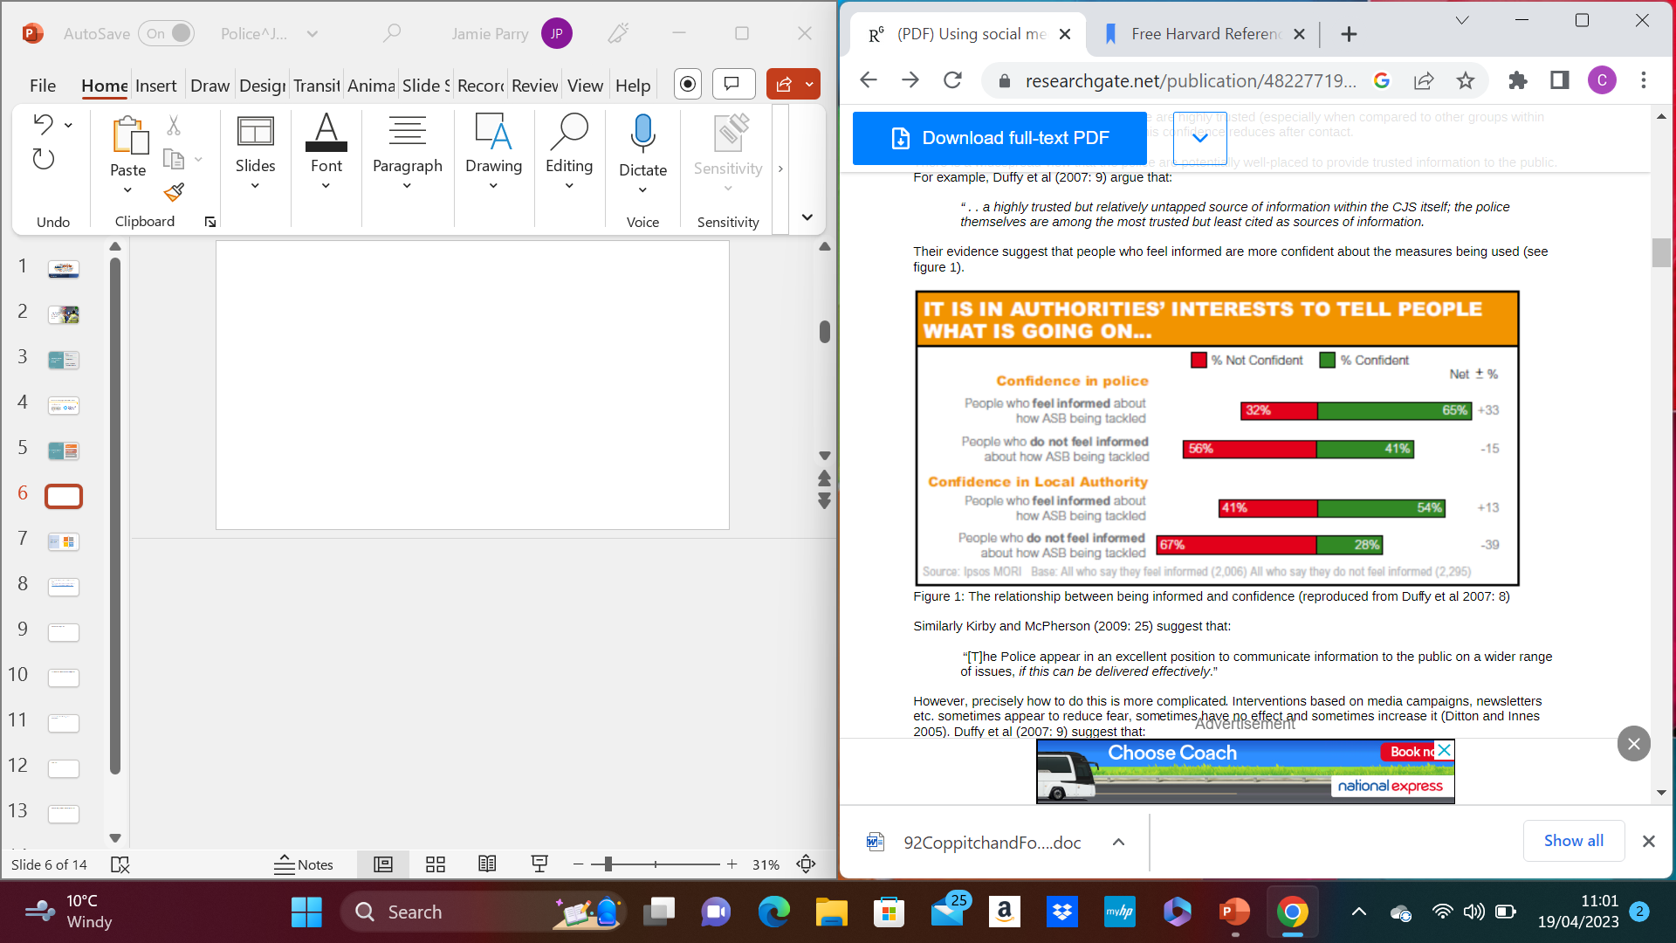
(Copitch and Fox, 2010)
Notes:
This graph highlights that confidence in the police had increased when the public were informed about local issues and their methodology of tackling them, in this case the issue was anti social behaviour.

Slide 7
Implications of police using the media
Social media related crime.
Invasions of privacy.
Getting the tone right.
Engagement in oppose to just giving out information.
(The PoliceFoundation, 2014)
Notes:
Social media related crime – The police must be careful with what they post to social media as this information is made public to almost everyone, they must also be considerate of their security as online criminals can hack and access sensitive information and potentially share it around.
Invasions of privacy – Many people argue that the police use of social media is an encroachment into the private lives of the public., for example in the recent case of Nicola Bulley, in which Lancashire Police publicly disclosed private information about her private struggles across social media (Daniel, 2023).
Getting the tone right - Information posted on social media by the police needs to be relevant and useful, otherwise the public may gain the perception that the police are wasting their time and resources (PoliceFoundation, 2014). There is also the case of police officers posting or sharing offensive content via social media, a number of investigations conducted by the Independent Office for Police Conduct (IOPC) concluded, while warning that such behaviour could result in investigations for misconduct (IOPC, 2021).
Engagement in oppose to just giving out information – The police must use the media effectively for the public to interact. If followers enjoy reading police updates, then they are more likely to engage and come forward with information, therefore the posts uploaded to the media by the police must be considered trustworthy and good sources of information (PoliceFoundation, 2014).

Slide 8
How media affects public confidence in the police
Studies have shown that following the publication of negative behaviour by the police, there is a decline in community support and an increased dissatisfaction.
The media also impacts how people view individual police as people
However, the medias focus on criminal activity can also lead to the public supporting the police
While research has shown that there is an impact from the media on public confidence, some research shows otherwise.
(Mullis,2009)
Notes:
1 This dissatisfaction can last for a prolonged period of time, and with this disdain for the officers, the community may become less cooperative which impacts the idea of community policing and can leave them with an us vs them attitude.
2 individuals who are frequently exposed to media accounts of misconducts often believe that the police engage in racial profiling, are prejudiced and discriminate against minorities.
3 This is because the focus on crime in their communities can make them fearful of crime, and therefore show support in their local police in attempt to make their communities safer for them and to make them crime free.
4 It is suggested that the impact the media has on confidence towards the police are not as far reaching as other research anticipated. A study conducted in 2005 by Miller, Davis, Henderson, Markovic and Ortiz, found that public opinions on the police remained fairly stable despite notable variations in media coverage.

Slide 9
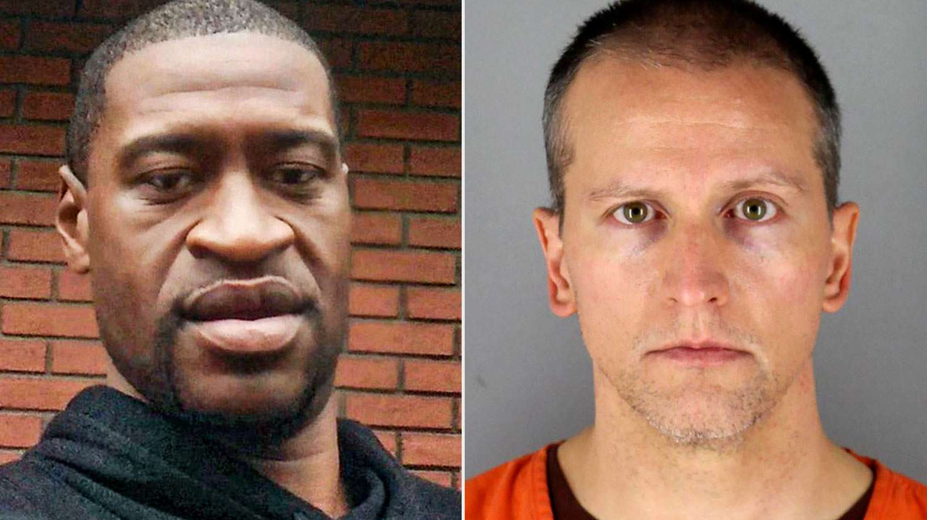
The case of George Floyd
(Truesdell,2021)
Notes:
On 25th May 2020, police were called after Mr Floyd purchased cigarettes with a counterfeit $20 bill. Four officers then arrived at the scene and moved to detain Mr Floyd resulting on him face down on the ground with officer Derek Chauvin kneeling on his neck.
Chauvin’s knee remained on Floyds neck for over 8 minutes despite him pleading that he cant breathe until he passed away (Marcus, 2022).

Slide 10
The case of George Floyd on social media
Black lives matter movement
Protests across the world
Notes:
The death of George Floyd sparked the black lives matter movement across social media and branded authorities like the police as institutionally racist, giving many people a negative perception of policing.
Protests reached all areas of the world and this is said to be as a result of its overwhelming presence on social media, particularly twitter, meaning police services had to face rioting for the days following the killing and immediately change their methods to deal with it. ‌(Cowart, Blackstone, and Riley, 2022)

Slide 11
The case of George Floyd and its impact on UK policing.
Due to its overwhelming presence on social media the IOPC launched its review of race-based discrimination.
The IOPC also developed national recommendations to help improve policing in the key areas of concern.
Increased police accountability.
(Naseem, 2021)
Notes:
They looked at all independent investigations involving issues of possible racial discrimination and assessed whether people from Black Asian and Minority Ethnic communities had been treated unfairly by the police.
The recommendations regarded the use of stop and search and the use of tasers with surrounding issues of racial discrimination and disproportionality. In Autumn 2020 the IOPC made a series of learning recommendations to the Metropolitan Police Service to address concerns in their use of stop and search which were identified in IOPC investigations.
Police accountability means being open to scrutiny, open to challenge and open to change and it also means listening to peoples concerns

Slide 12

The relationship between the police and the media
Case study; Metropolitan police

Slide 13
The relationship between the police and the media
Criminologist Marianne Colbran argues that although the Mets reputation is at an all time low, the force currently has the most control over the flow of information to the public than ever.
In previous times, access to the press was not always available, and many investigations were not reported.
The Phone hacking scandal and the 2011 riots.
Over the next couple of years, the Met realised that the use of social media allowed them to achieve many of their goals.
(Colbran,2022)
Notes:
She stated that from interviewing operation and press officers, she discovered that before the introduction of new technology such as social media, the power was firmly in favour of the press as the mainstream media were the channel that the police could use to communicate with the public.
If the police wanted the press to cover a story, it had to be newsworthy and appeal to the newspapers demographic, leaving the police unable to draw assistance from the public.
These 2 events started to balance the power between the Met and the national press. The phone hacking scandal led to reveal improper relations between senior met officers and the press, causing three reviews of police and media relations. Two of which recommended the recording of police/media contact which restricted official police/media contact and clampdowns on unofficial contacts. The riots led to the Met using Twitter and other social media platforms to call for witnesses and any other information for the first time.
They were able to deal with the mainstream media by promoting their services and encourage the trust and confidence in the police in oppose to struggling to place newsworthy stories in the media.
They could post stories directly onto social media, publicise new initiatives directly to the public, and show the human side of policing.

Slide 14
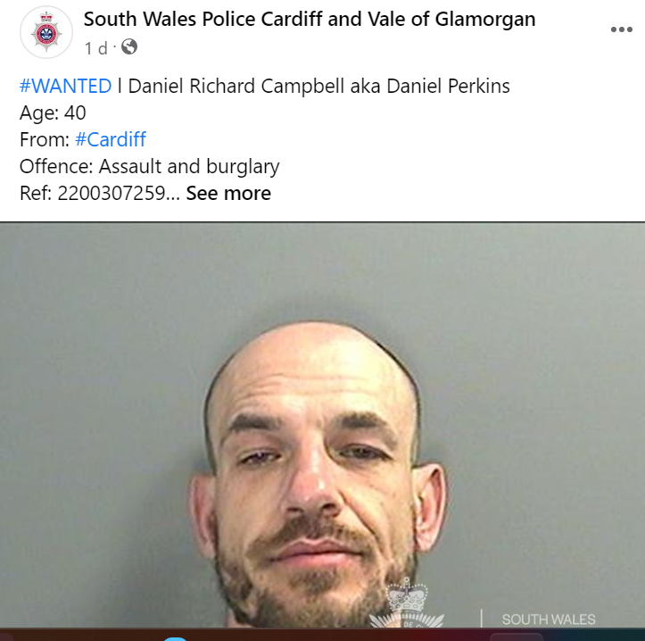
How the media can benefit police investigations
Digital media investigators use the media to enhance criminal investigations:
They may use public social media to gather evidence
Retrieve data that can be used as evidence from devices such as phones, laptops and tablets
In the Unites States 31 percent of investigators believed that media coverage assisted their investigation compared to 6 percent who opposed of it. (Fiest, 1999).
Notes:
Some police forces in the UK may upload photos to social media of people they are looking for and people on the media can assist them by providing any information they may have.
Data such as payment transactions, texts, phone calls, internet history and computer documents. DMIs may even create fake profiles on social media to carry out investigations although they must be specially trained and authorised to do so.
Hanfald, Keppel and Weis undertook a study of investigators of child homicides to conclude these findings and that 77 percent of them had used the media to identify witnesses.

Slide 15
Example of media affecting police investigation
The murder of Lucy McHugh

Slide 16

Lucy McHugh
Lucy was murdered in July 2018 after being stabbed 27 times by Stephen Nicholson in Southampton
Stephen was a prime suspect early on into the investigation, but police had little evidence against him
He was held on suspicion of her murder a day after the body was found, giving police 96 hours to charge or release him.

Slide 17

Lucy McHugh
In an interview, Nicholson told detectives that Lucy had messaged him via Facebook the night before her death telling him that she was pregnant.
This gave the police a reason to investigate the messages between Lucy and Stephen, though they soon found that he had changed his password prior to his arrest and refused to give them access.
Section 53 of the Regulation of Investigatory Powers Act meant that Stephen was charged with failure to comply with an order to disclose his password.

Slide 18
Lucy McHugh
Stephen then pleaded guilty at Southampton Court and was jailed for 14 months, which gave police the vital time for further investigations into the murder of Lucy in which the 96 hours previously hadn’t
With Stephen locked up, the police continued to find evidence linking him to the murder of Lucy.
Police then traced his phones’ route on the day of Lucy's murder and launched a fingertip search into an area in which police thought was a deviant from his other routes home.
A bag was found with a blue, bloodstained hoodie, police then concluded that the garment contained Stephens DNA and Lucy's blood which provided enough evidence to prosecute him.
(White, 2019)

Slide 19

Conclusion
To conclude, it is clear that the media has both a positive and negative impact on policing in the UK.
The negatives predominantly stem from bad publicity, although the media often reports on true stories, meaning that bad press of the police usually comes from the highlighting of mistakes made by the police which arguably shouldn’t occur in the first place.
The range of positives evidently outweigh these as it can benefit all aspects of policing from investigations to the relations the community have with the police.
Also, the implications of the media can be managed

Slide 20
Conclusion
Media related crime:
If the police use a solid security, them the risk of them being hacked is limited, police must be professional with what they post to reduce the risk of posting offensive information, further training could be introduced.
Invasion of privacy:
Again, with appropriate training, police could learn to use the media as a tool to gather relevant information that can assist them in oppose to its uses of invading the community's privacy.
Getting the tone right:
To achieve this, police must be considerate of what information they share, if senior officers check up on their social media representatives more regularly, the posting of irrelevant and useless information can be prevented.
Engagement in oppose to just giving out information:
Though giving out information isn’t necessarily a bad thing, the police would benefit more through engagement with the community. Therefore, anything shared via the media should be engaging and encouraging for the public.

Slide 21

Thankyou for your time and any questions?

Slide 22
References:
https://www.police-foundation.org.uk/2017/wp-content/uploads/2017/08/Social_media_briefing_FINAL.pdf
https://www.policeconduct.gov.uk/news/iopc-warns-officers-about-inappropriate-social-media-use
https://hamlins.com/nicola-bulley-the-role-of-the-police-and-media-in-the-invasion-of-privacy/
https://www.college.police.uk/app/engagement-and-communication/media-relations
https://www.cambridge.org/core/journals/social-policy-and-society/article/police-use-of-social-media-transformation-or-normalisation/19E5C6727038F01129B51CE4287D0FFB
Motschall, M. and Cao, L. (2002). An Analysis of the Public Relations Role of the Police Public Information Officer. Police Quarterly, 5(2), pp.152–180.
‌Williams, E. and Hesketh, I. (2017) A new canteen culture: the potential to use social media as evidence in policing. Policing: A Journal of Policy and Practice, 11 (3). pp. 346-355. ISSN 1752-4512.
Copitch, G. and Fox, C. (2010). Using social media as a means of improving public confidence. Safer Communities, 9(2), pp.42–48
Mullis,J. (2009.). The impact of the media on public opinion of the police - ProQuest. [online] Available at: https://www.proquest.com/openview/d00e6fb464c246ee3cf6ae09f0901c4e/1?pq-origsite=gscholar&cbl=18750.
‌Marcus, J. (2022). When and how did George Floyd die? The Independent. Available at: https://www.independent.co.uk/news/world/americas/when-george-floyd-death-b2087360.html.
‌Cowart, H.S., Blackstone, G.E. and Riley, J.K. (2022). Framing a Movement: Media Portrayals of the George Floyd Protests on Twitter. Journalism & Mass Communication Quarterly, 99(3), p.107769902211092.
‌ Naseem, S. (2021). Remembering George Floyd | Independent Office for Police Conduct. Policeconduct.gov.uk. Available at: https://www.policeconduct.gov.uk/news/our-podcasts-and-blogs/remembering-george-floyd.
‌Feist, A. (1999). Policing and Reducing Crime Unit Paper 120 The Effective Use of the Media in Serious Crime Investigations. Available at: https://www.politieacademie.nl/kennisenonderzoek/kennis/mediatheek/PDF/3435.pdf.
White, M. (2018). ‌Lucy McHugh: How a Facebook password trapped a killer. (2019). BBC News. 18 Jul. Available at: https://www.bbc.co.uk/news/uk-england-hampshire-48994913.
Colbran, M. (2022). The relationship between police and media: is the Met less accountable than ever before? British Politics and Policy at LSE. Available at: https://blogs.lse.ac.uk/politicsandpolicy/police-media-accountability/.
‌

