Slide 1
Leadership
Are you an Ant or a Duck?

Slide 2

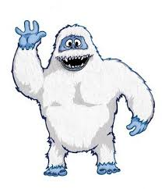
“Leadership is like the abominable snowman whose footprints are everywhere, but is nowhere to be seen.”
(Warren Bennis, 1985)

Slide 3
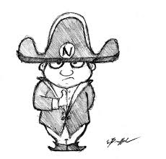
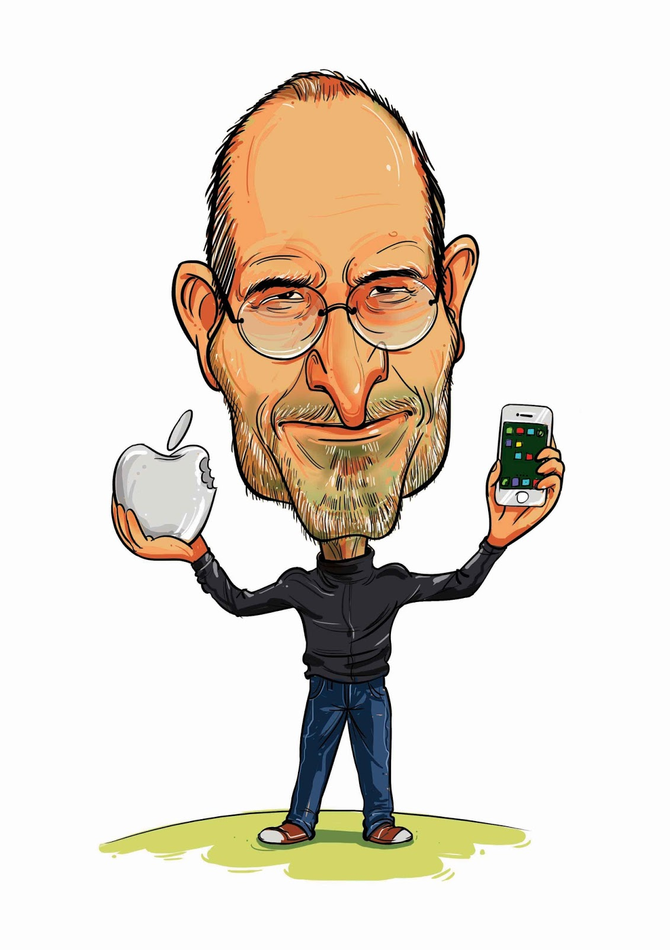
‘ A leader is a dealer in hope’ Napoleon Bonepart
‘Leadership is influence’ John Maxwell
‘As we look ahead into the next century, leaders will be those who empower others.’ Bill Gates
‘Innovation distinguishes between a leader and a follower.’ Steve Jobs

Slide 4

‘The
pessimist
complains about the wind.
The
optimist
expects it to change.
The
Leader adjusts the sails.’

Slide 5

“Leadership is the interpersonal influence, exercised in a situation, and directed, through the communications process, toward the attainment of a specified goal or goals.”
Tannenbaum, Weschler & Masserik (1961, p.24)
“Management is the efficiency in climbing the ladder of success; leadership determines whether the ladder is leaning against the
right wall.”
Stephen R. Covey

Slide 6
There are almost as many different definitions as there are people who have tried to define it.
(Stogdill,1974)
The function of leadership is to produce more leaders, not more followers
(Ralph Nadar)
The only definition of a leader is someone who has followers
(The Drucker Foundation, 1996)

Slide 7
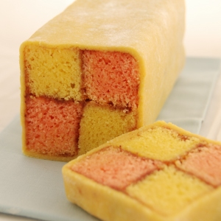
What do you want in a leader?
Is there a perfect recipe for leadership?
What would the ingredients be?
2 cups- Charisma
300ml – trust
9 teaspoons - Honesty
A dash of creativity
Emotional intelligence to taste
1 cup – analytical skill
A good dollup of vision
Mary Berry’s Leadership Battenburg

Slide 8
Pick your leader
Here are the facts about 3 candidates
Associates with crooked politicians, and consults with astrologists. He's had two Mistresses. He also chain smokes and drinks 8 to 10 martinis a day.
He was kicked out of office twice, sleeps until noon, used opium in college and drinks a quart of whiskey every evening.
He is a decorated war hero. He's a vegetarian, doesn't smoke, drinks an occasional beer and never cheated on his wife.
- Franklin D Roosevelt
- Winston Churchill
- Adolf Hitler

Slide 9
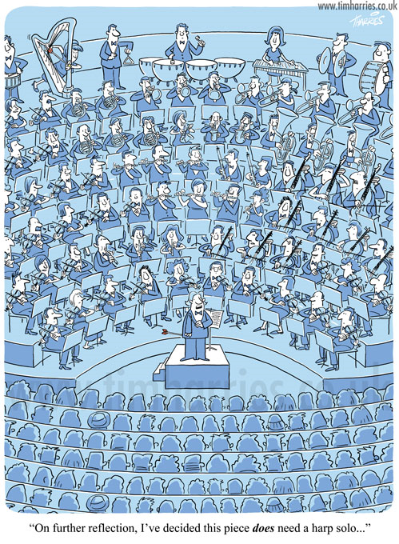
Who is the Leader
Is it…..
The musicians
The first violinist
The Conductor
Other

Slide 10
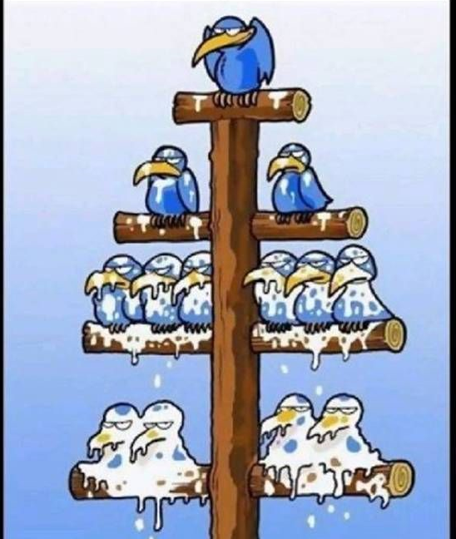
People find work
unpleasant!
They need to be directed and
controlled.
They want SECURITY not
RESPONSIBILITY
OR

Slide 11

Self-motivated,
accept
& seek responsibility
People like work

Slide 12
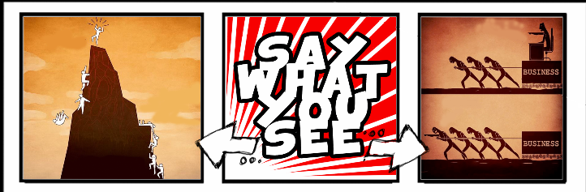

Slide 13
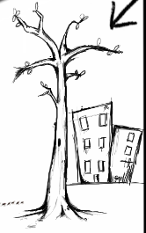
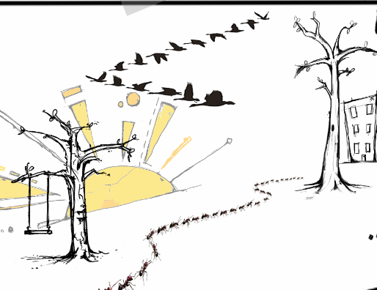

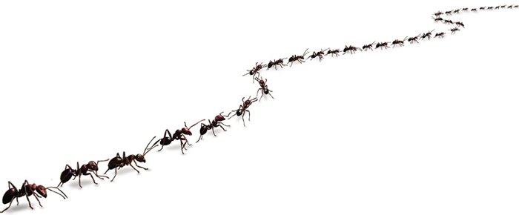
Are you a an ant or a duck?

Slide 14
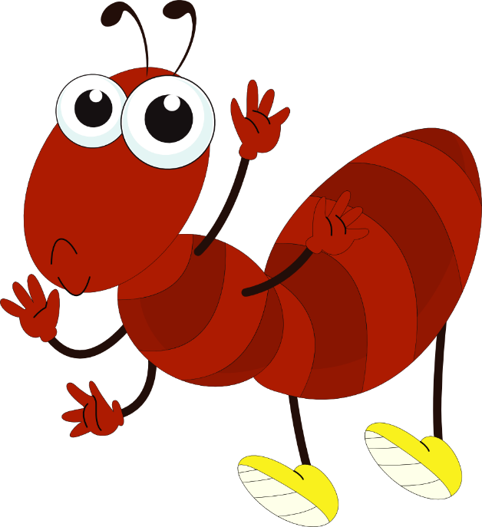

Let’s consider the Ant
Ants work together to overcome any obstacle
Qualities of the ant
Strong
Team working
Tenacious
Tireless
Organised
Uncompromising
Fierce
Structured
Hierarchical

Slide 15
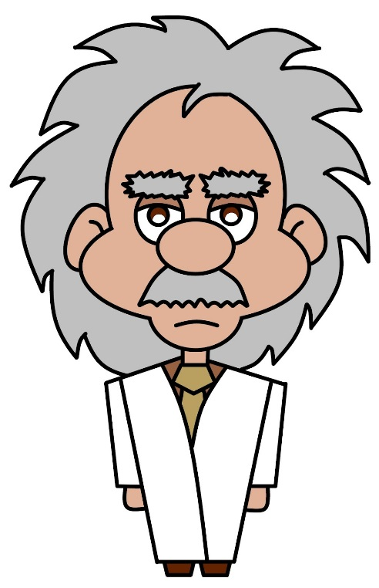
Transactional Leadership
Isn’t about changing the future.
It’s about getting the job done.
Transactional Leaders exchange rewards and punishments according to the quantity/quality of the work produced.
“If people are good only because they fear punishment,
and hope for reward then we are a sorry lot indeed.”
(Albert Einstein)

Slide 16
Transactional Leadership
Transactional leadership places Great
importance on short term goals & the observance of standard
operating procedures & Rules

Slide 17
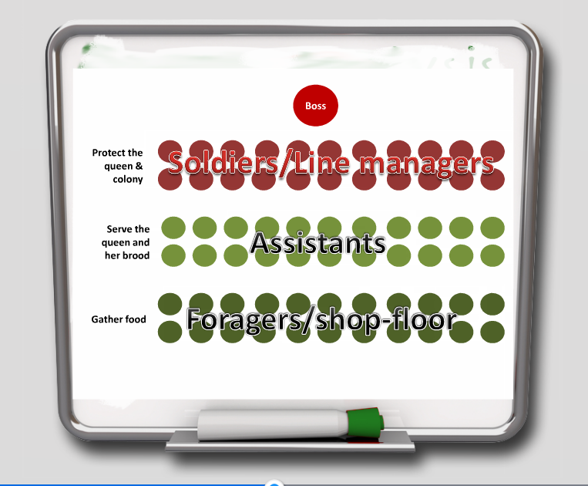

Slide 18
Ants do not always meet their goal
Some obstacles stop the colony from progress

Slide 19
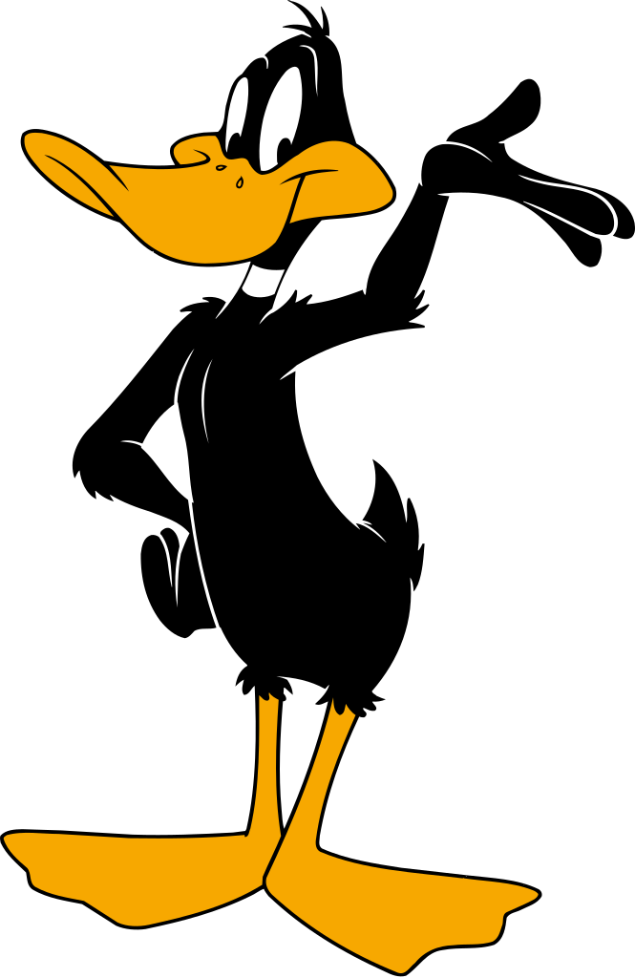
Now Ducks
Qualities of Ducks
Team work
Supportive
Intelligent
Focused
Tireless
Trusting
Sharing
Compromising
Successful

Slide 20
Lessons from nature

Slide 21
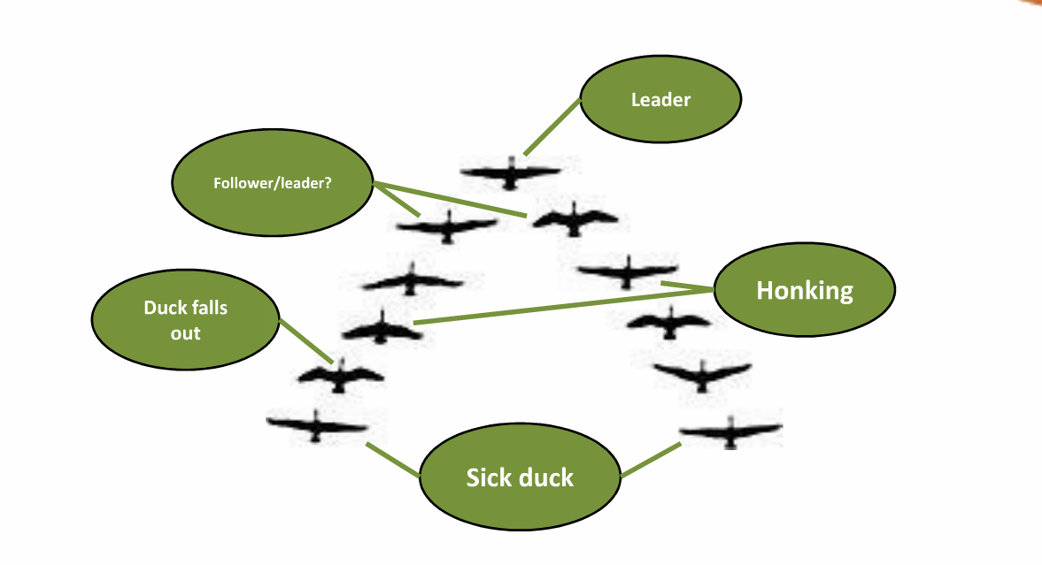

Slide 22
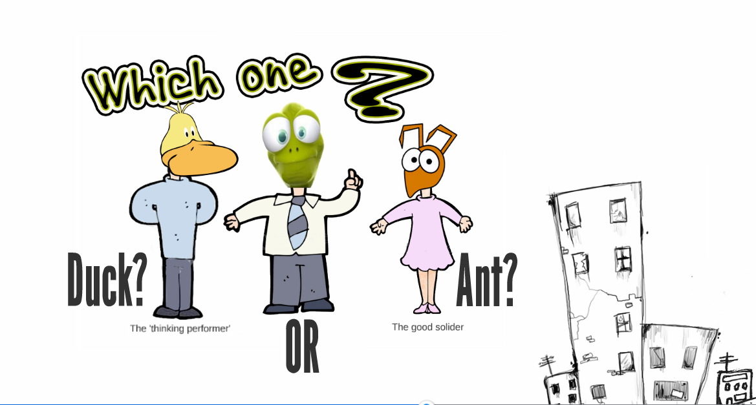

Slide 23
Spot the leader

