Slide 1
ECES6008/C
Radical Education
Addysg Radical
Sesiwn 3 / Session 3

Slide 2
Module Aims
Amcanion
Rhoi cyfle i fyfyrwyr ystyried posibiliadau ar gyfer strwythurau ac ystyron addysgol hollol wahanol. Defnyddir llawer o’r gwaith a wnaed yn y ddwy flynedd flaenorol i ddatblygu safbwyntiau beirniadol ar addysg ac i archwilio ffyrdd eraill o gysyniadoli.
Anogir myfyrwyr i feddwl yn feirniadol ac yn greadigol a rhoddir cyfle iddynt lunio ac amddiffyn eu datblygiadau addysgol newydd eu hunain
Give students the opportunity to consider possibilities for radically different educational structures and meanings. It will make use of much of the work covered in the previous two years to develop critical perspectives on education and to explore alternative conceptualizations
Students will be encouraged to think critically and creatively and will have the chance to produce and defend their own educational innovations

Slide 3

Learning Outcomes
Deilliannau Dysgu
Gynnig beirniadaeth eang o strwythurau addysgol traddodiadol (yn cynnwys addysg, cwricwlwm, asesu, addysgeg).
Offer a broad critique of traditional educational structures (including schooling, curriculum, assessment, pedagogy).

Slide 4

Learning Outcomes
Deilliannau Dysgu
Dangos ymwybyddiaeth feirniadol o ddamcaniaethau radical allweddol, dulliau o gysyniadoli a gweledigaethau o addysg (yn enwedig addysgeg feirniadol)
Demonstrate a critical awareness of key radical theories, conceptualizations and visions of education (in particular critical pedagogy)

Slide 5

Learning Outcomes
Deilliannau Dysgu
Datblygu ymagweddau dychmygus ac arloesol ar addysg, cwricwlwm, asesu, y dosbarth a deunyddiau dysgu ac addysgu eraill
Develop imaginative and innovative approaches to schooling, curriculum, assessment, the classroom and other learning and teaching materials

Slide 6


Learning Outcomes
Deilliannau Dysgu
Trefnu eu gwybodaeth a’r hyn y maent wedi’i ddysgu drwy ddefnyddio amrywiaeth o ffynonellau gwybodaeth, gan gynnwys TGCh, a chyflwyno’u gwaith ar y lefel briodol
Organize their knowledge and learning through the use of a range of information sources, including ICT and present their work at the appropriate level.

Slide 7


Imagine…
Dychmygwch…
What would a world where school had never been invented look like?
Beth fyddai byd ble mae ysgol heb ei greu yn edrych fel?

Slide 8
John Holt
(1923-1985)
Athro Americanaidd ac awdur addysg dadleuol a hyrwyddodd diwygiad mewn ysgolion ac a ddaeth yn un o’r grymoedd y tu ôl i’r symudiad dysgu yn y cartref yn y 70au a’r 80au.
Ysgrifennodd 10 o lyfrau am addysg a dechreuodd y cylchgrawn Growing Without Schooling.
John Holt was an American teacher and controversial education writer who advocated school reform and ultimately became one of the forces behind the homeschooling movement of the 70’s and 80’s.
He wrote ten books about education and founded the magazine Growing Without Schooling.

Slide 9
Syniadau Radicalaidd
Radical Ideas
Yn ei ddyddiau cynnar fel addysgwr, ceisiodd ddiwygio’r system addysg.
“Children do poorly in school because they’re bored with the meaningless work . . In essence I’d realized, from observing and teaching, that school is a place where children learn to be stupid!” (Holt)
In his early days of teaching, John Holt tried to reform the educational system.
“Children do poorly in school because they’re bored with the meaningless work... In essence I’d realized, from observing and teaching, that school is a place where children learn to be stupid!” (Holt)

Slide 10

Methiant… Ofn, Diflasrwydd a Dryswch
Failure… Fear, Boredom and Confusion
“It's not that I feel that school is a good idea gone wrong, but a wrong idea from the word go. It's a nutty notion that we can have a place where nothing but learning happens, cut off from the rest of life.“
John Holt

Slide 11
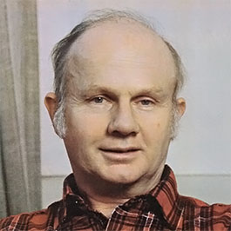
Beth oedd Holt yn credu am ddysgu?
What did Holt believe about learning?
Listen to Holt describe some of his key ideas about learning.
Write a list of any key messages or important ideas Holt shares about his beliefs of learning.
Gwrandewch i Holt yn esbonio ei syniadau ef ynglyn a dysgu.
Ysgrifennwch rhestr o’i brif syniadau neu negeseuon sy’n ymwneud a dysgu.
Holt ac Addysg/ Holt and Education

Slide 12
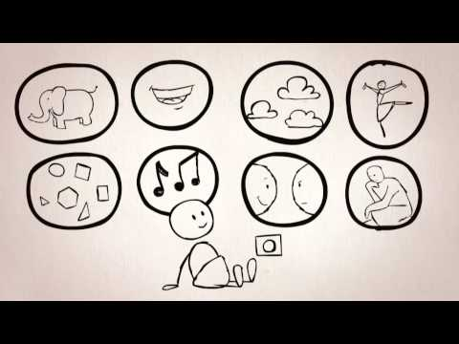
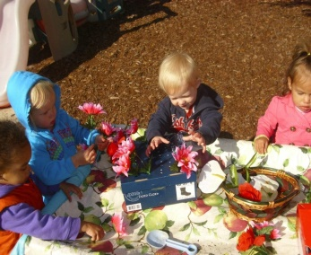

Syniadau Holt am Ddysgu
Holt’s Ideas about Learning
Geni fel dysgwyr
Born Learners
Diddordeb naturiol
Natural Curiosity – begins from birth
Hunain-arwain gan y plentyn
Driven by the child themselves

Slide 13
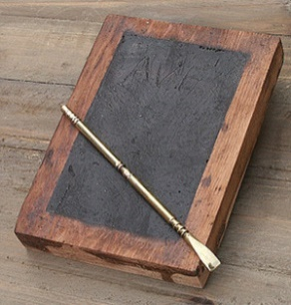

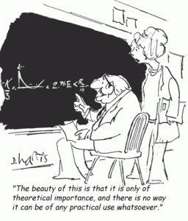
Gwrthododd Holt…
Holt Rejected…
The notion of the child as ‘Tabula Rasa’
The industrial setting of schools
Teaching knowledge through abstract methods
Syniad fod plant fel ‘Tabula Rasa’
Natur ddiwydiannol strwythurau ysgol
Dysgu gwybodaeth trwy ddulliau haniaethol

Slide 14
Credai Holt…
Holt believed…
Mae addysg ffurfiol yn aml yn difetha cariad naturiol at ddysgu
Mae gwobrau allanol yn ddinistriol i ddysgwyr yn y pendraw
Mae pobl yn deall orau o brofiadau bywyd go iawn
Dylai addysg gael ei yrru gan y dysgwr
Formal schooling often destroys the natural love of learning
Extrinsic rewards are ultimately harmful to learners
People learn the best from real-life experiences
Education should be driven by the learner

Slide 15
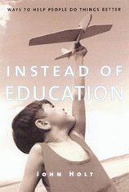
Geni er Mwyn Dysgu
Born to Learn
“The human animal is a learning animal. We like to learn; we need to learn; we are good at it; we don’t need to be shown how or made to do it, made to do it. What kills the processes are the people interfering with it or trying to regulate it or control it.”
(Holt )

Slide 16

“Unschooling”
Gan ystyried y wybodaeth sydd wedi cyflwyno cyn belled, beth gall Holt wedi golygu wrth y gair ‘unschooling’?
Based on what you’ve heard so far, what do you think Holt may have meant by the term ‘unschooling’?

Slide 17
Symud Addysg i’r Catref
From ‘Unschooling’ to ‘Home Schooling’
Fel hyrwyddwr ar gyfer dysgu adref, roedd Holt yn annog rhieni i adael y ‘myfyrwyr’ i arwain y dysgu a’u cynorthwyo i ddod o hyd i brofiadau bywyd go iawn.
As a homeschooling advocate, John Holt encouraged parents to let the “students” lead the learning and help them find legitimate, real-life experiences.
“I think that learning is not the result of teaching, but of the curiosity and activity of the learner. A teacher’s intervention in this process should be mostly to provide the learner with access to the various kinds of places, people, experiences, tools, and books that will correspond with that student’s interests… answer questions when they’re asked . . . and demonstrate physical skills.” (Holt)

Slide 18
Rôl yr Addysgwr
Role of the Educator
Rôl oddefol
Mae angen rhoi amser i blant i ddysgu
Cefnogi pan ofynnwyd a pheidio ymyrryd
I arwain a hyrwyddo
Arsylwi eraill (enwedig rhieni)
A passive role
Educators need to give children plenty of time to learn
Support only when asked and not interfere
To guide and to facilitate
Observation of others (esp. parents)

Slide 19

Tasg
Task
Gwobrau allanol
Ystyriwch ac adlewyrchwch
Profiad plant o wobrau allanol
Eich profiad o wobrau allanol fel oedolyn
Extrinsic rewards
Consider and reflect
Children’s experiences of extrinsic rewards
Your experience of extrinsic rewards as an adult

Slide 20

Llwybr Newydd
A New Path
Mae llyfrau Holt Instead of Education: Ways to Help People do Things Better, How Children Learn ac How Children Fail dal yn boblogaidd ymysg rhieni a phobl sydd yn edrych am addysg hunan- gyfeiriedig
John Holt’s books Instead of Education: Ways to Help People do Things Better, How Children Learn and How Children Fail are still popular among parents and people seeking a self-directed education.

Slide 21
Methiant yw dysgu…
Failing is learning…
Er iddo hyrwyddo addysg wedi ei gyfeirio gan y dysgwr, doedd y neges ddim ynglyn ac annog bobl i gymryd y ffordd hawdd.
Credai Holt fod pobl mwyaf galluog pan oeddent yn hollol rhydd i ddysgu.
Although he advocated for learner-directed education, John Holt’s message wasn’t about encouraging people to take the easy way out.
Holt believed that people were the most capable when they were completely free to learn.
“Maybe I’m kind of old-fashioned, but I don’t think the currently popular ‘therapeutic’ methods-which involve telling someone, ‘You’re OK, you’re really wonderful’ -do much good. Tackling a job that seems worth doing, and doing it in a competent manner, is-to my way of thinking-the best way for a person to gain self-esteem.”

Slide 22

Er fod gwaith Holt yn trafod plant, mae’r neges yn medru cael ei gymhwyso at ddysgwyr o bob oedran.
Although John Holt’s work primarily discusses children, the overall message can be applied to learners of all ages.

Slide 23
Etifeddiaeth
Legacy
Medr teuluoedd sydd yn dysgu adref heddiw ddiolch i John Holt am gyfreithloni’r symudiad. Parha nifer o rhieni i ddibynnu ar gyhoeddiadau Holt tra’n datblygu eu athroniaethau addysgol eu hunain.
Er fod addysgwyr traddodiadol yn edrych ar ysgrifennu Holt fel petai yn rhy radical, gall fod rhai o’i syniadau wedi dod mewn i feddwl prif ffrwd.
Today’s homeschooling families can thank John Holt for his efforts in giving the movement legitimacy. Many home-school parents continue to rely on Holt’s publications when developing their own educational philosophies.
Although traditional educators tend to view Holt’s writings as too radical, some of his ideas have made their way into mainstream thought.

Slide 24
Tasg
Task
Gwyliwch / Watch 'Changing Paradigms'
Ystyriwch impact damcaniaethau Holt ar feddwl prif ffrwd
  Profiadau?
  Cyfleoedd?
  Heriau?
Consider the impact of Holt’s theories on mainstream thought
  Experiences?
  Opportunities?
  Challenges?

Slide 25
Adlewyrchu:
Reflection:
Mewn grŵp o dri, dewiswch tri o brif syniadau Holt neu Robinson.
Beth fyddai ysgol sy’n mabwysiadu’r rhain yn edrych fel?
Cysylltwch i’r aseiniad – sut gall cynllun eich ysgol chi adlewyrchu’r syniadau yma?
In groups of three, choose three of Holt’s or Robinson’s ideas.
What would happen if they were applied in a school context?
Link to assignment – how could your school design reflect or incorporate these ideas?

Slide 26
Llyfryddiaeth
Bibliography
Farenga, P (2013) John Holt GWS. Available at http://www.johnholtgws.com/. (Accessed 28/01/2016).
Holt, J. (1984) How Children Learn. Harmondsworth: Pelican.
Holt, J. (1990) How Children Fail. Harmondsworth: Penguin.
YMCA George Williams College (No Date) John Holt: Learning and (Un)Schooling. Available at http://infed.org/mobi/john-holt-learning-and-unschooling/. (Accessed 28/01/2016).

