Slide 1
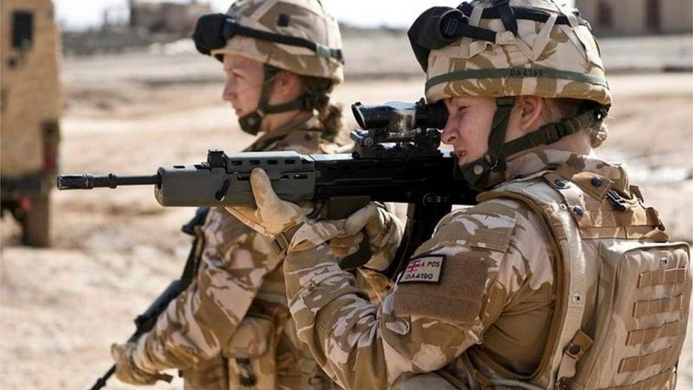
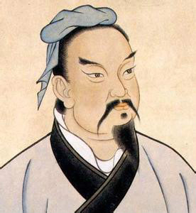
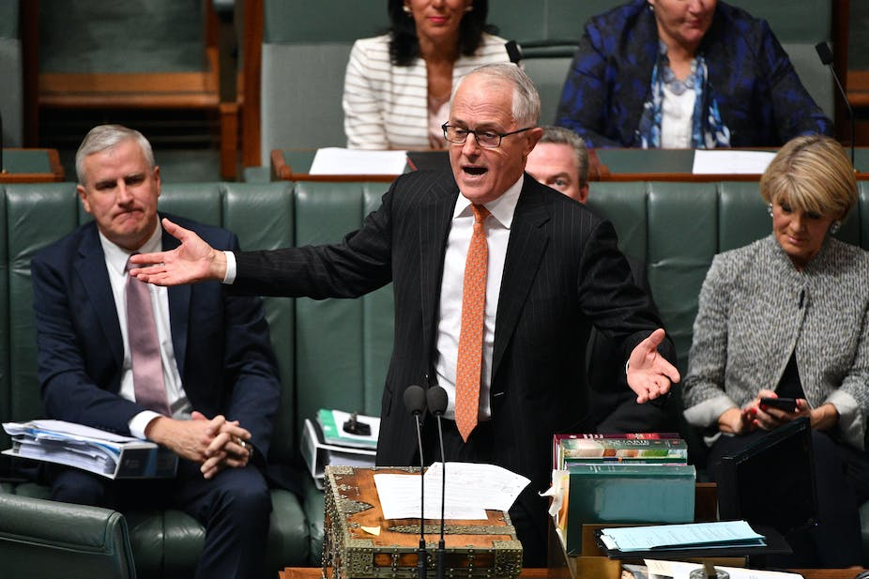
How has Sun Tzu's Art of War influenced modern-day lives?
Sun Tzu's Arts of War
HPHI5906 - Assignment 1
Katie L Pullen-O’Brien
Notes:
Image References:
Mick Tsikas (photographer), ‘If the politicians took a higher road, at least there would be pressure on the media to follow’ <https://theconversation.com/if-politicians-want-more-trust-from-voters-they-need-to-start-behaving-with-civility-and-respect-99010> [accessed 17 December 2023].
Ministry of Defence (photographer), ‘Women to serve in close combat roles in the British military’ <https://www.bbc.com/news/uk-36746917> [accessed 17 December 2023].
Unknown author, ‘Qing-era representation of Sun Tzu’ <https://en.wikipedia.org/wiki/Sun_Tzu#/media/File:吴司马孙武.jpg> [accessed 17 December 2023].

Slide 2
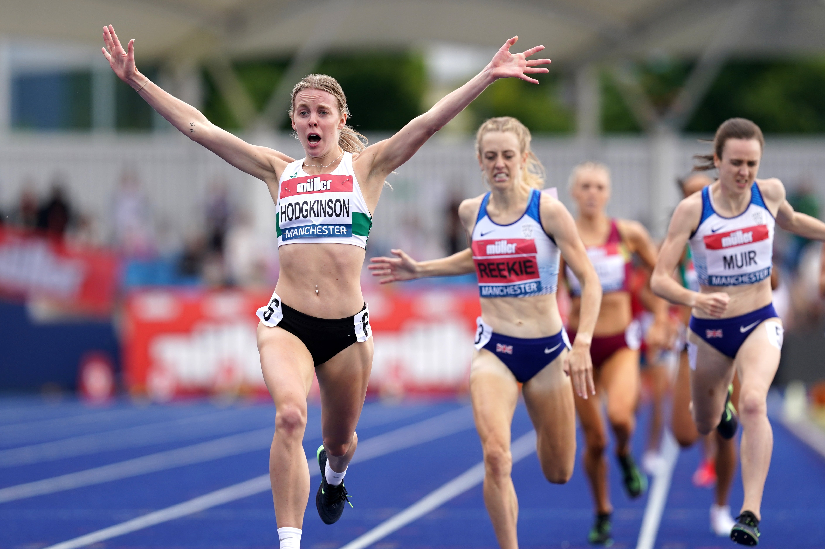

Index
Introduction – Who is Sun Tzu & the Art of War?
How has Art of War influenced the world?
  Military/ Warfare
  Sport
  Politics
  Business
Bibliography
Notes:
Image:
PA Wire (photographer) ‘Keely Hodgkinson celebrates’ <https://www.independent.co.uk/sport/shellyann-fraserpryce-adam-gemili-tokyo-team-gb-keely-hodgkinson-b1874079.html> [accessed 17 December 2023].
Davor Geber (photographer) ‘The tribunal case centred around an employee’s reference to a colleague’s status as a grandmother. <https://www.cio.com/article/288554/best-practices-how-to-create-an-effective-business-continuity-plan.html> [accessed 08 January 2024].

Slide 3
Introduction –
Who is Sun Tzu & the Art of War?
Sun Tzu was a trusted advisor to the King of Wu in the late sixth century BCE.
His book The Art of War is governed by five key factors: Moral Law, Heaven, Earth, Commander, and Method and Discipline.
The Art of War has inspired world leaders for centuries with its ancient manuscript on military tactics. Even in modern warfare, we can see the influence of Sun Tzu's writings.
Sun Tzu's strategies have continued to shape the thinking of generals and leaders worldwide.
The book emphasises preparation, strategic thinking, and understanding one's strengths and weaknesses and those of the opponent.
Sun Tzu's Art of War is essential reading for anyone seeking success in competitive environments.
Notes:
Sun Tzu, also known as Sun Wu or Sunzi, was a trusted advisor to the King of Wu in the sixth century BCE. His work was compiled during the final century of the Zhanguo period (475-221 BCE).
The Art of War is a timeless Chinese general Sun Tzu masterpiece. In this book, he combined his philosophical and strategic knowledge to create a work that has inspired world leaders for centuries with its ancient manuscript on military tactics. Even in modern warfare, we can see the influence of Sun Tzu's writings, which is a testament to the lasting power of his words. His strategies continue to shape the thinking of generals and leaders worldwide.
Sun Tzu's Art of War has dramatically impacted modern-day life. This influential book has been studied by military strategists, business leaders, and politicians worldwide, and its principles have been applied in various fields. The book emphasises preparation, strategic thinking, and understanding one's strengths and weaknesses, as well as those of the opponent, which has proven incredibly valuable. With its guidance on effective leadership, conflict resolution, and problem-solving, Sun Tzu's Art of War is essential for anyone seeking success in competitive environments.
Professors consider this one of the best books on strategy and warfare.
Referencing:
Sun Tzu and Michael Nylan, Art of War (New York: W. W. Norton & Company, 2020).
Manuel Poejo Torres, Sun Tzu Art of War (2018) <https://www.jwc.nato.int/images/stories/threeswords/SUNTZU_2018.pdf> [accessed 19 December 2023].

Slide 4
So…
How has Art of War influenced the world?
“The supreme art of war is to subdue the enemy without fighting.” - Sun Tzu
The Art of War by Sun Tzu has significantly impacted various fields.
Its principles have been universally applied, leading to unprecedented success across multiple industries and disciplines.
The book's timeless teachings inspire and guide individuals and organisations today.
Sun Tzu's ideas can be interpreted independently, whether practical or valuable.
Notes:
"The supreme art of war is to subdue the enemy without fighting," - Sun Tzu.
Sun Tzu's book The Art of War has significantly impacted fields like military strategy, leadership, politics, and philosophy. His book is still relevant today and helps people think strategically and adapt. Sun Tzu's ideas are timeless and have influenced many different areas, resulting in great success. Even though societies have changed since he wrote it, his book is helpful. People can interpret his ideas in their way, but they are practical and valuable.
An analogy to explain the influence of Art of War on the world would be that of a playbook used in sports. Just as a playbook provides strategies, tactics, and techniques for a team to win a game, Art of War offers similar guidance for winning battles. The book's teachings have been applied not only to warfare but also to business, politics, and other fields where competition and strategy play a critical role. Just as a successful sports team uses their playbook to gain an advantage over its opponents, individuals and organisations have used the Art of War to gain an edge in their respective fields.
Referencing:
Tzu and Nylan, Art of War.
Jozef Hlavaty & Jan Lizbetin, ‘The Use of the Art of War Ideas in the Strategic Decision-making of the Company’, Transportation Research Procedia, 55 (2021), 1273-1280. <https://www.sciencedirect.com/science/article/pii/S2352146521005251?via%3Dihub> [accessed 07 January 2024].

Slide 5
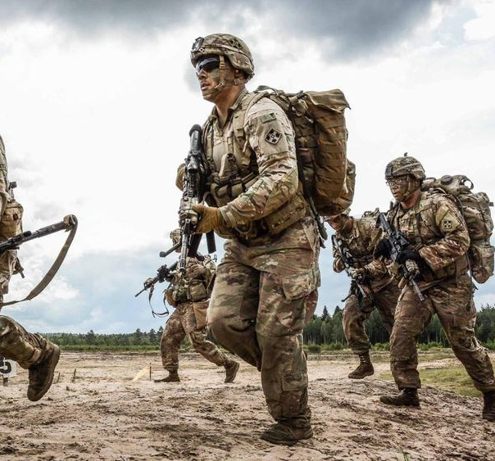
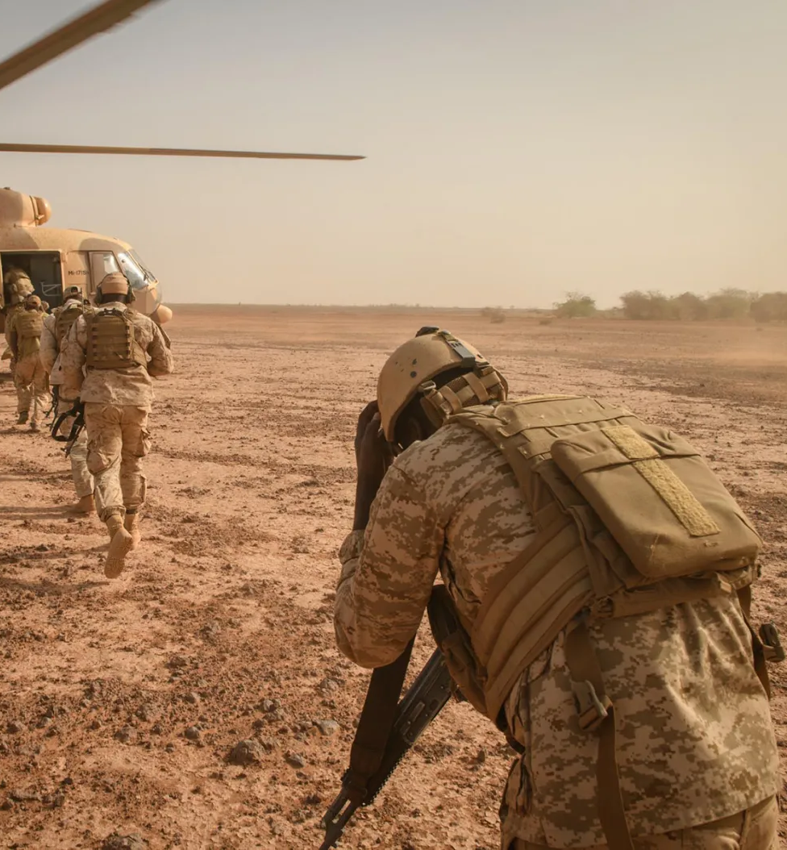
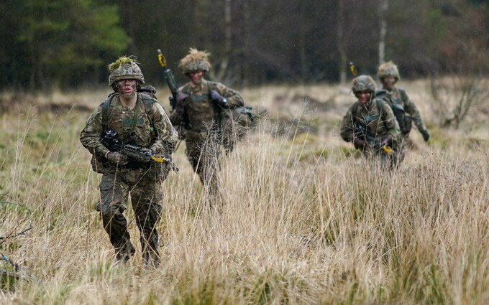
Military/ Warfare
Sun Tzu's teachings have influenced military strategy and tactics. His principles include understanding the terrain, knowing the enemy, and adapting strategies to exploit weaknesses.
Deception and psychological tactics have also been integral to warfare. Adapting to changing circumstances, intelligence gathering, and effective leadership are crucial principles of Sun Tzu's teachings.
Notes:
Sun Tzu's The Art of War has been widely applied in warfare, influencing military strategies, tactics, leadership, and decision-making throughout history. Its teachings have been used for strategic planning and tactical execution, deception and psychological warfare, adaptability and flexibility, intelligence gathering and analysis, leadership and command. The principles of understanding the terrain, knowing the enemy, adapting strategies, and effective leadership have all been drawn from "The Art of War" and applied by military commanders in leading their forces to victory.
Military commanders have used Sun Tzu's teachings to create strategic plans and execute tactics. The teachings emphasise understanding the terrain, knowing the enemy, and adapting strategies to exploit weaknesses. Deception, misinformation, and uncertainty have also been employed to gain strategic advantages, deceive opponents, and weaken their morale. Adapting to changing circumstances on the battlefield, altering tactics based on enemy movements, and responding swiftly to unexpected situations are crucial to success. Understanding the enemy's capabilities, intentions, and weaknesses through surveillance, espionage, and information gathering is also essential. Leaders can apply Sun Tzu's principles in effective leadership, strategic decision-making, and fostering troop unity.
For my second assignment, I will focus on the relevance of Sun Tzu's Art of War in modern warfare and its influence on the military.
World War II - Operation Fortitude: -- FIND EVIDENCE
During World War II, the Allies used strategic deception tactics similar to those taught by Sun Tzu. Operation Fortitude, a crucial part of the D-Day invasion, involved spreading false information and setting up decoy operations to confuse German forces about the actual location of the invasion. This psychological warfare and strategic deception aligned with Sun Tzu's focus on deceiving the enemy.
Referencing:
Torres, 2018.
Michael Howard & Peter Paret, On War (New Jersey: Princeton University Press, 1976).
Images:
Andrew Craft (photographer) ‘Soldiers with the 1st Expeditionary Force of Niger (EFoN), the country’s premier anti-terrorism unit, take part in an air interdiction exercise.’ <https://www.rollingstone.com/politics/politics-features/war-or-terror-africa-sahel-niger-pentagon-1234612083/> [accessed 17 December 2023].
Ian Forsyth (photographer), ‘The number of Army soldiers has dropped by 4 per cent in the last year, down to just 75,983’ <https://www.telegraph.co.uk/news/2023/12/16/troop-numbers-british-armed-forces-falls-record-low/> [accessed 17 December 2023].
Lithuanian Land Forces (photographer), ‘Will to Fight’ <https://www.rand.org/pubs/research_briefs/RB10040.html> [accessed 17 December 2023].
Ministry of Defence (photographer), ‘Women to serve in close combat roles in the British military’ <https://www.bbc.com/news/uk-36746917> [accessed 17 December 2023].

Slide 6
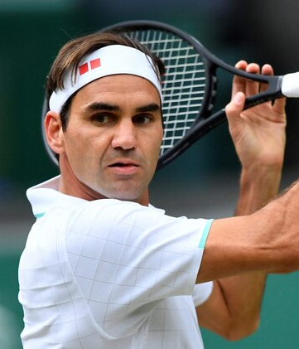
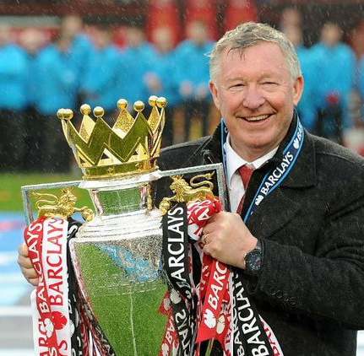
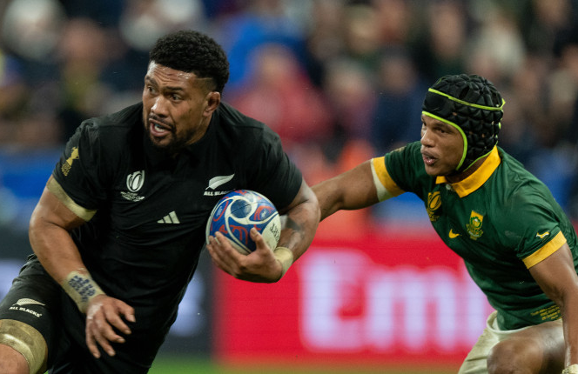
Sport
The Art of War by Sun Tzu has influenced sports significantly.
Athletes, coaches, and strategists often correlate Sun Tzu's teachings with sports tactics.
The book has impacted sports in several ways: strategic thinking, psychological insights, preparation and planning, adaptability, leadership, and teamwork.
The ethical implications of using psychological warfare, exploiting weaknesses, and winning without confrontation raise questions about fair play, sportsmanship, and ethical boundaries in competitive sports.
The Art of War is a timeless wisdom that athletes and coaches can use to enhance their performance and approach to competitive sports.
Notes:
The Art of War, a book written initially about military strategy, has significantly impacted sports. The book's teachings share similarities with sports tactics, which athletes, coaches, and strategists use to gain an advantage over opponents. Sun Tzu's guidance has even been applied to games like chess, which require strategic thinking.
Athletes have found Sun Tzu's psychological insights helpful in understanding their opponents' mindsets, taking advantage of weaknesses, and controlling their emotions. These tactics help athletes outmanoeuvre opponents without confrontation.
Sun Tzu's teachings on preparation and planning also apply to sports training and game preparation. Athletes and coaches use them to assess opponents' strengths and weaknesses and create effective game plans.
Adaptability is critical in sports, and Sun Tzu's teachings on flexibility and adaptability are reflected in sports strategies that require quick adjustments based on changing game situations. Athletes often adapt tactics mid-game, mirroring Sun Tzu's emphasis on flexibility in strategy.
Effective leadership, motivation, and unity are essential for sports teams to achieve their goals. The Art of War by Sun Tzu guides these principles. However, using psychological tactics, exploiting weaknesses, and winning unfairly in competitive sports raise ethical concerns.
Athletes and coaches use The Art of War to enhance their performance and approach to competitive sports. It is essential to consider fair play, sportsmanship, and ethical boundaries in sports.
Specific examples:
Rugby: New Zealand All Blacks' Team Culture
The rugby team of New Zealand, also known as the All Blacks, has a well-established reputation for success and a strong team culture. The team draws inspiration from "The Art of War" regarding their approach to leadership, unity, and mental preparation. Sun Tzu's teachings on effective teamwork and leadership align with the team's emphasis on leadership, adapting strategies, and fostering unity among players.
Football: Sir Alex Ferguson's Leadership (Manchester United)
Sir Alex Ferguson (3), the renowned manager of Manchester United, was a master of football management who drew inspiration from the ancient military strategist Sun Tzu. Following Sun Tzu's principles, Ferguson achieved unparalleled success and created a lasting legacy in the sport. He prepared meticulously for every game, analysed his opponents' weaknesses, and adjusted his tactics on the fly - all by Sun Tzu's teachings on strategy and flexibility. Additionally, Ferguson's ability to inspire and motivate his team to greatness directly resulted from his deep understanding of Sun Tzu's philosophy. By studying the ancient text and applying its lessons to football, Ferguson elevated himself to the highest level of managerial excellence, leaving a lasting impact on the sport that is still felt today.
Tennis: Roger Federer's Strategic Adaptability
Roger Federer, regarded as one of the greatest tennis players of all time, demonstrated strategic adaptability compared to Sun Tzu's teachings. His exceptional ability to analyse his opponents, make necessary adjustments during the game and exploit their weaknesses showcased his strategic prowess, reminiscent of Sun Tzu's emphasis on adaptability and understanding one's adversaries.
Referencing:
Robin Bairner, Sir Alex Ferguson: Manchester United history & managerial career profiled (2019) <https://www.goal.com/en-tza/news/sir-alex-ferguson-manchester-united-history--managerial-career-profiled/1oeahji6r8eu6189gihl5qfu3y> [accessed 06 January 2024]
RogerFederer.com, profile, (2024) <https://rogerfederer.com/index.php/profile> [accessed 06 Janaury 2024].
Grant, Robert M. Grant 'The Resource-Based Theory of Competitive Advantage: Implications for Strategy Formulation', California Management Review, 33.3 (1991), 1-33 (p.8). [https://www.blackwellpublishing.com/content/BPL_Images/Content_store/Sample_Chapter/0631231358/grant.pdf> [accessed 07 January 2024].
New Zealand Rugby (2024) <https://www.allblacks.com> [accessed 07 January 2024].
The Sports Vault, The Art of War in Modern-Day Sports [video]. 2022 <https://youtu.be/ofxqQOdGjWs?si=YOWCKyJGKoV9KQhH> [accessed 07 January 2024].
Images:
All Blacks.Com, ‘Ardie Savea Wins Top Prize At Asb Rugby Awards’ <https://www.Allblacks.Com/Fixtures/All-blacks/> [accessed 17 December 2023].
Reuters (photographer) ‘Roger Federer underwent triple knee surgery’ <https://www.telegraph.co.uk/tennis/2022/02/02/roger-federer-facing-make-break-months-return-balance/> [accessed 17 December 2023].
Sky Sports (photographer) <https://www.skysports.com/football/news/11096/8916447/premier-league-former-manchester-united-manager-sir-alex-ferguson-reveals-blueprint> [accessed 17 December 2023].
PA Wire, ‘Keely Hodgkinson celebrates’, 2021.

Slide 7
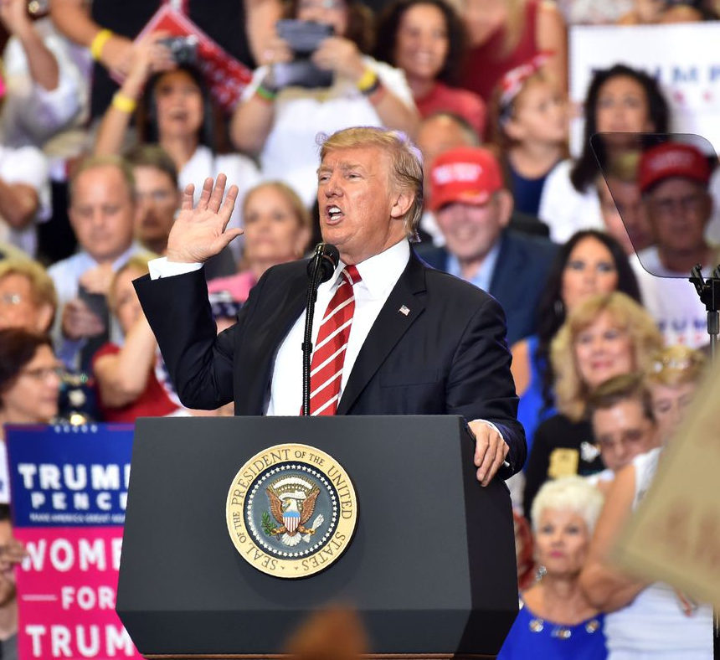
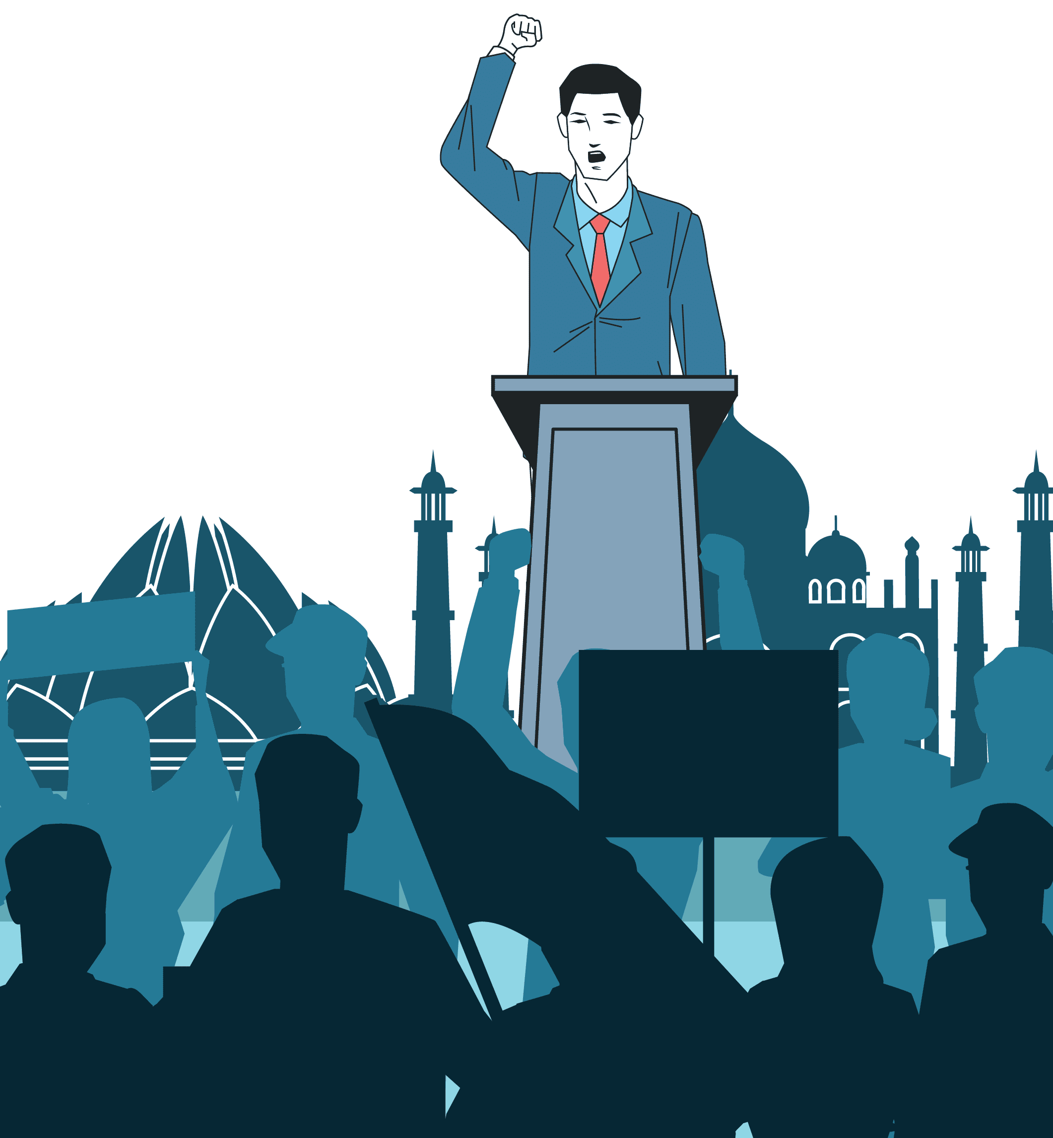
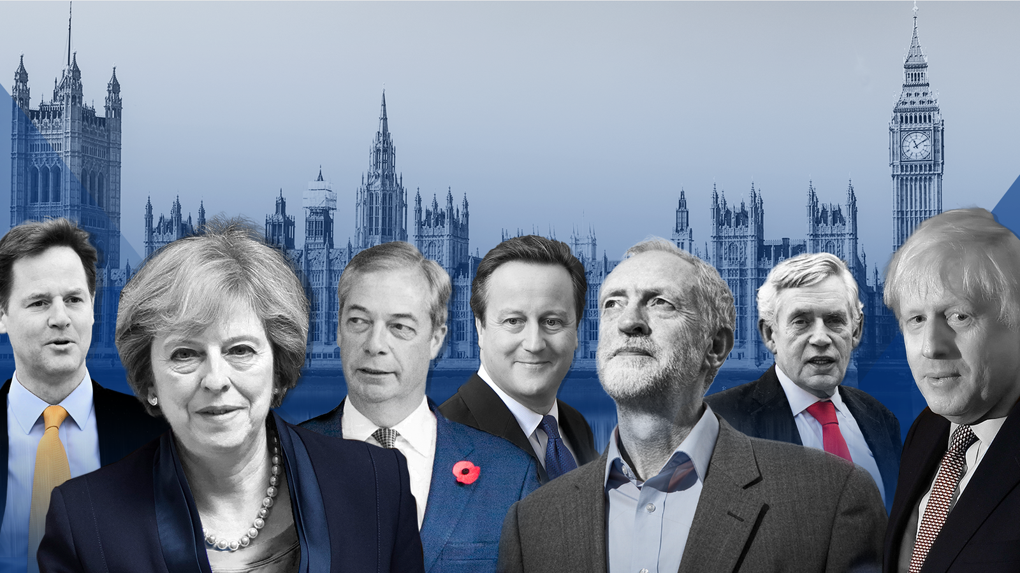
Politics
The Art of War has had a significant impact on politics. Politicians and leaders have studied and applied its principles to their strategies.
The book highlights the importance of understanding oneself and one's opponent and the significance of deception, patience, and flexibility in achieving victory.
The principles have been implemented in campaigns, negotiations, and policy-making. Its teachings continue to be studied and applied by leaders worldwide.
Notes:
The Art of War has had a significant impact on politics. Many politicians and leaders have studied and applied its principles to their strategies. The book highlights the importance of understanding oneself and one's opponent and the significance of deception, patience, and flexibility in achieving victory.
Politicians have implemented these principles in their campaigns, negotiations, and policy-making. For instance, some have used the "knowing your enemy" principle to gather intelligence and identify their opponents' weaknesses. Others have exercised the principle of "patience" to wait for the right moment to make a move or negotiate a deal. Overall, the Art of War has significantly influenced politics, and its teachings continue to be studied and applied by leaders worldwide.
References:
Keerthiraj, Bhup Singh Gaur & Mutyala Suresh, 'From Battlefield to Ballot Box: Applying Sun Tzu's Principles in Modern Political Campaigns', Social Science Journal, 13.3 (2023), 1-1860 <https://resmilitaris.net/menu-script/index.php/resmilitaris/article/view/3622> [accessed 07 January 2024].
Photos:
Gerardo Giuseppe Ramos Granada (photographer), ‘man making a speech and audience silhouette’ <https://www.vecteezy.com/vector-art/655023-man-making-a-speech-and-audience-silhouette> [accessed 17 December 2023].
Jeffrey McWhorter (photographer), ‘Donald Trump speaks during a campaign rally in Dallas’ <https://www.alamy.com/president-donald-trump-speaks-during-a-campaign-rally-thursday-oct-17-2019-at-the-american-airlines-center-in-dallas-ap-photojeffrey-mcwhorter-image510096526.html> [accessed 17 December 2023].
Sky News, ‘The 2010s saw four prime ministers and three referendums’ <https://news.sky.com/story/the-2010s-a-decade-that-shook-the-foundations-of-british-politics-11894896> [accessed 17 December 2023].
Tsikas (photographer) ’If the politicians took a higher road, at least there would be pressure on the media to follow’ <https://theconversation.com/if-politicians-want-more-trust-from-voters-they-need-to-start-behaving-with-civility-and-respect-99010> [accessed 17 December 2023].

Slide 8



Business
Business executives can benefit by using the principles of The Art of War by Sun Tzu.
The book has influenced management practices and has been applied to various aspects of business operations such as leadership, innovation, risk management, competition analysis, strategic planning, market positioning, negotiations, and alliances.
Sun Tzu's teachings help companies gain insights into the market and competition, adapt to changing market dynamics, and minimise and promote effective teamwork.
The principles derived from The Art of War guide decision-making and business strategies in the corporate world.
Notes:
The Art of War by Sun Tzu is a book that has significantly influenced business strategy and management practices. Its principles have been applied metaphorically to various aspects of business, such as strategic planning, competition analysis, market positioning, leadership, innovation, risk management, negotiations, and alliances.
Businesses have utilised Sun Tzu's teachings to understand their market and competition, adapt to changing market dynamics, minimise risks, and promote effective teamwork. The principles derived from The Art of War have been instrumental in guiding business decision-making and strategies in the corporate world.
Referencing:
Ron New, ‘Sun Tzu - The Art of War (in Your Business)’, LinkedIn, 24 February 2023. <https://www.linkedin.com/pulse/sun-tzu-art-war-your-business-ron-new> [accessed 07 January 2024].
Jozef Hlavaty & Jan Lizbetin, ‘The Use of the Art of War Ideas in the Strategic Decision-making of the Company’.
Images:
Geber (photographer) ‘The tribunal case centred around an employee’s reference to a colleague’s status as a grandmother’, 2021.
Getty (owner) <https://www.forbes.com/advisor/business/how-to-start-a-business/> [accessed 04 January 2024].
Harvard Business School Online (Unknown Photographer) <https://online.hbs.edu/blog/post/what-is-business-strategy> [accessed 04 January 2024].
Unknown (photographer) <https://www.linkedin.com/pulse/why-empowering-women-vital-successful-business-gerald-kühr> [accessed 04 January 2024].

Slide 9
Bibliography
Bairner, Robin, Sir Alex Ferguson: Manchester United history & managerial career profiled (2019) <https://www.goal.com/en-tza/news/sir-alex-ferguson-manchester-united-history--managerial-career-profiled/1oeahji6r8eu6189gihl5qfu3y> [accessed 06 January 2024]
Grant, Robert M. 'The Resource-Based Theory of Competitive Advantage: Implications for Strategy Formulation’, California Management Review, 33.3 (1991), 1-33 (p.8). <https://www.blackwellpublishing.com/content/BPL_Images/Content_store/Sample_Chapter/ 0631231358/grant.pdf> [accessed 07 January 2024]
Hlavaty, Jozef & Lizbetin, Jan, ‘The Use of the Art of War Ideas in the Strategic Decision-making of the Company’, Transportation Research Procedia, 55 (2021), 1273-1280. <https://www.sciencedirect.com/science/article/pii/S2352146521005251?via%3Dihub> [accessed 07 January 2024]
Howard, Michael & Peter Paret, On War (New Jersey: Princeton University Press, 1976)
Keerthiraj, Bhup Singh Gaur & Mutyala Suresh, 'From Battlefield to Ballot Box: Applying Sun Tzu's Principles in Modern Political Campaigns’, Social Science Journal, 13.3 (2023), 1-1860 <https://resmilitaris.net/menu-script/index.php/resmilitaris/article/view/3622> [accessed 07 January 2024]
New, Ron, ‘Sun Tzu - The Art of War (in Your Business)’, LinkedIn, 24 February 2023. <https://www.linkedin.com/pulse/sun-tzu-art-war-your-business-ron-new> [accessed 07 January 2024]
RogerFederer.com, profile, (2024) <https://rogerfederer.com/index.php/profile> [accessed 06 Janaury 2024].
The Sports Vault, The Art of War in Modern-Day Sports [video]. 2022 <https://youtu.be/ofxqQOdGjWs?si=YOWCKyJGKoV9KQhH> [accessed 07 January 2024]
Torres, Manuel Poejo, Sun Tzu Art of War (2018) <https://www.jwc.nato.int/images/stories/threeswords/SUNTZU_2018.pdf> [accessed 19 December 2023]
Tzu, Sun and Michael Nylan, Art of War (New York: W. W. Norton & Company, 2020)
New Zealand Rugby (2024) <https://www.allblacks.com> [accessed 07 January 2024]

Slide 10
Bibliography - Images
All Blacks.com, ‘Ardie Savea Wins Top Prize At Asb Rugby Awards’ <Https://Www.Allblacks.Com/Fixtures/All-blacks/> [accessed 17 December 2023]
Craft, Andrew (photographer) ‘Soldiers with the 1st Expeditionary Force of Niger (EFoN), the country’s premier anti-terrorism unit, take part in an air interdiction exercise.’ <https://www.rollingstone.com/politics/politics-features/war-or-terror-africa-sahel-niger-pentagon-1234612083/> [accessed 17 December 2023]
Davor, Geber (photographer) ‘The tribunal case centred around an employee’s reference to a colleague’s status as a grandmother.’ <https://www.cio.com/article/288554/best-practices-how-to-create-an-effective-business-continuity-plan.html> [accessed 08 January 2024]
Forsyth, Ian (photographer), ‘The number of Army soldiers has dropped by 4 per cent in the last year, down to just 75,983’ <https://www.telegraph.co.uk/news/2023/12/16/troop-numbers-british-armed-forces-falls-record-low/> [accessed 17 December 2023]
Getty (owner) <https://www.forbes.com/advisor/business/how-to-start-a-business/> [accessed 04 January 2024]
Granada, Gerardo Giuseppe Ramos (photographer), ‘man making a speech and audience silhouette’ <https://www.vecteezy.com/vector-art/655023-man-making-a-speech-and-audience-silhouette> [accessed 17 December 2023]
Harvard Business School Online (Unknown Photographer) <https://online.hbs.edu/blog/post/what-is-business-strategy> [accessed 04 January 2024]
Lithuanian Land Forces (photographer), ‘Will to Fight’ <https://www.rand.org/pubs/research_briefs/RB10040.html> [accessed 17 December 2023]
McWhorter, Jeffrey (photographer), ‘Donald Trump speaks during a campaign rally in Dallas’ <https://www.alamy.com/president-donald-trump-speaks-during-a-campaign-rally-thursday-oct-17-2019-at-the-american-airlines-center-in-dallas-ap- photojeffrey-mcwhorter-image510096526.html> [accessed 17 December 2023]

Slide 11
Bibliography - Images
Ministry of Defence (photographer), ‘Women to serve in close combat roles in the British military’ <https://www.bbc.com/news/uk-36746917> [accessed 17 December 2023]
PA Wire (photographer) ‘Keely Hodgkinson celebrates’ <https://www.independent.co.uk/sport/shellyann-fraserpryce-adam-gemili-tokyo-team-gb-keely-hodgkinson-b1874079.html> [accessed 17 December 2023]
Tsikas, Mick (photographer), ‘If the politicians took a higher road, at least there would be pressure on the media to follow’ <https://theconversation.com/if-politicians-want-more-trust-from-voters-they-need-to-start-behaving-with-civility-and-respect-99010> [accessed 17 December 2023]
Reuters (photographer) ‘Roger Federer underwent triple knee surgery’ <https://www.telegraph.co.uk/tennis/2022/02/02/roger-federer-facing-make-break-months-return-balance/> [accessed 17 December 2023]
Sky Sports (photographer), <https://www.skysports.com/football/news/11096/8916447/premier-league-former-manchester-united-manager-sir-alex-ferguson-reveals- blueprint> [accessed 17 December 2023]
Sky News, ‘The 2010s saw four prime ministers and three referendums’ <https://news.sky.com/story/the-2010s-a-decade-that-shook-the-foundations-of-british-politics-11894896> [accessed 17 December 2023]
Unknown (photographer) <https://www.linkedin.com/pulse/why-empowering-women-vital-successful-business-gerald-kühr> [accessed 04 January 2024]
Unknown (photographer), ‘Qing-era representation of Sun Tzu’ <https://en.wikipedia.org/wiki/Sun_Tzu#/media/File:吴司马孙武.jpg> [accessed 17 December 2023]

