Slide 1
ECED7001
Political: Influences on Inequality & Diversity
Phillip Morgan
Anarchism

Slide 2
Why do we believe what we believe?
What are the alternatives to accepting our current paradigm? What discourse are correct, correct for us right now? …and do we really have choice over our way in life and of life?

Slide 3
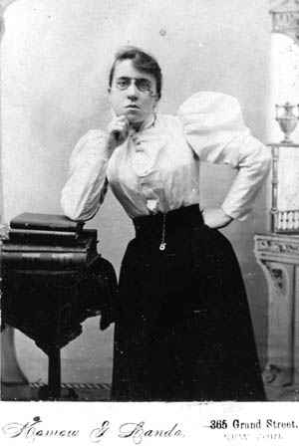
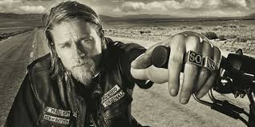
Sons of Anarchy
https://www.youtube.com/watch?v=EsskLNo6IlI

Slide 4
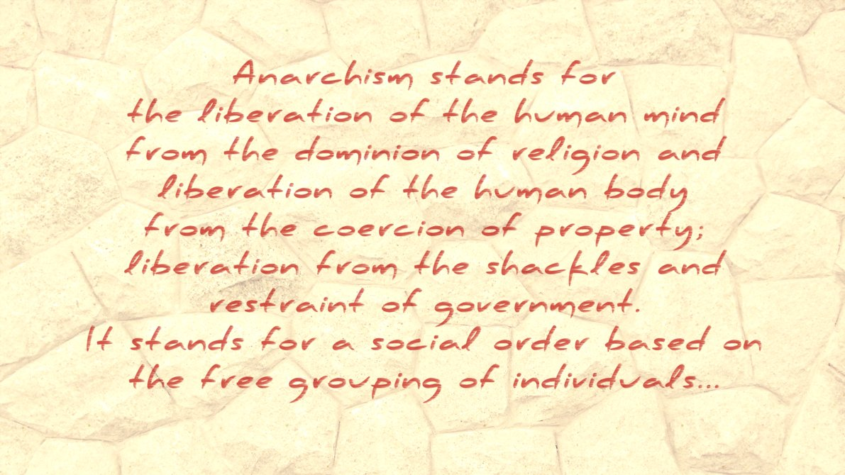
Anarchism
(Goldman, 1910)

Slide 5
ANARCHY
Ever reviled, accursed, ne'er understood,
Thou art the grisly terror of our age.
"Wreck of all order," cry the multitude,
"Art thou, and war and murder's endless rage."
O, let them cry. To them that ne'er have striven
The truth that lies behind a word to find,
To them the word's right meaning was not given.
They shall continue blind among the blind.
But thou, O word, so clear, so strong, so pure,
Thou sayest all which I for goal have taken.
I give thee to the future! Thine secure
When each at least unto himself shall waken.
Comes it in sunshine? In the tempest's thrill?
I cannot tell–but it the earth shall see!
I am an Anarchist! Wherefore I will
Not rule, and also ruled I will not be!
– John Henry Mackay

Slide 6
Emma Goldman
Other prominent anarchists of the time:
John Most- Freiheit
Peter Kropotkin
Louise Michel
Elisee’ Reclus
Russian immigrant to the USA-late 1800s
Factory worker
Emancipation from Wage slavery
Against the Government ‘propaganda machine’ in favour of capitalism

Slide 7
Emma Goldman
…that time and freedom requires sacrifice and pain. In truth they yearn for bondage of social order, rigid laws, materialism, they only freedom man really wants is the freedom to become comfortable…
(Emma Goldman, 1910)

Slide 8
References:
Goldman, E (1910) Anarchism and Other Essays. Great Britain: Hard Press.

