Slide 1


Problem Solving and Decision Making
BMSW4004
Rotaru Cristian
Student 2123735

Slide 2

Introduction
Staff shortage in United Kingdom's proper care
The greatest challenge lies for the caregivers
The pressure extends beyond NHS trust
The following presentation will define macro environmental elements that contribute to the challenge along with cause-effect analysis and alternative solution
Notes:
The key intent of this presentation is to derive a clear conception on the NHS staff shortage issue. There is a significant staff shortage of 100,000 FTE staff which indicates one individual in event posts. Additionally, 41,000 nurse vacancies are identified which shows that one nurse is posted for eight vacancies. Besides that, in general practice, this specific notion exists. Furthermore, the pressure extends beyond NHS trust. In order to further proceed with the current issues and identifying specific solution related to the discussing context, the following presentation will define macro environmental elements that contribute to the challenge along with cause-effect analysis and alternative solution. In order to attain these aim, nature as well as impact of the critical challenges will be defined based on which further analytical elements will be provided.

Slide 3
Nature of complex problem
Staff shortage in both nursing and medicine is identified¹
Lack of attention to the patients due to lack of workforce strength
Overall caregiving quality degradation leading to questionability regarding the sector’s sustainability
Notes:
As per the case study as well as recent researches, it has been identified that there is a significant staff shortage in different posts in healthcare sector of UK (NHS). The nature of the issue is regarding improvement and operations. This is because lack of attention to the patients due to lack of workforce strength is creating overall issues related to operational process of hospitals as well as other healthcare sector. Pertaining to this nature, the improvement paradigm is also being compromised to a greater extent. Furthermore, the overall caregiving quality degradation is seen which is further leading to questionability associated with the sector’s overall sustainability.

Slide 4

Impact of the complex problems
Deterioration of proper care
Added pressure on existing staff²
Brexit leading to issues in staff hiring
Unsuccessful government effort
Notes:
Due to the aforementioned nature of challenges, NHS tend to face difficulties in strategic challenges. Primarily, deterioration of proper care as the staffs are outnumbered in comparison with the number of patients; especially in current times of Covid-19 is identified. Additionally, this added pressure to the staff can be defined as a crucial component that tends to create further challenges. Moreover, due to Brexit, recruitment of new staff and getting the required number of professionals are becoming difficult. Moreover, the government's attempts to remove the NHS bursary for students beginning courses in August 2017 and increase the number of nurses and allied health professionals in training by up to 10,000 have so far been unsuccessful. Besides that, the number of English applicants placed for nurse undergraduate training in 2018 was 4% lower than in 2016. Pertaining to this, questionability about government decision regarding the overall process is creating significant impact on the overall growth.

Slide 5
Macro-environmental analysis: PESTEL
Factors | Key elements
Political | Brexit-related uncertainty³ Political turmoil
Economic | Economic downturn Austerity measures
Notes:
Brexit-related uncertainty is the most crucial political impact that is creating significant challenge in further strategic development. Concerns regarding Brexit's effects on NHS personnel have been present since the referendum's outcome. Due to the first sharp decline of 89 percent of new EEA nurses entering the registry after the referendum, the majority of study has focused on nurses leaving the NHS as a result of Brexit. Apart from that, political turmoil in Britain can be highlighted as another crucial factor that restraints hiring nursing staff. On the other hand, In the years since the global financial crisis of 2008, economies all around the world have been in decline. The NHS has been hit by this economic downturn, which naturally had an effect on the UK as well. The NHS is alleged to have been having financial issues for more than ten years pertaining to economic reasons as much as regulatory ones. This makes it challenging for the NHS to give its patients care that is of a high enough caliber. The UK government implemented a wide range of austerity measures in response to the current economic slump with the aim of reducing public spending. Although there was never a budget cut that directly impacted the NHS, it is thought that austerity measures had an indirect impact on the NHS's finances, aggravating the organization's financial issues.

Slide 6
PESTEL: Continued
Factors | Key elements
Social | Aging population High patient expectation⁴
Technological | Improved level of technological usage Technology inclusion in educating caregivers
Notes:
A typical occurrence seen all throughout the world is an ageing population. The average age of the population is rising as healthcare advances. Although this is definitely a desirable thing, older people frequently experience greater health issues. Late-life onset diseases that can be very expensive to treat or manage include diabetes and other malignancies. As a result, the NHS is experiencing increased pressure due to the UK's ageing population. Furthermore, increased level of high patient expectation due to the previous experience of NHS is identified which is creating significant issues. Moreover, in current times, EHR, automation and other technological usage are extended. Besides that, while educating caregivers, technological growth parameter needs to be considered

Slide 7
PESTEL: Continued
Factors | Key elements
Environmental | Proper training on chemical product handling safety
Legal | Litigation leading to issues⁵ Patient handling as per The Management of Health and Safety at Work Regulations 1999
Notes:
Even though any specific environmental aspects are not harmed by this specific macro environmental factor, yet proper training on chemical product handling with a safe proceeding needs to be taken into account. Furthermore, litigation in all kinds of situations is a global trend that is on the rise. However, patients (or family members) who are dissatisfied with the standard of their care are turning to the courts more frequently than ever to seek compensation. The UK has witnessed an increase in healthcare-related lawsuits, and the upward trend is not showing any indications of abating. The NHS is familiar with this problem. Unfortunately, because of the need to fund pricey legal defenses and make frequent compensation payments, this adds a new, significant expenditure for the healthcare body. Moreover, patient handling as per The Management of Health and Safety at Work Regulations 1999 gets difficult to a greater extent due to the staff shortage

Slide 8
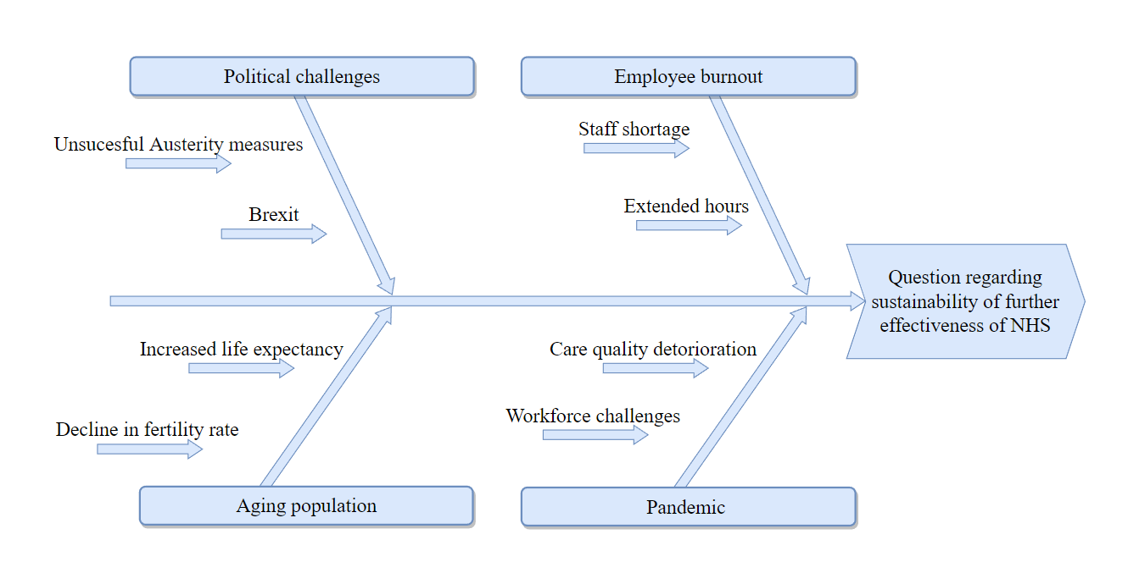
Cause and effect analysis
Notes:
Mostly, four basic cause regarding the questionability of sustaining the further effectiveness of NHS are identified in this specific context. Primarily, political challenges such as unsuccessful Austerity measures and Brexit are seen to create a significant number crunch in the healthcare sector. Moreover, employee burnout due to staff shortage and extended hours leading to massive exhaustion can be highlighted as a crucial issue. Aging population can be highlighted as another critical challenge caused by the combination of increased life expectancy as a contribution of modern medicine and decline in fertility rate due to current lifestyle. Finally, the pandemic of Covid-19 has excessively increased the number of patients around all healthcare sectors due to which care quality deterioration and timeliness maintenance to a greater extent. All these issues are further challenges for the entire sector in further strategic development.

Slide 9

Alternative solution
Exploring flexible schedule
Improving employee wellbeing⁶
Utilisation of robust absence management tool
Explaining caregiving expectations to the caregivers
Hiring new staff on immediate basis
Notes:
As an alternative solution to absenteeism amongst staff, exploring the concept of flexible schedule with appropriate rostering system needs to be done. In addition to that, focusing on improved level of employee wellbeing needs to be highlighted for further strategic development. Besides that, utilization of robust absence management tool must be focused as it can help depicting the idea regarding appropriate strategic development. In addition, explaining the caregiving expectation to the caregivers. Apart from that, hiring new staff on immediate basis from the developing countries can be essentially done to avoid critical challenges. Besides that, implementing these measures or alternative solution can help in overall strategic development.

Slide 10

Conclusion
Reducing staff shortage has become important to avoid questionability on further sustainability of the sector
Hiring staff for reducing the added pressure from the existing workforce
The root causes for the discussion context need to be properly handled
Macro-environmental factors usually create issues in terms of strategic development
Notes:
In order to conclude the overall process, it can be defined that, reducing staff shortage has become important to avoid questionability on further sustainability of the sector. Additionally, hiring staff for reducing the added pressure from the existing workforce. Apart from that, the root causes for the discussion context need to be properly handled. Finally, macro-environmental factors usually create issues in terms of strategic development. In order to handle the issues, the mentioned strategies can be further taken into account.

Slide 11
References
Dalingwater, L., 2019. NHS staffing shortages and the Brexit effect. Observatoire de la société britannique, (24), pp.67-86.
Buchan, J., Charlesworth, A., Gershlick, B. and Seccombe, I., 2019. A critical moment: NHS staffing trends, retention and attrition. London: The Health Foundation.
Sizmur, S. and Raleigh, V., 2018. The risks to care quality and staff wellbeing of an NHS system under pressure. The King’s Fund: Oxford, p.24.
Murray, R., 2021. The NHS needs a comprehensive plan for recovery. bmj, 373.
Sizmur, S. and Raleigh, V., 2018. The risks to care quality and staff wellbeing of an NHS system under pressure. The King’s Fund: Oxford, p.24.
Alderwick, H. and Charlesworth, A., 2022. A long term workforce plan for the English NHS. bmj, 377.

Slide 12


