Slide 1
SERVANT LEADERSHIP
Raven
Michelle
Eva
Lucia
Richard

Slide 2
DEFINITion
https://www.youtube.com/watch?v=aKk0AaaFqtU

Slide 3
advantages
Leads to better teamwork
Creates strong relationship among organizations
Gives employee support to meet individuals goals
Welcomes other people’s perspectives
For example: Starbucks

Slide 4
Disadvantages
Might not being able to achieve organizational goals/objectives
Too focused on the needs of followers

Slide 5
How servant leadership works in business
Providing subordinates with sufficient training to achieve goals
Providing subordinates with sufficient resources to achieve goals
Sharing information with employees
Empowering employees
Enabling employees

Slide 6

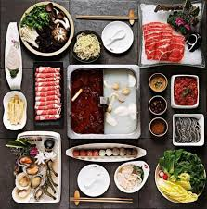
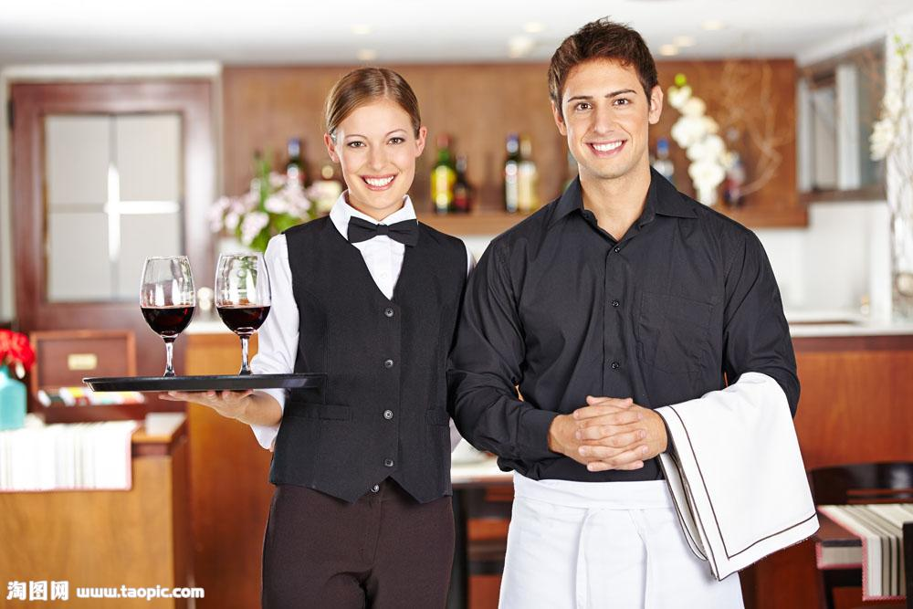
Application
Haidilao builds special dormitories and adopt special treatments to their employees
1.No need for the employees to wash clothes and cook meals.
(Haidilao serves their employees as “customers”)
Influences:Inspire employees' individual vitality growth.

Slide 7
Conclusion
Prospects
  Important course to train board members and directors
  Training community leaders
  To become an important course in university
Servant leadership
  Care about employees
  Meet needs
  Take serving as the priority

