Slide 1

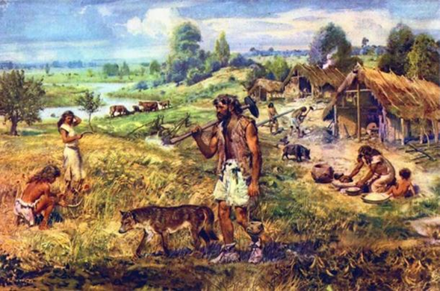
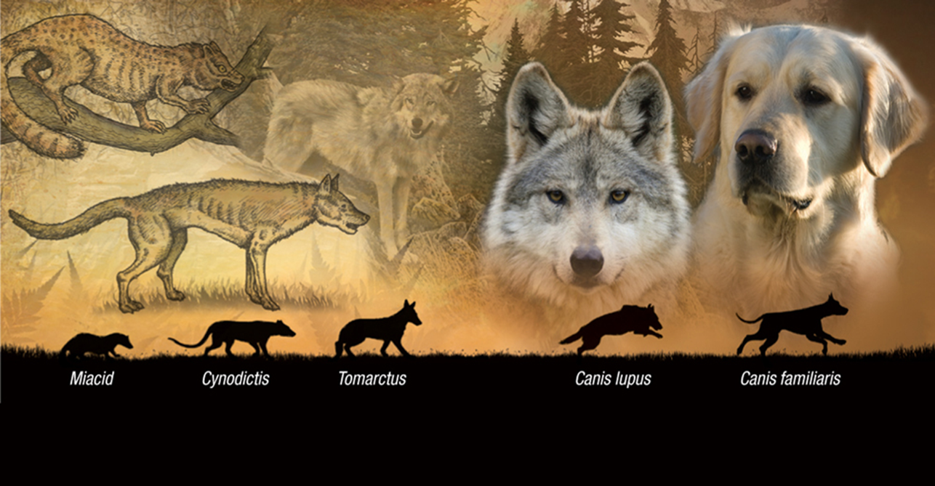


Dog and humans- who domesticated who?
Nikki Griffiths
2005557
Theories on human and dog domestication:
The commensal scavenger hypothesis- the theory that wolves began scavenging food on the periphery of settlements , gradually becoming domesticated when humans saw the benefits of having wolves in close proximity.
The pet keeping or cross-species adoption hypothesis- the deliberate capture, adoption, hand-rearing and socialization by of wild wolf pups by humans.
References: Davis, Simon & VALLA, FRAN|[Ccedil]|OIS. (1978). Evidence for domestication of the dog 12,000 years ago in the Natufian of Israel. Nature. 276. 608-610. 10.1038/276608a0.
Images: Cowie, Ashley (2017). From Mighty Bear Dogs to Breathless Bulldogs: How Human Manipulation Has Changed the Shape of Canines Forever. [online] www.ancient-origins.net. Available at: https://www.ancient-origins.net/history/mighty-bear-dogs-breathless-bulldogs-how-human-manipulation-has-changed-shape-canines-021341. [Accessed 07/12/2023]. PetSonic - Blog. (2019). ▷ La domesticación del perro a lo largo de la historia. [online] Available at: https://www.petsonic.com/blog/domesticacion-del-perro/. [Accessed 07/12/2023].

