Slide 1
Topic 11 - Java Collections
Dr Stephen Hole

Slide 2
Collections Framework
The Collections Framework is a sophisticated hierarchy of interfaces and classes that provide state-of-the-art technology for managing groups of objects.
The Java Collections Framework standardises the way in which groups of objects are handled by Java programs.
The Collections Framework was designed to meet several goals.
  First, the framework had to be high-performance.
  Second, the framework had to allow different types of collections to work in a similar manner and with a high degree of interoperability.
  Third, extending and/or adapting a collection had to be easy.

Slide 3
Main Collection Interfaces
There are 3 main types of Collection in the Collections API all of which are defined via interfaces:
  List: a list is an ordered collection of objects, and allows duplicate elements.
  Set: a set is a collection of unique elements that may or may not be sorted.
  Map: a map is a set of key / value pairs, and allows fast lookup of values via their key.
Collections can only hold objects (not primitives) and their size does not need to be specified in advance, they will grow as new data is added to them.

Slide 4
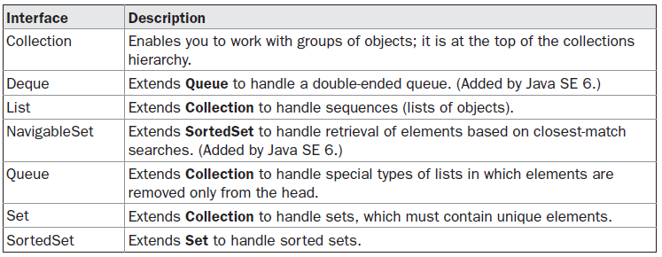
Collection Interfaces
The Collections Framework defines several interfaces.
The interfaces that underpin collections are summarized in the following table:

Slide 5
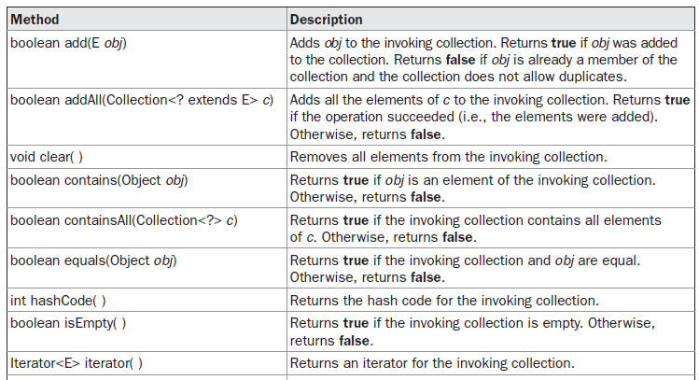
Methods Defined by Collection

Slide 6
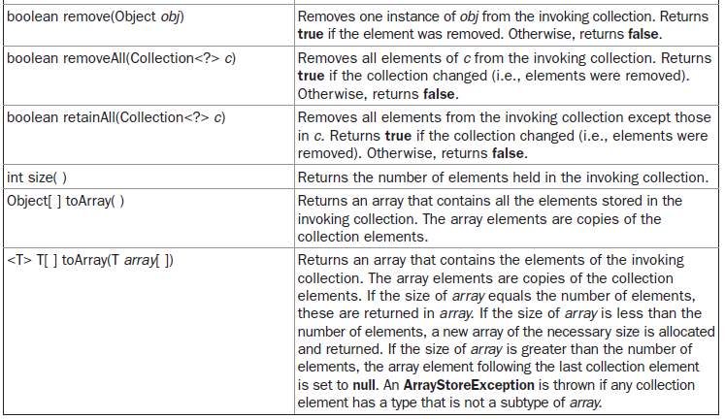
Methods Defined by Collection

Slide 7
ArrayList Class
The ArrayList class extends AbstractList and implements the List interface.
ArrayList is a generic class that has this declaration:
  class ArrayList<E>
  Here, E specifies the type of objects that the list will hold.
ArrayList supports dynamic arrays that can grow as needed.
In Java, standard arrays are of a fixed length.
After arrays are created, they cannot grow or shrink, which means that you must know in advance how many elements an array will hold.

Slide 8
ArrayList Constructors
ArrayList has the constructors shown here:
  ArrayList( )
  ArrayList(Collection<? extends E> c)
  ArrayList(int capacity)
The first constructor builds an empty array list.
The second constructor builds an array list that is initialized with the elements of the collection c.
The third constructor builds an array list that has the specified initial capacity.

Slide 9
ArrayList Constructors
The capacity is the size of the underlying array that is used to store the elements.
The capacity grows automatically as elements are added to an array list.
The following program shows a simple use of ArrayList.
An array list is created for objects of type String, and then several strings are added to it.
  A quoted string is translated into a String object.
The list is then displayed.
Some of the elements are removed and the list is displayed again.

Slide 10
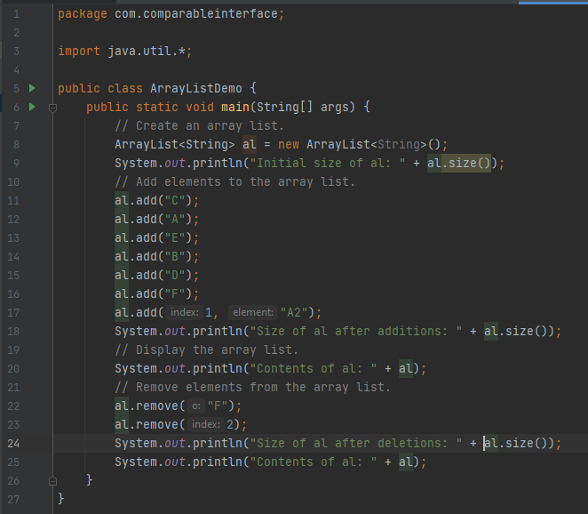

Slide 11
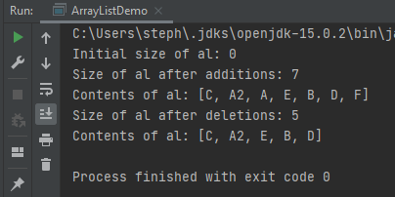
Sample Output

Slide 12
ArrayList in Operation
Notice that a1 starts out empty and grows as elements are added to it.
When elements are removed, its size is reduced.
In the preceding example, the contents of a collection are displayed using the default conversion provided by toString( ), which was inherited from AbstractCollection.
Although it is sufficient for short, sample programs, you seldom use this method to display the contents of a real-world collection.
Usually, you provide your own output routines.

Slide 13
ArrayList in Operation
Although the capacity of an ArrayList object increases automatically as objects are stored in it, you can increase the capacity of an ArrayList object manually by calling ensureCapacity( ).
You might want to do this if you know in advance that you will be storing many more items in the collection than it can currently hold.
Conversely, if you want to reduce the size of the array that underlies an ArrayList object so that it is precisely as large as the number of items that it is currently holding, call trimToSize( ).

Slide 14
Java Iterator
An Iterator is an object that can be used to loop through collections, like ArrayList and HashSet.
It is called an "iterator" because "iterating" is the technical term for looping.
To use an Iterator, you must import it from the java.util package.
The iterator() method can be used to get an Iterator for any collection:

Slide 15
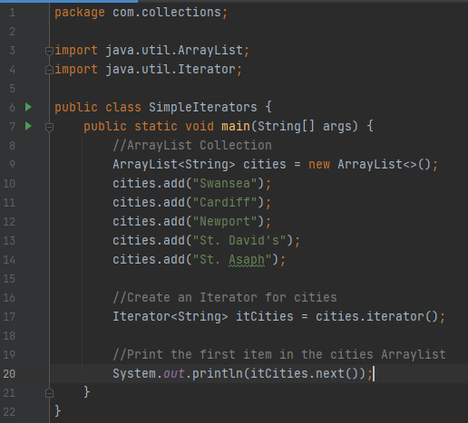
Iterator Example

Slide 16
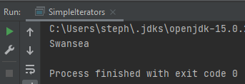
Sample Output

Slide 17
Looping Through a Collection
To loop through a collection, use the:
  hasNext();
  next().
methods of the Iterator:

Slide 18
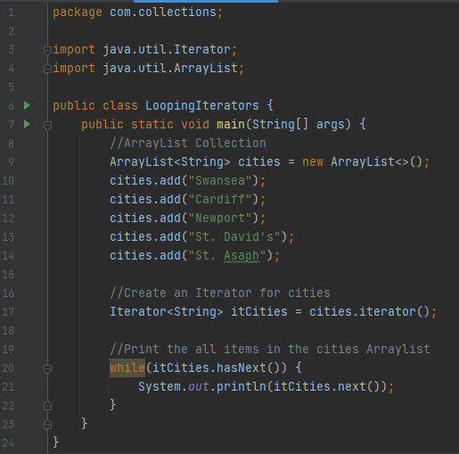
Looping With an Iterator

Slide 19
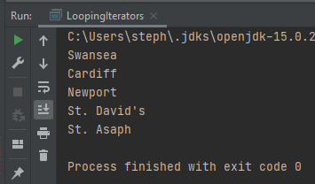
Sample Output

Slide 20
Removing Items from a Collection
Iterators are designed to easily change the collections that they loop through.
The remove() method can remove items from a collection while looping.

Slide 21
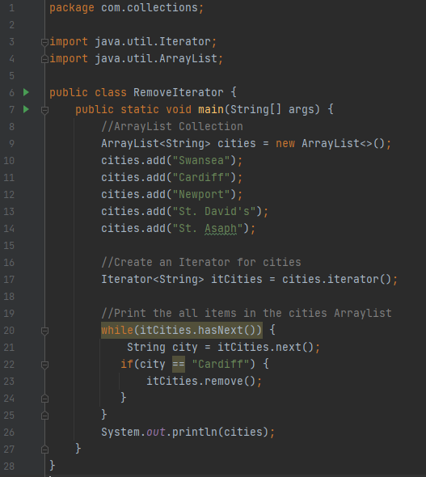

Slide 22
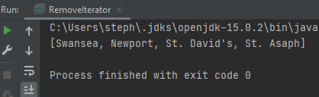
Sample Output

Slide 23
Create an Array from an ArrayList
Several reasons exist why you might want to convert a collection into an array, such as:
  To obtain faster processing times for certain operations;
  To pass an array to a method that is not overloaded to accept a collection;
  To integrate collection-based code with legacy code that does not understand collections.
You can do this by calling toArray( ), which is defined by Collection.

Slide 24
ArrayList to Array program
The program will begin by creating a collection of Integers.
Next, toArray( ) is called and it obtains an array of Integers.
Then, the contents of that array are summed by use of a for-each style for loop.

Slide 25
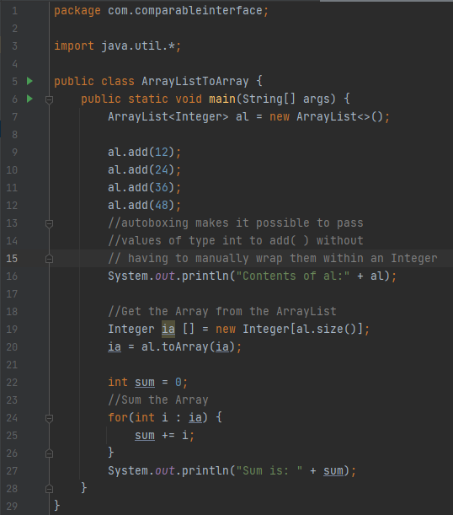

Slide 26
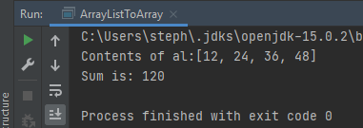
Sample Output

Slide 27
LinkedList Class
The LinkedList class extends AbstractSequentialList and implements the List, Deque, and Queue interfaces.
It provides a linked-list data structure.
LinkedList is a generic class.
To add elements to the start of a list you can use addFirst( ) or offerFirst( ).
To add elements to the end of the list, use addLast( ) or offerLast( ).
To obtain the first element, you can use getFirst( ) or peekFirst( ).
To obtain the last element, use getLast( ) or peekLast( ).
To remove the first element, use removeFirst( ) or pollFirst( ).
To remove the last element, use removeLast( ) or pollLast( ).

Slide 28
LinkedList Methods
To add elements to the start of a list you can use addFirst( ) or offerFirst( ).
To add elements to the end of the list, use addLast( ) or offerLast( ).
To obtain the first element, you can use getFirst( ) or peekFirst( ).
To obtain the last element, use getLast( ) or peekLast( ).
To remove the first element, use removeFirst( ) or pollFirst( ).
To remove the last element, use removeLast( ) or pollLast( ).

Slide 29
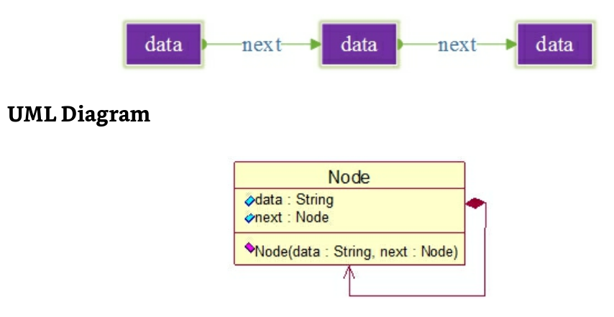
Single Linked List (traditional)
Single Link:
  Is a chained storage structure of a linear table, that is connected by a node.
  Each node consists of data and a pointer to the next node.

Slide 30
LinkedList Demo Program
The program will begin by creating a LinkedList of String.
Then a number of towns in south Wales as added using the add(), addLast() and addFirst() methods and then the LinkedList is displayed to the screen.
Then a number of items are removed using the remove(), removeFirst() and removeLast() methods and the updated LinkedList is displayed to the screen.
Finally get() and set() methods are used to change an element and the LinkedList is displayed to the screen.

Slide 31
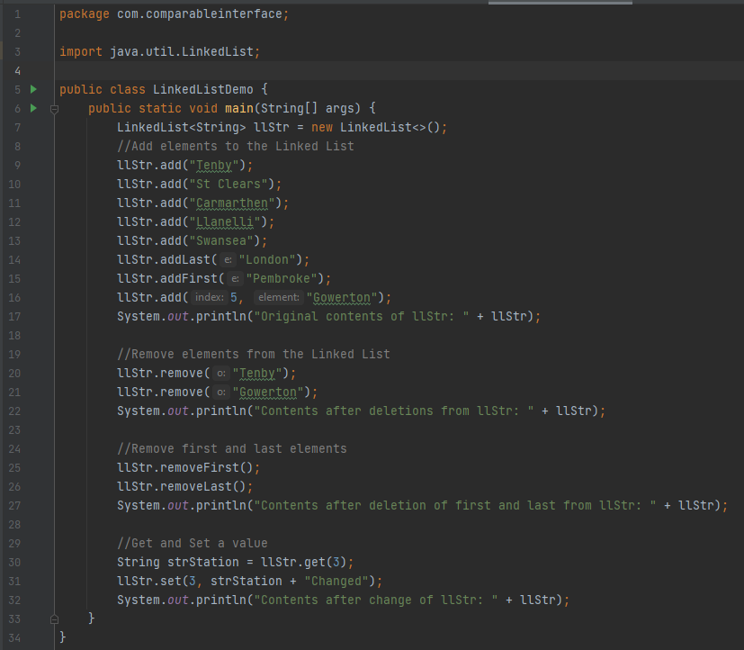

Slide 32
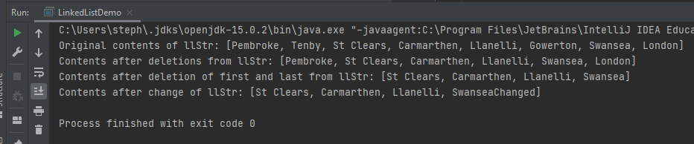
Sample Output

Slide 33
HashSet Class
HashSet extends AbstractSet and implements the Set interface.
It creates a collection that uses a hash table for storage.
HashSet is a generic class that has this declaration:
  class HashSet<E>
Here, E specifies the type of objects that the set will hold.

Slide 34
HashSet Class
A hash table stores information by using a mechanism called
hashing.
In hashing, the informational content of a key is used to determine a unique value, called its hash code.
The hash code is then used as the index at which the data associated with the key is stored.
The transformation of the key into its hash code is performed automatically—you never see the hash code itself.
Also, your code can’t directly index the hash table.
The advantage of hashing is that it allows the execution time of
  add( ), contains( ), remove( ), and
  size( ) to remain constant even for large sets.

Slide 35
HashSet Class
It is important to note that HashSet does not guarantee the order of its elements, because the process of hashing doesn’t usually lend itself to the creation of sorted sets.
If you need sorted storage, then another collection, such as TreeSet, is a better choice.

Slide 36
HashSet Demo Program
The program will begin by creating a HashSet of String.
Then a number of towns in south Wales as added using the add(), methods and then the HashSet is displayed to the screen.
Then an item is removed using the remove(), method and the updated HashSet is displayed to the screen.

Slide 37
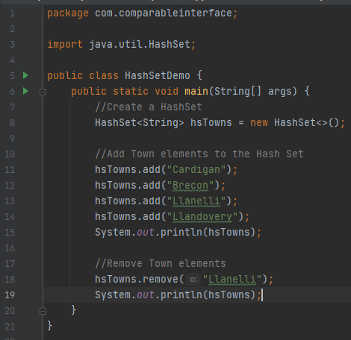

Slide 38
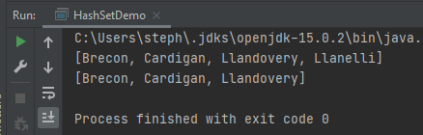
Sample Output

Slide 39
LinkedHashSet Class
The LinkedHashSet class extends HashSet and adds no members of its own.
It is a generic class that has this declaration:
  class LinkedHashSet<E>
LinkedHashSet maintains a linked list of the entries in the set, in the order in which they were inserted.
This allows insertion-order iteration over the set.
  That is, when cycling through a LinkedHashSet using an iterator, the elements will be returned in the order in which they were inserted.
The following LinkedHashSetDemo substitutes the LinkedHashSet for the HashSet.

Slide 40
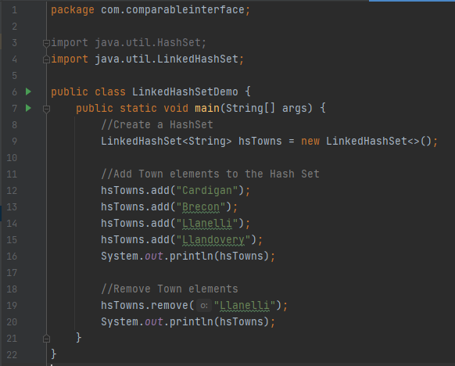
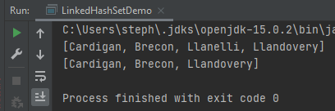

Slide 41
TreeSet Class
TreeSet extends AbstractSet and implements the NavigableSet interface.
It creates a collection that uses a tree for storage.
Objects are stored in sorted, ascending order.
Access and retrieval times are quite fast, which makes TreeSet an excellent choice when storing large amounts of sorted information that must be found quickly.
TreeSet is a generic class that has this declaration:
  class TreeSet<E>

Slide 42
TreeSet Class
TreeSet has the following constructors:
  TreeSet( )
  TreeSet(Collection<? extends E> c)
  TreeSet(Comparator<? super E> comp)
  TreeSet(SortedSet<E> ss)

Slide 43
Binary Tree Graphic
80
Node
65
85
Only Has 2 Children
No Need for 2 Children
72
62
90
Leaf
Left Child
70
73
Right Child

Slide 44
TreeSet Demo Program
The program will begin by creating a TreeSet of String.
Then a number of towns in south Wales as added using the add(), methods and then the TreeSet is displayed to the screen.
Then an item is removed using the remove(), method and the updated TreeSet is displayed to the screen.

Slide 45
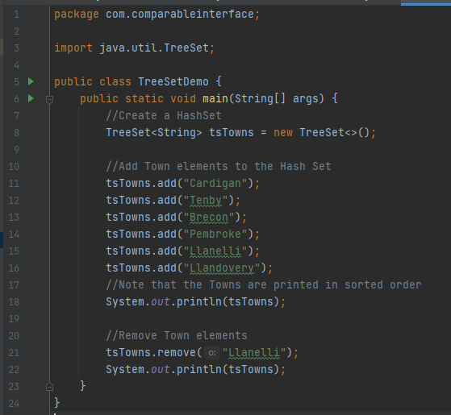
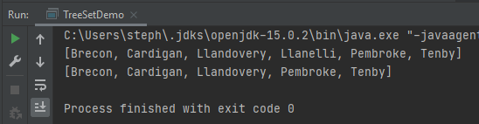

Slide 46
TreeSet subSet() Method
Because TreeSet implements the NavigableSet interface, you can use the methods defined by NavigableSet to retrieve elements of a TreeSet.
For example, assuming the preceding program, the following statement uses subSet( ) to obtain a subset of tsTowns that contains the elements between Llandovery (inclusive) and Tenby (exclusive).
It then displays the resulting set.

Slide 47
ArrayDeque Class
The ArrayDeque class, extends AbstractCollection and implements the Deque interface.
It adds no methods of its own.
ArrayDeque creates a dynamic array and has no capacity restrictions.
  (The Deque interface supports implementations that restrict capacity, but does not require such restrictions.)
ArrayDeque is a generic class that has this declaration:
  class ArrayDeque<E>

Slide 48
ArrayDeque Class
ArrayDeque defines the following constructors:
  ArrayDeque( )
  ArrayDeque(int size)
  ArrayDeque(Collection<? extends E> c)
In all cases, the capacity grows as needed to handle the elements added to the deque.
The following program demonstrates ArrayDeque by using it to create a stack:

Slide 49
Graphical Representation of Linked List Stack
Top
20
40
60
80
100
Key
data
next
120
null

Slide 50
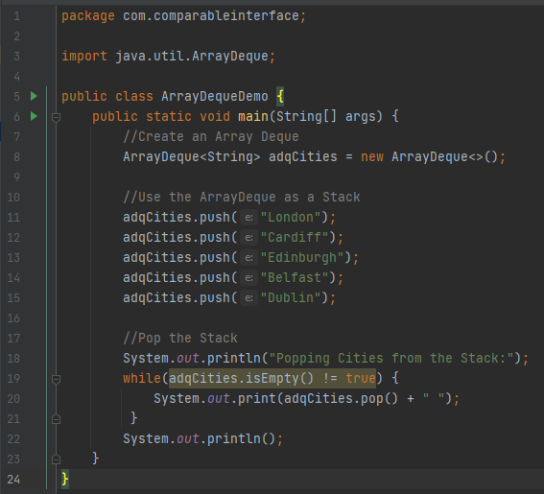
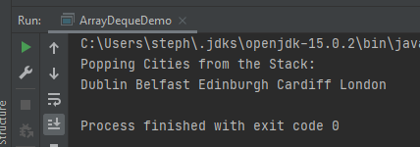

Slide 51
Tasks
Compare and Contrast the Operation of the following Collections Classes with their traditional counterparts:
  ArrayDeque and Node based Linked List Stack;
  TreeSet and Node based Linked List Binary Tree;
  LinkedList and Node based Linked List.
Start with a small number of elements and then double the number until you have a significant number of elements.
Check the running times for your comparisons.

