Slide 1
Study Skills- Lecture
Week 4
(BMLW4009)
Sadie France
Bluelightacademy@uwtsd.ac.uk
Lawacademy@uwtsd.ac.uk

Slide 2
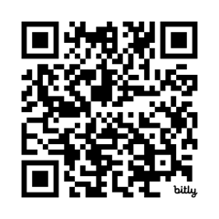
Aims for today's session
What is the importance of physical activity?
Domains of different activity
Benefits to physical activity
What is wellbeing?
What is resilience?

Slide 3

Reminder- next week...
Draft sessions- please book in

Slide 4

Task
What is "wellbeing"?
What are the different types of wellbeing?

Slide 5
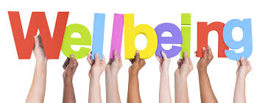
What is wellbeing?
a holistic concept that encompasses the overall state of an individual's physical, mental, and emotional health, as well as their social and spiritual dimensions.
reflects a person's sense of contentment, satisfaction, and the ability to cope with and adapt to various challenges in life.

Slide 6
Wellbeing
Wellness covers aspects of mental, physical, and spiritual health, as well as social and financial wellbeing.
To provide an effective service officers need to be mentally and physically able to carry out their duties, while seeking support should they experience any difficulties that impact on their physical or mental wellbeing.
Five ways to wellbeing; -
connecting with people,
being active,
taking notice,
continuous learning or trying something new,
acts of kindness,
which draw many parallels with a police officer’s role, while emphasising the importance of these actions to maintaining the continued health and wellbeing of officers

Slide 7

Mental wellbeing & mental health
What is the difference between mental wellbeing and mental health?

Slide 8
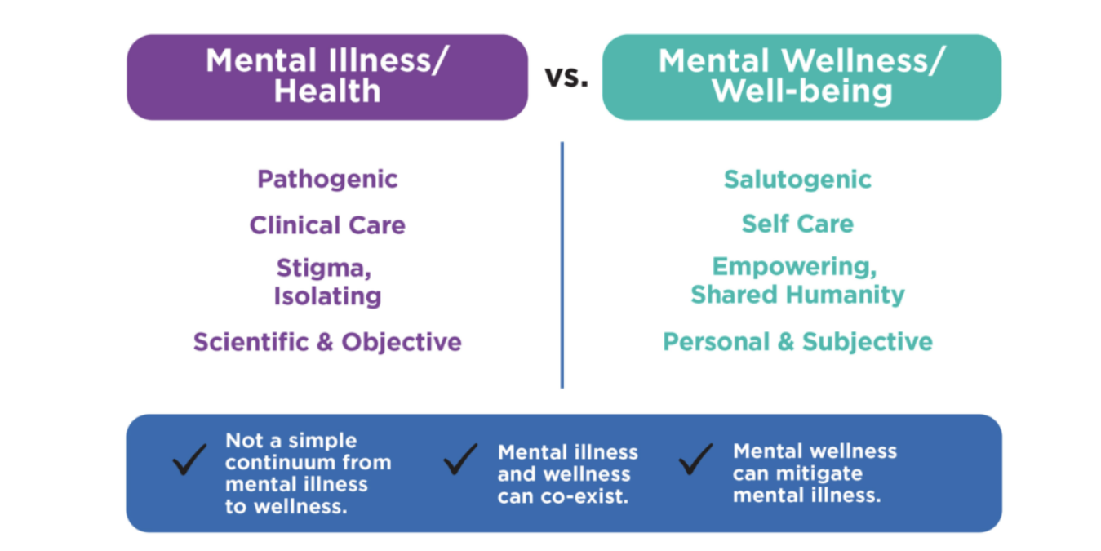

Slide 9
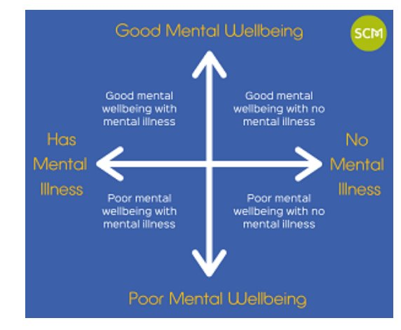

Slide 10
Task
What services does the university have to support student's mental wellbeing?
How would you go about seeking help?

Slide 11

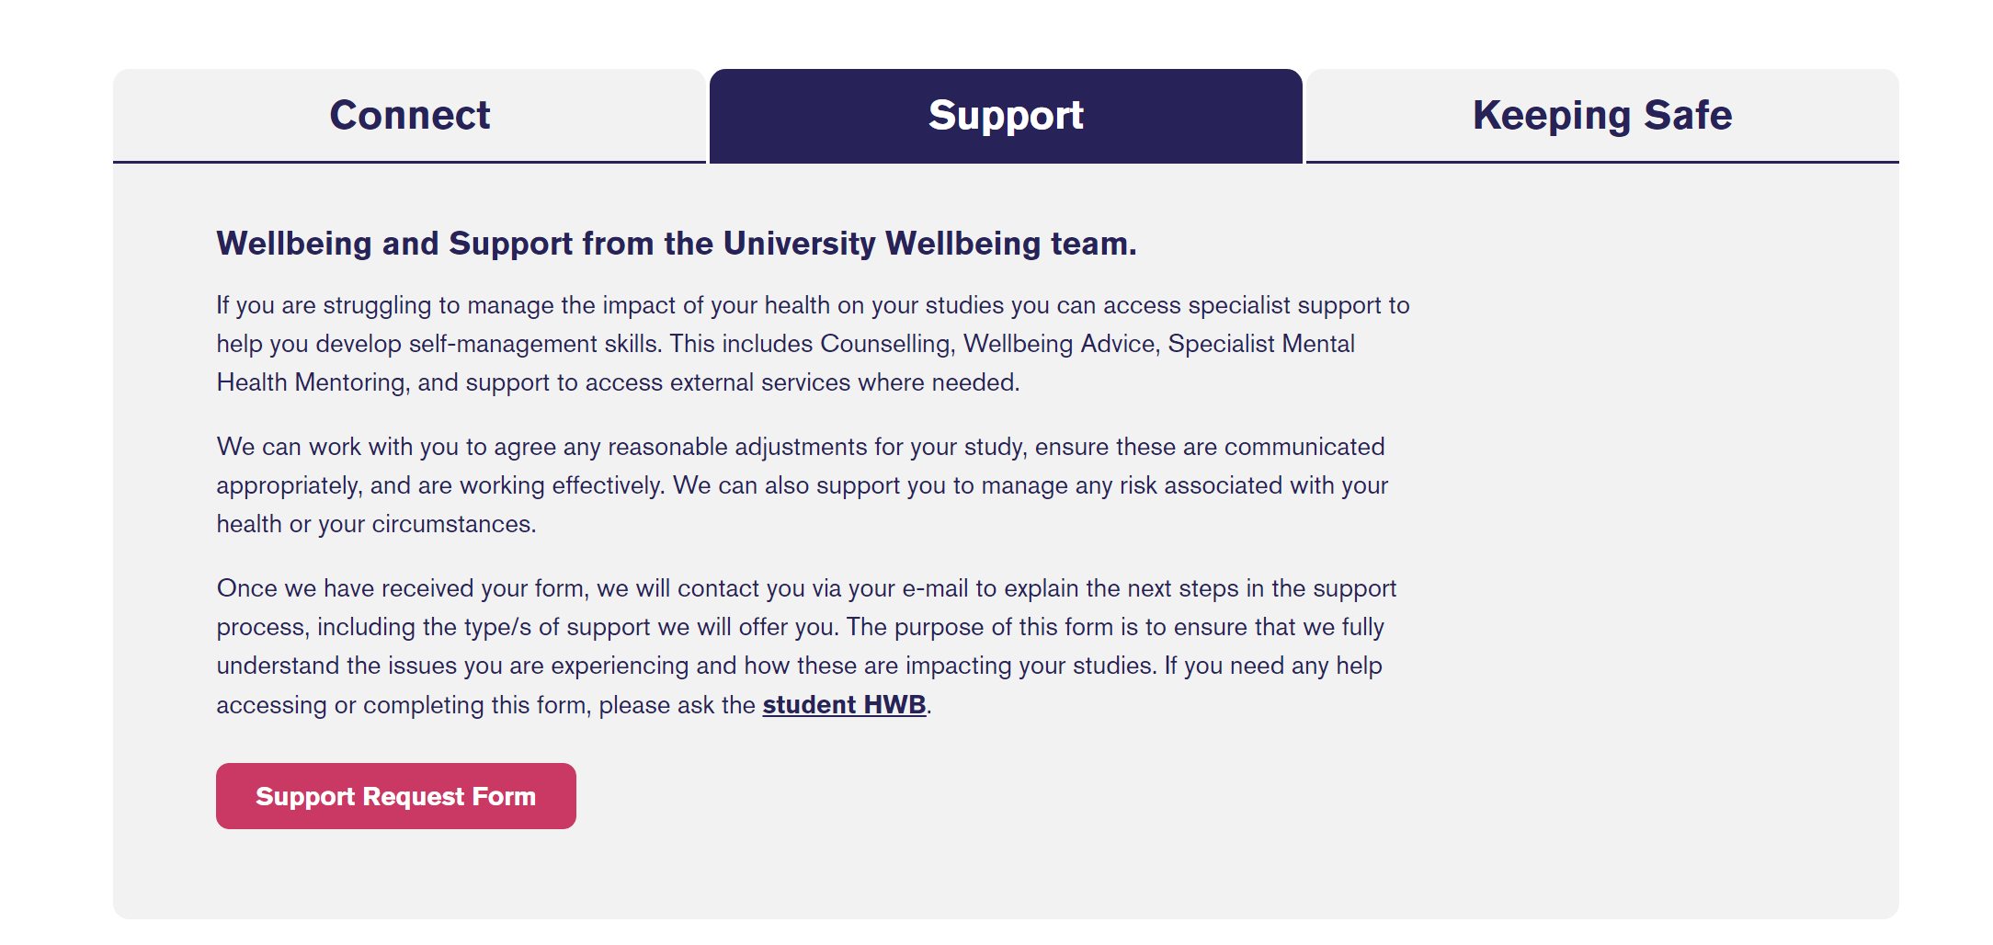
https://youtu.be/duv-hEikStI

Slide 12

Spiritual wellbeing
Spiritual wellbeing refers to the need for purpose and meaning, while encompassing an individual’s beliefs and values.
Where there are personal challenges such as change or disruption to plans, or where a person’s values or beliefs are challenged, spiritual wellbeing can be eroded.
This can have consequences for mental wellbeing and physical health.
Spiritual practices such as prayer, meditation, and mindfulness can help individuals manage stress more effectively.
Spiritual wellbeing can contribute to mental wellbeing by promoting coping skills, providing a sense of purpose, offering social support, and fostering compassion.

Slide 13

Task
What is mindfulness?
Provide 3 examples

Slide 14
Mental wellbeing
Mindfulness- a mental practice and state of awareness characterised by being fully present in the moment, without judgment or distraction.
It involves intentionally focusing your attention on the present experience, including your thoughts, feelings, bodily sensations, and the environment, without getting caught up in worries about the past or future.

Slide 15
Examples of mindfulness
Pay attention- It's hard to slow down and notice things in a busy world. Try to take the time to experience your environment with all of your senses — touch, sound, sight, smell and taste. For example, when you eat a favorite food, take the time to smell, taste and truly enjoy it.
Live in the moment- Try to intentionally bring an open, accepting and discerning attention to everything you do. Find joy in simple pleasures.
Accept yourself-Treat yourself the way you would treat a good friend.
Focus on your breathing- When you have negative thoughts, try to sit down, take a deep breath and close your eyes. Focus on your breath as it moves in and out of your body. Sitting and breathing for even just a minute can help.

Slide 16
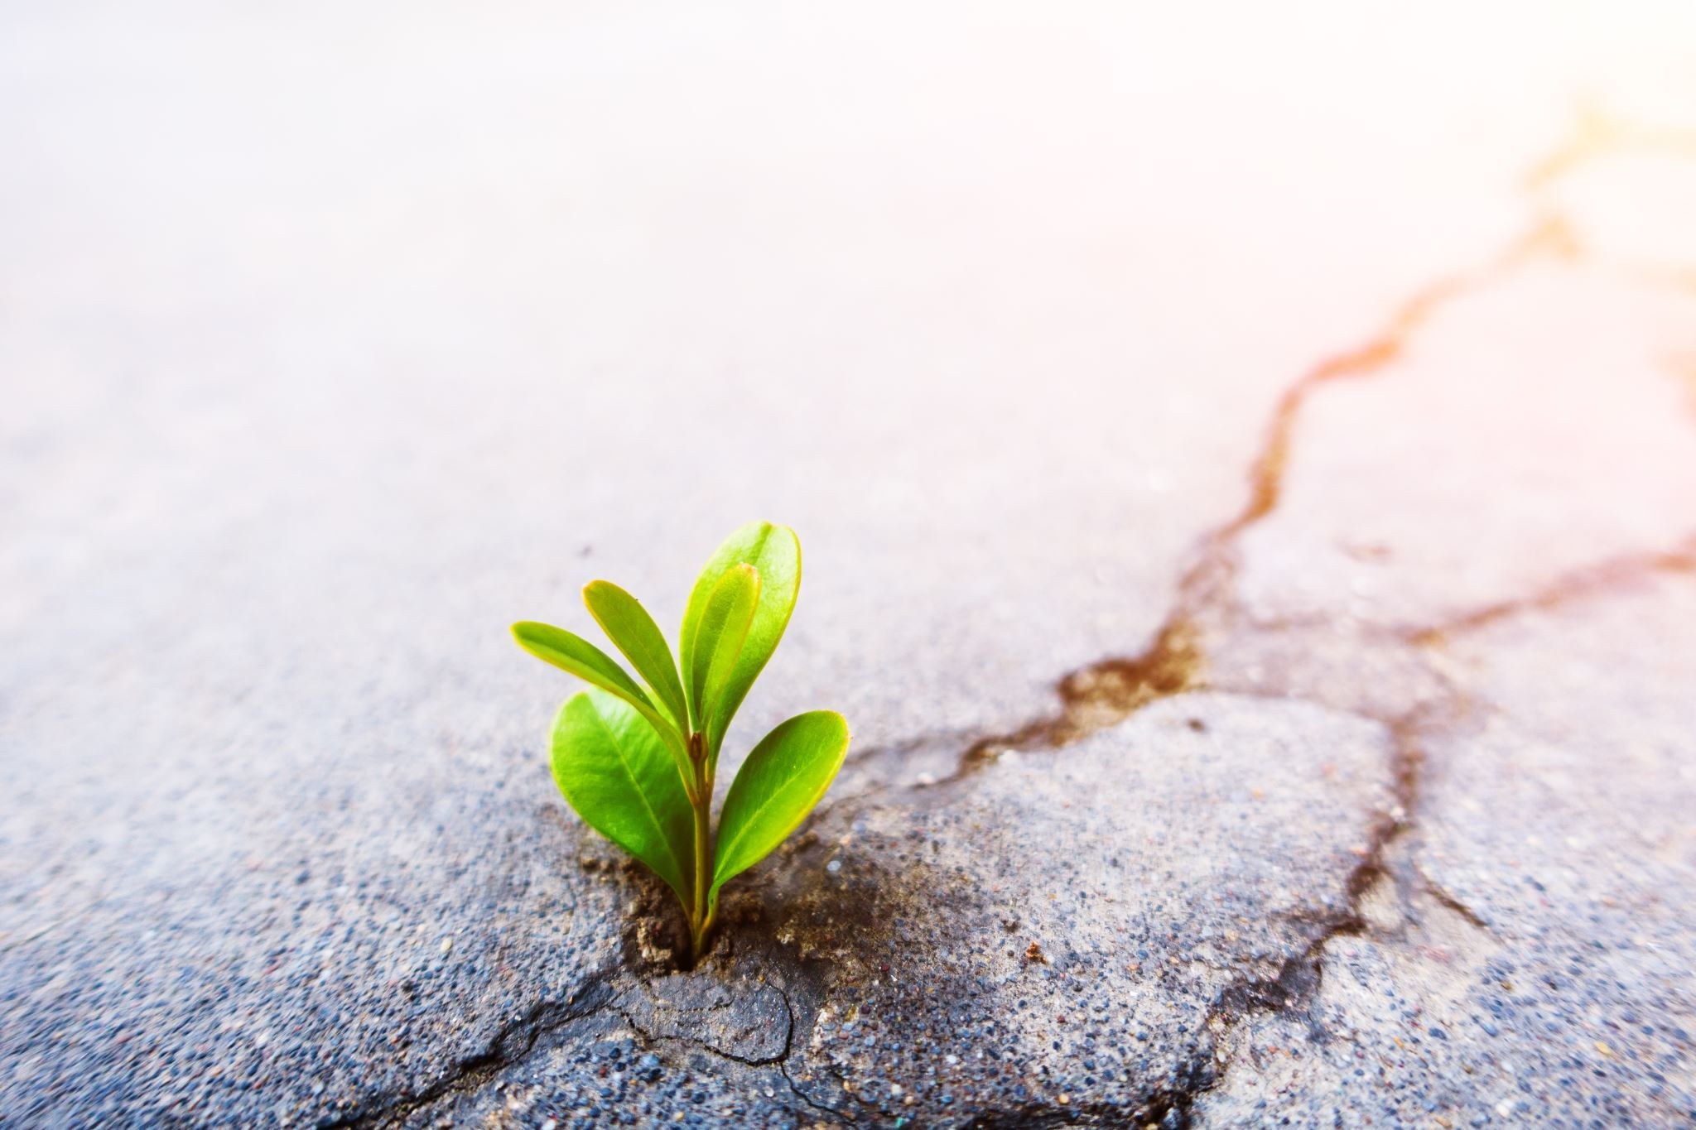
What is resilience?
Resilience is the capacity to adapt, recover, and bounce back from adversity, challenges, and setbacks.
Resilience refers to maintaining psychological well-being in the face of adversity by having the ability to adapt to stressors successfully.

Slide 17
Resilience
Everyone is born with a level of inbuilt resilience but it can be built on through time and experience, and on a personal level characteristics such as:-
adaptability,
flexibility,
effective problem solving skills,
and independence assist in building resilience
There are ways that this can be improved through maintaining positive coping strategies.
Do you think your resilience will grow during your career?

Slide 18

Resilience
Hesketh et al (2019) state that resilient individuals are better equipped to deal with the stressful nature of both policing and uncertain working environments.
Through research conducted, they explain that a combination of effective leadership and a harmonious working environment that supports employee wellbeing, enhances subsequent organisational performance.

Slide 19
Building effective coping strategies is the best way of relieving stress or dealing with trauma, compassion fatigue, or even PTSD.
Different people will have very different coping strategies and it can be as simple as doing regular exercise or enjoying a regular hobby outside of work.
Task-
Research into stress and how this impacts on your chosen career path.

Slide 20
Developing effective coping strategies
Here are some easy go-to suggestions for coping with stress and building resilience:-
Being Active -Exercise can help reduce some of the emotional intensity that you may be feeling and can help clear your thoughts allowing you to problem solve more effectively.
Connecting with people - Have a good support network of colleagues or friends and family. These can ease your troubles and help you see things in a different way. Activities with friends and family can also help you to relax and relieve stress

Slide 21
Have some personal time -Having time to yourself is important. Time away from the things that cause you stress can help, this could be socializing, taking exercise, or enjoying a hobby which is away from work and possibly home.
Challenge yourself - Setting yourself goals and challenges whether in or outside of work, can help build confidence and also may help deal with stress. An example could be something as simple as learning a new language, or learning to play an instrument.

Slide 22
Help other people - Evidence has shown that helping other people either as a volunteer or through community work can often help build resilience. If volunteering is not something that is accessible, maybe try helping someone with something each day, like a simple task in the workplace, or helping someone with their bags in the supermarket.
Try to be positive- Try to look for positives in life, or look around you and find the beauty in other things. Think of what makes you grateful in life. A simple exercise for this is writing down three things at the end of each day that made you feel good.

Slide 23
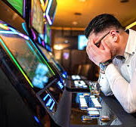
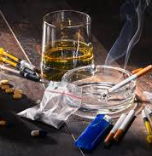

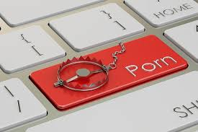
Negative coping strategies
Can you think of any negative coping strategies?

Slide 24
Negative coping strategies
There are some coping strategies that people turn to which could have a very detrimental impact on their lives, such as alcohol or drugs.
Some may say that popping out for a drink and socialising helps to relieve stress and often this is the case, however alcohol, if overused, can have extremely negative effects on individuals and can often lead to more problems over time.

Slide 25
Unhealthy coping strategies can lead to further problems with mental health and where possible officers should avoid unhealthy habits as coping strategies.
Alcohol, smoking, and caffeine are the most common negative coping strategies. Even though they may provide temporary relief, they will not provide relief in the long term and will likely become crutches that will not solve your problems, only create new ones.

Slide 26
Avoiding issues - Avoiding an issue may feel like the easiest way to deal with current problems, however pushing back the problems will ultimately find a way of reaching the surface, possibly with some kind of trigger.
Over sleeping- This is similar to avoiding issues. The body may need sleep and rest but it also needs physical activity as well to remain fit and healthy.

Slide 27
Excessive drug or alcohol use- Alcohol, in small doses, can often be seen as a way of relieving stress, however substance misuse is a slippery slope. Stimulants and depressants may numb feelings, pain, and negative thoughts in the short term, however long term excessive use will only lead to severe health complications, addiction, overdose, and possibly death.
Impulsive spending- Many people find retail therapy a way to relieve stress, however, again this could very quickly lead to overspending and then on to severe financial problems. By relieving some stress, you will be replacing this with other problems.

Slide 28
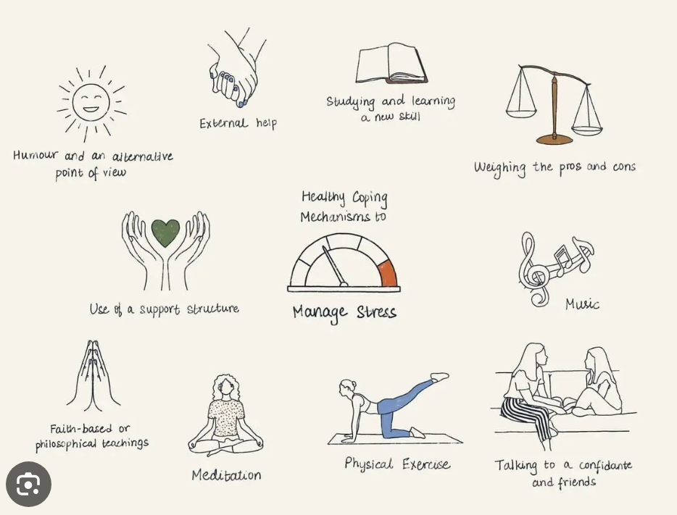
Over or under eating- Food is important for your body and provides nutrition and fuel to function throughout the day, however many people, when feeling anxious, have a tendency to either over or under eat, sometimes to extremes. This will go on to cause major health issues or sickness.

Slide 29

Services
Many support services within the police and available to the general public:-
Occupational health
Articles, books, journals, apps
Charities
Support groups

Slide 30
Key aspects of wellbeing:-
Physical Wellbeing: relates to the physical health and functioning of the body. It includes factors such as nutrition, exercise, sleep, and the absence of illness or chronic conditions.
Mental Wellbeing: encompasses emotional resilience, cognitive functioning, and the ability to manage stress, anxiety, and other emotional challenges. It involves having a positive self-image and the capacity to handle difficult emotions.
Emotional Wellbeing: refers to the ability to recognise, express, and manage a range of emotions in a healthy and balanced way. It involves self-awareness and empathy toward others.
Social Wellbeing: relates to the quality and quantity of social connections and relationships an individual has. Strong social networks and supportive relationships contribute to a sense of belonging and social integration.

Slide 31
Spiritual Wellbeing: doesn't necessarily relate to religious beliefs but rather to a sense of purpose, meaning, and connection to something larger than oneself. It involves exploring existential questions and values.
Environmental Wellbeing: This aspect considers the relationship between individuals and their physical environment. It involves factors such as access to clean air, water, and green spaces, as well as sustainable practices.
Occupational Wellbeing: pertains to satisfaction and fulfilment in one's work or chosen activities. It includes having a sense of purpose in one's professional pursuits.
Financial Wellbeing: involves feeling secure and in control of one's financial situation. It includes managing money effectively and making decisions that support long-term financial stability.

Slide 32
Mental wellbeing
Mindfulness- a mental practice and state of awareness characterised by being fully present in the moment, without judgment or distraction.
It involves intentionally focusing your attention on the present experience, including your thoughts, feelings, bodily sensations, and the environment, without getting caught up in worries about the past or future.

Slide 33
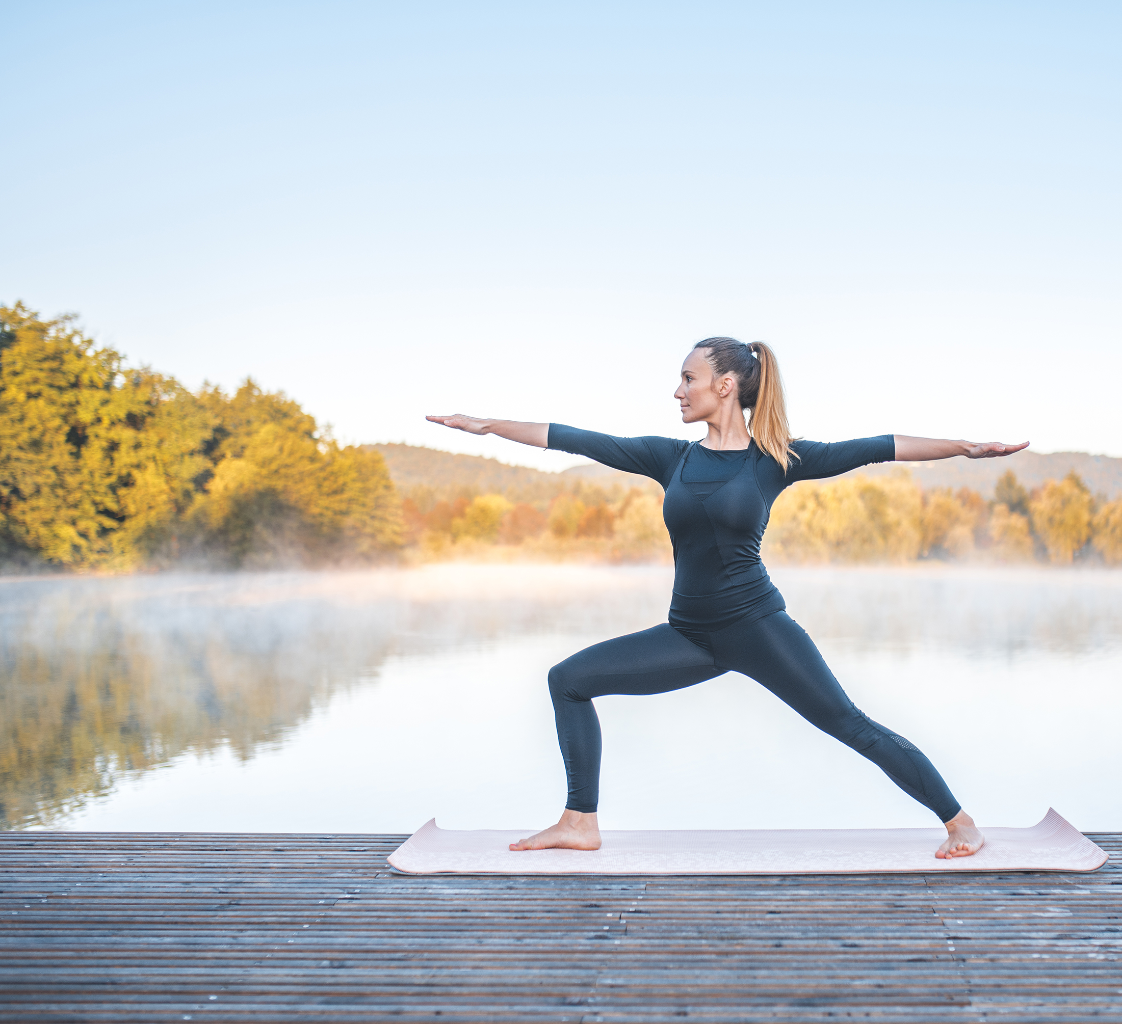
Physical wellbeing
What physical activity have you done this weekend?
How much physical activity do you do daily?
What impact is this having on your wellbeing?

Slide 34
The importance of regular physical activity
"Physical inactivity is one of the leading risk factors for noncommunicable diseases (NCDs) and death worldwide. It increases the risk of cancer, heart disease, stroke and diabetes by 20–30%. It is estimated that four to five million deaths per year could be averted if the global population was more active."
(WHO, 2023)

Slide 35
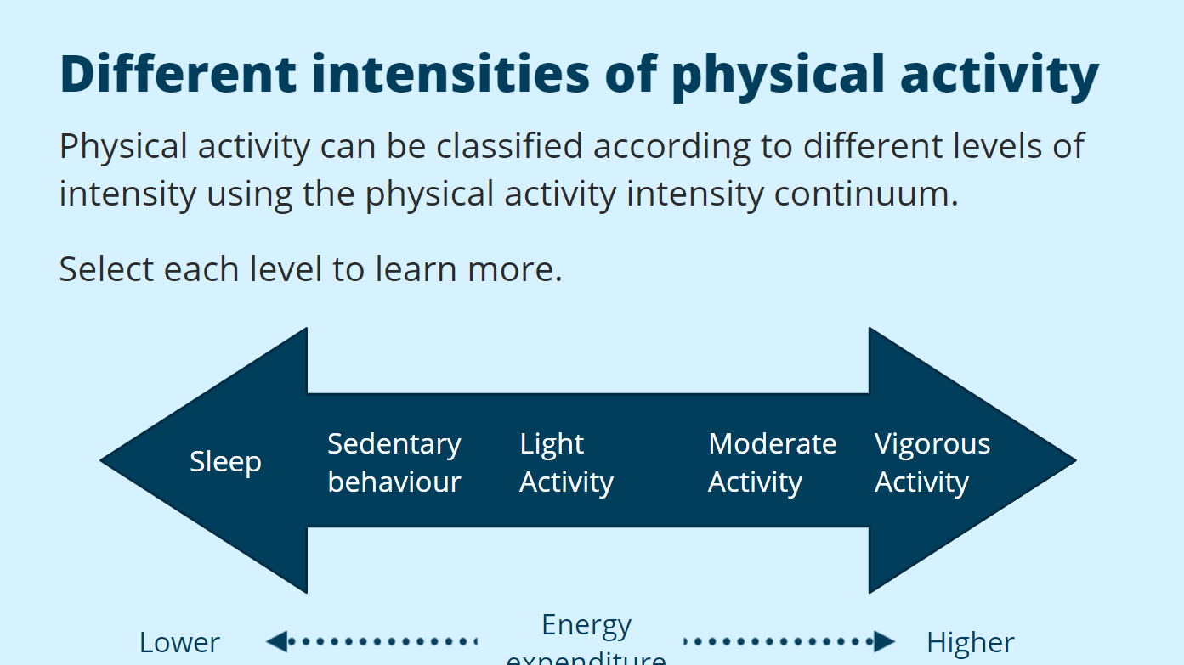

Slide 36

Domains of physical activity
Leisure- Physical activity performed by an individual that is not required as an essential activity of daily living and is performed at their discretion.
Occupation- Physical activity undertaken during paid or voluntary work.
Transport- Physical activity performed for the purpose of getting to and from places.
Education- Physical activity undertaken in educational contexts
Home- Physical activity undertaken in the home for domestic duties

Slide 37
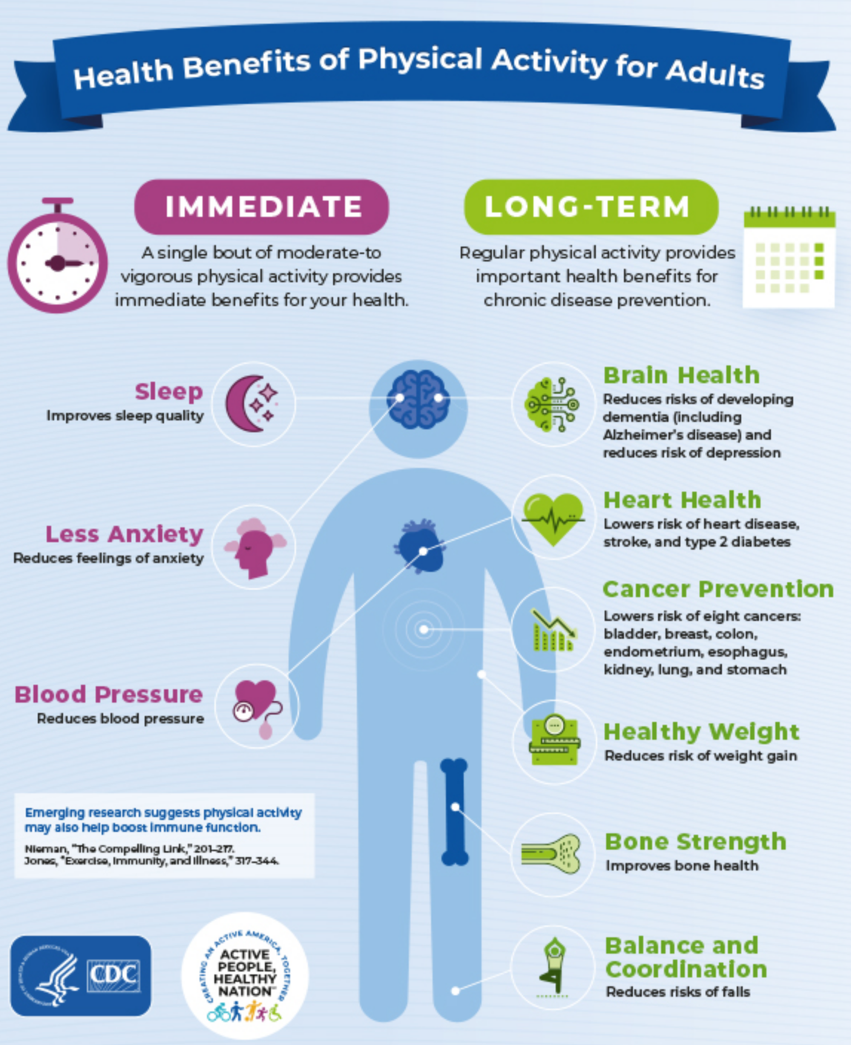
Benefits of physical activity
https://youtu.be/yTL_bNvXJ9s
(Centre for Disease Control and Prevention, 2020)

Slide 38
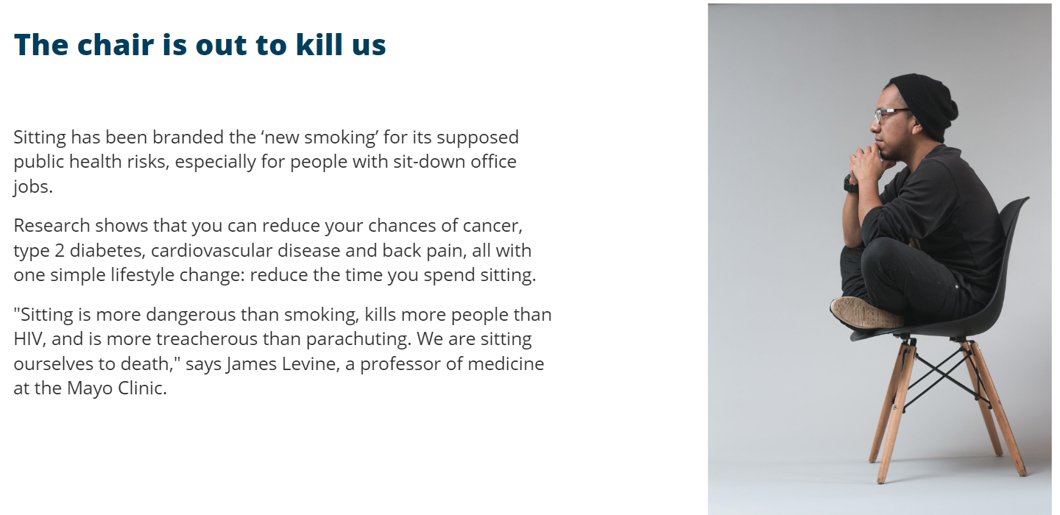

Why sitting is the new smoking

Slide 39
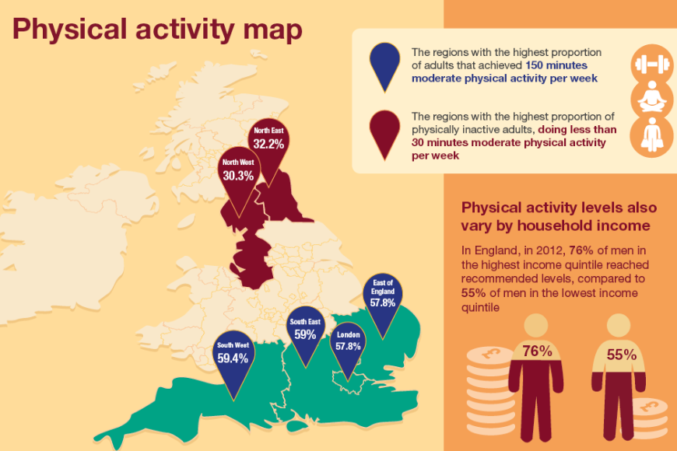
Notes:
We talked last week about inequality and the negative impact this has.
Looking at the map by Public health England (2016), we can see that areas of deprivation have less activity compared to the wealthier areas. The stats also say that... READ

Slide 40
Why is this happening?
Cost
Lack of parks
Shortage of pedestrian walkways
COVID?
Frequent work commitments
Lack of motivation/ energy
Lack of time
Cost of living crisis?
Air pollution
Shortage of leisure facilities
Increase in technology/ social media- How much screentime do you use?
Notes:
What happened in Covid? Lots of research done to show how the pandemic has impacted on our physical activity. Lots of people now WFH, no wlaking to work, walking on lunch, sat at a desk all day. UNI- done on teams, no walking to the bus, into uni and around the building etc.
COST OF LIVING CRISIS- What impact will this have? Can people afford a gym membership? Will people be doing overtime more and therefore, less time being active especially if the job is a desk job? Flip side, people could work in physically demanding jobs and therefore their physical activity will increase?

Slide 41
Why is it important for police officers to maintain healthy levels of physical activity?
Health- mental and physical
More confident to carry out their role
Direct impact of job performance
Protect officers from becoming victims
Unfit officers pose a risk
Notes:
Police officers are exposed to a range of acute chronic stressors, work shifts which often means they inherit poor sleeping habits and unhealthy diets. Physical exercise as we have seen a few slides ago, helps with stress, diet and sleep.
Research shows that PC's are more confident to carry out their role when they feel physically fit.
Direct impact- Officers are able to carry put tasks easier such as running after a criminal
Protect officers from becoming victims- Officers are less likely to be challenegd if they appear fit.
Unfit officers who are out of shape, pose a risk in many areas. Firstly, their own wellbeing

Slide 42
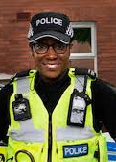

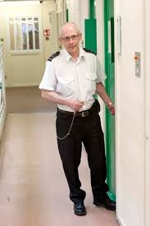
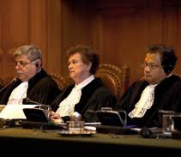
Resilience
What is resilience?
Why is it important within your chosen field?

Slide 43
What is resilience?
Resilience is the capacity to adapt, recover, and bounce back from adversity, challenges, and setbacks.

Slide 44
The importance of resilience
Coping with Challenges: Life is full of uncertainties, setbacks, and challenges. Resilience equips individuals with the mental and emotional tools to handle these difficulties, reducing the risk of being overwhelmed by stress or trauma.
Mental Health: Resilience plays a crucial role in maintaining good mental health. It helps prevent or mitigate the development of conditions like anxiety, depression, and post-traumatic stress disorder, as individuals are better equipped to manage stressors.

Slide 45
Personal Growth: Resilience fosters personal growth and development. Overcoming challenges can lead to increased self-confidence, improved problem-solving skills, and a sense of accomplishment.
Adaptability: Resilient individuals are better at adapting to change. They are open to new perspectives, flexible in their thinking, and more willing to embrace opportunities that arise from unexpected situations.

Slide 46
Enhanced Relationships: Resilient people often have healthier interpersonal relationships. They're better at handling conflicts, maintaining empathy, and offering support to others during their tough times.
Professional Success: In the workplace, resilience is valued by employers. Individuals who can handle stress, setbacks, and change effectively are more likely to perform well under pressure, innovate, and contribute positively to teams.

Slide 47
Improved Decision-Making: Resilient individuals tend to make better decisions, as they approach problems with a clear and rational mindset even when faced with emotional challenges.
Stress Reduction: Resilience can reduce the negative impact of chronic stress on physical health. It helps individuals manage stressors in healthier ways, thus preventing the development of stress-related health issues.

Slide 48
Positive Outlook: Resilience fosters a more positive outlook on life. Individuals with high resilience levels are more likely to see challenges as opportunities for growth rather than insurmountable obstacles.
Community and Social Impact: Resilient individuals can contribute positively to their communities. They often act as role models, offering support and inspiration to others facing adversity.
.
Notes:
Overall, resilience empowers individuals to navigate life's ups and downs with greater emotional strength and mental well-being. It's an essential trait that helps people lead healthier, happier, and more fulfilling lives

Slide 49
Resilience- the role of a lawyer
"Resilience helps legal professionals manage stress effectively by recognising the importance of self-care and making it a priority. They engage in activities that promote physical and mental well-being such as exercise, mindfulness, and maintaining a healthy work-life balance (Debenham, 2023)"

Slide 50
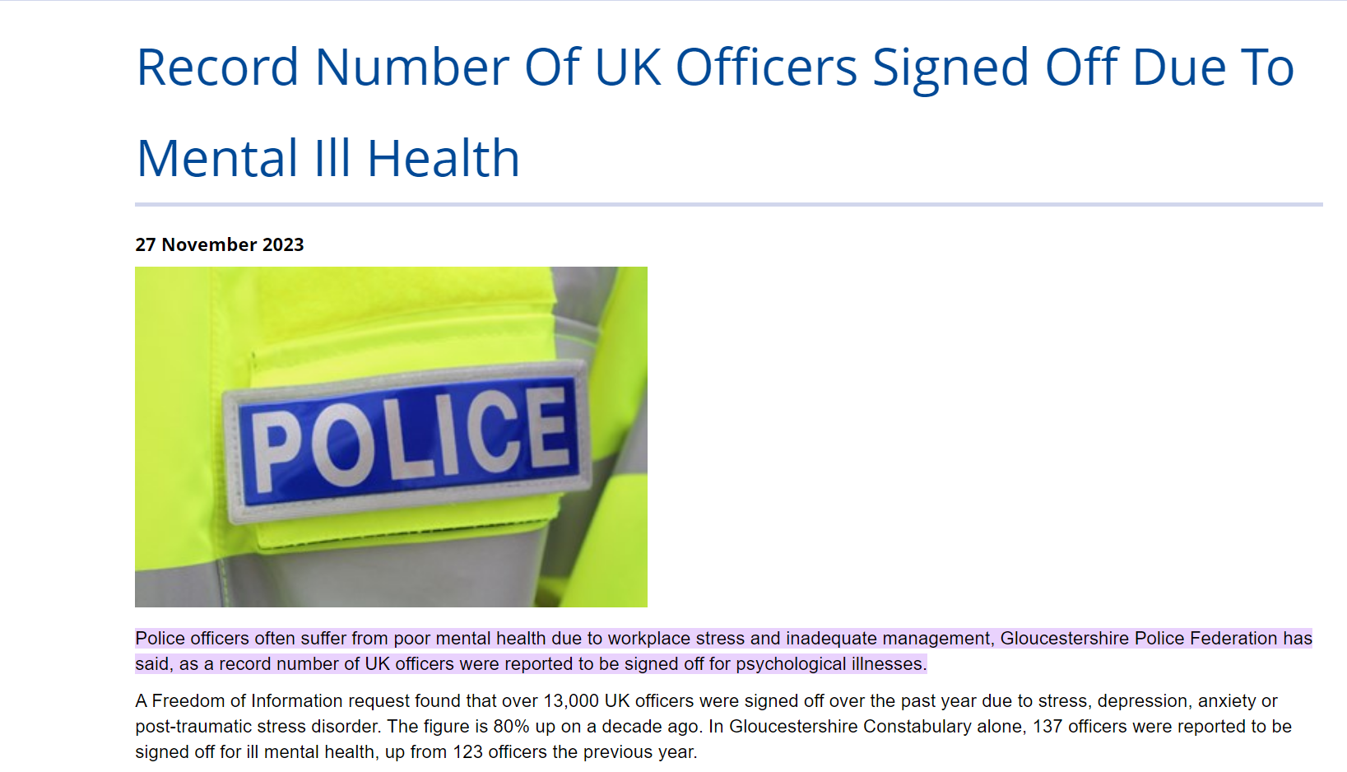
Stress
(Police Federation Gloucester, 2023)

Slide 51
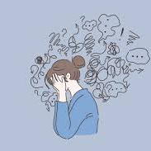
Task
What is stress?
How does it impact on us mentally?
How does it impact on us physically?
How does it relate to your chosen field?
What dangers does stress pose?
How can you manage stress?

Slide 52

Any questions

Slide 53
Session 2

Slide 54
Aims for today
Recap- What is resilience? Why is it important? How does it impact on your chosen discipline?
Practical tasks- Academic writing, paraphrase, cite and reference.

Slide 55
Practical elements
How to insert a cover page
How to insert a contents page
How to create a PP- Theme, Animations, insert pictures
How to record a video using PP

Slide 56
Task
TITLE-The importance of physical wellbeing
Research into the levels of activity within adults and children in the UK. How do we compare on a global level? Why do we see these statistics?
OR
TITLE- The importance of resilience
Research into the importance of resilience within your chosen field. Why is it important? What evidence can you find to support this?
Create a 500 word essay on the above. You must include a cover page (student name, number, title) You need to include at least 3 references. To include the following:-
1 website
1 journal/ article
1 book
Email finished document to s.france@uwtsd.ac.uk

Slide 57

REMEMBER!
Next session is drafts only- NO TAUGHT SESSION

