Slide 1
ADDRESSING THE GREAT WAR
WAR MEMORIAL UNVEILING SPEECHES IN WEST WALES 1919-25

Slide 2

LOCAL NEWSPAPERS
RICH SOURCE FOR WAR MEMORIAL UNVEILINGS FROM 1919; E.G.
CARMARTHEN JOURNAL ;
AMMAN VALLEY CHRONICLE;
PEMBROKESHIRE TELEGRAPH;
LLANELLI MERCURY

Slide 3
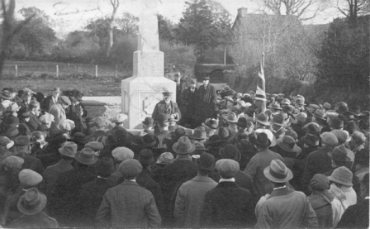
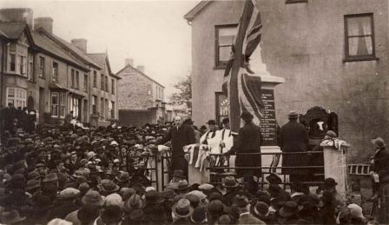
UNVEILINGS
Newspapers hold verbatim accounts of unveiling speeches
Addresses by local dignitaries deemed ‘a safe pair of hands’
Editors willing to include more critical addresses about the war
Pictured Cellan (top) and Pencader unveilings

Slide 4
AIMS
To bring to life the addresses made to the crowds that gathered at memorial unveilings in west Wales
To evaluate levels of support for the war and the commemoration process
Seek evidence for a more critical response to the war, how it was fought, how it was remembered
To place in context with aspects of war commemoration in Britain

Slide 5
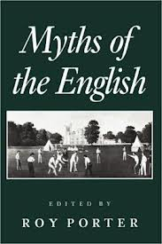
COMMEMORATION
1. Purging discontent?:
‘through the annual acts of remembrance…the demons of discontent and disorder were purged’
Bushaway in Porter, (CUP,1993),p,131.

Slide 6
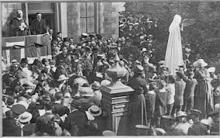
COMMEMORATION
2. Remembering to forget:
‘by remembering the dead…the living tended to forget or ignore the material realities which precipitated the war’
Michael Heffernan in Ecumene II No3 (1995),p. 312

Slide 7
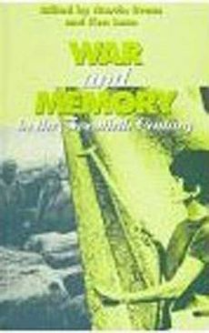
COMMEMORATION
3. A unified national memory?:
The ultimate objective of public remembrance ‘was to mould and control…as a specific stabilised narrative which served to unify national memory’ Moriaty in Evans and Lunn (OUP, 1997), p.125.
Unveilings were well orchestrated and organised

Slide 8
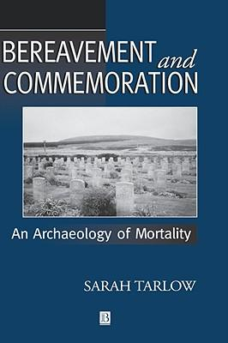
COMMEMORATION
4. Free will?
‘public and personal, local and national forms of commemoration were supported by, rather than imposed upon the British people’
Sarah Tarlow, (Blackwell, 1999), p.163.

Slide 9
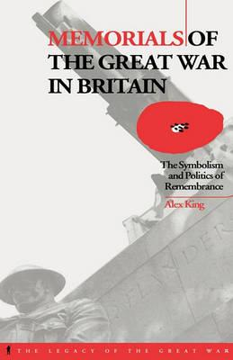
COMMEMORATION
5. Control?
Monument construction ‘relied for its organisation on the institutions of local politics…’
King, (PhD, University of London, 1993), p.11.
Veterans and bereaved secondary within decision making

Slide 10
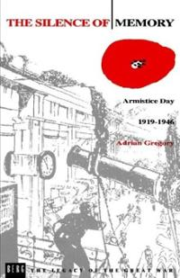
COMMEMORATION
6. Innate conservatism
Commemoration in Britain held a preference for
‘the traditional rhetoric of patriotism’
Gregory (Oxford: Berg, 1994), p.34.
Honour, duty, sacrifice, King and Country
Such language gave comfort and succour at time of unprecedented bereavement.

Slide 11
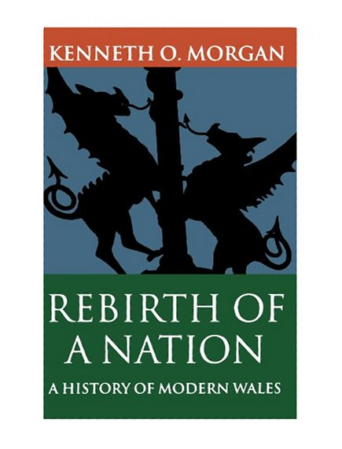
WALES AND THE WAR
MOOD:
1914 –’Nonconformist ministers whipped up their congregations and urged them to enlist’
1918 – ‘reflection, soon turning to disillusion…even at times despair’
(OUP, 1982), p.159; p.180.

Slide 12

WALES AND THE WAR
THE CHAPEL:
‘the radical, Nonconformist, and anti-militarist traditions of Carmarthenshire, ensured that support for the war was neither universal nor wholehearted’
Robin Barlow (PhD, Lampeter, 2000), p.82.

Slide 13
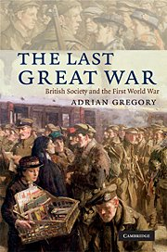
WALES AND THE WAR
RELUCTANT WARRIORS:
Gregory takes issue with Kenneth Morgan’s judgement about the Welsh throwing themselves into war with gusto, claiming ‘this is far from true’
(CUP, 2008), p,11.

Slide 14
SPEAKERS
Organisers chose dignitaries from the community and beyond
Dignitaries from the military, judiciary, landed, business world, religious leaders; politics:
Aim: ‘a safe pair of hands’
        correct message conveyed about the war and the fallen
        talk of ‘honour, duty, sacrifice’
        legacy of fallen – through their sacrifice they set an example for others to follow

Slide 15
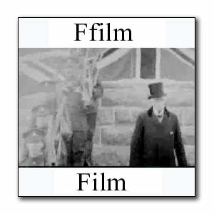
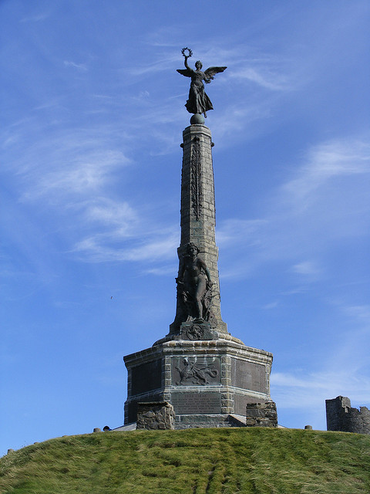
THE CAUSE
LORD YSTWYTH:
‘we, with our Allies and a united Europe, had right and justice on our side’ (Aberystwyth September 1923)
CANON GRIFFITHS: ‘the noble lads…laid down their lives in the cause of liberty, justice, and righteousness’ (Letterston, December 1920)

Slide 16
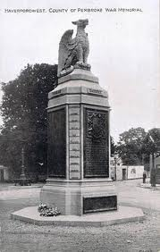
‘BIG WORDS’
SIR IVOR PHILLIPS:
‘we are here to honour those gallant sons of Pembrokeshire’ (September 1921)
COUNCILLOR E.J. GOWER
‘their names would stand immortal and for future ages the memorial would testify to their great sacrifice ‘
(Kidwelly, July 1924)

Slide 17
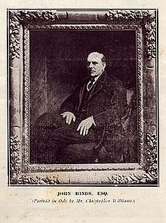
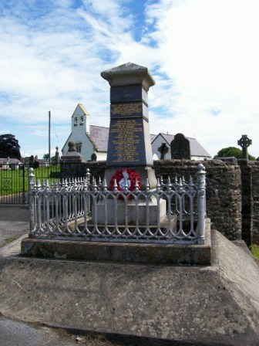
‘BIG WORDS’
JOHN HINDS M.P:
‘we must be faithful to the sacrifices of the past, to the great principles that were at stake, life, honour, justice, liberty’
(Llansadwrn, February 1920 )

Slide 18
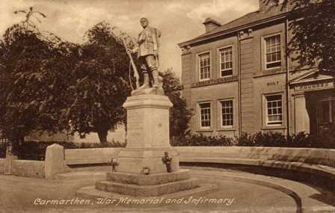
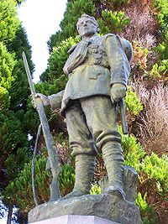
LEGACY
JOHN HINDS M.P:
‘something that would stand age after age, so that future generations could see and learn the lessons of patriotism’
(Carmarthen, September 1924)
‘let the memorial be an inspiration to the children of the future, urging them to
service’
(Drefach Velindre, December 1921)

Slide 19
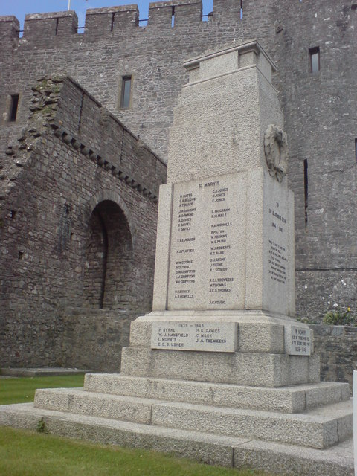
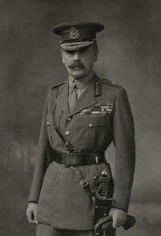
LEGACY
LADY KYSLANT:
‘let us endeavour to follow their example…their patience in suffering, their courage in
adversity’
(Haverfordwest hospital, May 1923)
GENERAL SIR FRANCIS LLOYD :
‘it was the remembrance of what was done in the war which would be an inspiration and
encouragement’
(Pembroke, June 1924)

Slide 20
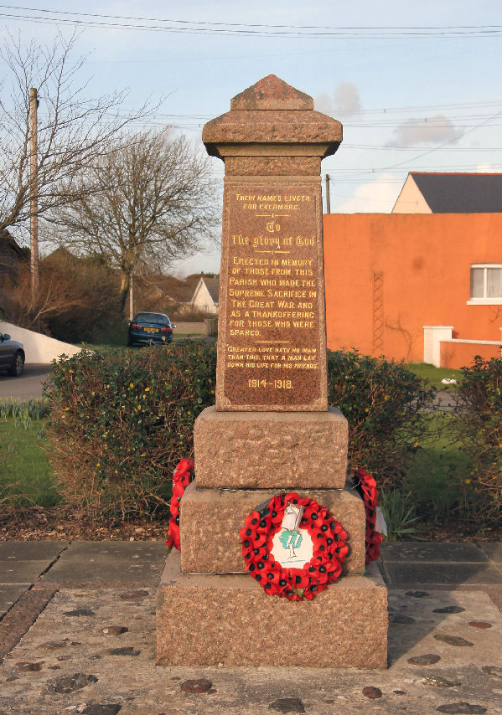
LEGACY
GENERAL SIR FREDERICK MEYRICK:
‘The best way to remember the fallen ‘would be for them to do their duty as the departed ones had done theirs, and leading a better life as they would have wished’
(Hundleton, May 1923)

Slide 21
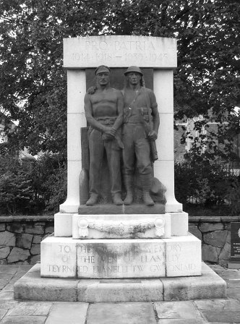
EMPIRE
GENERAL STANLEY FIELDER MOTT:
‘ without it (the sacrifice) we should be unable to preserve the tradition and ideals for which Wales, and the rest of the great Empire, fought for’
(Llanelli October 1923)

Slide 22
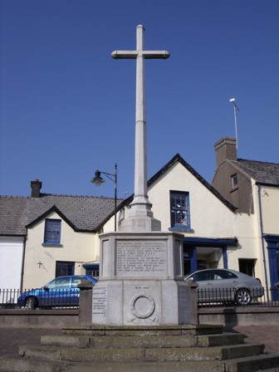
CHRIST AND THE FALLEN
WALTER JAMES:
The cross is ‘the emblem of the great sacrifice of the son of God, and the emblem of the supreme sacrifice of the men of Narberth’
(March 1924)
COLONEL DRUMMOND :
‘the fallen had lost their lives in retrieving its (Jerusalem’s) role to Christianity, what it had not enjoyed since the days of the Crusades’
(Talley, April 1925)

Slide 23
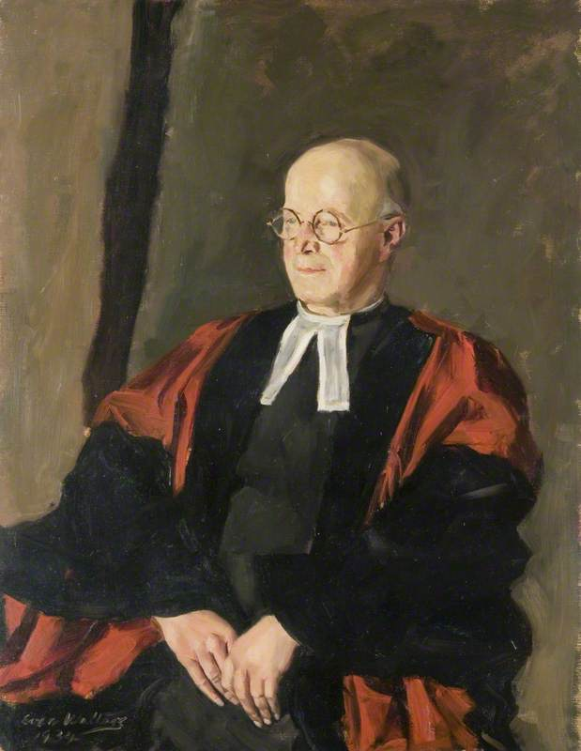
APATHY
REVEREND CANON MAURICE JONES (Principal of St David College):
‘they forget the many sacrifices made for them…’and are ‘beginning to lose sense of its (the war’s) great realities’
(Carmarthen, September 1924)

Slide 24
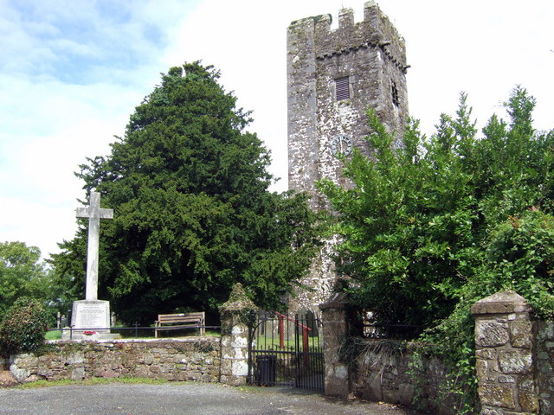
APATHY
MAJOR C.W.M. PRICE:
‘memory in one way has been kind, it has softened the grief for many of us who have lost in the war. But in another way memory has been unkind, because many of the people’s memories have forgotten what it was that won the war’
(Robeston Wathen, September 1924)

Slide 25

ECONOMY OF SACRIFICE
SIR MARTEINE LLOYD:
‘no one here, except those who have been over there can have any conceptions of what our boys went through’
(Newport, September 1923)

Slide 26

THOSE LEFT BEHIND!
CHARLES MASON (Miners’ Welfare Committee):
‘it was a lasting disgrace that there were ¾ million ex-servicemen unemployed…many promises had been made…but there were thousands king out a miserable existence’
(Llandybie, November 1925)

Slide 27
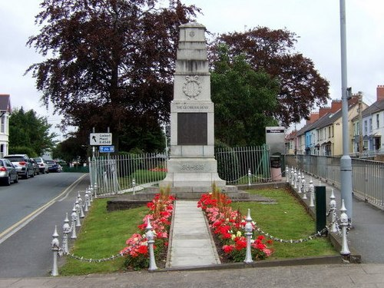
CRITIQUE OF WAR
MAYOR DAN WILLIAMS:
‘war was a terrible crime against humanity’
(Cardigan, August 1923)
COLONEL J.V. BOWEN:
‘the world had made a terrible mistake…they gave their lives with definite intention of avoiding future war’
(Newport, September 1923)

Slide 28
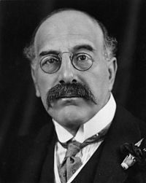
CRITIQUE OF WAR
SIR ALFRED MOND M.P. (pictured):
hope ‘that never again would the world be plunged into the horrors of a similar war’
(Kidwelly, September 1924)
CANON GRIFFITHS:
‘thank God for the termination of this terrible war…’ prayer ‘that wars would cease throughout the world’
(Letterston, December 1920)

Slide 29
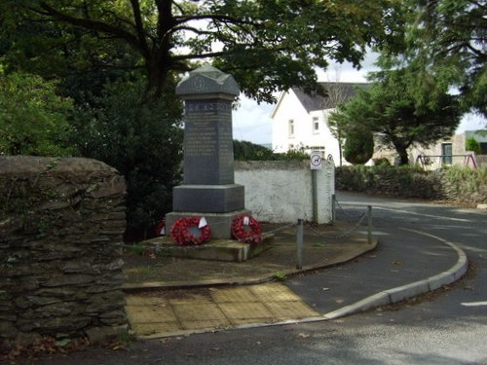
CRITIQUE OF WAR
ALDERMAN WILLIAMS:
‘future children will live in peace with all peoples of the world’
REVEREND LEWIS:
Spoke of ‘the cruelty and destructiveness of war’
(both Letterston December 1920)

Slide 30
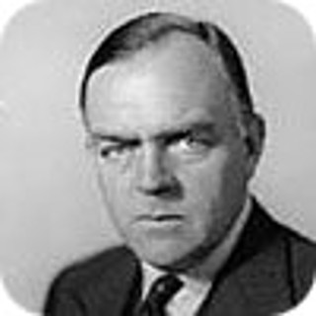
CRITIQUE OF WAR
MAJOR GWILYM LLOYD GEORGE:
‘what does war do? It leaves behind poverty, unrest, sorrow, and suffering…to my mind the glory does not exist…if the next generation…will always remember this, and not be carried away by talk about the glory of war, then the sacrifices of these men would not have been in vain’ (Clynderwen, September 1923).

Slide 31
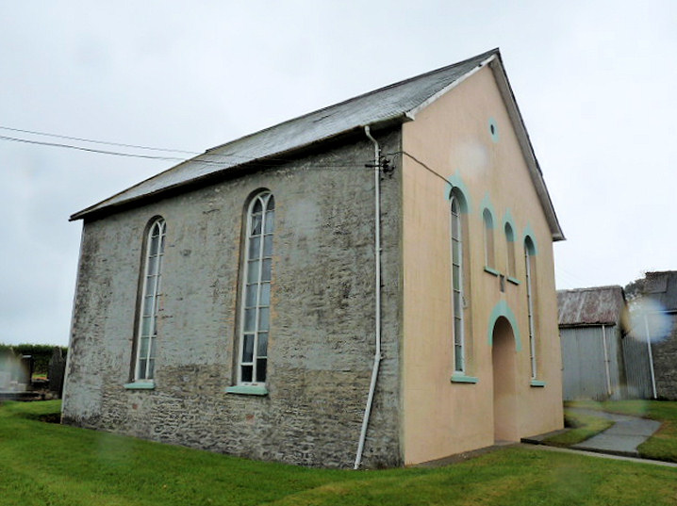
MILITARISM
REV ESGAR JAMES
‘they were not there to glorify militarism nor war, but to pay tribute to one who had laid down his life for them’
Reply: COLONEL SPENCE COLBY
‘those miserable people who went up and down the country speaking against, what they were pleased to call, militarism, should leave the country and show themselves to be what they really are – traitors’
(Vachendre Boncath, October 1920)

Slide 32
ENGLAND’S WAR!
SIR IVOR PHILLIPS:
‘the British soldier and sailor…gave their lives so that England might live’ (Cosheston, January 1921)
SIR CHARLES PHILLIPS:
‘if Germany had been victorious over England, England would have been a place of slavery’ (Manorbier, August 1922)
LT COLONEL MINSHALL FORD:
‘as strangers they needed no further evidence that the people of this glorious bit of England did their part in the war and did their duty nobly’ (Dale, May 1923)

Slide 33
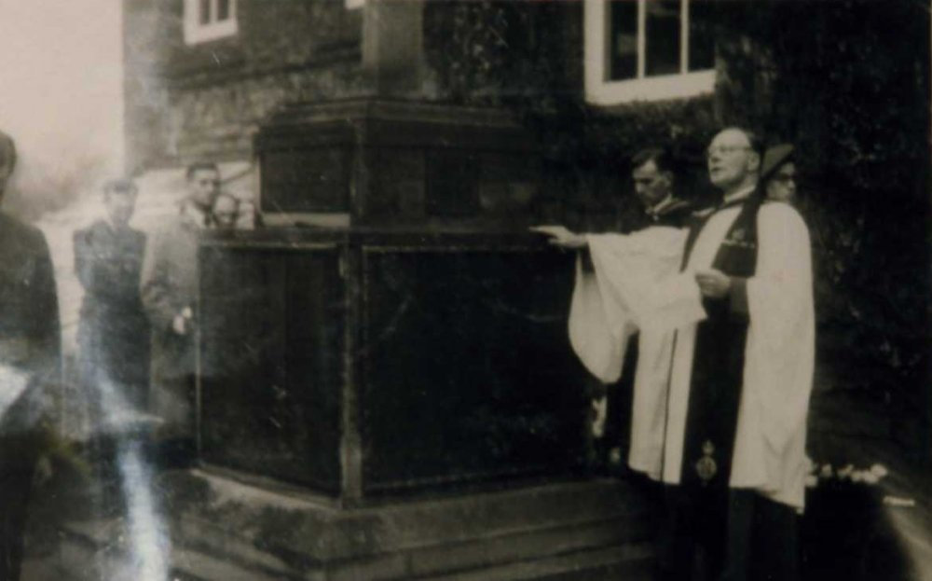
NECESSARY WAR
CANON D.W. THOMAS:
‘the war was an entirely necessary war…there had never been a just war since the beginning of time, but there had been necessary wars’
(Llandybie, November 1925)

Slide 34
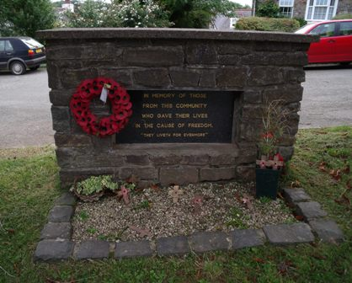
BY JINGO!
REVEREND D.M. PRYCE:
imagined ‘the Llangwm men who went down with Amphion, Aboukir, and Louvain, shouting on the crest of the waves, Brittania rule the waves!’
(Llangwm, November 1919)

