Slide 1
John Calvin
And His Contribution to the Reformation

Slide 2
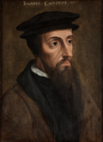
Biography
John Calvin was born July 10, 1509, in Noyon, France, in a Roman Catholic family.
At the age of 14, he was sent to Paris to study at the College de Marche, then transferred to the more famous College Montaigu.
His education was supported by a church-granted stipend with the intention to prepare him for a clerical career.
Instead, in 1528, Calvin moved to Orleans to study civil law. He finished his law studies in 1532 and published his first book, a commentary on De Clementia by the Roman philosopher, Seneca.
It is thought that in 1533, Calvin experienced a sudden and unexpected conversion. He fled Paris and reappeared the following year in Noyon to surrender his clerical benefices.

Slide 3
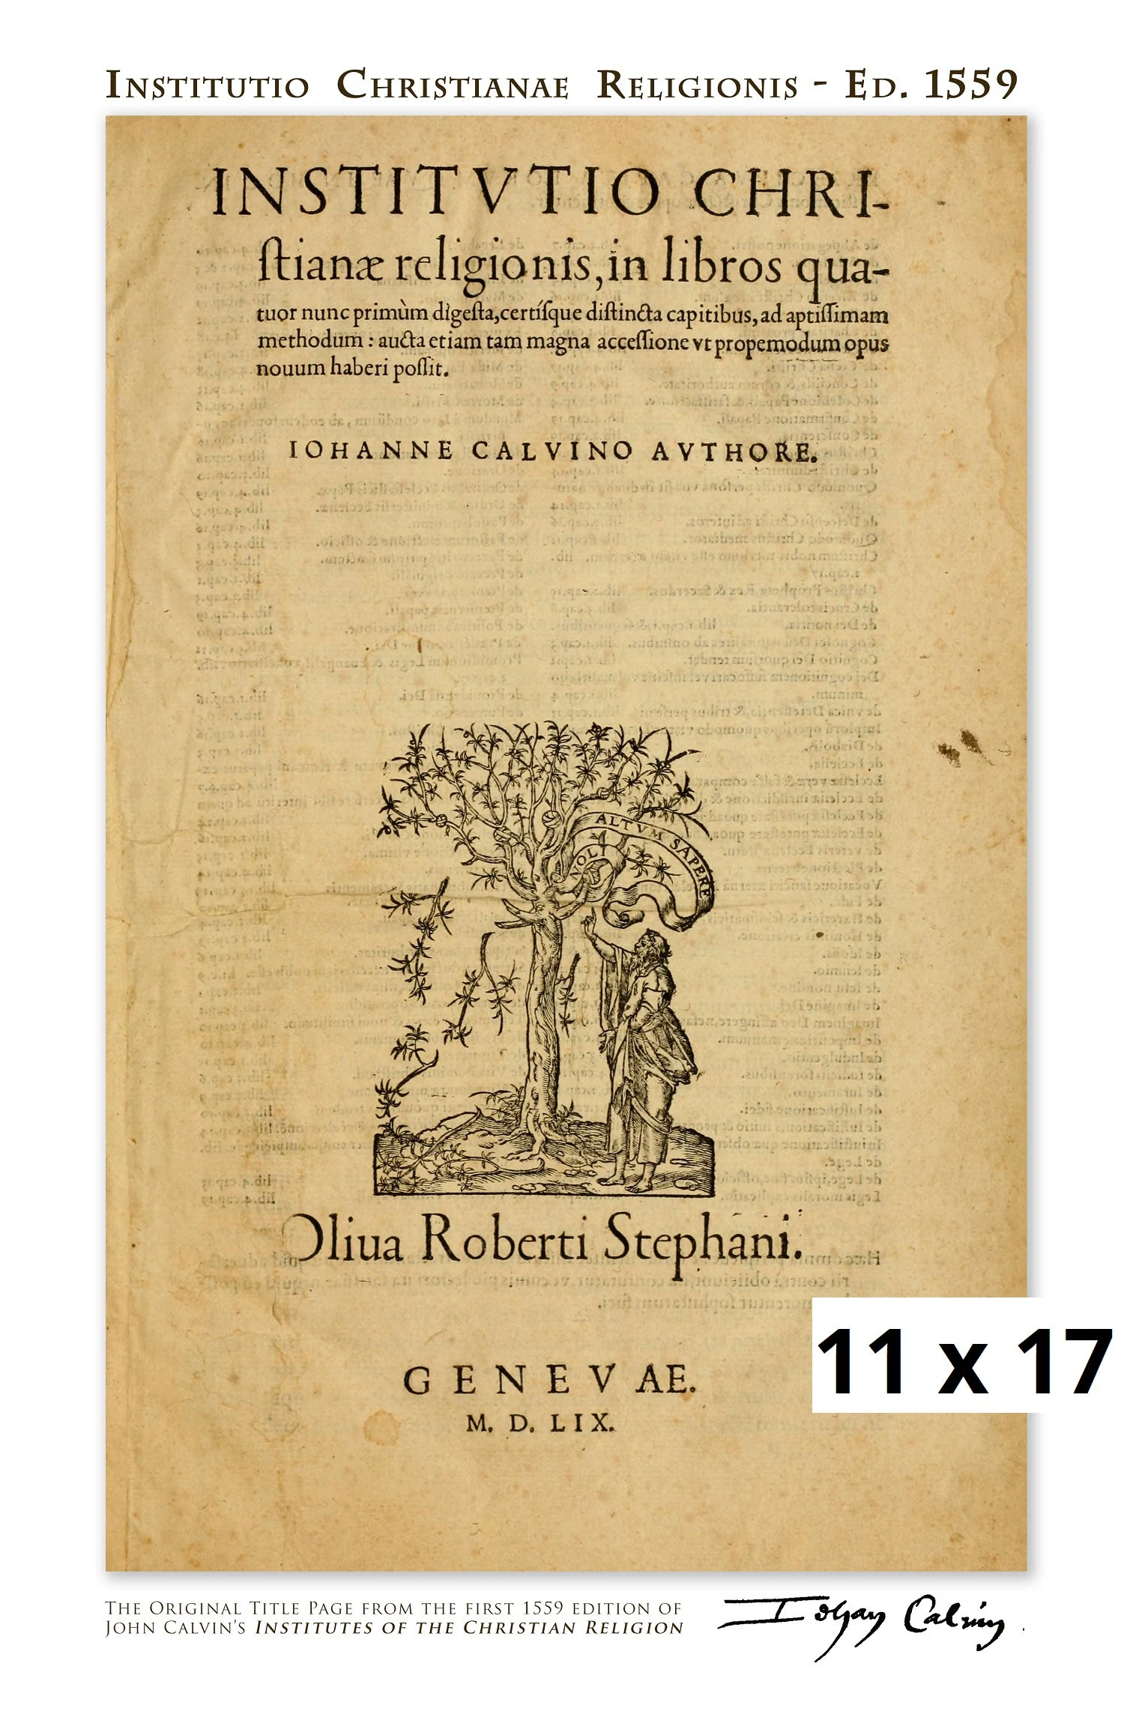
In 1536 Calvin finished the first edition of his Institutes of the Christian Religion which became an instant best seller.
He moved to Geneva, then Strasbourg where he started writing his comments upon the books of the Bible.
In 1541 Calvin returned to Geneva where he lived and worked until his death in 1564. It was in this period that Calvin made his other great contribution to the Church –he prepared and then forced the city council to ratify his Ecclesiastical Ordinances of the Church of Geneva which contained all the principles of Reformed polity.

Slide 4
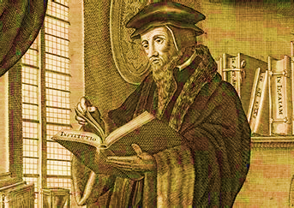
‘Calvin brought to the study of theology a passion for biblical truth and a coherent understanding of the Word of God. Of all of the thinkers of the sixteenth century, Calvin was most noted for his ability to provide a systematic theological understanding of Christian truth’ (Sproul). His greatest work, Institutes of the Christian Religion, has remained important for Protestant theology for almost five centuries. To this day, he is regarded with the sobriquet “the Theologian.”
Systematic theology is a discipline of Christian theology that formulates an orderly, rational, and coherent account of the doctrines of the Christian faith.

Slide 5
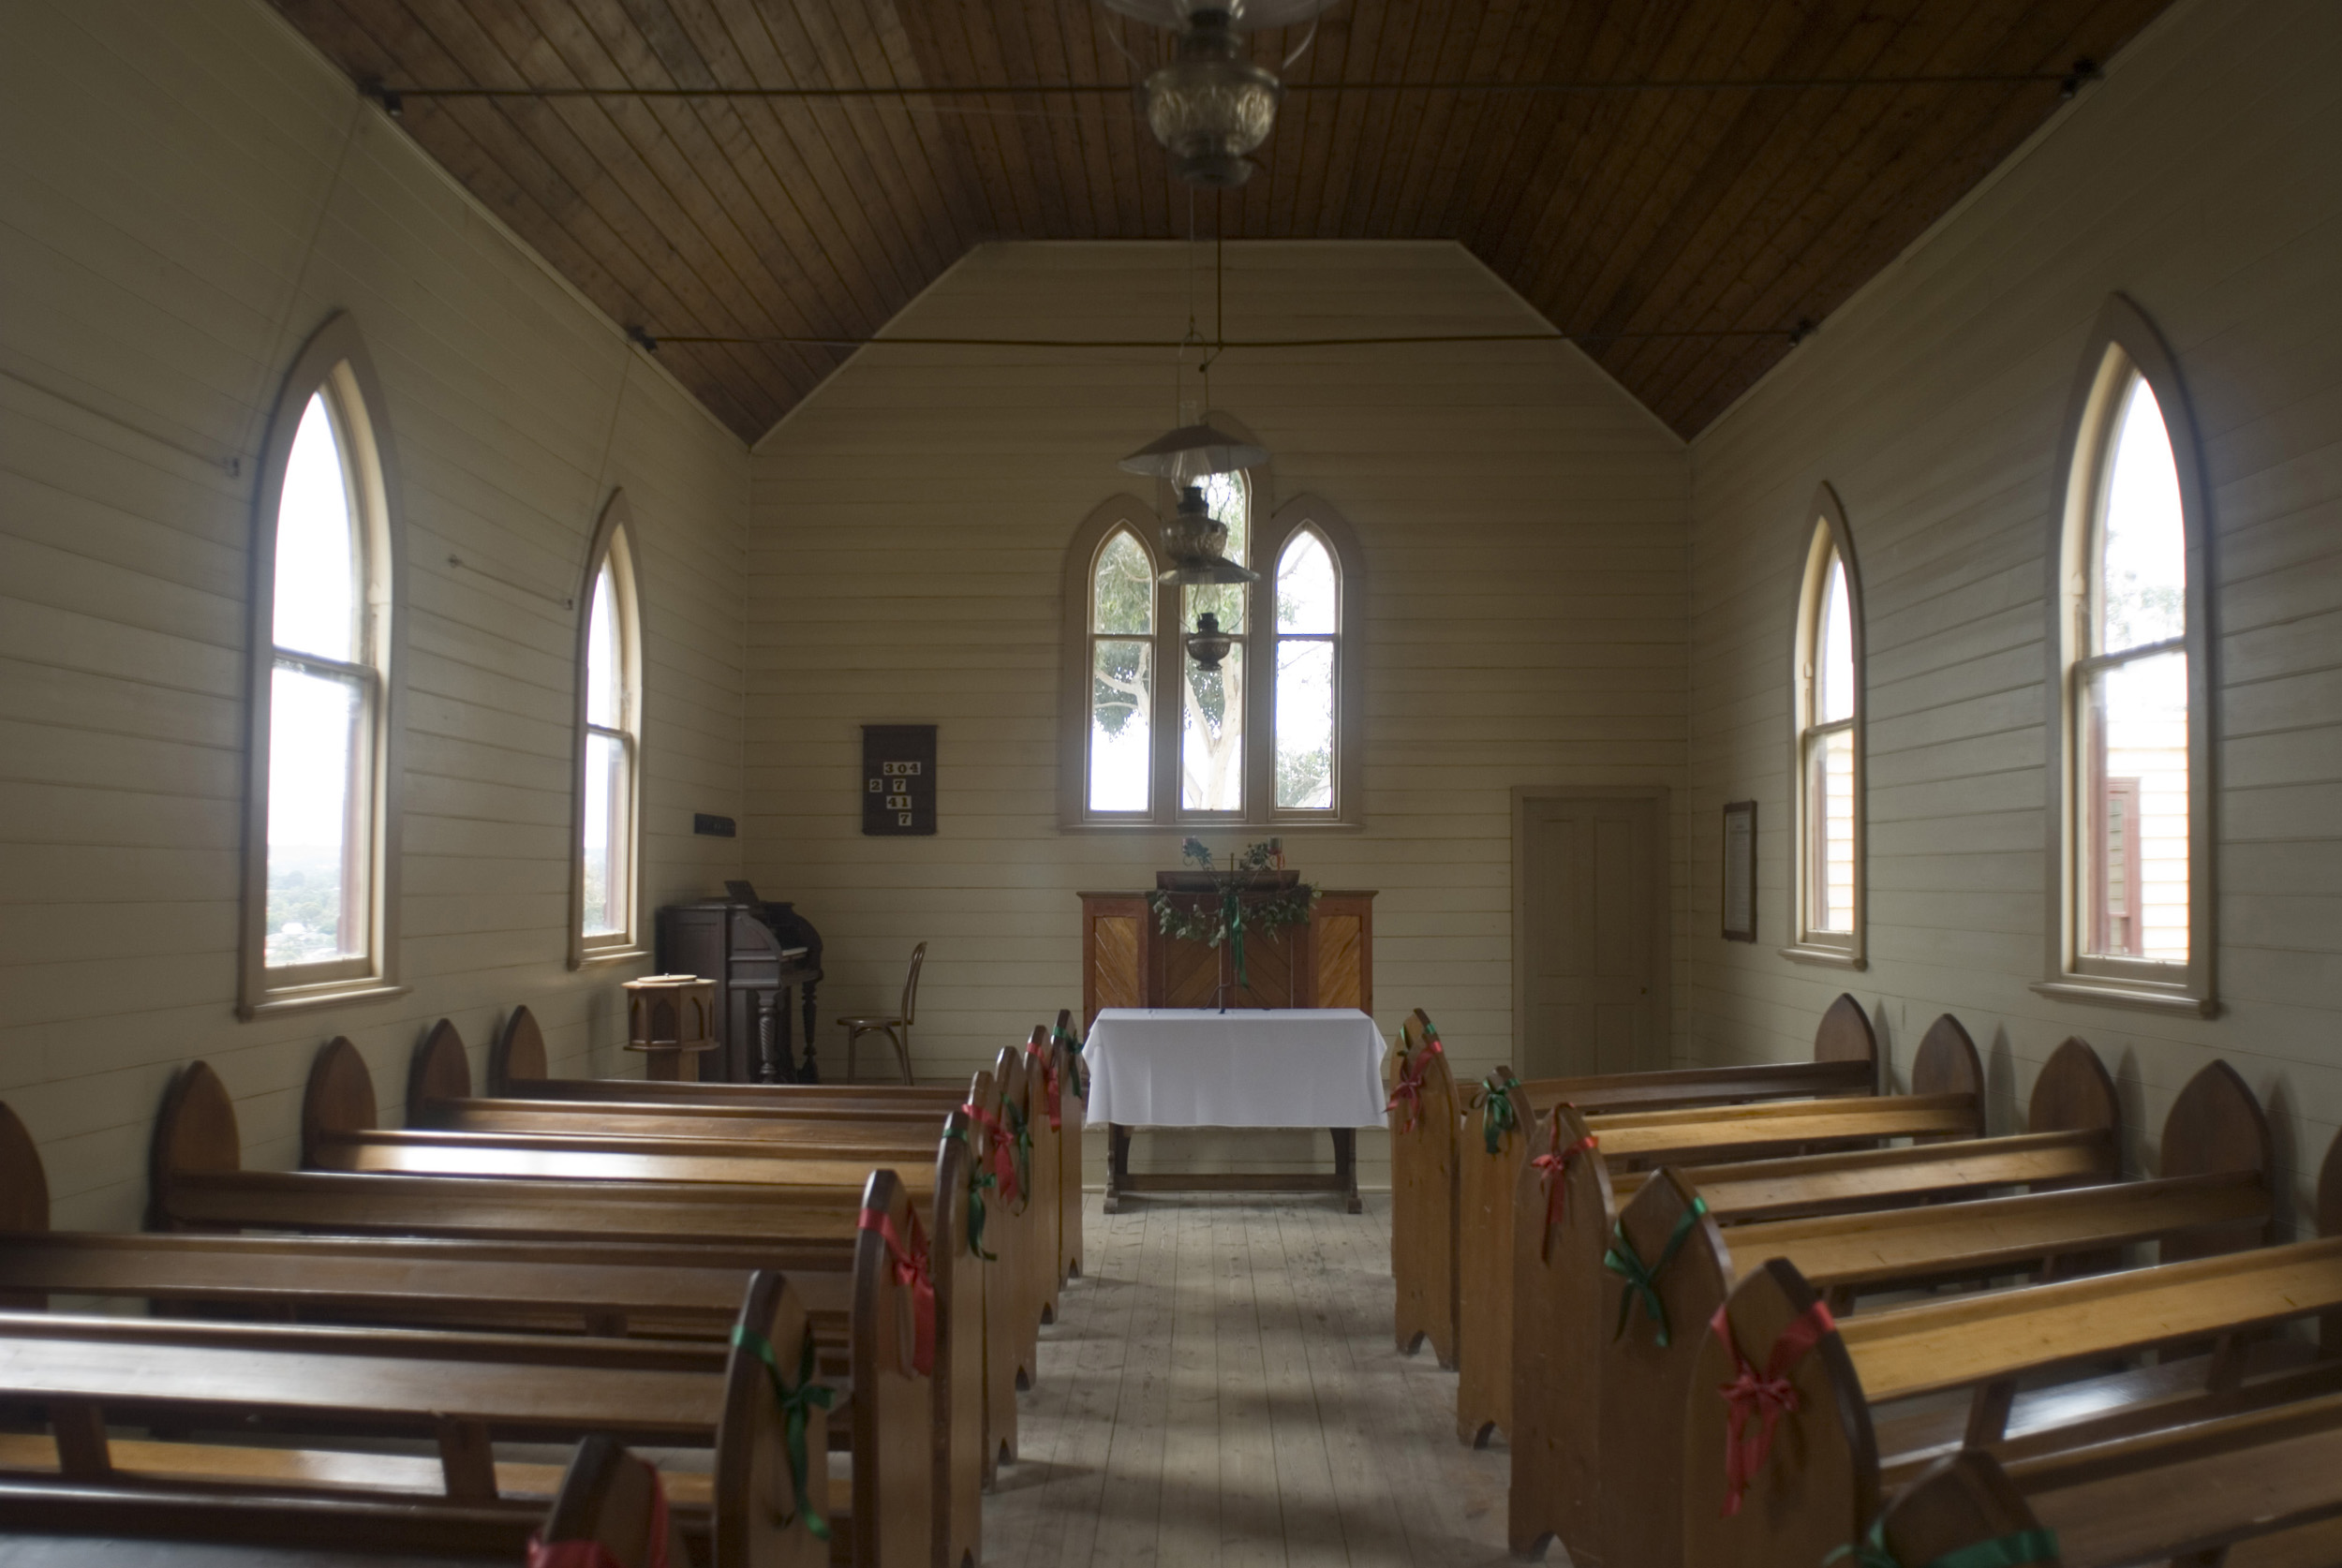
“Institutes of the Christian Religion” was first published in Latin in 1536 with a preface addressed to King Francis I of France, beseeching him to hear out the Protestants instead of persecuting them. In the following years, Calvin issued three more books of the The Institutes.
Some of the major points in his work are:
To find happiness in God and serve Him, one should know God.
The Knowledge of God and That of Ourselves Are Connected.
We see God in the creation; however, nature is not God.
Man-made images cannot contain the representation of the character of God in any way.
Eternal life is foreordained for some people, eternal damnation for others.
God is Father, Son and Holy Spirit.
Jesus Christ, the Redeemer, came incarnate, lived and suffered under Pontius Pilate, died, was buried, rose from the dead, ascended into heaven and intercedes at the right hand of the Father.
Nothing happens in the known universe without God’s knowledge and His ordained decree.
‘The Papacy has overthrown the Gospel and has corrupted the sacraments and cannot be called the church, but the apostate Babylon’ (McMahon).

Slide 6
The Institutes (continued)
The purpose of the knowledge of God is to teach us fear and reverence, and to guide us to seek every good from Him and give Him credit when received.
Superstition is the result of vain curiosity, an inordinate desire for too much knowledge and false confidence.
God bestows the actual knowledge of Himself upon us only in the Scriptures.
Scripture has its authority from God, not from the church.
The fruits of repentance are holiness of life, confession and remission of sins, and lifelong mortification.
The Romanist confession has become a plague in the church creating a false sense of security for the people in their sin.
Indulgences profane the blood of Christ and are pious frauds that deceive men into a false assurance.
We are to present ourselves as living sacrifices before God, and to be transformed into the image of Christ, not after the pattern of the world.

Slide 7
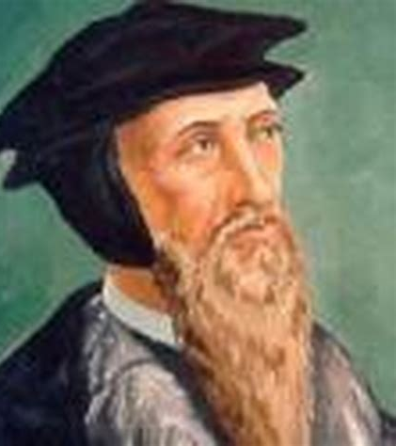
Calvin’s thoughts on Pastoral Ministry
Calvin defined the Pastoral ministry is a spiritual warfare against Satan, who targets ministers much more that other believers.
‘Calvin specifically cautioned pastors to subject themselves to the judgement of the church when they were in conflict, to use moderation in their reproofs so as not to wound the minds of their people, and never give even the appearance of delight over their critics if they prevailed in church conflicts’ (Brown).
Among all the struggles pastors face, “How many things there are within that are far worse! Ambitious men openly attack us … impudent men insult us, hypocrites rage against us, those who are wise after the flesh do us harm, and we are harassed in many different ways on every side.”(John Calvin Bible commentary on 1 Timothy 6:14)

Slide 8

Eucharist and the Holy Spirit
Calvin explains the Sacred Supper of Christ as a sacrament that is not only memorial in nature but also an act of faith. While partaking in the sacrament, the believers are unified with Jesus through the Holy Spirit. Even though the wine and bread never physically transform into the blood and body, we are spiritually unified, and Jesus’ life passes onto us. According to Calvin, ‘this mystery of Christ’s secret union with the devout is by nature incomprehensible’ because it takes place in both the physical and spiritual realm by the Holy Spirit. It is also a ‘bond of love’ between believers that should be practiced often and with joy.
Calvin rejects the transubstantiation and the idea that the Lord’s Supper is a propitiatory sacrifice (as practiced in the Roman Catholic church).
His views on works of the Spirit in the Supper come close to the modern-day Pentecostals.

Slide 9
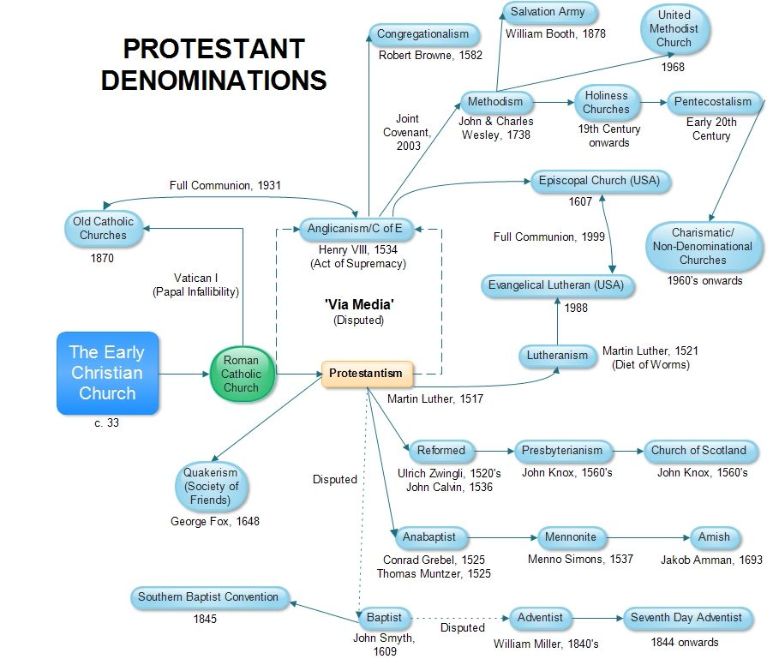
Calvinism is not a specific denomination, but a branch of Christian Theology developed by John Calvin.
It’s defined by its ‘five points’ (referred to as TULIP):
Total depravity
Unconditional election
Limited atonement
Irresistible Grace
Perseverance of the Saints
Denominations with strong Calvinist roots are the Reformed, the Presbyterians and Reformed Baptists.
In contrast to the Lutheran doctrine of electing a hierarchy of bishops (Greek: Episcopoi ) to govern the church, Reformed churches usually elect elders (Greek: Presbyteroi ) to carry out this function. The elders work together as a group but are accountable to higher groups known as presbyteries, synods or assemblies.

Slide 10
Bibliography
’
Brown, Leland, ‘The Standard-Bearer: Pastoral Suffering in the Theology of John Calvin’. Themelios, 47(2) (2022), 326–336
Butler, Geoffrey, ‘John Calvin’s Eucharistic Theology: A Pentecostal Analysis’, Themelios, 47(1) (2022), 81–94
‘Introduction to Protestanism’ <http://protestantism.co.uk/denominations> [accessed 15 November 2022]
Calvin, John, ‘JOHN CALVIN'S BIBLE COMMENTARY 1 Timothy 6:14’, Bibliaplus <https://www.bibliaplus.org/en/commentaries/3/john-calvins-bible-commentary/1-timothy/6/14> [accessed 15 November 2022]
Calvin, John, ‘Institutes of the Christian Religion’, 4.17.1 (Library of Christian Classics, ed. John T. McNeil), 2:1362
McMahon, Matthew, ‘An Overview of Calvin’s “Institutes of the Christian Religion”’, APM <https://www.apuritansmind.com/the-reformation/a-short-summary-of-calvins-institutes-by-dr-c-matthew-mcmahon/> [accessed 15 November 2022]
R.C. Sproul, R. C., ‘John Calvin's Legacy: The Theologian of Theologians’, Ligonier <https://www.ligonier.org/learn/articles/theologian?utm_campaign=redirect> [accessed 15 November 2022]
Samson, John, ‘The Lord’s Supper According to Calvin’, Effectual Grace <https://effectualgrace.com/2019/07/18/the-lords-supper-according-to-calvin/> [accessed 16 November 2022]

