Slide 1
Gas Turbine Plant
Rob Goodson

Slide 2
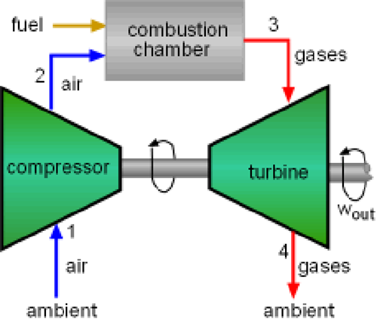
The Gas Turbine Plant
A Gas turbine plant is mainly used for aircraft propulsion but is also used in ships, locomotives, pumping and power generation.
The Joule Cycle
The open cycle ideal gas turbine plant is shown below and is known as the Joule cycle; it is a constant pressure flow process cycle. The SFEE is used to analyse each of the four processes, whereby changes in kinetic and potential energy being neglected.
Air is compressed between 1 and 2, and fuel is added in the combustion chamber between 2 and 3 at constant pressure. Expansion of the hot gases takes place in the turbine between 3 and 4. There are only two pressures to consider, these are usually expressed as a pressure ratio across which the turbine operates.
Compressor & turbine are on common shaft hence some work produced in turbine in lost in driving the compressor. Usually, increased mass of gases after combustion due to fuel addition is neglected.
NOTE: in the following equations for work and heat transfer, they are written in term so ‘per unit mass’.

Slide 3
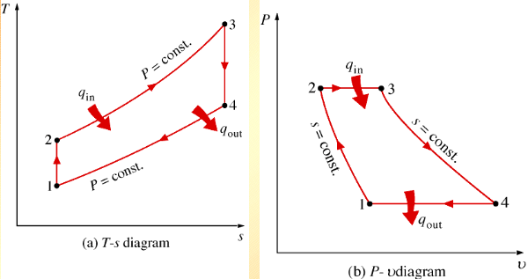
The Gas Turbine Plant
1-2 reversible, adiabatic compression in a rotary compressor w_{c} = h₂ – h₁ = c_{p} (T₂ – T₁)
2-3 reversible, constant pressure heat transfer (combustion) q_{in} = h₃ – h₂ = c_{p} (T₃ – T₂)
3-4 reversible, adiabatic expansion in a turbine w_{t} = h₃ – h₄ = c_{p} (T₃ – T₄)
4-1 reversible, constant pressure heat transfer (cooler) q_{out} = h₁ – h₄ = c_{p} (T₁ – T₄)
Note: 1-2 & 3-4 on the T-s diagram are isentropic processes.
W_{c}

Slide 4
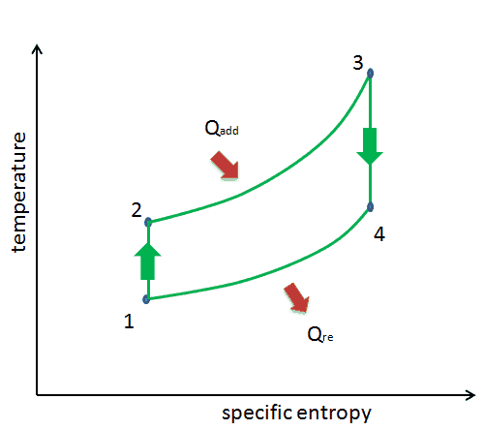
The Gas Turbine Plant
The specific or net work ( W_{out} – W_{in} or, W_{t} − W_{c} ) for the Joule cycle is,
w = c_{p} (T₃ – T₄) − c_{p} (T₂ – T₁)
and therefore, the thermal (or plant) efficiency of the cycle is found to be,
η_{th} = net work / heat energy supplied = W_{t} – W_{c} / Q_{in}
so, η_{th} = [c_{p} (T₃ – T₄) – c_{p} (T₂ – T₁)] / c_{p} (T₃ – T₂)
or, η_{th} = 1 – (T₄ – T₁)/(T₃ – T₂)
p₂
p₁

Slide 5

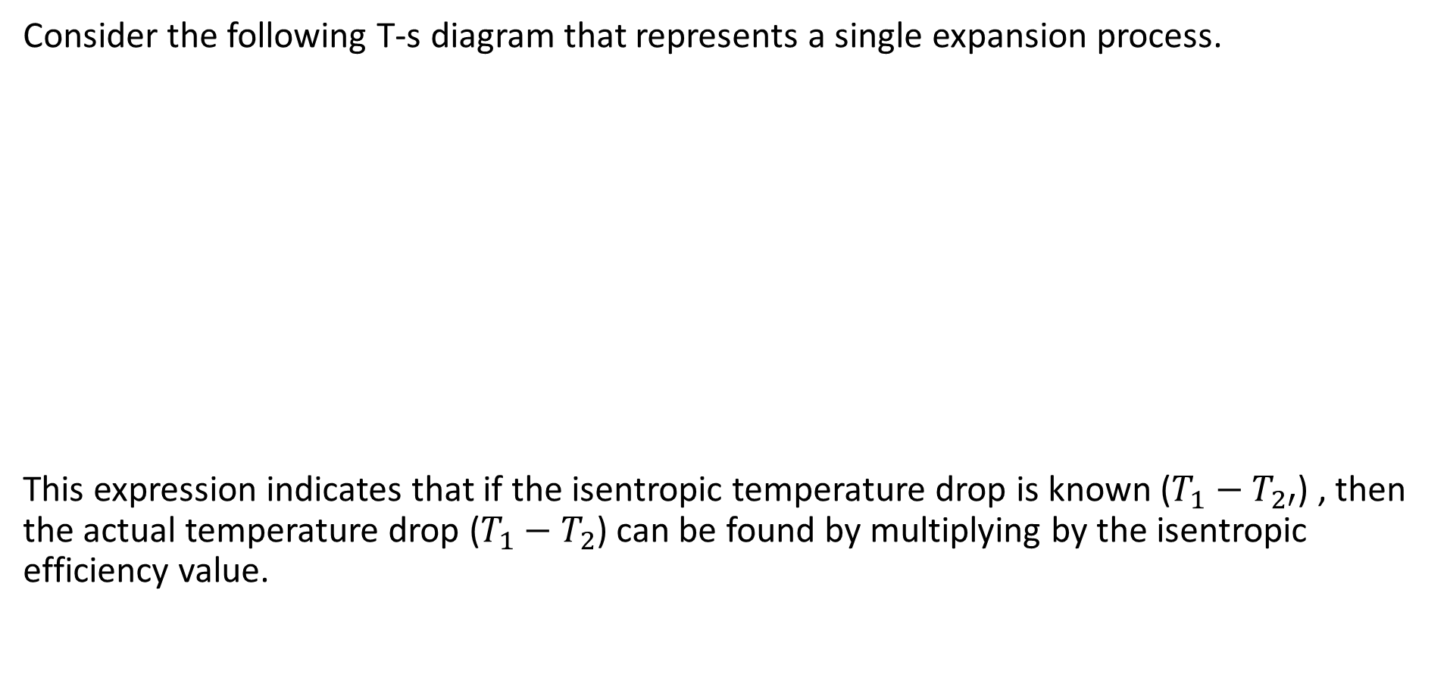
Isentropic efficiency – copy from lecture 1
Consider the following T-s diagram that represents a single expansion process.
This expression indicates that if the isentropic temperature drop is known ($T_{1}−T_{2′}$) , then the actual temperature drop ($T_{1}−T_{2}$) can be found by multiplying by the isentropic efficiency value.
T
1
The isentropic efficiency of this process is
determined as;
$η= \frac{T_{1}−T_{2}}{T_{1}−T_{2}′}$
T₁
T₂
2
T_{2’}
2’
s

Slide 6
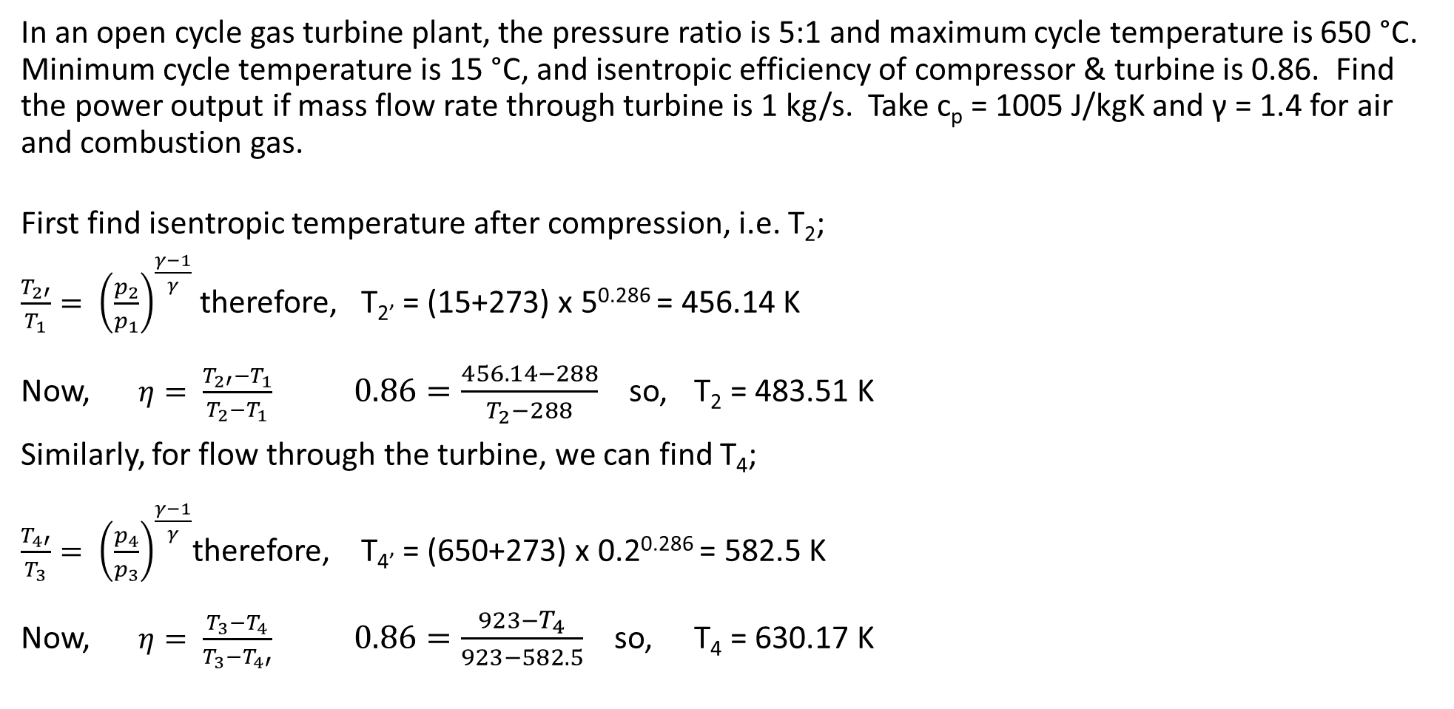
Gas turbine plant - example
In an open cycle gas turbine plant, the pressure ratio is 5:1 and maximum cycle temperature is 650 °C. Minimum cycle temperature is 15 °C, and isentropic efficiency of compressor & turbine is 0.86. Find the power output if mass flow rate through turbine is 1 kg/s. Take c_{p} = 1005 J/kgK and γ = 1.4 for air and combustion gas.
First find isentropic temperature after compression, i.e. T₂;
$\frac{T_{2′}}{T_{1}}= {\left(\frac{p_{2}}{p_{1}}\right)}^{\frac{γ−1}{γ}}$ therefore, T_{2’} = (15+273) x 5^{0.286} = 456.14 K
Now, $η= \frac{T_{2′}−T_{1}}{T_{2}−T_{1}}$ $0.86=\frac{456.14−288}{T_{2}−288}$ so, T₂ = 483.51 K
Similarly, for flow through the turbine, we can find T₄;
$\frac{T_{4′}}{T_{3}}= {\left(\frac{p_{4}}{p_{3}}\right)}^{\frac{γ−1}{γ}}$therefore, T_{4’} = (650+273) x 0.2^{0.286} = 582.5 K
Now, $η= \frac{T_{3}−T_{4}}{T_{3}−T_{4′}}$ $0.86=\frac{923−T_{4}}{923−582.5}$ so, T₄ = 630.17 K
T
5
3
T₂
2
1
2’
T_{2’}
4
4’
T₁
1
s

Slide 7
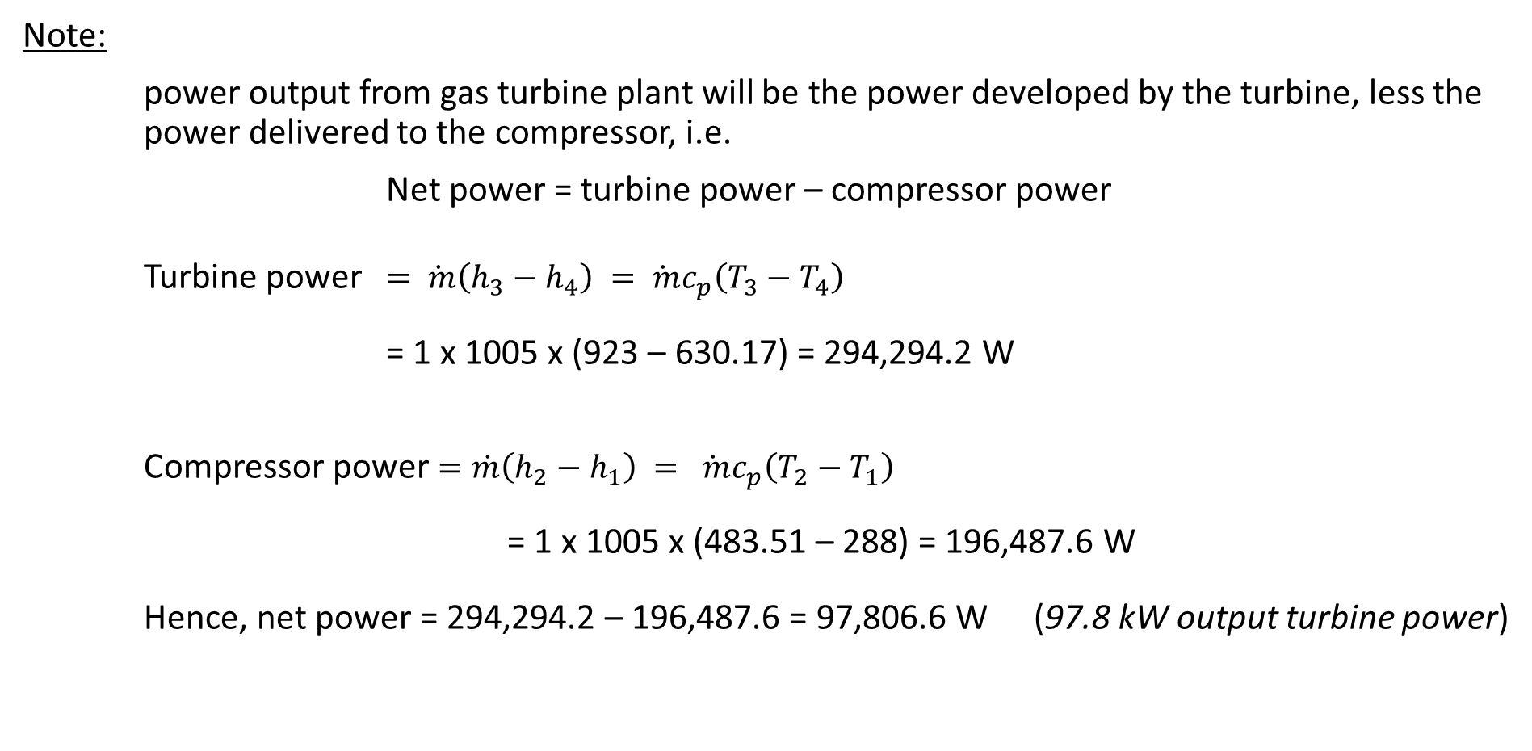
Gas turbine plant - example
Note:
power output from gas turbine plant will be the power developed by the turbine, less the power delivered to the compressor, i.e.
Net power = turbine power – compressor power
Turbine power $=\dot{ m}\left(h_{3}−h_{4}\right)$ $=\dot{ m}c_{p}\left(T_{3}−T_{4}\right)$
= 1 x 1005 x (923 – 630.17) = 294,294.2 W
Compressor power $=\dot{m}\left(h_{2}−h_{1}\right) = \dot{ m}c_{p}\left(T_{2}−T_{1}\right)$
= 1 x 1005 x (483.51 – 288) = 196,487.6 W
Hence, net power = 294,294.2 – 196,487.6 = 97,806.6 W (97.8 kW output turbine power)

Slide 8
Gas turbine plant - Problem
The temperature of a gas entering a turbine is 725°C. If the gas leaves the turbine at a temperature of 495°C, and the mass flow rate of the gas is 3.25 kg/s, calculate the power developed by the turbine for the ideal Joule cycle. Take c_{p} = 980 J/kgK.
If the power output was required to be increased to 800 kW, what would be the necessary inlet steam temperature (assuming that the exiting gas temperature does not change)?

