Slide 1
CHANGE & STABILITY MANAGEMENT of tesco

Slide 2
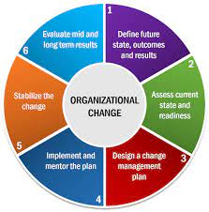
Organizational Change
Process of making strategic modifications
In response to external pressures (Lewis, 2019)
Increased efficiency
Notes:
Organizational change is the process of making strategic modifications to an organization's goals, structure, policies, or culture in order to adapt to a new internal or external environment. It can involve changes in strategy, technology, processes, personnel, or culture. Organizations may choose to change in response to external pressures, such as competition, or to internal pressures, such as a need for increased efficiency. The success of organizational change initiatives depends on effective planning, implementation, and communication.

Slide 3
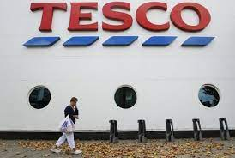
Introduction to Tesco
British multinational grocery
Market share of 28.4% (Tesco, 2023)
Committed to providing customers with the best possible shopping experience
Notes:
Tesco is a British multinational grocery and general merchandise retailer founded in 1919 in London, England. It is the third-largest retailer in the world measured by gross revenues and ninth-largest retailer in the world measured by revenue. The company has stores in seven countries across Europe and Asia and is the market leader of groceries in the UK where it has a market share of 28.4%. Tesco has a range of products including food and non-food items, clothing, financial services and telecoms. Tesco also offers services such as home delivery, clubcard loyalty scheme, click and collect and an online grocery store. Tesco is committed to providing customers with the best possible shopping experience and strives to be the leader in customer service, value and choice.

Slide 4

Adopted changes
Contactless payments and introduced home delivery
Offering online shopping (Metwally and Diab, 2023)
Priority slots for elderly and disabled customers
Notes:
Tesco has had to implement a range of significant changes due to the Covid pandemic. They have also implemented contactless payments and introduced home delivery slots to reduce the amount of people in stores. They have also started offering online shopping, with an increased capacity to cope with the extra demand. Alongside these changes, they are also offering an increased range of products online to meet customers’ needs. As well as this, they have introduced a range of initiatives to support vulnerable customers, such as priority slots for elderly and disabled customers.

Slide 5
Key factors and drivers of change
Culture
Tesco has implemented a culture of customer service and responsibility.
Leadership
Tesco's leadership has been critical in the company's ability to adapt to the pandemic (Utama et al. 2022).
Digitalisation
Digitalisation has been a key factor in Tesco's success during the pandemic.
Notes:
This culture has been instrumental in the success of the company during the Covid pandemic. By embracing digitalisation, diversifying into new markets, and introducing new concepts, Tesco has been able to remain resilient. Tesco has embraced digital solutions such as online ordering, contactless payment, and delivery services.

Slide 6

Internal factors
Strengths: a wide range of products and services (Tesco, 2023)
Weaknesses: a late entrant into the online retail space
Opportunities: increase customer loyalty
Threats: pricing pressure
Notes:
Strengths include being one of the leading retailers in the world, with a strong brand, market leadership. Weaknesses include being a late entrant into the online retail space and a lack of presence in the US market. Opportunities include the potential to expand into new markets, and launch new products. Threats include increased competition from rivals, and changes in consumer preferences.

Slide 7
External factors
Political
Fiscal policy
Chapter I of the UK Competition Act 1998 under competition laws (Ashurst, 2023)
Economic
Interest rates at 4%
Technological
Use of online shopping
Inflation rates at 9.2% (ons.gov.uk, 2023)
Self-checkout machines
Notes:
Tesco also has to take into account the political environment in the countries in which it operates, such as India and Thailand. In addition, changes in consumer spending and disposable income levels will have an impact on Tesco's sales.

Slide 8
External factors
Social
Changes in tastes and preferences
Legal
Management of Health and Safety at Work Regulations 1999
Environmental
Reduce its carbon emissions and waste
Demographic trends
National Minimum Wage Act 1998 (legislation.gov.uk , 2023)
Introduction of packaging reduction initiatives
Notes:
Changes in dietary habits can have an impact on the types of products that Tesco sells.
Overall, Tesco must constantly monitor and adapt to the changing macro-environment in order to remain competitive.

Slide 9
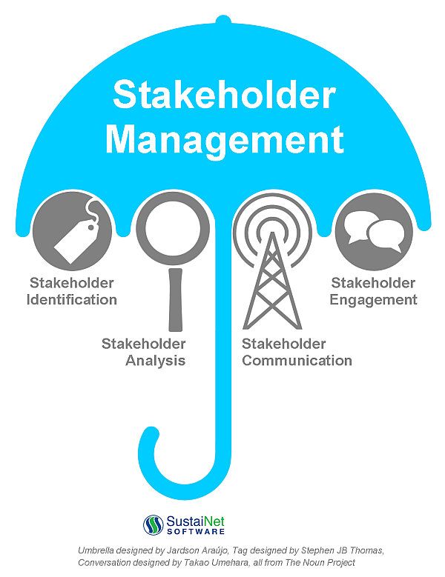
Stakeholders
Assured of payment and a stable relationship
Expect dividends
Investments generate a return
Notes:
Tesco has a wide array of stakeholders ranging from customers, employees, suppliers, investors, shareholders, and the local community. Customers are Tesco’s primary stakeholders and they require quality goods and services at competitive prices. Employees need a safe and fair working environment with opportunities for growth and development. Suppliers need to be assured of payment and a stable relationship with Tesco. Investors want to ensure that their capital is secure and that their investments generate a return. Shareholders expect dividends, as well as a share price that is rising. Finally, the local community needs to be taken into account, with Tesco providing jobs, contributing to the local economy, and giving back to the community.

Slide 10
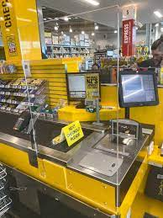
Planned change
A one-way system
Perspex screens at the checkouts (Monte, 2021)
Introduce new online shopping slots
Notes:
In response to the global pandemic, Tesco has implemented a number of radical changes to its operations. In order to maintain social distancing, Tesco has planned a one-way system in their stores, restricted the number of people allowed in the store at one time, and also planned to introduce perspex screens at the checkouts to protect both customers and staff. Besides that, Tesco has planned to launch priority access to online shopping slots for their loyal over-65s and vulnerable customers.

Slide 11
Bringing changes
A free delivery service for NHS workers
Priority access to online shopping slots for over-65s and vulnerable customers (Alexander, 2020)
Introduced enhanced cleaning and hygiene measures
Notes:
Additionally, Tesco has introduced contactless delivery and collection services, as well as a contactless payment system. In order to ensure the safety of staff and customers, Tesco has also introduced enhanced cleaning and hygiene measures, including more frequent cleaning and disinfecting of trolley handles and shopping baskets. Finally, Tesco has also introduced new measures to make shopping easier for vulnerable customers, including priority access to online shopping slots, a dedicated shopping hour for over-65s and vulnerable customers, and a free delivery service for NHS workers.

Slide 12

Resistance to change
Unhappy customers
Missing of adequate protective equipment
Extra demands
Notes:
Tesco faced some resistance to the radical changes they had to implement due to the global pandemic. Many customers were unhappy with the changes to opening times, limits on items purchased and the introduction of a queuing system. Customers also felt that the staff were not given adequate protective equipment, which was a cause for concern. In addition, some employees were concerned about their safety, particularly in terms of the extra demands that were being placed on them, and some felt that the changes were too extreme.

Slide 13

Overcoming ways
Unhappy Customers: Unhappy customers should be approached with empathy and understanding.
Lack of adequate protective equipment: Tesco should ensure that all staff have access to the necessary protective equipment (Srinivasan and Eden, 2021).
Extra demands: Tesco should ensure that all changes are communicated clearly to staff and customers.
Notes:
Therefore, they should also develop effective strategies to make sure that the changes are implemented smoothly. Tesco should also make sure that these changes are properly documented and monitored, so that any issues can be addressed quickly and effectively.

Slide 14
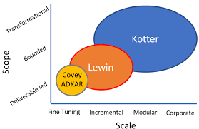
Theoritical management model
Generating Short-Term Wins
Institutionalizing New Approaches
Communicating the Change Vision
Notes:
Lewin's model emphasizes the need for a structured approach to change, with Unfreeze, Change and Refreeze stages. Tesco applied this in the early stages of the pandemic, quickly adapting to the changes in demand and implementing new safety measures. Tesco have used this model to create successful change, such as introducing new delivery and click and collect services, prioritizing vulnerable customers and quickly adapting to changing customer needs. Both Lewin and Kotter's theories have been successful in helping Tesco respond to the pandemic and make radical changes in a short period of time.

Slide 15
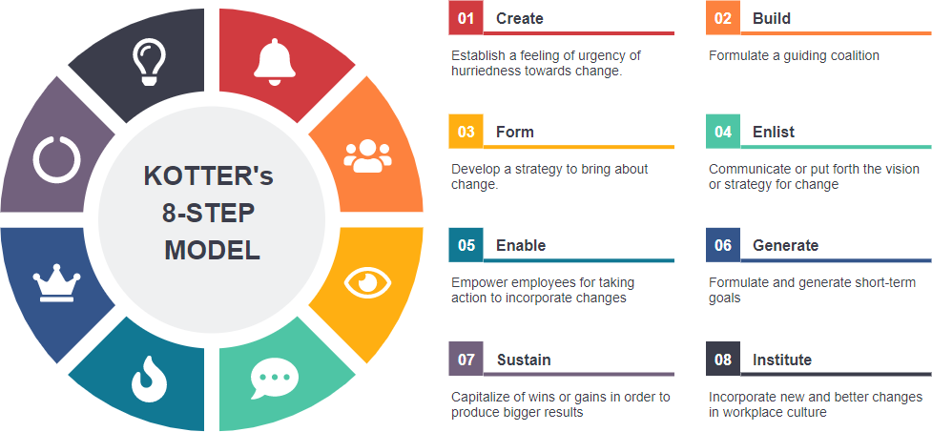
Benefits
The Lewin and Kotter change model has provided Tesco with a comprehensive framework for managing and adapting to the changes brought about by the pandemic.
Additionally, it has allowed Tesco to adapt to customer needs and preferences, such as the development of online ordering and delivery services.
Furthermore, the model has allowed Tesco to focus on employee engagement and wellbeing, ensuring staff have the necessary resources and support to be able to work safely and effectively.
Notes:
In particular, it has enabled Tesco to create effective communication strategies to ensure all employees understand the changes and how to work within them. Overall, the Lewin and Kotter change model has enabled Tesco to effectively manage the pandemic and adapt to the changing environment.

Slide 16

Conclusion
Purchases quickly and securely
Minimal disruption
Reducing queues
Notes:
The introduction of contactless payments and home delivery by Tesco during the pandemic has provided many benefits to the company. Contactless payments allow customers to pay for their purchases quickly and securely, reducing queues and the need for cash. Home delivery allows customers to shop from the comfort of their homes, providing convenience and safety. Priority slots for elderly and disabled customers ensure that these customers receive the necessary items with minimal disruption.

Slide 17
References
Alexander, I.N., 2020. The influence of technological innovations on organization's competitive advantage: Case study on Irish food retail company (Tesco) (Doctoral dissertation, Dublin, National College of Ireland).
Ashurst, 2023. Overview of UK competition law. Available at: https://www.ashurst.com/en/news-and-insights/legal-updates/quickguide---overview-of-uk-competition-law/#:~:text=Chapter%20I%20of%20the%20UK,part%20of%20it)%3B%20and [Accessed on: 26-02-2023]
legislation.gov.uk , 2023. National Minimum Wage Act 1998. Available at: https://www.legislation.gov.uk/ukpga/1998/39/contents [Accessed on: 26-02-2023]
Lewis, L., 2019. Organizational change. In Origins and traditions of organizational communication (pp. 406-423). Routledge.
Metwally, A.B.M. and Diab, A., 2023. An institutional analysis of the risk management process during the COVID-19 pandemic: evidence from an emerging market. Journal of Accounting & Organizational Change, 19(1), pp.40-62.
Monte, A., 2021. A study of value chain reconfiguration processes under Covid-19 pressures: the case of Tesco PLC in the United Kingdom.
ons.gov.uk, 2023. Inflation and price indices. Available at: https://www.ons.gov.uk/economy/inflationandpriceindices#:~:text=Consumer%20price%20inflation%2C%20UK%3A%20January%202023&text=The%20Consumer%20Prices%20Index%20including,from%209.2%25%20in%20December%202022. [Accessed on: 26-02-2023]
Srinivasan, N. and Eden, L., 2021. Going digital multinationals: Navigating economic and social imperatives in a post-pandemic world. Journal of International Business Policy, 4(2), pp.228-243.
Tesco, 2023. About us. Available at: https://www.tesco.com/ [Accessed on: 26-02-2023]
Utama, A.G.S., Verma, M., Ng, J.Y., Kee, D.M.H., Nga, C.S., Izzati, N.N., Ng, Y.X. and Khoiruwnia, F., 2022. A Research on Tesco's Consumer Purchasing Behavior towards E-Commerce during the Pandemic Period. International Journal of Accounting & Finance in Asia Pasific (IJAFAP), 5(1), pp.53-63.

Slide 18
THANK YOU

