Slide 1

Student name: Bianca-iuliana decu student id: 2425690
Programme:Programme:Certificate in Higher Education Business Skills for the Workplace module:Enterprise and Entrepreneurship module code: lclm4006

Slide 2
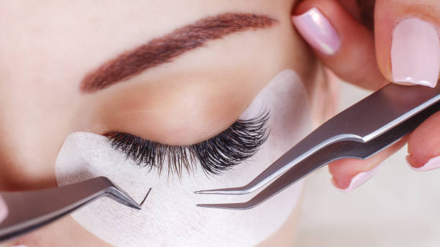
Business name: Luxe Lashes Brmingham
Concept: A specialist salon providing professional eyelash services in Birmingham, focusing on quality,
Affordability, and personalised experiences.
Services offered:
-Classic Lash Extensions
-Hybrid Lashes
- Russian Volume Lashes
-Lash Lifts& Tints
- Infills& Aftercare Products
Mission Statement:
“To blend quality, safety, and affordability, empowering clients with
confidence through personalised lash
Treatments.”

Slide 3
Legal Format and Management Structure
Legal Structure:
At the beginning, the business will be set up as a sole proprietorship (for it to be simple to register and I will have full control). After a year or two, I will be setting it up as a Limited Company to reduce the amount of personal liability and without a doubt increase the credibility of the business.
Management Structure:
Bianca, the owner and manager, will be in charge of the strategy, treatments, and finance. Once the business begins to thrive, the Lash Technician will be recruited to meet the service demand. In the final phases of development, I will hire part-time staff for appointments, social media, and client handling.
Compliance:
All technicians will be fully certified and will have the necessary insurance. In addition, they will undergo training for health, safety, and hygiene as required.

Slide 4
Environmental Analysis (PESTEL Overview)
Political | Beauty salons are required to comply with the UK laws on health and safety as well as licensing regulations. Due to increased expenses stemming from Brexit, the cost of EU lash supplies has also increased.
Economic | Inflation limits spending, but “affordable luxury” beauty remains resilient. Large student base provides stable demand.
Social | Rising beauty consciousness, social media influence, demand for personalised treatments.
Technological | Online booking, digital marketing (TikTok/Instagram), innovations in lash materials
Environmental | Use of cruelty-free, vegan, and recyclable products; energy efficiency measures.
Legal | Must comply with employment law, certification, and treatment insurance requirements
Summary;
There is the potential for growth when considering social trends and technologybut there are also potential pitfalls when you factor in rising costs and strict regulations.

Slide 5
Marketing Strategy
Digital Initiatives:
Instagram and TikTok: “Before and After” reels, tutorials, and collaborations with influencers.
Google My Business: Optimized Local SEO and review management.
Customer Incentives:
Referral discount: 20% off for client referrals.
Student Packages: “Student Lash Monday Specials."
Loyalty Programme: 6th infill free after 5 sessions.
Offline Initiatives:
Flyers in gyms, universities, and hair salons.
Collaborations with makeup artists and photographers.
Branding
Soft, modern, luxurious but affordable image — emphasis on comfort, empowerment, and safety

Slide 6
Funding Requirements
Rent& Deposit | 2000£
Furniture & Décor | 1,500£
Lash Equipment & Supplies | 1,200£
Certification, Licensing & Insurance | 800£
Marketing (Website, Logo, Flyers, Ads) | 700£
Part-time Wages | 1000£
Contingency Fund | 1000£
Total | 8200£
Funding Sources:Personal savings: £3,000
Small business loan: £5,000–£7,000
Financial Goal:Break-even expected within 6–8 months, with projected monthly revenue of £3,500–£4,500.

Slide 7
Luxe Lashes Birmingham occupies a gap between luxury salons and budget-friendly beauty services.
There is considerable demand among students and young professionals in Birmingham.
Having a sustainable, ethical, and technologically advanced approach will guarantee competitiveness in the long run.
There is potential for growth based on the brand reputation and subsequent expansion to several locations.
Conclusion

Slide 8
GOV.UK (2025). Set up a business. Retrieved fromhttps://www.gov.uk/set-up-business
Mintel (2024). UK Beauty and Personal Care Market Report.
Citizens Advice (2025). Business Regulations for Beauty Salons.
British Beauty Council (2024). Industry Standards and Insights.
References

