Slide 1
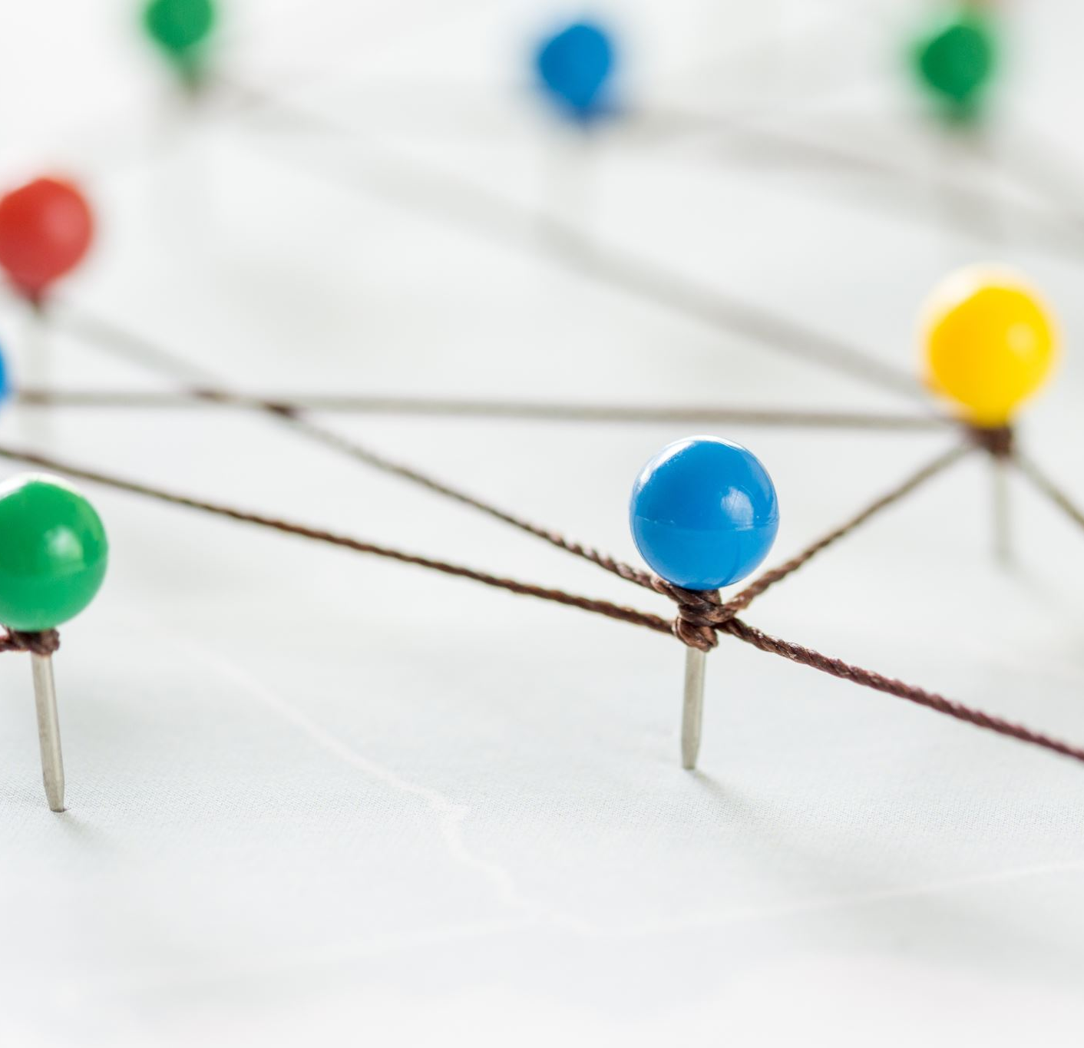
Global Leadership
18th June 2024

Slide 2
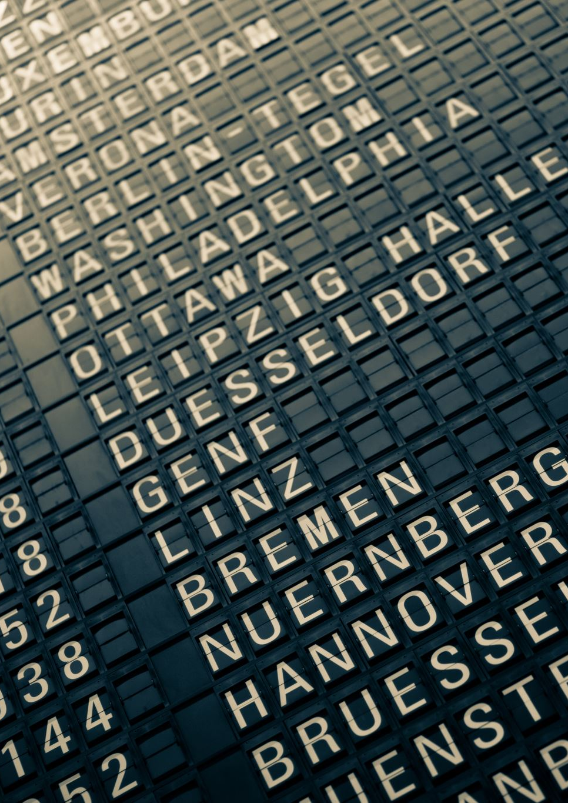
Agenda
Overview of this module
Political challenges & AI
Next week

Slide 3
Cultural Differences
Impact on communication styles, work ethics, decision-making processes and business etiquette
Leaders must be culturally aware and adaptable to build trust, foster collaboration, and effectively manage diverse teams

Slide 4
Promote cultural intelligence
Crucial for business leaders
  Build self-awareness of one's own cultural biases and assumptions
  Actively learning about difficult cultural norms, values, and communication styles
  Cultivating empathy and respect for diverse perspectives
  Foster open communication
  Use professional interpreters

Slide 5

What steps can organisations take?
Conduct cultural value assessments
Training and resources
Encourage employees to learn other languages
Foster a culture of curiousity
Create opportunities for employees to immerse themselves in diverse cultures and settings
Celebrate different holidays and cultural events
Diversify hiring practices
Measure and track data

Slide 6
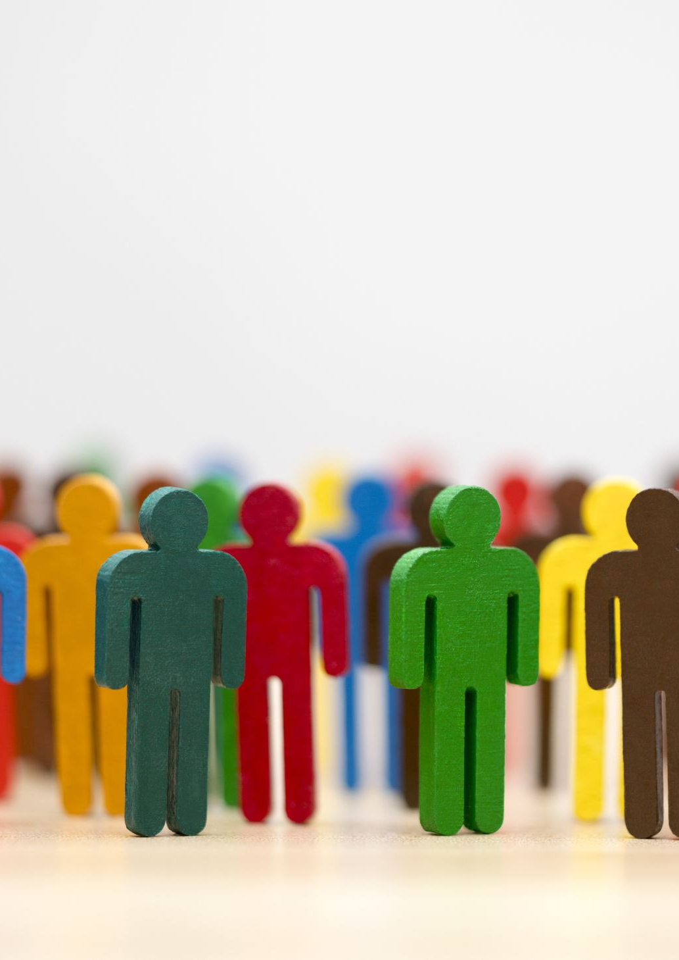
How can leaders foster unity in diverse teams?
Encourage peer learning and mentoring
Celebrating milestones, success and festivals together
Establish common goals
Encourage open communications
Embrace diversity
Foster trust

Slide 7
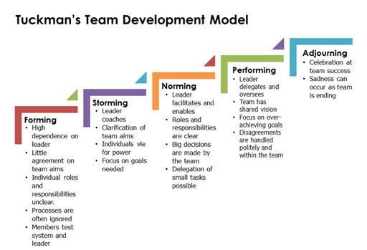
Tuckman

Slide 8
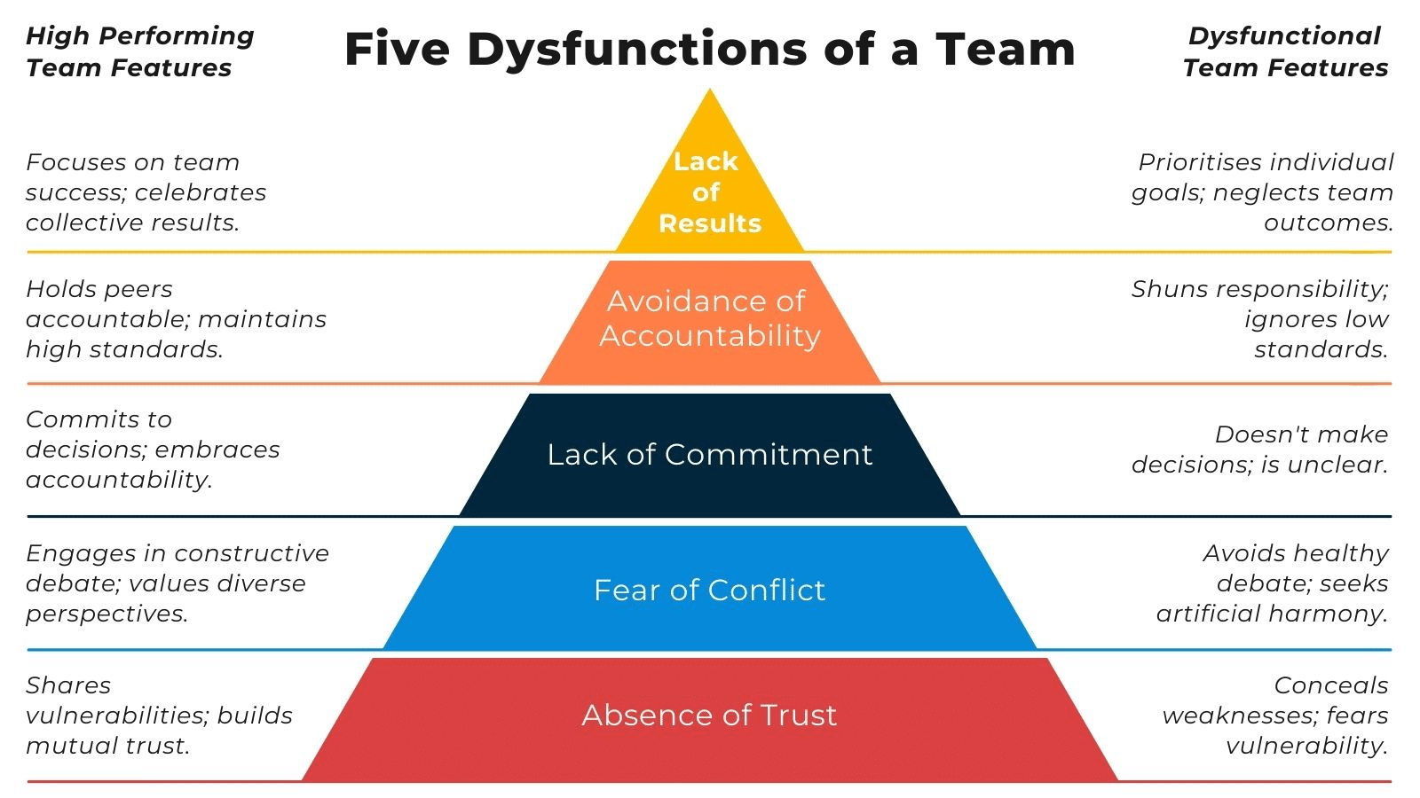
Lencioni

Slide 9
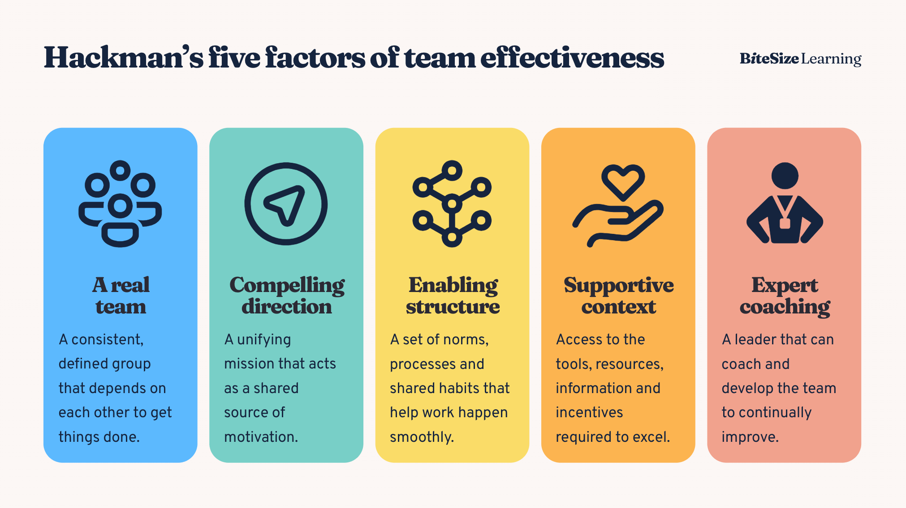

Slide 10
Managing the tension between global and local approaches
Must balance tension between global consistency and local adaptation. This includes:
  Establish a global mindset and act globally
  Think and act locally
  Increase understanding of geopolitical dynamics affecting the business
  Be explicit about appetite for risk
  Culture of respect and ability to manage local conflict
  Find common ground

Slide 11
Geopolitics – where to begin
Understand who the key actors are, such as people, organisations, companies and national governments
Understand how geography influences international relations

Slide 12

Factors impacting on geopolitics
Geography
Demographics
Economics
Politics
Defence
Regional factors
Culture
Technology

Slide 13
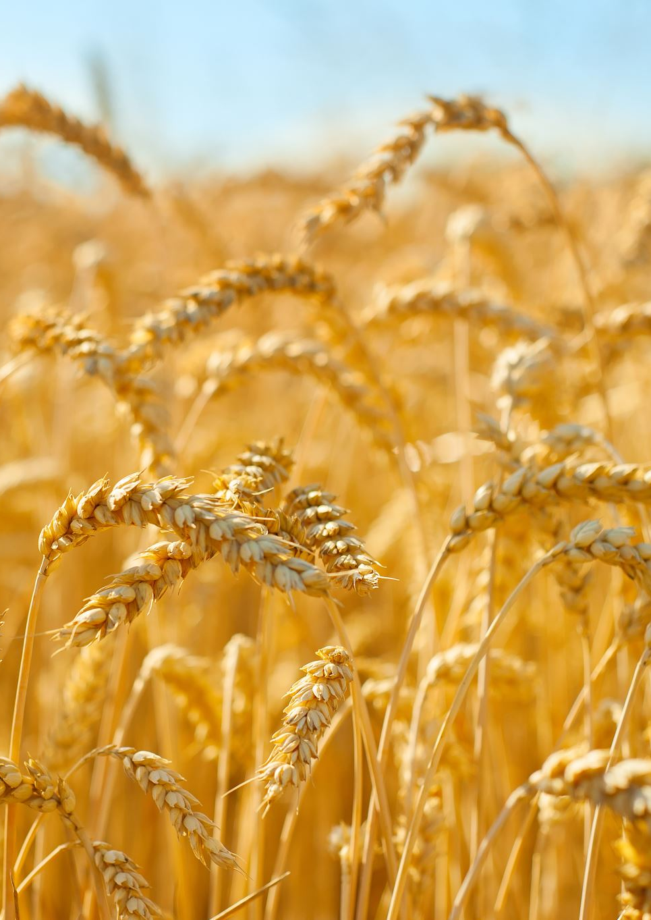
War in Ukraine
Increase in the cost of commodities such as wheat, corn and energy
Volume of global trade declined by 3.4% due to the war (IMF)
Trade flows have shifted due to sanctions
Supply chains of have been interrupted
Could result in less reliance on US $
Impact of sanctions on Russia: losses for businesses exiting Russia

Slide 14
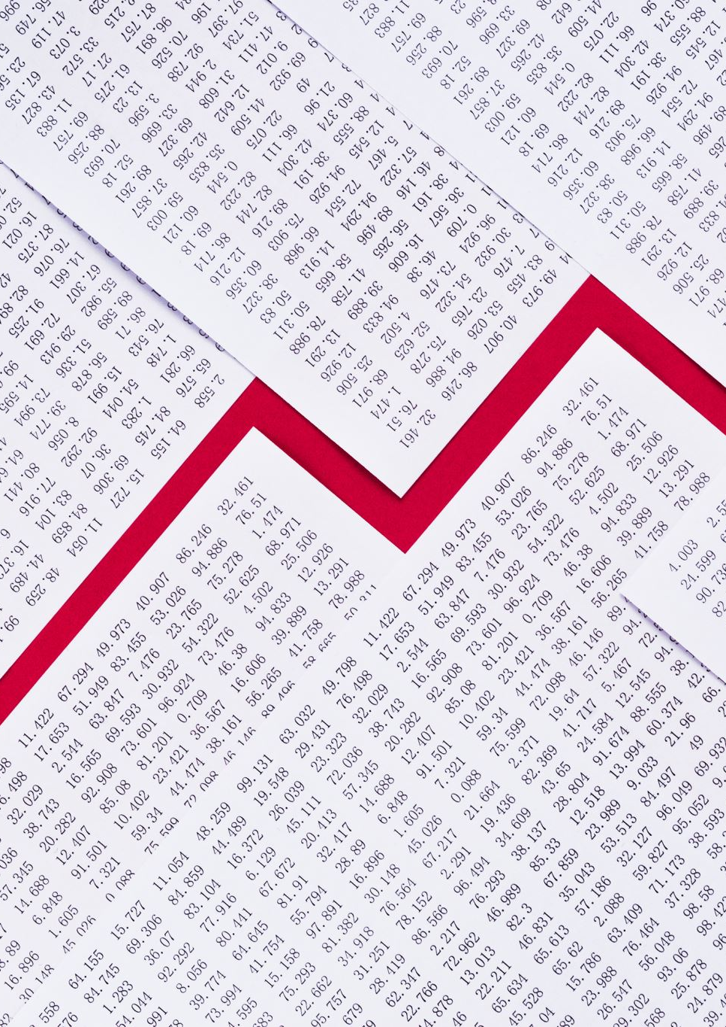
Elections
70 countries holding elections in 2024 (France, UK, India, US)
Results could lead to:
  Shifts in regulatory environments, market access
  Impact on trade agreements
  Increase/decrease reliance on dominant economic powers
  Relationship with EU
  Uncertainty and challenges

Slide 15
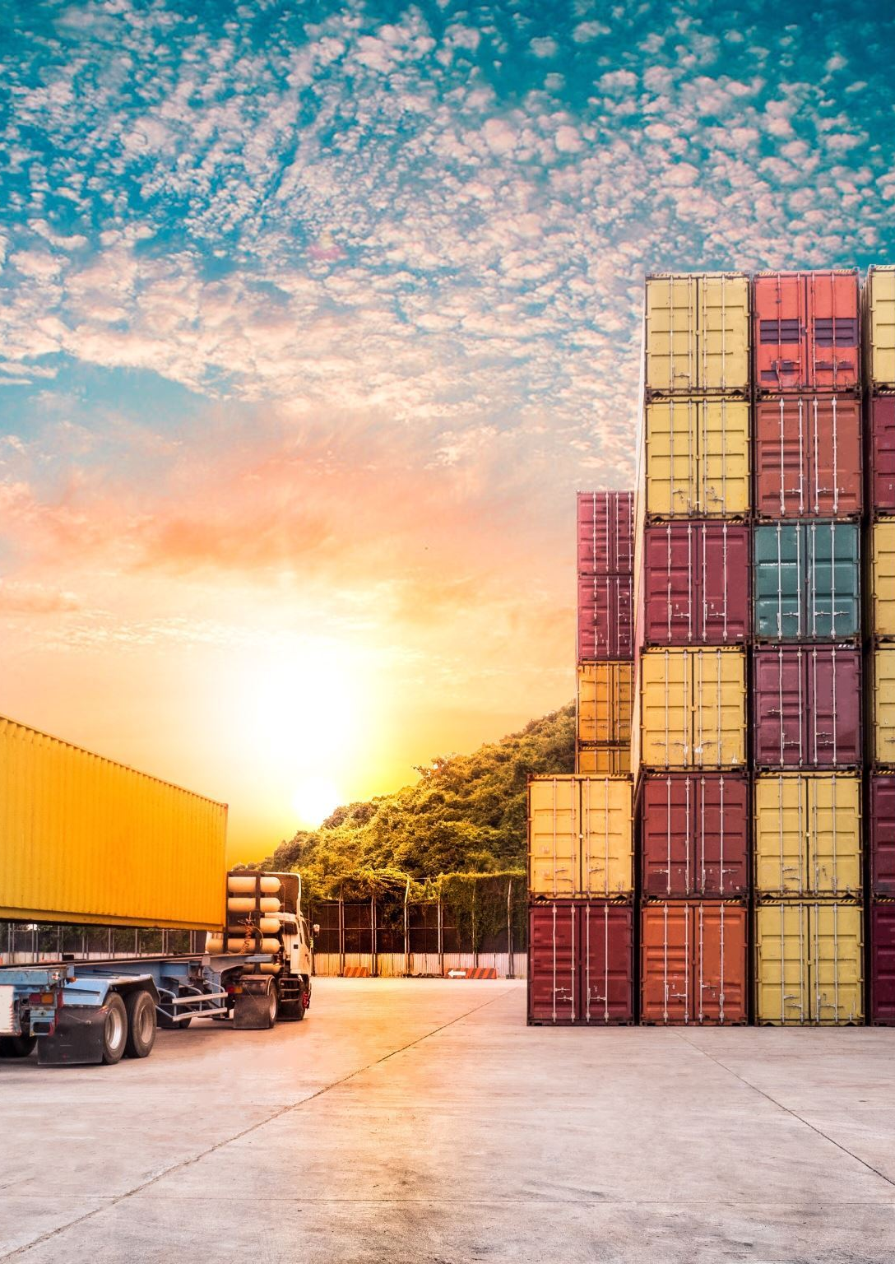
Trade Agreements
WTO Agreeements (GATT, GATTS, TRIPS, TRIMS) provide legal framework for trade
Free Trade Agrreements: make it easier for the US to export
Regional Trade Agreements

Slide 16

Trump & Global Trade
Increased protectionism and trade wars: he has vowed to include a 10% tarrif on all imports to the US
Retaliation from others? Trade Wars possible
Weaken other agreements such as the WTO
Anticipated negative impact on global trade

Slide 17
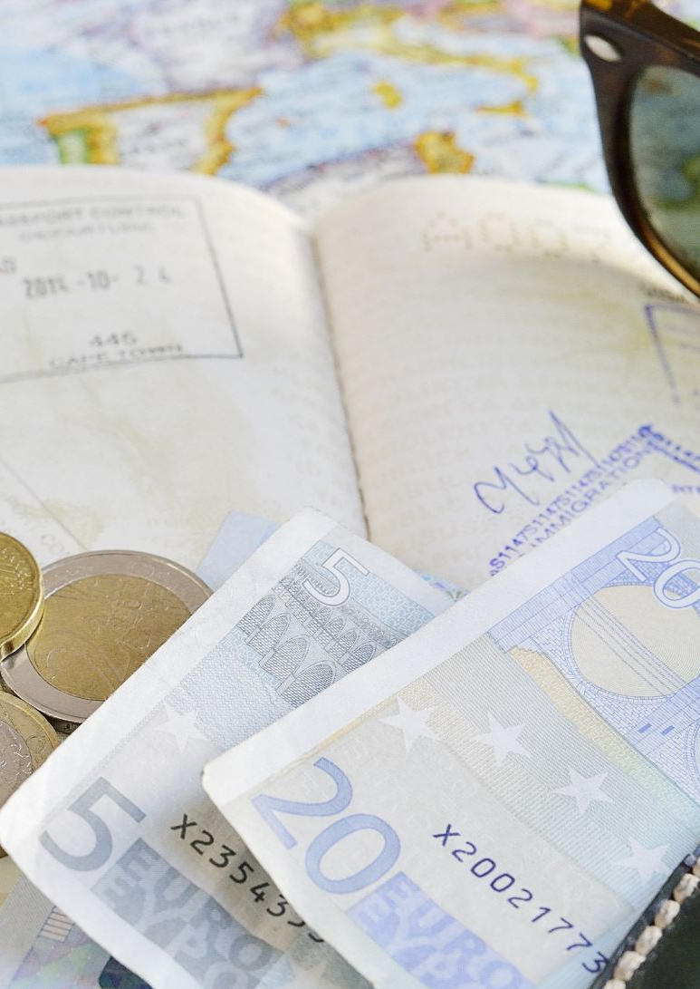
Trump & European trade
Increased costs and inflation
Higher costs for European exporters
Exports and investments will weaken
Undermine rules based framework

Slide 18
And what about relations with China?
Tensions and tariffs
Uncertainty over Taiwan
Diplomatic challenges

Slide 19

Planning for uncertain times
Contingency planning and disaster prepredness plans
Identification of risk
Stakeholder identification
Action plans, comms channels
Back up systems for critical infrastructure
Stockpile essentials
Culture of resilience

Slide 20

Pfizer Case Study - Covid
Focus on business continuity with measures
Leveraged global supply chain to ramp up production of critical meds and vaccine development
Collaborated with stakeholders, pooling expertise and resources
Engaged with governments and IOs to ensure equitable access to vaccines across the world
Demonstrated Corporate Citizenship

Slide 21
Corporate Citizenship
Refers to how companies exercise their rights, obligations and responsibilities within local and global environments
Goes beyond legal compliance and philanthropy to become a central factor in determining corporate success and legitimacy

Slide 22

Origins
Gained prominence in 1990s as businesses faced pressure to be socially responsble
Logan et al (1997) defined it as the conduct of business in ways that reflect proactive, responsible behaviour in business...and with respect to communities, society and natural environment generally.
Matten and Crane (2003) "the social role of business"
ISO: introduced a voluntaty code for CSR in 2010

Slide 23
Measuring CSR
Global Reporting Initiative
ISO 26000
UN Global Compact
Dow Jones Sustainability Indices
Quantify value through Social Return on Investment, Balaned Scorecard
Stakeholder feedback

Slide 24
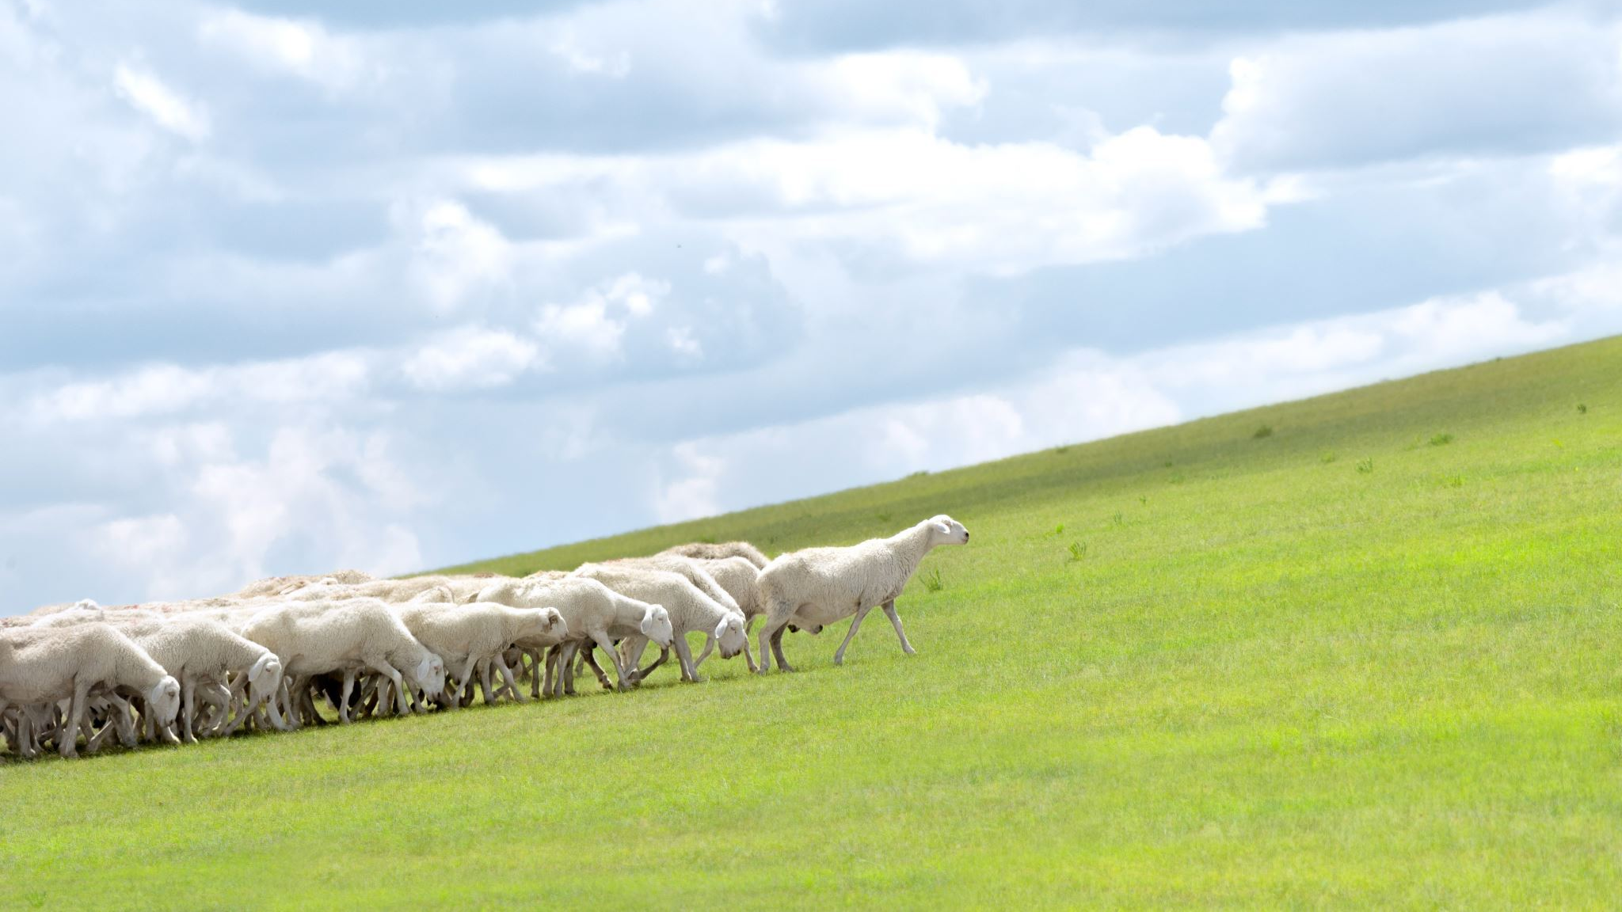
Responsible Stewardship

Slide 25

Defined
The use of influence by instituional investors to maximise overall long-term value including the value of common economic, social and environmental assets, on which returns and clients' and benficiaries' interests depend

Slide 26
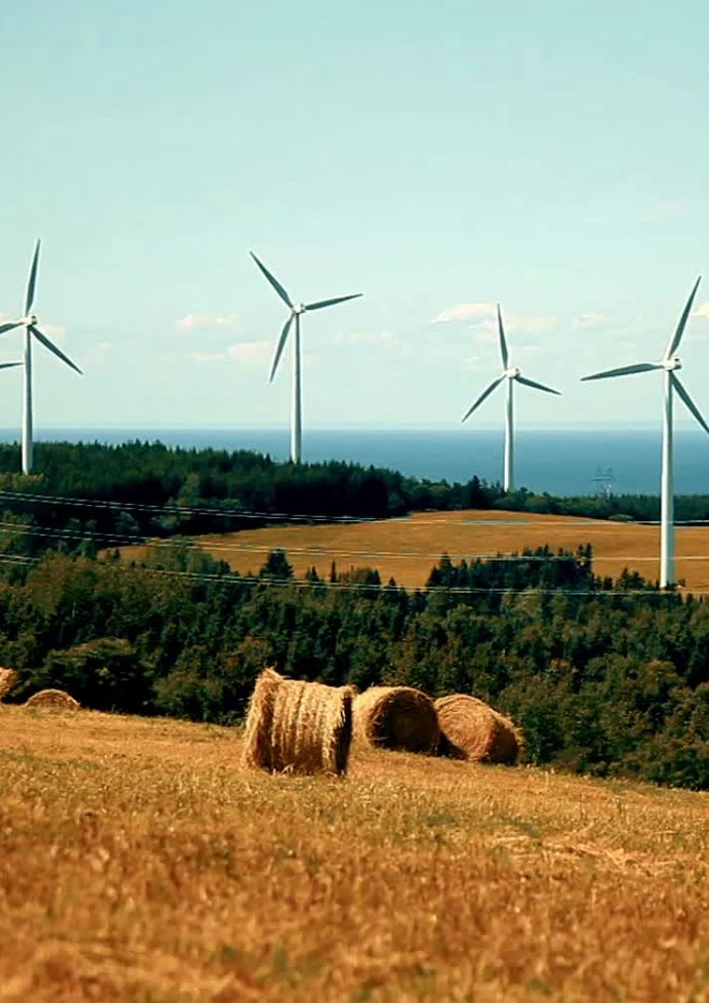
Some examples
Environmental: using sustainable materials, renewable energy
Corporate: focusing on long-term sustainability
Organisational: one's role as a steward to pass on the organisation to future generations in a better shape
Investors: using their influence to maximise long-term value, including the value of common economic, social and environmental assets
Notes:
So in summary, modern stewardship involves carefully managing and preserving valuable resources and assets - whether environmental, organizational, or financial - for the long-term benefit of stakeholders and future generations. It requires foresight, sustainability and a sense of responsibility.

Slide 27

International Business Ethics
Moral principles and values that guide decision-making and behaviour
  Compliance with local laws and customs
  Respect for cultural differences
  Fair employment practices
  Avoiding bribery and corruption, even if common
  Protecting the environment
  Truthful adverising and integtity
Notes:
While some ethical standards are universal, such as prohibiting physical harm to others, many aspects of international business ethics are influenced by cultural norms and local laws. Companies must navigate this complexity by developing a strong ethical culture, clear codes of conduct, and consistent enforcement.Ultimately, ethical behavior in international business is both a moral imperative and a strategic advantage.

Slide 28

Ethical Dilemma
Child labor: A company may find that a foreign subsidiary has hired underage workers, violating the company's policy against child labor. However, the local manager explains that the child is an orphan with no other means of support and would likely become homeless if fired
Notes:
What would you do? Companies must decide whether to apply standards of the home nation, host nation, or something else
When in Rome, do as the Romans do? Cultural relativism
Friedman: make money, that’s all that matters
The righteoous moralist: home country standard
Naïve ommoralist
Moral worth judged by the consequences – action desirable if it leads to good consequences
Rights theories: humans have fundamental rights that transcend national boundaries

Slide 29
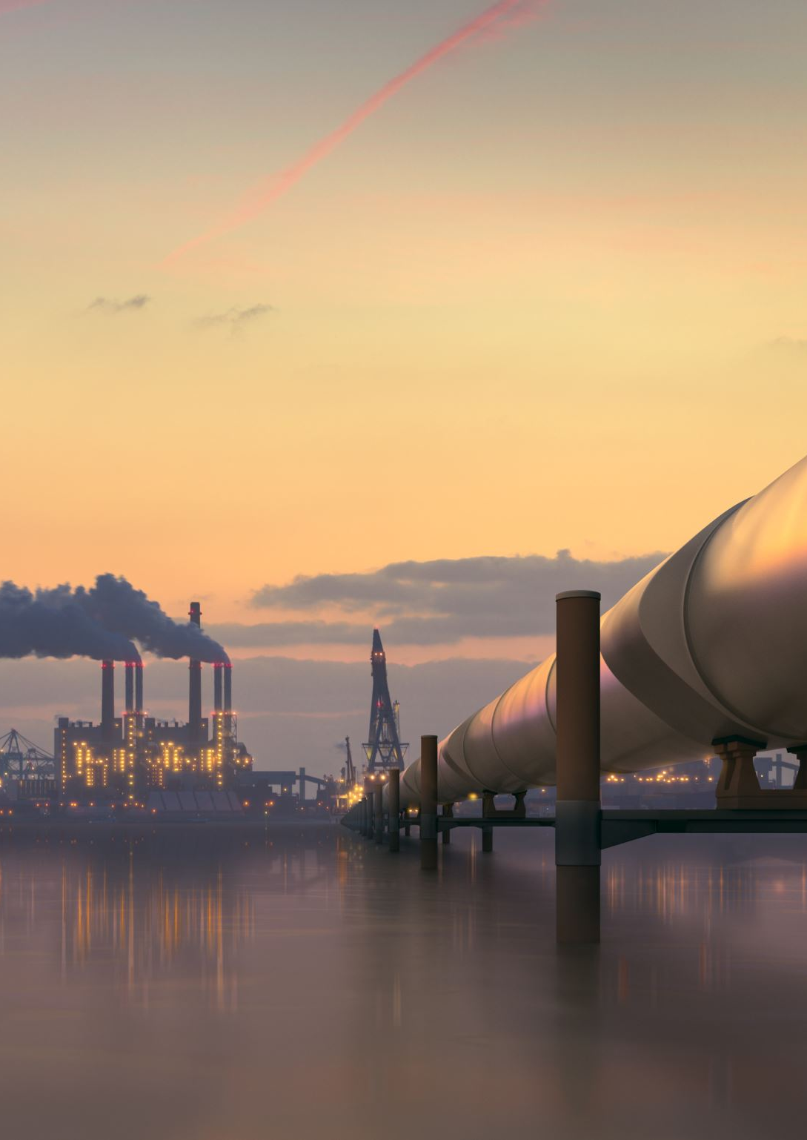
Ethical dilemma
Environmental standards: A company may find that environmental regulations are lax in a foreign country, allowing them to pollute more cheaply. However, this could damage the local environment and the company's reputation

Slide 30
The role of the Ethics Officer
Train
Train employees to be ethically aware and consider ethical implications in decision-making
Ensure
Ensure ethics play a role at all levels
Monitor
Monitor adherence to the code of conduct
Promote
Promote moral courage
Conduct
Conduct audits
Serve
Serve as a truted advisor

Slide 31

Theories of international communication
It's the exchange of messages and information across international borders, encompassing political, economic, social, cultural and military concerns
Gained importance due to globalisation, and the high demand for professionals skilled in communicating across cultures
Covers "government to government" "B2B" and "people to people" interactions at a global level

Slide 32
Free flow of information theory
Free flow of information, data and ideas essential for business growth, innovation and global integration
Allows people to participate in the global market
Underpins the free market
Allows companies of all sizes to connect via digital platforms
Brings down the cost of doing business globally

Slide 33
Modernization theory
Developing countries can make progress by emulating devloping paths of Western industrialised nations
Enabled the spread of tech & ideas
Allowed for global value chains where different stages of production are located in different nations
Allowed increased trade in services

Slide 34
Dependency Theory
Free flow of global communication reinforces the economic dependency of developing nations
Criticises modernisation theory, contending that global media and cultural products from the West perpetute inequalities and hinder development of the global South

Slide 35
World Systems Theory
World is divided: core of wealthy nations and a periphery of poor nations
Global communication and media reflect and reinforce this unequal economic order and power dynamics
Notes:
In summary, while these theories offer different perspectives, they generally highlight how patterns of global communication interact with and reinforce economic power structures and dependencies that impact the dynamics of international trade relations between nations.

Slide 36
AI & World Trade
AI refers to the development of computer systems capable of performing tasks that typically require human intelligence
What are the potential benefits and challenges of AI on global trade?
Notes:
In summary, while these theories offer different perspectives, they generally highlight how patterns of global communication interact with and reinforce economic power structures and dependencies that impact the dynamics of international trade relations between nations.
Share
Rewrite

Slide 37
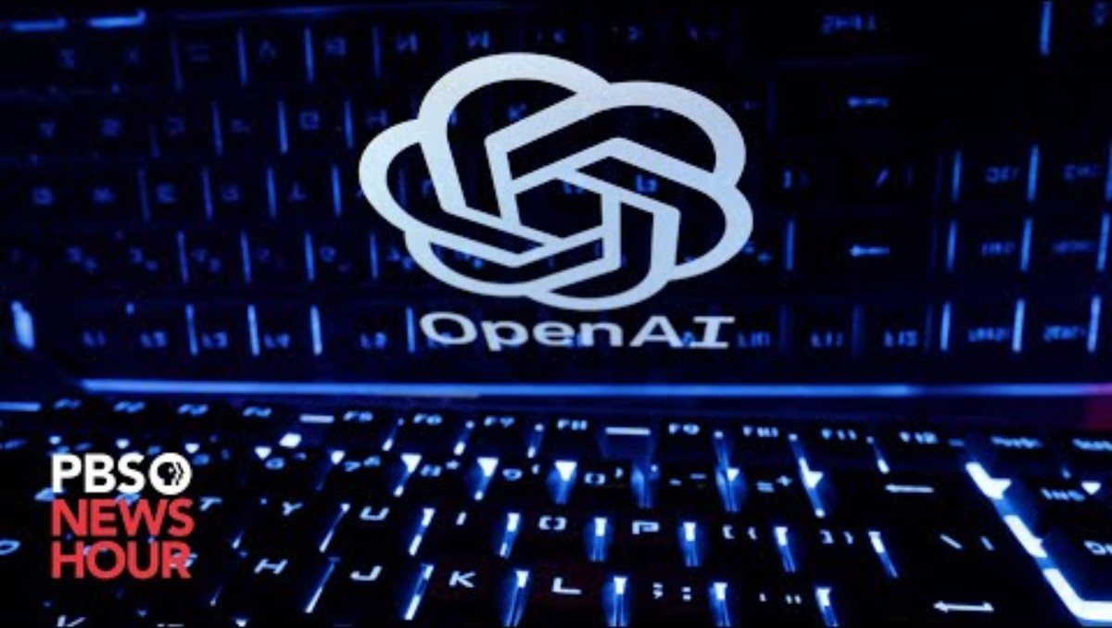
AI & the media

Slide 38

Benefits
Increased operational efficiency from automation
Predictive analytics will improve supply chain efficiency and forecasting
Enhanced customer experience (chat bots etc)
Enable innovation, identify new markets, analyse data
Enable data-driven decision-making
Enable agility

Slide 39
Anticipated benefits
$15.7 bn contribution to the global economy by 2030
26% boost in GDP for local economies from AI by 2030
Notes:
PWC report

Slide 40
Role of IOs
Address policy gaps, decrease the impact of fragmentation
UN: sees AI as an opportunity for sustainable development
Compliance & montioring
UN sees impact of AI as compensating for the impact of the ageing population
EU countries behind US and China in R&D tech

Slide 41
AI principles (UN)
Intepretability
Robustness and security
Accountability
Auditability and transparency
Data protection & privacy
Human agency
Fairness
lawful

Slide 42
Who is responsible?
In March 2016, Microsoft released a chatbot named Tay who could interact and learn from real users on social platforms. Soon Tay was exposed to nasty tweets and ended up becoming mean and racist on her own.
In March 2018, an Uber self-driving vehicle killed a pedestrian. Who is responsible: the distracted driver, the pedestrian, Uber, the developers who wrote the code, a sensor manufacturer? It's unrealistic to expect AI systems to be perfect, but determining liability isn't trivial.
In 2015, Amazon found that their machine-learning-driven recruiting tool was showing bias against women applicants. They ended up scrapping the tool.
Notes:
Despite the existence of responsible AI principles, the question remains—who is responsible for the consequences resulting from the misuse of an AI system? Other key questions are, who is responsible for the actions of an AI system? Is it the developer/maintainer, intellectual property owner, end users, the owner of the data used for its training, the AI itself? Is the answer to this question the same for all AI or might it differ, for example, for systems capable of learning and adapting their behaviour? Given that AI enables society to automate more tasks to a larger extent than before, are those who benefit or profit from its advances also responsible for any harms occurring from its use? Can these questions be answered by ethics or responsibility?

Slide 43
Who is responsible?
Business leaders?
The AI developers?
Consumers?
Government?

Slide 44
Challenges
Regulatory fragmentation
Data-sharing across borders
Biases in training data
Ethical considerations

Slide 45
How do organisations identify & deliver learning and development?
Workforce planning and talent management
War for talent
Identify & support high potential talent
Provide diverse experiences
Coaching
Networking
Soft skills

Slide 46
Global Mindset
Takes a global view of business and people
Can account for local cultures and customs
Can anticipate global trends
Cultural competence

