Slide 1
Renewable energy
Micro-hydro
Jonathan Squire
P147392

Slide 2
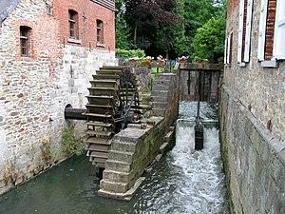
What is Micro-Hydro?
Micro-Hydro energy used from the natural flow of water to produce electrical power
This idea has been used for 100’s of years with water mills
Water flown from higher point through turbines to a lower point

Slide 3
The components
Water – water flows through pipes into the turbine
Turbine – the water then flows through the turbine
Generator – transforms the spinning movement from the turbine into electricity
Regulator – controls the generator
Wiring – delivers the electricity

Slide 4
Turbine types
Screw turbine – efficiency 85%
Kaplan turbine – efficiency 90%
Water wheel – efficiency 67% - 85%*
Water vortex power plant – efficiency 64% - 83%*
*these very as they use natural rivers, meaning if there is rainfall the efficiency will increase

Slide 5
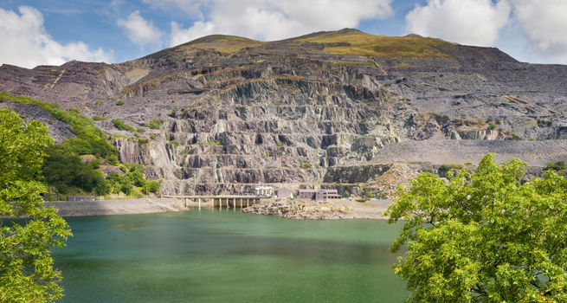
Electric mountain – Llanberis
6 turbines which have vertical spindle
0 to full load in 75 seconds
Can spin up to 6 hours before water shortage**
1800MW load in 16 seconds
74-76% efficiency
**Water then gets pumped back up when turbines are not on

Slide 6
The future – Swansea tidal lagoon?
Can produce power for 14 hours a day
Can have the capacity to generate 320 megawatts
Will be able to produce power for 120 years
155,000 homes in wales will receive its power
>50% efficiency
236,000 carbon savings each year

