Slide 1

MSc Public Health and Social Care in Practice
Community Care and Management of Longer-term Conditions
LCHS7003
Student Name:
Student ID:

Slide 2
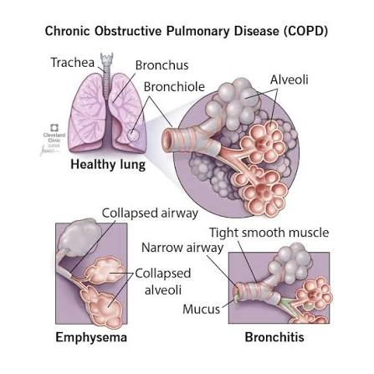
Overview of COPD—Definition, Symptoms and Aetiology
COPD is a heterogeneous lung condition causing persistent respiratory symptoms and progressive airflow obstruction (Agustí et al., 2023).
Chronic airway inflammation and alveolar destruction progressively impair expiration and pulmonary gas exchange (Xu et al., 2024).
Breathlessness, chronic cough, sputum production and wheezing are the principal clinical symptoms (NHS, 2023).
Tobacco smoking remains the leading cause, although non-smoking pathways are increasingly recognised (Curtis, 2023).
Air pollution, occupational dusts and early-life respiratory insults also substantially increase COPD risk (World Health Organization, 2026).
Alpha-1 antitrypsin deficiency is an important inherited cause requiring targeted clinical consideration (NHLBI, 2024).
Figure 1: COPD
(Source: Cleveland Clinic, 2024)

Slide 3
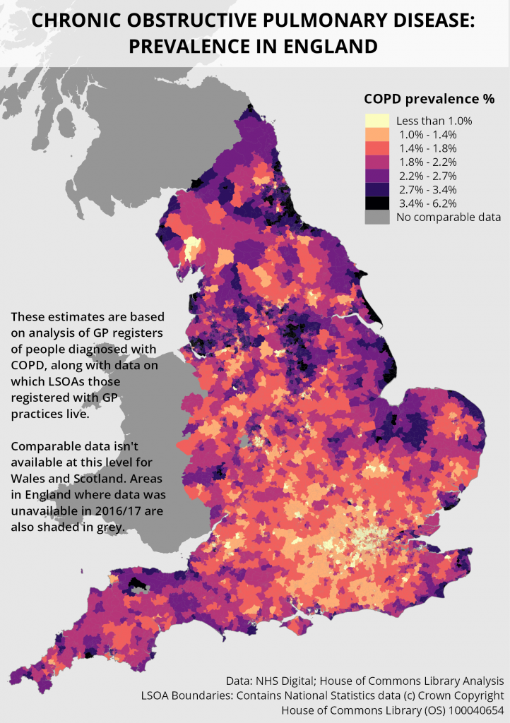
Prevalence of COPD in the UK and Worldwide
England recorded 1,207,974 COPD patients in 2024/25, representing 1.9% prevalence across general practices (OHID, 2025).
Approximately 1.4 million UK residents have diagnosed COPD, equalling 2% nationally, including 4.5% of over-forties (Asthma and Lung UK, 2022).
Undiagnosed COPD prevalence ranged from 1.3% to 2.5% across English regions during 2019 (Stone et al., 2023).
Globally, 391.9 million adults aged 30–79 had COPD, representing 10.3% prevalence in 2019 (Adeloye et al., 2022).
Among over-forties, global COPD prevalence reached 12.64% using fixed-ratio diagnostic criteria (AL Wachami et al., 2024).
Global COPD cases may approach 600 million by 2050, increasing 23% from 2020 (Boers et al., 2023).
Figure 2: Chronic Obstructive Pulmonary Disease prevalence in England
(Source: Jackson, 2026)

Slide 4
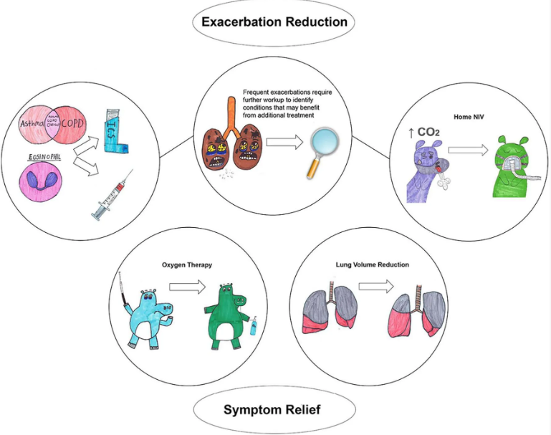
Economic and Social Burden of COPD
COPD costs the NHS approximately £2 billion annually, substantially increasing healthcare expenditure (NHS England, 2026).
Exacerbations generate nearly 45% of total COPD spending through emergency and inpatient care (NHS England, 2026).
England recorded 121,129 COPD emergency admissions during 2023/24, increasing hospital pressures significantly (GOV.UK, 2025).
COPD forced 22.1% of working patients to leave employment, reducing household income (Abdelwahab et al., 2023).
Loneliness affects approximately 32% of COPD patients, worsening wellbeing and healthcare vulnerability (Alqahtani et al., 2024).
Figure 3: Clinical relevant COPD phenotypes and corresponding treatments
(Source: Fortis et al., 2024)

Slide 5
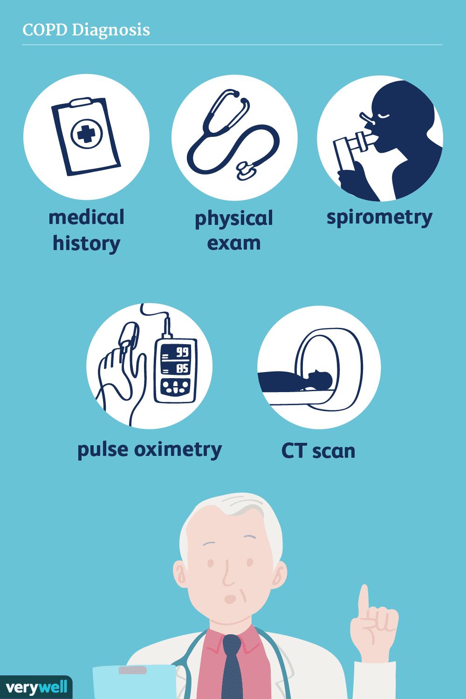
Diagnosis and Initial Assessment of COPD
Suspect COPD in adults over 35 with symptoms and relevant exposure history (NICE, 2025).
Clinical history should assess smoking, occupational exposure, breathlessness, cough and exacerbations (NICE, 2025).
Post-bronchodilator spirometry confirms COPD when the FEV₁/FVC ratio remains below 0.70 (GOLD, 2025).
Chest examination should assess wheeze, reduced air entry, cyanosis and hyperinflation (NICE, 2025b).
Initial investigations include chest X-ray, blood count and body mass index assessment (NICE, 2025b).
Symptom burden and exacerbation risk should be evaluated using CAT or mMRC tools (Agustí et al., 2023).
Figure 4: COPD Diagnosis
(Source: Respiratory London, 2024)

Slide 6
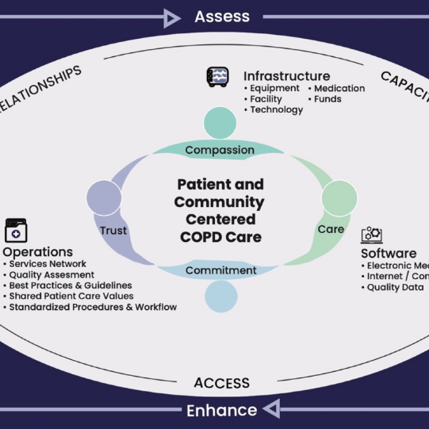
Guideline-Based Management and Care Frameworks for COPD
NICE NG115 recommends individualised management combining smoking cessation, vaccination and optimised inhaled treatment (NICE, 2025).
Personalised self-management plans should explain daily care and recognising worsening symptoms early (NICE CKS, 2025c).
Pulmonary rehabilitation is a combination of prescribed exercise and education which enhance functional capacity and control of symptoms (NHS England, 2024).
Shared decision making, choice and supported self-management are a key part of the Comprehensive Personalised Care Model (NHS England, 2020).
COPD discharge care bundles standardise post-exacerbation interventions and help reduce avoidable readmissions (NHS England, 2021).
Virtual wards enable multidisciplinary monitoring and acute COPD care within patients’ homes (NHS England, 2024a).
Figure 5: Patient centered COPD care
(Source: Responsum Health, 2025)

Slide 7
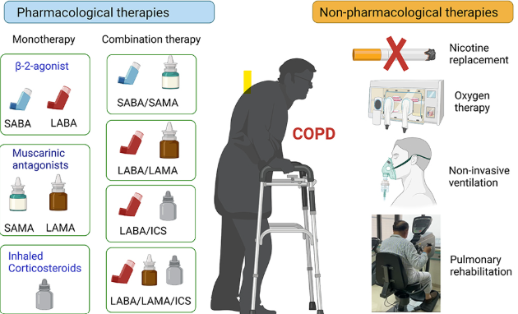
COPD Treatment Options Available in the United Kingdom
Short-acting bronchodilator inhalers provide rapid relief from intermittent breathlessness and wheezing (NHS, 2023b).
Persistent symptoms require long-acting bronchodilators, including LABA or LAMA inhaled therapies (NICE, 2025b).
Inhaled corticosteroids are combined with bronchodilators for selected patients experiencing frequent exacerbations (NICE, 2025b).
Pulmonary rehabilitation combines supervised exercise and education to improve functioning and breathlessness (NHS England, 2024a).
Long-term oxygen therapy is considered for eligible patients with persistent severe hypoxaemia (National Institute for Health and Care Excellence, 2025).
Severe emphysema may require bullectomy, lung-volume reduction procedures or transplantation assessment (NICE, 2025).
Figure 6: COPD treatment options
(Source: NICE, 2025b)

Slide 8
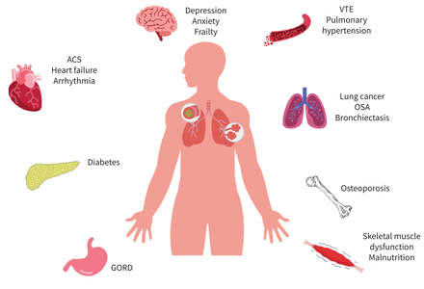
Comorbidities Accompanying COPD
Cardiovascular disease commonly accompanies COPD and substantially increases hospitalisation and mortality risks (Cronin et al., 2025).
Hypertension affects approximately 17%–64.7% of patients across studied COPD populations (dos Santos et al., 2022).
Anxiety and depression worsen treatment adherence, symptom perception, quality of life and outcomes (Siraj et al., 2025).
Osteoporosis frequently develops through ageing, inactivity, low BMI and corticosteroid exposure (Cronin et al., 2025).
Lung cancer shares smoking-related pathways with COPD and contributes significantly to mortality (Kallieri et al., 2025).
Diabetes, sleep apnoea and musculoskeletal disease further complicate personalised COPD management (Almagro et al., 2024).
Figure 7: The comorbidities of COPD
(Source: Cronin and Cushen, 2025).

Slide 9
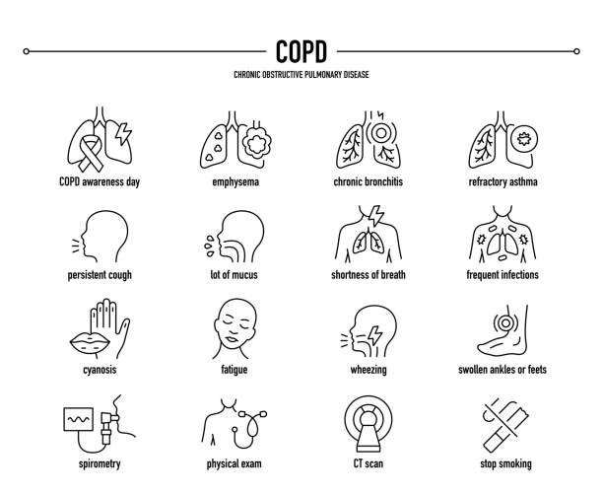
Prevention of COPD and Disease Progression
Avoiding tobacco smoking is the most effective strategy for preventing COPD development (WHO, 2026).
Smoking cessation slows lung-function decline and remains essential after COPD diagnosis (NHS, 2023).
Reducing exposure to second-hand smoke, air pollution, dust and chemical fumes protects lungs.
Workplace ventilation, protective equipment and exposure monitoring can reduce occupational COPD risks.
Influenza and pneumococcal vaccination help prevent infections that may trigger serious exacerbations (NICE, 2025).
Early symptom recognition, spirometry and personalised self-management can limit deterioration and hospitalisation.
Figure 8: Prevention of COPD
(Source: (NHS, 2023)

Slide 10
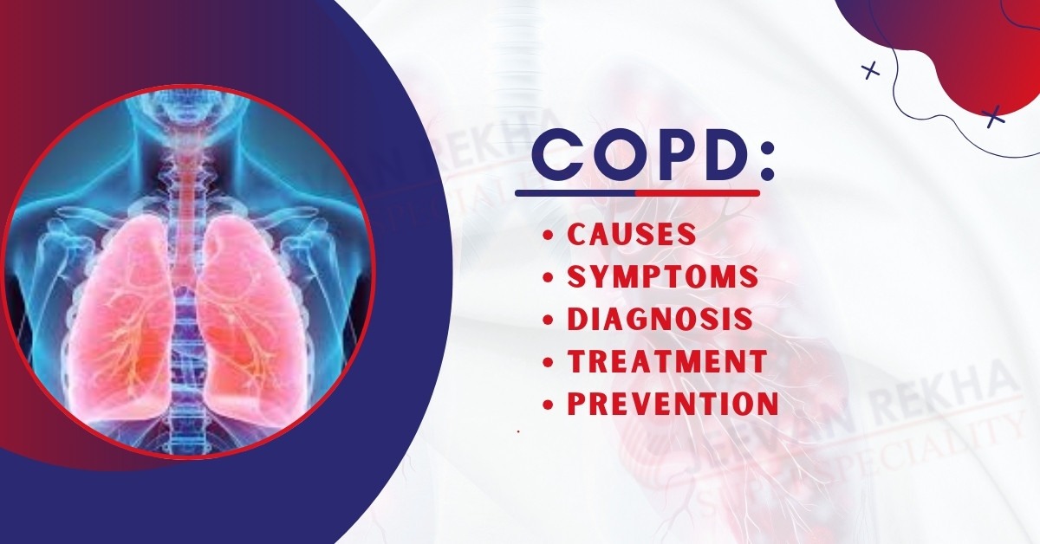
Skills, Values and Behaviours for Co-productive COPD Care
Active listening helps community nurses understand symptoms, priorities, beliefs and treatment concerns.
Clear, jargon-free communication enables informed discussions about inhalers, rehabilitation and exacerbation planning (NICE, 2021).
Shared decision-making must involve clinical evidence as well as patient preferences, contexts, and objectives (NHS England, 2025).
It is important to show empathy, respect and non-judgement, particularly when talking about smoking-related diseases.
Coaching and motivational interviewing techniques aid confidence, behavioural change, and effective self-management.
Cultural competence and literacy help avoid inequality of participation in COPD care decisions.
Coordinated care between primary and respiratory/community care is achieved through reliability and interprofessional working.
Co-production, in turn, is superficial when time is limited for consultation or options are pre-assigned to the group.
Figure 9: Knowledge about COPD treatment
(Source: NHS England, 2025)

Slide 11

Recommendations Using the Comprehensive Personalised Care Model
Shared decision-making: Community nurses should make decisions together about which inhalers, rehabilitation, and cessation to use for an individual patient.
COPD care planning: Ensure that all patients have a COPD care plan which is reviewed and includes a plan of symptoms, medications and escalations (Heaven et al., 2025).
Allowing choice: Patients should have access to choosing right providers, inhalers and pulmonary rehab programmes.
Create a referral pathway for patients to exercise, welfare, housing and peer groups as part of the social prescribing process.
Supported self-management: Nurses should assist patients with learning how to use inhalers, make observations about symptoms and how to respond to exacerbations.
Personal health budgets: Personal health budgets can be obtained for some patients for items that they need, such as equipment (Franks, 2026).
Implementation should involve frequent multidisciplinary review, health-literacy assessment and monitoring of outcomes for the prevention of inequity.
(Franks, 2026)

Slide 12
References
Abdelwahab, H.W., Sehsah, R., El-Gilany, A.H. and Shehta, M., 2024. Factors affecting work productivity and activity impairment among chronic obstructive pulmonary disease patients. Industrial health, 62(1), pp.20-31. https://www.jstage.jst.go.jp/article/indhealth/62/1/62_2022-0174/_pdf
Adeloye, D., Song, P., Zhu, Y., Campbell, H., Sheikh, A. and Rudan, I., 2022. Global, regional, and national prevalence of, and risk factors for, chronic obstructive pulmonary disease (COPD) in 2019: a systematic review and modelling analysis. The Lancet Respiratory Medicine, 10(5), pp.447-458. https://www.thelancet.com/pdfs/journals/lanres/PIIS2213-2600(21)00511-7.pdf
Agustí, A., Celli, B.R., Criner, G.J., Halpin, D., Anzueto, A., Barnes, P., Bourbeau, J., Han, M.K., Martinez, F.J., Montes de Oca, M. and Mortimer, K., 2023. Global initiative for chronic obstructive lung disease 2023 report: GOLD executive summary. European Respiratory Journal, 61(4), p.2300239. https://publications.ersnet.org/content/erj/61/4/2300239.full.pdf
Al Wachami, N., Guennouni, M., Iderdar, Y., Boumendil, K., Arraji, M., Mourajid, Y., Bouchachi, F.Z., Barkaoui, M., Louerdi, M.L., Hilali, A. and Chahboune, M., 2024. Estimating the global prevalence of chronic obstructive pulmonary disease (COPD): a systematic review and meta-analysis. BMC Public Health, 24(1), p.297. https://link.springer.com/content/pdf/10.1186/s12889-024-17686-9.pdf
Almagro, P., Soler-Cataluña, J.J., Huerta, A., González-Segura, D., Cosío, B.G. and CLAVE Study Investigators, 2024. Impact of comorbidities in COPD clinical control criteria. The CLAVE study. BMC pulmonary medicine, 24(1), p.6. https://link.springer.com/content/pdf/10.1186/s12890-023-02758-0.pdf
Alqahtani, J.S., Arowosegbe, A., Aldhahir, A.M., Alghamdi, S.M., Alqarni, A.A., Siraj, R.A., AlDraiwiesh, I.A., Alwafi, H. and Oyelade, T., 2024. Prevalence and burden of loneliness in COPD: A systematic review and meta-analysis. Respiratory medicine, 233, p.107768.
Asthma and Lung UK (2022). COPD in the UK: Delayed diagnosis and unequal care. [online] Asthmaandlung.org.uk. Available at: https://www.asthmaandlung.org.uk/sites/default/files/2023-03/delayed-diagnosis-unequal-care-executive-summary.pdf [Accessed 5 Aug. 2026].
Boers, E., Barrett, M., Su, J.G., Benjafield, A.V., Sinha, S., Kaye, L., Zar, H.J., Vuong, V., Tellez, D., Gondalia, R. and Rice, M.B., 2023. Global burden of chronic obstructive pulmonary disease through 2050. JAMA network open, 6(12), p.e2346598. https://jamanetwork.com/journals/jamanetworkopen/articlepdf/2812622/boers_2023_oi_231360_1701362164.36361.pdf
Cleveland Clinic (2024). What is COPD? Symptoms, treatment & more. [online] Cleveland Clinic. Available at: https://my.clevelandclinic.org/health/diseases/8709-chronic-obstructive-pulmonary-disease-copd [Accessed 5 Aug. 2026].
Cronin, E. and Cushen, B., 2025. Diagnosis and management of comorbid disease in COPD. Breathe, 21(1), p.240099. https://publications.ersnet.org/content/breathe/21/1/240099.full.pdf
Curtis, J.L., 2023. Understanding COPD etiology, pathophysiology, and definition. Respiratory care, 68(7), pp.859-870. https://pmc.ncbi.nlm.nih.gov/articles/PMC10289621/pdf/zrk859.pdf
Dos Santos, N.C., Miravitlles, M., Camelier, A.A., De Almeida, V.D.C., Maciel, R.R.B.T. and Camelier, F.W.R., 2022. Prevalence and impact of comorbidities in individuals with chronic obstructive pulmonary disease: a systematic review. Tuberculosis and respiratory diseases, 85(3), p.205. https://pmc.ncbi.nlm.nih.gov/articles/PMC9263346/pdf/trd-2021-0179.pdf
Fortis, S., Georgopoulos, D., Tzanakis, N., Sciurba, F., Zabner, J. and Comellas, A.P. (2024). Chronic obstructive pulmonary disease (COPD) and COPD-like phenotypes. Frontiers in Medicine, [online] 11, p.1375457. doi: https://www.doi.org/10.3389/fmed.2024.1375457.
Franks, L., 2026. Personal Health Budgets for children with complex medical needs: a rapid scoping review. https://osf.io/preprints/socarxiv/8b276
GOLD (2025). 2025 REPORT global strategy for the diagnosis, management, and prevention of chronic obstructive pulmonary disease global initiative for chronic obstructive lung disease global strategy for the diagnosis, management, and prevention of chronic obstructive pulmonary disease. [online] Available at: https://goldcopd.org/wp-content/uploads/2024/11/GOLD-2025-Report-v1.0-15Nov2024_WMV.pdf [Accessed 5 Aug. 2026].
GOV.UK (2025). Respiratory disease profile: Statistical commentary, june 2025. [online] GOV.UK. Available at: https://www.gov.uk/government/statistics/update-of-indicators-in-the-respiratory-disease-profile-june-2025/respiratory-disease-profile-statistical-commentary-june-2025 [Accessed 5 Aug. 2026].
Heaven, A., Foster, M., Foy, R., Hawkins, R., Hulme, C., Humphrey, S., Smith, J. and Clegg, A.P., 2025. Personalised care planning for older people with frailty: a review of factors influencing implementation. BJGP open, 9(1), pp.BJGPO-2024. https://bjgpopen.org/content/bjgpoa/9/1/BJGPO.2024.0163.full.pdf
Jackson, L. (2026). What is Chronic Obstructive Pulmonary Disease and who does it affect? commonslibrary.parliament.uk. [online] Available at: https://commonslibrary.parliament.uk/what-is-chronic-obstructive-pulmonary-disease-and-who-does-it-affect/ [Accessed 5 Aug. 2026].
Kallieri, M., Hillas, G., Bartziokas, K., Loukides, S. and Toumpanakis, D., 2026. COPD and the burden of multimorbidity: navigating the complexity. Expert Review of Respiratory Medicine, 20(3), pp.251-266. https://www.tandfonline.com/doi/abs/10.1080/17476348.2025.2569126
National Institute for Health and Care Excellence (2025). Rationale and impact | chronic obstructive pulmonary disease in over 16s: Diagnosis and management | guidance | NICE. [online] Nice.org.uk. NICE. Available at: https://www.nice.org.uk/guidance/ng115/chapter/Rationale-and-impact [Accessed 5 Aug. 2026].
National Institute for Health and Care Excellence (NICE) (2021). Diagnosis of Chronic Obstructive Pulmonary Disease. [online] NICE. Available at: https://cks.nice.org.uk/topics/chronic-obstructive-pulmonary-disease/diagnosis/diagnosis-copd/ [Accessed 5 Aug. 2026].

Slide 13
References
NHLBI (2024). COPD - what is COPD? [online] www.nhlbi.nih.gov. Available at: https://www.nhlbi.nih.gov/health/copd [Accessed 5 Aug. 2026].
NHS (2023). Chronic obstructive pulmonary disease (COPD). [online] NHS. NHS. Available at: https://www.nhs.uk/conditions/chronic-obstructive-pulmonary-disease-copd/ [Accessed 5 Aug. 2026].
NHS (2023b). Treatment - chronic obstructive pulmonary disease (COPD). [online] NHS. NHS. Available at: https://www.nhs.uk/conditions/chronic-obstructive-pulmonary-disease-copd/treatment/ [Accessed 5 Aug. 2026].
NHS England (2020). Supported self-management. [online] NHS England. NHS England. Available at: https://www.england.nhs.uk/personalisedcare/supported-self-management/ [Accessed 5 Aug. 2026].
NHS England (2021). The national patient safety improvement programmes. [online] Available at: https://www.england.nhs.uk/patient-safety/patient-safety-improvement-programmes/ [Accessed 5 Aug. 2026].
NHS England (2024). NHS England » Pulmonary rehabilitation commissioning standards. [online] www.england.nhs.uk. Available at: https://www.england.nhs.uk/long-read/pulmonary-rehabilitation-commissioning-standards/ [Accessed 5 Aug. 2026].
NHS England (2024a). NHS England » guidance note: Virtual ward care for people with acute respiratory infection including chronic obstructive pulmonary disease. [online] www.england.nhs.uk. Available at: https://www.england.nhs.uk/long-read/guidance-note-virtual-ward-care-for-people-with-acute-respiratory-infection-including-chronic-obstructive-pulmonary-disease/ [Accessed 5 Aug. 2026].
NHS England (2024a). NHS England, pulmonary rehabilitation. [online] NHS England. Available at: https://www.england.nhs.uk/ourwork/clinical-policy/respiratory-disease/pulmonary-rehabilitation/ [Accessed 5 Aug. 2026].
NHS England (2026). NHS England » chronic obstructive pulmonary disease: Commissioning strategies and resources. [online] England.nhs.uk. Available at: https://www.england.nhs.uk/long-read/copd-commissioning-strategies-resources/ [Accessed 5 Aug. 2026].
NICE (2025). Chronic obstructive pulmonary disease. [online] NICE. Available at: https://cks.nice.org.uk/topics/chronic-obstructive-pulmonary-disease/ [Accessed 5 Aug. 2026].
NICE (2025b). Recommendations | chronic obstructive pulmonary disease in over 16s: Diagnosis and management | guidance | NICE. [online] Nice.org.uk. NICE. Available at: https://www.nice.org.uk/guidance/ng115/chapter/Recommendations [Accessed 5 Aug. 2026].
NICE CKS (2025c). Stable chronic obstructive pulmonary disease. [online] NICE. Available at: https://cks.nice.org.uk/topics/chronic-obstructive-pulmonary-disease/management/stable-copd/ [Accessed 5 Aug. 2026].
Respiratory London (2024). Chronic obstructive pulmonary disease (COPD, previously known as emphysema and chronic bronchitis). [online] Respiratorylondon.co.uk. Available at: https://respiratorylondon.co.uk/chronic-obstructive-pulmonary-disease-copd-previously-known-as-emphysema-and-chronic-bronchitis/ [Accessed 5 Aug. 2026].
Responsum Health (2025). What is COPD? A simple guide to understanding your lungs - responsum health. [online] Responsum Health. Available at: https://responsumhealth.com/conditions/copd/what-is-copd/ [Accessed 5 Aug. 2026].
OHID (2024). Public health profiles - OHID. [online] fingertips.phe.org.uk. Available at: https://fingertips.phe.org.uk/search/COPD [Accessed 5 Aug. 2026].
Siraj, R.A., 2025. COPD and comorbid mental health: addressing anxiety, and depression, and their clinical management. Medicina, 61(8), p.1426. https://www.mdpi.com/1648-9144/61/8/1426
Stone, P.W., Hickman, K., Holmes, S., Feary, J.R. and Quint, J.K., 2022. Comparison of COPD primary care in england, scotland, wales, and northern Ireland. NPJ primary care respiratory medicine, 32(1), p.46. https://www.nature.com/articles/s41533-022-00305-8.pdf
Stone, P.W., Osen, M., Ellis, A., Coaker, R. and Quint, J.K., 2023. Prevalence of chronic obstructive pulmonary disease in England from 2000 to 2019. International Journal of Chronic Obstructive Pulmonary Disease, pp.1565-1574. https://www.tandfonline.com/doi/pdf/10.2147/COPD.S411739
World Health Organization (2021). Chronic obstructive pulmonary disease (COPD). [online] Who.int. World Health Organization: WHO. Available at: https://www.who.int/news-room/fact-sheets/detail/chronic-obstructive-pulmonary-disease-%28copd%29 [Accessed 5 Aug. 2026].
Xu, J., Zeng, Q., Li, S., Su, Q. and Fan, H., 2024. Inflammation mechanism and research progress of COPD. Frontiers in immunology, 15, p.1404615. https://www.frontiersin.org/journals/immunology/articles/10.3389/fimmu.2024.1404615/pdf

