Slide 1
Understand your role
1
Standard

Slide 2
Learning outcomes
The worker will:
1.1 Understand their own role
1.2 Work in ways that have been agreed with
their employer
1.3 Understand working relationships in health and social care
1.4 Work in partnership with others.
1
Standard

Slide 3

Tasks, behaviours and standards of work
The duties and responsibilities that are part of your role will be listed in your job description.
Your role is likely to include:
  Providing care and support
  Working as part of a team
  Contributing to activities
  Respecting confidentiality
Your work must always be carried out in agreed ways and must keep to regulations.
^{Regulations}
are rules that come from legislation or laws. The legislation establishes the general ‘laws of the land’. Regulations provide the specific ways in which those laws are interpreted and applied.
Notes:
Providing care and support, working in a person centred way, communicating well, building relationships and promoting equality and diversity.
Working as part of a team, being a supportive team member and developing your skills to improve your work.
Contributing to activities in a safe way, keeping and filing clear records, keeping to regulations, following the agreed way of working.
Respecting confidentiality by not discussing any personal information on individuals or staff with unauthorised people, and storing records securely.

Slide 4
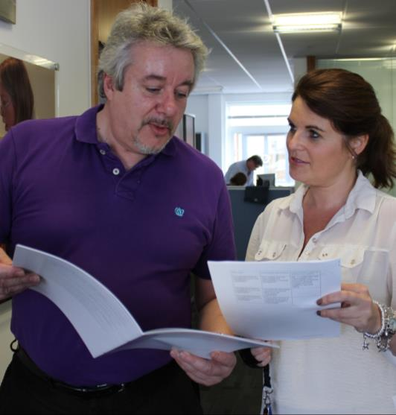

Standards and codes of conduct and practice
To be able to do your job competently you must have skills and knowledge and work in ways that are set out nationally.
The Care Certificate
The Code of Conduct for Healthcare Support Workers and Adult Social Care Workers
in England
^{Competence}
Having the ability and expertise to understand an individual’s needs in order to deliver effective care.
Notes:
The Care Certificate is the shared health and social care training, which must be completed and assessed, before new health care support workers or adult social care workers can work out of their supervisor’s line of sight in any workplace.
The 15 standards can be found here:
www.skillsforhealth.org.uk/projects/item/24-care-certificate
www.skillsforcare.org.uk/Standards/Care-Certificate/Care-Certificate.aspx
The Code of Conduct for Healthcare Support Workers and Adult Social Care Workers in England has the moral and ethical standards expected of all health and social care workers. The Code can be found here:
www.skillsforcare.org.uk/Document-library/Standards/National-minimumtraining-standard-and-code/CodeofConduct.pdf
www.skillsforhealth.org.uk/code-of-conduct

Slide 5

Discussion
The ways we need to work to safeguard the people we support
The skills and knowledge we need to be competent in our role
Care Certificate and Code of Conduct Standards include…
The moral and ethical standards that we must meet in all aspects of our work
How we should behave when we are at work
Notes:
QUESTION
What are included in The Care Certificate and Code of Conduct Standards

Slide 6
Experiences, attitudes and beliefs
Your experiences, attitudes and beliefs affect how you think and behave.
They can:
Lead you to make assumptions
Make judgements
Self-awareness and learning to understand the attitudes and beliefs of others can help you to work in ways that value the individuals that you support.
Beliefs: can be described as things in life that you feel strongly about, that guide you in your daily life and are linked very closely to your morals and values
Attitudes: are the approaches, opinions and mind-set that you have developed through your upbringing and life and learning experiences.
Notes:
QUESTION
What things can influence your experiences, attitudes and beliefs?
Answers could include:
Your background, upbringing, relationships, education, the media, attitudes of your friends and family

Slide 7
Values, aims and objectives
Understanding the values, aims and objectives of your employer will help you to understand your role.
Values
Aims
Objectives
Values are the beliefs or ideals that should be evident in all aspects of the service you provide
Aims are the
general goals that an organisation hopes to achieve through their activity. The purpose of your job will be to contribute to achieving these’
Objectives are specific things that must be in place in order to achieve the aims.

Slide 8

Rights at work
Legislation gives employees rights and responsibilities at work.
Rights:
To work in a safe environment and
be provided with equipment to
keep them safe
To have personal and sensitive information treated confidentially
To equal pay for equal work
To fair terms of employment including pay and working hours.
Notes:
The Health & Safety at Work etc. Act sets out the rights and responsibilities of the employee in the workplace.
Employees’ have the right to:
Work in an environment that is safe
Be provided, free of charge, with the equipment they need to keep them safe at work.
Employees have the responsibility to work in agreed ways that are safe for them, for others in the workplace and for the people they support.
If you have concerns about safety in your workplace you must talk to your manager.
You can find more information about the Health & Safety at Work etc. Act 1974 here:
www.hse.gov.uk/legislation/hswa.htm
The Data Protection Act protects people’s rights to confidentiality. It restricts how personal and sensitive information can be used, stored and passed on. It applies to employees information and to how they share the information of others.
You can find more information about the Data Protection Act here:
www.gov.uk/data-protection/the-data-protection-act
The Equality Act 2010 gives all people in the UK the right to be treated fairly and afforded equality of opportunity. This means that people must be paid ‘equal pay for equal work.’
You can find more information about the Equality Act 2010 here:
www.gov.uk/equality-act-2010-guidance
Protected
There are many pieces of legislation that set out what are considered to be fair terms of employment including pay and hours of work.
You can find out more about working contracts and conditions here:
www.gov.uk/employment-contracts-and-conditions/overview

Slide 9

Responsibilities at work
Responsibilities:
To work in agreed ways that are safe for them and those around them and to discuss safety concerns with their manager
To treat other people’s private and sensitive information confidentially
To treat others equally regardless of protected characteristics.
Protected characteristics
The Equality Act 2010 identifies nine protected characteristics or groups that are protected under equalities law.

Slide 10
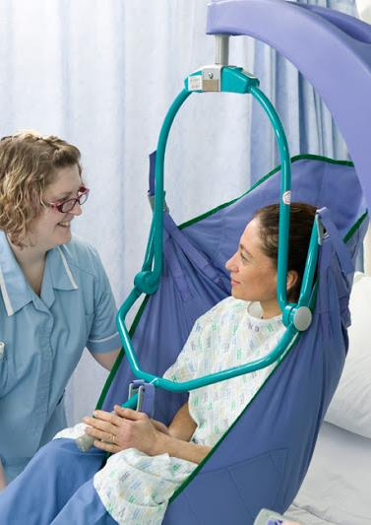
Responsibilities to the individuals you support
You have responsibilities to the people that you provide care and support for including:
Safeguarding their safety and welfare
Involving the individual and their support network in the planning,
delivery and review of their care
Ensuring that their dignity is promoted and their
rights upheld
Supporting the person to complain
or raising concerns if care is
inadequate or rights are not upheld.
Notes:
You have responsibilities to the people that you provide care and support for including:
Safeguarding their safety and welfare by ensuring their care plan is followed and that care is provided in agreed, safe ways
Involving the individual and their support network in the planning, delivery and review of their care to ensure that it meets their needs
Ensuring that care is delivered in ways that promote their dignity and upholds their rights
Supporting the person to complain or raising concerns if care is inadequate or rights are not upheld.

Slide 11

Agreed ways of working
Agreed ways of working are the ways in which employers expect employees to work. This could be:
Part of a policy
Provided by your manager or colleague
Part of an individual’s care plan.

Slide 12

Reporting errors - discussion
Mistakes sometimes happen and it is important to be honest and identify when errors have been made.
What action should
be taken?
Why is it important to be honest and admit when errors have been made?
What are the potential consequences of not reporting a mistake?
Notes:
QUESTION
Ask the group to think of a mistake they have made or offer a scenario.
What action should be taken?
Why is it important to be honest and admit when errors have been made?
What are the potential consequences of not reporting a mistake?
Suggested Activity
Ask worker/s to think of a mistake they have made or give a scenario.
Scenario 1
A meal containing meat is given to a vegetarian. They don’t eat it.
What action should be taken?
The meal should be replaced with something the person can eat – the individual’s welfare is the top priority and they should not be allowed to go hungry.
The mistake should be reported (in line with the agreed ways of working)
Why is it important to be honest and admit when errors have been made?
If a worker does not admit the mistake the individual may miss a meal. This standard of care would not be acceptable.
What are the potential consequences of not reporting a mistake?
In this scenario the individual may be hungry
A complaint could be made
Not eating could affect the effectiveness of medication which has to be taken with or after food.
Not reporting may mean that similar incidents happen in the future.
If it happens repeatedly to the same person they could become malnourished.
If an unsuitable meal were given to an individual with allergies it could have serious consequences
Scenario 2
An individual tells a worker that they have been experiencing severe headaches everyday an hour after they have taken their medication. The worker forgets to make a note of this in the individual’s care plan
What action should be taken?
The worker must tell their supervisor as soon as possible.
Why is it important to be honest and admit when errors have been made?
The individual is experiencing pain which may be avoidable if medication is changed
The headaches could be a sign of a more serious problem
What are the potential consequences of not reporting a mistake?
The individual will continue to experience pain- this is not an acceptable level of care if pain could be avoided
The individual may become reluctant to take their medication which could affect other aspects of their health
The individual’s care plan will not be up to date

Slide 13

Whistleblowing
Reporting things that you feel are not right or are illegal is known as whistleblowing
You have a responsibility to report concerns about the safety and welfare of all people in the workplace
You must follow the whistleblowing policy for your employer.

Slide 14
Whistleblowing - discussion
 | Report?
The health and safety of staff is in danger | YES | NO
Individuals are treated with dignity and respect | YES | NO
The environment is being damaged by work activity | YES | NO
Wrongdoing is being covered up | YES | NO
The individual’s care is inadequate but they cannot or will not complain | YES | NO
Care plans are reassessed and updated regularly | YES | NO
Your manager is involved in the abuse of individuals | YES | NO
Notes:
QUESTION:
Ask group to decide whether each should be reported as a concern – yes/no answers
Alternative suggestion:
This could be printed out as a handout and given to the group to circle their answers

Slide 15
Working in partnership
In your role you will be working with people in a variety of roles. This is known as ‘partnership working.’
Working relationships fall into four groups:
Individuals and their friends and family
Your colleagues and managers
People from other workplaces, including advocates.
Volunteers and community groups.
Advocate
Is a trusted, independent person who can speak and act for the individual. They can advise on matters such as benefits and can ensure that the individual’s voice is heard in care planning meetings, making sure that decisions are made in the interests of the individual. The role of advocates and advocacy services are made more important with the Care Act 2014.
Notes:
Question
Think about some of the people who are involved in providing support to an individual.
Suggested answers:
The person
The person’s family and friends
Colleagues doing the same or similar jobs
Managers and supervisors
People who do other jobs such as nurses, GPs, physiotherapists, social workers, dieticians
People who work for charitable organisations
Religious groups
Special interest, recreational and support groups.

Slide 16
Effective partnership working
The effectiveness of partnership working affects the quality of care delivery. Skills and values necessary for it to be effective include:
Communication
Record keeping
Trust
Respect
Conflicts and disagreements can affect the quality of care provided. Seek advice from managers and colleagues who have the experience to help and advise you.
Working well in partnership
Failings in partnership working
Good quality care
Meets all the individual’s needs
Poor standard of care
Often identified as a factor when things go wrong.
Notes:
The effectiveness of partnership working affects the quality of care delivery. Skills and values necessary for it to be effective include:
Communication – choosing appropriate ways of communicating, language and avoiding jargon. Workers may need to use interpreters, communication aids etc. to communicate effectively
Record keeping – information must be understandable, accessible and shared with those who need to know and up to date
Trust – Workers must build working relationships based on trust as this helps to promote openness and honesty and so that everyone is confident that they can rely on the people that they are working with
Respect – Workers must always work in ways that promote respect. All those involved in partnership working play a valuable part in planning and providing care. Respecting the part that each person has to play helps to promote effective partnership working.

Slide 17







Knowledge check
Which of the following statements about rights and responsibilities is true?
Click to reveal answer
The law states that your employer can choose how they treat you
You have legal rights and responsibilities when you are employed
You can behave however you want
in the workplace
The law does not apply to people who
work in agreed ways
Notes:
QUESTION:
Ask group question then to answer A,B,C or D
Trainer should ask class why they chose the correct answer.

Slide 18


Knowledge check
Which of the following is important for effective partnership working?
Click to reveal answer
Whistleblowing
Keeping relevant information to yourself
Open and honest communication
Making judgements based on
your past experiences
Notes:
QUESTION:
Ask group question then to answer A,B,C or D
Trainer should ask class why they chose the correct answer.

Slide 19


Knowledge check
What should you do if you are concerned that one of your colleagues is mistreating an individual they are providing care and support for?
Click to reveal answer
I should keep quiet and not complain
I should discuss my concerns with the individuals that I support
I should report concerns to the Care Quality Commission (CQC) immediately
I should report my concerns to my manager
Notes:
QUESTION:
Ask group question then to answer A,B,C or D
Trainer should ask class why they chose the correct answer.
Feedback – Answers to Q&A’s
A – Agreeing a PDP is part of an ongoing process of learning and development to improve your skills and knowledge which may be informed by you reflecting on your own practice.
B – Feedback from others can be helpful in developing your skills and knowledge but it is not part of reflection on your own work.
C – Giving constructive feedback to others can help them to improve the ways in which they work but it is not part of reflecting on your own work.
D – Reflection is a form of learning and development in which workers think about what they have done in the past. By thinking about how they could have done things differently to get a different result, they can learn from past experiences and improve the ways in which they work.

