Slide 1
Digital and Social Media in Customer Relationship Management (CRM): A Case Study of M&S Food
Student Name: Alexandra-Maria Zara
Student ID: 2329733

Slide 2
Table of Contents
Slide 3: Introduction
Slide 4: Understanding CRM in the Digital Context
Slide 6:Defining Digital and Social Media in CRM
Slide 8: M&S Food’s Digital and Social Media Ecosystem
Slide 9: Developing and Sustaining Customer Relationships
Slide 10: Enhancing Customer Experience and Engagement
Slide 11: Supporting Organisational Performance
Slide 12: Critical Assessment of M&S Food’s Digital CRM Strategy
Slide 13: Recommendations
Slide 14: Conclusion
Slide 15: References

Slide 3

Introduction
The purpose of this presentation is to examine the role of digital and social media in supporting customer relationships as part of the CRM strategy of M&S Food.
Objectives
Define Digital and Social Media
Evaluate M&S digital CRM practices
Assess effectiveness
Recommend improvements
The presentation focuses on the exploration of key social media strategies used by M&S Food to foster better relationships with customers (marksandspencer,2025a) .
The effectiveness of M&S Food’s CRM tactics will be evaluated first. After the critical assessment of its applied strategies, recommendations will be provided in this context briefly.

Slide 4
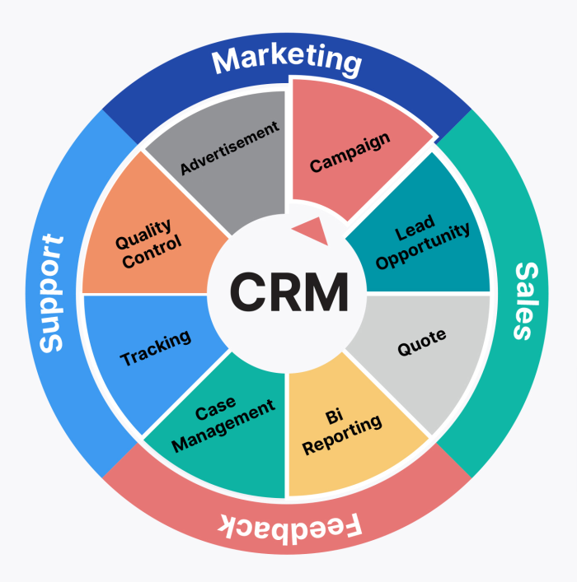
Understanding CRM in the Digital Context
2.1 Definition of Customer Relationship Management (CRM)
Customer relationship management can be defined as a strategic technique that has a greater focus on strengthening the connection with the consumers.
CRM can enhance customer satisfaction, maintain consumer loyalty and increase the profitability level of the company through the consistent delivery of high-quality products and understanding of customer needs.
Marks & Spencer's food can build strong connections with customers with the help of customer relationship management strategies.
It is effective to build long-lasting connections with customers, shaping their behaviour and offering products as per their expectations.
As per Buttle (2019), it is not considered to be a technology only; however, it is also considered to be a customer-focused process for maintaining value.

Slide 5
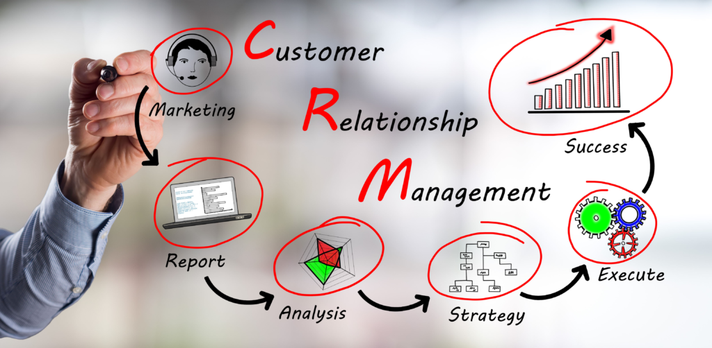
Contd…
2.2 Role of Digitalisation in CRM
Digitalisation has a significant role in shaping CRM strategies (Gary Armstrong, 2020).
It helps to collect real-time information and personalised communication with the consumers.
Different digital tools, such as applications and website loyalty systems, help businesses to make informed decisions.
Digital CRM systems increase efficiency and enhance the customer service experience.
It allows the business Marks & Spencer to reply to the queries of the customers instantly.
Marketing can also get more personalised, targeted as well and responsive as a result of im plementing these digital systems (marksandspencer,2025b) .
Automation of communication and the improvement of customer service quality highly depend on the implementation of these digital systems into the customer relationship management strategies.

Slide 6
Defining Digital and Social Media in CRM
3.1 Digital Media and Social Media
Digital media can be described as electronic platforms that consist of applications, email marketing, search engine optimisation, along with paid advertisements used by companies to promote their products and services.
Customer relationship management is highly supported by such a platform in collecting real-time data.
Businesses can share personalised information about the product and promote through targeted marketing through these digital media channels.
Social media platforms are Facebook, Instagram, TikTok Tok and others, which help to increase customer engagement and have become an effective platform for gathering feedback (Wahyuni et al., 2024).
Social media platforms are vital in fostering two-way communication channels.
Digital media is effective enough for Marks & Spencer food for determining the customer behaviour and sharing personalised content to meet their preferences and choices (marksandspencer, 2025a).
Customer relationships are strengthened by the continuous engagement of customers and interaction through the digital campaigns run on social media channels.
It is not only effective in gathering feedback but also helps to make the brand visible and interactive.

Slide 7

Contd…
3.2 Importance of Digital and Social Media in CRM
Digital and social media are effective in increasing customer engagement and earning the trust of consumers (Gu and Duan, 2024).
Data-driven insights help the company to adopt continued improvement and better service quality.
Sharing on digital and social media is important as it allows the business to gather information about the consumer's likes and preferences and develop their products as per their preference.
The sense of trust can be established by maintaining transparency, and regular engagement can be forced by this strategic initiative involving digital and social media channels.

Slide 8

M&S Food’s Digital and Social Media Ecosystem
The key social media channels and digital tools used by Marks & Spencer are its website, online store, loyalty application, along email marketing.
Instagram, Facebook, YouTube, TikTok and other channels are also used to share promotional content in the form of storytelling and others.
Information from all these platforms or gathered into the CRM system for preparing strategies by the company(Ileana et al., 2025).
Marks & Spencer connect with their consumers using multiple digital platforms.
Its application and the website offer personalised rewards, and one can order products online easily without much complication.
With the social media channels, the company shares their stories, advertisement content and makes a better interaction with its customers.

Slide 9

Developing and Sustaining Customer Relationships
Marks & Spencer utilises data-driven personalisation in its application, which is effective in sharing customised deals, rewards, incentives and product recommendations to the targeted consumers.
Data analytics tools are also used by the company to understand customer preferences.
The relationship marketing approach has been maintained by the company using the customer life cycle model, which is effective enough to maintain consistent communication.
The company is strong enough to retain its customer base and establish long-term trust; however, it has a limited engagement with the young generation people especially with Gen Z.
Marks & Spencer focuses on personalisation to build customer relationships.
Its application is designed in a way that uses the Data analytics tool so that it can predict the customer behaviour and offer personalised recommendations to its consumers.
Hafeez (2025) states it is strong enough to build customer loyalty using the customer life cycle model along with the customer lifetime value approach.
The company has Limited engagement with the young generations as they do not get excited about the loyalty schemes.

Slide 10

Enhancing Customer Experience and Engagement
M&S Food provides an exceptional omnichannel experience by allowing customers to easily transition between their website, Sparks loyalty app, and physical stores.
The shopping journey is very well integrated and convenient, as customers can easily browse products online, get personalised offers through the app, and redeem rewards in-store.
The brand creates a dialogue through social media campaigns, sharing recipes, and storytelling that are all centred around the notions of innovation and ethical values.
One example is its “Plan A” sustainability postings and features on food innovation that communicate transparency and social responsibility, thus building customer trust.
Utilising the RACE Model (Reach, Act, Convert, Engage), M&S successfully draws customers to its website, invites interaction, turns interested customers into buyers, and maintains long-term communication and loyalty through reliable incentives.
Hafeez (2025) states this integrated digital strategy works together to increase customer satisfaction, retention, and brand loyalty.

Slide 11
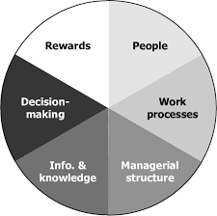
Supporting Organisational Performance
The online sales of the M&S Food have been boosted by the Ocado partnership, which helped the business to deliver food products nationwide.
Sparks membership helped to influence the customers in making repeat purchases and enhance customer loyalty.
The application of the digital CRM tools by the brand is effective enough to strengthen the brand recognition and maintain its competitive position.
However, M&S needs to adopt innovative digital tools to compete with the new brands that are already online-focused and innovative (marksandspencer, 2025a) .
Ocado's partnership plays a crucial role in helping the brand to deliver its food products online all over the UK.
A large number of customers can purchase its food products online without much hassle.
marksandspencer (2025a) states Sparks membership offers personalised recommendations, rewards to keep the customers loyal and increase the purchase history.
However, for staying competitive, the company needs to rely on continuous innovation and service improvement.

Slide 12
Critical Assessment of M&S Food’s Digital CRM Strategy
Strengths
Strong CRM system
Personalised engagement using the Sparks app
Ethical and sustainability reputation (Plan A)
Weaknesses
Limited influencer marketing
Weak youth targeting
Lower activity on TikTok
Slow innovation in social media
The key competitors of this company, namely Tesco, Aldi and Sainsbury’s uses already use digital storytelling along with influencer marketing to get customer attention and shape their behaviour.
The CRM system implemented by Marks & Spencer is good and effective enough to offer personalised recommendations to the targeted customers. The Sparks app is also effective in retaining loyal customers (marksandspencer,2025a).
The company is famous for its ethical and social responsibilities, also. These are the key areas of strength of this company; however, there is room for improvement.
The company does not implement any new marketing strategies, like involving social media stars.
They are unable to attract the attention of the young generations there, who are highly active on the social media platform, select Tik TikTok.
In comparison with the competitors, the company falls behind in its digital marketing approaches, which demonstrate clear areas for improvement.

Slide 13
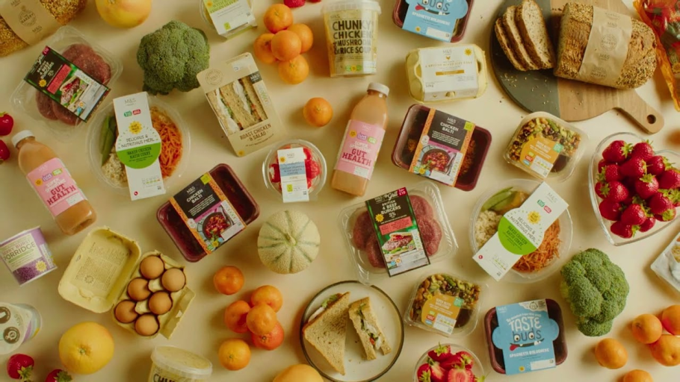
Recommendations
M&S is highly recommended to strengthen its digital engagement by involving social media stars, and it will also be effective in attracting the attention of the young generations.
The company is also suggested to expand its social media presence by employing TikTok and YouTube Shorts.
The company is suggested to use new AI-driven innovative measures for digital marketing. Employing influencers to promote products will be effective for this business.

Slide 14
Conclusion
Digital and social media are essential for the success of Customer Relationship Management (CRM) at M&S Food.
The retailer illustrates how data-driven, customer-focused, and eco-friendly practices are intertwined and thus progressively gaining and reinforcing customer trust.
The engagement and loyalty developed around the brand have been mainly due to the company’s digital channels, especially the Sparks loyalty app and social media.
Yet, M&S cannot afford to be complacent and will have to constantly come up with new ideas for its digital CRM strategy, as well as keep emotionally connecting with the younger customer segments who are likely to change their preferences during the process, to achieve sustainable growth and customer loyalty that lasts for a long time.

Slide 15
References
Buttle, F. (2019) Customer Relationship Management: Concepts and Technologies. 4th Edition. Routledge.
Gu, C. and Duan, Q. (2024)‘Exploring the dynamics of consumer engagement in social media influencer marketing: From the self-determination theory perspective.’ Humanities and Social Sciences Communications, 11(1), pp.1-17. Available at: https://www.nature.com/articles/s41599-024-03127-w.pdf
Hafeez, K. (2025)‘IMC Frameworks and Models: Aligning Messaging Across Channels.’ Copyright© 2025 Eurasian Research Institute, p.244.Available at: https://www.gbppublications.com/_files/ugd/5e526c_d512b35bd3f04b9eac3a95ed47ef78ea.pdf#page=257
Ileana, M., Petrov, P. and Milev, V. (2025)‘Optimizing customer experience by exploiting real-time data generated by IoT and leveraging distributed web systems in CRM systems.’ IoT, 6(2), p.24.Available at: https://www.mdpi.com/2624-831X/6/2/24
Kotler, P. and Armstrong, G. (2020) Marketing: An introduction, Global Edition. 14th edition. Pearson.
marksandspencer (2025b) Key facts. Available at: https://corporate.marksandspencer.com/about-us/key-facts-figures (Accessed: 15 November 2025).
marksandspencer(2025a) Reshaping M&S. Available at: https://corporate.marksandspencer.com/sites/marksandspencer/files/2025-05/Marks-and-Spencer-Group-plc-Annual-Report-and-Financial-Statements-2025_INTERACTIVE_FINAL.pdf(Accessed: 15 November 2025).
Wahyuni, I., Arifiansyah, R., Meidasari, E. and Siskawati, I. (2024)‘The role of brand equity, digital marketing, customer experience, and social media engagement on consumer purchase intention on TikTok shop application.’ International Journal of Business, Law, and Education, 5(2), pp.2806-2815. Available at: http://www.ijble.com/index.php/journal/article/download/942/855

