Slide 1
LCLM4003 Effective Teamwork and Communication
ASSIGNMENT 2: Group Presentation
Student: Oussama Siied ID No. 2528897
Student: Sapna Ghai ID No. 2533208
Student: Tatiana Viera ID No. 2527734
Student: Reece Anyata ID No. 2441537
Student: Geormi Dikila ID No. 2518654
Tutor’s Name: Timothy Hopkins

Slide 2
Overview
Introduction
1 Age/Generation - Oussama Siied
2 Language - Sapna Ghai
3 Cultural - Tatiana Vieira
4 Emotional - Geormi Dikila
5 Environmental Noise - Reece Anyata
Conclusion
References
Questions

Slide 3
Introduction
Flight Foods Ltd. is a company that sells ready meals to airlines.
Decreasing in sales and complaints about the products.
5 different barriers affecting the company.
Environmental Noise, Language/communication, Age/Generation, Emotional and Cultural.
3

Slide 4
Age/Generation Description
Age ranges of workers 16-60
5 different backgrounds
Lack of English and understanding

Slide 5
Age/Generation Analysis Shannon & Weaver Model
Sender (Gary)
Encoder
Channel
Decoder
Receiver (Workers)
Factory
No understanding of English and written signs.
English only language and written signs.
Noise
Lack of understanding English
No Feedback
Source: Author Oussama
5

Slide 6
Age/Generation Solution
Groups of people with same or similar background/language.
Presentations and pictures.
Translations throughout members of the group that understand the most English.
Groups mixed of age to also learn from each other.

Slide 7
Age/Generation Solution Shannon & Weaver Model
Receivers (Workers)
Sender (Gary)
Encoder
Channel
Decoder
Presentations
Pictures
Groups
Factory
Reading pictures and presentations
Learning from teammates on the group.
Noise
Lack of understanding English
Feedback
Source: Author Oussama

Slide 8
Age/Generation Conclusion
Workers understand the job better.
Less stress for Gary and also the workers which helps the flow of work.
Better results for the company.
Workers work better with each other younger and older.

Slide 9
Language Description
Workers speak different languages.
Instructions are often given in English.
Some workers have limited English skills.
This can lead to misunderstanding and communication barriers.

Slide 10
Language analysis
Sender (Gary)
Encoder
Spoken English and written instruction/signs
Channel
Factory
Noise
Language barriers &
Poor English understanding
No feedback
Decoder
Workers struggle to understand
Spoken and written English
Receiver (Workers)

Slide 11
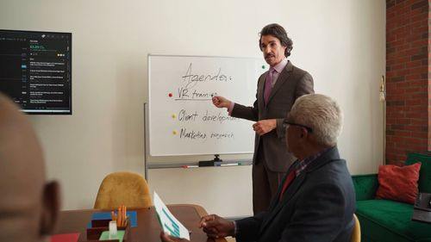
Language Solution
SOLUTION :
Use clear and simple language.
Provide pictures and visual instructions
Translate instructions in workers language
Use bilingual workers to help with communication
Encourage feedback by asking the receiver to repeat or confirm the message.

Slide 12
Language solution using Shannon/weaver model
Receivers (Workers)
Sender (Gary)
Encoder
Simple english
Pictures
Channel
Decoder
Workers understand through pictures and translation
Factory
Noise
Reduced by visual aids & translation
Feedback

Slide 13

Language conclusion
Workers understand instructions more clearly
Fewer communication mistakes are made
Employees feel more confident
Teamwork improves between workers from different language backgrounds
Better productivity and safer working environments
for everyone.
PIXABAY com

Slide 14

BARRIER 3 – Cultural
Description
Factory has 5 distinct cultural groups, diff. communication styles and attitudes
The majority are immigrants with limited English proficiency
Written signs on the wall – misinterpretation
Manager VS employees different cultural backgrounds and experience = instruction interpretation affected
Food hygiene and safety procedures errors
(The iStock, 2026)

Slide 15
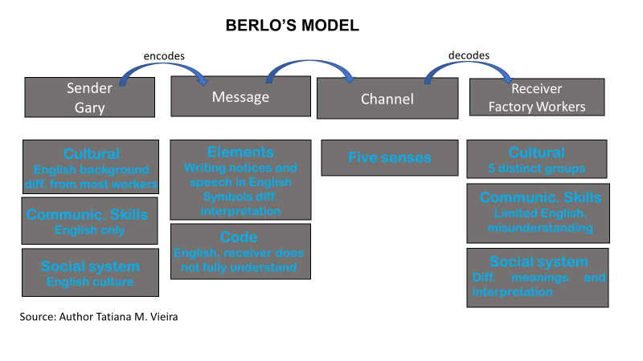
BARRIER 3 - Cultural​

Slide 16

BARRIER 3 – Cultural
Solution
Visual communication improvement
Provide multilingual training
Regulate communication
Promote cultural awareness
Two-way communication (clarifying doubts)*
Formal and accessible food hygiene training before start working
(Safety Sign , 2026)
*Two-way communication ensures both sender and receiver understand, ask questions, and turn instructions into collaboration (Sociabble, 2025).

Slide 17
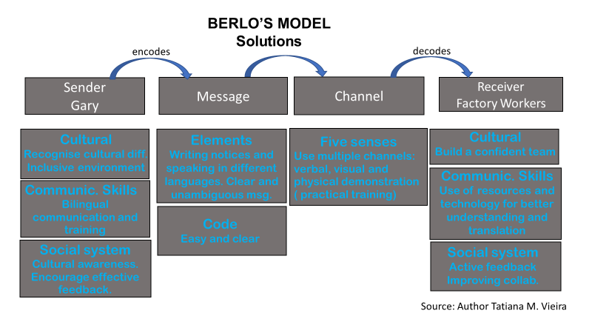
BARRIER 3 - Cultural

Slide 18
BARRIER 3 – Cultural
Conclusion
Main communication barrier: mix of cultural diversity is one of the most important
Result: inefficient communication/understanding. Unsafety workplace. Production and revenue compromised
Berlo’s SMCR model: shows how differences in cultural background and communications skills reduce message efficiency.
Recommended solutions: make the communication more effective and accessible to employees.
Expected results: better communication, fewer misunderstanding and minimize food safety incidents. Gary less overwhelmed. Best-case scenario, increase Flight Food Ltd.'s revenue.

Slide 19
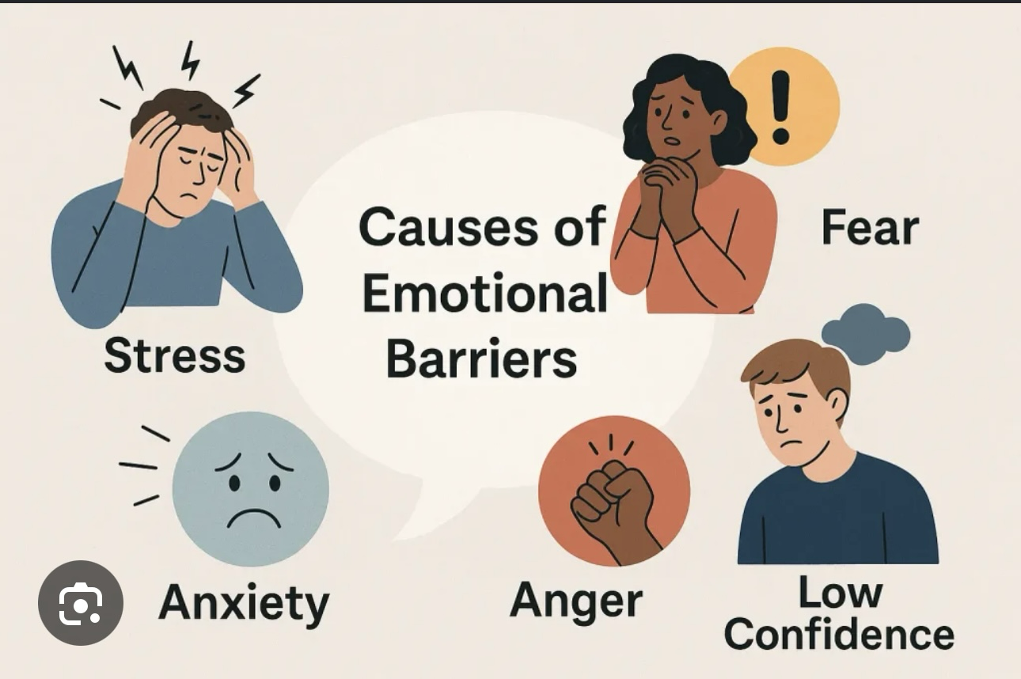
EMOTIONAL BARRIER
Emotions can affect effective communication.
Stress and frustration make it harder to communicate clearly.
Gary is stressed, tired and overwhelmed.
He becomes frustrated instead of checking staff understanding.
Staff misunderstand food hygiene instructions.
This leads to mistakes, poor food quality and customer complaints.
Stock images

Slide 20
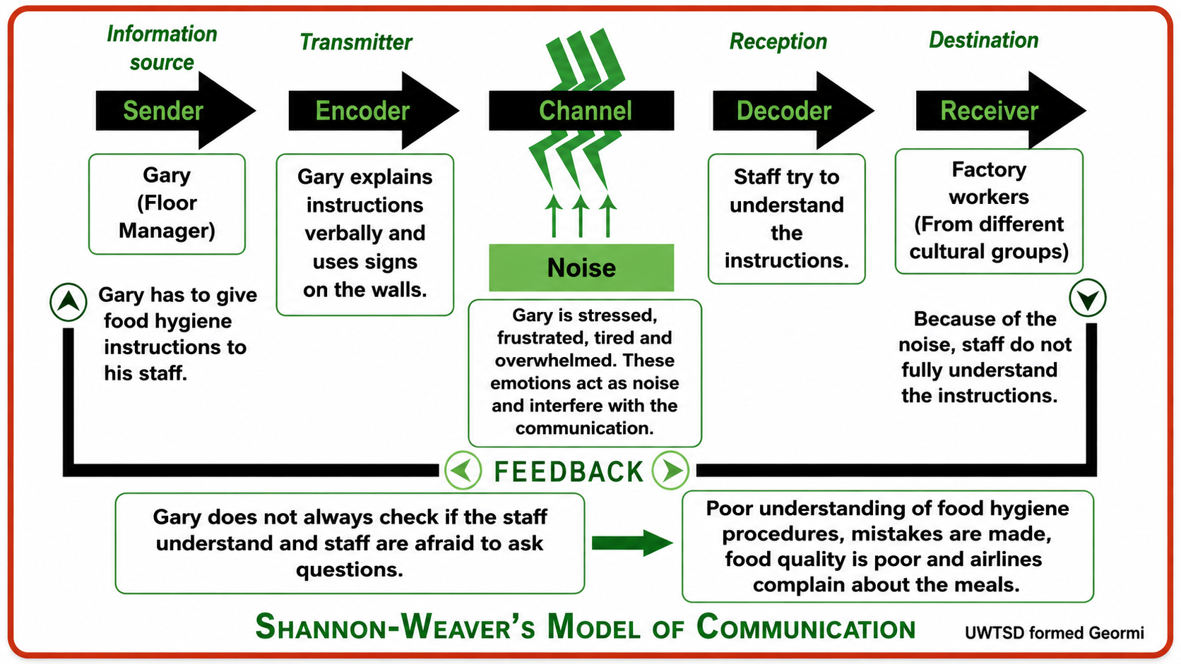
PROBLME USING SHANNON-WEAVERS

Slide 21
SOLUTIONS
Gary could reduce emotional barriers by:
Managing his stress through better workload planning.
Getting enough rest before work.
Remaining calm when giving instructions.
Holding regular team briefings to check understanding.
Encouraging two-way communication so staff can ask questions.
Receiving leadership and emotional intelligence training.

Slide 22
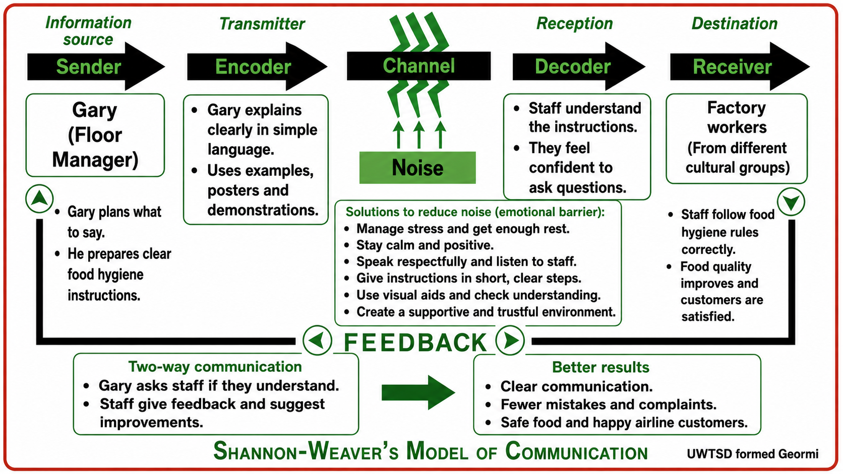
THE SOLUTION USING SHANNON- WEAVER’ S MODULE

Slide 23
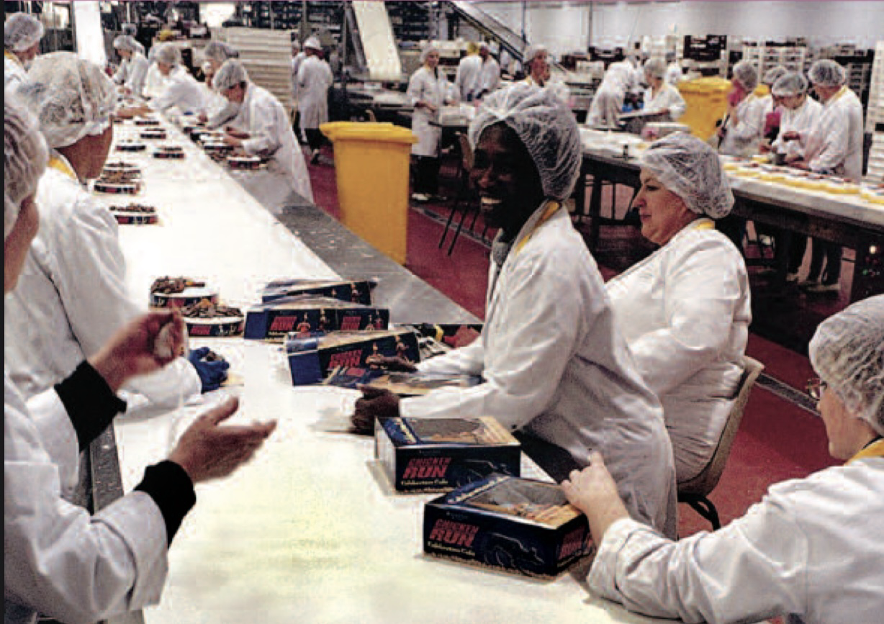
CONCLUSION
Gary’s stress and frustration affect his communication.
Staff misunderstand food hygiene instructions.
This leads to mistakes, complaints and lost business.
Better emotional management improves communication.
Clear communication creates a safer workplace.
The business can improve its performance.
(Gov.uk.,2009

Slide 24
ENVIRONMENTAL NOISE DESCRIPTION.
Environmental noise refers to any background sounds or physical distractions that disrupt communication. For example, in the Flight Foods case study, Gary had to communicate with employees in a bustling kitchen. The constant hum of machinery and equipment created a cacophony that hindered his ability to deliver clear instructions. Consequently, some employees might have missed or misinterpreted his directions.
This communication barrier can lead to misunderstandings reduced productivity and delays in task completion. More critically, it poses potential health and safety risks by disrupting the intended flow of information.

Slide 25
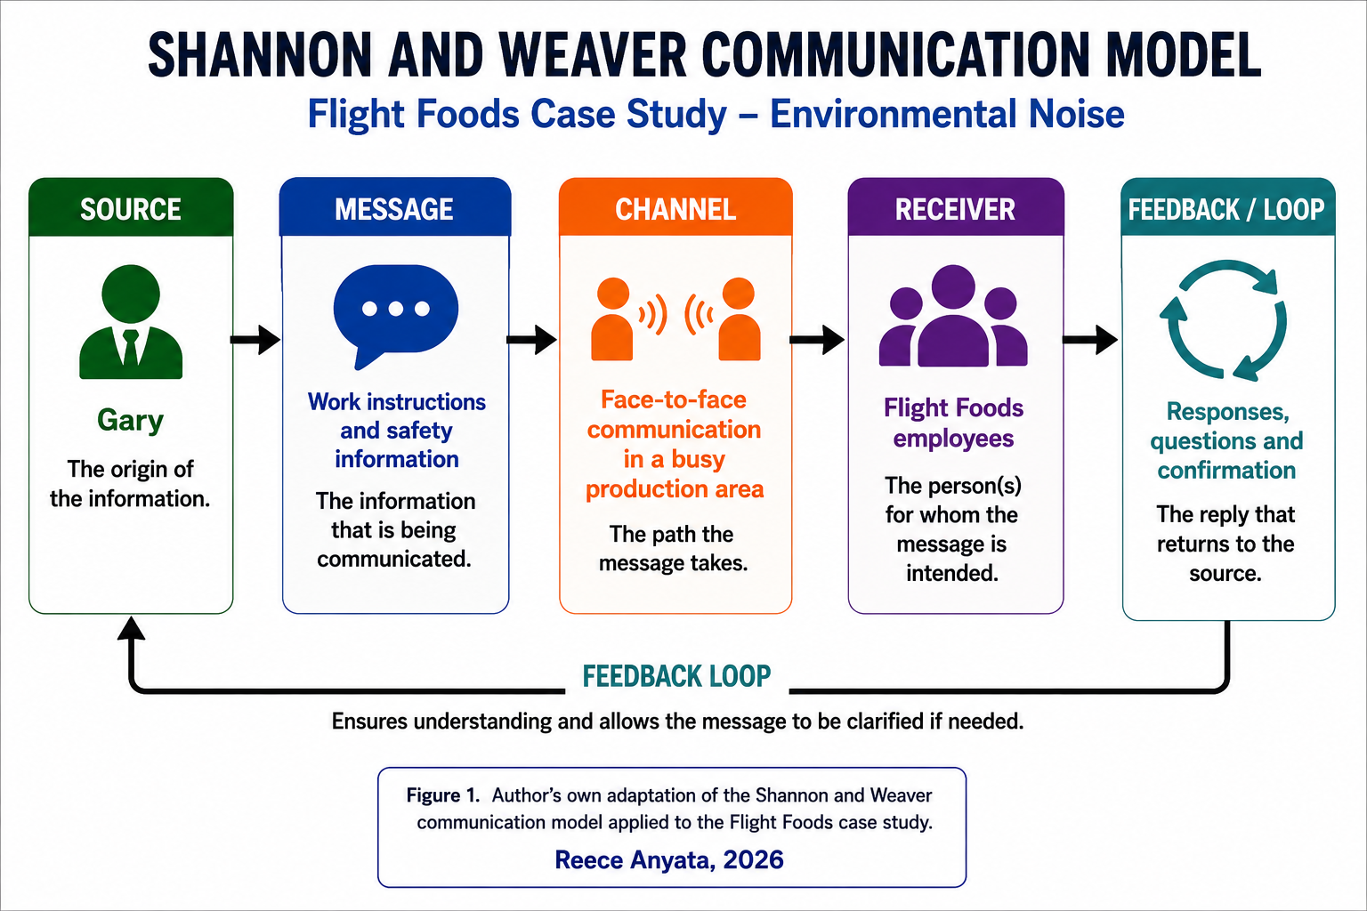
(Source: Author Reece Anyata)

Slide 26
ENVIRONMENTAL NOISE SOLUTION.
To mitigate environmental noise, Gary could choose quieter areas for communication. He could also repeat key instructions and use clear visual signs. Confirming understanding through feedback and ensuring employees acknowledge important safety information before starting work would further enhance clarity and safety.

Slide 27
ENVIRONMENTAL NOISE.
The Shannon and Weaver model suggests that communication can be improved at every stage. Gary should start by crafting a clear message and using simple language when encoding it. He should also consider improving the channel by reducing background noise or relocating staff to a quieter area before giving instructions. Employees then decode the message and should feel free to ask questions if anything is unclear. Finally, feedback is crucial as it allows Gary to verify that everyone has understood the instructions correctly. By minimising environmental noise and encouraging feedback, communication becomes more accurate reducing misunderstandings and ultimately improving workplace safety.

Slide 28
ENVIRONMENTAL NOISE CONCLUSION.
Environmental noise can hinder effective communication. By applying the Shannon and Weaver model and employing clear communication, minimising distractions and providing regular feedback, instructions are more likely to be understood correctly. This leads to improved safety and efficiency at Flight Foods.

Slide 29
CONCLUSION
Using the solutions provided by the team on this sliders to each problem can help improve the company.
Will built a team that can work together and better in the future when new hires come to the factory.
Stress and issues will decline and work will be followed accordingly to the rules and laws.

Slide 30
REFERENCES
GOV.uk (2009) working safely in a multicultural food and drink industry,
Available at: https://libary2.nics.gov.uk/pdf/dard/2009/DYKF.pdf. [Accessed: 4th August 2026]
Safety Sign (2026) Food productions area roles sign. Available at: https://www.safetysign.com/products/1777/production-area-wash-hands-sign?s=st1zskfh0zgp373 [accessed: 4th August 2026]
Sociabble (2025) Two-way communication in the workplace: Importance and best practices. Available at: Two-Way Communication in the Workplace: Importance & Practices [accessed: 8th August 2026]
The iStock (2026) Vector illustration of multicultural national children, people on planet earth stock illustration. Available at: https://www.istockphoto.com/vector/vector-illustration-of-multicultural-national-children-people-on-planet-earth-gm504183810-82999353 [accessed: 4th August 2026]
Shannon, CE. and Weaver, W. (1949) The mathematical theory of communication. Urbana, IL: University of Illinois Press.

Slide 31
Any Questions?

