Slide 1
Effective Study Skills

Slide 2
Objectives of the session
After this session you will be able to:
Identify important study skills
Identify and use a wide range of learning and studying strategies.
Reflect on your current academic skills and work out an action plan for improvement.
Improve your reading skills

Slide 3
Approaches to learning and teaching
lectures
seminars
presentations
role plays
Class Discussion
group and team activities
tutorials
on-line activities
independent research
practical projects

Slide 4
Who is an independent learners?
Independent learners are good at:
managing time, stress and other commitments
reflecting critically on how and what they learn
using a wide range of learning opportunities and resources, for example, using appropriate printed and electronic sources
adapting the learning process to make use of new opportunities

Slide 5
Important Study Skills
Time Management
Information Skills
Listening to Lectures and Taking Notes
Academic Reading Skills
Academic Writing Skills
Referencing and Avoiding plagiarism
Presentation Skills
Working in Groups
Examination Skills

Slide 6
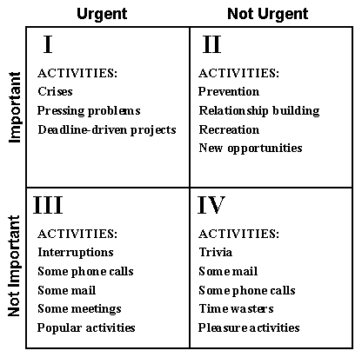
Time Management
Do it
Delegate it
Delay it
Delete it

Slide 7
Listening to Lectures and Taking Notes
Before the Lecture
Know the title and topic of the lecture
Skim the required chapters or notes
Reflecting on what you already know about the topic
Be prepared to ask questions

Slide 8
During Lecture
How to concentrate
Avoid talking to your friends
Avoid side thought trips
Avoid distractions from mobile and any other electronic device
Take Notes

Slide 9
Taking Notes
Note taking is an important academic task that helps you to remember what you have learnt and helps you to review materials for re-use in revision and assignments
Take your notes according to the week, topic, or assignment
Write in short phrases rather than in complete sentences
It is important that you are critical when note taking and that you only write or draw what you will need later on

Slide 10
After the Lecture
Review your notes
Summarize your notes in your own words
Discuss important points with friends
Add any further explanation based on your reading

Slide 11
Academic Reading Skills
Academic reading will need you to:
Identify arguments
Recognise whether the writing support or oppose the main premise
Identify the evidence
Identify conclusions and whether the evidence supports the conclusions
Be a critical thinker.

Slide 12
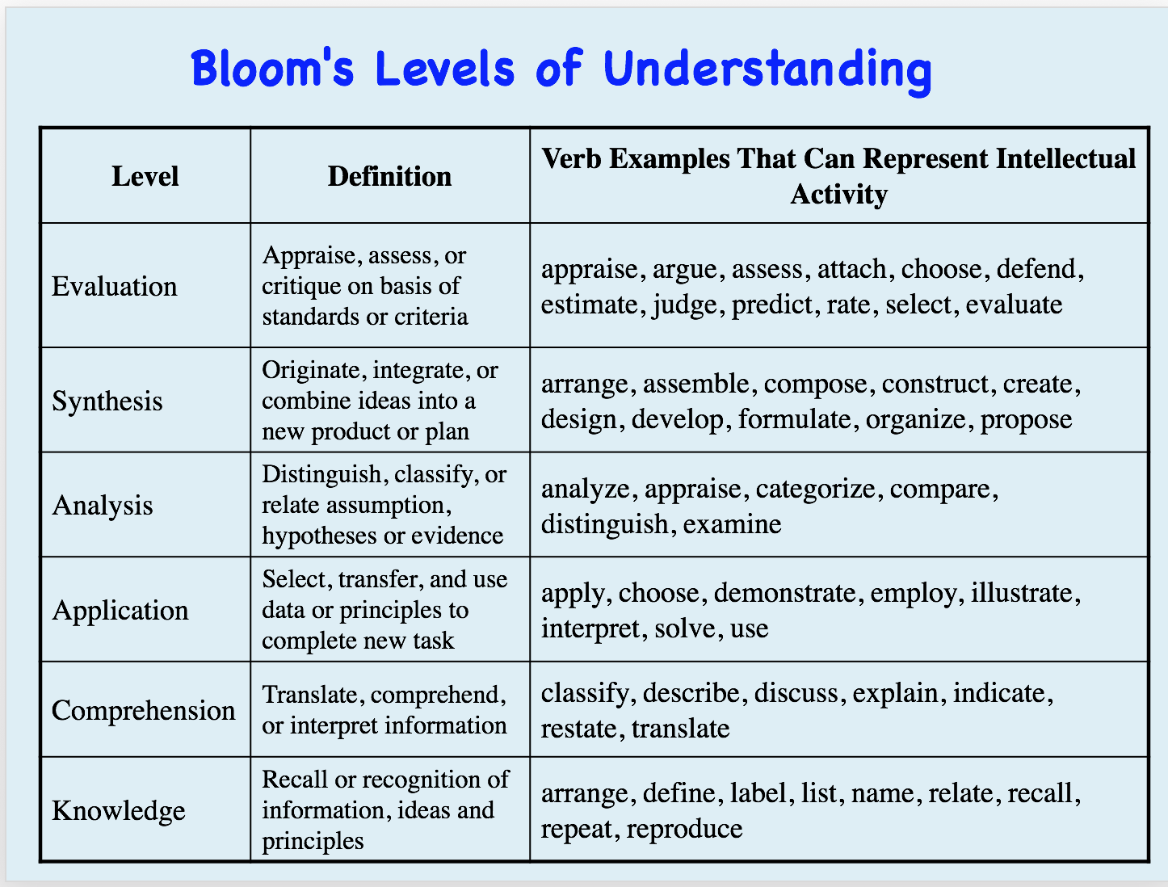

Slide 13
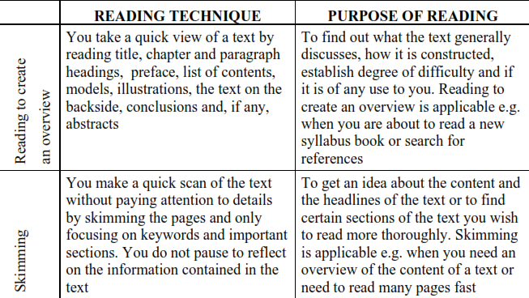
Selecting the Right Reading Techniques

Slide 14
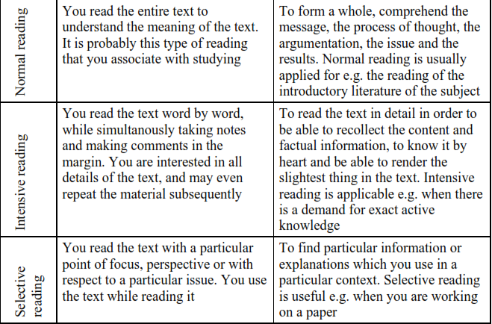
Selecting the Right Reading Technique

Slide 15
Improving Reading Skills (SQ3R)
Survey
Question
Read
Recall
Review

Slide 16
Making Notes from Reading
Use margins of the printed text to write brief comments
Use separate pages for detail notes
Do not copy chunks from the texts
Take notes in your own words
Use colour codes
File and organise your notes properly

Slide 17
The ability to write clear and logical assignments or reports is an essential academic skill and it is also an essential professional skill
Academic Writing Skills
Different genres in Academic writing are:
Book reviews
Literature reviews
Reflective writing
Annotated bibliographies
Academic Essays
Research Papers
Research Reports
Case Studies
Research proposals

Slide 18
Academic Writing should be:
♦ analytic – concerned with real facts and details, rather than general aspects;
♦ objective – based on things which can be seen or measured, rather than on personal feelings
♦ intellectual – based on an enlightened judgment of complex ideas and information, rather than an appeal to emotions;
♦ rational – using clear thinking to make decisions and judgments based on reason, rather than passionate arguments against a doctrine or belief.

Slide 19
Referencing and Avoiding plagiarism
Referencing means acknowledging the source of information you have used in your writing. Referencing your work:
Give your work academic credibility
Demonstrate how your work links into your subject area
prevent accusation of stealing other people’s ideas or words that is PLAGIARISM

Slide 20
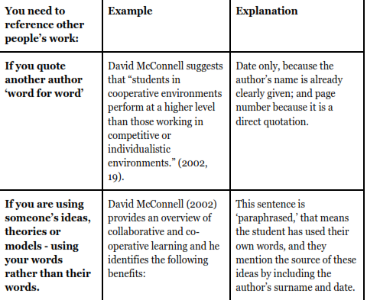
How to give reference

Slide 21
Presentation Skills
Presentation skills are important as presentations are frequently used in the workplace as a means of disseminating information and influencing people.
Some of the assessments for your programme of study may involve giving a presentation. This could take the form of an individual presentation or a group presentation

Slide 22
Working in Groups
Team working is an essential skill required by employers for almost every job.
It provides opportunities for you to develop and demonstrate transferable skills such as:
communication,
negotiation,
participation,
compromise,
decision making,
teamwork.

Slide 23
Conflict Management in Groups
Establish a joint level of ambition
Agree on time spent
Keep appointments
Concentrate on academic matters
Communicate in a proper and polite manner
Make ongoing evaluations

Slide 24
Examination Skills
The aim of the examination process is to test your knowledge and understanding in an environment with a time constraint.
Examinations are not merely a memory test either – they test understanding, rather than the specific description of each and every theory and concept.
They also seek to evaluate some generic skills such as time management (have you answered all the questions you need to in the given time period?) and your effectiveness under pressure.

Slide 25
Class activity
How do you plan to improve in the following skills? Write a brief paragraph for each skill
  Time Management
  Information gathering Skills
  Listening to Lectures and Taking Notes
  Academic Reading Skills
  Academic Writing Skills
  Referencing and Avoiding plagiarism
  Presentation Skills
  Working in Groups
  Examination Skills
  (This activity can help with tasks 2.1,2.2,2.3 of the assessment)

