Slide 1

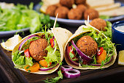
Syrian Street Food Business
Enterprise and Entrepreneurships LCLM 4006
Shahed Al krad
Charles Ohman

Slide 2
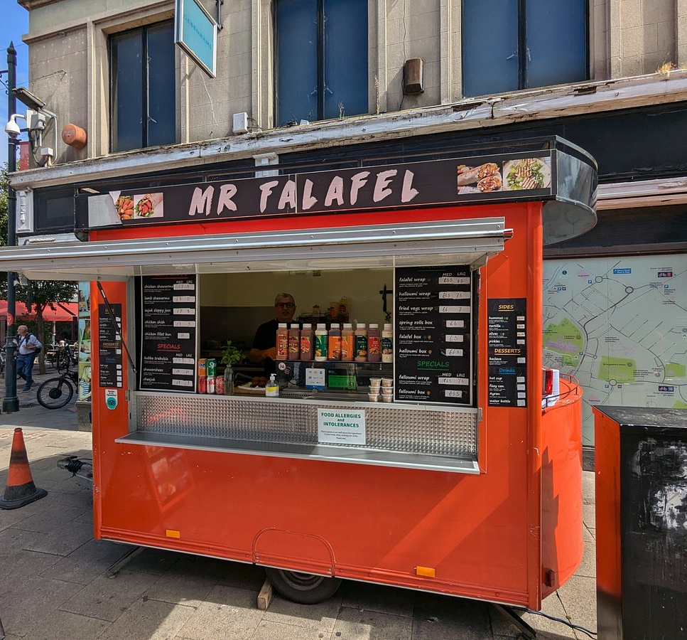



Syrian Street Food Business
The business plan is for a Syrian food takeaway.
Proving authentic meals such as shawarma and falafel.
The aim is to offer quick service and high-quality food to attract a wide range of customers.

Slide 3
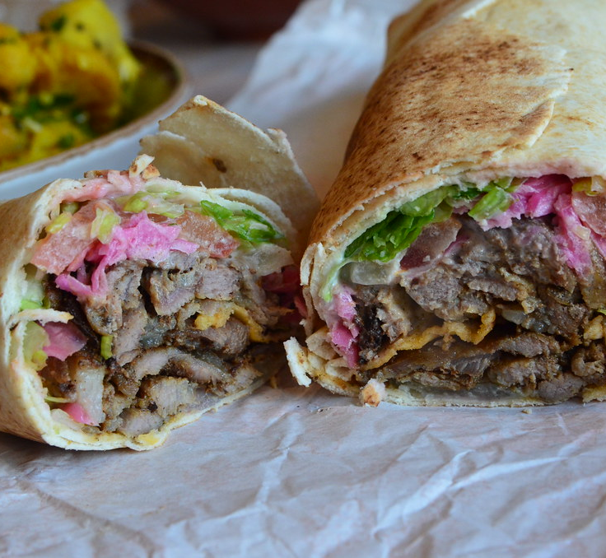
Business Idea
The business idea is to create a small street food takeaway that offers fresh and traditional Syrian quality
Products:
USP: Tasty Fresh food and Affordable price for student, and easy to eat and fast service.
The business will be sole trading employing two people
I will be manager of the business
This Photo by Unknown Author is licensed under CC BY-NC

Slide 4
Marketing Strategy
4PS of Marketing
Product: Authentic Syrian food like shawarma and falafel made fresh daily.
Prices: Affordable prices (£10.00 -£6.50) to attract students and local customers.
Place: Located in busy areas such as near universities.
Promotion: Social media, discounts, and word of- mouth.

Slide 5
Business Street Food
PESTILE ANALYSIS
The business is influenced by several external factors
Economic: Customer prefer cheaper food
Social: Demand for international food is growing
Legal: Must follow food safety laws

Slide 6

Marketing Strategies
The business will use social media marketing and student discounts to attract customers. Good customers service will help build loyalty and increase repeat sales.

Slide 7
Funding Requirement
Financials
Loan requirement: £10,000
Turnover £182,000
Breakeven 5000 order
Profit £120,000

Slide 8

Financial Continued
The break-even point is when revenue equals costs. This can be achieved by selling around 200 meals per day.
Student discount to attract customers.

Slide 9
Conclusion
In conclusion, the business is profitable, but improvements are needed to make it realistic and sustainable. The projected profit of £102,000 is quite high, so costs such as staff wages and working hours should be increased to reflect real operations. Hiring more staff will help mange workload and maintain service quality.
In addition, pricing, expenses, and daily sales should be reviewed regularly to ensure the business remains balanced and achievable.

Slide 10
References
Kotler, P. and Keller, K. (2016). Marketing Management. 15th ed. Harlow: Pearson Education.
Burns, P. (2016). Entrepreneurship and Small Business: Start-up, Growth and Macmillan.
Statista (2024). Street Food Market Trends and Consumer Preferences. Available at: https://www.statista.com (Accessed:27March 2026).

