Slide 1
BMSW5104
Knowledge and Information Management Skills for the Workplace
Project Management Plan
Ioanna Bakogiorgou ID 1916883
Lecturer Charles Nwaogwugwu

Slide 2
Project Management Plan
More Yoga Retreat
1. Scope and Key Points
2. Budget Analysis
3. Project Life Cycle
4. Quad Chart
5. Stakeholders Analysis Table
6. WBS
7. Risk Analysis

Slide 3
More Yoga Retreat Scope
A yoga organisation expanding business into new services in more areas
It is crucial for More Yoga to start offering retreats and engage more customers in the next year
  Great profit opportunities from retreats
  Focus on wellbeing increased after pandemic
  Minimising Covid risk (and/or cost) with online offers
  Potential for international growth for the business

Slide 4
Scope and Key Points Analysis
Project: Organising a retreat in Cornwall in the next 3 months
Group : 30 participants
Product: A 1-week yoga retreat including:
        6 nights accommodation
        Transport from Cornwall to the venue (cottage 5km away from central)
        Meals (light breakfast, lunch and light dinner)
Product Price: £1500 p.p
Project Start /Finish Dates: 4th October 2022 - 10th January 2023
Delivery Date: first week of New Year, 2-8 January 2023

Slide 5
Budget Analysis Fixed Costs- Profit
Fixed Cost | Price | Units | TOTAL
Transport A/R | £300 | 2 | £600
Yoga instructors | £1.000 | 2 | £2.000
Marketing & social media advertising | £500 | 1 | £500
Photographer | £500 | 1 | £500
Retreat venue Cornwall | £25.200 | 1 | £25.200
Venue, refreshments & sandwiches meeting | £500 | 1 | £500
Post equipment's | £100 | 1 | £100
TOTAL Cost |  |  | £29.400
Customer Cost | Price | Projected | TOTAL PROFIT
Yoga retreat (week) | £45.000 | 30 | £15.600

Slide 6
Quad Chart
More Yoga Retreat
GOALS/OBJECTIVES
Competitive in the Market – Great reviews
Increase Profit
Schedule 3 retreats in the next year
Gain International customers
CUSTOMERS/STAKEHOLEDERS
30 participants in the first retreat
In the potential covid scenario we offer online retreats
Advertise the retreat in website and social media
DESIRED RESULTS
Engage with customers
Regular retreats in the future
Increase income for the business
Yoga instructors development
Increase online reputation
MEASURES OF SUCCESS
Profit the desired amount
10 excellent Yogis reviews
New category to get involved

Slide 7
Project life cycle
8 Days More Yoga retreat in Cornwall
INITIATION
Agree on Budget - Profit £15.600
Project Manager approval
PLANNING Scheduled tasks with all departments
Allocate responsibilities
Book Advertising
EXECUTION Project on schedule
Budget and meeting specification
Report
CLOSING Delivering the retreat 2nd to 8th of January
Project review
Assessing performance

Slide 8
Stakeholders
INTERNAL
Owners
Project Manager
Employees
  Finance Department
  Marketing Department
  Social media advertisers
  IT Department
  Yoga instructors
Legal consumer contracts regulation
EXTERNAL
Customers
Cornwall local community
Local suppliers
  Food
  Venue
  Transport
The public
Yoga Alliance
More Yoga

Slide 9
Stakeholders Analysis Table
Priority | Stakeholders | Stakeholder’s Perspective | Action
High | Customers | Their participation will impact the delivery of the project | Regular communication and update
High | Venue Owner | Failure to follow up with agreement will impact the project financially | Weekly communication and follow the procedure
Medium | Yoga Alliance | Any delay will effect the project | Check instructors YA two months in advance to
Medium | Transport Supplier | Any cancellation will impact the smooth operation | Communicate every two weeks following with deposit

Slide 10
Stakeholders Analysis Table
Priority | Stakeholders | Stakeholder’s Perspective | Action
High | Finance MY department | Failure to follow with figures will impact the whole project | Once a week
High | Marketing MY department | Highly impact of the participants for the retreat | Once a week
High | IT department | Highly impact of the online delivery in case of covid | Every two weeks
Low | Local community in Cornwall | Is not effecting our project but good to know anything relevant to ament | Once a month

Slide 11
WBS More Yoga Retreat- Project starts 2nd of January
Level | WBS | Task Description | Notes
1 | WBS1 | Secure the venue | Search for venue
1 | WP1 | Search online-send emails | Cornwall websites – local community
1 | WP1.1 | Booked the venue | HR create a contract
1 | WP1.2 | Finance - Pay the venue | Create invoices – keep record (Agreed price £25.200)
1 | WBS2 | Advertising retreat in MY website | All members in More Yoga receive an email – posters in London Studios
1 | WP2 | Sign up 30 yogis for the retreat | HR create agreement documents
1 | WP3 | Finance – collect the fee from participants | Create invoices – agreed price £45.000
1 | WBS3 | Search 2 Yoga Instructors | Do our studios at More Yoga
1 | WP3 | Secure 2 Yoga Instructors | Advertise the position on MY website

Slide 12
WBS More Yoga Retreat - Project starts 2nd of January
Level | WEB | Task Description | Notes
1 | WP3.1 | Booked the Yoga Instructors | HR create a contract
1 | WP3.2 | Finance – Yoga Instructors payment | Create pay-roll (£2.000)
1 | WBS4 | Search for Mini-Bus driver | Online-due local community – local drivers
1 | WP4 | Select & Book the Mini-Bus driver | HR – sign agreement document
1 | WP4.1 | Finance – Mini-Bus driver payment | Keep invoices – sign documents (£600)
2 | WBS5 | Create food menu | Send emails with requirements to Venue Chef
3 | WP5 | Agreed to food menu specification | HR – sign agreement
3 | WP5.1 | Communicate with participants | Marketing department share with participants details

Slide 13
WBS More Yoga Retreat- Project starts 2nd of January
Level | WBS | Task description | Notes
3 | WBS6 | Search for photographer – photo shoots – video recorder | IT – with local community websites
3 | WP6 | Select a photographer | HR create – sign agreement
3 | WP6.1 | Paid the photographer | Finance – create invoice (£500)
3 | WBS7 | List of equipment we need for the workshop class | Marketing to collect them from our London Studios
3 | WP7 | Equipment transferred to Cornwall venue | Marketing arrange to post equipment’s (£100)
4 | WBS8 | Book a venue for final meeting inclusive coffee and sandwiches | Finance – create invoice paid (£500)
5 | WBS8.1 | Final meeting – last details /amends | All teams report – participate
6 | WP9 | Avoiding scope creep | All departments communicate
7 | WBS10 | Review – profit – outcome | All departments meeting – PM

Slide 14
Risk Analysis Matrix
Risk | Probability (1-5) | Gravity (1-5) | Total risk | Response
Participants cancelation | 3 | 5 | 15 | Offer alternative dates
Yoga instructors' absence | 4 | 1 | 4 | Replace instructor even myself
Public transport strike | 2 | 1 | 2 | Alternative dates option
Venue Issues | 1 | 1 | 1 | Online retreat
COVID | 2 | 2 | 4 | PCR – Online record
Drivers issues | 1 | 1 | 1 | Drive myself with my car
Severe weather conditions | 1 | 1 | 1 | Stay indoors – go online
High cost of living | 1 | 1 | 1 | Discount for the next retreat
Photographer cancellation | 1 | 1 | 1 | Using IT from London

Slide 15
Potential Risks
INTERNAL
Yoga Instructors absence
Participants cancellation
Problems with venue
Drivers cancellation
Human mistakes by IT and marketing team
EXTERNAL
Covid
High cost of living
Public transport cancellations
Severe weather warnings
More Yoga
Notes:
Note: Appendix

Slide 16
References
More Yoga 2022. Available at : https://www.moreyoga.co.uk/discover-moreyoga/ Accessed 1st October 2022
Quad Chart 2022. Available at: SlideShare from Scribd https://www.slideshare.net/minwir/project-management-1-16207030
Accessed 1st October 2022
Association for Project Management 2022. Available at: https://www.apm.org.uk/resources/what-is-project-management/what-is-a-life-cycle/
Accessed 25th October 2022
P.Beltran, G.Melon, M. Valera ‘ How to assess stakeholder’s influences based on the analytic Network’ page 451-462. Available at: https://www.sciencedirect.com/science/article/abs/pii/S0263786317300261 Accessed 3rd November 2022
Project Management Structure. Available at: https://www.projectmanager.com/guides/work-breakdown-structure
Accessed 10th November 2022

Slide 17
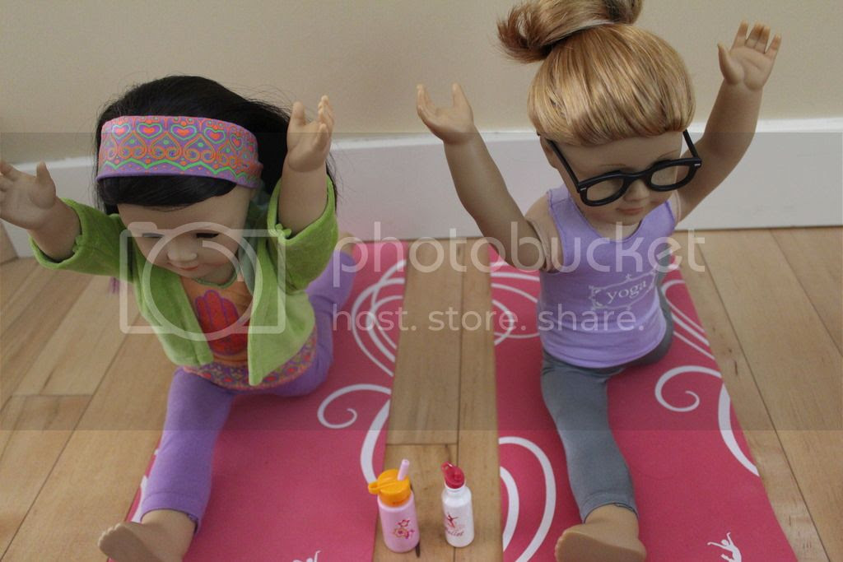
Thank you – Namaste !
This Photo by Unknown Author is licensed under CC BY-NC-ND

